Slide 1

EML 3035 Programming Concepts
An Engineering Problem
Autar Kaw
Department of Mechanical Engineering
University of South Florida, Tampa, FL 33620

Slide 2
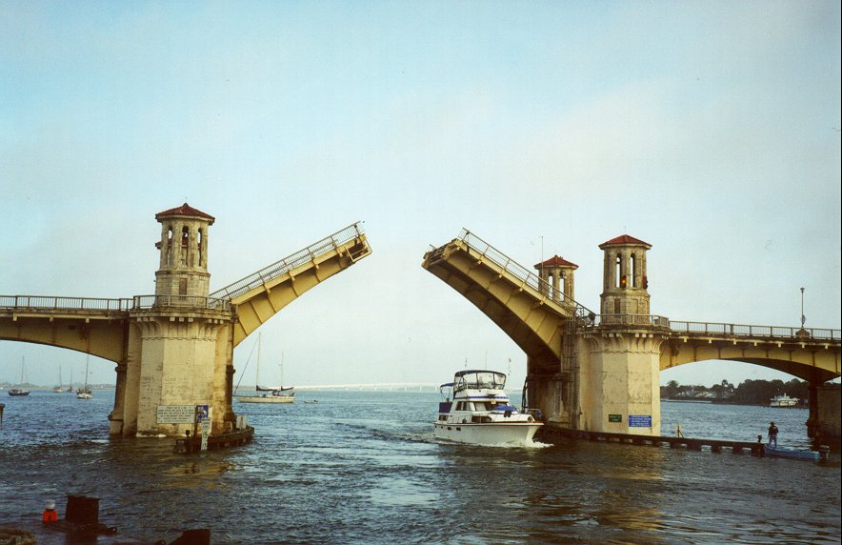
Example of Solving an Engineering Problem
Notes:
Oldest city’s oldest bascule bridge – the Bridge of Lions in St. Augustine, Florida

Slide 3
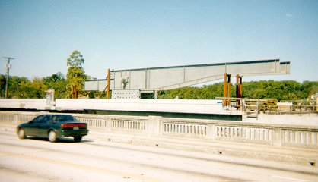
Bascule Bridge THG

Slide 4
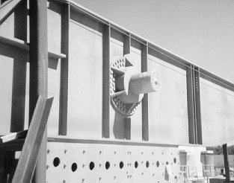
Bascule Bridge THG
Hub
Trunnion
Girder
Notes:
THG picture

Slide 5
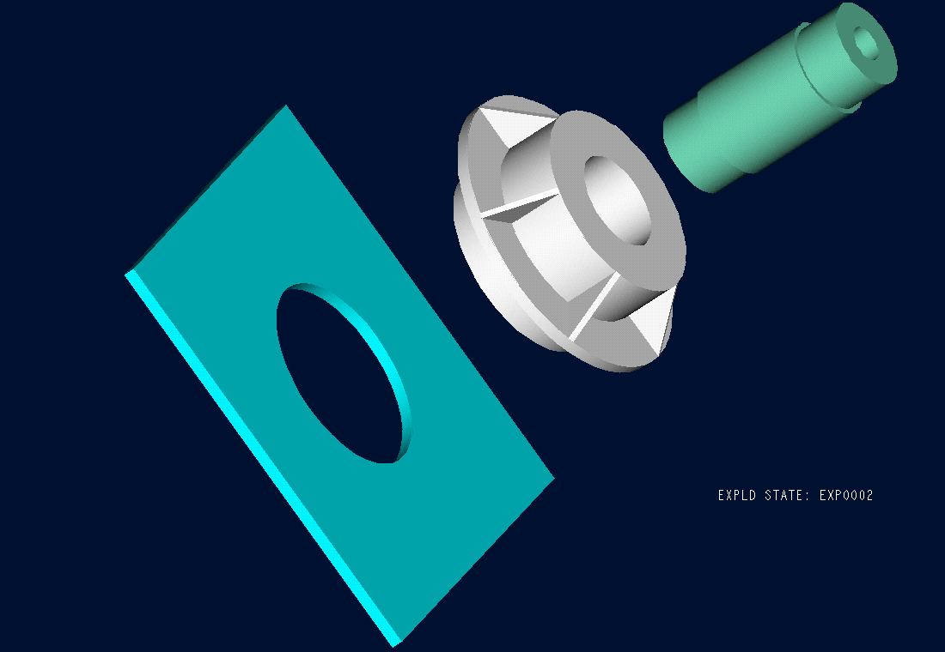

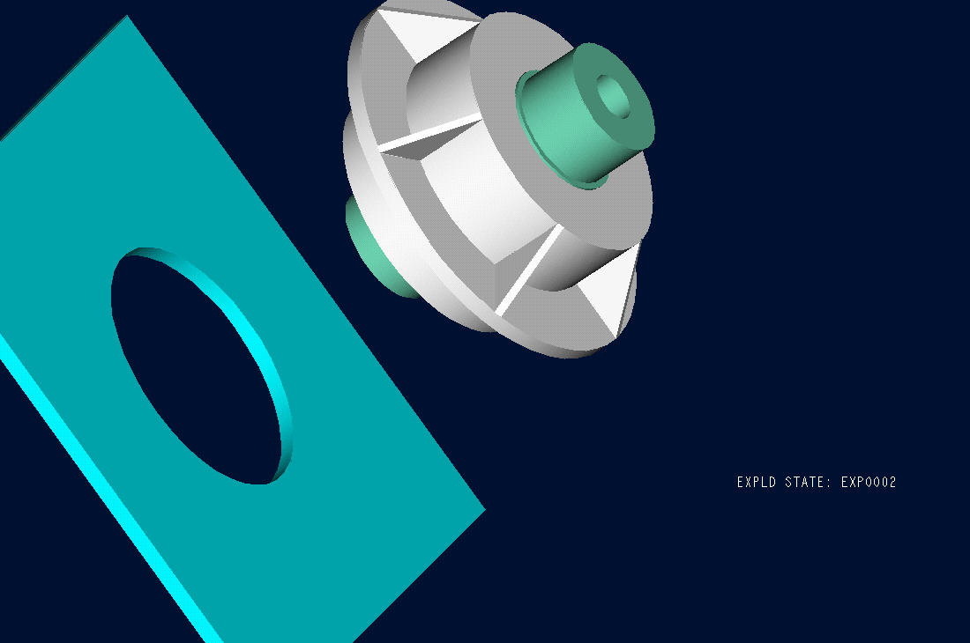
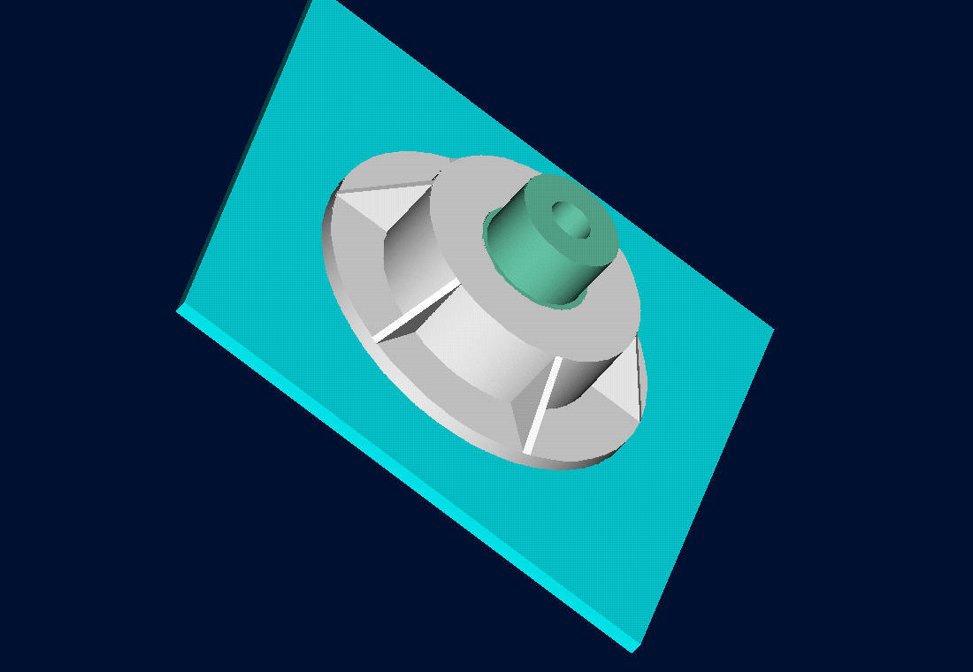
Trunnion-Hub-Girder Assembly Procedure
  Step1. Trunnion immersed in dry-ice/alcohol
  Step2. Trunnion warm-up in hub
  Step3. Trunnion-Hub immersed in
  dry-ice/alcohol
  Step4. Trunnion-Hub warm-up into girder

Slide 6
Problem
After Cooling, the Trunnion Got Stuck in Hub

Slide 7
END

