Slide 1
Why Composites?
Mechanical Engineering
Instructor: Autar Kaw

Slide 2
First Rule of Composite Materials
If you don't let a teacher know at what level you are - by asking a question, or revealing your ignorance - you will not learn or grow. You can't pretend for long, for you will
eventually be found out. Admission of ignorance is often the first step in our education.
Steven Covey - Seven Habits of Highly Effective People

Slide 3
Why Composites?

Slide 4
INTRODUCTION:
"Do not give them any more straw to make bricks with, as your custom has been; let them go and find straw for themselves" (Exodus 5). Although man-made composites have existed for thousands of years, the high technology of advanced composites has been used in the aerospace industry only for the last thirty years. The applications are becoming diverse ranging from aircraft structures and missile canisters to tennis racquets and fishing rods. The objective of this course is to analyze and design fiber reinforced composite materials.

Slide 5
By end of this course, you will
Be able to know terminology of advanced composite materials and their applications.
Be able to develop fundamental relationships for predicting the mechanical and hygrothermal response of multi-layered materials and structures.
Be able to develop micromechanical and macromechanical relationships for lamina and laminated materials with emphasis on continuous filaments.
Design composite material structures such as thin pressure vessels and thin-walled drive shafts.

Slide 6
PRE-REQUISITES
Machine Design and Analysis I, EML 3500 or equivalent.
Computational Methods, EML3041 or equivalent.

Slide 7
Composite Materials
By end of this course, you will be able to answer the following three questions about design and analysis of composite materials.

Slide 8
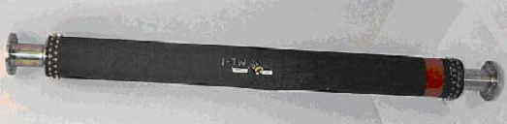
Three Questions
Question 1
How do I design a drive shaft made of composite materials and is it any better than making it out of steel or aluminum?

Slide 9
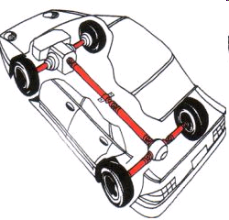
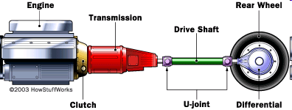
Problem Statement
A drive shaft for a Chevy Pickup truck is made of steel. Check whether replacing it with a drive shaft made of composite materials will save weight?

Slide 10
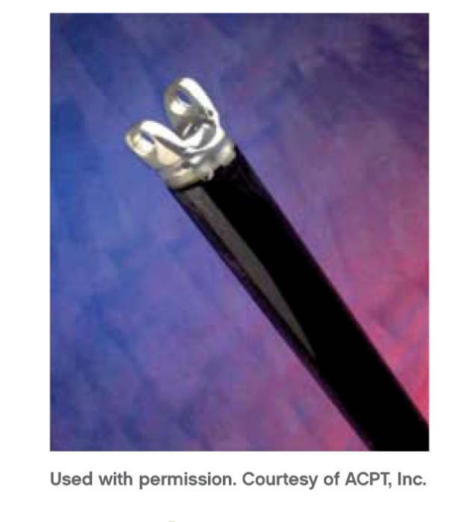
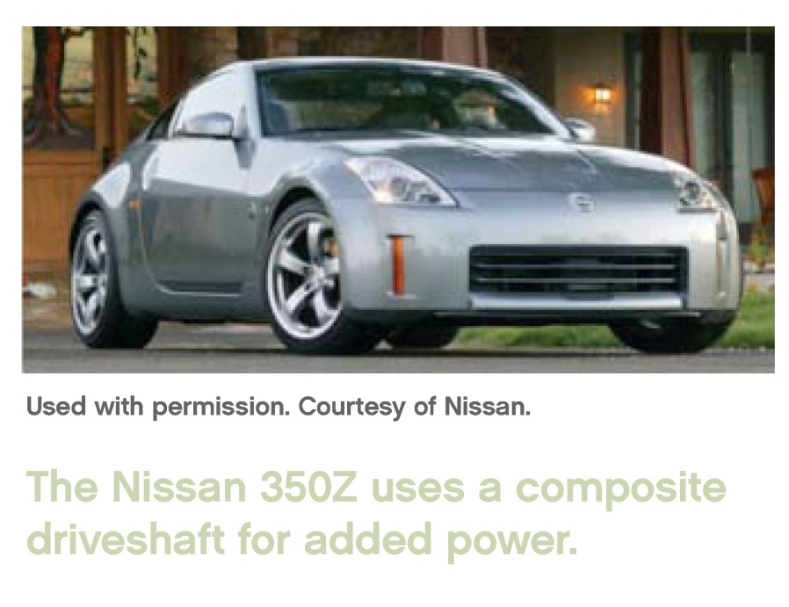
Design of a Composite Drive Shaft

Slide 11
Why composite materials?
Light weight ___ reduces energy consumption; increases amount of power transmitted to the wheels. About 17-22% of engine power is lost to rotating the mass of the drive train.
Fatigue resistant ___ durable life.
Non-corrosive ___ reduced maintenance cost and increased life.
Single piece ___ reduces manufacturing cost.

Slide 12
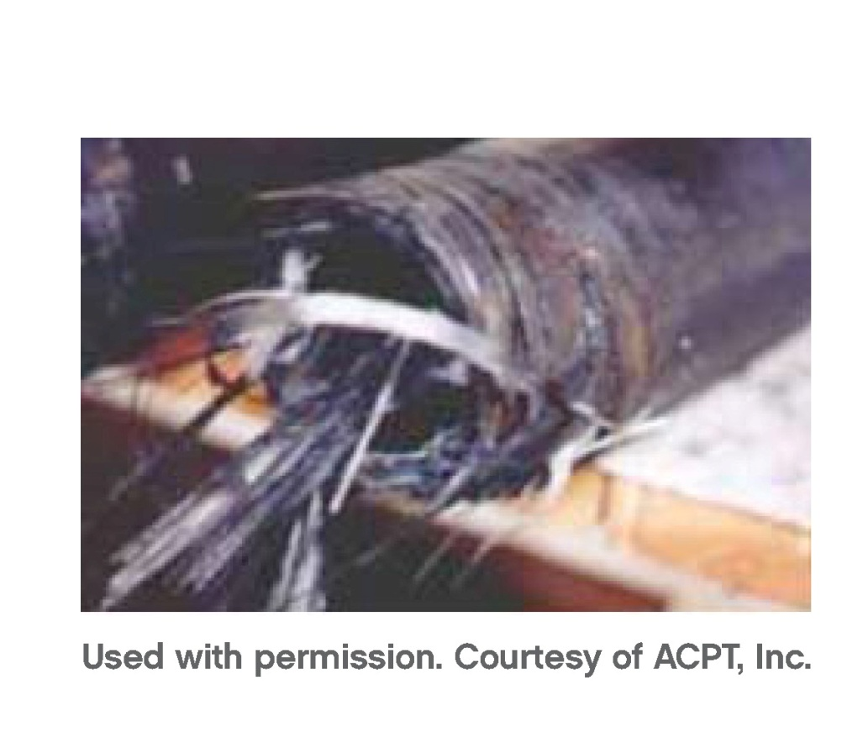
Why composite materials?
Prevent injuries – the composite drive shaft “broom” on failure

Slide 13
Problem Description
Design Constraints
1. Maximum horsepower= 175 HP @4200rpm
2. Maximum torque = 265 lb-ft @2800rpm
3. Factor of safety = 3
3. Outside radius = 1.75 in
4. Length = 43.5 in

Slide 14
Design Parameters
Torque Resistance.
  Should carry load without failure
Not rotate close to natural frequency.
  Need high natural frequency otherwise whirling may take place
Buckling Resistance.
  May buckle before failing

Slide 15

Three Questions
Question 2
Why does the two-ply balsa-wood laminate twist and bend under bending load when stacked one way, and why does it only bend when stacked another way?

Slide 16

Three Questions
Question 3
How do I design a pressure vessel? Is it better than building it out of steel?

Slide 17
END

Slide 19
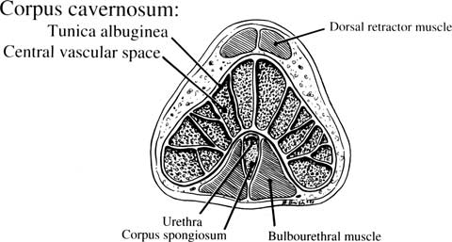
Three Questions
Question 3
Why does the penis not bend on erection?
D. Kelly, “Penises as Variable-Volume Hydrostatic Skeletons”, Annals of the New York Academy of Sciences, Volume 1101, Reproductive Biomechanics pages 453–463, April 2007.

