Slide 1
Introduction to Composite Materials
(Laminated Composite Materials)
Mechanical Engineering
Instructor: Autar Kaw

Slide 2
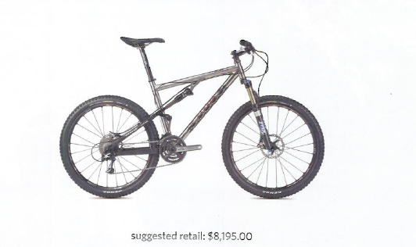
2007 Titus Racer X Exogrid

Slide 3
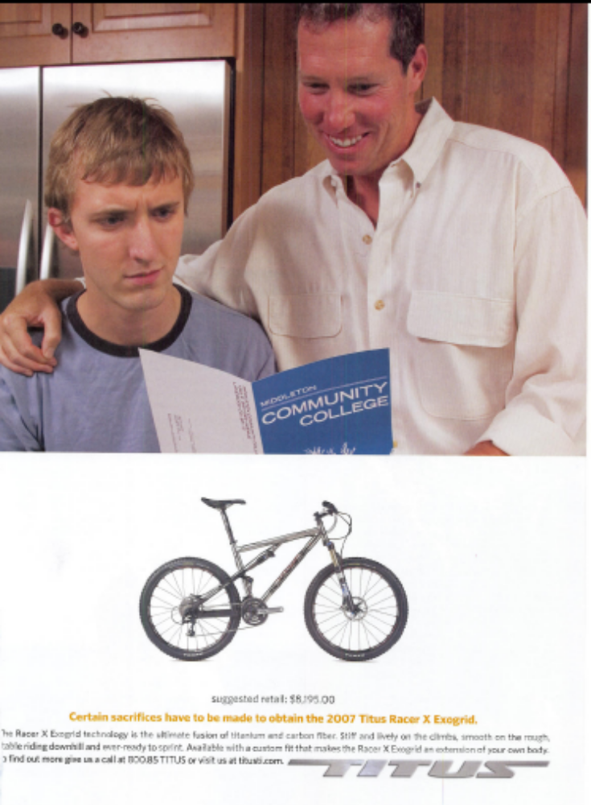
The Full Page Ad for
2007 Titus Racer X Exogrid

Slide 4
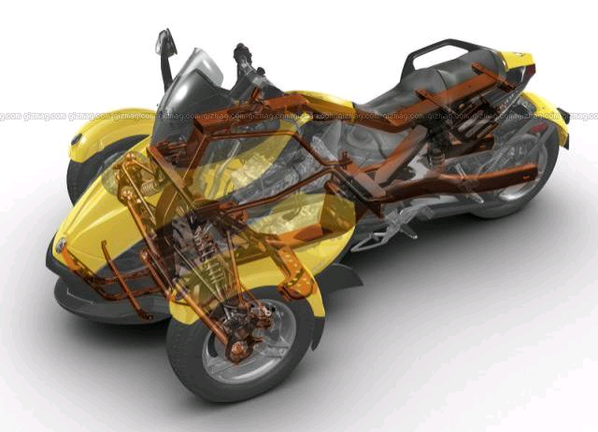
My wish

Slide 5
What are you going to learn?
What are composite materials?
How are they manufactured?
What advantages and drawbacks do composites have over metals?
Develop mathematical models to understand the mechanical response of composites to mechanical and hygrothermal loads?
Use the above mathematical models to optimally design structures made of composites.

Slide 6
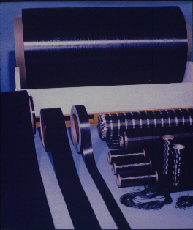
What is a composite?
A composite is a structural material which consists of combining two or more constituents
Examples:
  Flesh in your leg reinforced with bones
  Concrete reinforced with steel
  Epoxy reinforced with graphite fibers.

Slide 7
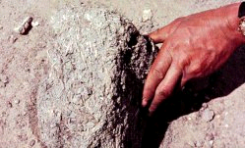
“You are no longer to supply the people with straw for making bricks; let them go and gather their own straw” - Exodus 5.7.

Slide 8

Shift in Paradigm About Materials
“More important than any one new application is the new ‘materials’ concept itself ”
Peter F. Drucker
The Age of Discontinuity, 1969

Slide 9
What is this paradigm shift in materials?
From substance to structures
From artisan to science
From workshop to mathematical modeling
From what nature provides to what man can accomplish

Slide 10
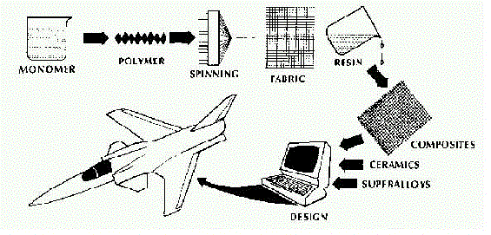
From constituents to application

Slide 11

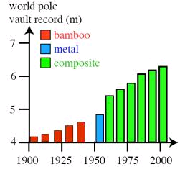
Chapter 1
Introduction to Composite Materials

Slide 12
Short Videos on Composite Materials
Some videos of composite materials
NASA uses composite materials in shuttle
Composites improve efficiency
Cloth composites

Slide 13
Chapter 1: Objectives
What is a composite?
What are the advantages and drawbacks of composites over monolithic materials?
What factors influence mechanical properties of a composite

Slide 14
Chapter Objectives (continued)
How do we classify composites?
What are the common types of fibers and matrices?
How are composite materials manufactured?
What are the mechanical properties of composite materials?

Slide 15
Chapter Objectives (continued)
Give applications of composite materials.
How are composites recycled?
What terminology is used for studying mechanics of composites?

Slide 16
What is an advanced composite?
Advanced composites are composite materials which were traditionally used in aerospace industries
Examples include graphite/epoxy, Kevlar/epoxy and Boron/aluminum

Slide 17
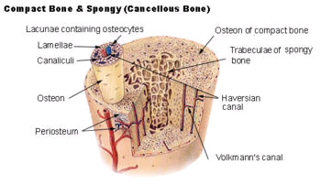
Examples of Natural Composites
Wood
  Cellulose Fibers
  Lignin Matrix
Bones
  Collagen Fibers
  Mineral Matrix

Slide 18
Why composites over metals?
High Strength and High Stiffness
Tailored Design
Fatigue Life
Dimensional Stability
Corrosion Resistance

Slide 19
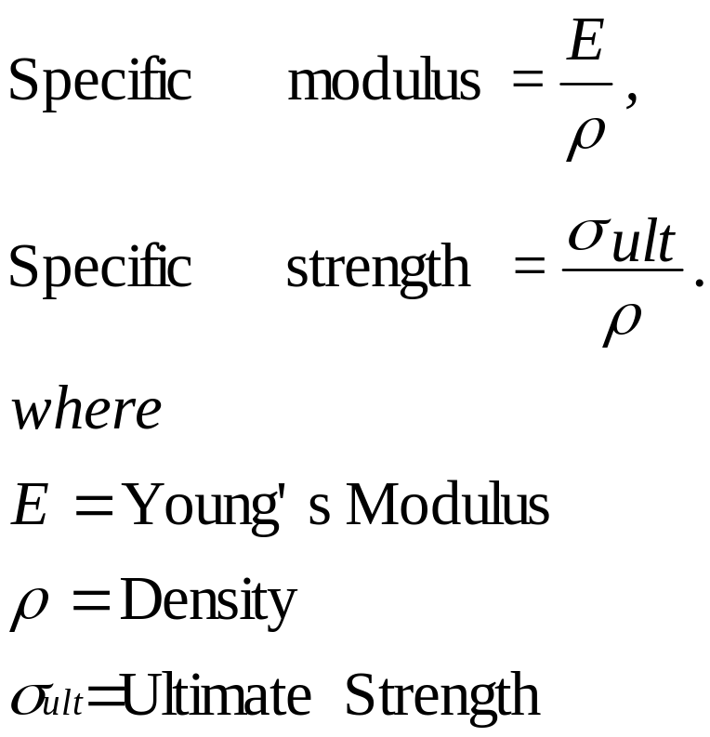
Why Composites over Metals?
How is the mechanical advantage of composite measured?

Slide 20
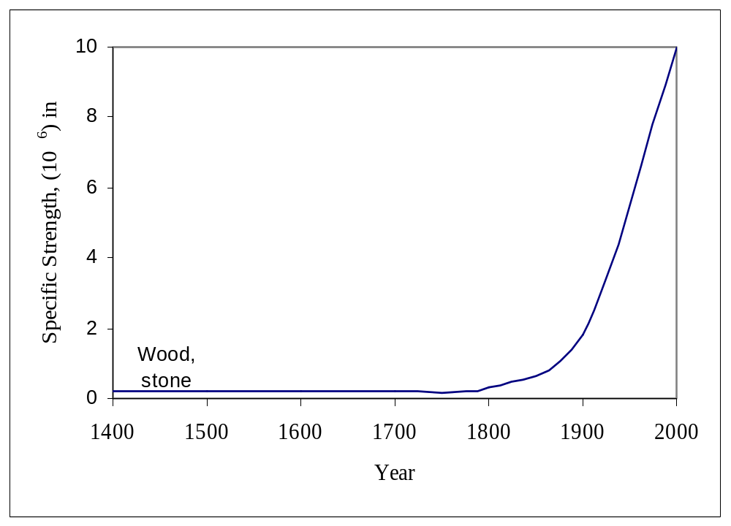
Specific Strength vs. Year

Slide 21
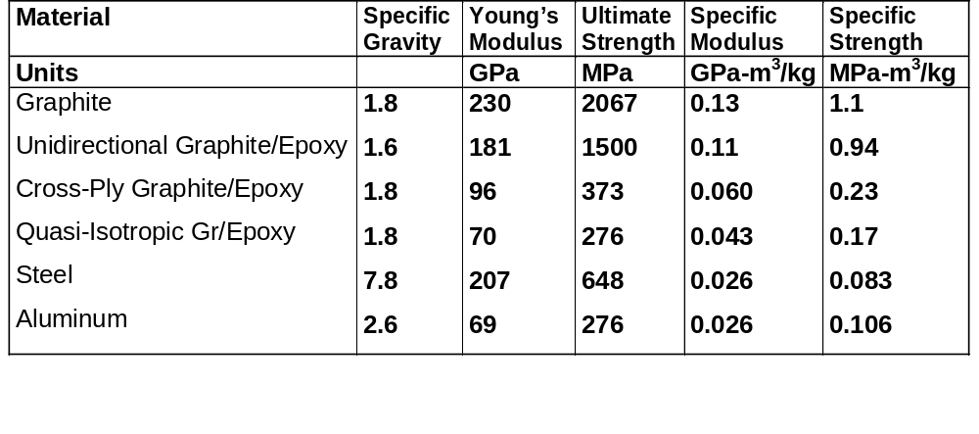
Table 1.1. Specific modulus and strength of typical fibers, composites and bulk metals

Slide 22
Comparative Thermal Expansion Coefficients (μin/in/ºF)
Material | Direction-x | Direction-y
Steel | 6.5 | 6.5
Aluminum | 12.8 | 12.8
Graphite | -0.02 | 1.1
Unidirectional Graphite/Epoxy | 0.01 | 12.5
Cross-Ply Graphite/Epoxy | 0.84 | 0.84
Quasi-Isotropic Graphite/Epoxy | 0.84 | 0.84

Slide 23
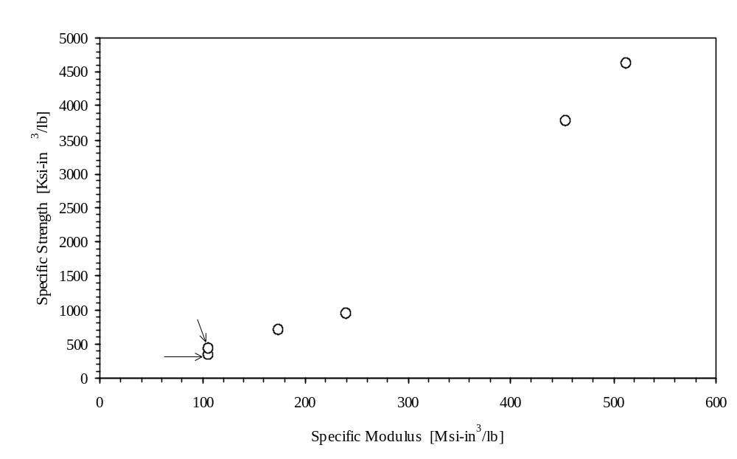
Specific Strength vs Specific Modulus

Slide 24
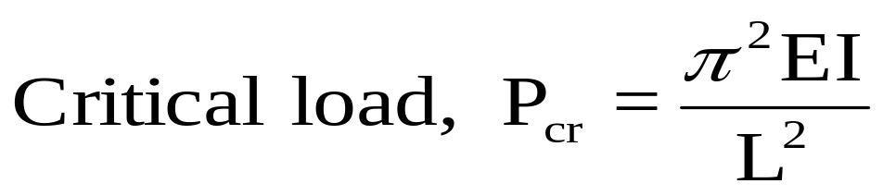
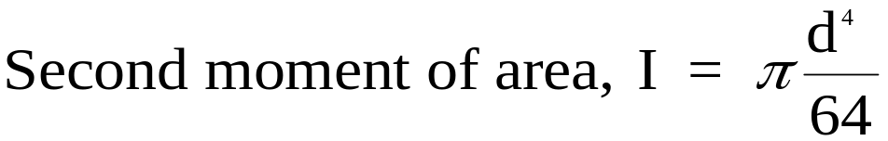
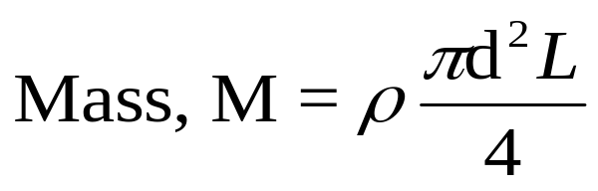
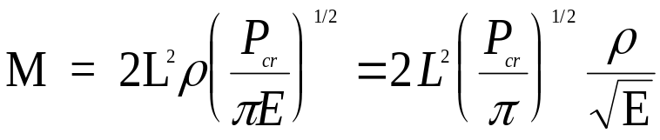
Other Mechanical Parameters
Are specific modulus and specific strength the only mechanical parameters used for measuring the relative advantage of composites over metals? NO!!

Slide 25
Tailored Design
Engineered to meet specific demands as choices of making the material are many more as compared to metals.
Examples of choices
  fiber volume fraction
  layer orientation
  type of layer
  layer stacking sequence

Slide 26
Fatigue Life
Fatigue life is higher than metals such as aluminum.
Important consideration in applications such as
  aircrafts
  bridges
  structures exposed to wind

Slide 27
Dimensional Stability
Temperature changes can result
  in overheating of components (example engines)
  thermal fatigue due to cyclic temperature changes (space structures)
  render structures inoperable (space antennas)

Slide 28
Corrosion Resistance
Polymers and ceramics matrix are corrosion resistant
Examples include
  underground storage tanks
  doors
  window frames
  structural members of offshore drilling platforms

Slide 29
What is most limiting factor in the use of composites in structures?
Lack of engineers with the knowledge and experience to design with these materials!!!!

Slide 30

Cost Considerations
Composites may be more expensive per pound than conventional materials. Then why do we use composite materials?

Slide 31
Factors in Cost Estimate
For Composite Materials
  Fewer pounds are required
  Fabrication cost may be lower
  Transportation costs are generally lower
  Less maintenance than conventional materials is required

Slide 32
Fiber Factors
What fiber factors contribute to the mechanical performance of a composite?
    Length
    Orientation
    Shape
    Material

Slide 33
Fiber Factor - Length
Long Fibers
  Easy to orient
  Easy to process
  Higher impact resistance
  Dimensional stability
Short Fibers
  Low Cost
  Fast cycle time

Slide 34
Fiber Factor - Orientation
One direction orientation
  High stiffness and strength in that direction
  Low stiffness and strength in other directions
Multi-direction orientation
  Less stiffness but more direction independent

Slide 35
Fiber Factor - Shape
Most common shape is circular
Hexagon and square shapes give high packing factors

Slide 36
Fiber Factor - Material
Graphite and aramids have high strength and stiffness
Glass has low stiffness but cost less

Slide 37
Matrix Factors
What are the matrix factors which contribute to the mechanical performance of composites?
  Binds fibers together
  Protects fibers from environment
  Shielding from damage due to handling
  Distributing the load to fibers.

Slide 38
Factors Other Than
Fiber and Matrix
Fiber-matrix interface
  Chemical bonding
  Mechanical bonding

Slide 39
Fiber Types
Glass Fiber (first synthetic fiber)
Boron (first advanced fiber)
Carbon
Silicon Carbide

Slide 40
Types of Matrices
Polymers
Metals
Ceramics

Slide 41
Polymer Matrix
Thermosets
  polyester
  epoxy
  polymide
Thermoplastics
  polypropylene
  polyvinyl chloride
  nylon

Slide 42
Metal Matrix
Aluminum
Titanium
Copper

Slide 43
Ceramic Matrix
Carbon
Silicon Carbide
Calcium AluminoSilicate
Lithium AluminoSilicate

Slide 44
Why do fibers have thin diameter?
Less flaws
More toughness and ductility
Higher flexibility
Thin Fiber
Thick Fiber

Slide 45
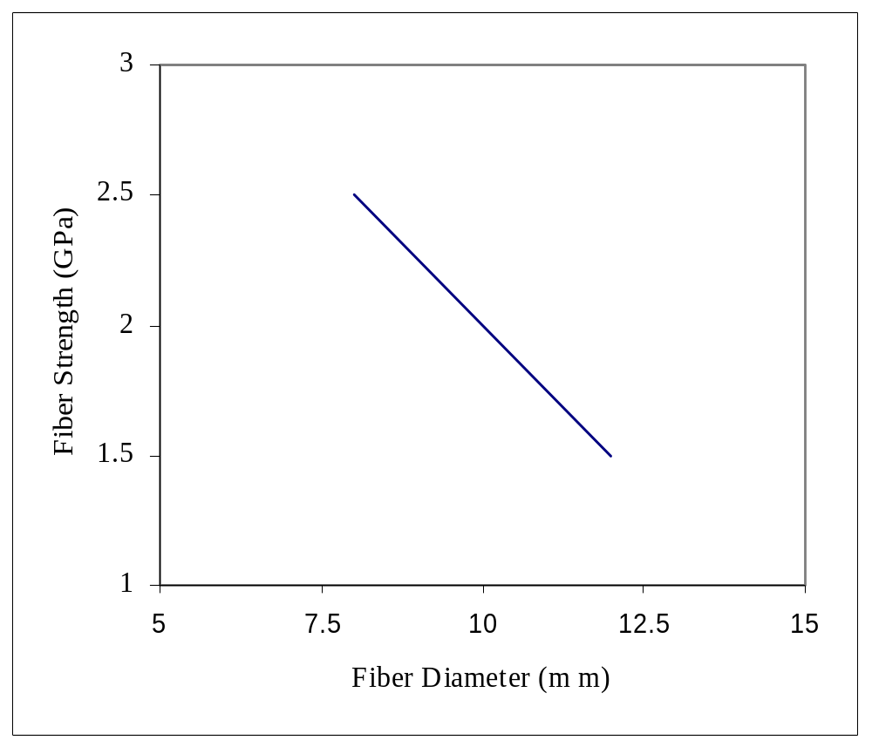
Less Flaws

Slide 46
More Toughness and Ductility
Fiber-matrix interface area is inversely proportional to the diameter of the fibers
Higher surface area of fiber-matrix interface results in higher ductility and toughness, and better transfer of loads.

Slide 47
More Flexibility
Flexibility is proportional to inverse of
    Young’s modulus
    Fourth power of diameter
Thinner fibers hence have a higher flexibility and are easy to handle in manufacturing.

Slide 48
END

Slide 49

Fibrous Composites
Generally there are two phases
  Fiber as a reinforcement
  Matrix as a binder

Slide 50
Historical Perspective
4000 B.C. Fibrous composites were used in Egypt in making laminated writing materials
1300 BC: Reference to Book of Exodus
1700 AD: French Scientist, Reumer talked about potential of glass fibers

Slide 51
Historical Perspectives (continued)
1939: Glass fiber manufactured commercially for high temperature electrical applications
1950s: Boron and carbon fibers were produced to make ropes.
1960s: Matrix added to make polymeric matrix composites

Slide 52
Historical Perspectives (continued)
1970s: Cold war forces development of metal matrix composites for military aircrafts and missile guidance systems
1990s: High temperature ceramic matrix composites are being aggressively researched for use in next generation aircraft engines and power plant turbines

Slide 53
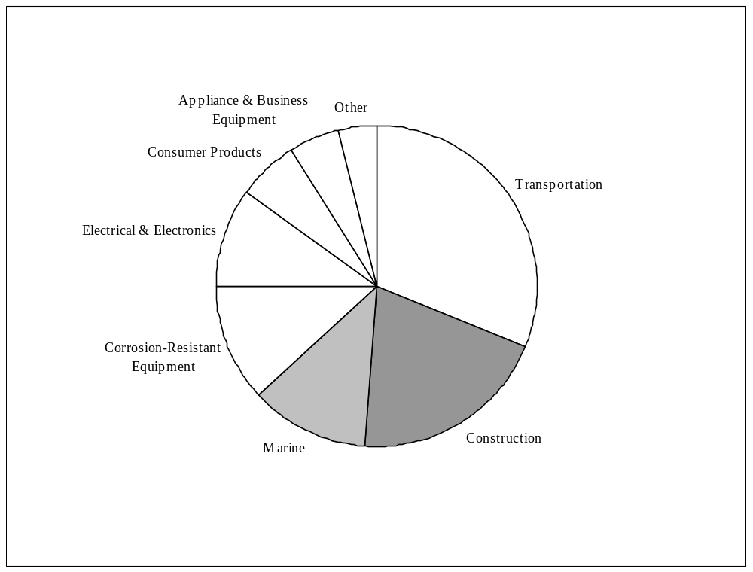
Shipments of Composites

Slide 54
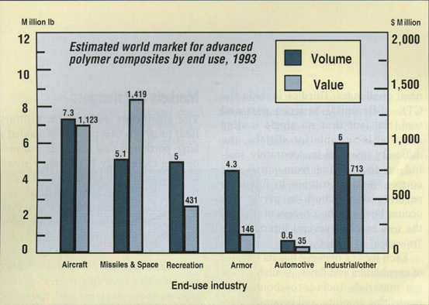
World Market of Composites

Slide 55
Advantages of Composites
Specific Strength and Stiffness
Tailored Design
Fatigue Life
Dimensional Stability
Corrosion Resistance
Cost-Effective Fabrication

Slide 56
Drawbacks of Composites
High cost of fabrication of composites
Complex mechanical characterization
Complicated repair of composite structures
High combination of all required properties may not be available

Slide 57
END

Slide 58
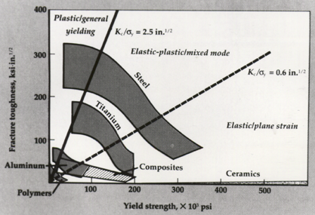
Composites vs. Metals

Slide 59
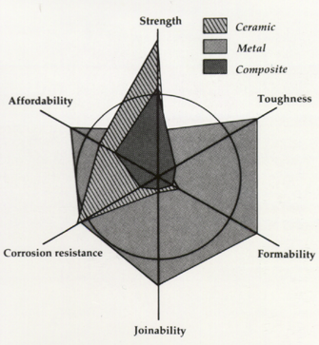
Composites vs. Metals
Comparison based on six primary material selection parameters

Slide 60
Design Parameters
Torque Resistance.
  Should carry load without failure
Not rotate close to natural frequency.
  Need high natural frequency otherwise whirling may take place
Buckling Resistance.
  May buckle before failing

