Slide 1
Classification of Composite Materials
Mechanical Engineering
Instructor: Autar Kaw

Slide 2
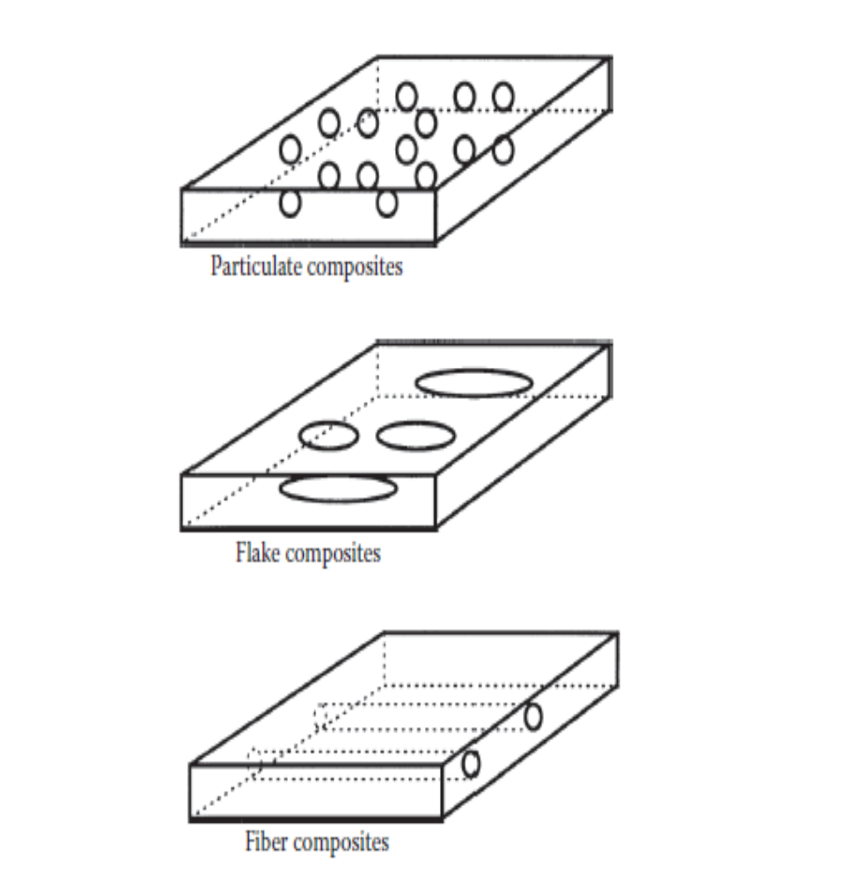
Classification
CONCRETE:
Gravel, sand and cement
PAINT:
Paint and aluminum flakes
GRAPHITE/EPOXY:
Graphite fibers in epoxy matrix

Slide 3
Polymer Matrix Composites
What are the most common advanced composites?
  Graphite/Epoxy
  Kevlar/Epoxy
  Boron/Epoxy

Slide 4
Polymer Matrix Composites
What are the drawbacks of polymer matrix composites?
  Low operating temperatures
  High CTE and CMEs
  Low elastic properties in certian directions

Slide 5
Are Carbon and Graphite the Same?
No
  Carbon fibers have 93%-95% carbon content and graphite has >99% carbon content
  Carbon fibers are produced at 2400º F and graphite fibers are produced at 3400º F

Slide 6
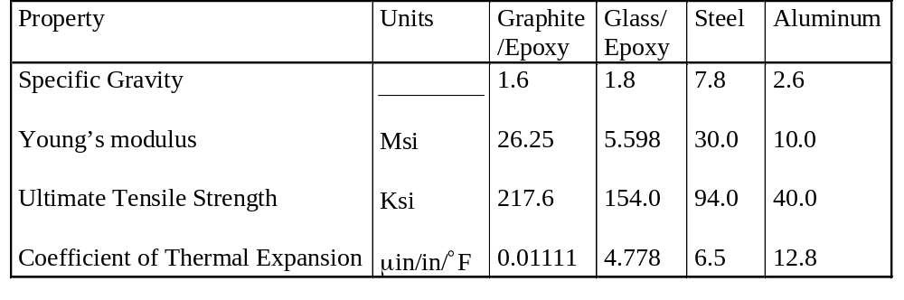
Table 1.4. Typical mechanical properties of polymer matrix composites and monolithic materials

Slide 7
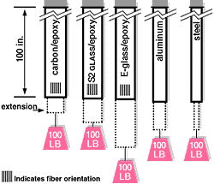
Comparative Stiffness of PMCs and Metals

Slide 8
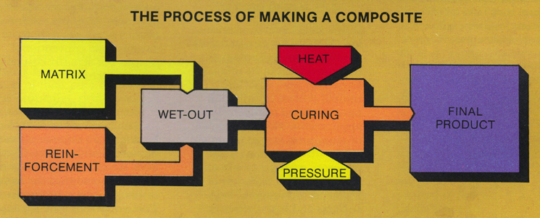
How to make a PMC

Slide 9
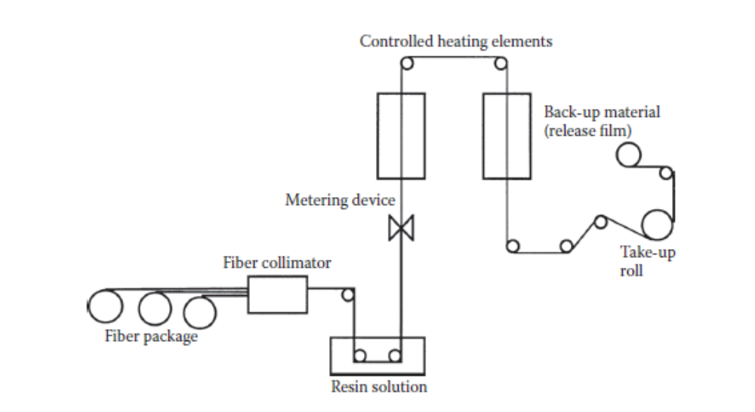
Schematic of Prepreg Manufacturing

Slide 10
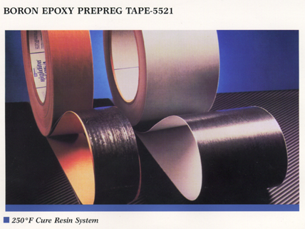
Prepreg Boron/Epoxy

Slide 11
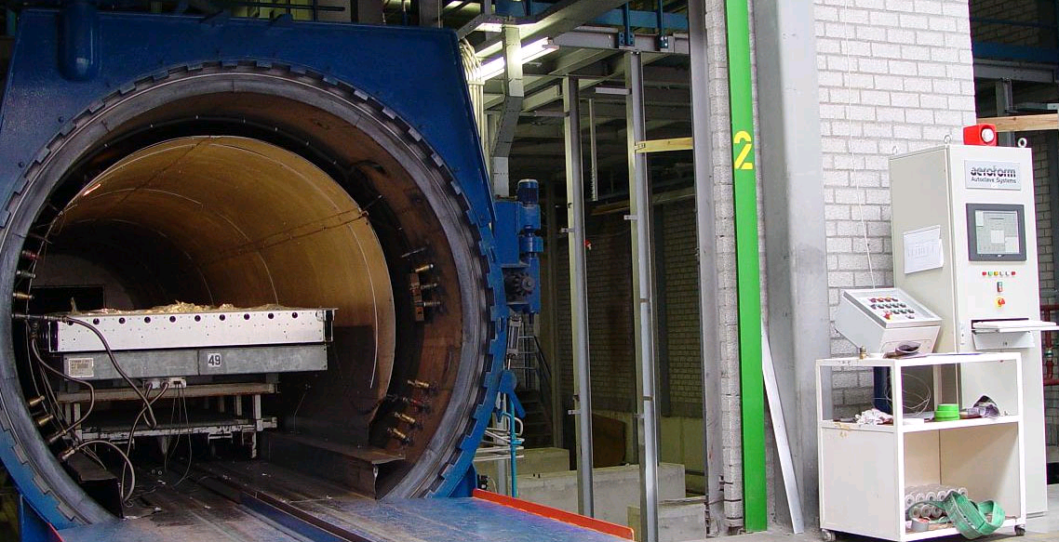
Autoclave Lamination

Slide 12
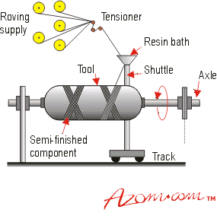
Filament Winding
Filament Winding Video

Slide 13
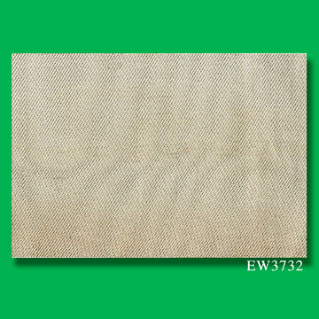
Common PMC Fibers & Matrices
Fibers
  Graphite
  Glass
  Kevlar
Matrices
  Epoxy
  Phenolic
  Polyester

Slide 14
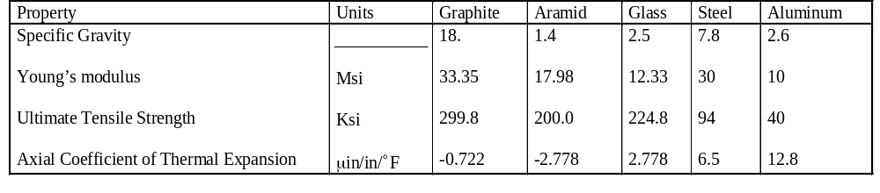
Table 1.5 Typical mechanical properties of fibers used in polymer matrix composites

Slide 15
Cost Comparison of PMC fibers
Type of fiber Cost ($ per pound)
A-glass 0.65 - .90
C-glass 0.75 - 1.00
E-glass 0.75 - 1.00
S-2 Glass 6.00 - 8.00
Heavy Tow 9.00 - 12.00
Medium Tow 15.00 -20.00
Low Tow 40.00 -70.00+
Kev29 12.00 -14.00
Kev149 25.00 -30.00

Slide 16
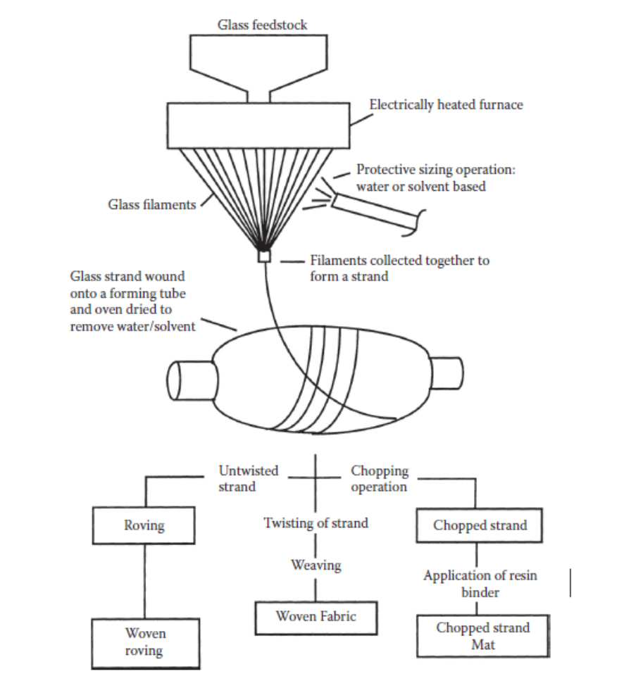
Manufacturing of Glass Fibers

Slide 17
Glass Fiber Types
E-glass (fiberglass) - electrical applications
S-glass - strength applications
C-glass - Corrosion resistant
D-glass - Low dielectric applications
A-glass - Appearance applications
AR-glass - Alkali resistant

Slide 18
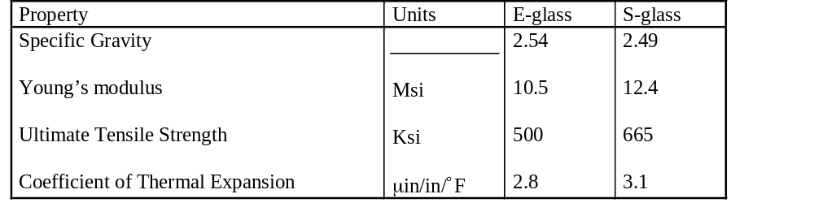
Table 1.6 Comparison of properties of E-glass and S-glass

Slide 19
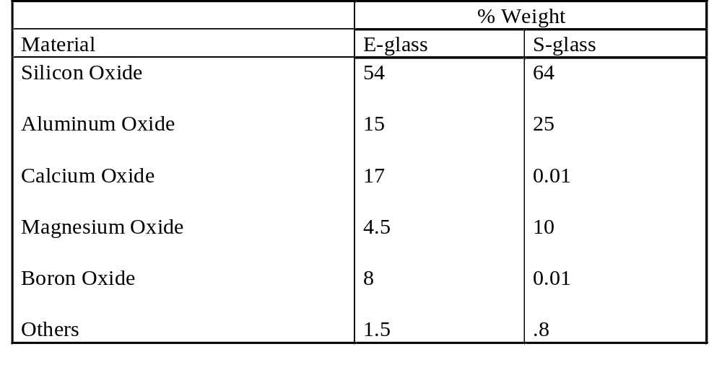
Table 1.7 Chemical Composition of E-Glass and S-Glass Fibers

Slide 20
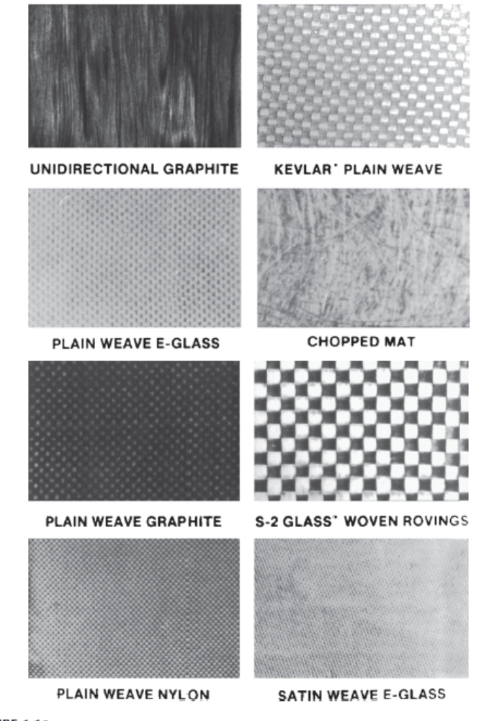
Fig 1.10 Forms of Fibers

Slide 21
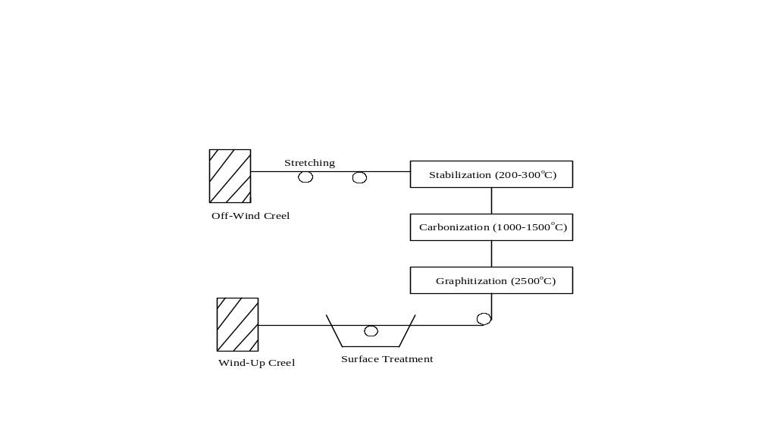
Fig 1.11 Manufacturing Graphite Fibers

Slide 22
Resin Systems
Polyester
Phenolics
Epoxy
Silicone
Polymide

Slide 23
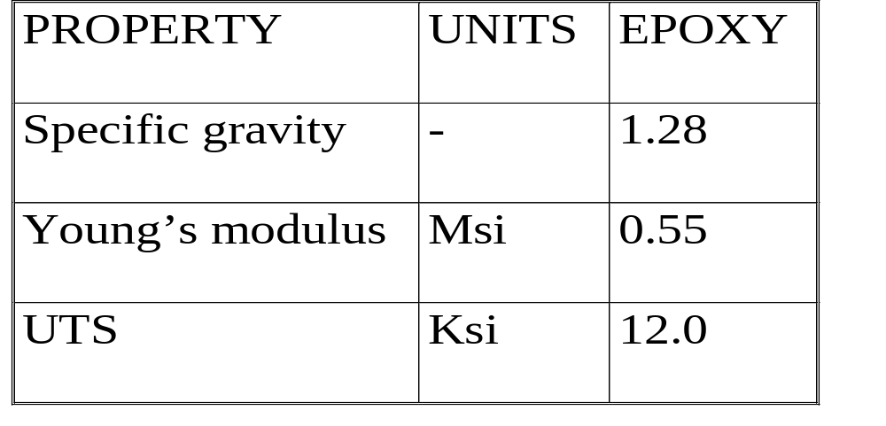
Properties of epoxy

Slide 24
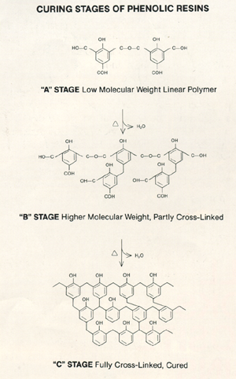
Curing Stages of Epoxy

Slide 25
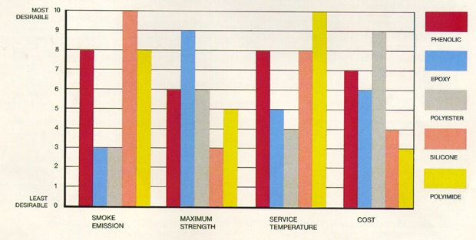
Comparison of Resins

Slide 26
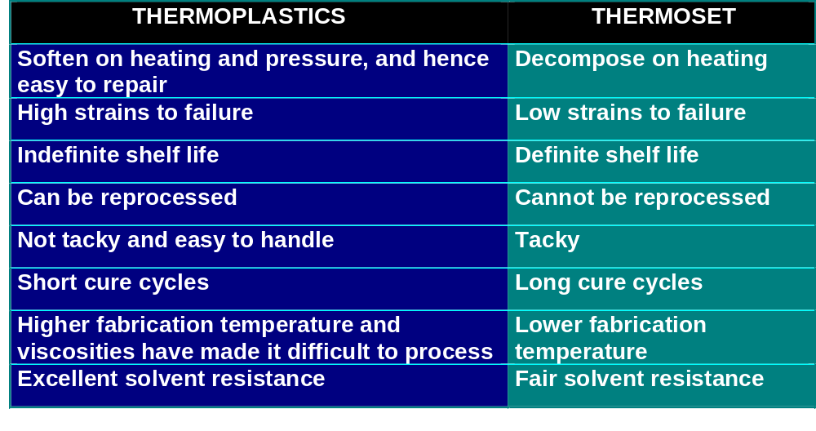
Difference between thermosets and thermoplastics

Slide 27
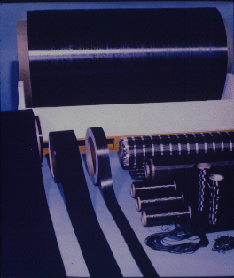
Pre-Preg Graphite/Epoxy

