Slide 1
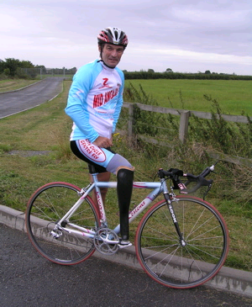
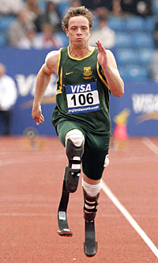
Application of Polymer Matrix Composites
A strong, ultra light leg prosthesis of graphite/epoxy help athletes compete at the highest levels.

Slide 2
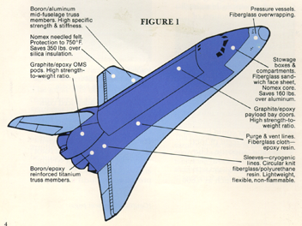
Space Shuttle

Slide 3
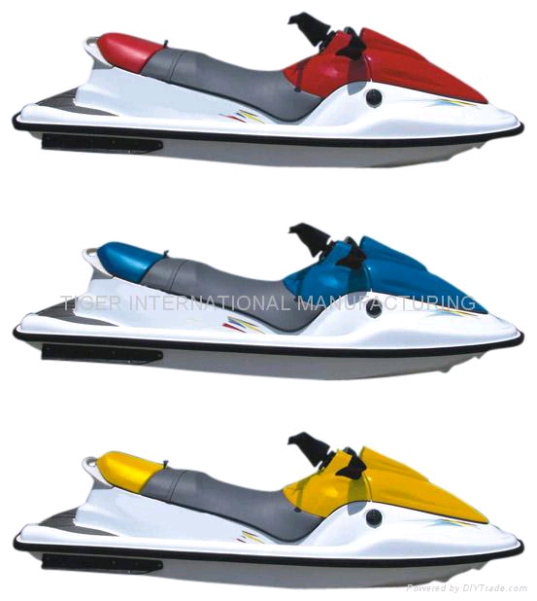
Every body skiing USA
SMC: sheet molded compound
FRC : Fiberglass Reinforced composite .

Slide 4
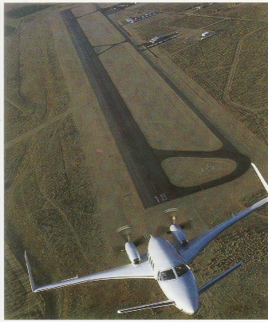
Lear Fan

Slide 5
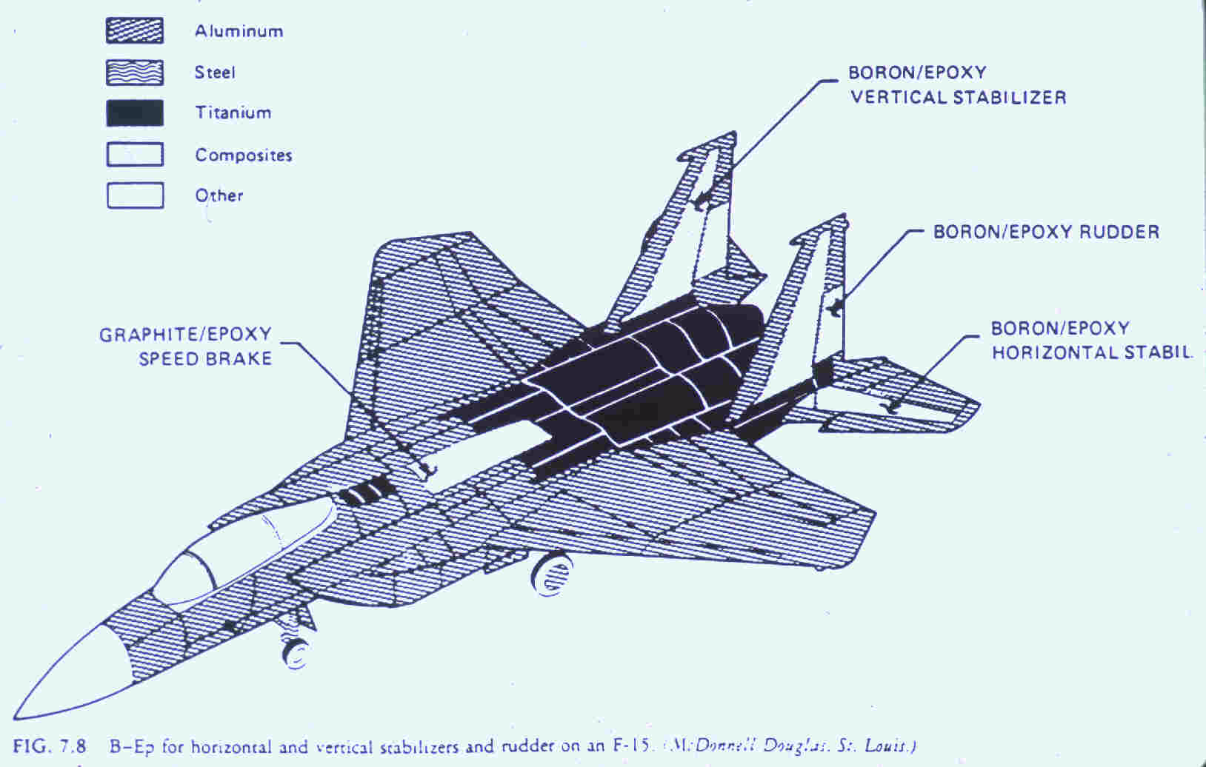
Fighter Jets

Slide 6
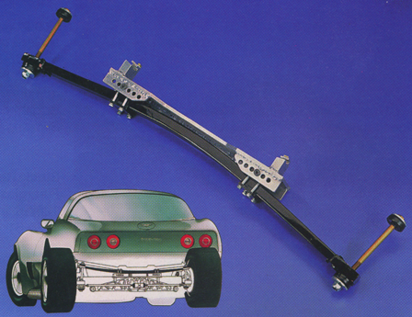
Corvette Leaf Springs

Slide 7
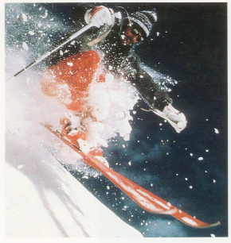
Snow Skis

Slide 8
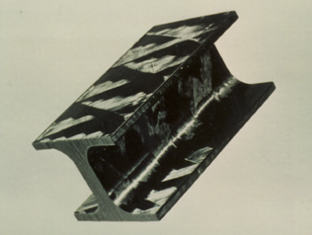
I-beam

Slide 9
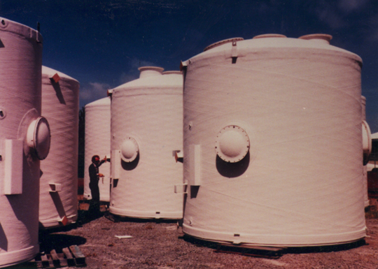
Pressure vessels

Slide 10
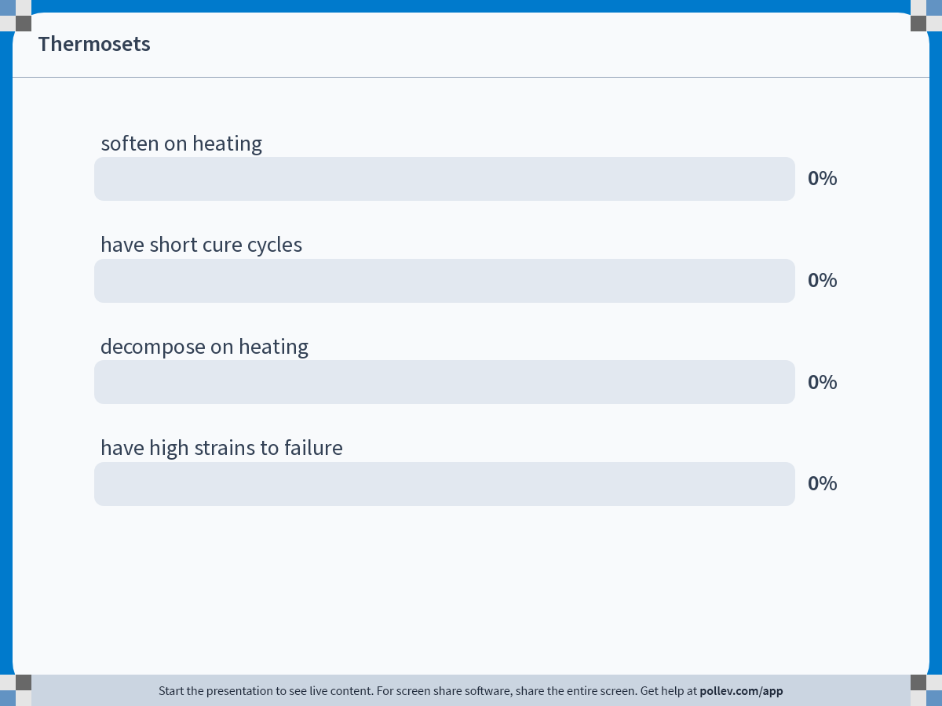
Notes:
Poll Title: Do not modify the notes in this section to avoid tampering with the Poll Everywhere activity.
More info at polleverywhere.com/support
Thermosets
https://www.polleverywhere.com/multiple_choice_polls/4ZcmHxN0Ub3vZyOKVznXK

Slide 11
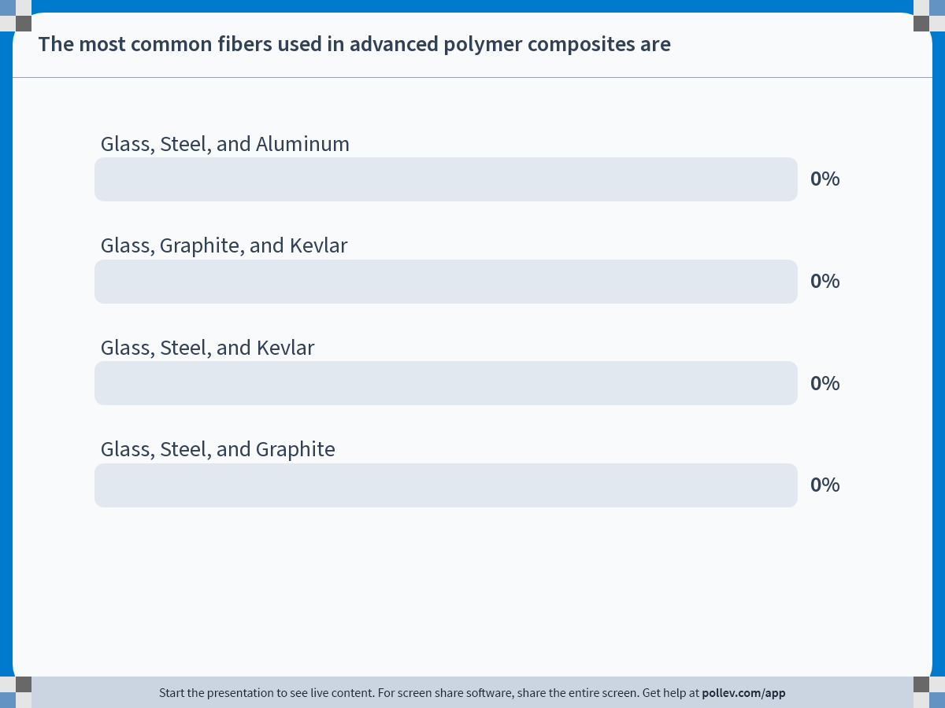
Notes:
Poll Title: Do not modify the notes in this section to avoid tampering with the Poll Everywhere activity.
More info at polleverywhere.com/support
The most common fibers used in advanced polymer composites are
https://www.polleverywhere.com/multiple_choice_polls/NRLvpXVBRJYe464JLxdaB

Slide 12
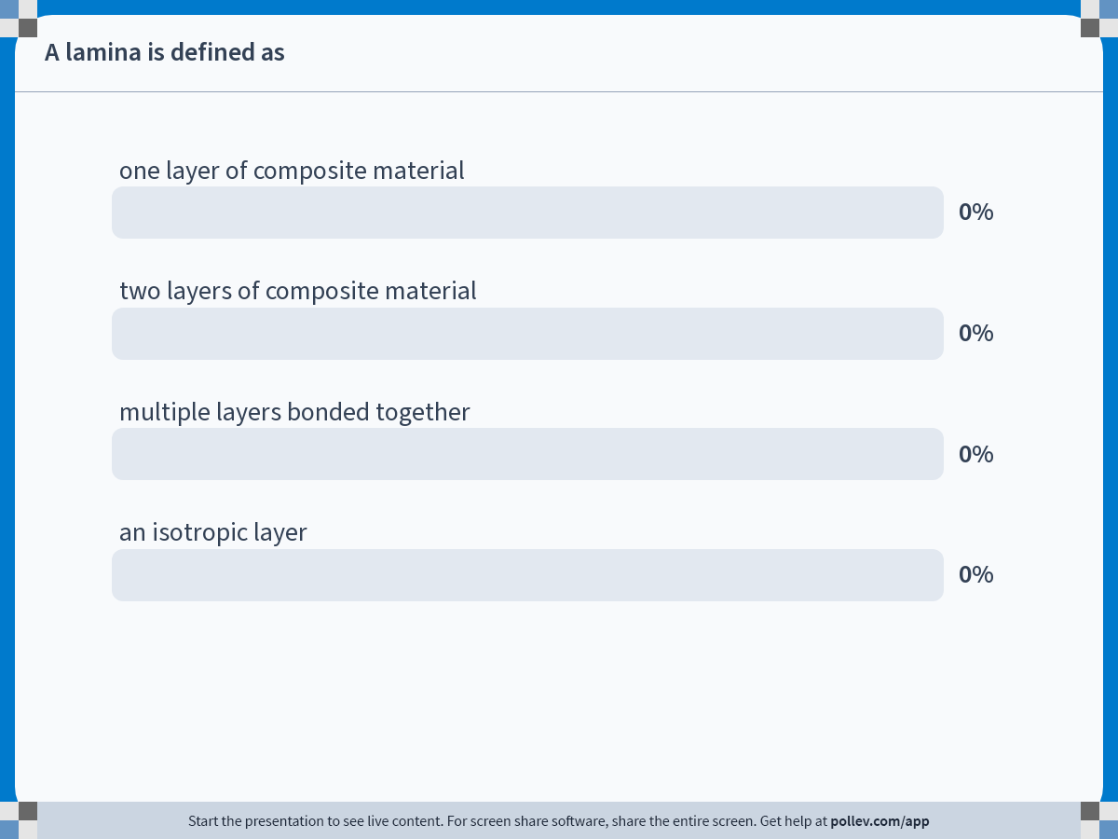
Notes:
Poll Title: Do not modify the notes in this section to avoid tampering with the Poll Everywhere activity.
More info at polleverywhere.com/support
A lamina is defined as
https://www.polleverywhere.com/multiple_choice_polls/VyRwE6S0UGijbFSVQxPnW

Slide 13
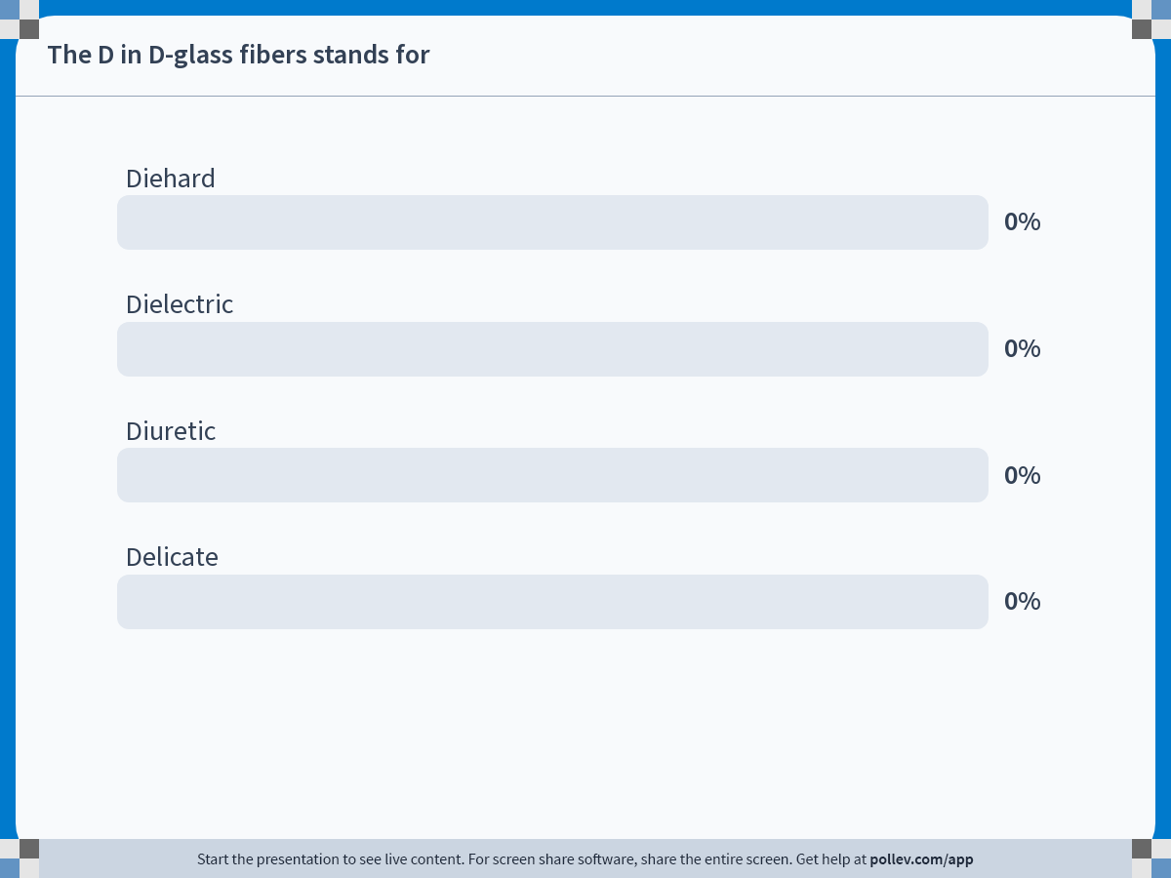
Notes:
Poll Title: Do not modify the notes in this section to avoid tampering with the Poll Everywhere activity.
More info at polleverywhere.com/support
The D in D-glass fibers stands for
https://www.polleverywhere.com/multiple_choice_polls/9obGiBt9yBDZCs5SO7FhW

Slide 14
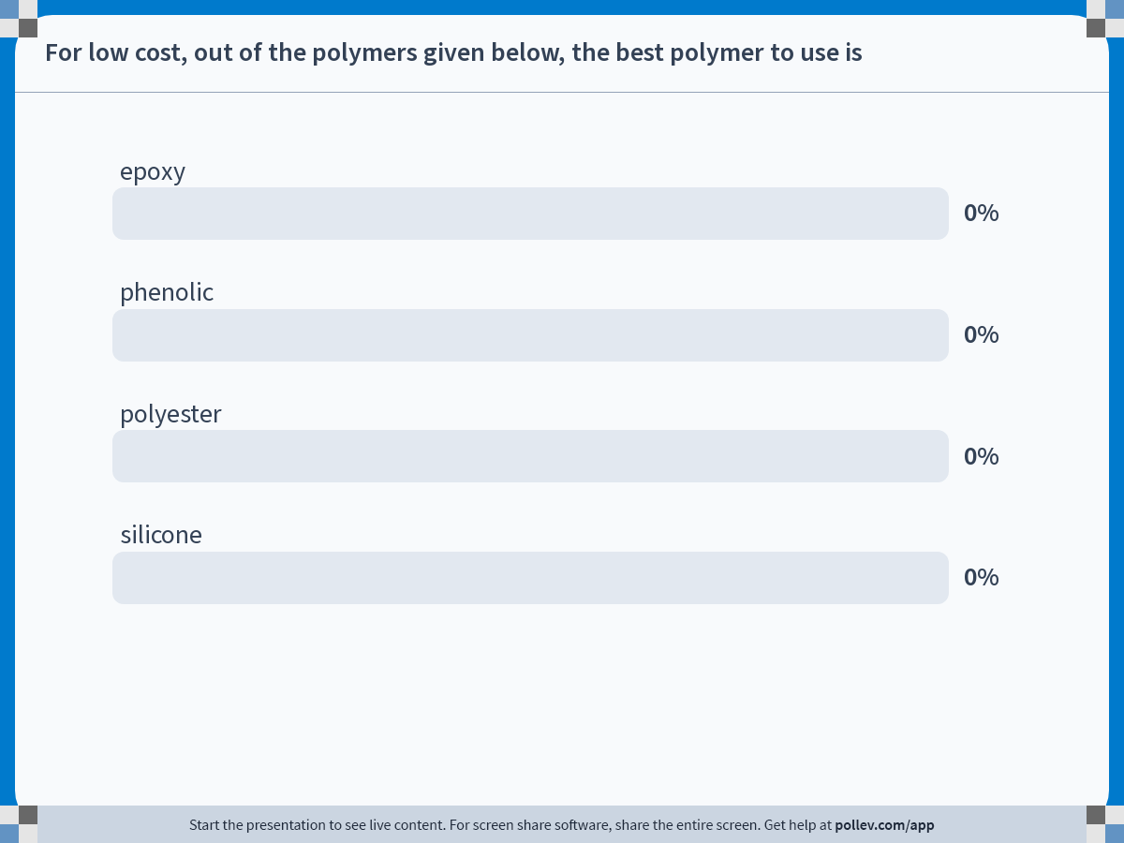
Notes:
Poll Title: Do not modify the notes in this section to avoid tampering with the Poll Everywhere activity.
More info at polleverywhere.com/support
For low cost, out of the polymers given below, the best polymer to use is
https://www.polleverywhere.com/multiple_choice_polls/V0UyyS59BqlR1iiSNcr10

Slide 15
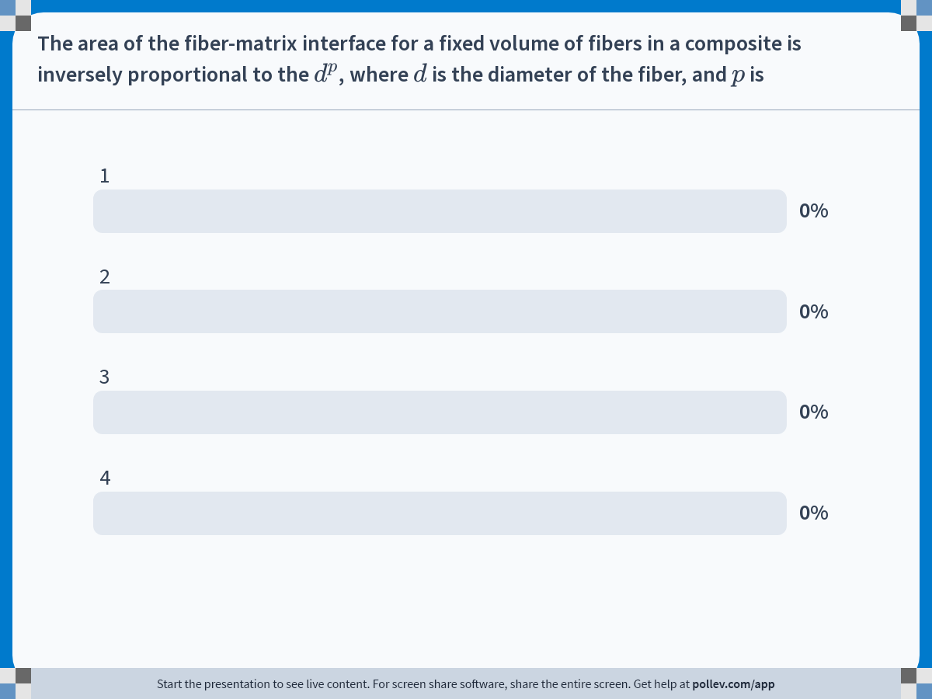
Notes:
Poll Title: Do not modify the notes in this section to avoid tampering with the Poll Everywhere activity.
More info at polleverywhere.com/support
The area of the fiber-matrix interface for a fixed volume of fibers in a composite is inversely proportional to the $$d^p$$, where $$d$$ is the diameter of the fiber, and $$p$$ is
https://www.polleverywhere.com/multiple_choice_polls/v4bYq4IigqqPVvYj3n0DX

Slide 16
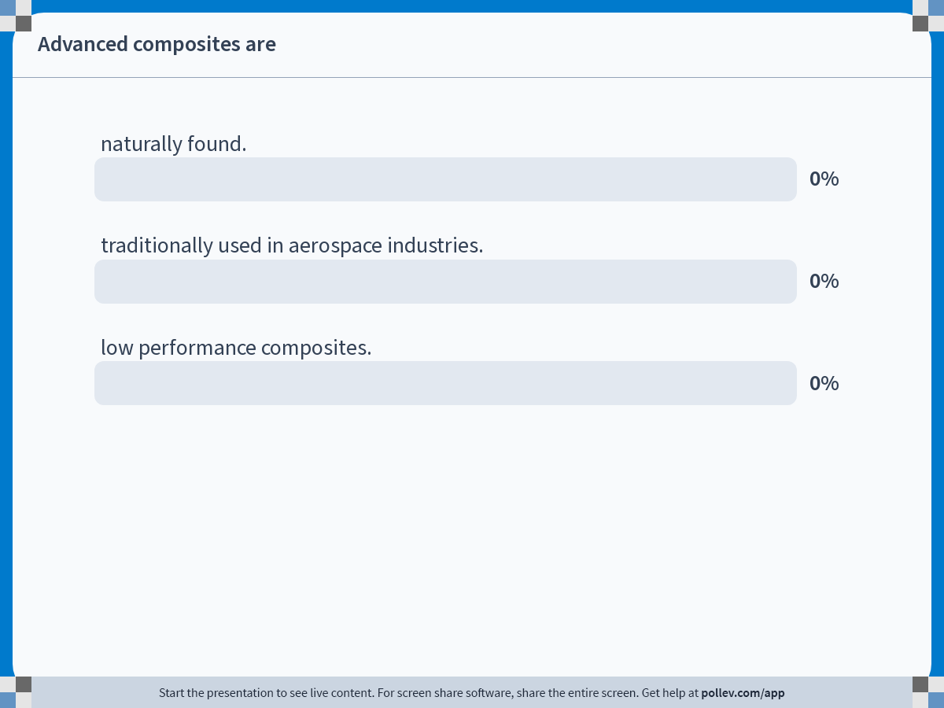
Notes:
Poll Title: Do not modify the notes in this section to avoid tampering with the Poll Everywhere activity.
More info at polleverywhere.com/support
Advanced composites are
https://www.polleverywhere.com/multiple_choice_polls/JUKFAB8Durq2xJjj09L6V

Slide 17
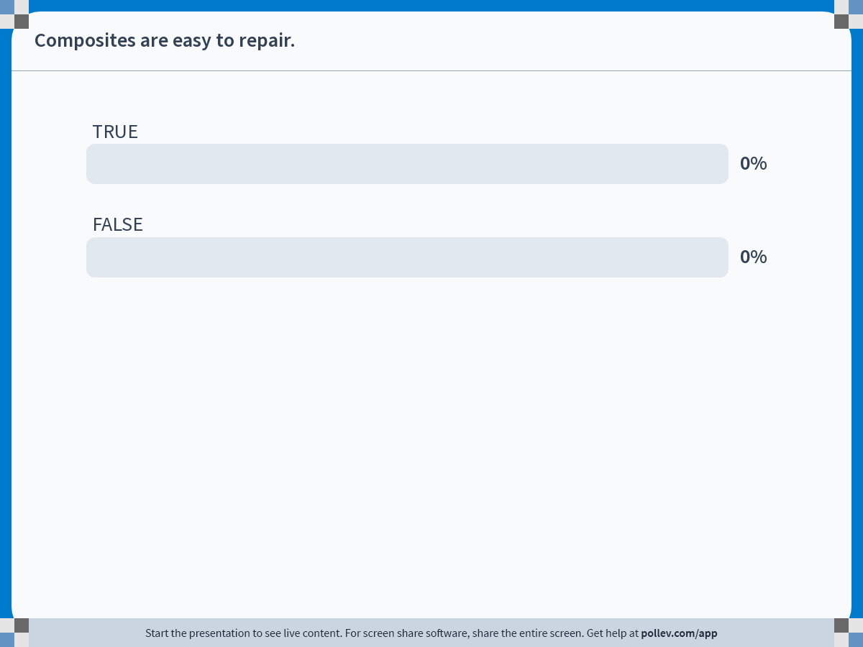
Notes:
Poll Title: Do not modify the notes in this section to avoid tampering with the Poll Everywhere activity.
More info at polleverywhere.com/support
Composites are easy to repair.
https://www.polleverywhere.com/multiple_choice_polls/4MPGOvIqOGt8CPIPQOZrp

Slide 18
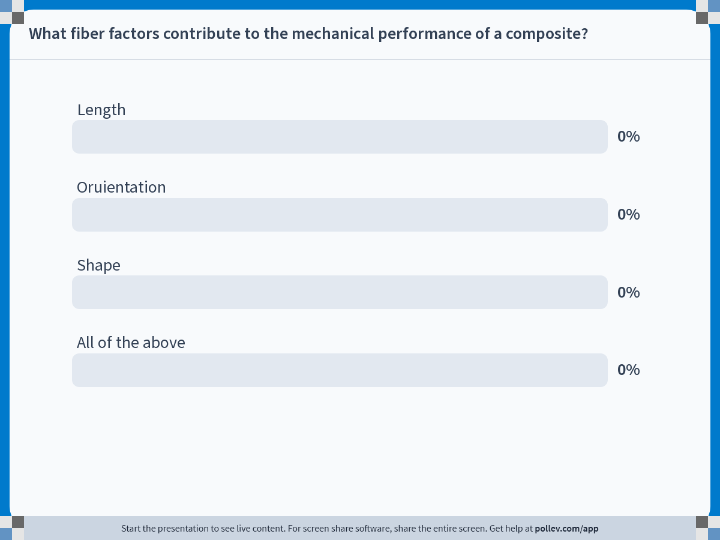
Notes:
Poll Title: Do not modify the notes in this section to avoid tampering with the Poll Everywhere activity.
More info at polleverywhere.com/support
What fiber factors contribute to the mechanical performance of a composite?
https://www.polleverywhere.com/multiple_choice_polls/isxNYIHHwXN1TjOMkRsJf

Slide 19

Notes:
Poll Title: Do not modify the notes in this section to avoid tampering with the Poll Everywhere activity.
More info at polleverywhere.com/support
PMC stands for
https://www.polleverywhere.com/multiple_choice_polls/Pon7z4GzSn6p4cErKhJDK

Slide 20
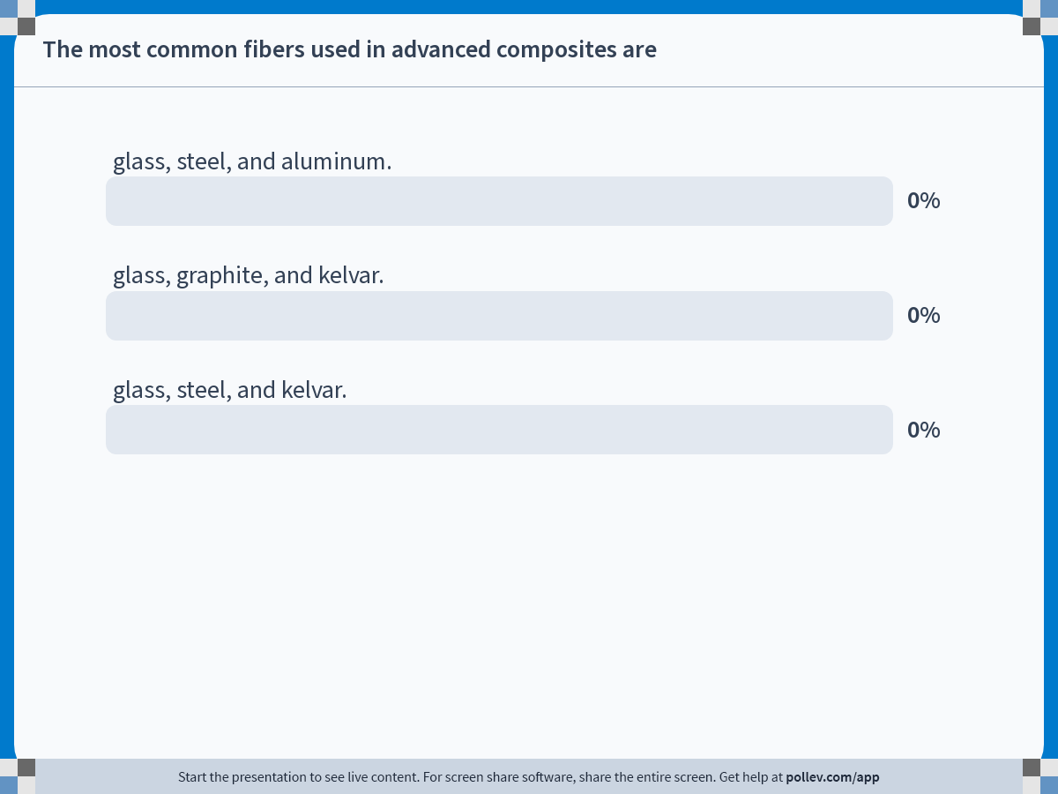
Notes:
Poll Title: Do not modify the notes in this section to avoid tampering with the Poll Everywhere activity.
More info at polleverywhere.com/support
The most common fibers used in advanced composites are
https://www.polleverywhere.com/multiple_choice_polls/Xp0JV6B57h3kmwIsvF5VG

Slide 21
Notes:
Poll Title: Do not modify the notes in this section to avoid tampering with the Poll Everywhere activity.
More info at polleverywhere.com/support
E-glass type fiber is used for
https://www.polleverywhere.com/multiple_choice_polls/HR875rTmbypoyCgKlOry9

Slide 22
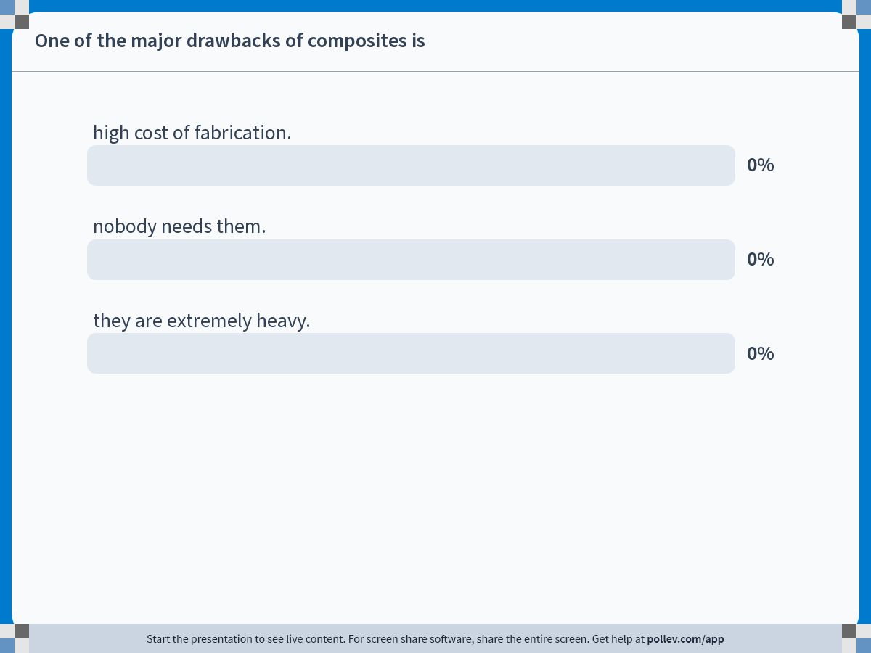
Notes:
Poll Title: Do not modify the notes in this section to avoid tampering with the Poll Everywhere activity.
More info at polleverywhere.com/support
One of the major drawbacks of composites is
https://www.polleverywhere.com/multiple_choice_polls/CchkmhtMVNWLvIyhoE7v4

Slide 23
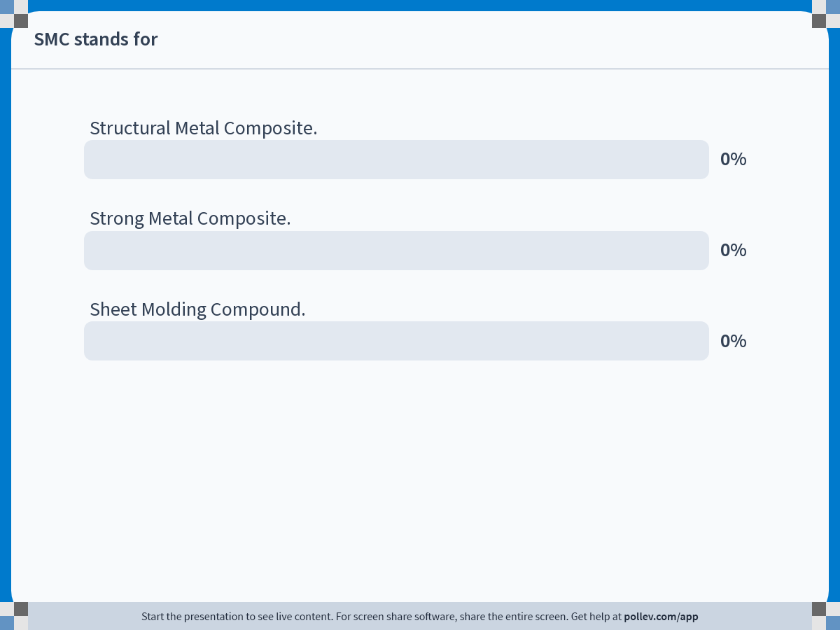
Notes:
Poll Title: Do not modify the notes in this section to avoid tampering with the Poll Everywhere activity.
More info at polleverywhere.com/support
SMC stands for
https://www.polleverywhere.com/multiple_choice_polls/PcS10qowz1aomSjaA9EEa

Slide 24
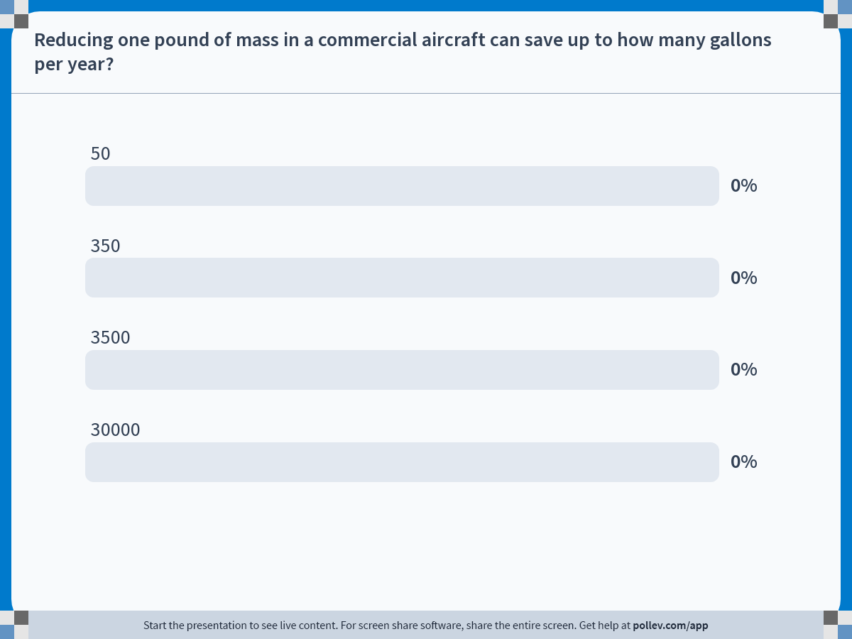
Notes:
Poll Title: Do not modify the notes in this section to avoid tampering with the Poll Everywhere activity.
More info at polleverywhere.com/support
Reducing one pound of mass in a commercial aircraft can save up to how many gallons per year?
https://www.polleverywhere.com/multiple_choice_polls/sqeexGBLp0Z2764iMAqpX

Slide 25
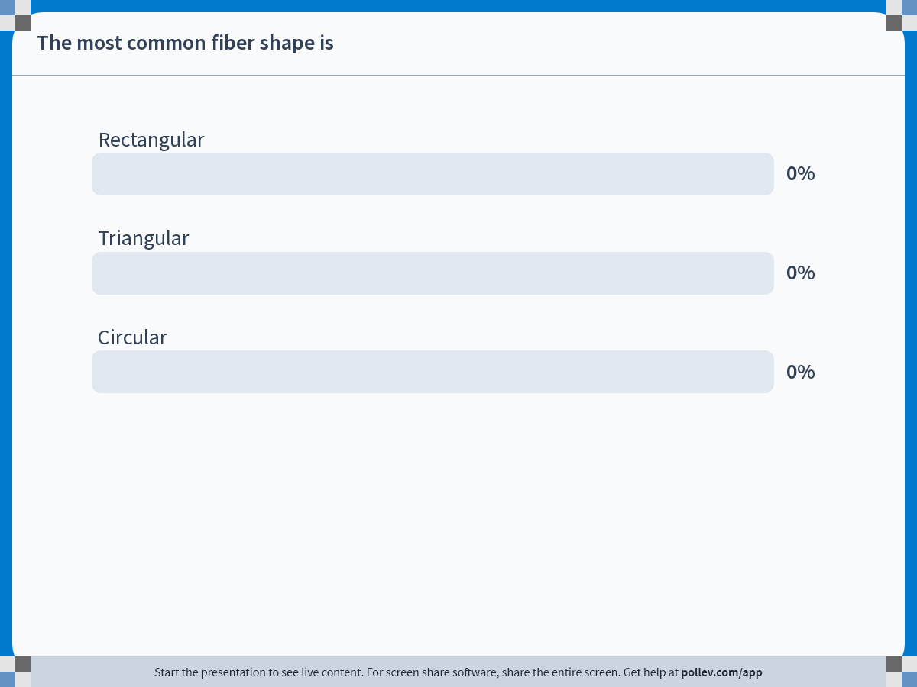
Notes:
Poll Title: Do not modify the notes in this section to avoid tampering with the Poll Everywhere activity.
More info at polleverywhere.com/support
The most common fiber shape is
https://www.polleverywhere.com/multiple_choice_polls/09cM9ovl5KIi8IO1SnXdR

Slide 26
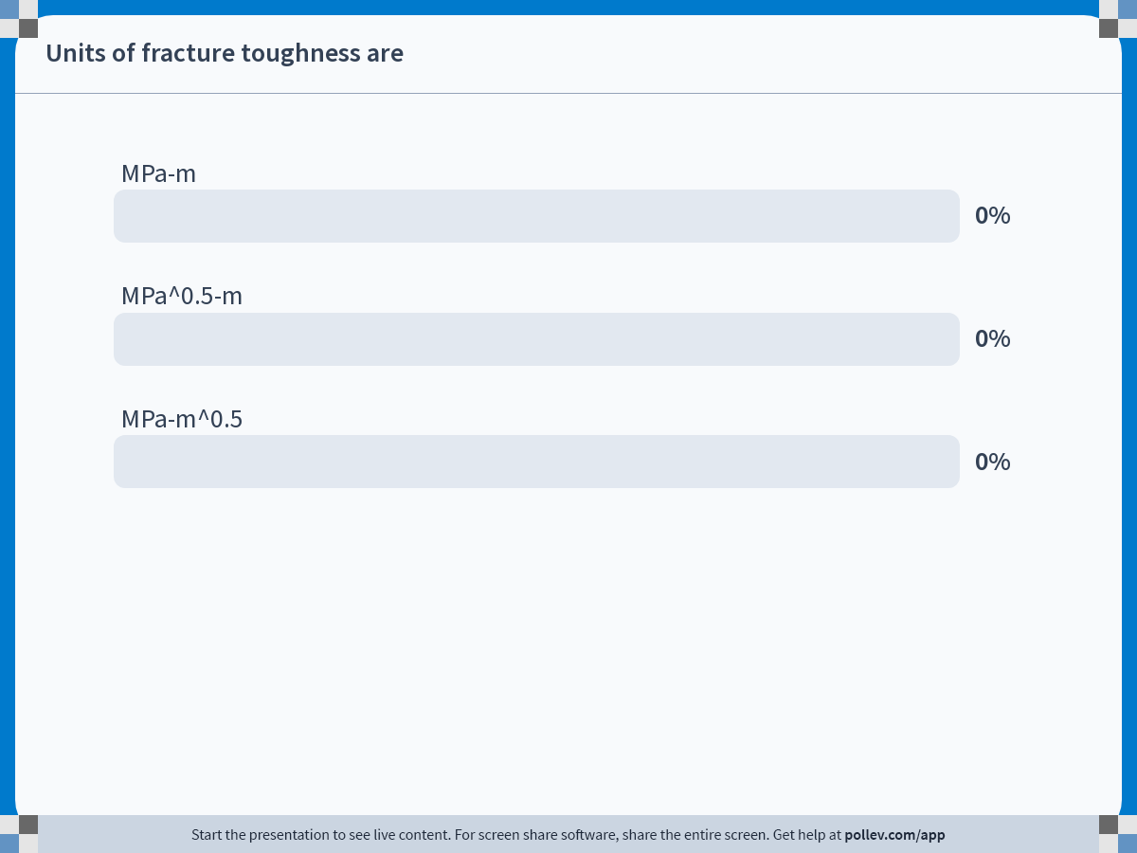
Notes:
Poll Title: Do not modify the notes in this section to avoid tampering with the Poll Everywhere activity.
More info at polleverywhere.com/support
Units of fracture toughness are
https://www.polleverywhere.com/multiple_choice_polls/p9kVKwlwgqeRf2h6VLqJE

Slide 27
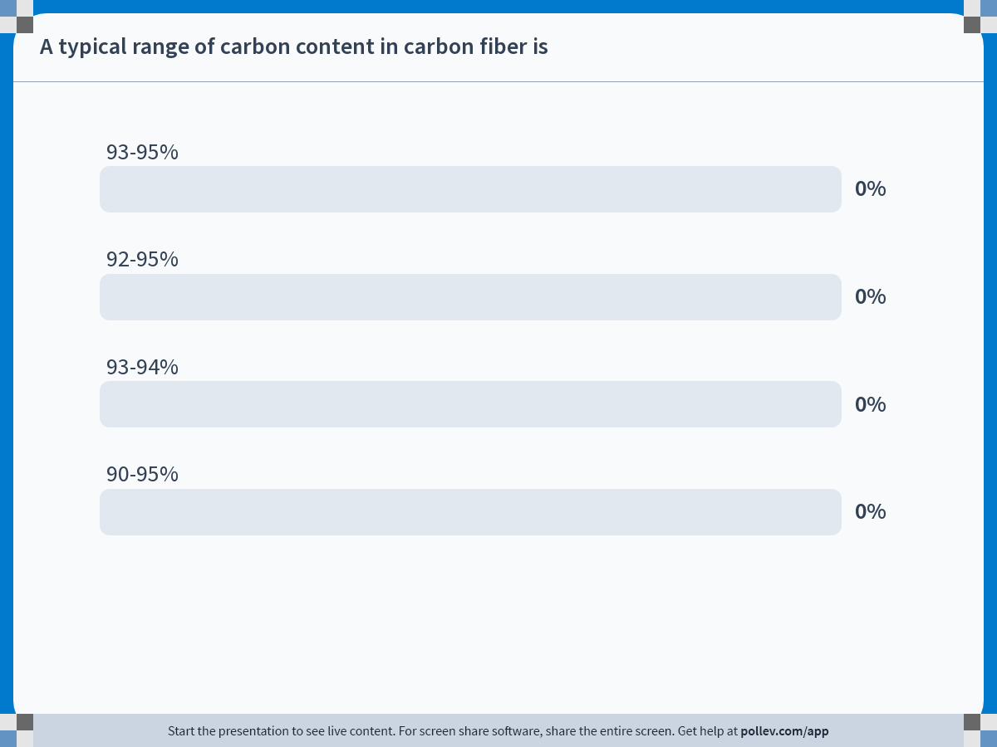
Notes:
Poll Title: Do not modify the notes in this section to avoid tampering with the Poll Everywhere activity.
More info at polleverywhere.com/support
A typical range of carbon content in carbon fiber is
https://www.polleverywhere.com/multiple_choice_polls/OoSg0GGpHwLqjt8r9ByVW

Slide 28
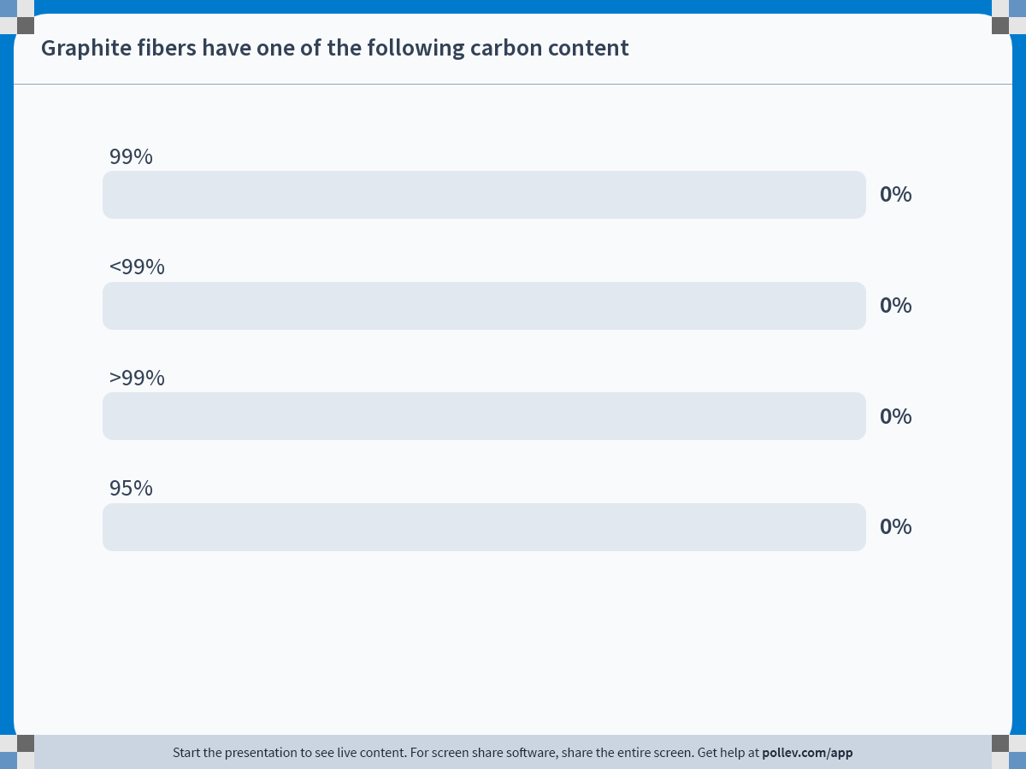
Notes:
Poll Title: Do not modify the notes in this section to avoid tampering with the Poll Everywhere activity.
More info at polleverywhere.com/support
Graphite fibers have one of the following carbon content
https://www.polleverywhere.com/multiple_choice_polls/3Xe17b76OBsZOaaJGKwUK

Slide 29
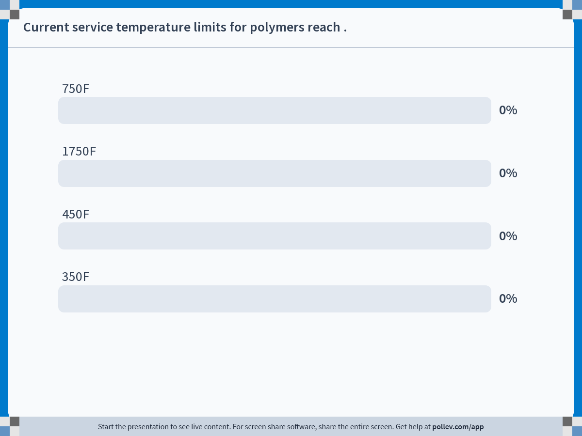
Notes:
Poll Title: Do not modify the notes in this section to avoid tampering with the Poll Everywhere activity.
More info at polleverywhere.com/support
Current service temperature limits for polymers reach .
https://www.polleverywhere.com/multiple_choice_polls/WGApHwwHfmjeIBUgPfTL4

Slide 30
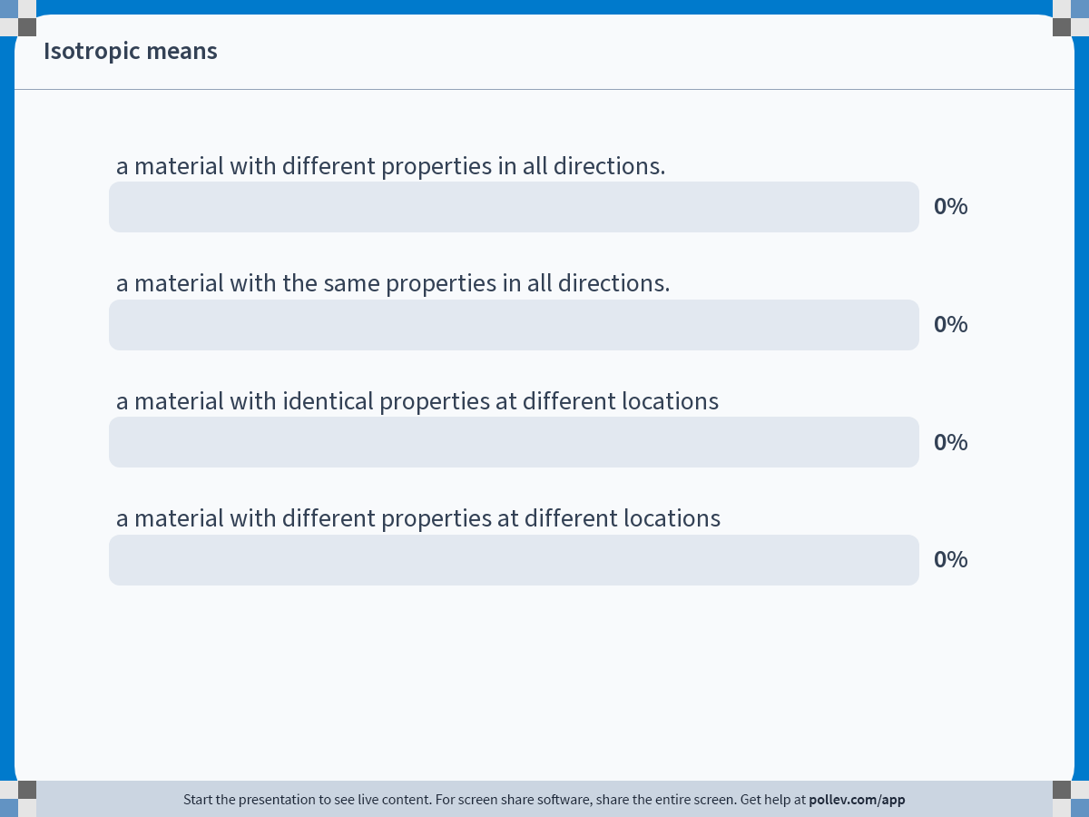
Notes:
Poll Title: Do not modify the notes in this section to avoid tampering with the Poll Everywhere activity.
More info at polleverywhere.com/support
Isotropic means
https://www.polleverywhere.com/multiple_choice_polls/F6rO74lecRlluE5CHf9US

Slide 31
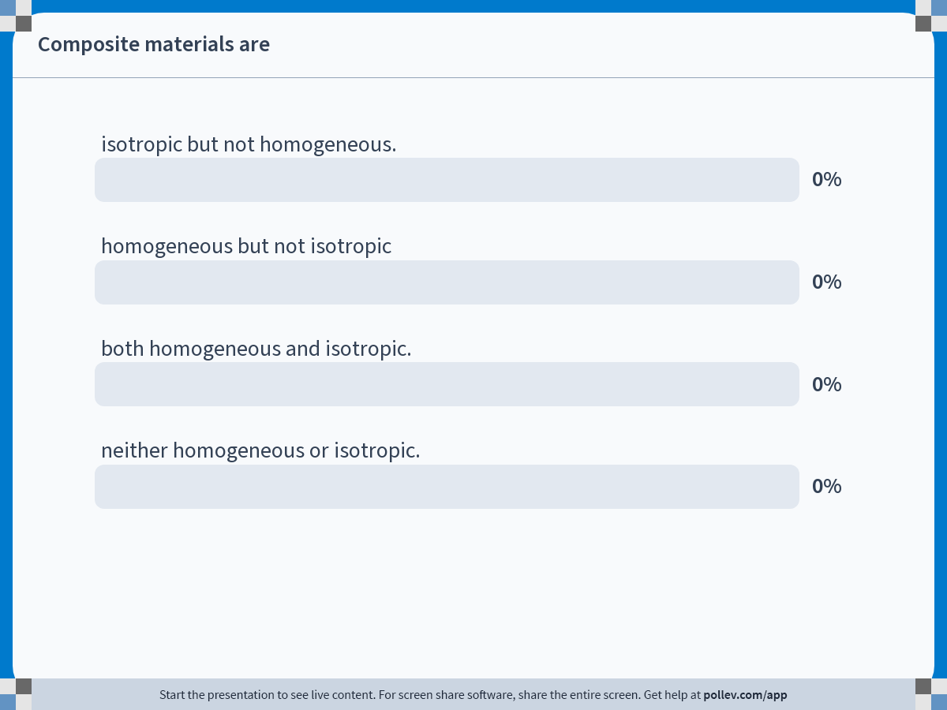
Notes:
Poll Title: Do not modify the notes in this section to avoid tampering with the Poll Everywhere activity.
More info at polleverywhere.com/support
Composite materials are
https://www.polleverywhere.com/multiple_choice_polls/hH0UOPjyDB6r10iU29vvy

Slide 32

Notes:
Poll Title: Do not modify the notes in this section to avoid tampering with the Poll Everywhere activity.
More info at polleverywhere.com/support
Anisotropic means
https://www.polleverywhere.com/multiple_choice_polls/asxWo2ueG1AMuwUOvhFO9

Slide 33
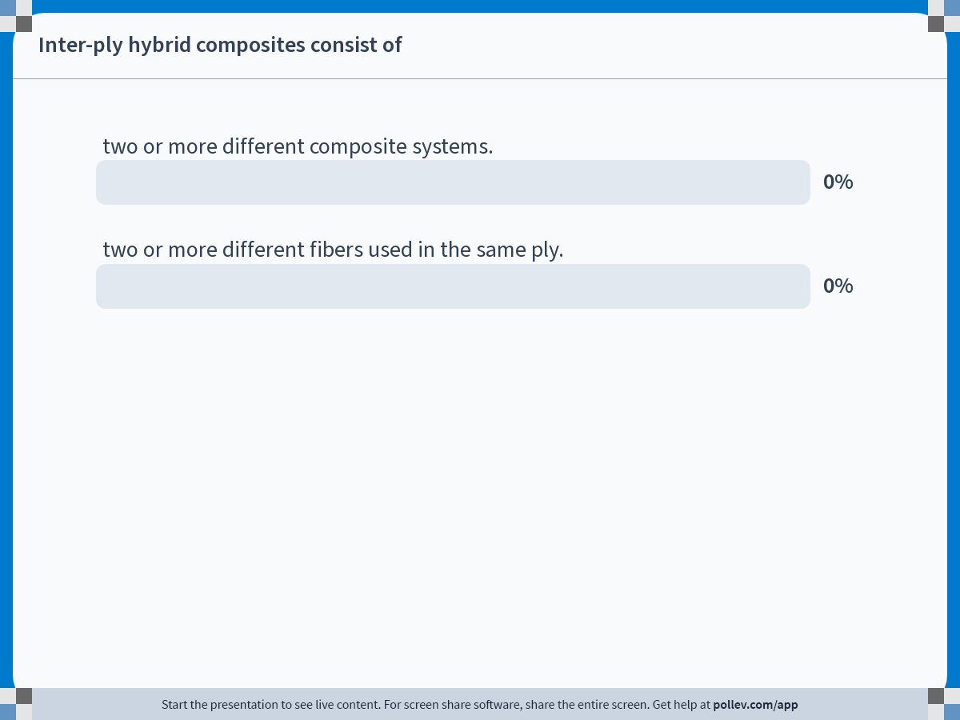
Notes:
Poll Title: Do not modify the notes in this section to avoid tampering with the Poll Everywhere activity.
More info at polleverywhere.com/support
Inter-ply hybrid composites consist of
https://www.polleverywhere.com/multiple_choice_polls/PdDm6JWBfLRddXqBzfdgB

Slide 34
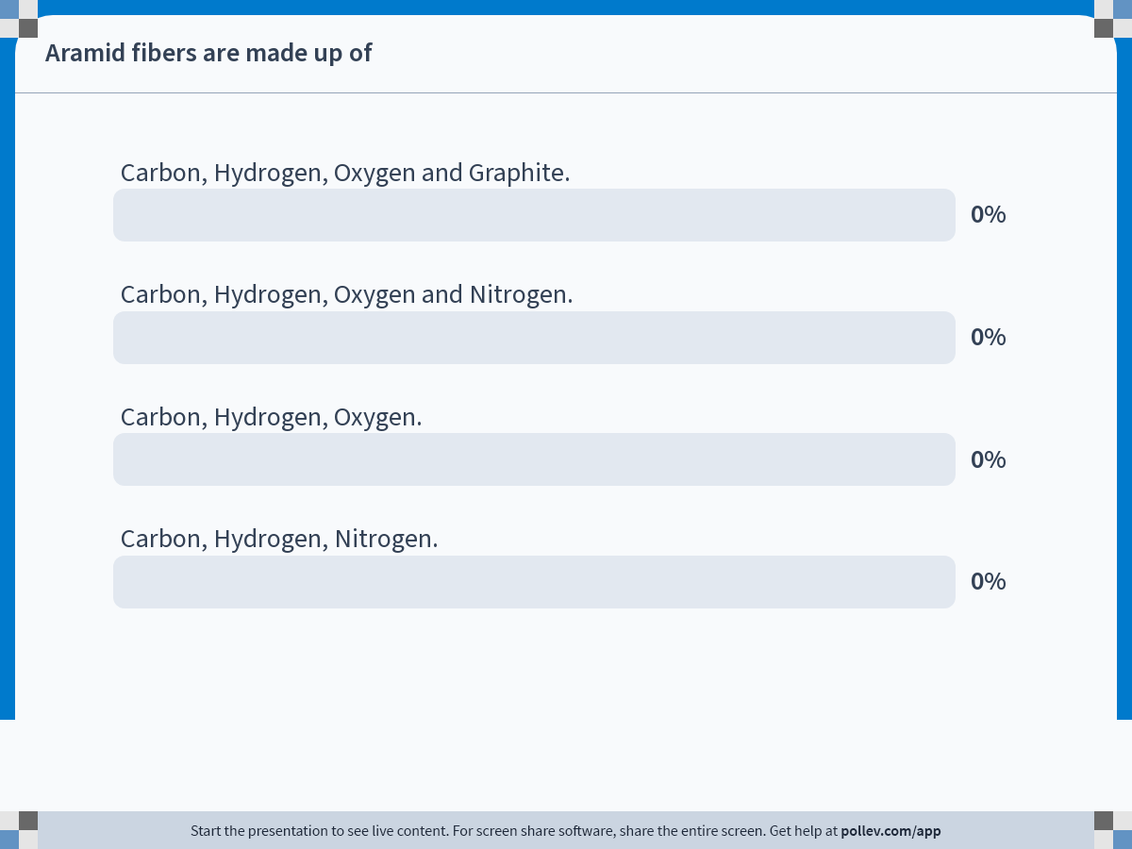
Notes:
Poll Title: Do not modify the notes in this section to avoid tampering with the Poll Everywhere activity.
More info at polleverywhere.com/support
Aramid fibers are made up of
https://www.polleverywhere.com/multiple_choice_polls/Tc4CDILdBW4EUBjrjpDIu

Slide 35
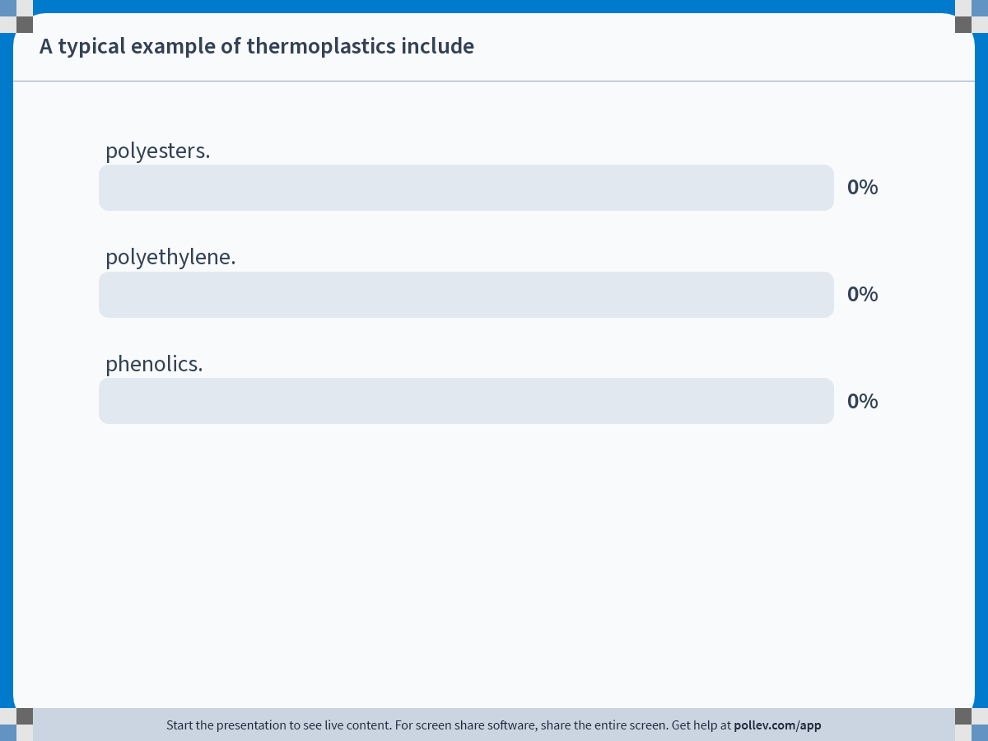
Notes:
Poll Title: Do not modify the notes in this section to avoid tampering with the Poll Everywhere activity.
More info at polleverywhere.com/support
A typical example of thermoplastics include
https://www.polleverywhere.com/multiple_choice_polls/pTkGFKz9cMBuK2oEQLf84

Slide 36
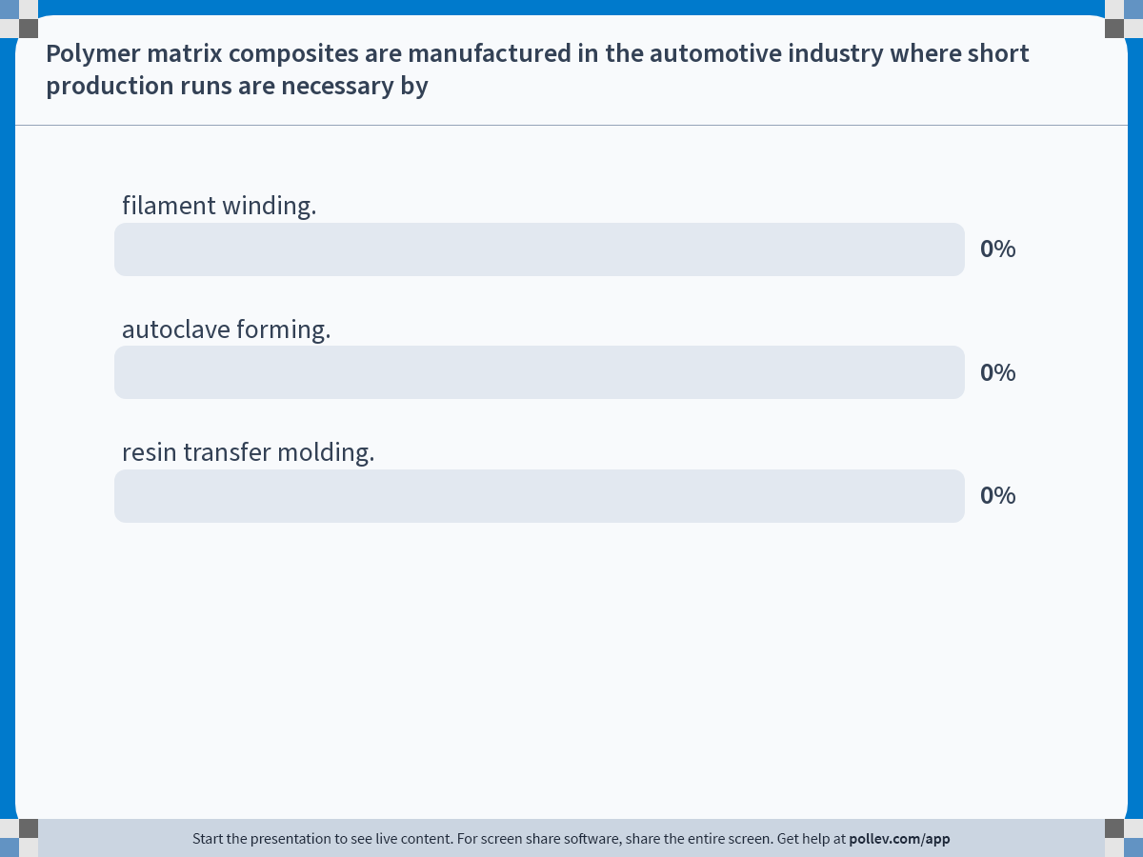
Notes:
Poll Title: Do not modify the notes in this section to avoid tampering with the Poll Everywhere activity.
More info at polleverywhere.com/support
Polymer matrix composites are manufactured in the automotive industry where short production runs are necessary by
https://www.polleverywhere.com/multiple_choice_polls/CKx1NGD9NvbEfyS3sFQ9I

Slide 37
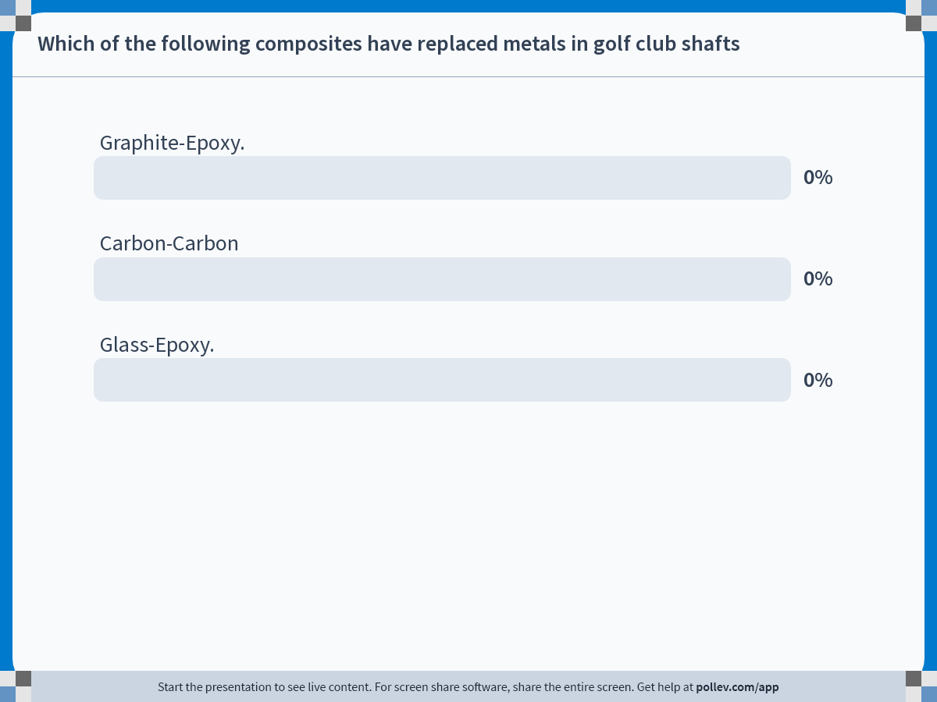
Notes:
Poll Title: Do not modify the notes in this section to avoid tampering with the Poll Everywhere activity.
More info at polleverywhere.com/support
Which of the following composites have replaced metals in golf club shafts
https://www.polleverywhere.com/multiple_choice_polls/OKmAXu9tiB00Z0VP0dluy

Slide 38
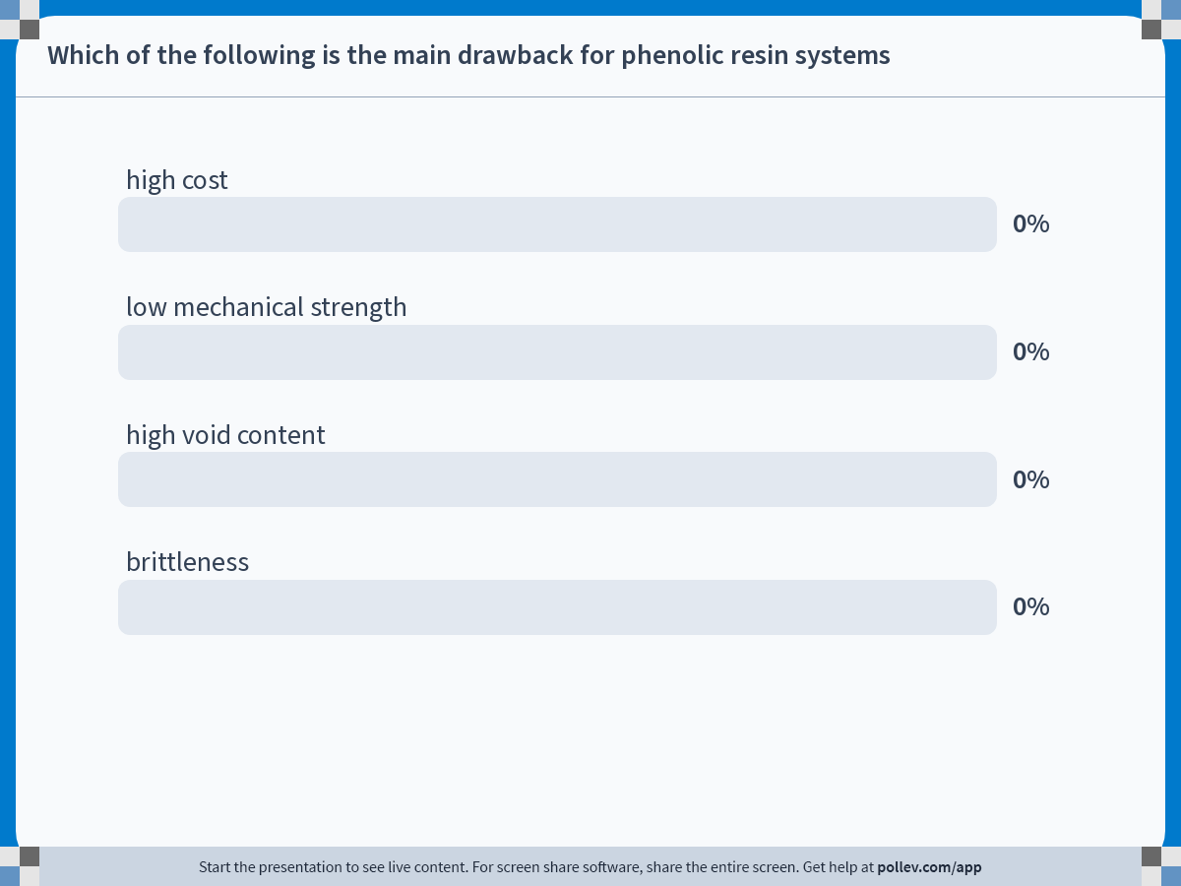
Notes:
Poll Title: Do not modify the notes in this section to avoid tampering with the Poll Everywhere activity.
More info at polleverywhere.com/support
Which of the following is the main drawback for phenolic resin systems
https://www.polleverywhere.com/multiple_choice_polls/2VnAToZSuX6maSUS97oBw

Slide 39
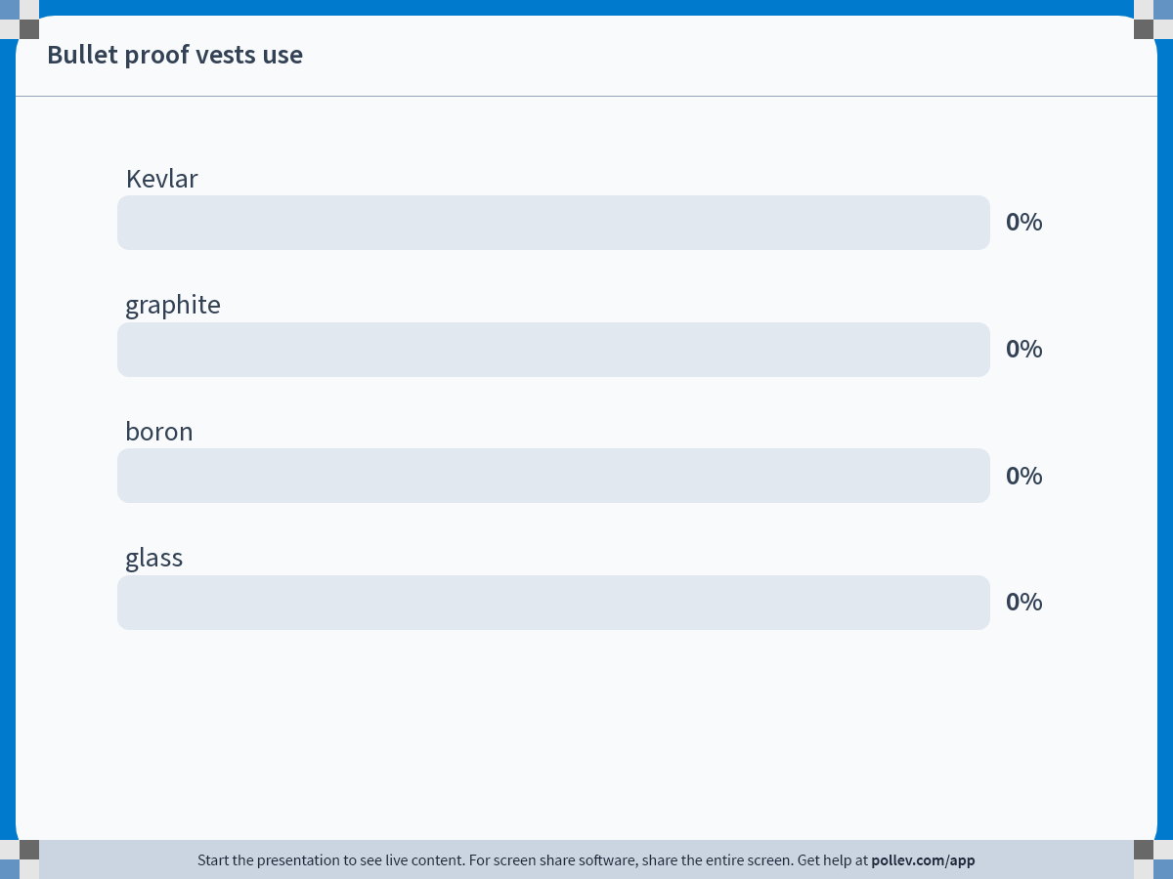
Notes:
Poll Title: Do not modify the notes in this section to avoid tampering with the Poll Everywhere activity.
More info at polleverywhere.com/support
Bullet proof vests use
https://www.polleverywhere.com/multiple_choice_polls/oDVnLq7S3JOcYAs7bvZh7

Slide 40
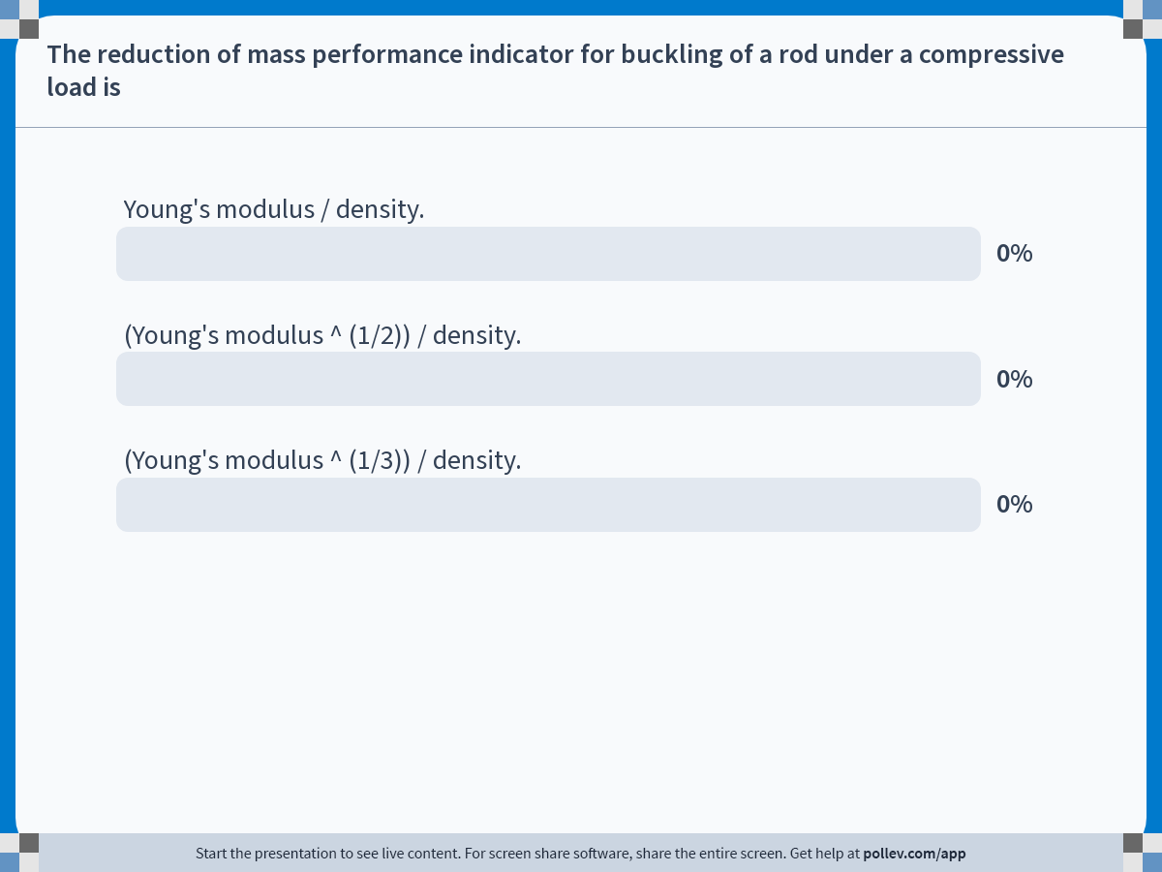
Notes:
Poll Title: Do not modify the notes in this section to avoid tampering with the Poll Everywhere activity.
More info at polleverywhere.com/support
The reduction of mass performance indicator for buckling of a rod under a compressive load is
https://www.polleverywhere.com/multiple_choice_polls/OGmacGEa1tztB8kfbSvCz

Slide 41
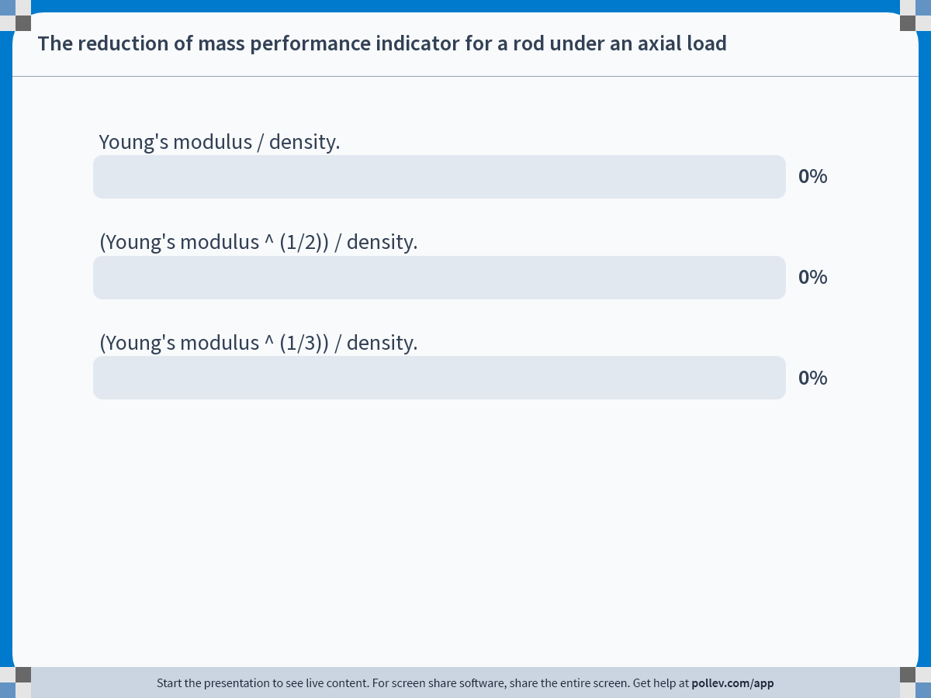
Notes:
Poll Title: Do not modify the notes in this section to avoid tampering with the Poll Everywhere activity.
More info at polleverywhere.com/support
The reduction of mass performance indicator for a rod under an axial load
https://www.polleverywhere.com/multiple_choice_polls/4NaCc7240fzuc5QCQ0VKU

Slide 42
Notes:
Poll Title: Do not modify the notes in this section to avoid tampering with the Poll Everywhere activity.
More info at polleverywhere.com/support
The reduction of mass performance indicator for bending of a rod is
https://www.polleverywhere.com/multiple_choice_polls/jj4xeZkXjtpA7hEJclY71

Slide 43
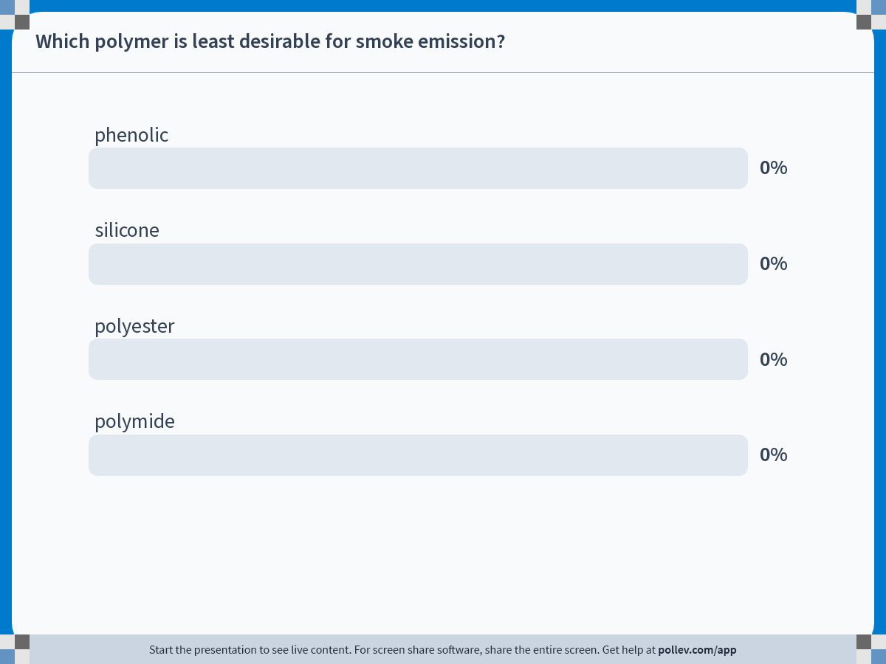
Notes:
Poll Title: Do not modify the notes in this section to avoid tampering with the Poll Everywhere activity.
More info at polleverywhere.com/support
Which polymer is least desirable for smoke emission?
https://www.polleverywhere.com/multiple_choice_polls/t9Y4uQf3EtJJCN9N5Guwo

Slide 44
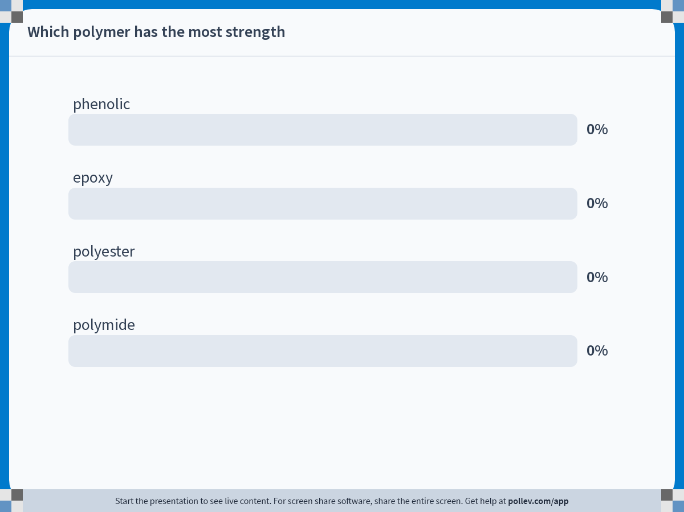
Notes:
Poll Title: Do not modify the notes in this section to avoid tampering with the Poll Everywhere activity.
More info at polleverywhere.com/support
Which polymer has the most strength
https://www.polleverywhere.com/multiple_choice_polls/aALX1yloNpzLRG3Fd8Qtq

Slide 45
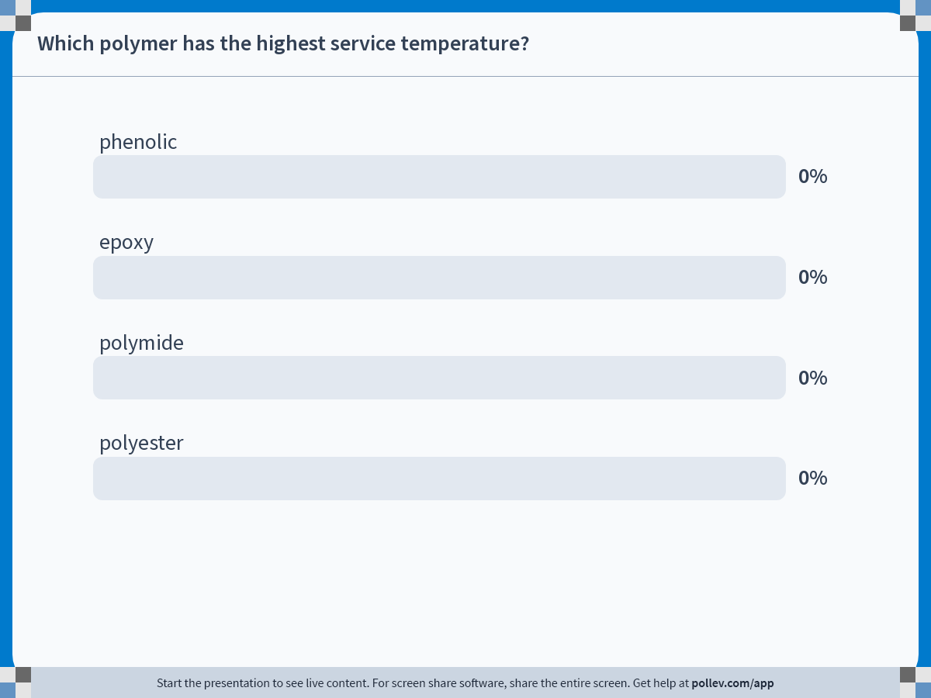
Notes:
Poll Title: Do not modify the notes in this section to avoid tampering with the Poll Everywhere activity.
More info at polleverywhere.com/support
Which polymer has the highest service temperature?
https://www.polleverywhere.com/multiple_choice_polls/p3muoeElBOgGD4aVcot93

