Slide 1
Metal Matrix Composites
Instructor: Autar Kaw

Slide 2
Metal Matrix Composites
What are metal-matrix composites?
Metal matrix composites have a metal matrix.
Examples include silicon carbide fibers in aluminum, graphite fibers in aluminum.

Slide 3
Advantages of MMCs
Higher specific strength and modulus over metals.
Lower coefficients of thermal expansion than metals by reinforcing with graphite.
Maintenance of high strength properties at high temperatures.

Slide 4
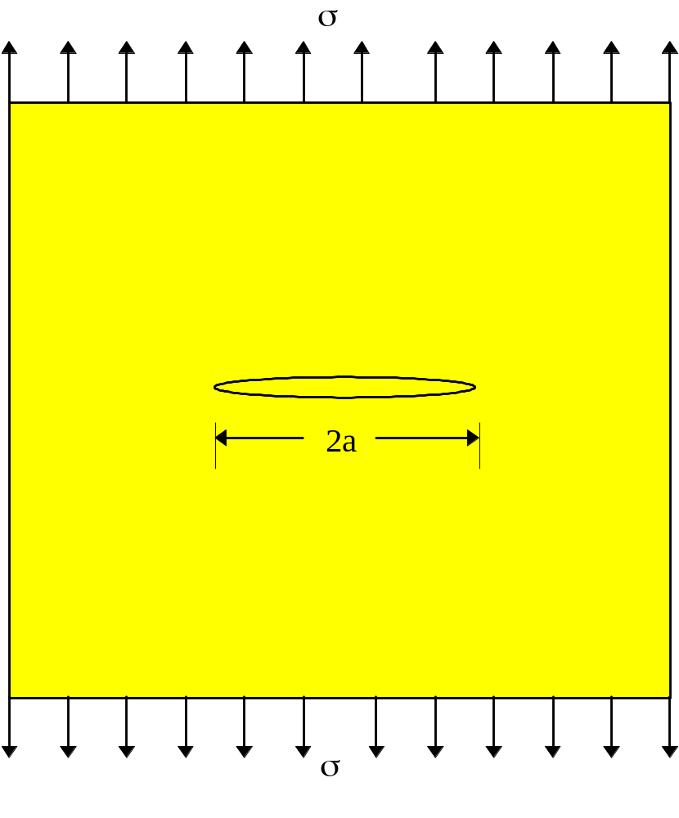
Degrading properties in MMCs
Are there any properties which degrade when metals are reinforced with fibers?
Yes, they may have reduced ductility and fracture toughness.

Slide 5
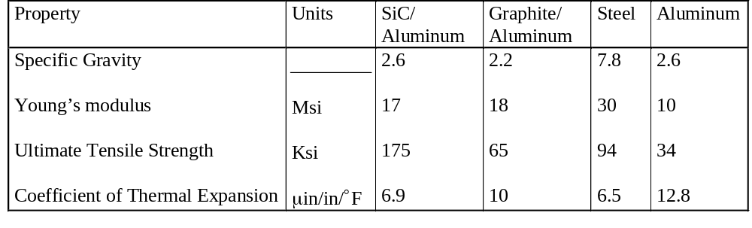
Typical mechanical properties of metal matrix composites

Slide 6
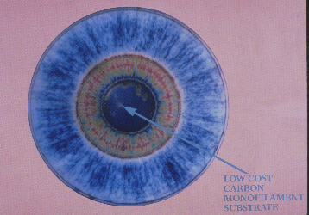
Boron Fiber

Slide 7
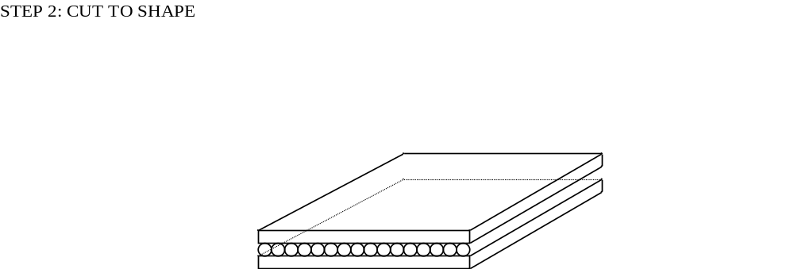
Step 0: Cutting the shape

Slide 8
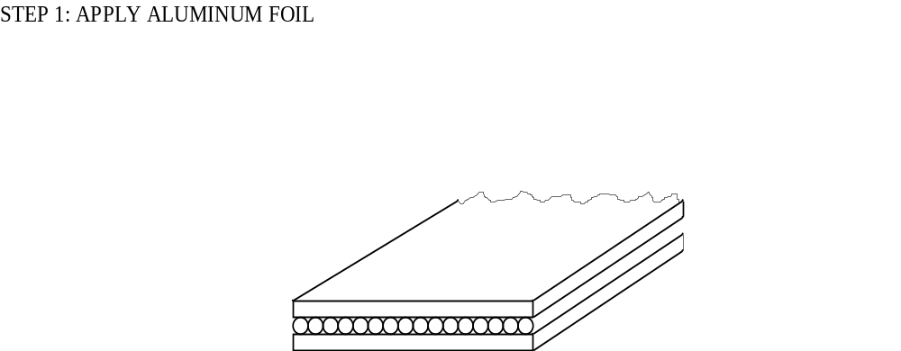
Step 1: Apply Aluminum File

Slide 9
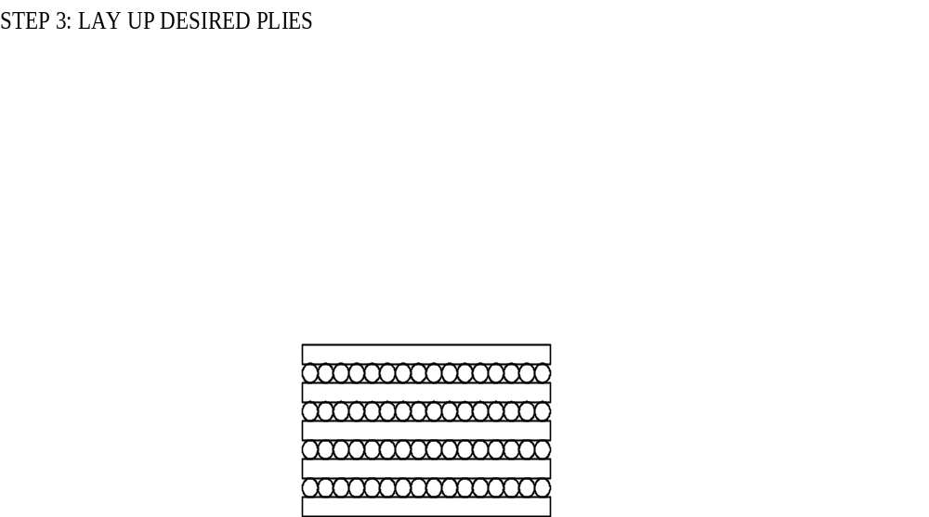
Step 3: Lay Up Desired Plies

Slide 10
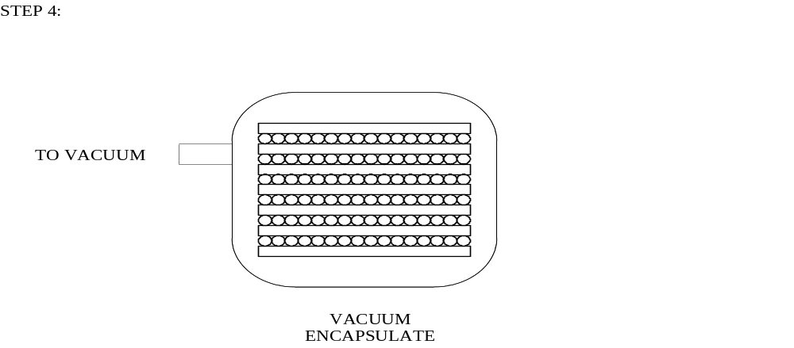
Step 4:Vacuum the specimen

Slide 11
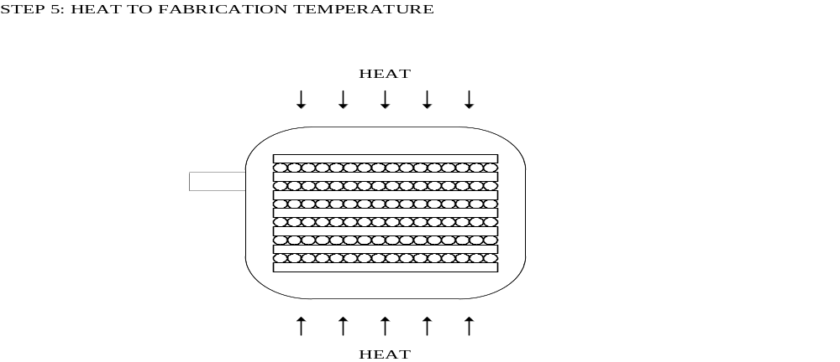
Step5: Heat to Fabrication Temperature

Slide 12
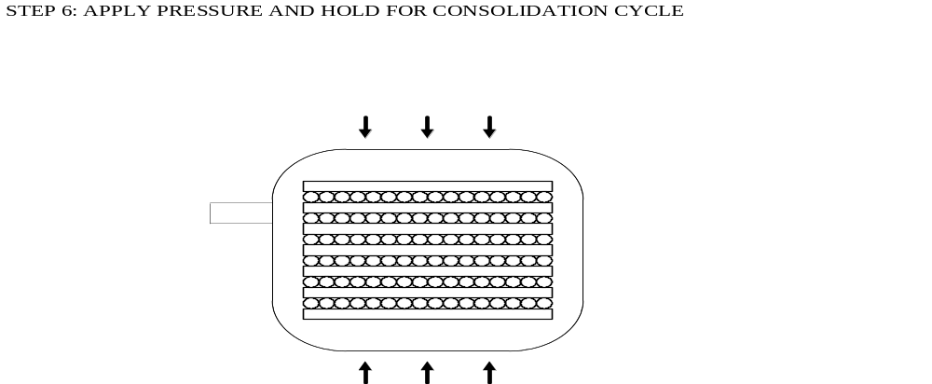
Step 6: Apply Pressure and Hold for Consolidation Cycle

Slide 13
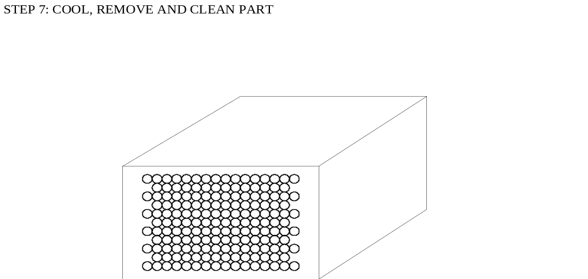
Step 7: Cool, Remove and Clean Part

Slide 14
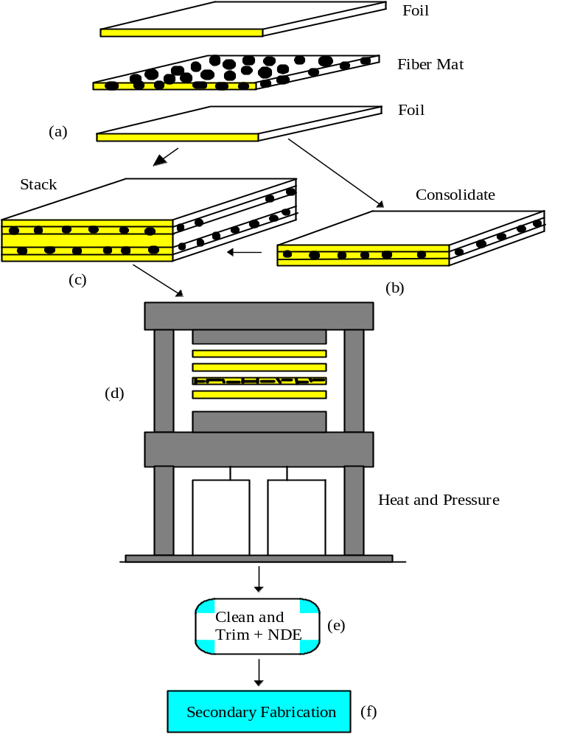
Schematic of Diffusion Bonding

Slide 15
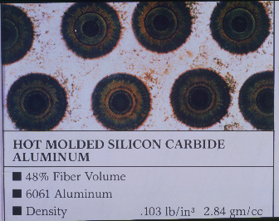
Silicon Carbide/ Aluminum Composite

Slide 16
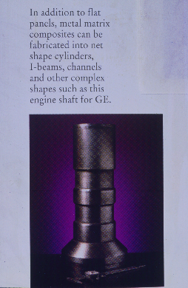
Application of MMCs

Slide 17
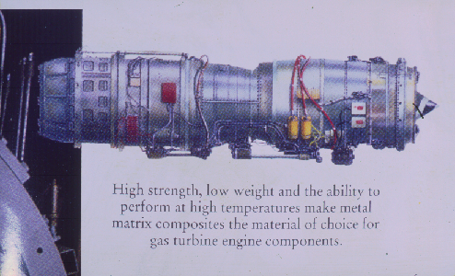
Application of MMCs

Slide 18
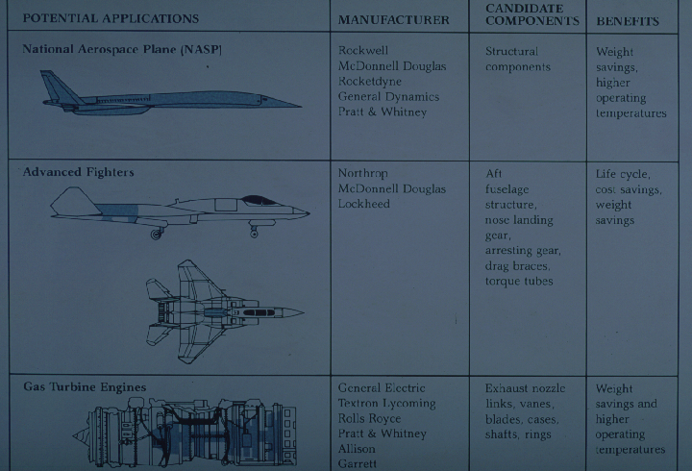
Application of MMCs

