Slide 1
Ceramic Matrix Composites
Instructor: Autar Kaw

Slide 2
Ceramic Matrix Composites
What are ceramic matrix composites?
Ceramic matrix composites have matrices of alumina, calcium alumino silicate (CAS), lithium alumino silicate (LAS). Examples include Silicon Carbide/CAS and Carbon/LAS.

Slide 3
Advantages of CMCs
High strength, hardness and high service temperatures
Chemical inertness
Low Density

Slide 4
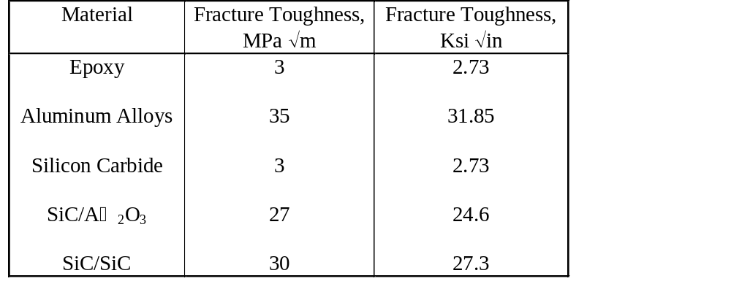
Table 1.12 Typical fracture toughness of monolithic materials and ceramic matrix composites

Slide 5
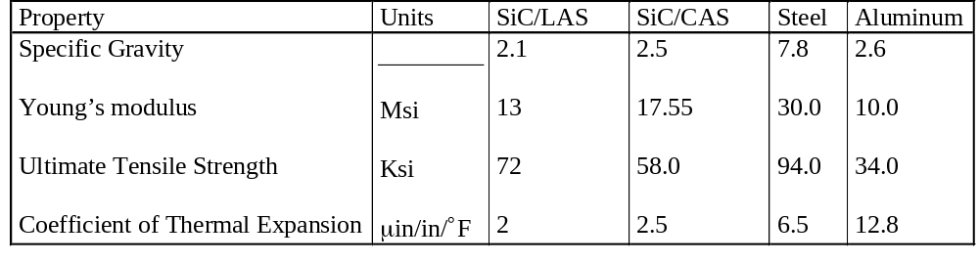
Table 1.13 Typical mechanical properties of some ceramic matrix composites

Slide 6
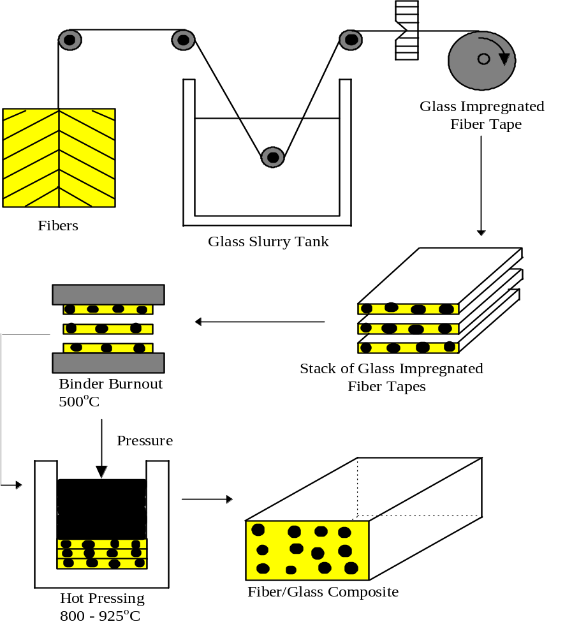
Manufacturing of Ceramic Matrix Composites - Slurry Infiltration

Slide 7
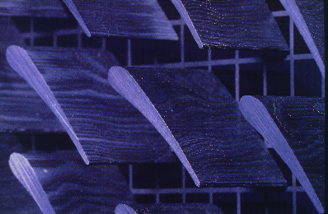
Application of CMCs

