Slide 1
Carbon-Carbon Composites
Instructor: Autar Kaw

Slide 2
Carbon-Carbon Compoistes
What are carbon-carbon composites?
Carbon - Carbon composites have carbon fibers in carbon matrix.

Slide 3
Advantages of Carbon-Carbon Composites
Gradual failure
Withstand high temperatures
Low creep at high temperatures
Low density
High thermal conductivity
Low and tailorable coefficient of thermal expansion

Slide 4
Advantages of Carbon-Carbon Composites
Great strength to weight ratio
High modulus, thermal conductivity, and electrical conductivity
Good thermal shock resistance, abrasion resistance, and fracture toughness
Excellent high temperature durability in inert or vacuum environment
Good corrosion resistance

Slide 5
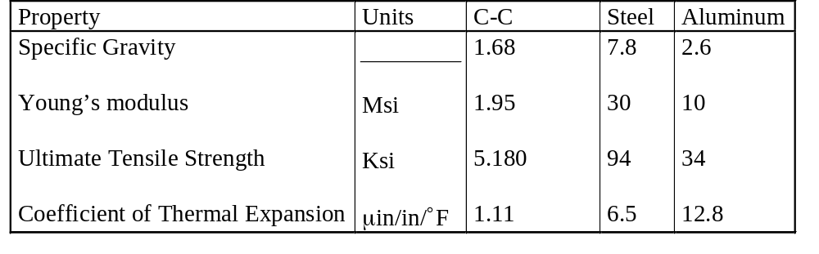
Table 1.14 Typical mechanical properties of carbon-carbon matrix composites

Slide 6
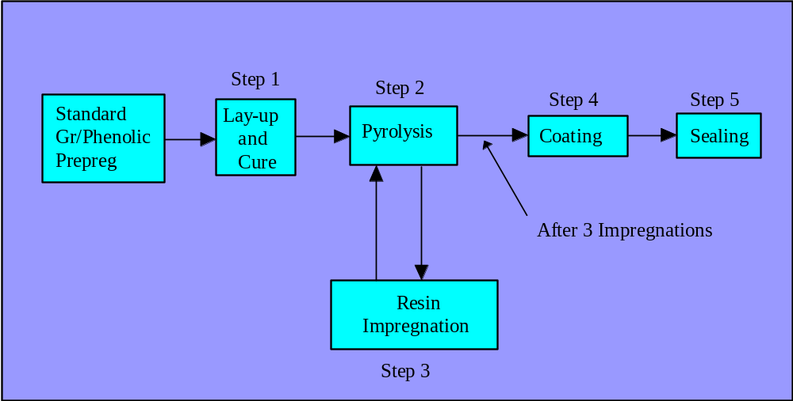
Carbon-Carbon Manufacturing

Slide 7
Applications of C-C Composites
Space Shuttle Nose Cones
  Re-entry temperature of 3092 K
Aircraft Brakes
  Saves 450 kgs of mass
  2-4 times durability vs. steel
  2.5 times specific heat of steel

