Slide 1
Recycling and Mechanics of Composites
Instructor: Autar Kaw

Slide 2
Recycling of Composites
What types of process are used for recycling of composites?
Why is recycling of composites complex?
What can one do if one cannot separate different types of composites?

Slide 3
Recycling Continued
What are the various steps in mechanical recycling of short fiber-reinforced composites?
Where are mechanically recycled short fiber composites used?

Slide 4
Chemical Recycling
Why is chemical recycling not as popular as mechanical recycling?
Which chemical process shows the most promise?

Slide 5
Definitions
Isotropic body
Homogeneous body
Anisotropic body
Nonhomogeneous body
Lamina
Laminate

Slide 6
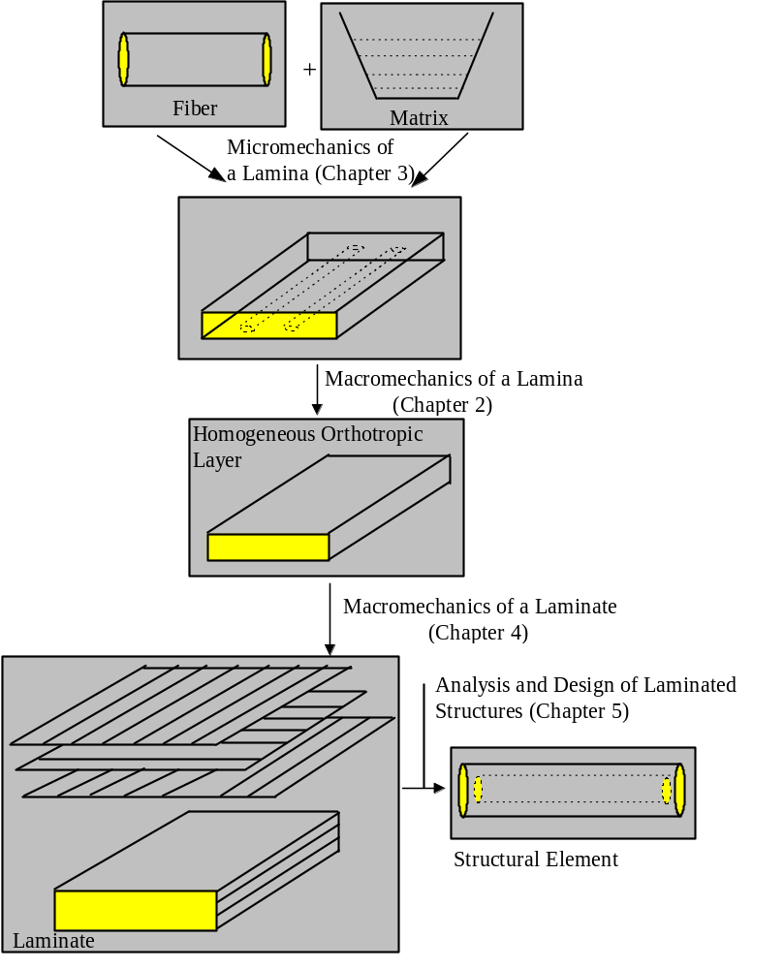
Schematic of Analysis of Laminated Composites

Slide 7
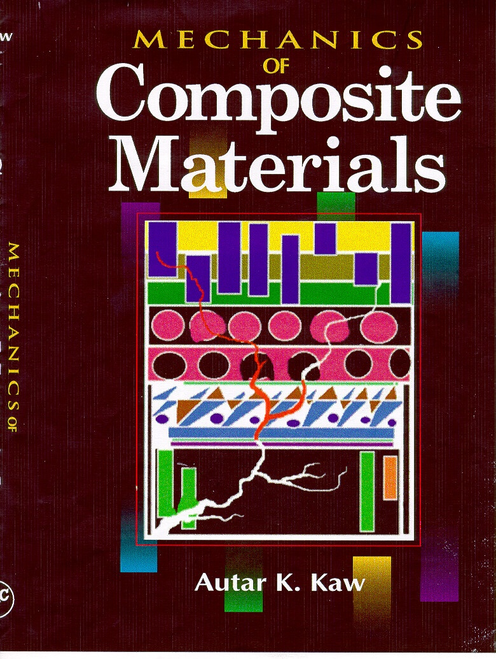
An Artist’s Rendition of a Composite Material

