Slide 1

EML 4230 Introduction to Composite Materials
Chapter 2 Macromechanical Analysis of a Lamina
Part 1
Deformations of a Unidirectional
Lamina Under Applied Loads
Dr. Autar Kaw
Department of Mechanical Engineering
University of South Florida, Tampa, FL 33620
Courtesy of the Textbook
Mechanics of Composite Materials by Kaw

Slide 2
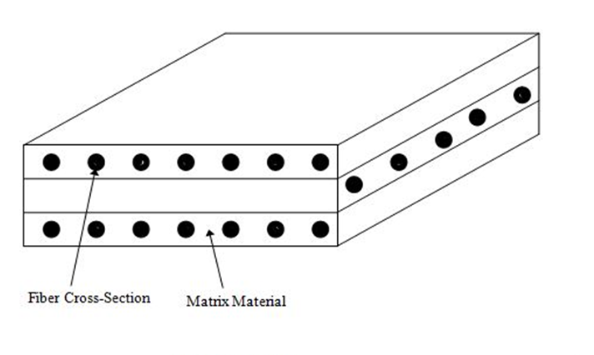
Typical Laminate
FIGURE 2.1
Typical laminate made of three laminas

Slide 3
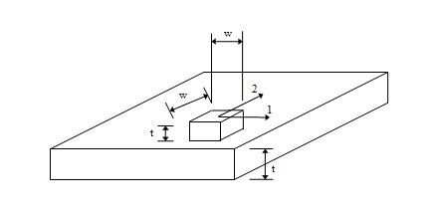
Deformation of Unidirectional Lamina
FIGURE 2.2
Deformation of square, isotropic plate
under normal loads

Slide 4
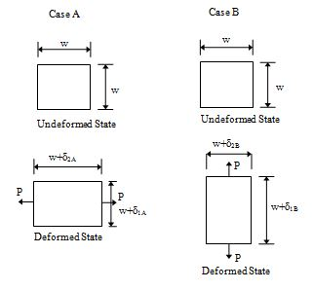
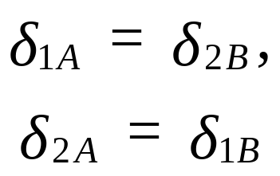
Deformation of Unidirectional Lamina
FIGURE 2.2
Deformation of square, isotropic plate
under normal loads

Slide 5
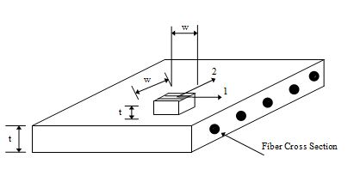
Deformation of Unidirectional Lamina
FIGURE 2.3
Deformation of square, unidirectional lamina
with fibers at zero angle under normal loads

Slide 6
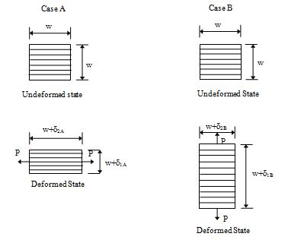
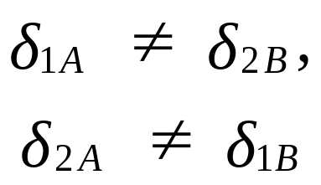
Deformation of Unidirectional Lamina
FIGURE 2.2
Deformation of square, unidirectional lamina
with fibers at zero angle under normal loads

Slide 7
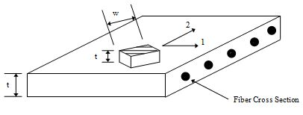
Deformation of Unidirectional Lamina
FIGURE 2.4
Deformation of square, unidirectional lamina
with fibers at an angle to normal loads

Slide 8
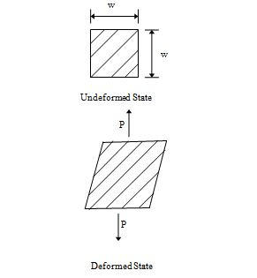
Deformation of Unidirectional Lamina
FIGURE 2.4
Deformation of square, unidirectional lamina
with fibers at an angle to normal loads

Slide 9
END

