Slide 1

EML 4230 Introduction to Composite Materials
Chapter 2 Macromechanical Analysis of a Lamina
Part 3
3D Stiffness and Compliance Matrices
Dr. Autar Kaw
Department of Mechanical Engineering
University of South Florida, Tampa, FL 33620
Courtesy of the Textbook
Mechanics of Composite Materials by Kaw

Slide 2
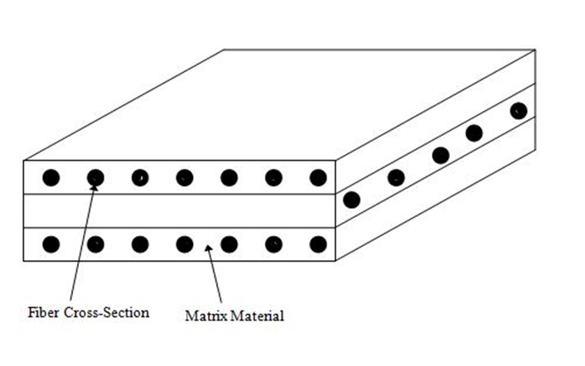
Lamina and Laminate
FIGURE 2.1
Typical laminate made of three laminas

Slide 3
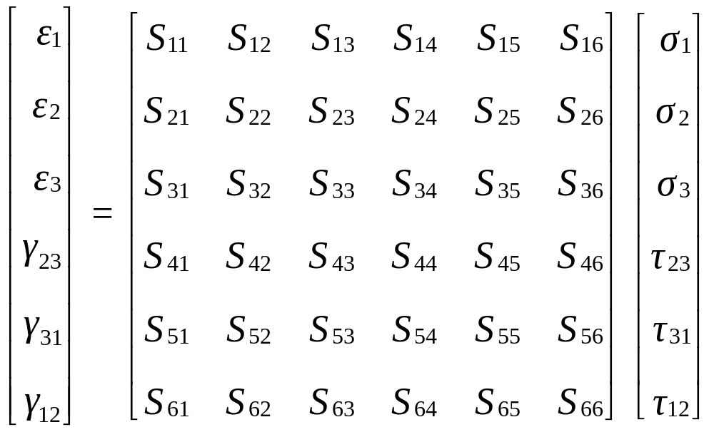
Compliance Matrix [S] for General Material

Slide 4
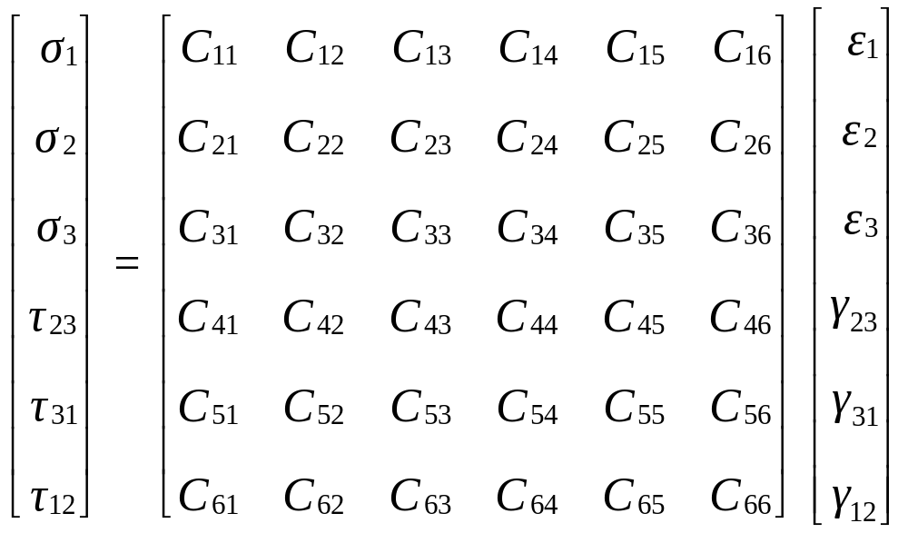
Stiffness Matrix [C] for General Material
Stiffness matrix [C] has 36 constants

Slide 5
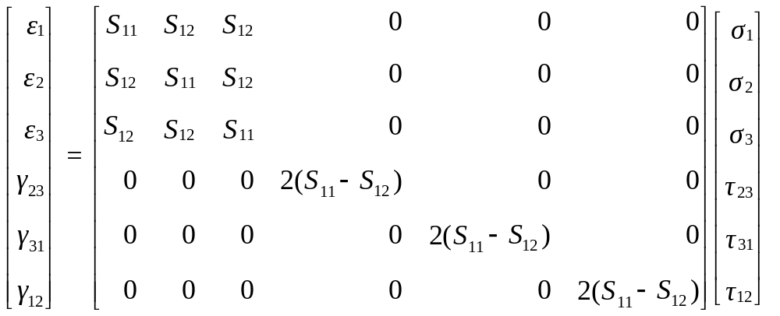
Compliance Matrix [S] for Isotropic Materials

Slide 6

Stiffness Matrix [C] for Isotropic Materials

Slide 7
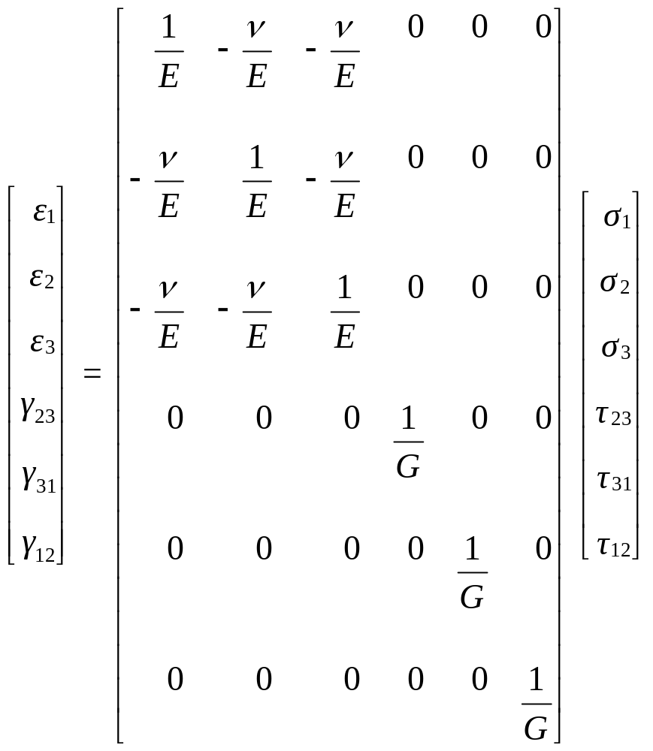
Compliance Matrix [S] for Isotropic Materials

Slide 8
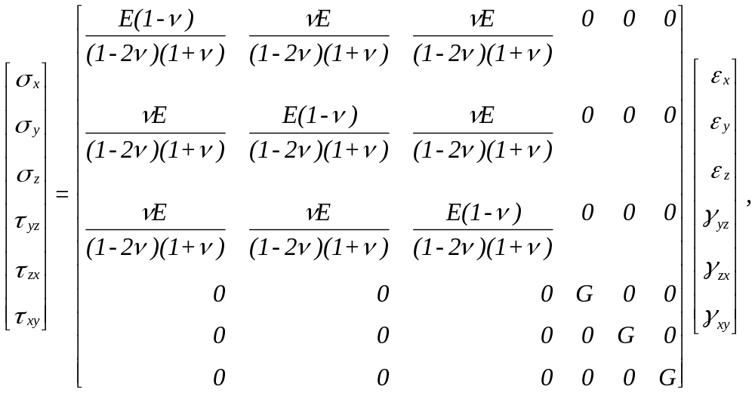
Stiffness Matrix [C] for Isotropic Materials

Slide 9
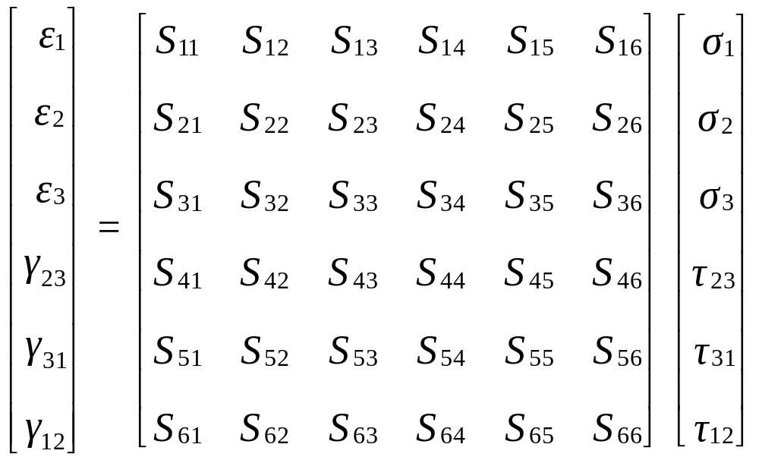
Compliance Matrix [S] for
Anisotropic Material

Slide 10
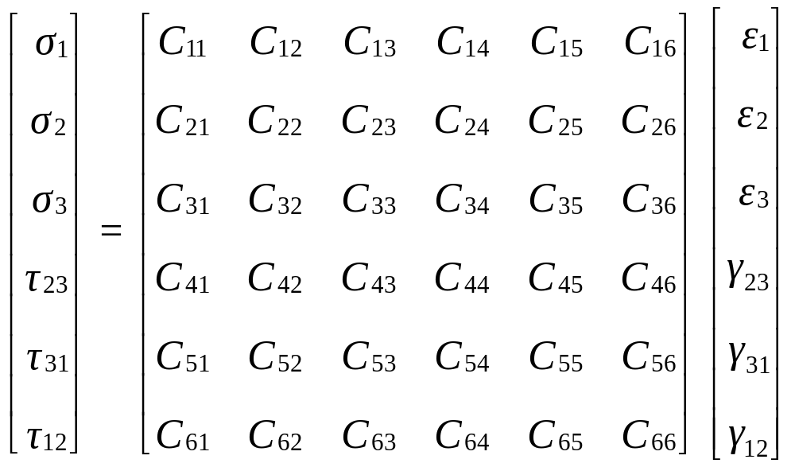
Stiffness Matrix [C] for Anisotropic Material
Stiffness matrix [C] has 36 constants

Slide 11
Compliance Matrix [S] for
Anisotropic Material

Slide 12
Stiffness Matrix [C] for Anisotropic Material

Slide 13
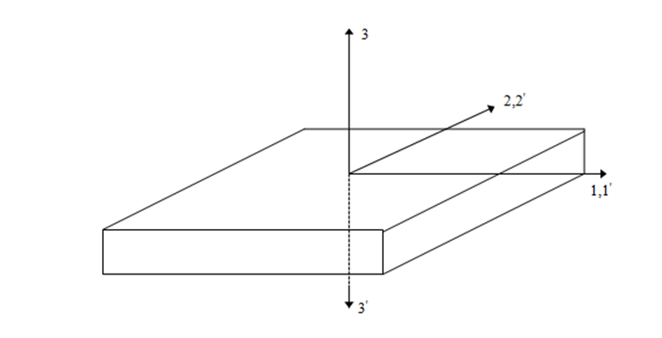
Monoclinic Materials
FIGURE 2.11
Transformation of coordinate axes for 1-2
plane of symmetry for a monoclinic material

Slide 14
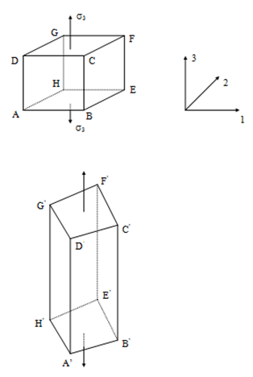
Monoclinic Materials
FIGURE 2.12
Deformation of a cubic element
made of monoclinic material

Slide 15
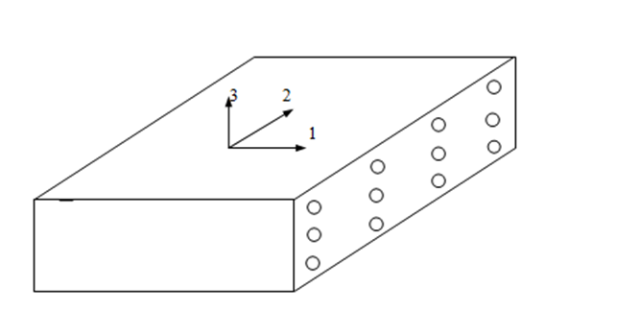
Monoclinic Materials
FIGURE 2.13
A unidirectional lamina as a
monoclinic material with fibers
arranged in a rectangular array

Slide 16
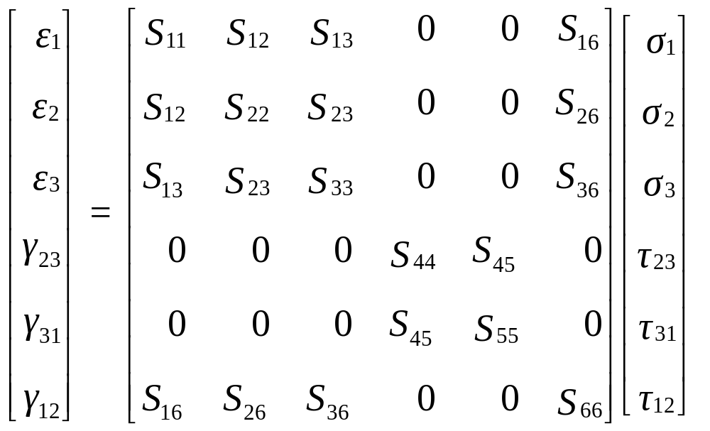
Compliance Matrix [S] for Monoclinic Materials

Slide 17
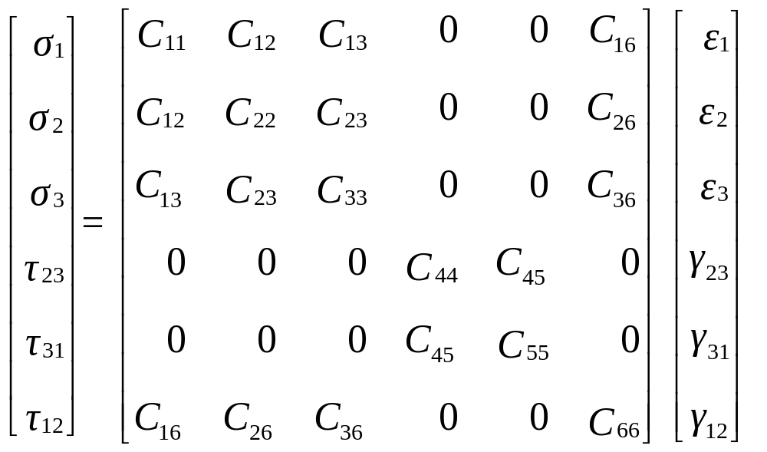
Stiffness Matrix [C] for Monoclinic Materials

Slide 18
Compliance Matrix [S] for Monoclinic Materials

Slide 19
Stiffness Matrix [C] for Monoclinic Materials

Slide 20
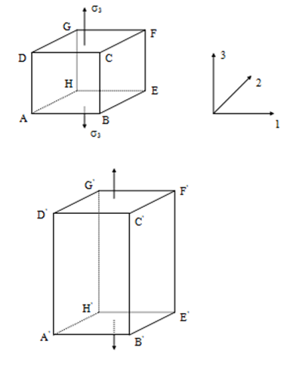
Orthotropic Materials
FIGURE 2.14
Deformation of a cubic element made
of orthotropic material

Slide 21
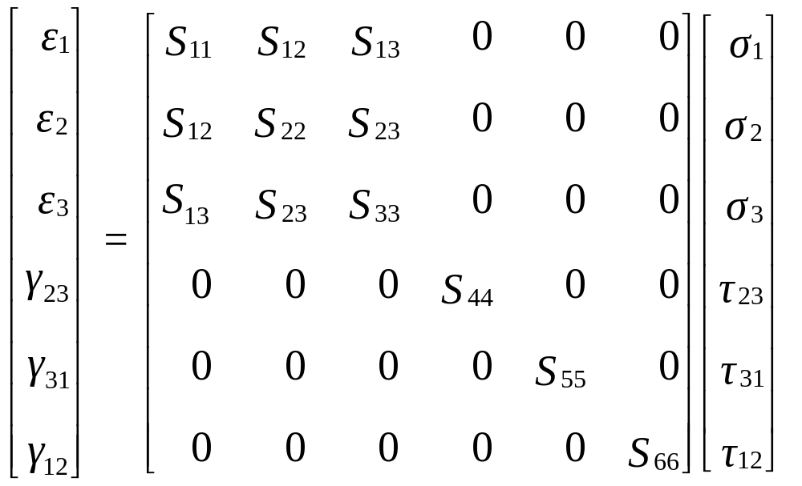
Compliance Matrix [S] for Orthotropic Materials

Slide 22
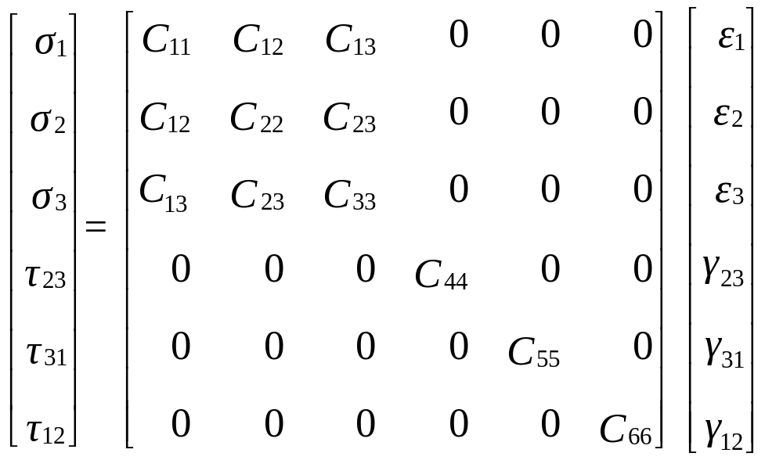
Stiffness Matrix [C] for Orthotropic Materials

Slide 23
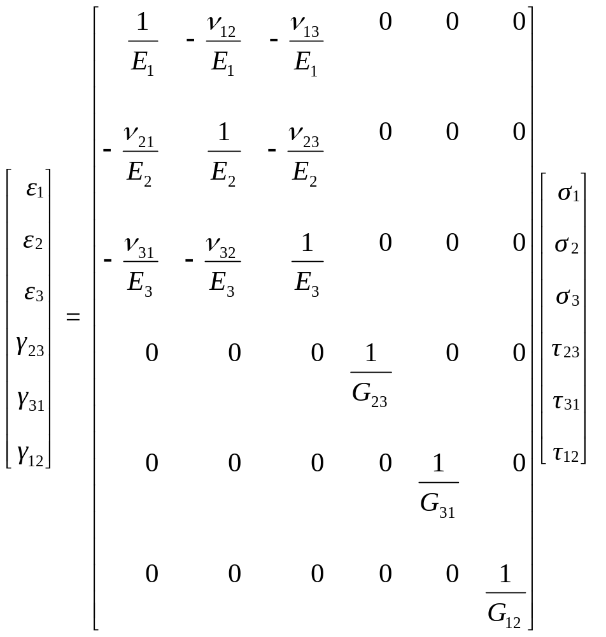
Compliance Matrix [S] for Orthotropic Materials

Slide 24
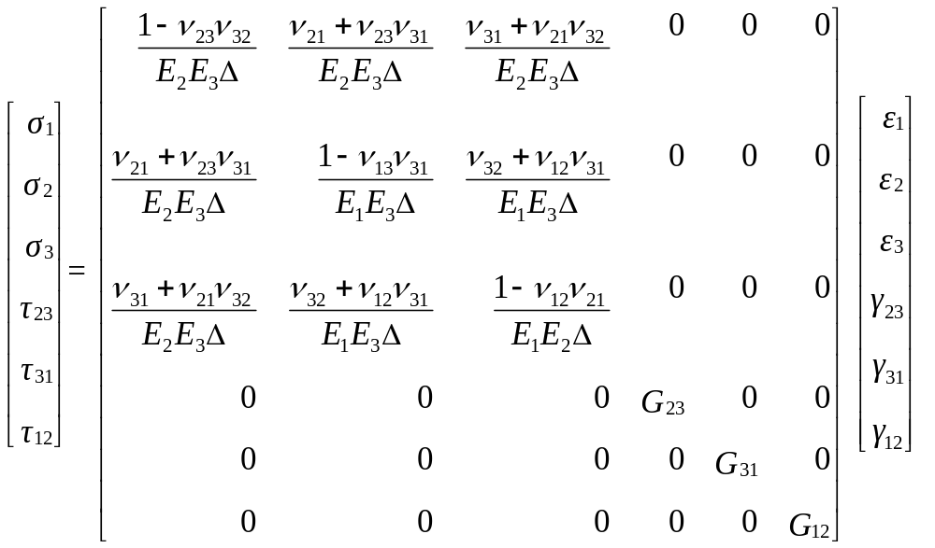
Stiffness Matrix [C] for Orthotropic Materials

Slide 25
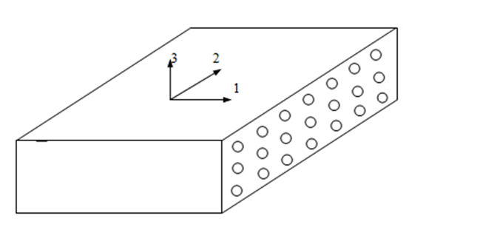
Transversely Isotropic Materials
FIGURE 2.15
A unidirectional lamina as a
transversely isotropic material with
fibers arranged in a rectangular array

Slide 26
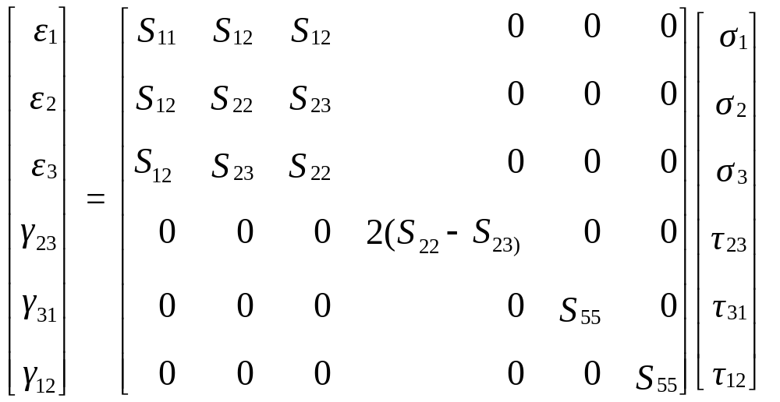
Compliance Matrix [S] for Transversely
Isotropic Materials

Slide 27
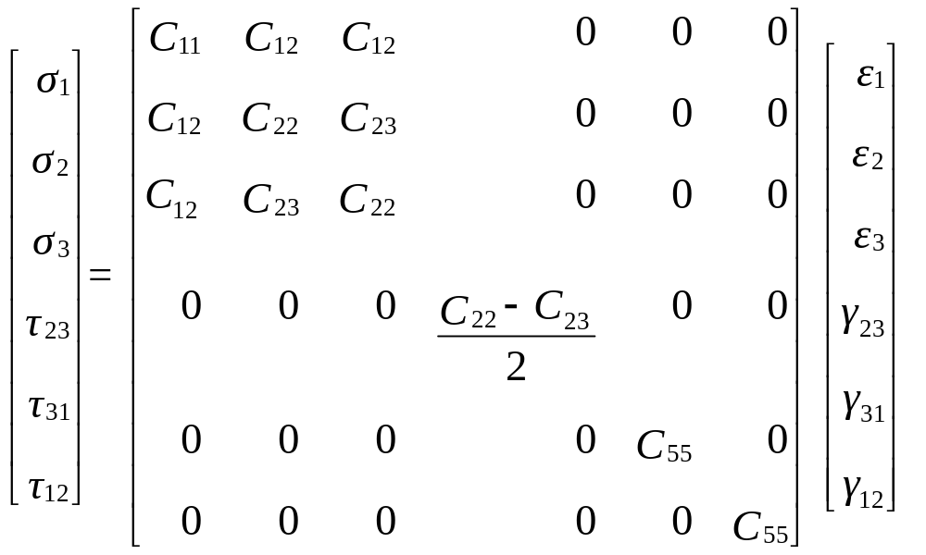
Stiffness Matrix [C] for Transversely
Isotropic Materials

Slide 28
Compliance Matrix [S] for Transversely
Isotropic Materials

Slide 29
Stiffness Matrix [C] for Transversely
Isotropic Materials

Slide 30

Compliance Matrix [S] for Isotropic Materials

Slide 31

Stiffness Matrix [C] for Isotropic Materials

Slide 32

Compliance Matrix [S] for Isotropic Materials

Slide 33
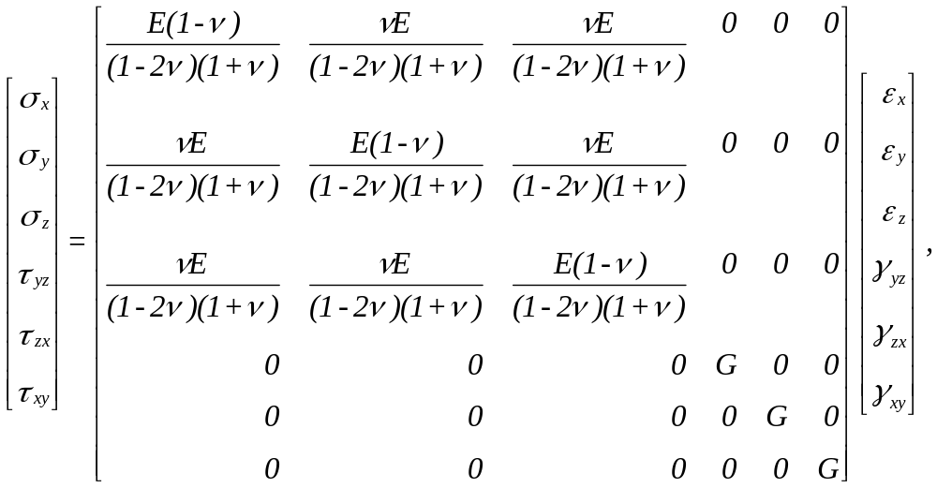
Stiffness Matrix [C] for Isotropic Materials

Slide 34
Independent Elastic Constants
Material Type | Independent Elastic Constants
Anisotropic | 21
Monoclinic | 13
Orthotropic | 9
Transversely Isotropic | 5
Isotropic | 2

Slide 35
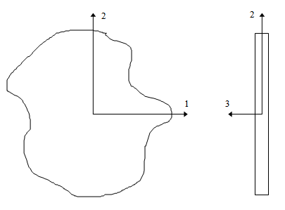


Plane Stress Assumption
Upper and lower surfaces are free from external loads
FIGURE 2.17
Plane stress conditions for a thin plate

