Slide 1

EML 4230 Introduction to Composite Materials
Chapter 2 Macromechanical Analysis of a Lamina
Part 4
2D Stiffness and Compliance Matrix for Unidirectional Lamina
Dr. Autar Kaw
Department of Mechanical Engineering
University of South Florida, Tampa, FL 33620
Courtesy of the Textbook
Mechanics of Composite Materials by Kaw

Slide 2
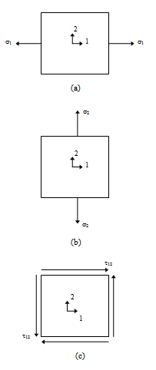
Compliance and Stiffness Matrix Elements in Terms of Elastic Constants
(a) Tensile load in direction 1
(b) Tensile load in direction in 2
(c) Pure shear stress in plane of 1-2
FIGURE 2.18
Application of stresses to
find engineering constants
of a unidirectional lamina

Slide 3

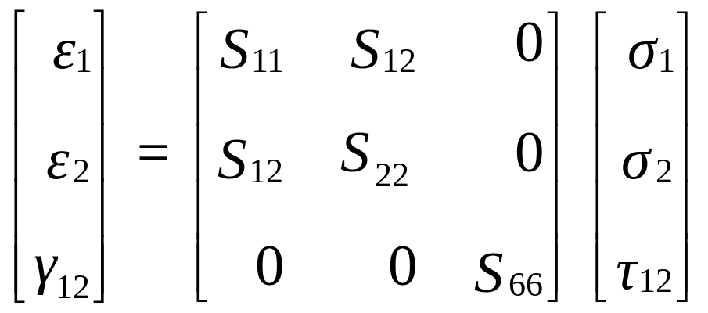
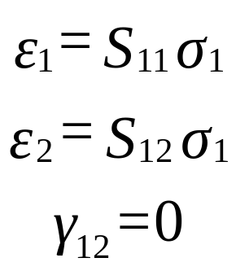
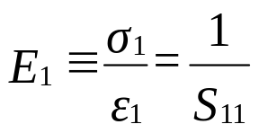
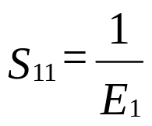
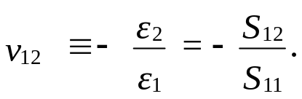
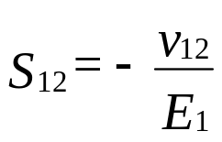
Pure Axial Load in Direction 1
Apply a pure axial load in direction 1

Slide 4

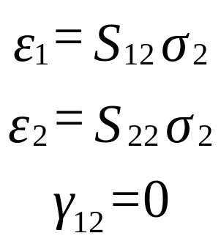
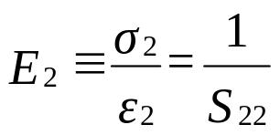
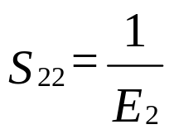
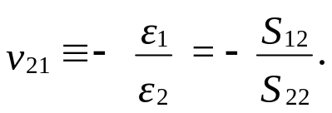
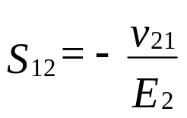
Pure Axial Load in Direction 2
Apply a pure axial load in direction 2

Slide 5
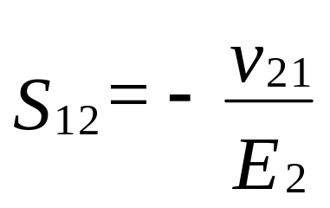
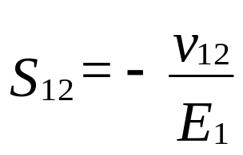
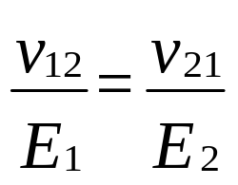
Reciprocal Relationship

Slide 6

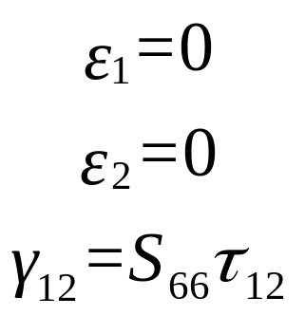
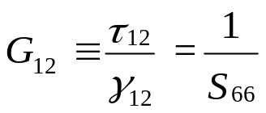
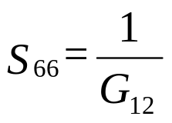
Pure Shear Load in Plane 12
Apply a pure shear load in Plane 12

Slide 7

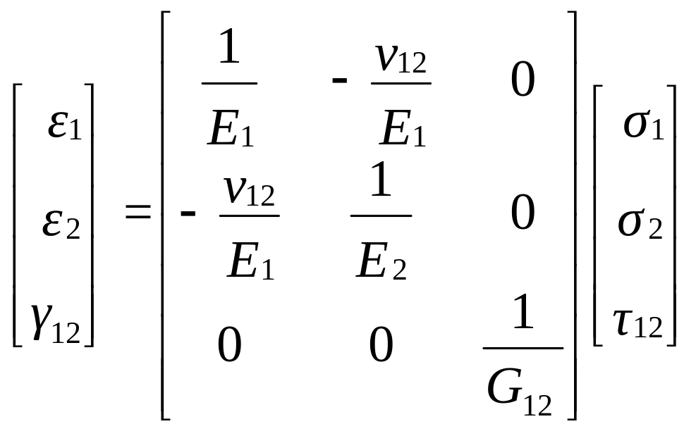
Compliance Matrix

Slide 8
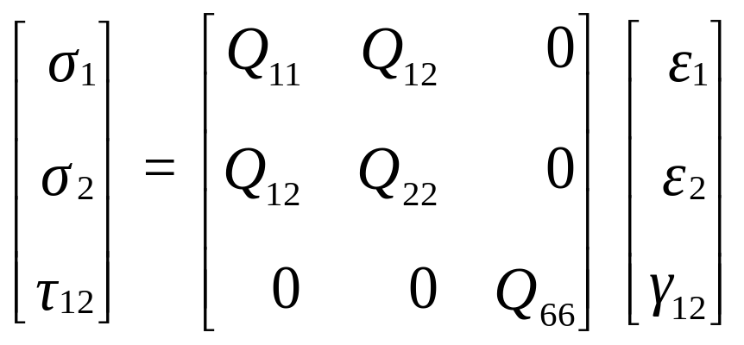
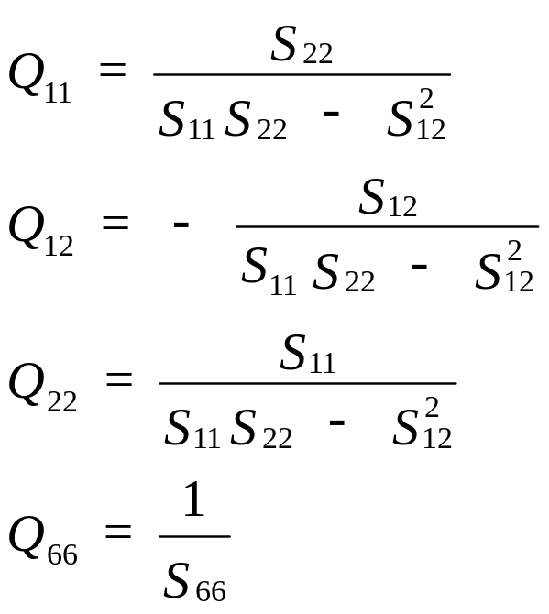
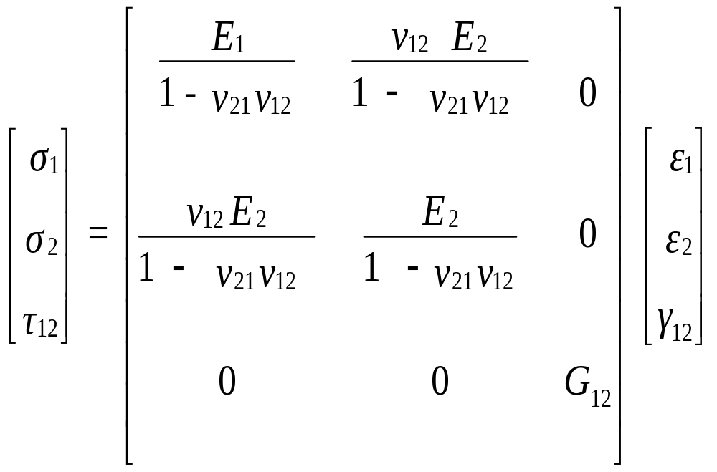
Coefficients of Stiffness Matrix

Slide 9
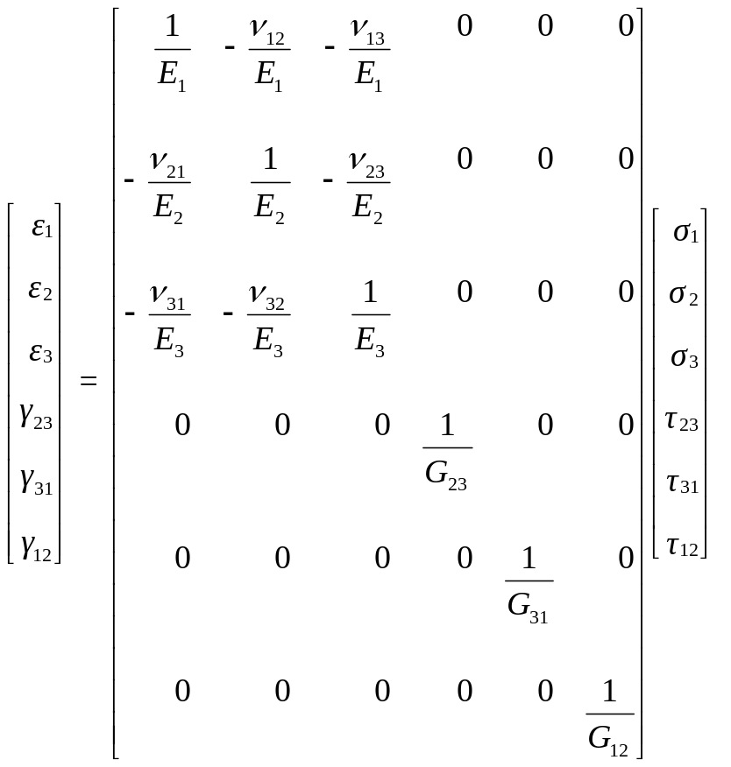
3D and 2D compliance matrices

Slide 10
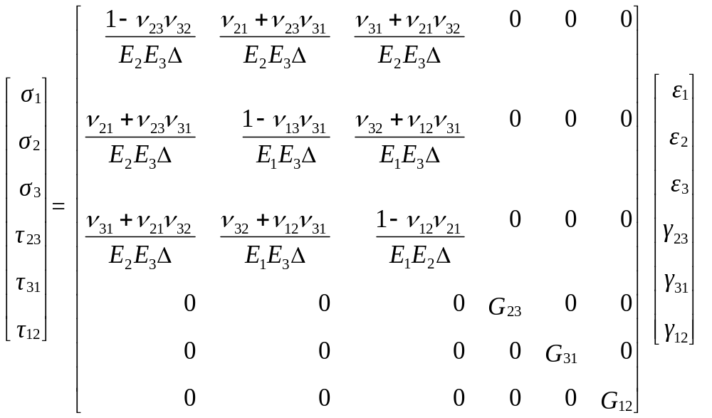


3D and 2D stiffness matrices

Slide 11
END

