Slide 1

EML 4230 Introduction to Composite Materials
Chapter 2 Macromechanical Analysis of a Lamina
Angle Lamina Stress-Strain
Part 5
Dr. Autar Kaw
Department of Mechanical Engineering
University of South Florida, Tampa, FL 33620
Courtesy of the Textbook
Mechanics of Composite Materials by Kaw

Slide 2
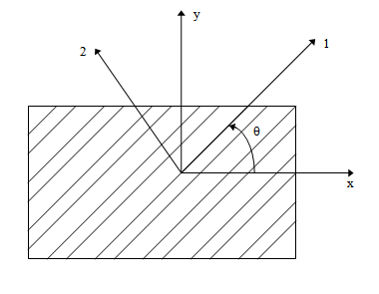
Hooke's Law for a 2D Angle Lamina
FIGURE 2.20
Local and global axes of an angle lamina

Slide 3
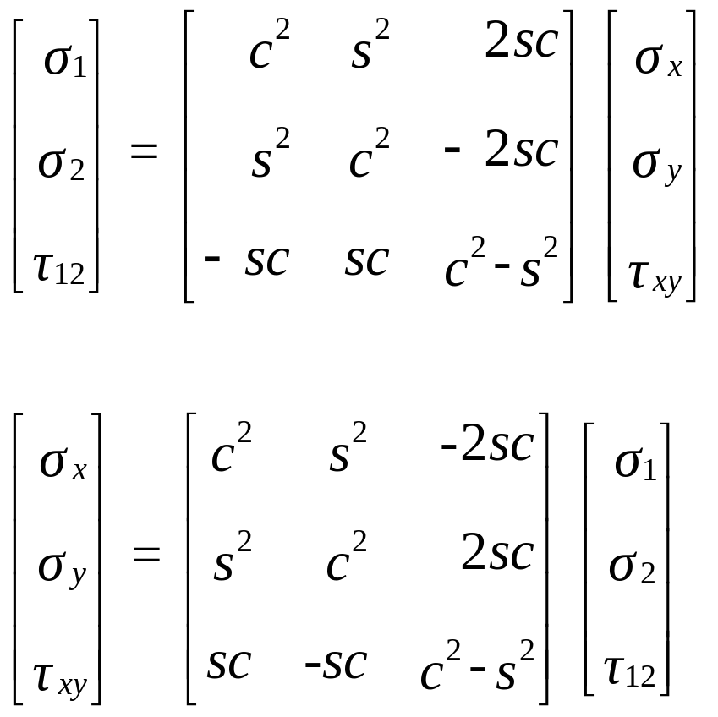
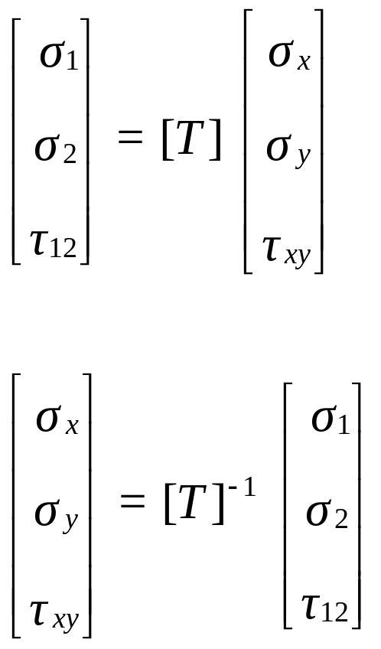
Relationship of Global and Local Stresses

Slide 4
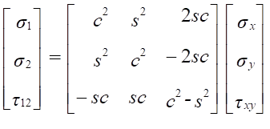
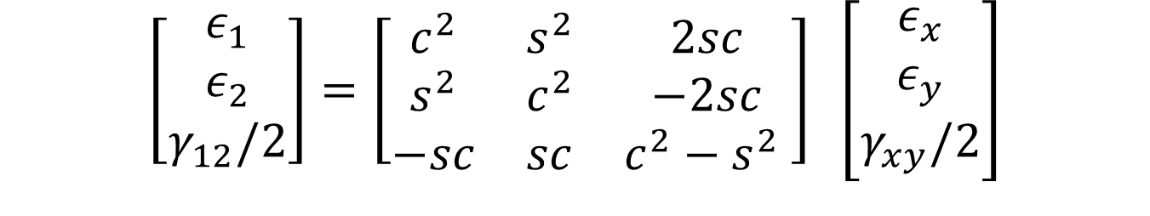

Relationship of Global and Local Strains
$$\left[\begin{matrix}ε_{1} \\ ε_{2} \\ γ_{12}\end{matrix}\right]=\left[\begin{matrix}c^{2} & s^{2} & sc \\ s^{2} & c^{2} & −sc \\ −2sc & 2sc & c^{2}−s^{2} \end{matrix}\right] \left[\begin{matrix}ε_{x} \\ ε_{y} \\ γ_{xy}\end{matrix}\right]$$
$$\left[\begin{matrix}ε_{1} \\ ε_{2} \\ γ_{12}/2\end{matrix}\right]=\left[\begin{matrix}c^{2} & s^{2} & 2sc \\ s^{2} & c^{2} & −2sc \\ −sc & sc & c^{2}−s^{2} \end{matrix}\right] \left[\begin{matrix}ε_{x} \\ ε_{y} \\ γ_{xy}/2\end{matrix}\right]$$

Slide 5
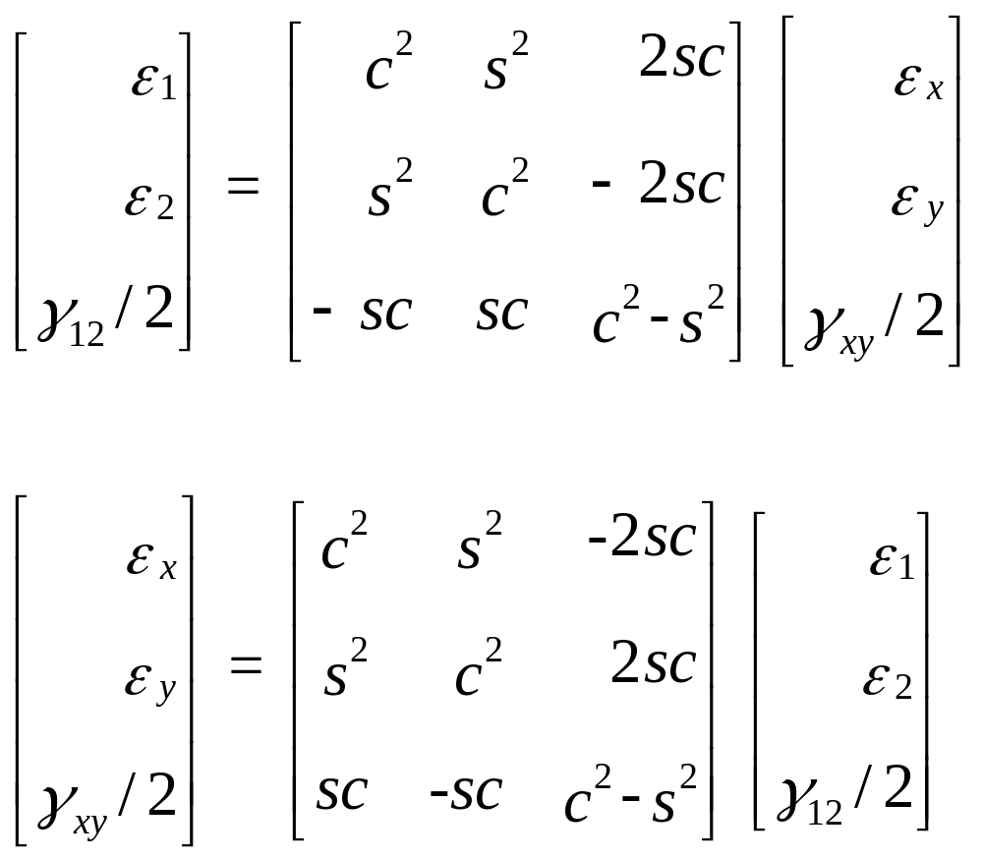
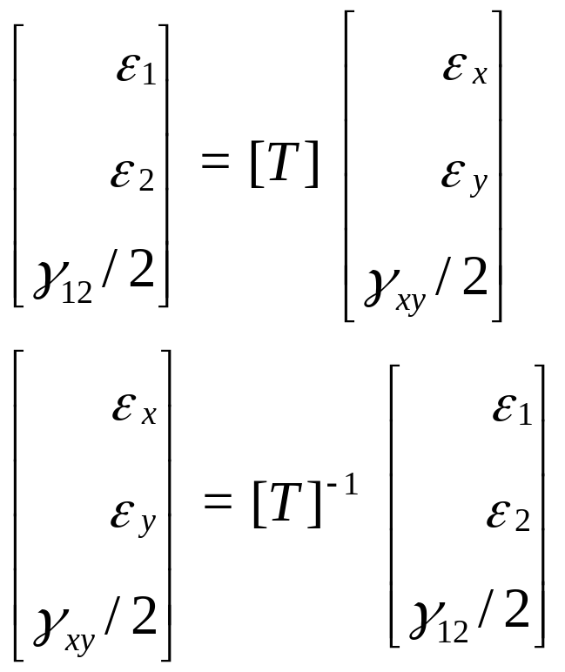
Relationship of Global and Local Strains

Slide 6
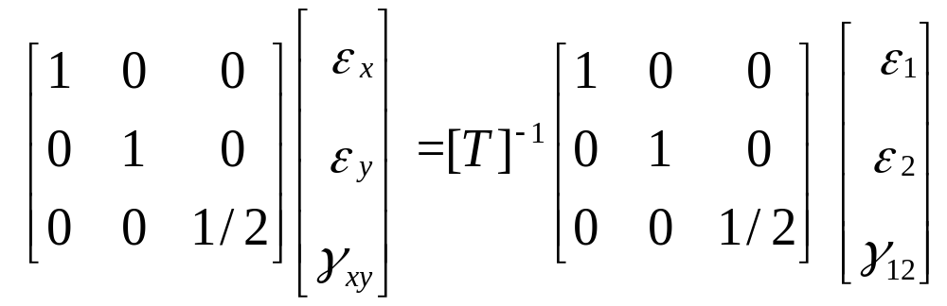
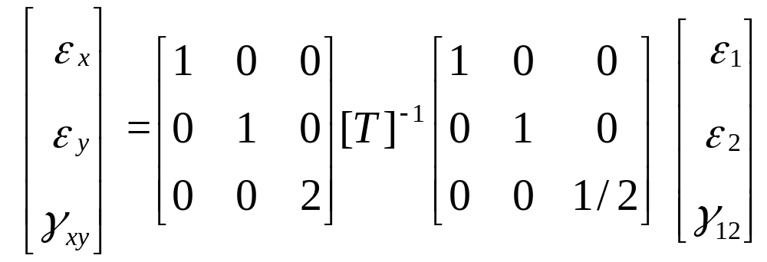
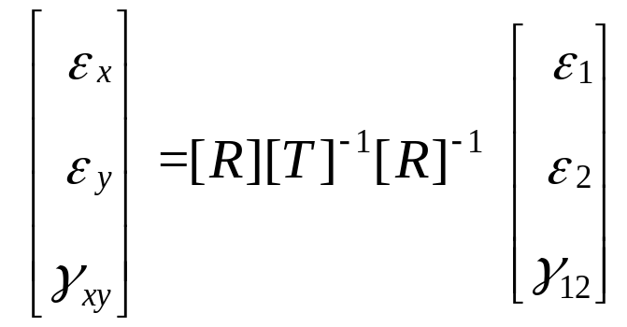
Expanding Global Strain-Local Strain Relationship

Slide 7
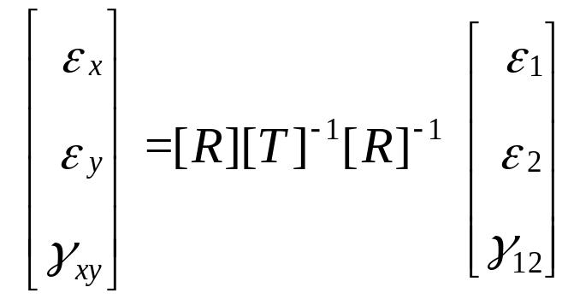
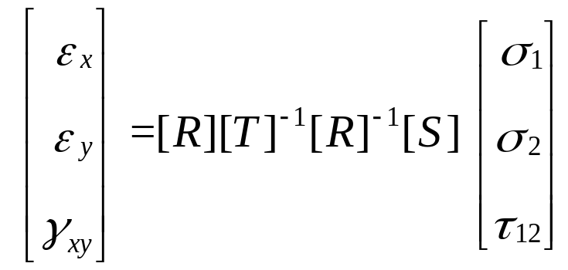
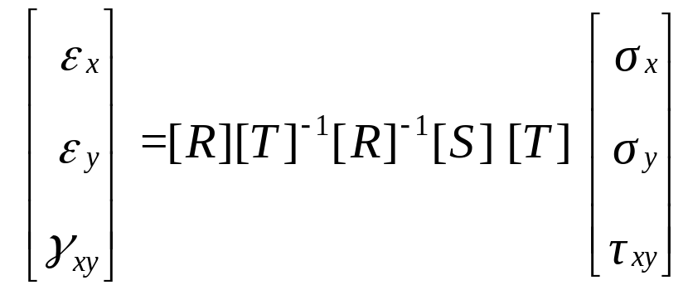
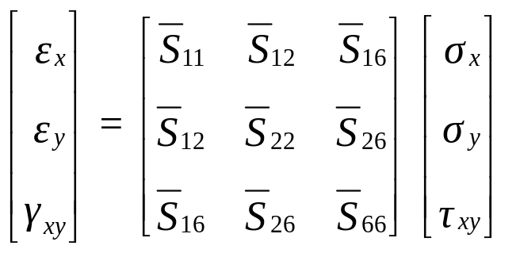
Global Stress and Strain

Slide 8


Transformed Compliance Matrix

Slide 9
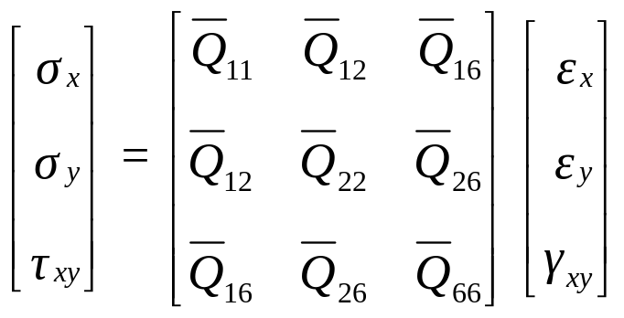


Transformed Reduced Stiffness Matrix

Slide 10
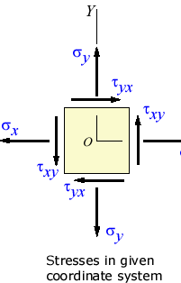
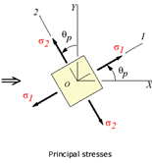
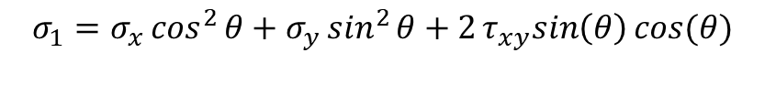
Transformation of stresses
$$σ_{1}=σ_{x}\cos^{2}{θ+σ_{y}\sin^{2}{θ+2τ_{xy}sin\left(θ\right)cos⁡(θ)}}$$
$$τ_{12}=σ_{x}sin\left(θ\right)\cos\left(θ\right)−σ_{y}sin\left(θ\right)\cos\left(θ\right)+{τ_{xy}(cos}^{2}{θ−\sin^{2}{θ}})$$

Slide 11
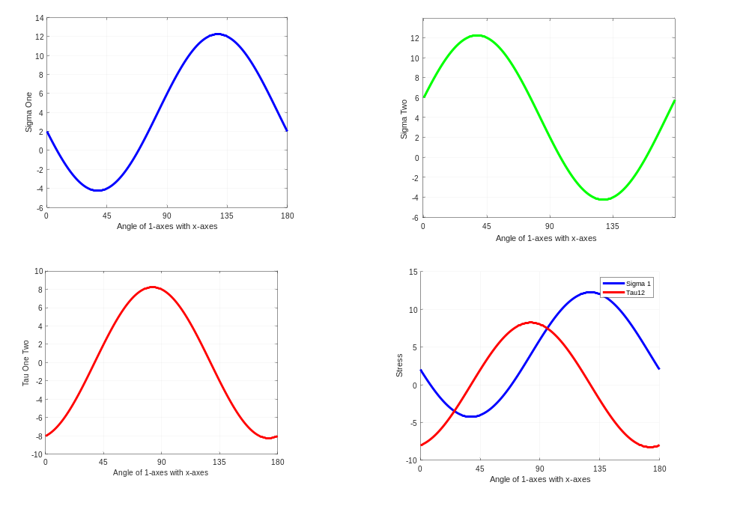
Stress Transformation

Slide 12
END

