Slide 1

EML 4230 Introduction to Composite Materials
Chapter 2 Macromechanical Analysis of a Lamina
Maximum Stress Failure Theory
Dr. Autar Kaw
Department of Mechanical Engineering
University of South Florida, Tampa, FL 33620
Courtesy of the Textbook
Mechanics of Composite Materials by Kaw

Slide 2





Strength Failure Theories for an Angle Lamina
The failure theories are generally based on the normal and shear strengths of a unidirectional lamina.
In the case of a unidirectional lamina, the five strength parameters are:
  Longitudinal tensile strength
  Longitudinal compressive strength
  Transverse tensile strength
  Transverse compressive strength
  In-plane shear strength

Slide 3
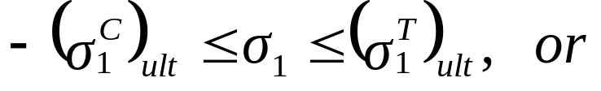
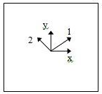
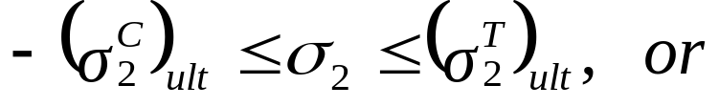
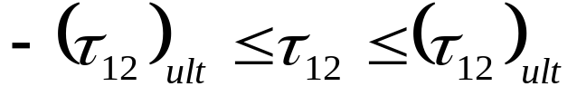
Maximum Stress Failure Theory
The lamina is considered to be failed if:
is violated.
Note that all five strength parameters are positive numbers.
Each component of stress does not interact with each other.

Slide 4

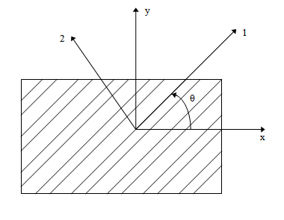
Example
Find the maximum value of S>0 if a stress of
is applied to a 60º lamina of Graphite/Epoxy. Use Maximum Stress failure theory. Use properties of a unidirectional Graphite/Epoxy lamina given in Table 2.1 of the textbook Mechanics of Composite Materials by Autar Kaw.
FIGURE 2.33
Off-axis loading in the x-direction

Slide 5
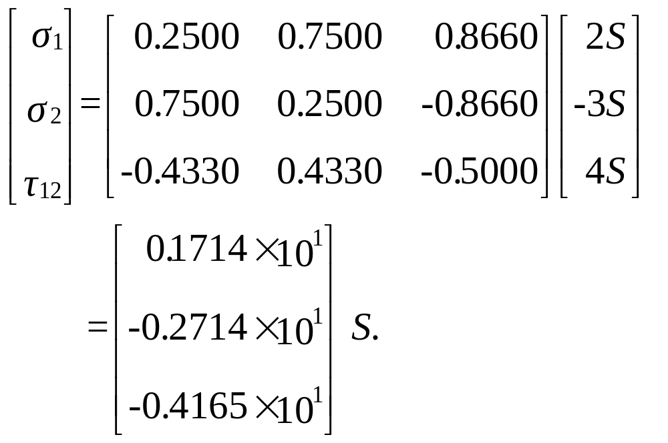
Solution
The stresses in the local axes are

Slide 6
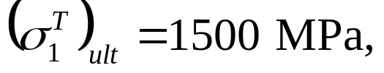
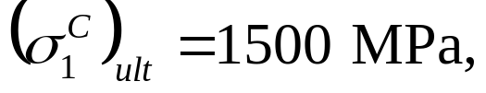
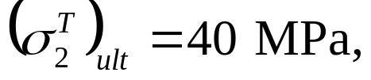
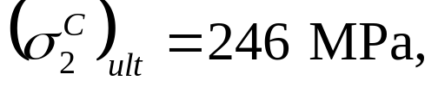

Solution
The ultimate strengths of a unidirectional Graphite/Epoxy lamina are:

Slide 7
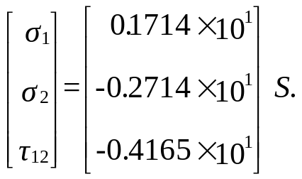





Solution
Then using the inequalities of the Maximum Stress Failure Theory:
or,
All the inequality conditions (and
)are satisfied if
The above inequalities also show that the angle lamina will fail in shear. The maximum stress that can be applied before failure is:

Slide 8
END

