Slide 1

EML 4230 Introduction to Composite Materials
Chapter 2 Macromechanical Analysis of a Lamina
Maximum Strain Failure Theory
Dr. Autar Kaw
Department of Mechanical Engineering
University of South Florida, Tampa, FL 33620
Courtesy of the Textbook
Mechanics of Composite Materials by Kaw

Slide 2





Strength Failure Theories for an Angle Lamina
The failure theories are generally based on the normal and shear strengths of a unidirectional lamina.
In the case of a unidirectional lamina, the five strength parameters are:
  Longitudinal tensile strength
  Longitudinal compressive strength
  Transverse tensile strength
  Transverse compressive strength
  In-plane shear strength

Slide 3
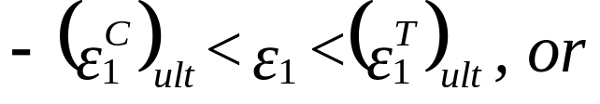
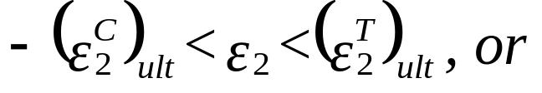
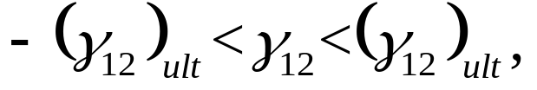





Maximum Strain Theory
The lamina is considered to be failed if:
is violated, where:
= Ultimate longitudinal tensile strain (in direction 1),
= Ultimate longitudinal compressive strain (in direction 1),
= Ultimate transverse tensile strain (in direction 2),
= Ultimate transverse compressive strain (in direction 2),
= Ultimate in-plane shear strain (in plane 1-2).

Slide 4

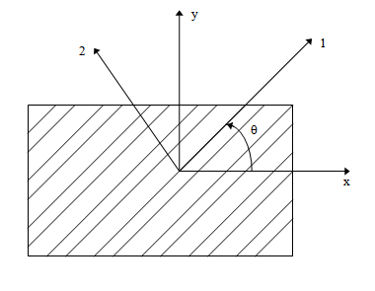
Example
Find the maximum value of S>0 if a stress of
is applied to a 60º lamina of Graphite/Epoxy. Use Maximum Strain Failure Theory. Use properties of a unidirectional Graphite/Epoxy lamina given in Table 2.1 of the textbook Mechanics of Composite Materials by Autar Kaw.
FIGURE 2.33
Off-axis loading in the x-direction

Slide 5
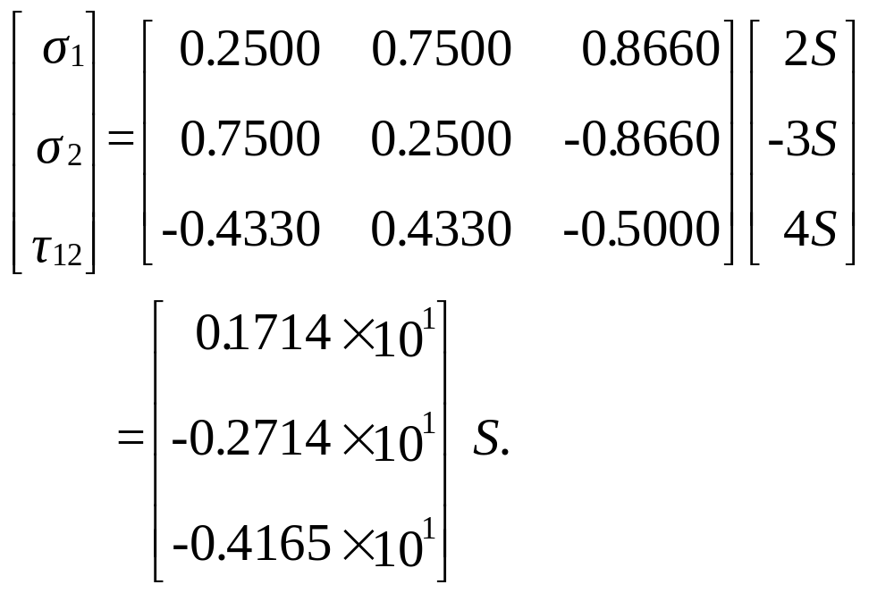
Solution
The stresses in the local axes are:

Slide 6
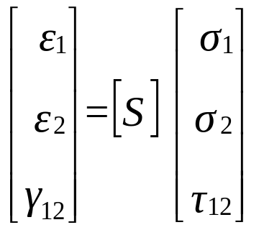
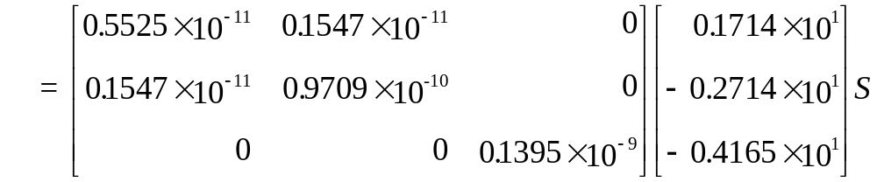
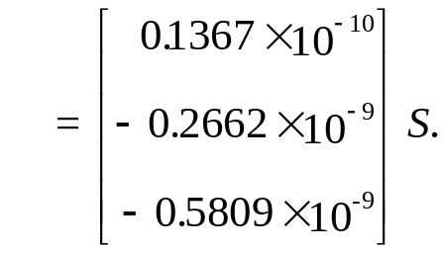
Example
The strains in the local axes are:

Slide 7
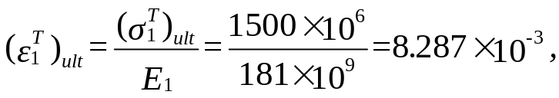

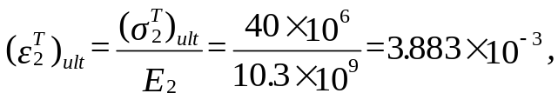
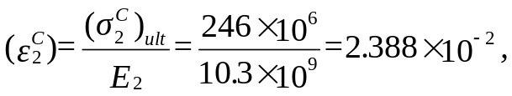
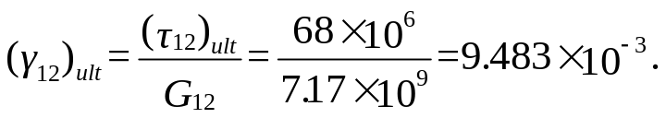
Example
Assume there is a linear relationship between all the stresses and strains till failure, then the ultimate failure strains are:

Slide 8

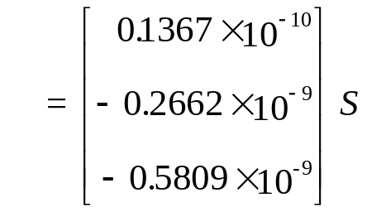









Example
or:
which give:

Slide 9
Observations
The strength ratio from Maximum Stress Failure Theory and Maximum Strain Failure Theory is 16.33 MPa. There is no difference between the two values because the mode of failure is shear.
However, if the mode of failure were other than shear, there would have been a difference between the strength ratios due to the Poisson's ratio effect, which couples the normal strains and stresses in the local axes.
Neither, the Maximum Stress Failure Theory nor the Maximum Strain Failure Theory have any coupling between the three possible modes of failure.

Slide 10
END

