Slide 1

EML 4230 Introduction to Composite Materials
Chapter 2 Macromechanical Analysis of a Lamina
Tsai-Hill Failure Theory
Dr. Autar Kaw
Department of Mechanical Engineering
University of South Florida, Tampa, FL 33620
Courtesy of the Textbook
Mechanics of Composite Materials by Kaw

Slide 2





Strength Failure Theories for an Angle Lamina
The failure theories are generally based on the normal and shear strengths of a unidirectional lamina.
In the case of a unidirectional lamina, the five strength parameters are:
  Longitudinal tensile strength
  Longitudinal compressive strength
  Transverse tensile strength
  Transverse compressive strength
  In-plane shear strength

Slide 3
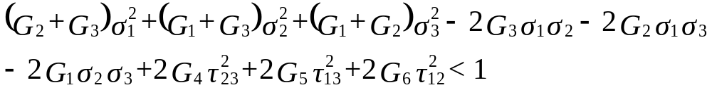
Tsai-Hill Failure Theory
Based on the distortion energy theory, Tsai and Hill proposed that a lamina has failed if:
This theory is based on the interaction failure theory.
The components G₁ thru G₆ of the strength criteria depend on the strengths of a unidirectional lamina.

Slide 4

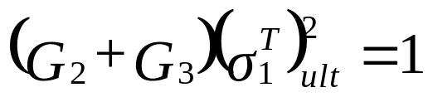
Components of Tsai-Hill Failure Theory
Apply to a unidirectional lamina, then the lamina will fail. Hence, Equation reduces to:

Slide 5

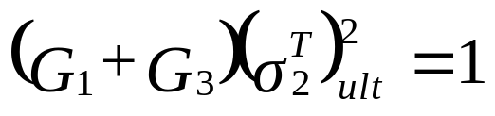
Components of Tsai-Hill Failure Theory
Apply to a unidirectional lamina, then the lamina will fail. Hence, Equation reduces to:

Slide 6

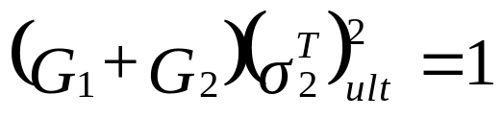
Components of Tsai-Hill Failure Theory
Apply to a unidirectional lamina, and assuming that the normal tensile failure strength is the same in direction (2) and (3), then the lamina will fail. Hence, Equation reduces to:

Slide 7

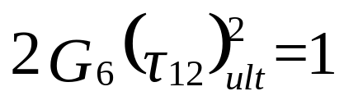
Components of Tsai-Hill Failure Theory
Apply to a unidirectional lamina, then the lamina will fail. Hence, Equation reduces to

Slide 8
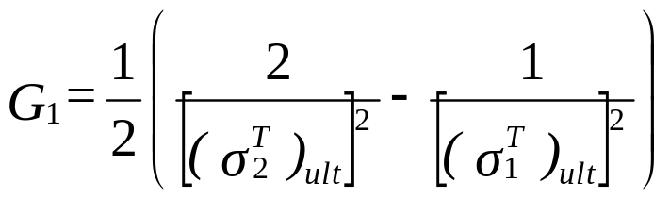
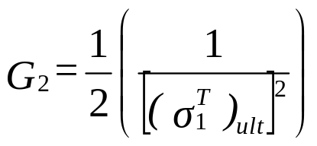
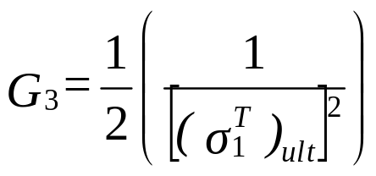
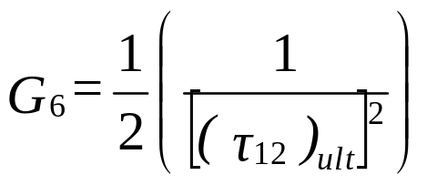
Components of Tsai-Hill Failure Theory

Slide 9

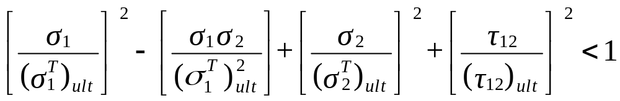
Tsai-Hill Failure Theory – Plane Stress
Because the unidirectional lamina is assumed to be under plane stress - that is,

Slide 10
Tsai-Hill Failure Theory
Unlike the Maximum Strain and Maximum Stress Failure Theories, the Tsai-Hill failure theory considers the interaction among the three unidirectional lamina strength parameter.
The Tsai-Hill Failure Theory does not distinguish between the compressive and tensile strengths in its equation. This can result in underestimation of the maximum loads that can be applied when compared to other failure theories.
Tsai-Hill Failure Theory underestimates the failure stress because the transverse strength of a unidirectional lamina is generally much less than its transverse compressive strength.

Slide 11

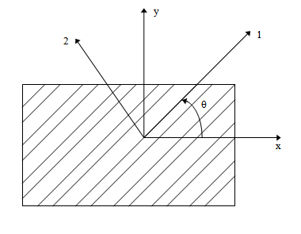
Example
Find the maximum value of S>0 if a stress of
is applied to a 60º lamina of Graphite/Epoxy. Use Tsai-Hill Failure Theory. Use properties of a unidirectional Graphite/Epoxy lamina given in Table 2.1 of the textbook Mechanics of Composite Materials by Autar Kaw.
FIGURE 2.33
Off-axis loading in the x-direction

Slide 12
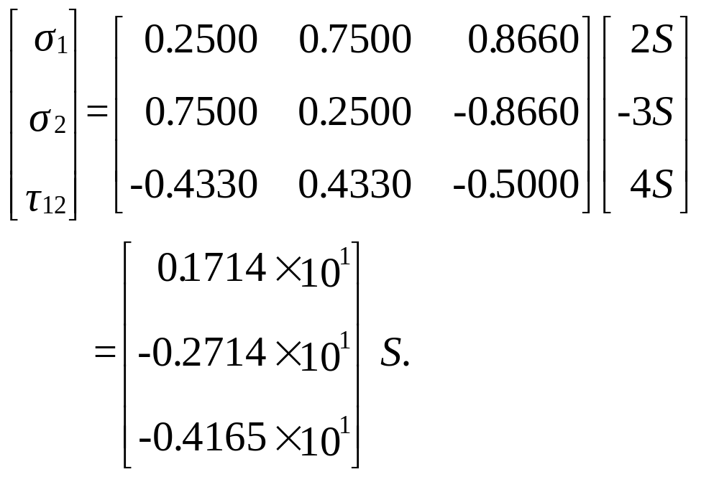
Solution
The stresses in the local axes are:

Slide 13
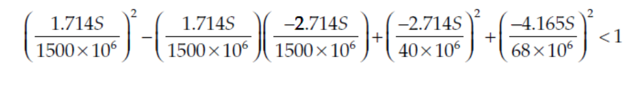
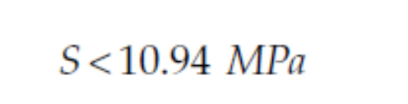
Example

Slide 14
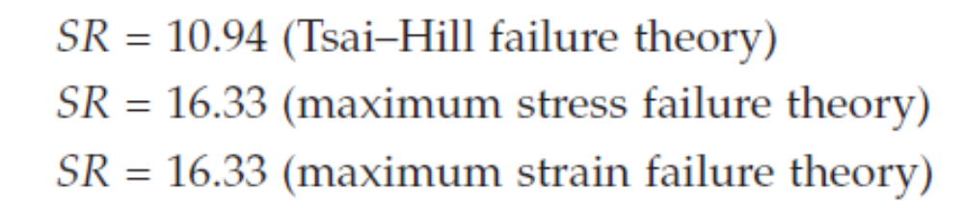
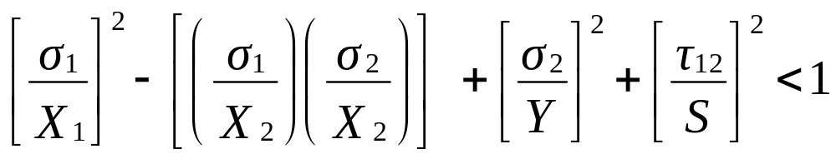
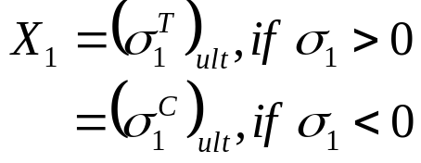
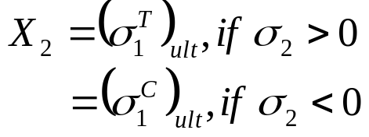
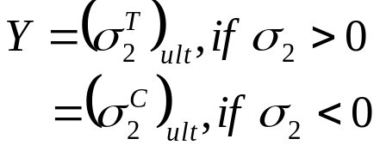

Modified Tsai-Hill Failure Theory

Slide 15
END

