Slide 1

EML 4230 Introduction to Composite Materials
Chapter 2 Macromechanical Analysis of a Lamina
Tsai-Wu Failure Theory
Dr. Autar Kaw
Department of Mechanical Engineering
University of South Florida, Tampa, FL 33620
Courtesy of the Textbook
Mechanics of Composite Materials by Kaw

Slide 2
Tsai-Wu Failure Theory
H₁σ₁+H₂σ₂+H₆τ₁₂+H₁₁
+H₂₂
+H₆₆
+2H₁₂σ₁σ₂< 1
Tsai-Wu applied the failure theory to a lamina in plane stress. A lamina is considered to be failed if:
is violated. This failure theory is more general than the Tsai-Hill failure theory because it distinguishes between the compressive and tensile strengths of a lamina.
The components H1 – H66 of the failure theory are found using the five strength parameters of a unidirectional lamina.

Slide 3




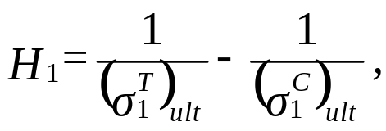
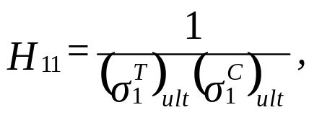
Components of Tsai-Wu Fail
a) Apply
to a unidirectional lamina, the lamina will fail. Equation
(2.152) reduces to:
b) Apply
to a unidirectional lamina, the lamina will fail. Equation
(2.152) reduces to:
From Equations (2.153) and (2.154),

Slide 4




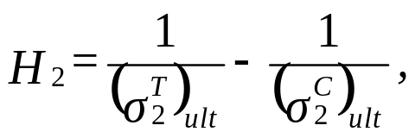
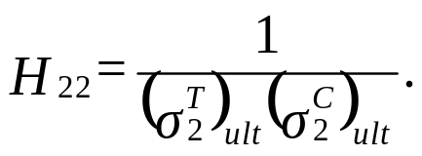
Components of Tsai-Wu Fail
c) Apply
to a unidirectional lamina, the lamina will fail. Equation
(2.152) reduces to
d) Apply
to a unidirectional lamina, the lamina will fail. Equation
(2.152) reduces to:
From Equations (2.157) and (2.158):

Slide 5





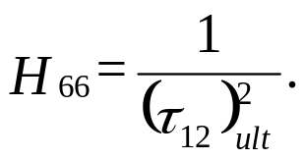
Components of Tsai-Wu Fail
e) Apply
to a unidirectional lamina, the lamina will fail. Equation
(2.152) reduces to:
f) Apply
to a unidirectional lamina, the lamina will fail. Equation
(2.152) reduces to:
From Equations (2.157) and (2.158),

Slide 6


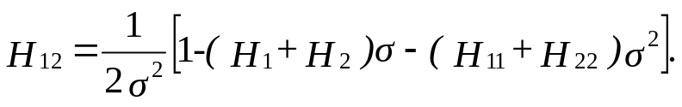

Determination of $H_{12}$
Apply equal tensile loads along the two material axes in a unidirectional composite. If
is the load at which the lamina fails, then:
The solution of the Equation (2.165) gives:

Slide 7


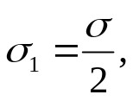
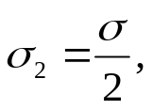
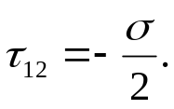
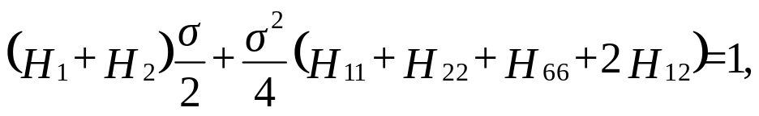
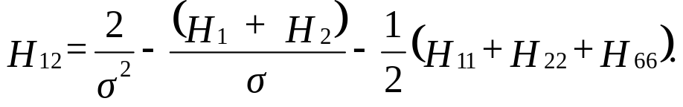
Determination of $H_{12}$
Take a 45⁰ lamina under uniaxial tension
. The stress
at failure is noted.
If this stress is
then using Equation (2.94), the local stresses at failure are:
Substituting the above local stresses in Equation (2.152):

Slide 8
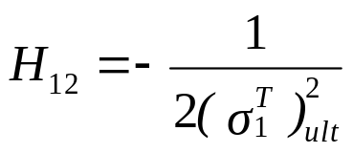
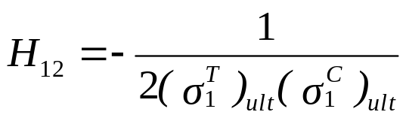
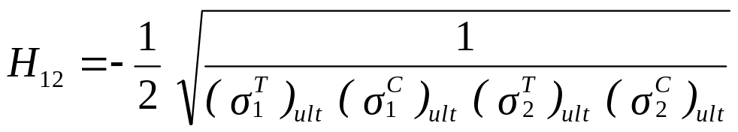

Empirical Models of $H_{12}$
as per Tsai-Hill failure theory⁸
as per Hoffman criterion¹⁰
as per Mises-Hencky criterion¹¹

Slide 9



Example 2.19
Find the maximum value of
if a stress
and
are applied to a 60⁰ lamina of Graphite/Epoxy. Use Tsai-Wu failure theory. Use the properties of a unidirectional Graphite/Epoxy lamina from Table 2.1.

Slide 10
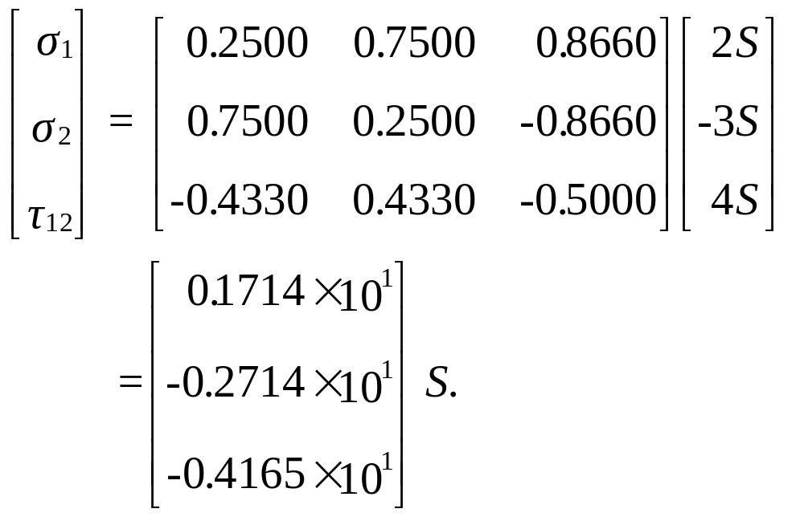
Example 2.19
Using Equation (2.94), the stresses in the local axes are:

Slide 11
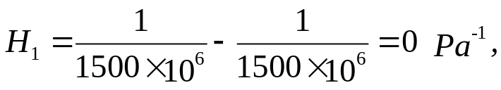
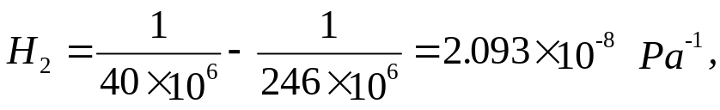

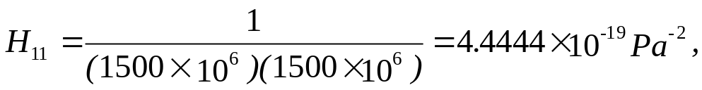
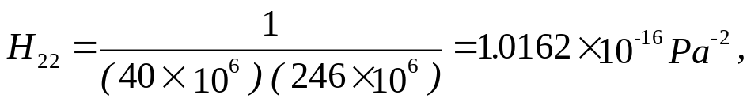
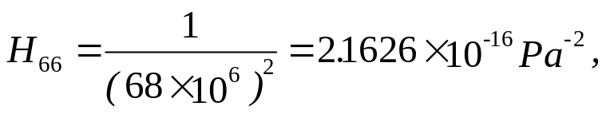
Example 2.19
H₁₂=

Slide 12



Example 2.19
Substituting these values in Equation (2.152), we obtain:
or

Slide 13
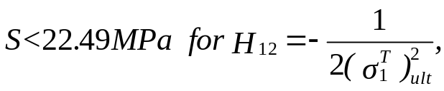
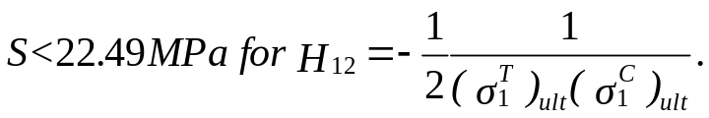
Example 2.19
If one uses the other two empirical criteria for H₁₂ as per Equation (2.171), one obtains:
Summarizing the four failure theories for the same stress-state, the value of S obtained is:
S = 16.33 (Maximum Stress failure theory),
= 16.33 (Maximum Strain failure theory),
= 10.94 (Tsai-Hill failure theory),
= 16.06 (Modified Tsai-Hill failure theory),
= 22.39 (Tsai-Wu failure theory).

Slide 14
END

