Slide 1

EML 4230 Introduction to Composite Materials
Chapter 2 Macromechanical Analysis of a Lamina
Comparison of Failure Theories
Dr. Autar Kaw
Department of Mechanical Engineering
University of South Florida, Tampa, FL 33620
Courtesy of the Textbook
Mechanics of Composite Materials by Kaw

Slide 2





Strength Failure Theories of an Angle Lamina
The failure theories are generally based on the normal and shear strengths of a unidirectional lamina.
An isotropic material generally has two strength parameters:
normal strength and shear strength.
In the case of a unidirectional lamina, the five strength parameters are:
  Longitudinal tensile strength
  Longitudinal compressive strength
  Transverse tensile strength
  Transverse compressive strength
  In-plane shear strength

Slide 3
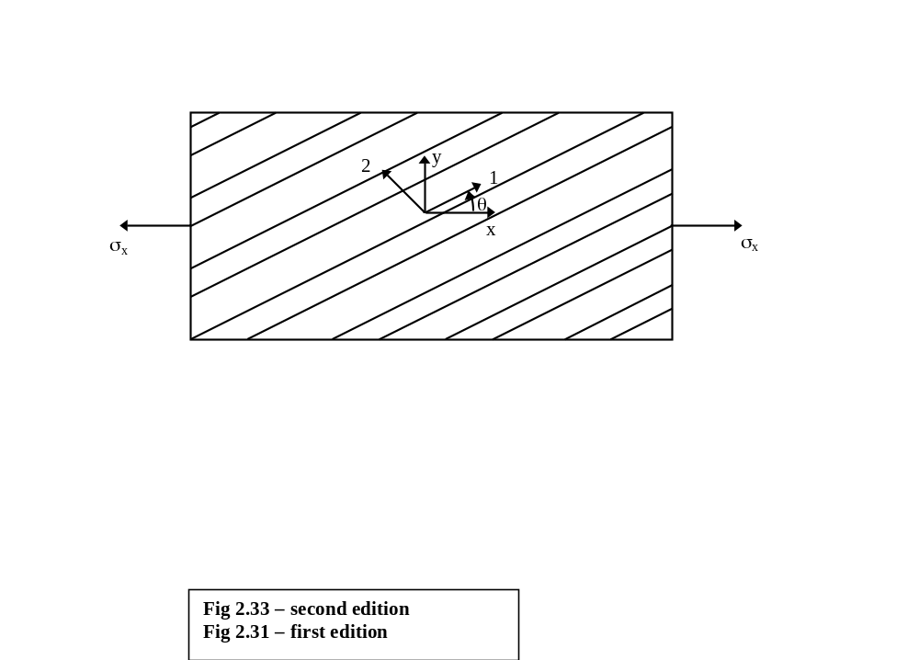
Experimental Results and Failure Theories
Tsai and Wu compared the results from various failure theories to some experimental results. He considered an angle lamina subjected to a uniaxial load in the x-direction.
FIGURE 2.33
Off-axis loading in the x-direction

Slide 4
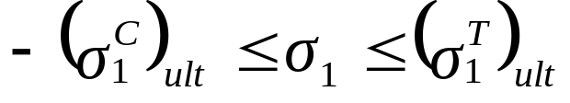
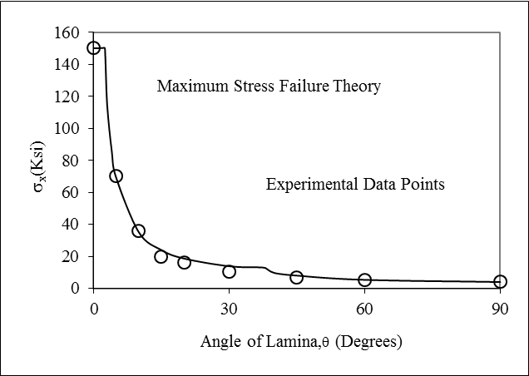
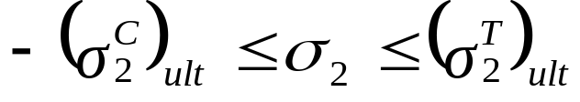
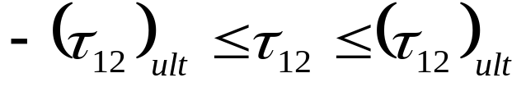
Experimental Results and
Maximum Stress Failure Theory
FIGURE 2.34
Maximum normal tensile stress in x-direction
as function of angle of lamina using maximum
stress failure theory

Slide 5
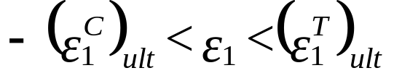
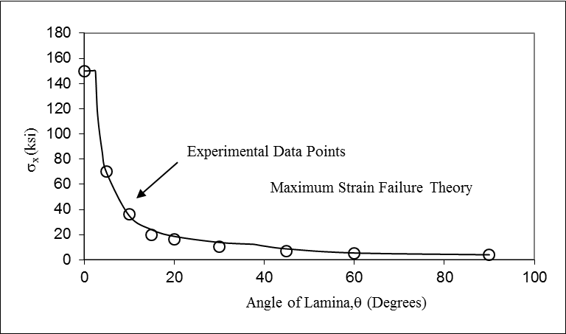
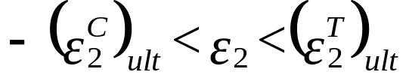
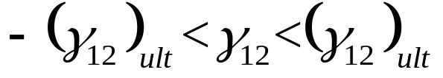
Experimental Results and
Maximum Strain Failure Theory
FIGURE 2.35
Maximum normal tensile stress in x-direction
as function of angle of lamina using maximum
Strain failure theory

Slide 6
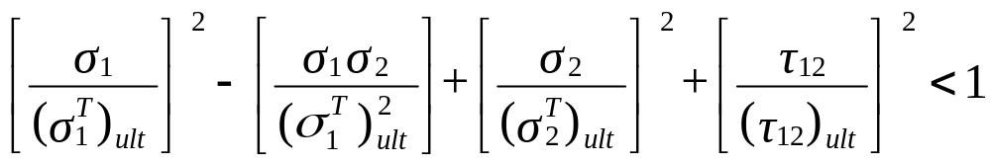
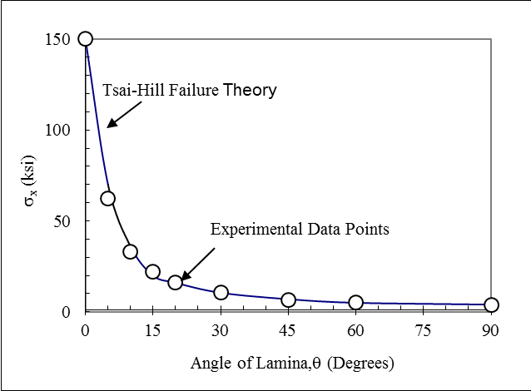
Experimental Results and
Tsai-Hill Failure Theory
FIGURE 2.36
Maximum normal tensile stress in
x-direction as function of angle of
lamina using Tsai-Hill failure theory

Slide 7
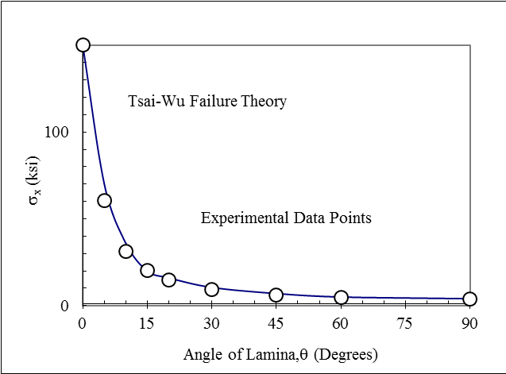
Experimental Results and
Tsai-Wu Failure Theory
FIGURE 2.37
Maximum normal tensile stress in
x-direction as function of angle of
lamina using Tsai-Wu failure theory

Slide 8
Comparison of Strength Ratios
S = 16.33 (Maximum Stress failure theory),
= 16.33 (Maximum Strain failure theory),
= 10.94 (Tsai-Hill failure theory),
= 16.06 (Modified Tsai-Hill failure theory),
= 22.39 (Tsai-Wu failure theory)

Slide 9
END

