Slide 1

EML 4230 Introduction to Composite Materials
Chapter 2 Macromechanical Analysis of a Lamina
Hygrothermal Stresses and Strains
Dr. Autar Kaw
Department of Mechanical Engineering
University of South Florida, Tampa, FL 33620
Courtesy of the Textbook
Mechanics of Composite Materials by Kaw

Slide 2
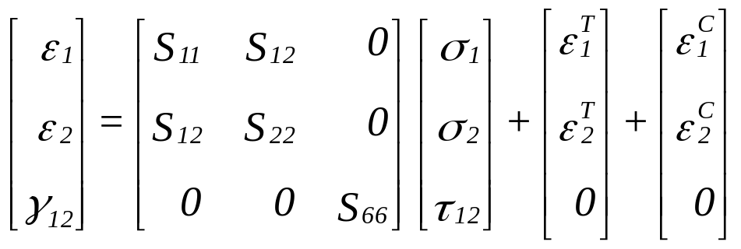
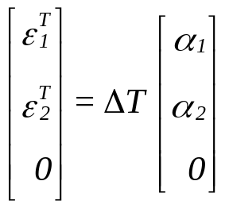
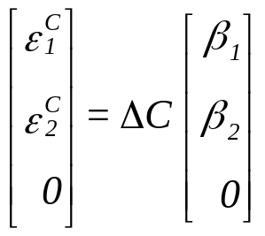
Hygrothermal Stress-Strain Relationship
For a unidirectional lamina
Thermally induced strains:
Moisture induced strains:
(2.174)
(2.175)
(2.176)

Slide 3
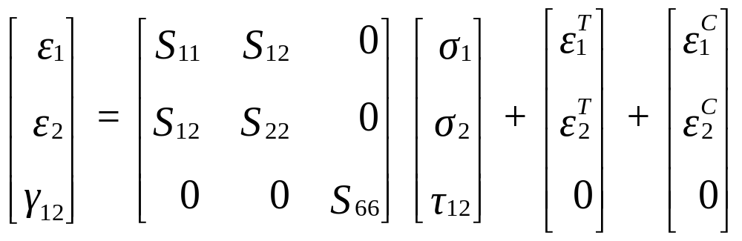
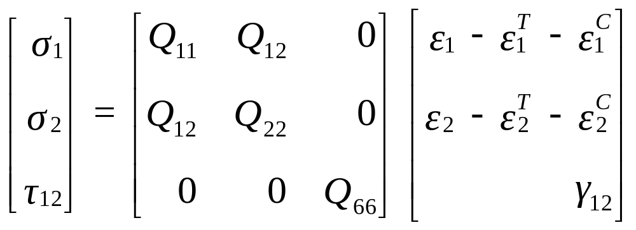
Hygrothermal Stress-Strain Relationship
For a unidirectional lamina
(2.174)
(2.177)

Slide 4
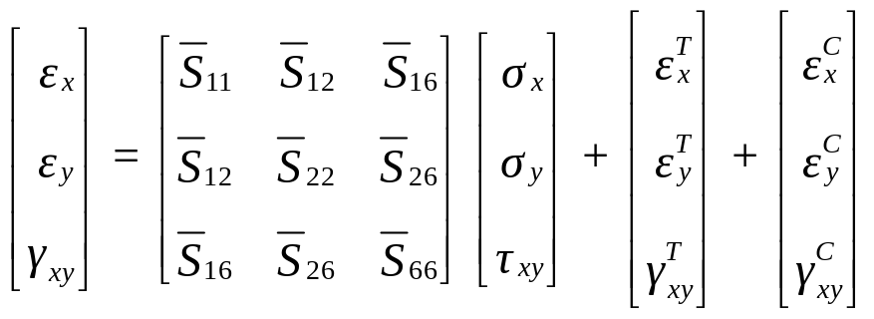
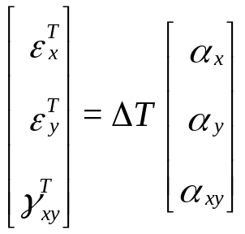
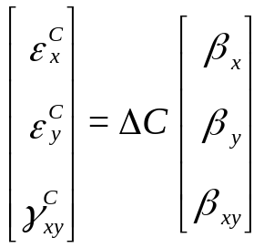
Hygrothermal Stress-Strain Relationship
For an angular lamina
Thermally induced strains:
Moisture induced strains:
(2.178)
(2.179)
(2.180)

Slide 5
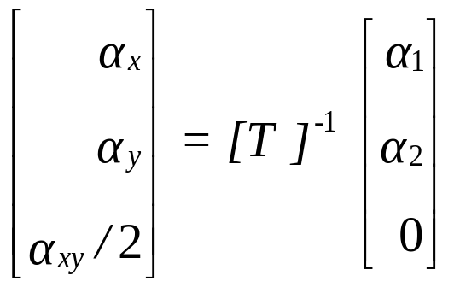
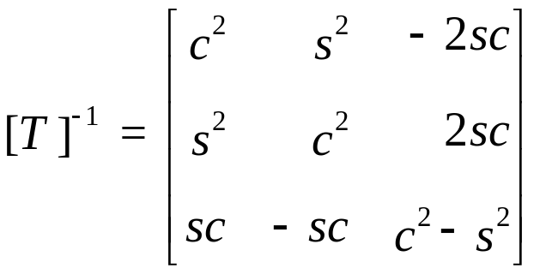
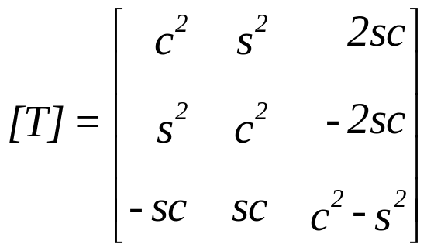


Transformation of CTE
For an angular lamina
(2.181)
(2.95)
(2.96)
(2.97a,b)

Slide 6
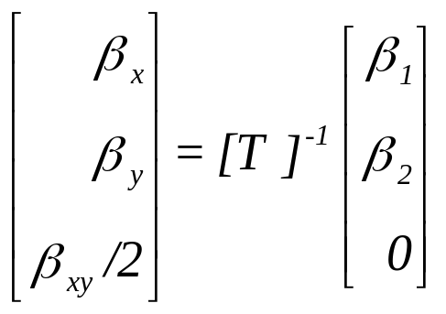
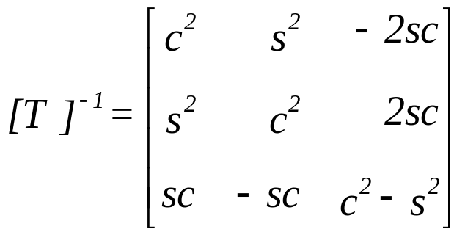
Transformation of Coefficients of Moisture Expansion
For an angular lamina
(2.182)
(2.95)
(2.96)
(2.97a,b)

Slide 7
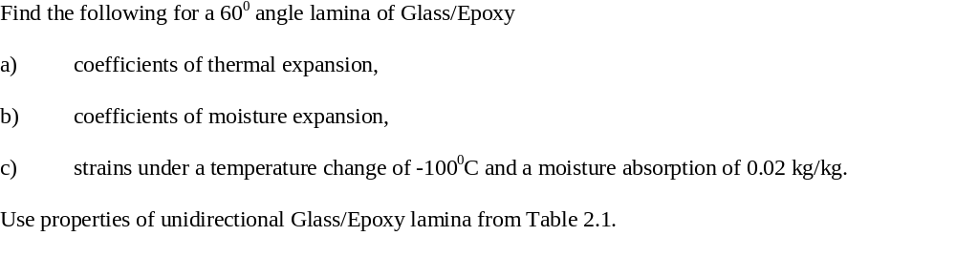
Example 2.20

Slide 8
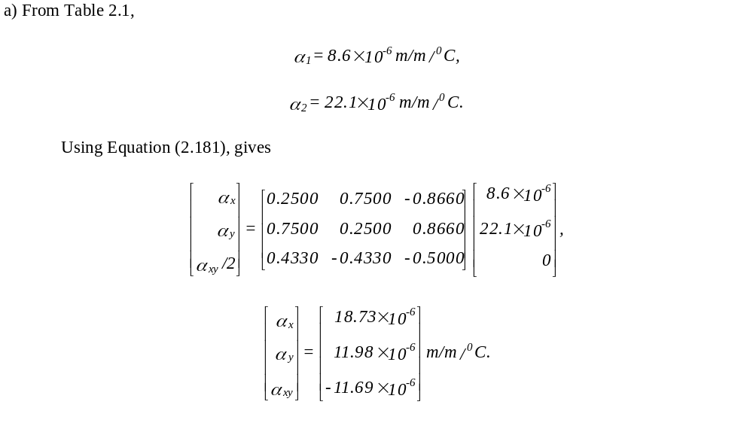
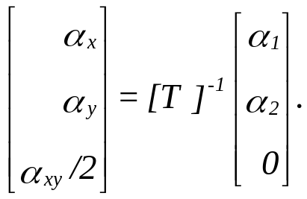
Example 2.20
(2.181)

Slide 9
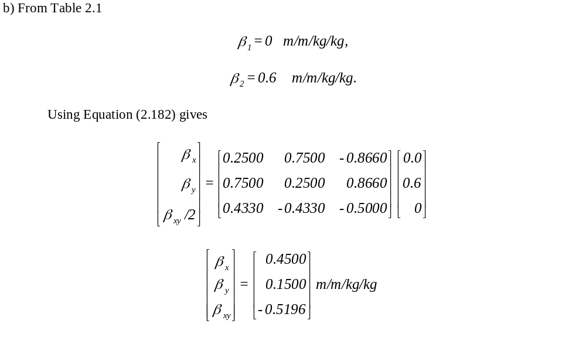
Example 2.20
(2.182)

Slide 10
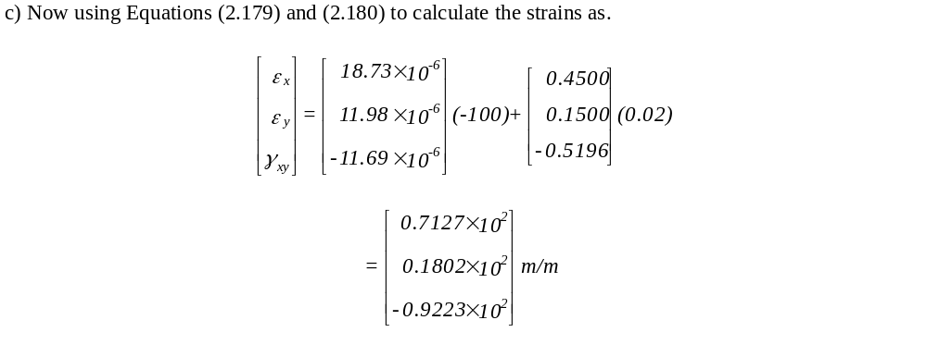
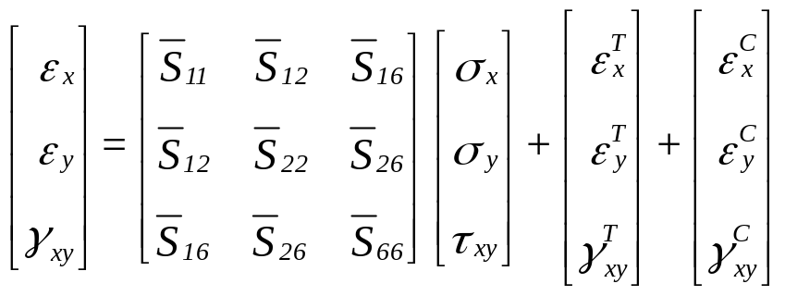
Example 2.20
(2.178)

Slide 11
END

