Slide 1

EML 4230 Introduction to Composite Materials
Chapter 3 Micromechanical Analysis of a Lamina
Introduction
Dr. Autar Kaw
Department of Mechanical Engineering
University of South Florida, Tampa, FL 33620
Courtesy of the Textbook
Mechanics of Composite Materials by Kaw

Slide 2
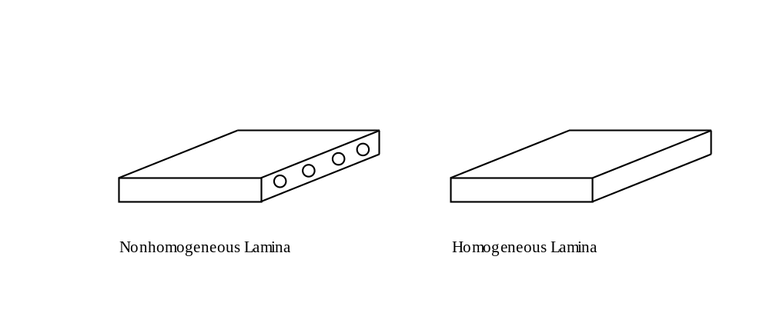
Lamina Assumption
FIGURE 3.1
A nonhomogeneous lamina with fibers and matrix
Approximated as a homogeneous lamina.

Slide 3
END

