Slide 1

EML 4230 Introduction to Composite Materials
Chapter 3 Micromechanical Analysis of a Lamina
Volume Fractions, Weight Fractions,
Density, and Void Content
Dr. Autar Kaw
Department of Mechanical Engineering
University of South Florida, Tampa, FL 33620
Courtesy of the Textbook
Mechanics of Composite Materials by Kaw

Slide 2
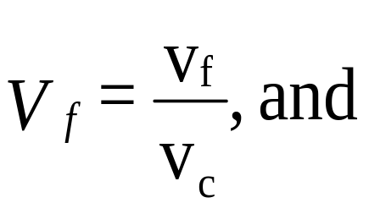
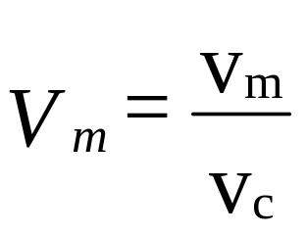
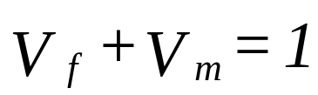
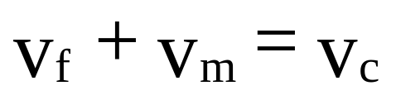
Volume Fractions

Slide 3
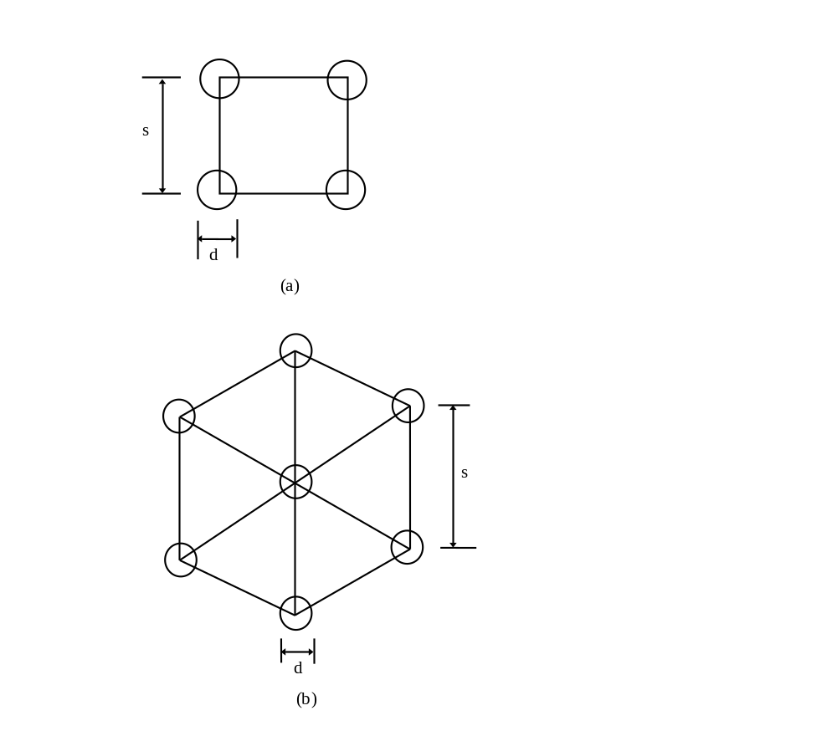
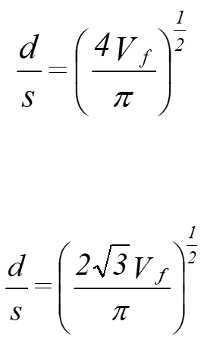
Fiber Packing
FIGURE 3.9
Fiber to fiber spacing in (a) square packing geometry and (b) hexagonal packing geometry.

Slide 4
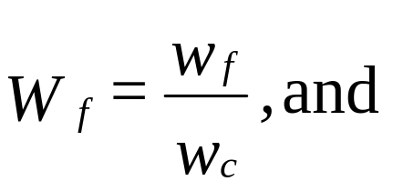
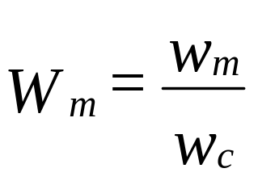
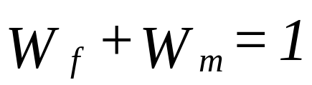
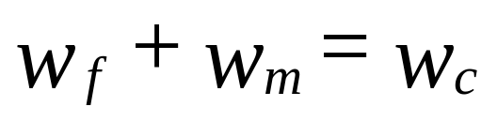
Weight Fractions

Slide 5
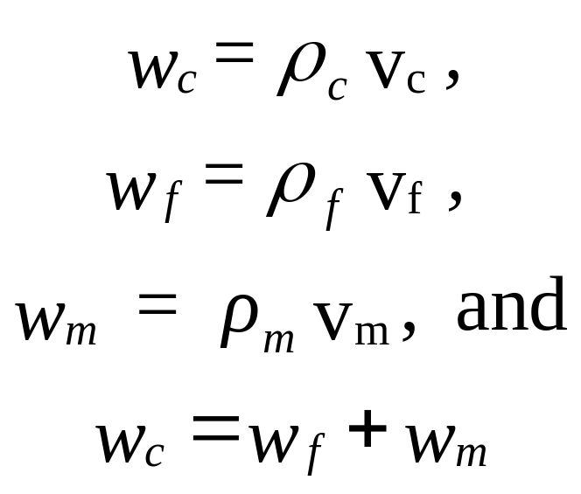
Volume and Weight Fractions

Slide 6
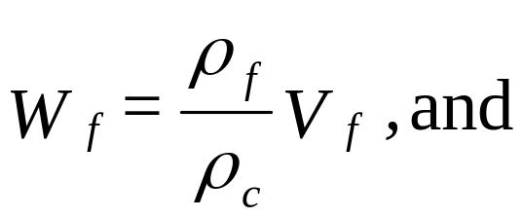
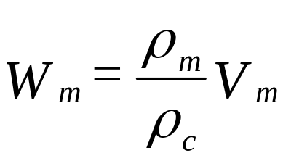
Volume and Weight Fractions

Slide 7
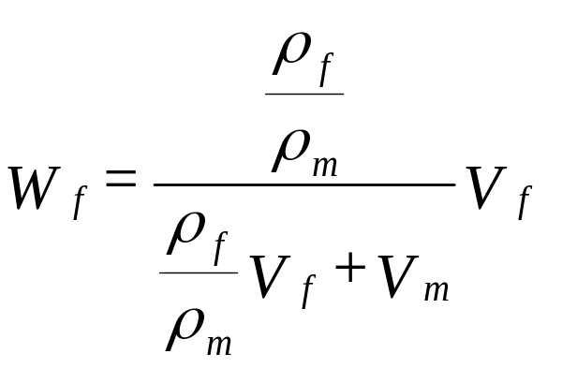
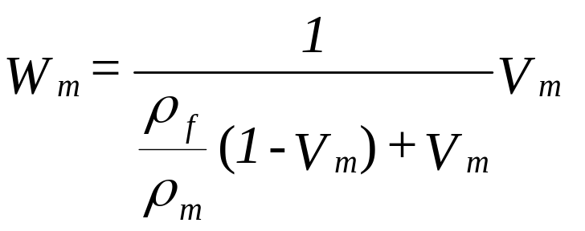
Volume and Weight Fractions

Slide 8
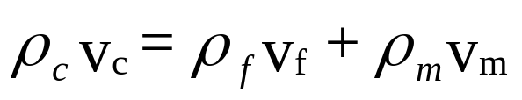
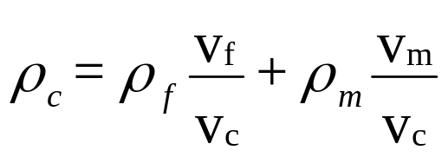
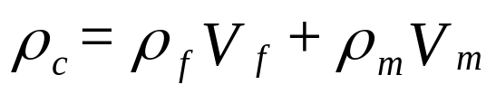
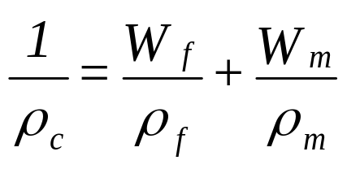
Density

Slide 9
Example
Example 3.1
A Glass/Epoxy lamina consists of a 70% fiber volume fraction. Use properties of glass and epoxy from Tables 3.1 and 3.2, respectively to determine the
density of lamina
b) mass fractions of the glass and epoxy
c) volume of composite lamina if the mass of the lamina is 4 kg.
d) volume and mass of glass and epoxy in part (c).

Slide 10
Example
Table 3.1 Typical Properties of Fibers (SI system of units)
Property | Units | Graphite | Glass | Aramid
Axial modulus Transverse modulus Axial Poisson's ratio Transverse Poisson's ratio Axial shear modulus Axial coefficient of thermal expansion Transverse coefficient of thermal expansion Axial tensile strength Axial compressive strength Transverse tensile strength Transverse compressive strength Shear strength Specific gravity | GPa GPa - - - - - - GPa μm/m/⁰C μm/m/⁰C MPa MPa MPa MPa MPa - - - | 230 22 0.30 0.35 22 -1.3 7.0 2067 1999 77 42 36 1.8 | 85 85 0.20 0.20 35.42 5 5 1550 1550 1550 1550 35 2.5 | 124 8 0.36 0.37 3 -5.0 4.1 1379 276 7 7 21 1.4

Slide 11
Example
Table 3.2 Typical Properties of Matrices (SI system of units)
Property | Units | Epoxy | Aluminum | Polyamide
Axial modulus Transverse modulus Axial Poisson's ratio Transverse Poisson's ratio Axial shear modulus Coefficient of thermal expansion Coefficient of moisture expansion Axial tensile strength Axial compressive strength Transverse tensile strength Transverse compressive strength Shear strength Specific gravity | GPa GPa - - - - - - GPa μm/m/⁰C m/m/kg/kg MPa MPa MPa MPa MPa - - - | 3.4 3.4 0.3 0.3 1.308 63 0.33 72 102 72 102 34 1.2 | 71 71 0.30 0.30 27 23 0.00 276 276 276 276 138 2.7 | 3.5 3.5 0.35 0.35 1.3 90 0.33 54 108 54 108 54 1.2

Slide 12
Example
Table 3.3 Typical Properties of Fibers (USCS system of units)
Property | Units | Graphite | Glass | Aramid
Axial Modulus Transverse modulus Axial Poisson's ratio Transverse Poisson's ratio Axial shear modulus Axial coefficient of thermal expansion Transverse coefficient of thermal expansion Axial tensile strength Axial compressive strength Transverse tensile strength Transverse compressive strength Shear strength Specific gravity | Msi Msi - - - - - - Msi μin/in/⁰F μin/in/⁰F ksi ksi ksi ksi ksi - - - | 33.35 3.19 0.30 0.35 3.19 -0.7222 3.889 299.7 289.8 11.16 6.09 5.22 1.8 | 12.33 12.33 0.20 0.20 5.136 2.778 2.778 224.8 224.8 224.8 224.8 5.08 2.5 | 17.98 1.16 0.36 0.37 0.435 -2.778 2.278 200.0 40.02 1.015 1.015 3.045 1.4

Slide 13
Example
Table 3.4 Typical Properties of Matrices (USCS system of units)
Property | Units | Epoxy | Aluminum | Polyamide
Axial modulus Transverse modulus Axial Poisson's ratio Transverse Poisson's ratio Axial shear modulus Coefficient of thermal expansion Coefficient of moisture expansion Axial tensile strength Axial compressive strength Transverse tensile strength Transverse compressive strength Shear strength Specific gravity | Msi Msi - - - - - - Msi μin/in/⁰F in/in/lb/lb ksi ksi ksi ksi ksi - - - | 0.493 0.493 0.3 0.3 0.1897 35 0.33 10.44 14.79 10.44 14.79 4.93 1.2 | 10.30 10.30 0.30 0.30 3.915 12.78 0.00 40.02 40.02 40.02 40.02 20.01 2.7 | 0.5075 0.5075 0.35 0.35 0.1885 50 0.33 7.83 15.66 7.83 15.66 7.83 1.2

Slide 14
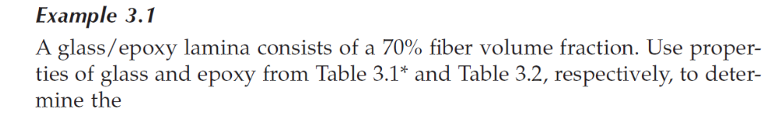
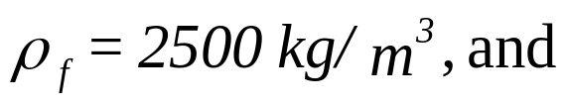
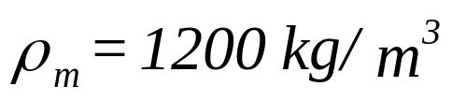
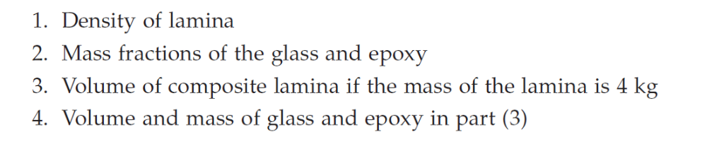
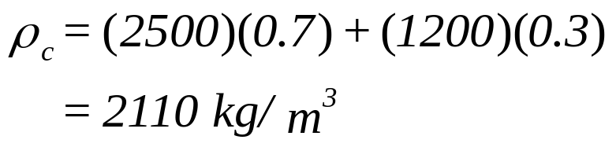
Example
a)

Slide 15

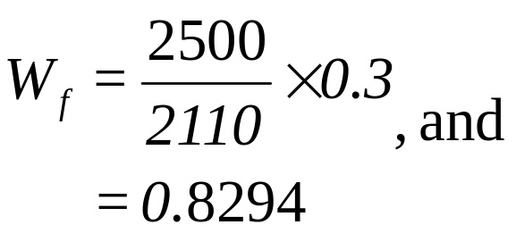
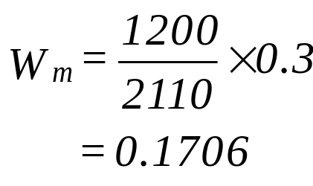
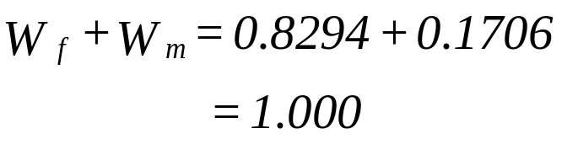
Example
Example 3.1
b)

Slide 16
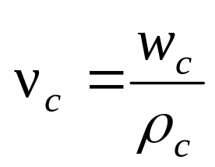
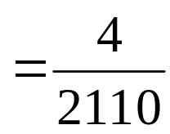

Example
Example 3.1
c)

Slide 17
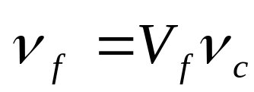
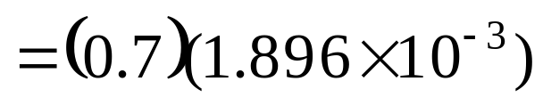
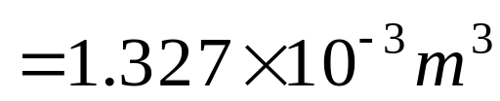
Example
Example 3.1
d)

Slide 18
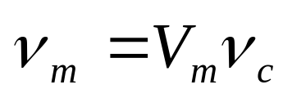
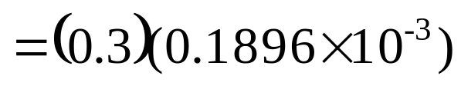

Example
Example 3.1
d)

Slide 19
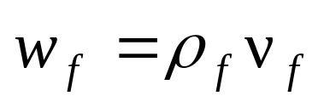
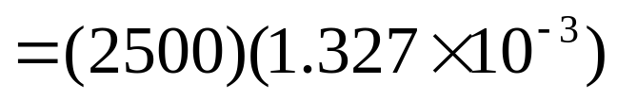

Example
Example 3.1
d)

Slide 20
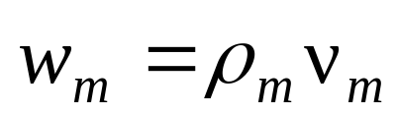
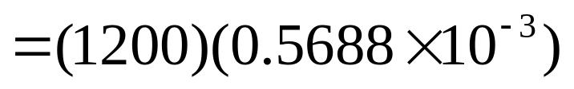

Example
Example 3.1
d)

Slide 21
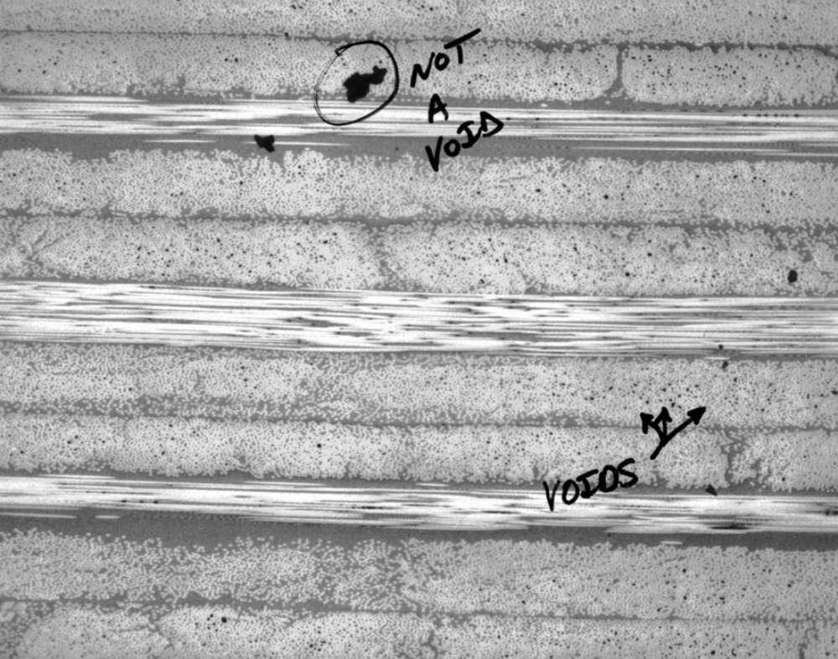
Void Content
FIGURE 3.2 Photomicrographs of cross-section of a lamina with voids.

Slide 22
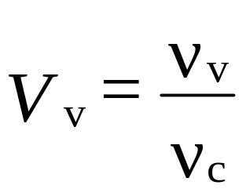
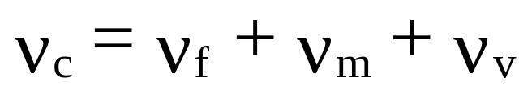
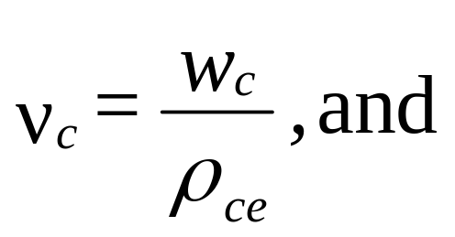
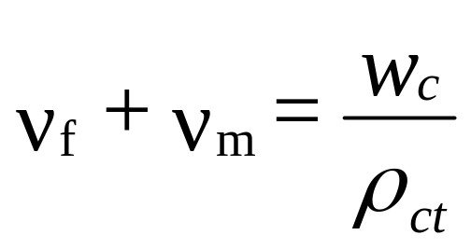
Void Content

Slide 23
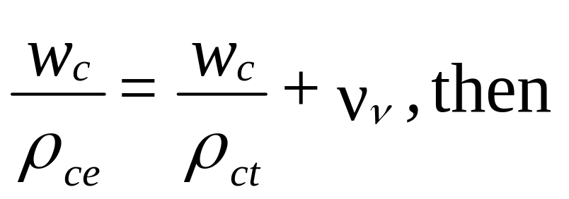
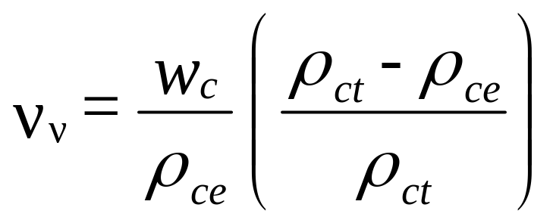
Void Content

Slide 24
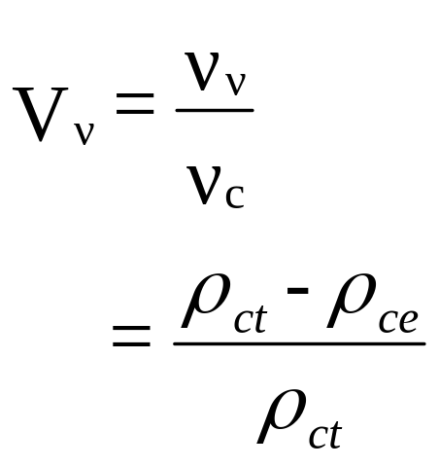
Void Content

Slide 25
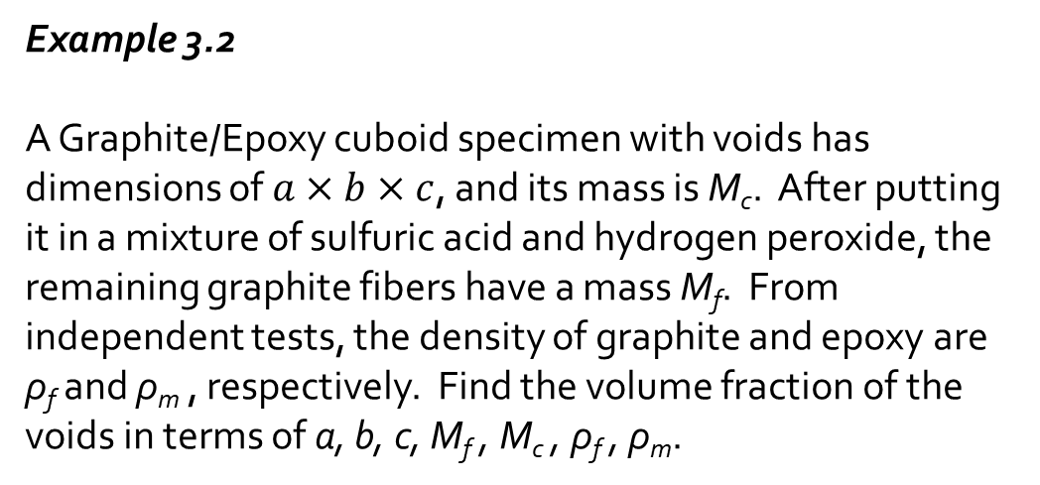
Example
Example 3.2
A Graphite/Epoxy cuboid specimen with voids has dimensions of $a×b×c$, and its mass is M_{c}. After putting it in a mixture of sulfuric acid and hydrogen peroxide, the remaining graphite fibers have a mass M_{f}. From independent tests, the density of graphite and epoxy are ρ_{f} and ρ_{m} , respectively. Find the volume fraction of the voids in terms of a, b, c, M_{f} , M_{c} , ρ_{f} , ρ_{m}.

Slide 26

Example

Slide 27
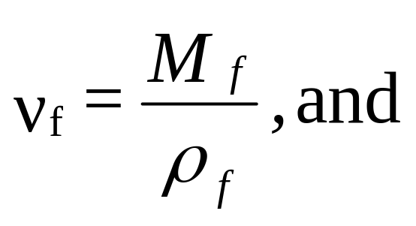
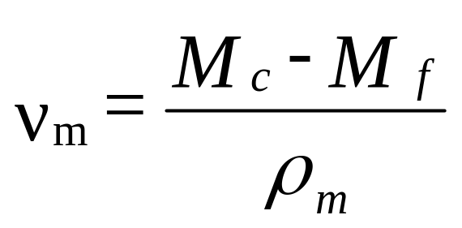
Example

Slide 28
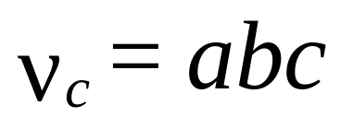
Example

Slide 29


Example

Slide 30



Example
Alternative Solution

Slide 31



Example
Alternative Solution

Slide 32

Example
Alternative Solution

Slide 33

Example
Alternative Solution

Slide 34

Example
Alternative Solution

Slide 35
END

