Slide 1

EML 4230 Introduction to Composite Materials
Chapter 3 Micromechanical Analysis of a Lamina
Elastic Moduli of Unidirectional Lamina
Dr. Autar Kaw
Department of Mechanical Engineering
University of South Florida, Tampa, FL 33620
Courtesy of the Textbook
Mechanics of Composite Materials by Kaw

Slide 2
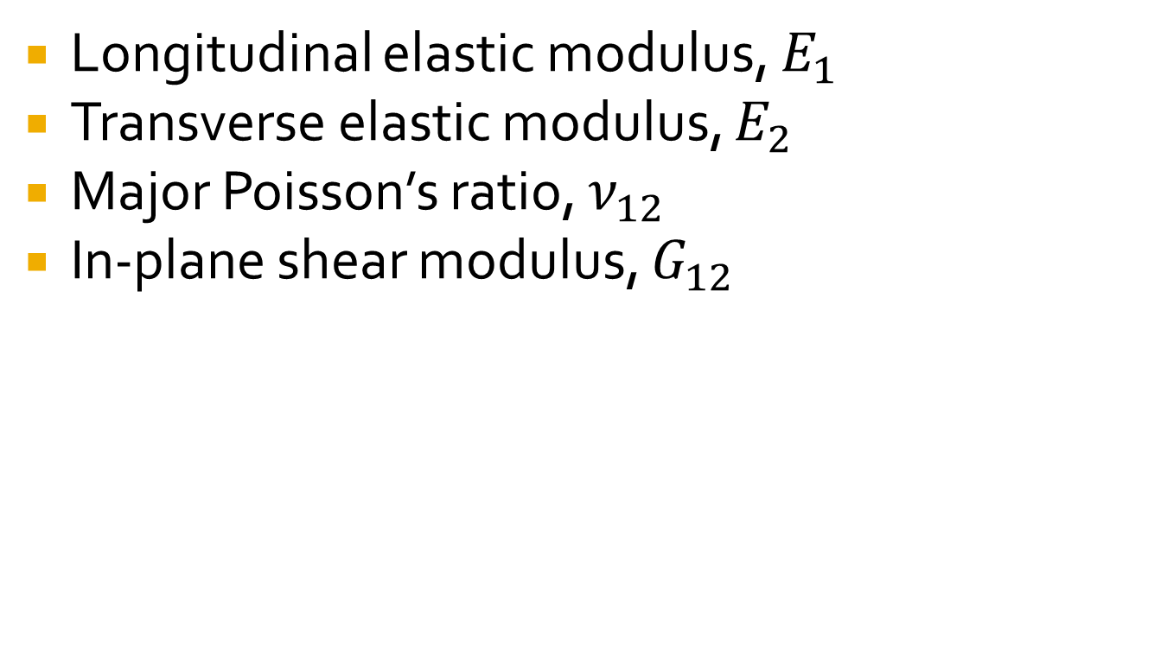
Elastic Moduli of Unidirectional Lamina
Longitudinal elastic modulus, $E_{1}$
Transverse elastic modulus, $E_{2}$
Major Poisson’s ratio, $ν_{12}$
In-plane shear modulus, $G_{12}$

Slide 3
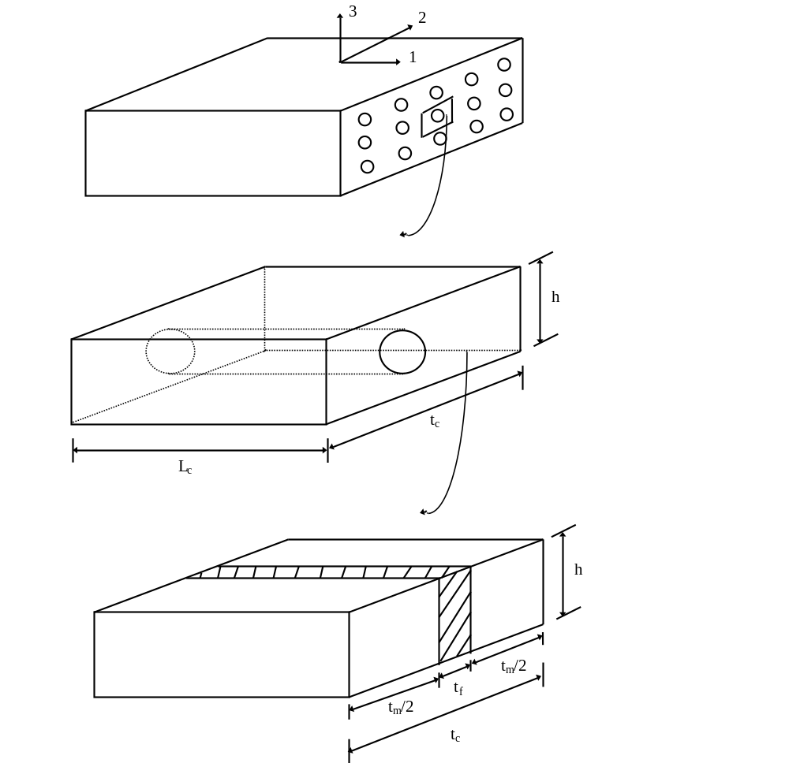
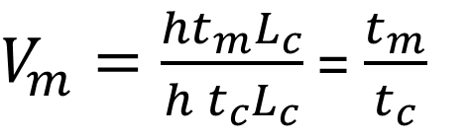
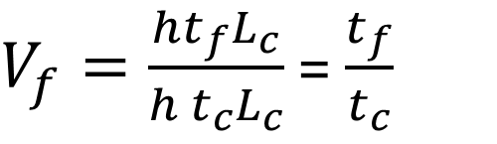
Strength of Materials Approach
$V_{f}=\frac{ht_{f}L_{c}}{h t_{c}L_{c}}$ = $\frac{t_{f}}{t_{c}}$
$V_{m}=\frac{{ht}_{m}L_{c}}{h t_{c}L_{c}}$ = $\frac{t_{m}}{t_{c}}$
FIGURE 3.3
Representative volume element of a unidirectional lamina.

Slide 4
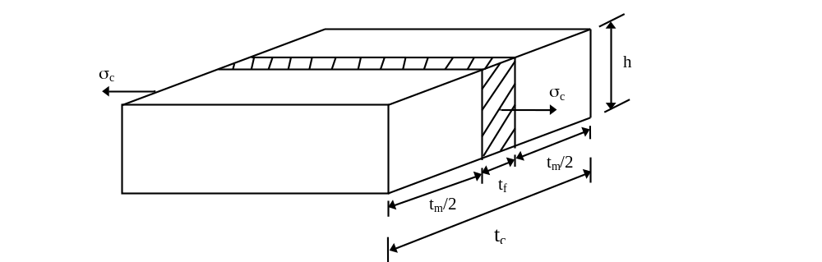
Longitudinal Young’s Modulus
FIGURE 3.4
A longitudinal stress applied to the representative volume element to calculate the longitudinal Young’s modulus for a unidirectional lamina.

Slide 5
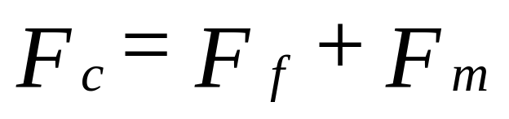
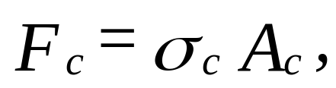
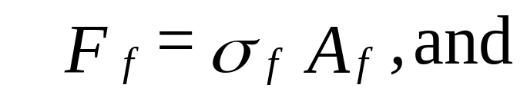
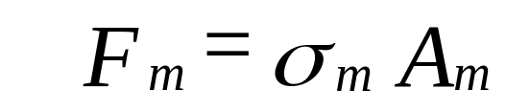

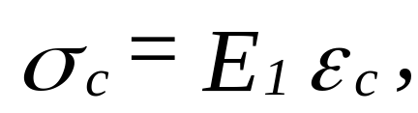
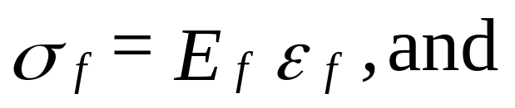
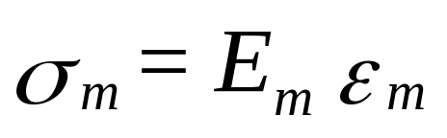
Longitudinal Young’s Modulus

Slide 6
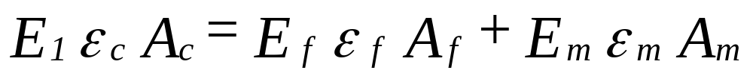
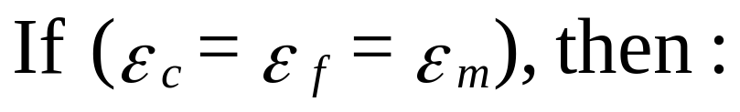
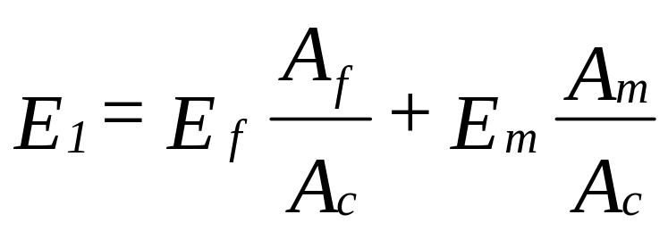
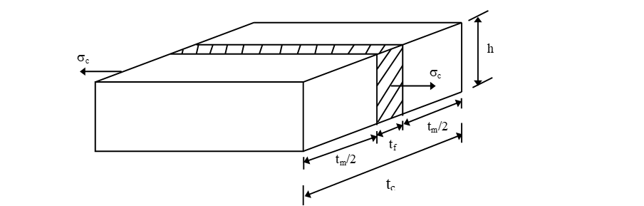
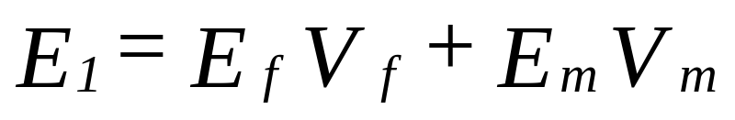
Longitudinal Young’s Modulus

Slide 7


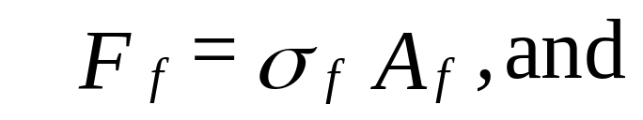


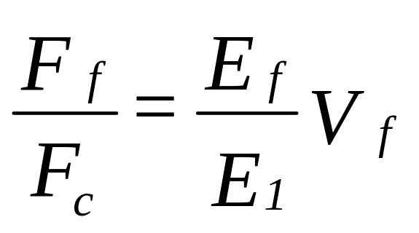
Ratio of force taken by fiber to composite

Slide 8
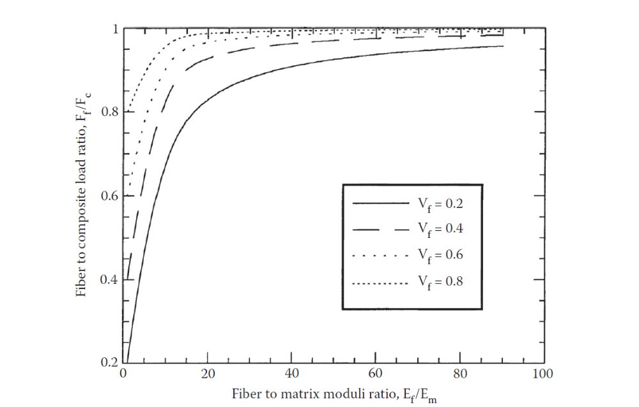
Ratio of force taken by fiber to composite
FIGURE 3.5
Fraction of load of composite carried by fibers as a function of fiber volume fraction for constant fiber to matrix moduli ratio.

Slide 9

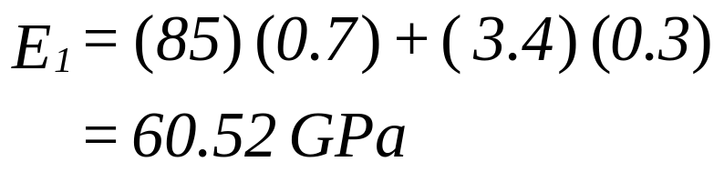
Example – Longitudinal Young’s Modulus
Find the longitudinal elastic modulus of a unidirectional Glass/Epoxy lamina with a 70% fiber volume fraction. Use the properties of glass and epoxy from Tables 3.1 and 3.2, respectively. Also, find the ratio of the load the fibers take to that of the composite.
E_{f} = 85 GPa
E_{m} = 3.4 GPa

Slide 10
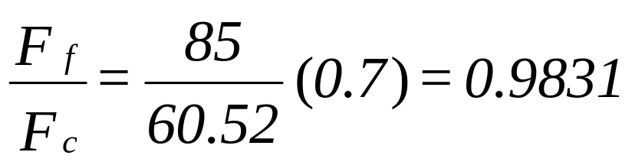
Force in fiber to composite ratio

Slide 11
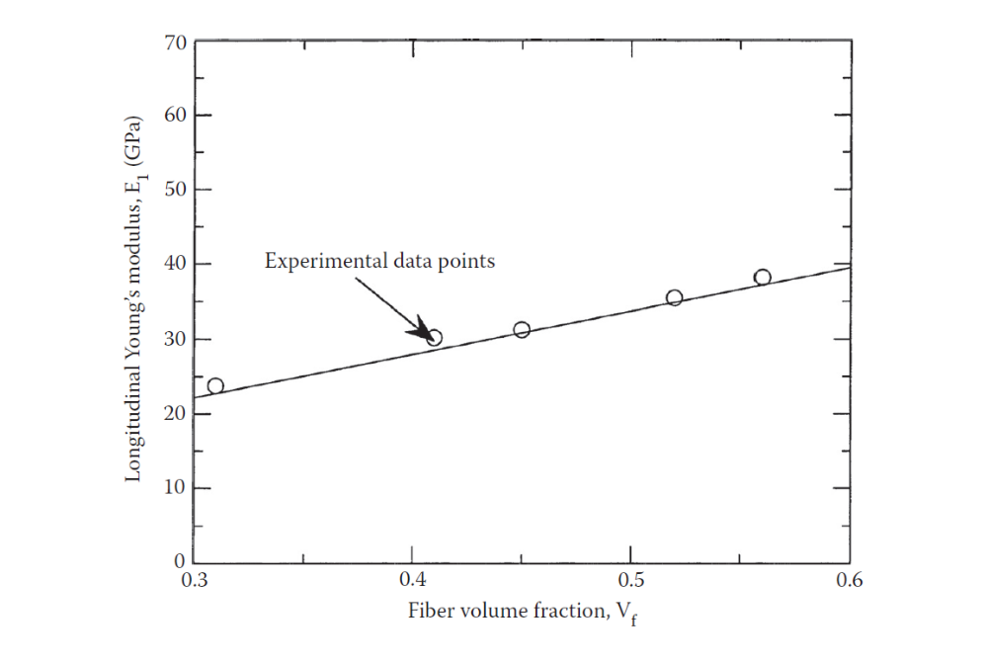
Comparing with experimental results
FIGURE 3.6
Longitudinal Young’s modulus as function of fiber volume fraction and comparison with experimental data points for a typical glass/polyester lamina.

Slide 12
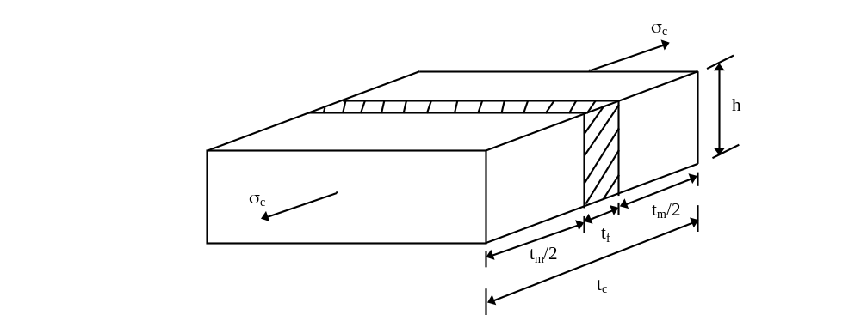
Transverse Young’s Modulus
FIGURE 3.7
A transverse stress applied to a representative volume element used to calculate transverse Young’s modulus of a unidirectional lamina.

Slide 13
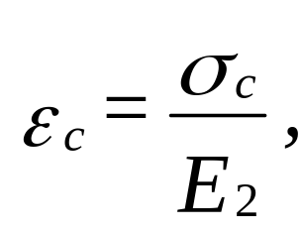
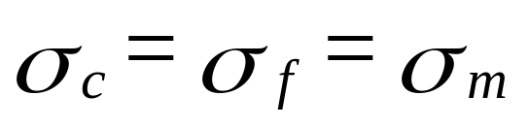
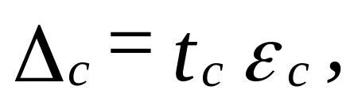
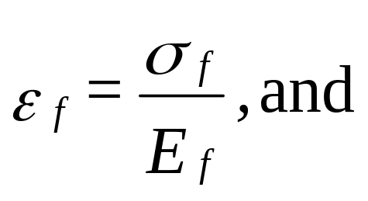
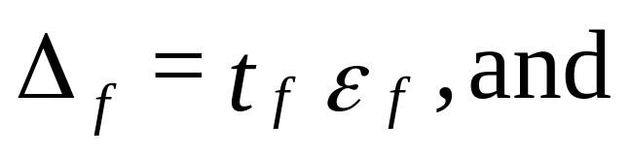
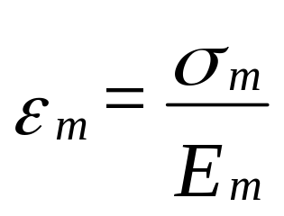

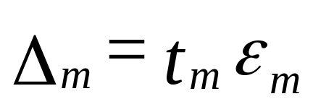
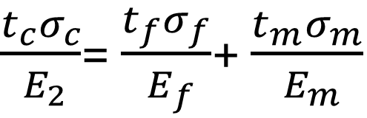
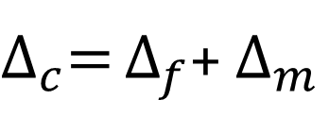
Transverse Young’s Modulus
$∆_{c}=$ $∆_{f}$+ $∆_{m}$
$\frac{t_{c}σ_{c}}{{ E}_{2}}$= $\frac{t_{f}σ_{f}}{{ E}_{f}}$+ $\frac{t_{m}σ_{m}}{{ E}_{m}}$

Slide 14
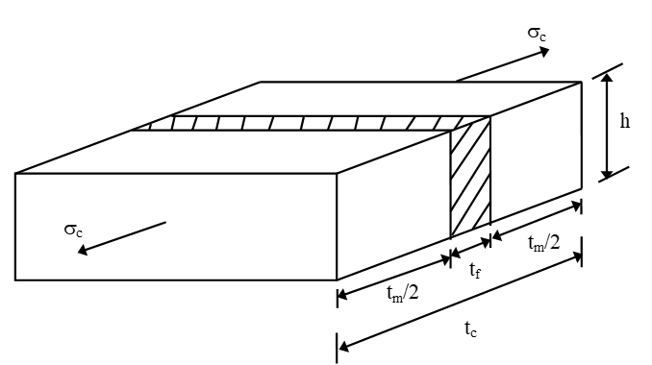
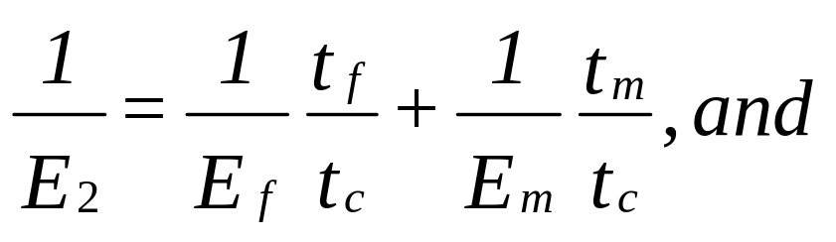
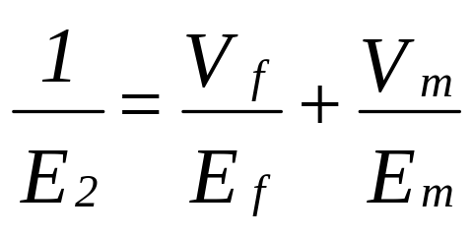
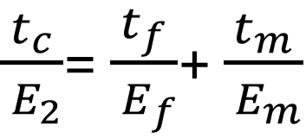
Transverse Young’s Modulus
$\frac{t_{c}}{{ E}_{2}}$= $\frac{t_{f}}{{ E}_{f}}$+ $\frac{t_{m}}{{ E}_{m}}$

Slide 15
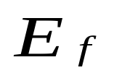

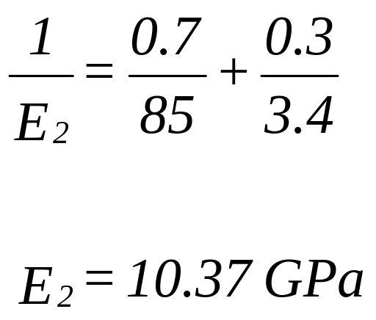
Example
Example 3.4
Find the transverse Young's modulus of a Glass/Epoxy lamina with a fiber volume fraction of 70%. Use the properties of glass and epoxy from Tables 3.1 and 3.2, respectively.
= 85 GPa
E_{m} = 3.4 GPa

Slide 16
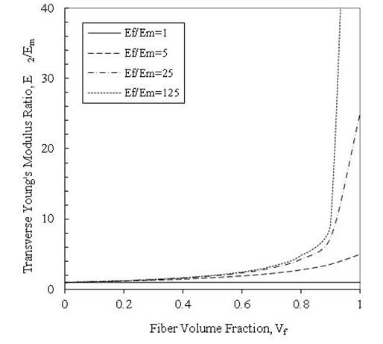
Transverse Young’s Modulus vs Fiber Volume Fraction
FIGURE 3.8
Transverse Young’s modulus as a function of fiber volume fraction for constant fiber to matrix moduli ratio.

Slide 17
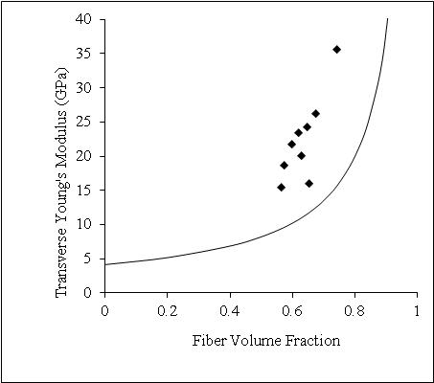
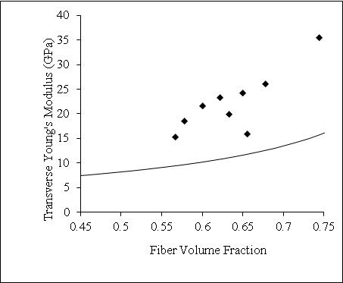
Transverse Young’s modulus comparison with experimental data
FIGURE 3.10 Theoretical values of transverse Young’s modulus as a function
of fiber volume fraction for a boron/epoxy unidirectional lamina (Ef = 414 GPa, vf = 0.2, Em = 4.14 GPa, vm = 0.35) and comparison with experimental values. Figure (b) zooms figure (a) for fiber volume fraction between 0.45 and 0.75. (Experimental data from Hashin, Z., NASA tech. rep. contract no. NAS1-8818, November 1970.)

Slide 18
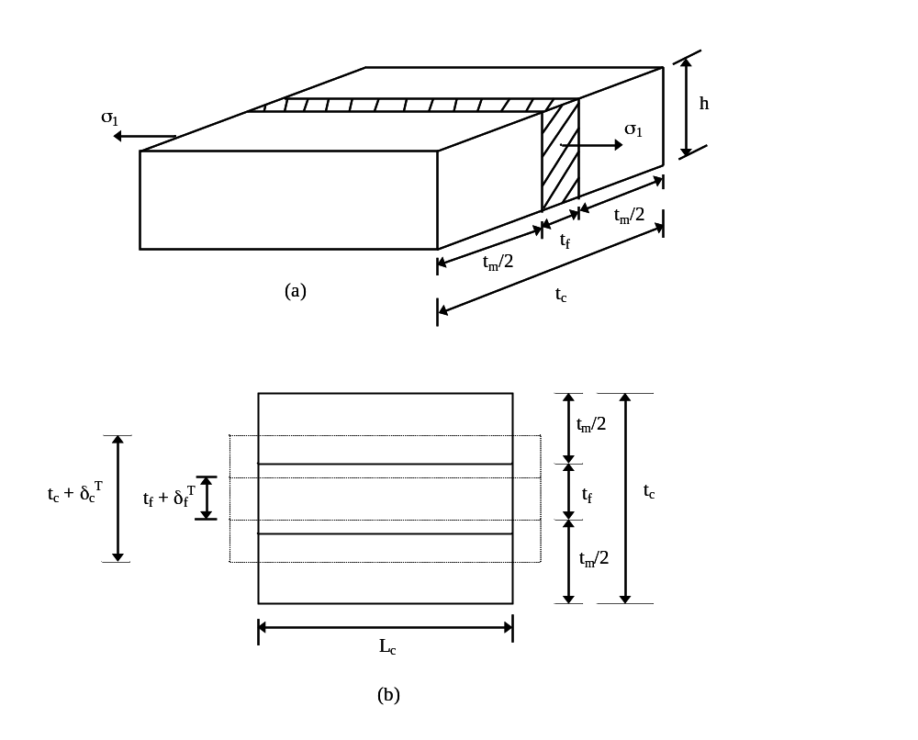
Major Poisson’s ratio, $ν_{12}$
FIGURE 3.11
A longitudinal stress applied to a representative volume element to calculate Poisson’s ratio of unidirectional lamina.

Slide 19
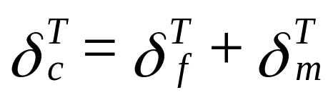
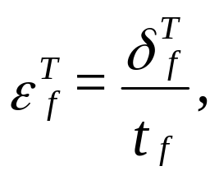
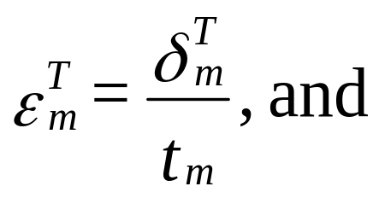
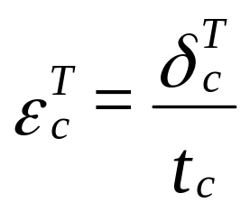
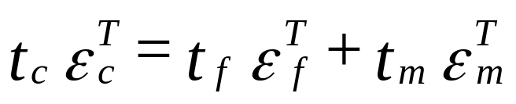
Major Poisson’s Ratio Derivation

Slide 20
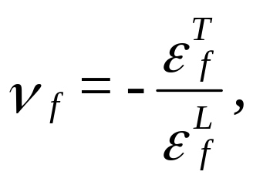
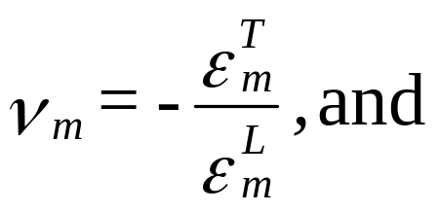



Major Poisson’s Ratio

Slide 21






Major Poisson’s Ratio

Slide 22




Example
Find the major and minor Poisson's ratio of a Glass/Epoxy lamina with a 70% fiber volume fraction. Use the properties of glass and epoxy from Tables 3.1 and 3.2, respectively.

Slide 23

Example
E₁ = 60.52 GPa
E₂ = 10.37 GPa

Slide 24

In-Plane Shear Modulus
FIGURE 3.12
An in-plane shear stress applied to a representative volume element for finding in-plane shear modulus of a unidirectional lamina.

Slide 25




In-Plane Shear Modulus

Slide 26






In-Plane Shear Modulus

Slide 27




In-Plane Shear Modulus

Slide 28






Example
Find the in-plane shear modulus of a Glass/Epoxy lamina with a 70% fiber volume fraction. Use properties of glass and epoxy from Tables 3.1 and 3.2, respectively.

Slide 29


Example

Slide 30


In-Plane Shear Modulus comparison with experimental data
FIGURE 3.13 Theoretical values of in-plane shear modulus as a function of fiber volume fraction and comparison with experimental values for a unidirectional glass/epoxy lamina (Gf = 30.19 GPa, Gm = 1.83 GPa). Figure (b) zooms figure (a) for fiber volume fraction between 0.45 and 0.75. (Experimental data from Hashin, Z., NASA tech. rep. contract no. NAS1-8818, November 1970.)

Slide 31


Mechanics of Materials Equations for Elastic Moduli Summary

Slide 32




Halpin Tsai Equations
Same as MOM equations for E1 and $ν_{12}$ but NOT for E2 and G12

Slide 33


Transverse Young’s Modulus
The term ξ is called the reinforcing factor and depends on the following
Fiber Geometry
Packing Geometry
Loading Conditions
Example: For a fiber geometry of circular fibers in a packing geometry of a square array, ξ = 2

Slide 34





Does $η$ have meaning?
E_{f}/E_{m} = 1 implies = 0, (homogeneous medium)
E_{f}/E_{m} implies = 1, (rigid inclusions)
E_{f}/E_{m} implies (voids)

Slide 35


What is 𝜉 for another case?
The term ξ is depends on
Fiber Geometry
Packing Geometry
Loading Conditions
For a rectangular fiber cross-section of length a and width b in a hexagonal array,
$ξ$ = 2(a/b),
where a is in the direction of loading.

Slide 36



Example: Transverse Young’s Modulus
Find the transverse Young's modulus for a Glass/Epoxy lamina with a 70% fiber volume fraction. Use the properties for glass and epoxy from Tables 3.1 and 3.2, respectively. Use Halpin-Tsai equations for a circular fiber in a square array packing geometry.
E_{f} = 85 GPa
E_{m} = 3.4 GPa
$$\begin{aligned}η = \frac{(85/3.4) − 1}{(85/3.4) + 2} \\ \\ \\ = 0.8889\end{aligned}$$

Slide 37


Transverse Young’s Modulus
MOM vs HT
FIGURE 3.15 Theoretical values of transverse Young’s modulus as a function of fiber volume fraction and comparison with experimental values for boron/epoxy unidirectional lamina (Ef = 414 GPa, νf = 0.2, Em = 4.14 GPa, νm = 0.35). Figure (b) zooms figure (a) for fiber volume fraction between 0.45 and 0.75. (Experimental data from Hashin, Z., NASA tech. rep. contract no. NAS1-8818, November 1970.)

Slide 38


In-plane Shear Modulus
The term ξ is called the reinforcing factor and depends on the following
Fiber Geometry
Packing Geometry
Loading Conditions
Example: For a fiber geometry of circular fibers in a packing geometry of a square array, ξ = 1

Slide 39


What is 𝜉 for another case?
The term ξ is depends on
Fiber Geometry
Packing Geometry
Loading Conditions
For a rectangular fiber cross-section of length a and width b in a hexagonal array,
$ξ=\sqrt{3}ln(\frac{a}{b})$,
where $a$ is in the direction of loading

Slide 40





Example: In-Plane Shear Modulus
Using Halpin-Tsai equations, find the shear modulus of a Glass/Epoxy composite with a 70% fiber volume fraction. Use the properties of glass and epoxy from Tables 3.1 and 3.2, respectively. Assume the fibers are circular and are packed in a square array.

Slide 41


Shear Modulus
MOM vs HT
Theoretical values of in-plane shear modulus as a function of fiber volume fraction compared with experimental values for unidirectional glass/epoxy lamina (Gf = 30.19 GPa, Gm = 1.83 GPa). Figure (b) zooms figure (a) for fiber volume fraction between 0.45 and 0.75. (Experimental data from Hashin, Z., NASA tech. rep. contract No. NAS1-8818, November 1970.)

Slide 42
END

