Slide 1

EML 4230 Introduction to Composite Materials
Chapter 3 Micromechanical Analysis of a Lamina
Coefficients of Moisture Expansion
Dr. Autar Kaw
Department of Mechanical Engineering
University of South Florida, Tampa, FL 33620
Courtesy of the Textbook
Mechanics of Composite Materials by Kaw

Slide 2
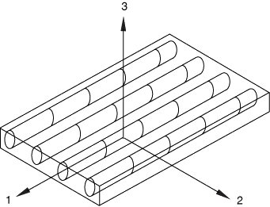
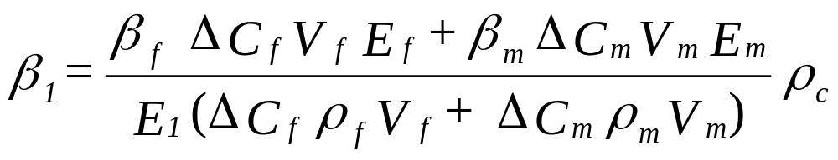
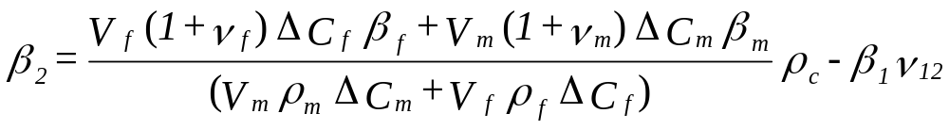
General Formulas for Coefficients of Moisture Expansion
Source: https://docs.software.vt.edu/abaqusv2022/English/SIMACAEMATRefMap/simamat-c-damagefibercomposite.htm

Slide 3
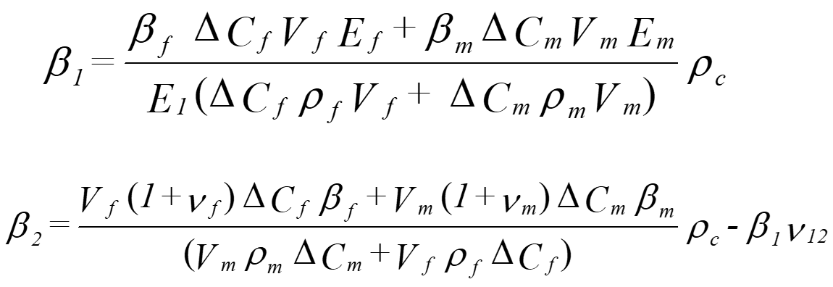
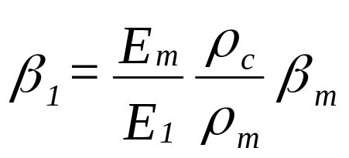
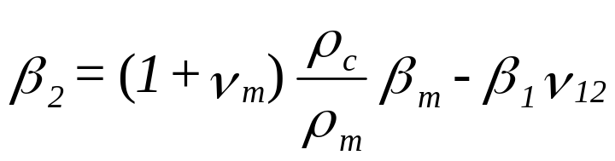
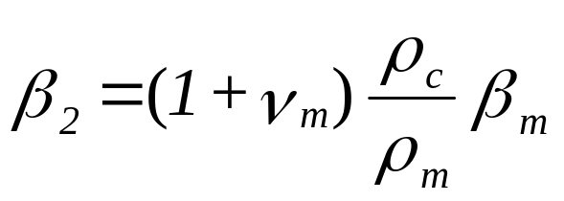
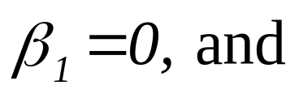
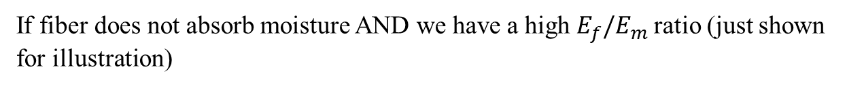
Coefficients of Moisture Expansion with No Moisture Absorbed by Fiber
If fiber does not absorb moisture
If fiber does not absorb moisture AND we have a high $E_{f}/E_{m}$ratio (just shown for illustration)

Slide 4
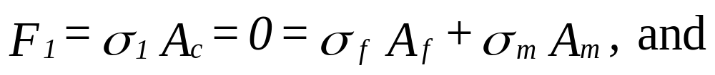
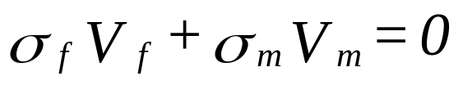


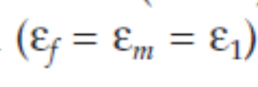
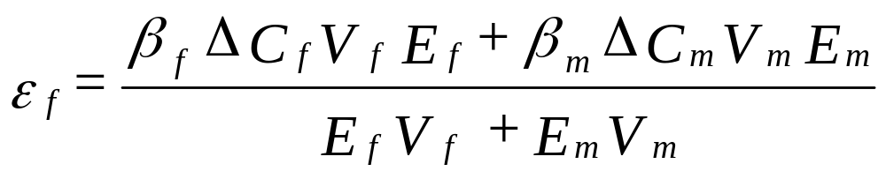

Derivation, Coefficient of Moisture Expansion, $β_{1}$

Slide 5

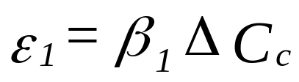
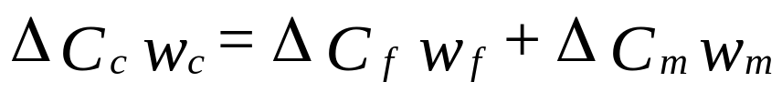
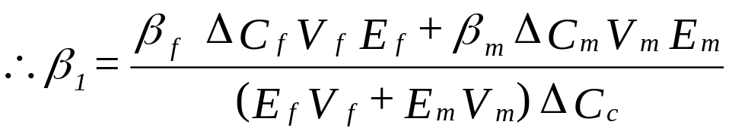
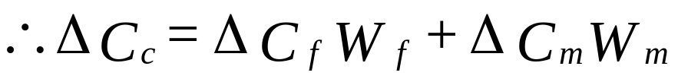
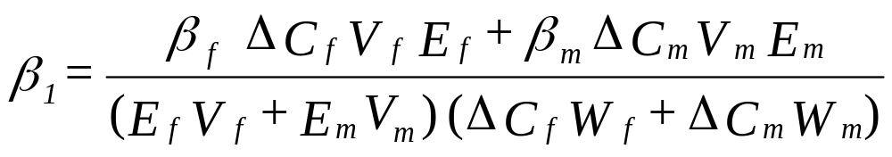
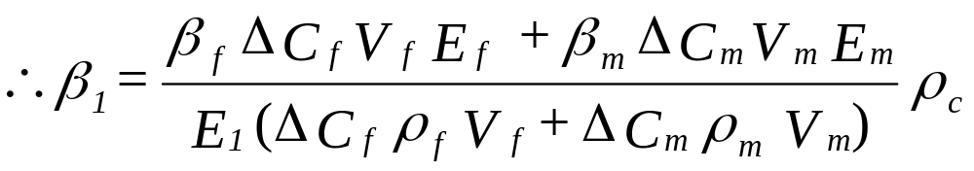

Derivation, Coefficient of Moisture Expansion, $β_{1}$

Slide 6
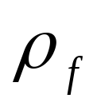
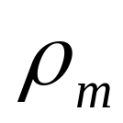
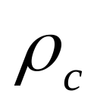
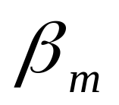
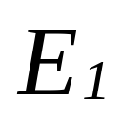
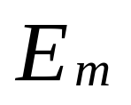
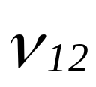
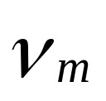
Example, Coefficients of Moisture Expansion
Find the two coefficients of moisture expansion for a Glass/Epoxy lamina with 70% fiber volume fraction. Use properties for glass and epoxy from Tables 3.1 and 3.2, respectively. Assume glass does not absorb moisture.
= 2500 kg/m³
= 1200 kg/m³
= 2110 kg/m³
= 0.33 m/m/kg/kg
= 60.52 GPa
= 3.4 GPa
= 0.230
= 0.3

Slide 7
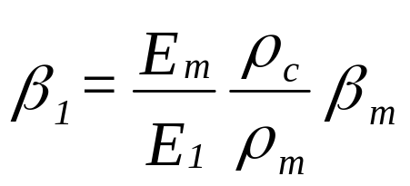
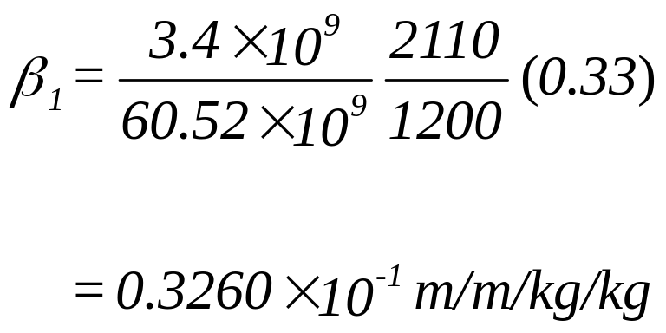
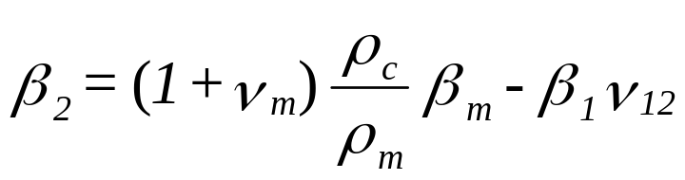
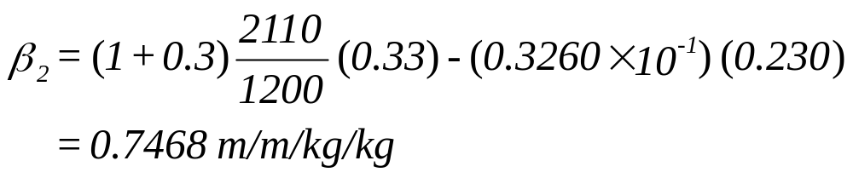
Example, Coefficients of Moisture Expansion

Slide 8
END

