Slide 1

EML 4230 Introduction to Composite Materials
Chapter 4 Macromechanical Analysis of a Laminate
Objectives and Laminate Code
Dr. Autar Kaw
Department of Mechanical Engineering
University of South Florida, Tampa, FL 33620
Courtesy of the Textbook
Mechanics of Composite Materials by Kaw

Slide 2
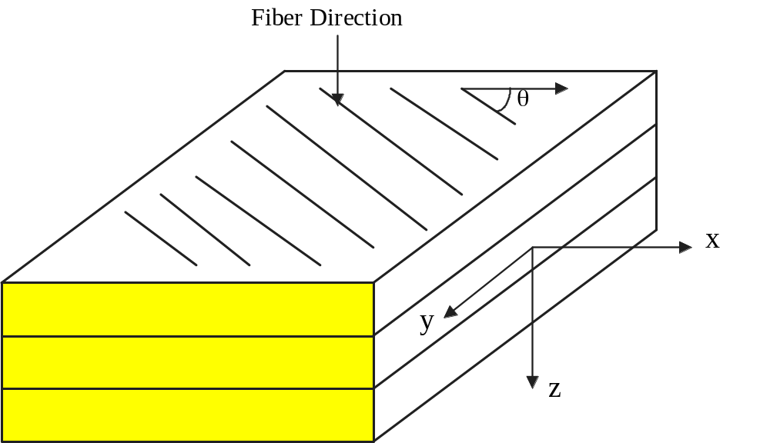
Laminate Stacking Sequence
FIGURE 4.1
Schematic of a lamina

Slide 3
Chapter Objectives
  Understand the code for laminate stacking sequence
  Develop relationships of mechanical and hygrothermal loads applied to a laminate to strains and stresses in each lamina
  Find the elastic stiffnesses of laminate based on the elastic moduli of individual laminas and the stacking sequence
  Find the coefficients of thermal and moisture expansion of a laminate based on elastic moduli, coefficients of thermal and moisture expansion of individual laminas, and stacking sequence

Slide 4
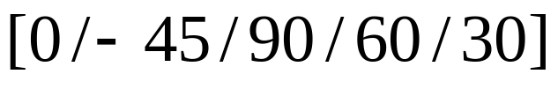
Laminate Code
0
-45
90
60
30

Slide 5
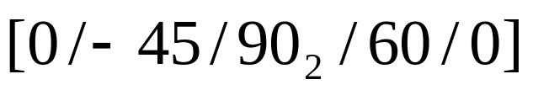
Laminate Code
0
-45
90
90
60
0

Slide 6
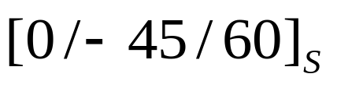
Laminate Code
0
-45
60
60
-45
0

Slide 7
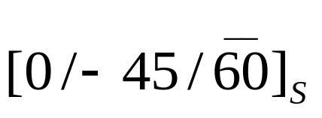
Laminate Code
0
-45
60
-45
0

Slide 8
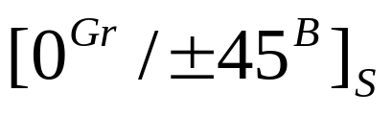
Laminate Code
Graphite/Epoxy | 0
Boron/Epoxy | 45
Boron/Epoxy | -45
Boron/Epoxy | -45
Boron/Epoxy | 45
Graphite/Epoxy | 0

Slide 9
Special Types of Laminates
  Symmetric Laminate: For every ply above the laminate midplane, there is an identical ply (material and orientation) an equal distance below the midplane.
  Balanced Laminate: For every ply at a +θ orientation, there is another ply at the – θ orientation somewhere in the laminate.

Slide 10
Special Types of Laminates
  Cross-ply Laminate: Composted of plies of either 0° or 90° (no other ply orientation).
  Quasi-isotropic Laminate: Produced using at least three different ply orientations, all with equal angles between them. Exhibits isotropic extensional stiffness properties.

Slide 11
Laminate Behavior
Elastic Moduli
Stacking Position
Thickness
Angles of Orientation
Coefficients of Thermal Expansion
Coefficients of Moisture Expansion

Slide 12
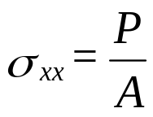
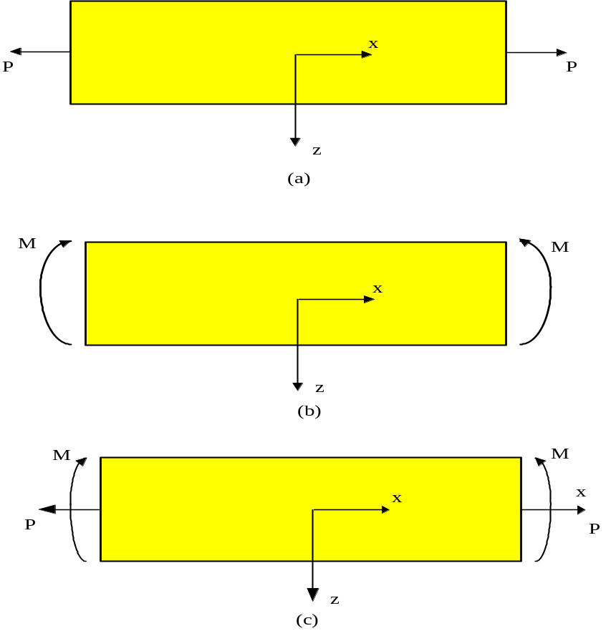
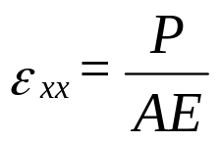
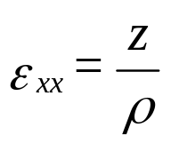
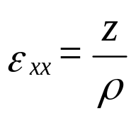
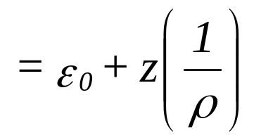

Strains in a beam
(4.1)
(due to axial load)
(due to bending load)
(due to axial and bending load)
FIGURE 4.2
A beam under (a) axial load, (b) bending moment, and (c) combined axial and bending moment.

Slide 13
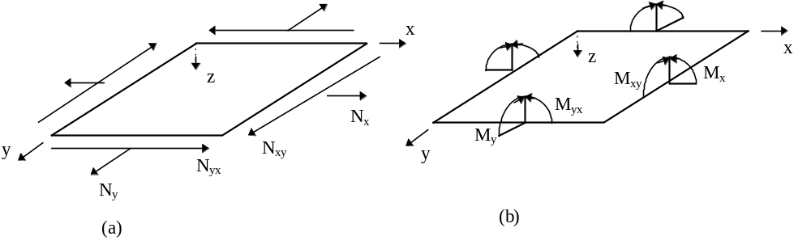
Types of loads allowed in CLT analysis
N_{x} = normal force resultant in the x direction (per unit length)
N_{y} = normal force resultant in the y direction (per unit length)
N_{xy} = shear force resultant (per unit length)
Resultant forces and moments on a laminate.

Slide 14
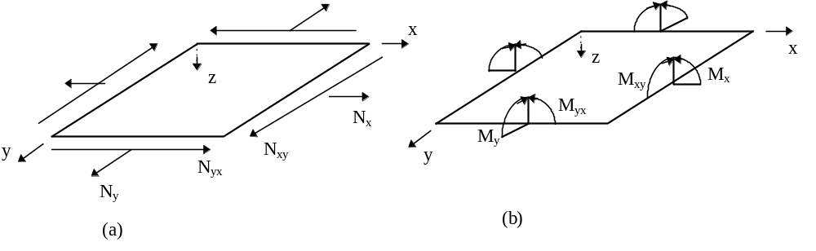
Types of loads allowed in CLT analysis
M_{x} = bending moment resultant in the yz plane (per unit length)
M_{y} = bending moment resultant in the xz plane (per unit length)
M_{xy} = twisting moment resultant (per unit length)

Slide 15
END

