Slide 1

EML 4230 Introduction to Composite Materials
Chapter 4 Macromechanical Analysis of a Laminate
Classical Lamination Theory
Dr. Autar Kaw
Department of Mechanical Engineering
University of South Florida, Tampa, FL 33620
Courtesy of the Textbook
Mechanics of Composite Materials by Kaw

Slide 2
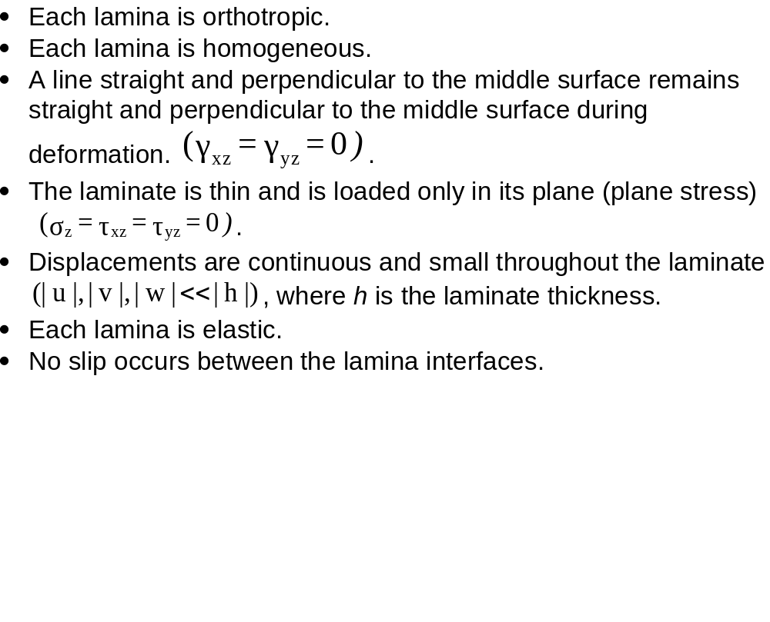
Classical Lamination Theory

Slide 3
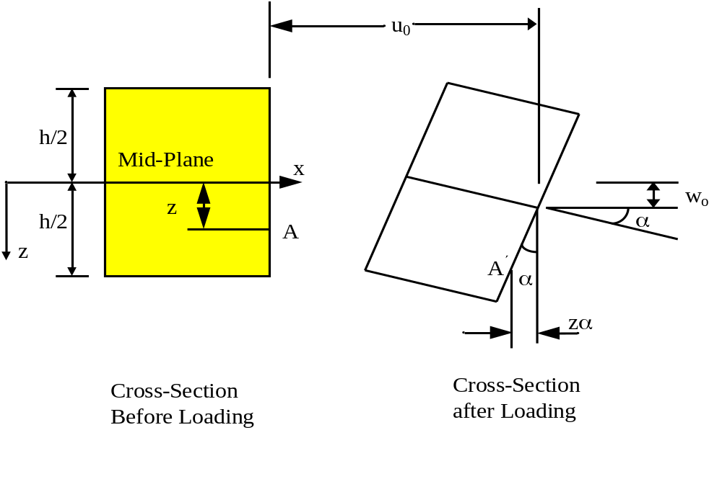
Midplane strains and curvatures
Relationship between displacements through the thickness of a plate to midplane displacements and curvatures.

Slide 4
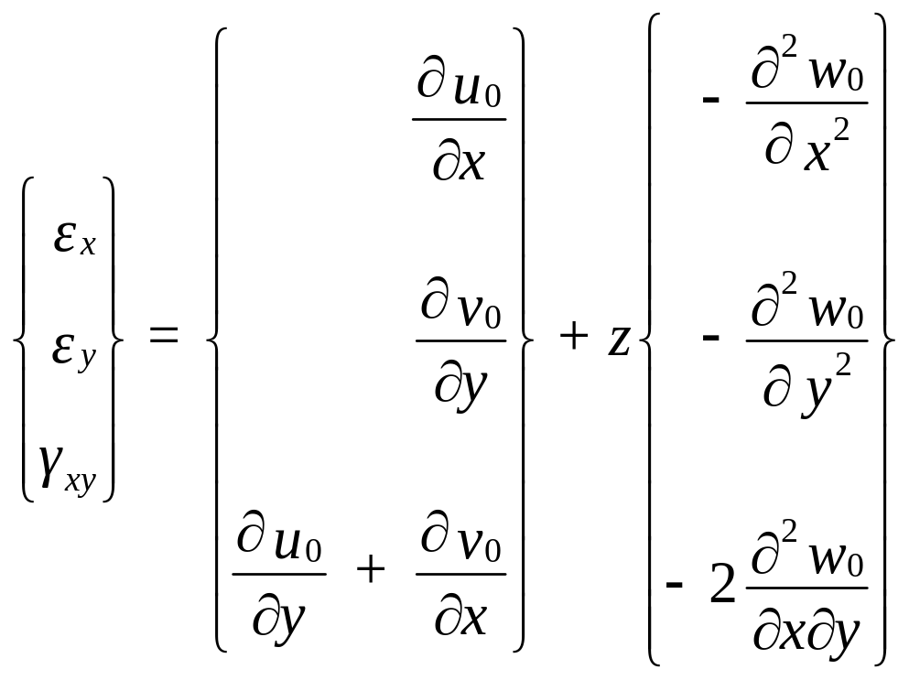
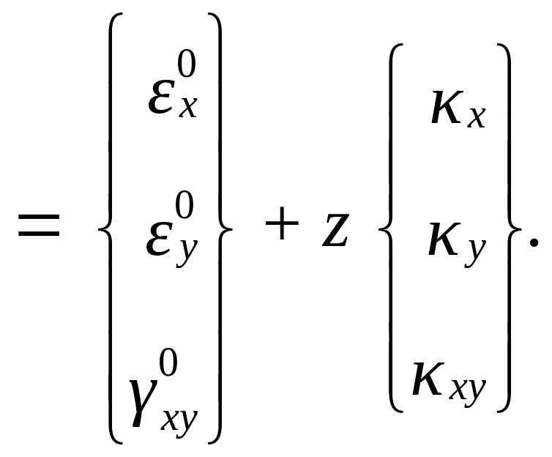
Global Strains in a Laminate

Slide 5
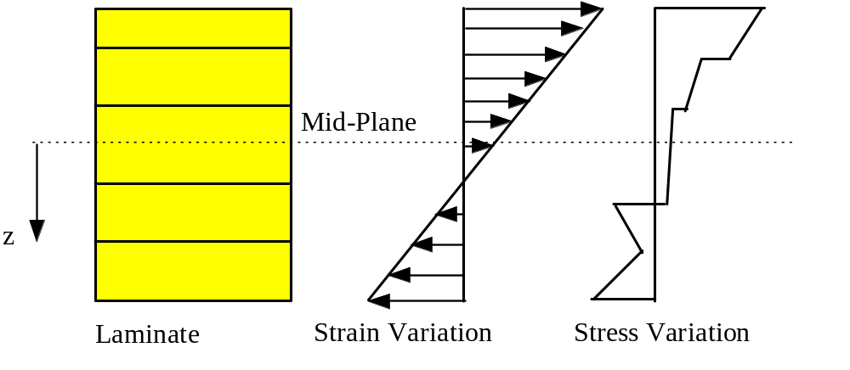
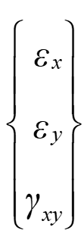

How do stresses and strains vary through the thickness
Strain and stress variation through the thickness of the laminate.

Slide 6
END

