Slide 1

EML 4230 Introduction to Composite Materials
Chapter 4 Macromechanical Analysis of a Laminate
Relating Loads to Midplane Strains/Curvatures
Dr. Autar Kaw
Department of Mechanical Engineering
University of South Florida, Tampa, FL 33620
Courtesy of the Textbook
Mechanics of Composite Materials by Kaw

Slide 2
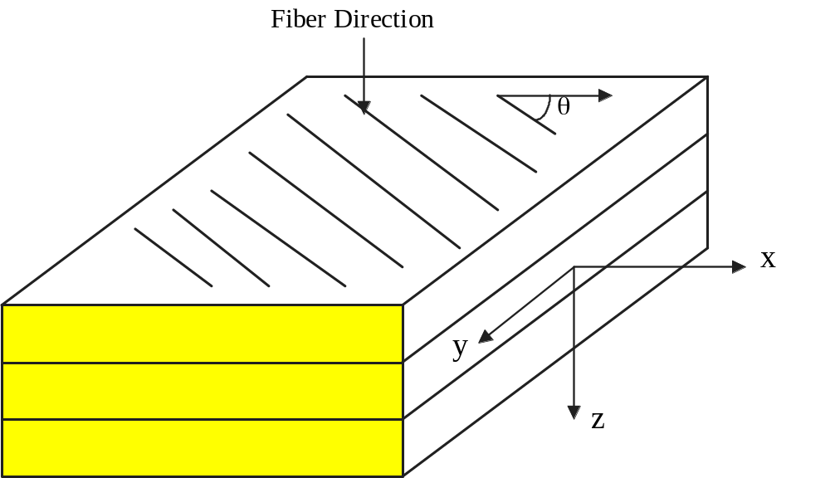
Laminate Stacking Sequence
FIGURE 4.1
Schematic of a lamina

Slide 3
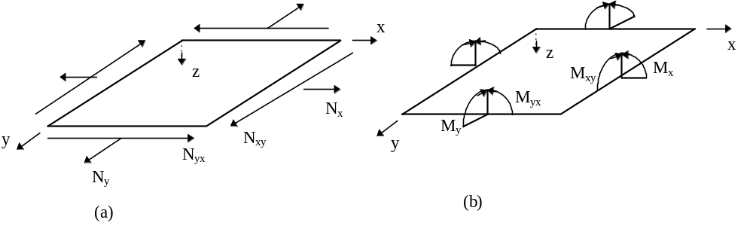
Types of loads allowed in CLT analysis
N_{x} = normal force resultant in the x direction (per unit length)
N_{y} = normal force resultant in the y direction (per unit length)
N_{xy} = shear force resultant (per unit length)
FIGURE 4.3
Resultant forces and moments on a laminate.

Slide 4
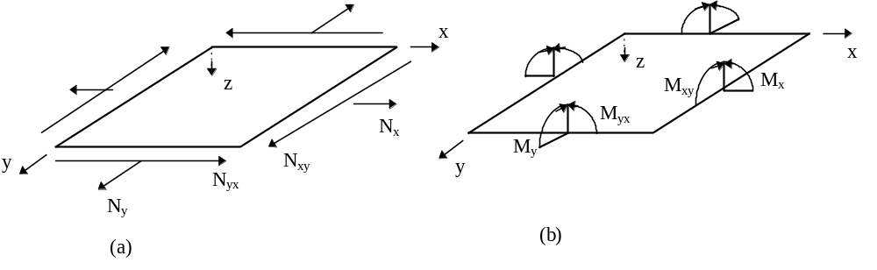
Types of loads allowed in CLT analysis
M_{x} = bending moment resultant in the yz plane (per unit length)
M_{y} = bending moment resultant in the xz plane (per unit length)
M_{xy} = twisting moment resultant (per unit length)

Slide 5
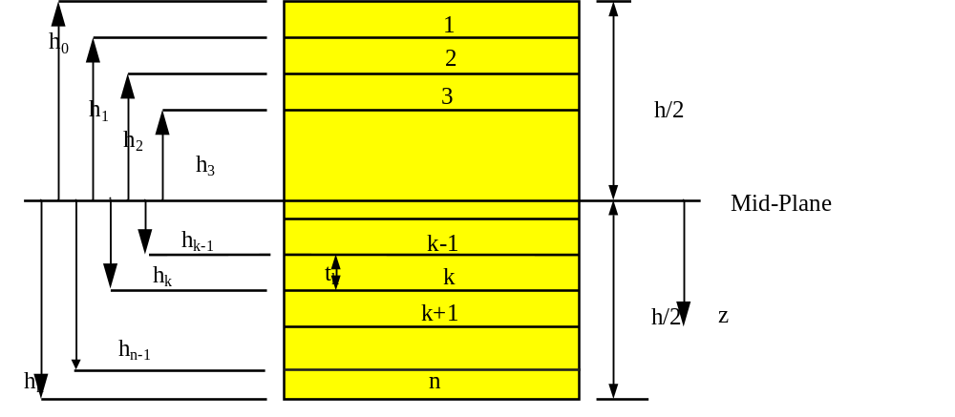
Stacking Sequence
FIGURE 4.6
Coordinate locations of plies in the laminate.

Slide 6
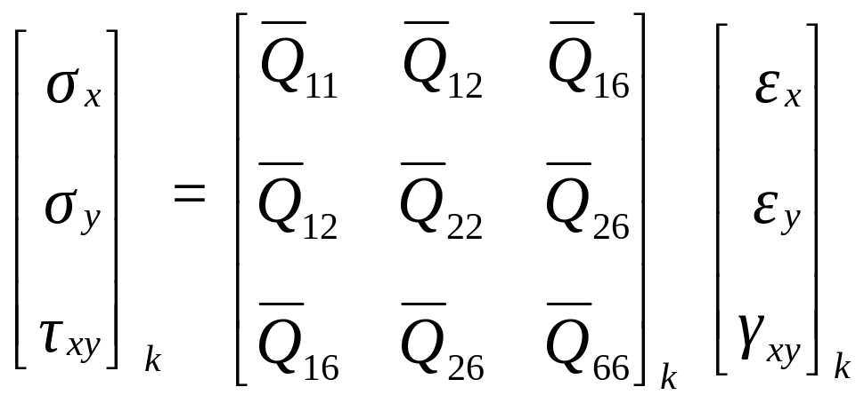
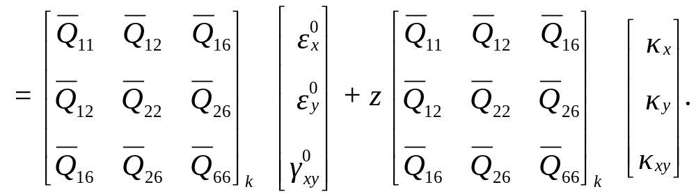
Stresses in a Lamina in a Laminate

Slide 7
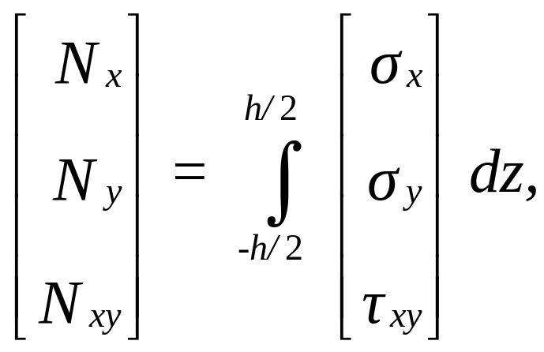
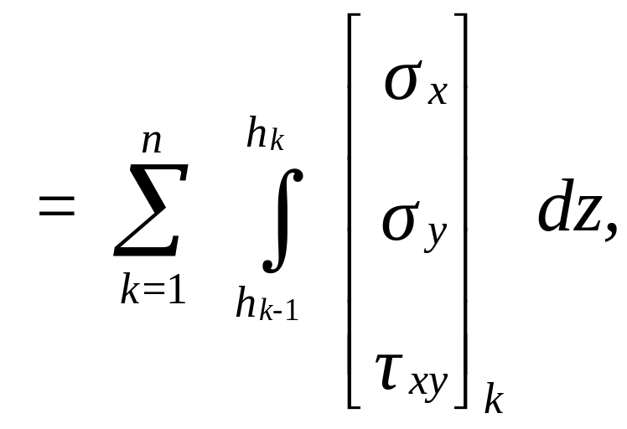
Forces and Stresses

Slide 8
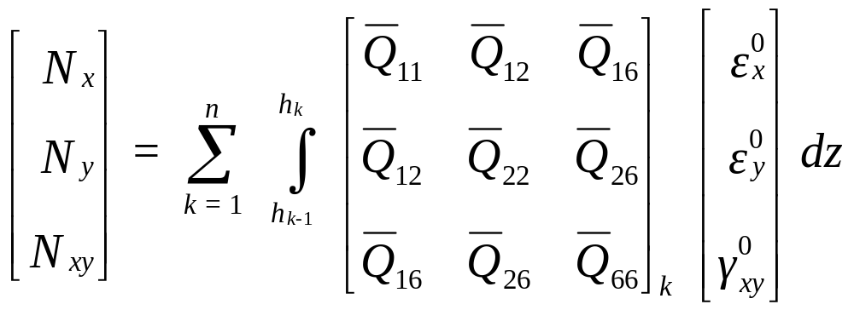
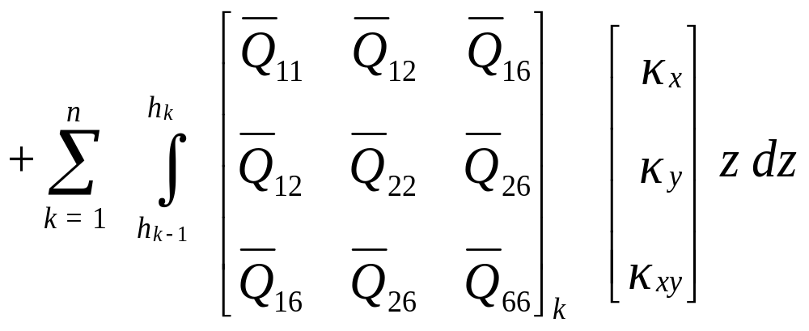
Forces & Midplane Strains/Curvatures

Slide 9
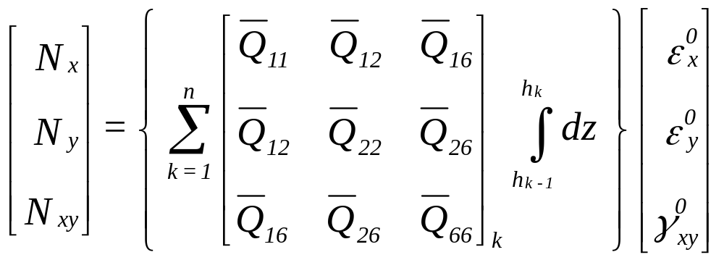
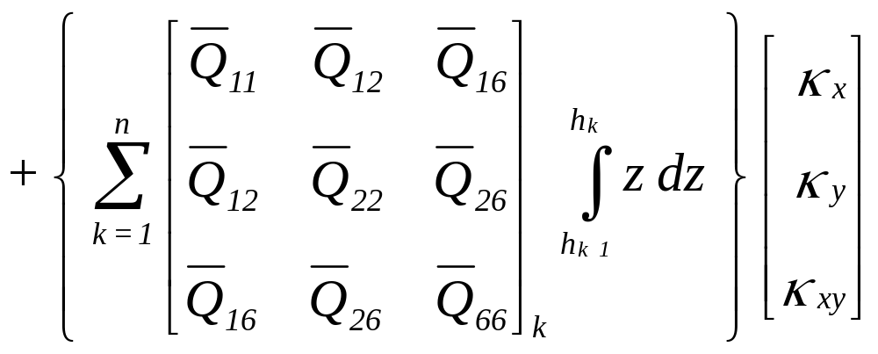
Forces & Midplane Strains/Curvatures

Slide 10
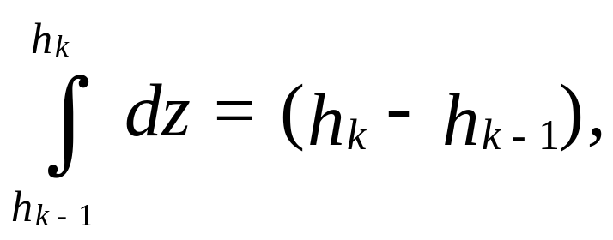
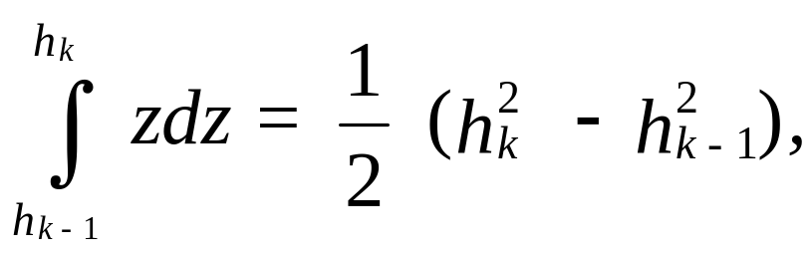
Integrating terms

Slide 11
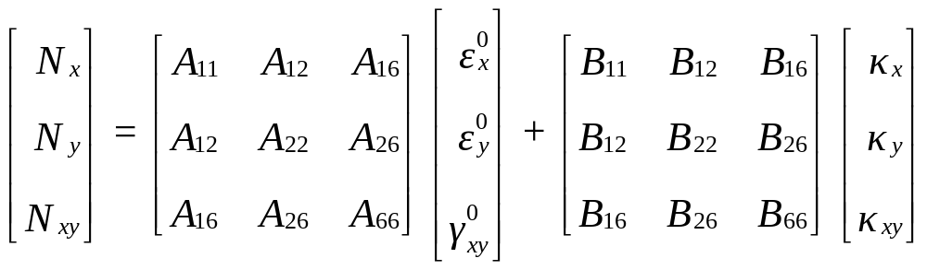
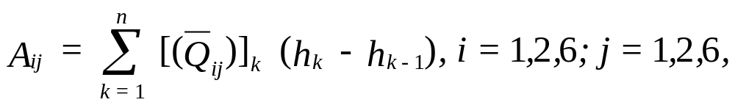
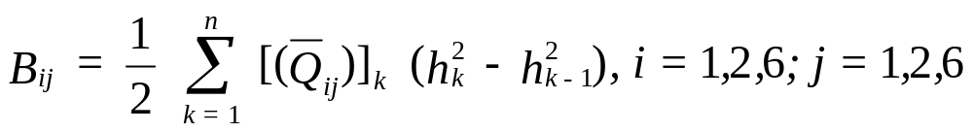
Forces & Midplane Strains/Curvatures

Slide 12
Stiffness Matrices
[A] – Extensional stiffness matrix relating the resultant in-plane forces to the in-plane strains.
[B] – Coupling stiffness matrix coupling the force and moment terms to the midplane strains and midplane curvatures.

Slide 13
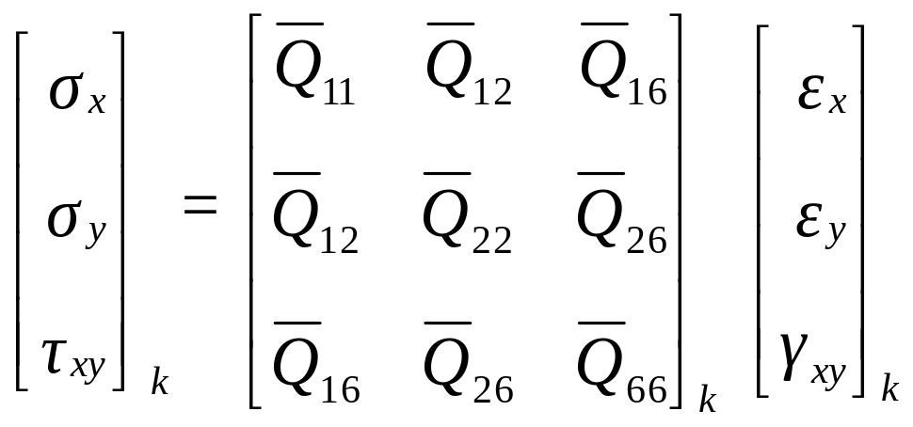

Stresses in a Lamina in a Laminate

Slide 14
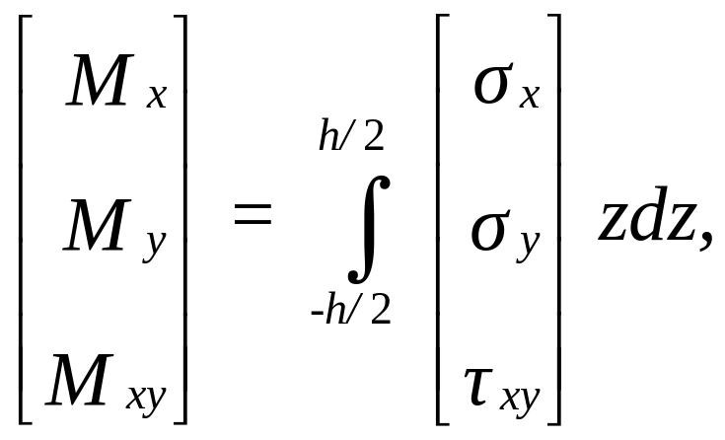
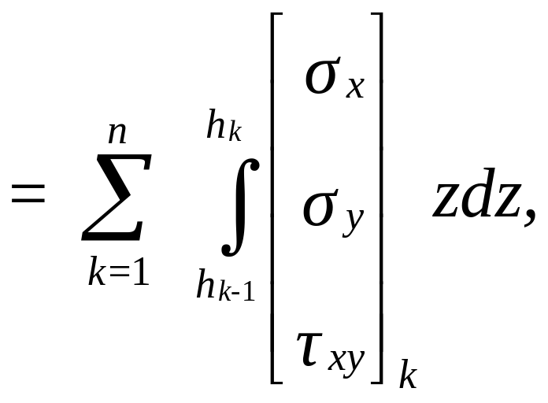
Moments and Stresses

Slide 15
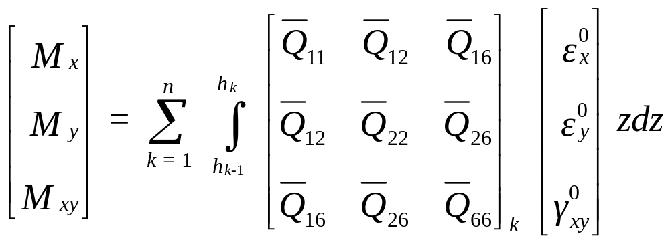
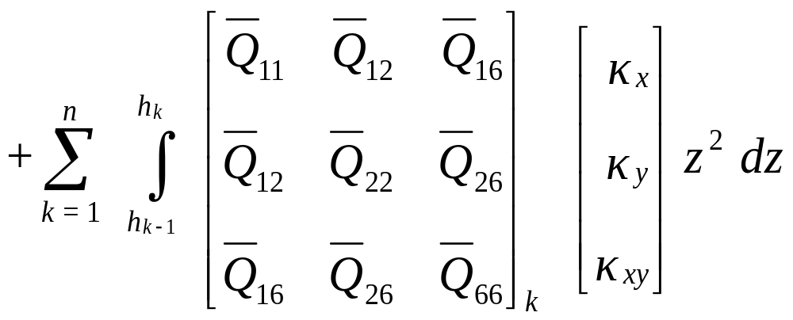
Moments & Midplane Strains/Curvatures

Slide 16

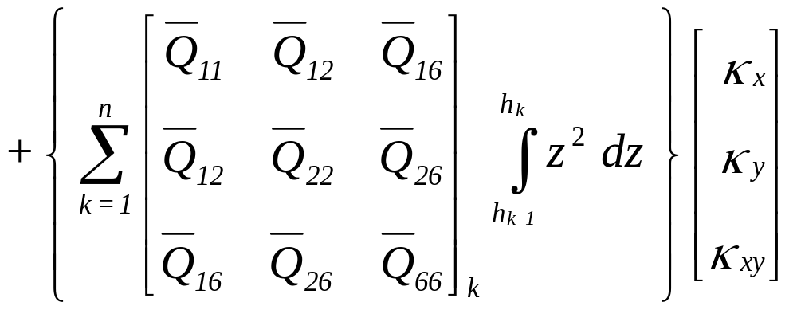
Moments & Midplane Strains/Curvatures

Slide 17
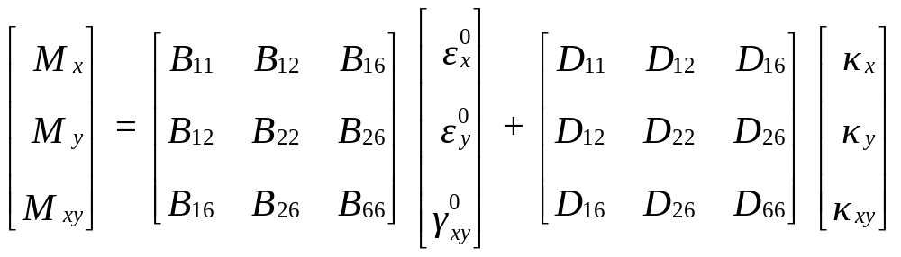
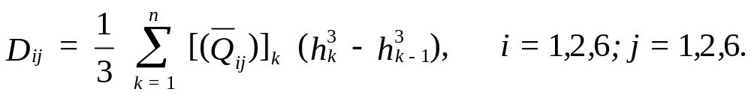
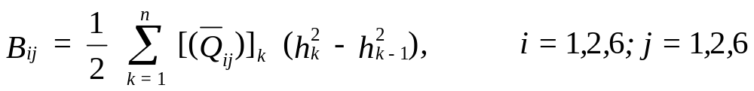
Moments & Midplane Strains/Curvatures

Slide 18
Stiffness Matrices
[A] – Extensional stiffness matrix relating the resultant in-plane forces to the in-plane strains.
[B] – Coupling stiffness matrix coupling the force and moment terms to the midplane strains and midplane curvatures.
[D] – Bending stiffness matrix relating the resultant bending moments to the plate curvatures.

Slide 19
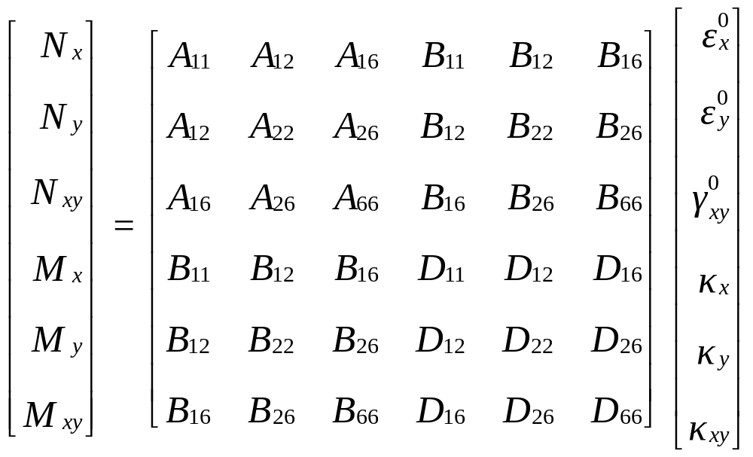
Forces, Moments, Midplane Strains, Midplane Curvatures

Slide 20
END

