Slide 1

EML 4230 Introduction to Composite Materials
Chapter 4 Macromechanical Analysis of a Laminate
Laminate Analysis Steps
Dr. Autar Kaw
Department of Mechanical Engineering
University of South Florida, Tampa, FL 33620
Courtesy of the Textbook
Mechanics of Composite Materials by Kaw

Slide 2
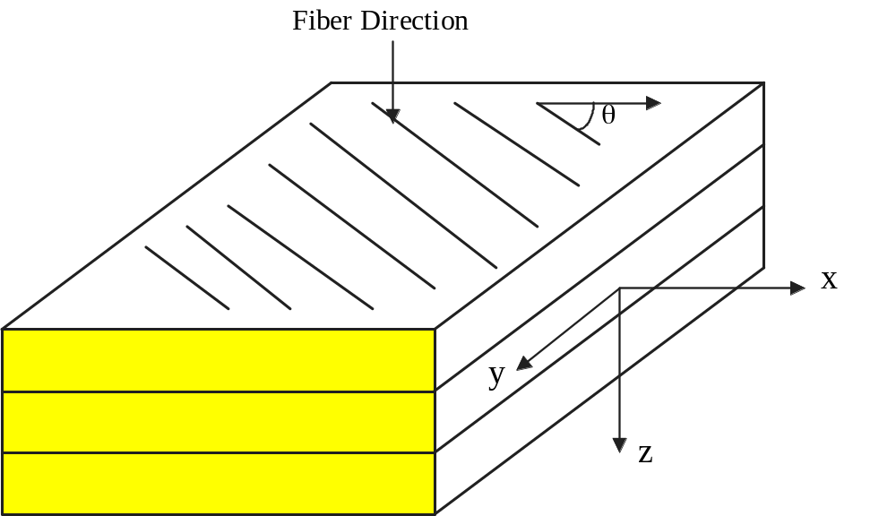
Laminate Stacking Sequence
FIGURE 4.1
Schematic of a lamina

Slide 3
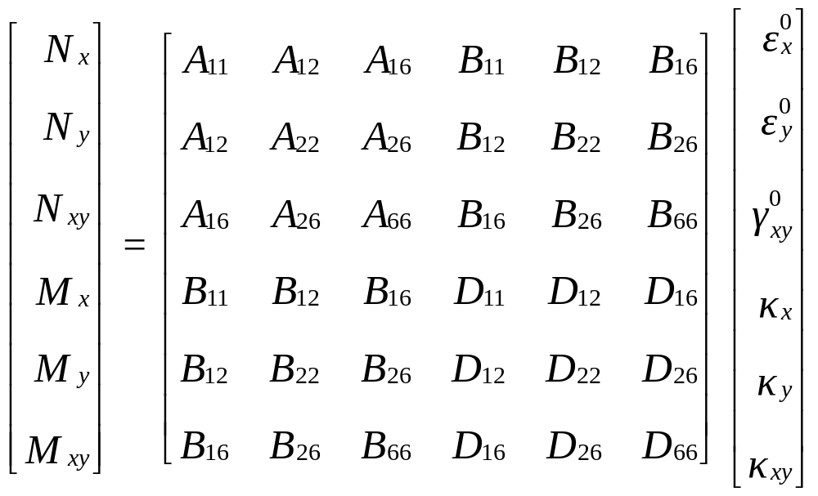
Forces, Moments, Strains, Curvatures

Slide 4
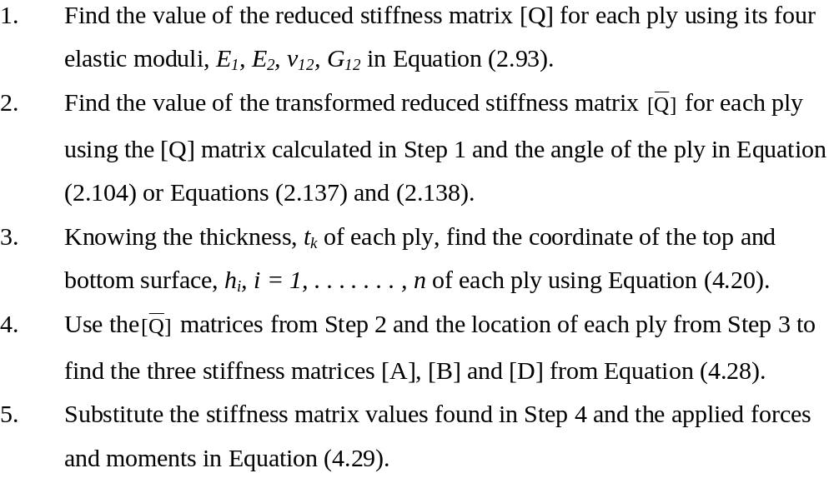
Steps

Slide 5
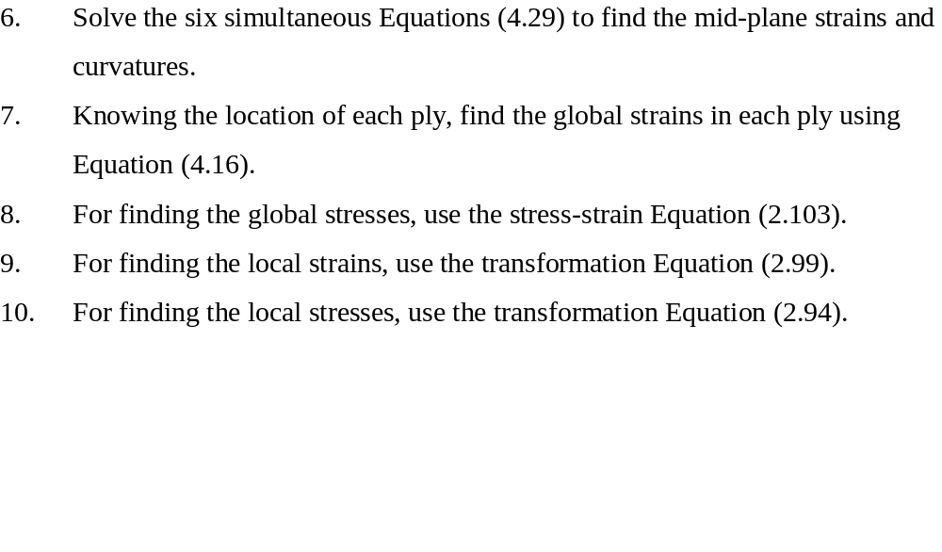
Steps

Slide 6
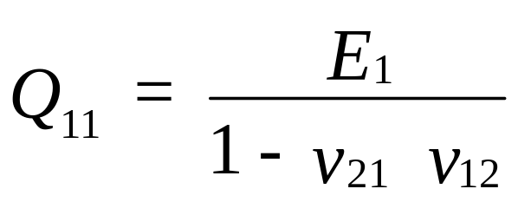
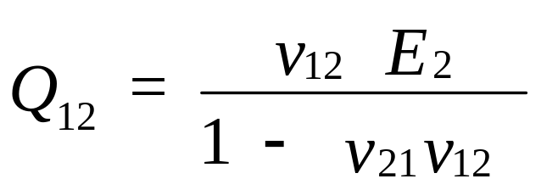
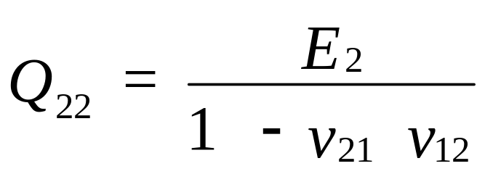
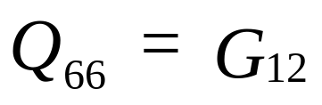
Step 1: Find reduced stiffness matrix for each ply
Step 1: Find the reduced stiffness matrix [Q] for each ply

Slide 7



Step 2: Find transformed reduced stiffness for each ply
Step 2: Find the transformed stiffness matrix [Q] using the reduced stiffness matrix [Q] and the angle of the ply.

Slide 8
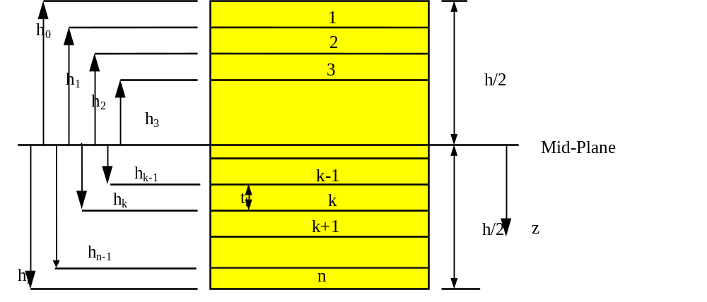
Step 3: Find co-ordinates of top and bottom surface of each ply
Step 3: Find the coordinate of the top and bottom surface of each ply.
FIGURE 4.6
Coordinate locations of plies in the laminate.

Slide 9
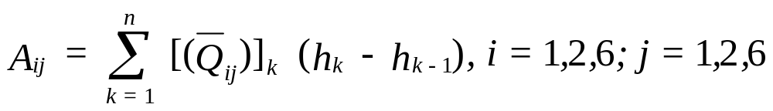
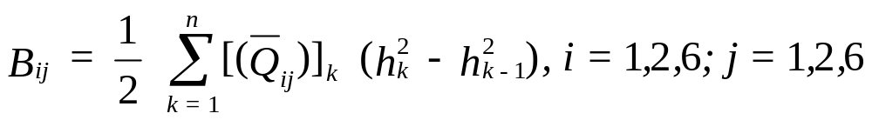
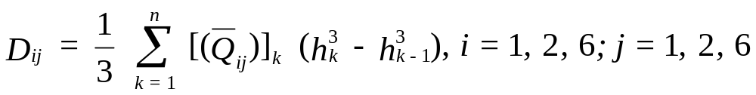
Step 4: Find the three stiffness matrices
Step 4: Find three stiffness matrices [A], [B], and [D]

Slide 10
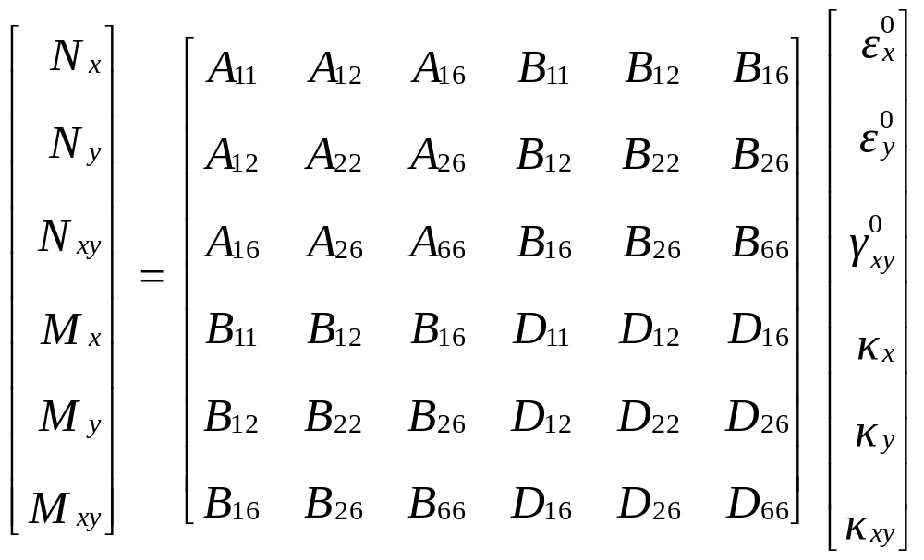
Step 5: Set up the six equations – six unknowns
Step 5: Substitute the three stiffness matrices [A], [B], and [D] and the applied forces and moments.

Slide 11
Step 6: Solve the equations for midplane strains and curvatures
Step 6: Solve the six simultaneous equations to find the midplane strains and curvatures.

Slide 12
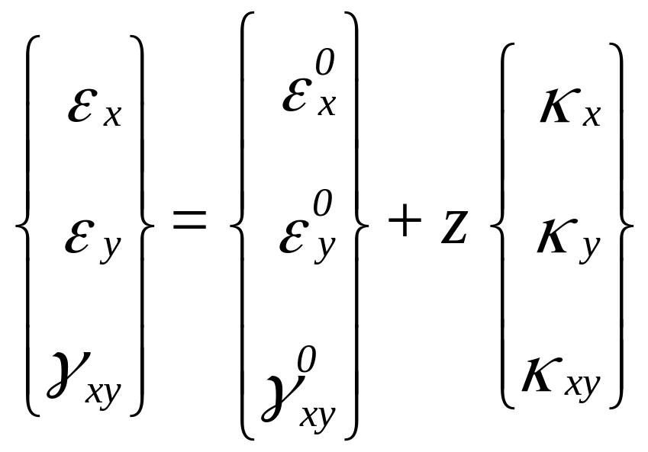
Step 7: Find the global strains
Step 7: Find the global strains in each ply.

Slide 13
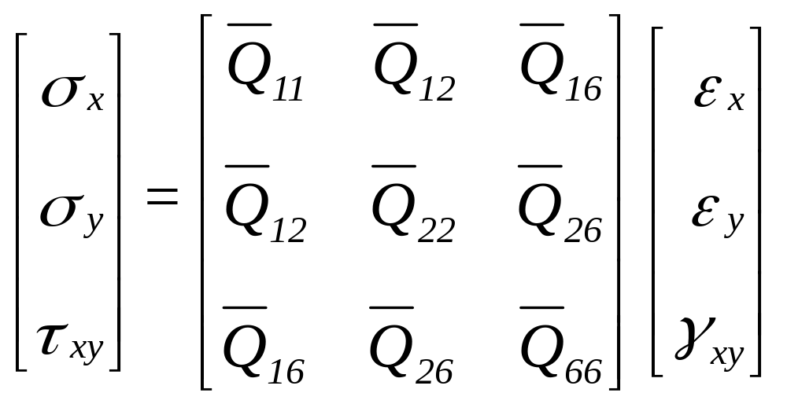
Step 8: Find the global stresses
Step 8: Find the global stresses using the stress-strain equation.

Slide 14
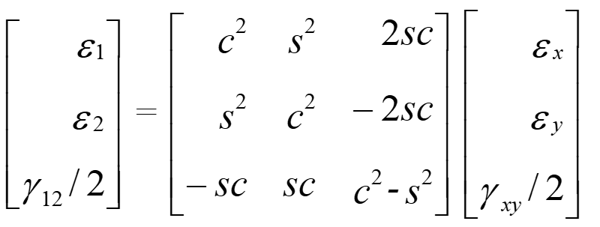
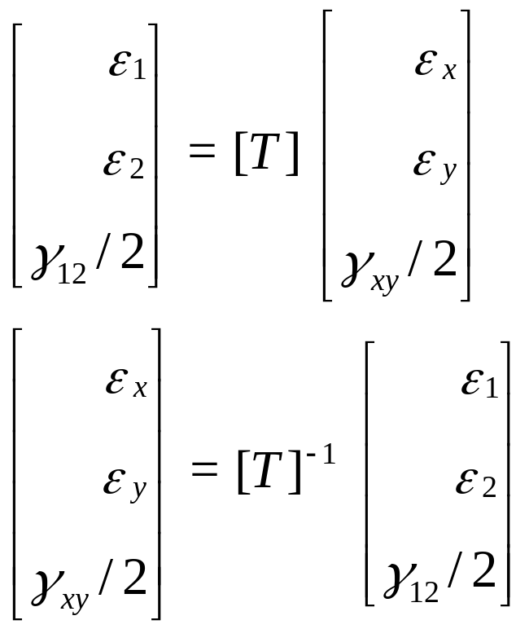
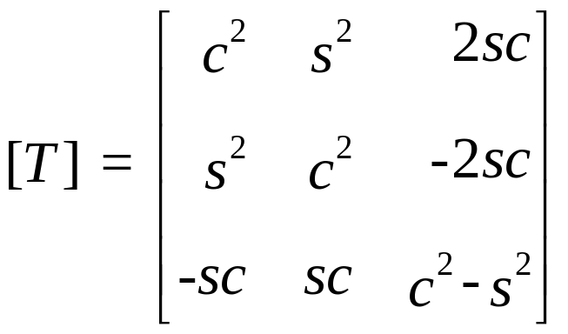


Step 9: Find the local strains
Step 9: Find the local strains using the transformation equation.

Slide 15
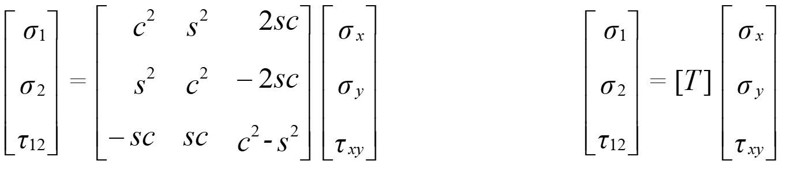
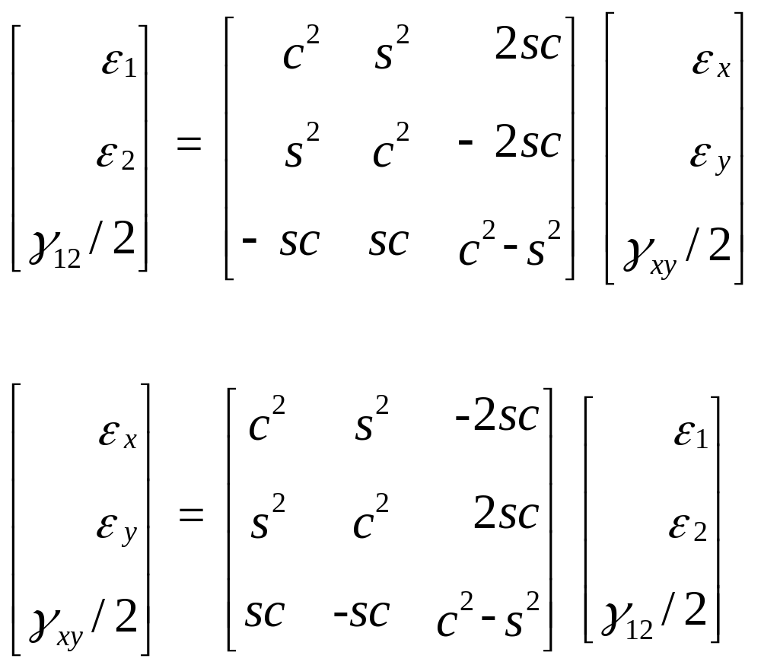



Step 10: Find the local stresses
Step 10: Find the local stresses using the transformation equation.
$$[T]$$

Slide 16
END

