Slide 1

EML 4230 Introduction to Composite Materials
Chapter 4 Macromechanical Analysis of a Laminate
Laminate Modulus: Example
Dr. Autar Kaw
Department of Mechanical Engineering
University of South Florida, Tampa, FL 33620
Courtesy of the Textbook
Mechanics of Composite Materials by Kaw

Slide 2
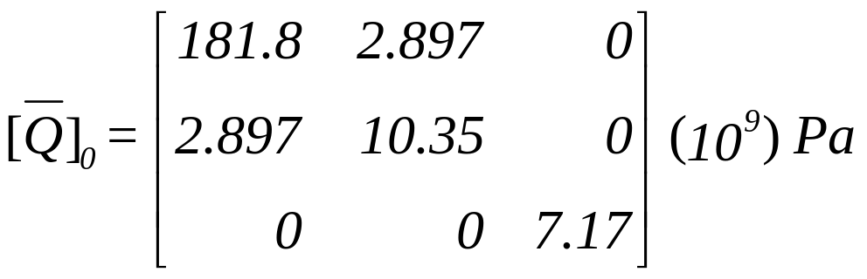
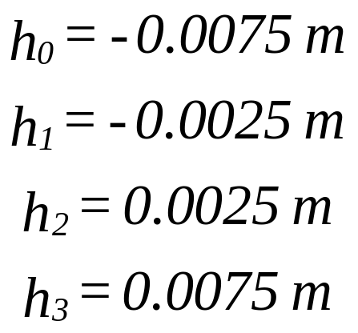
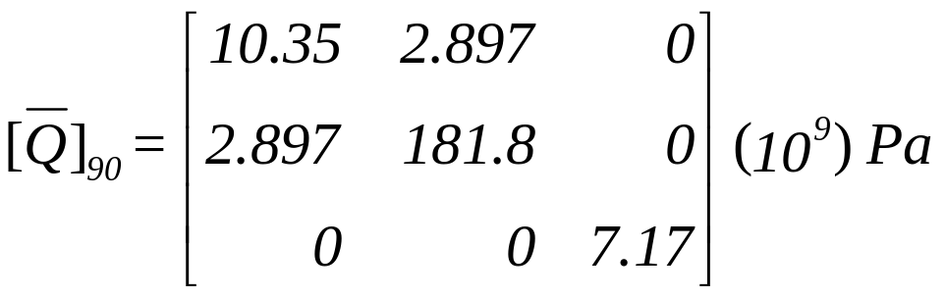

Q bars and co-ordinates
Find the in-plane and flexural stiffness constants for a three-ply [$0∕\overline{90}∕0]$ graphite/epoxy laminate. Use the unidirectional properties of graphite/epoxy from Table 2.1. Each lamina is 5 mm thick.

Slide 3
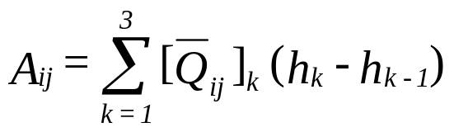
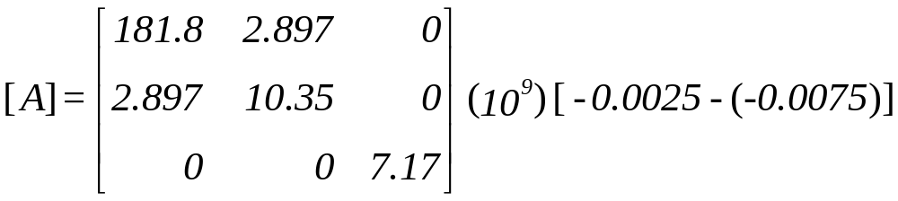
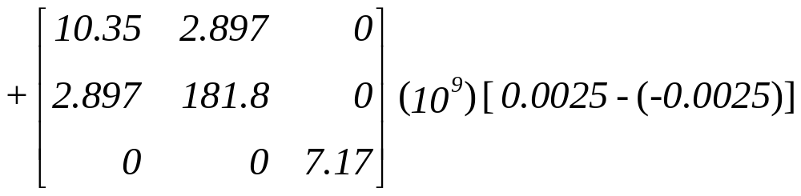
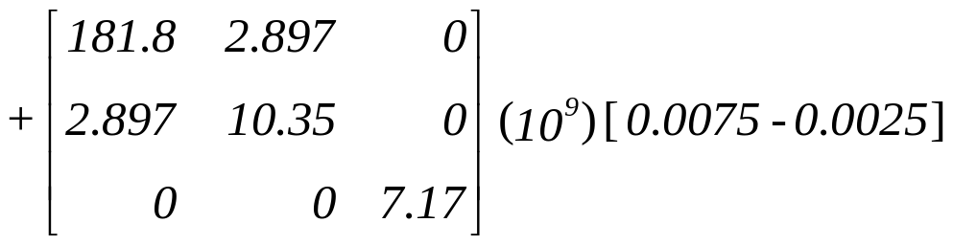
The extensional stiffness matrix, A

Slide 4
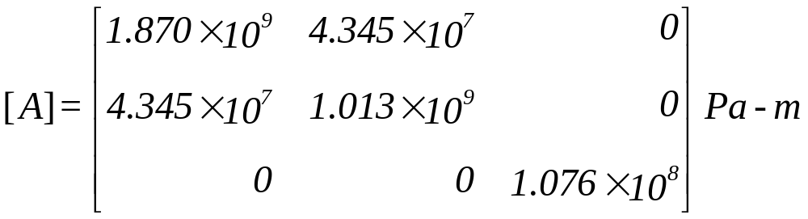
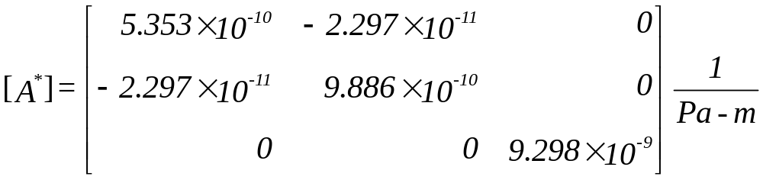
The extensional compliance matrix, A*

Slide 5
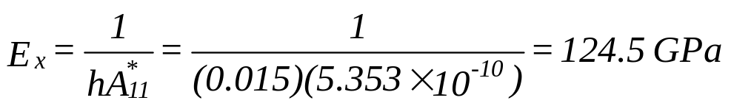
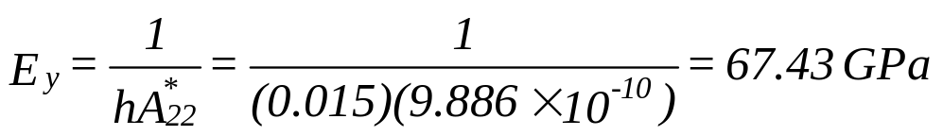
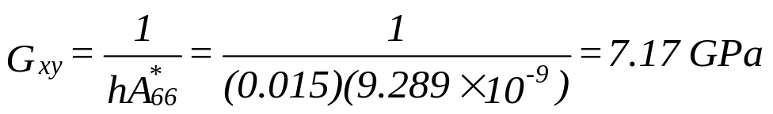

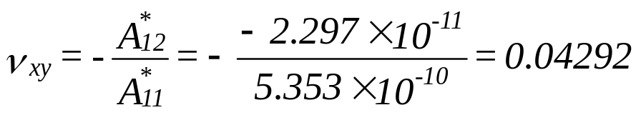
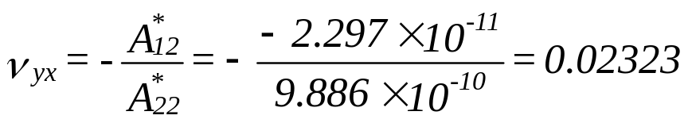
In-plane Elastic moduli

Slide 6
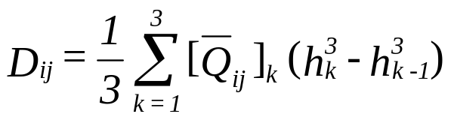
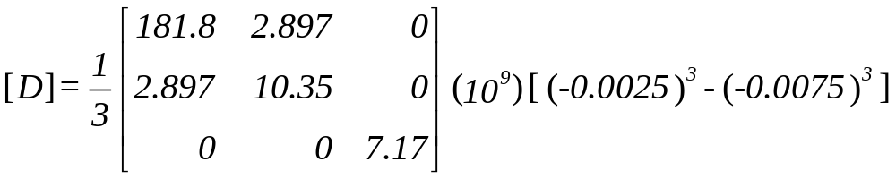
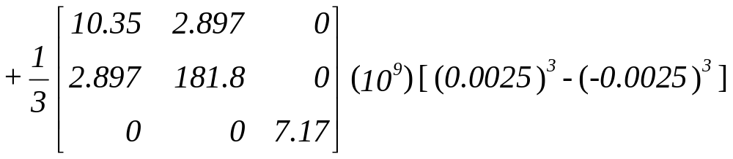

Bending stiffness matrix, D

Slide 7
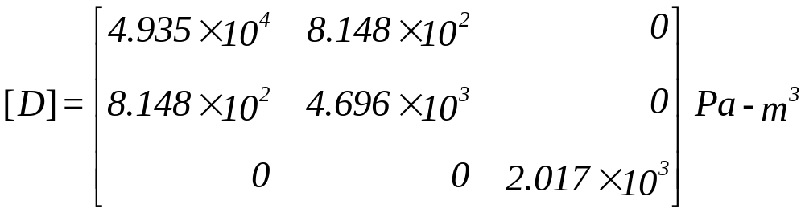
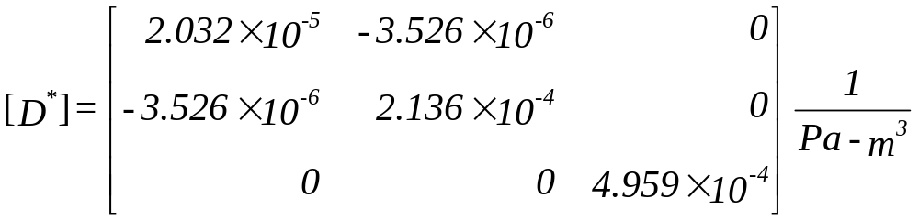
Bending compliance Matrix, D*

Slide 8
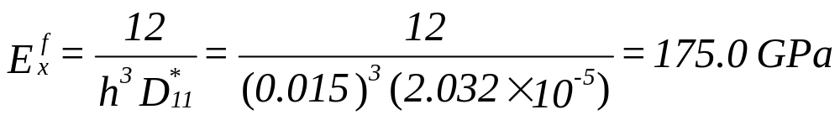
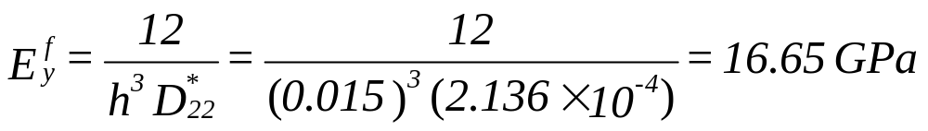

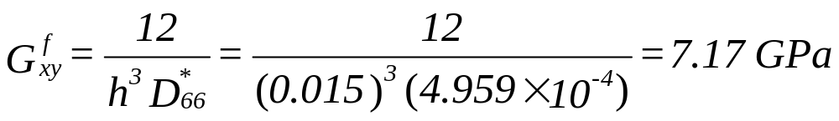
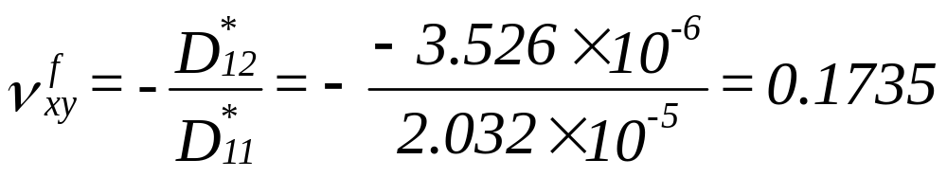
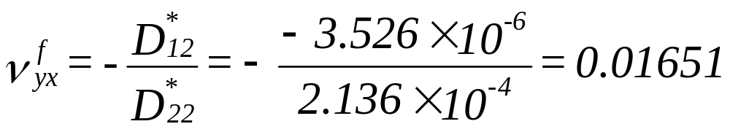
Flexural Laminate Moduli

Slide 9
END

