Slide 1

EML 4230 Introduction to Composite Materials
Chapter 4 Macromechanical Analysis of a Laminate
Hygrothermal Loads
Dr. Autar Kaw
Department of Mechanical Engineering
University of South Florida, Tampa, FL 33620
Courtesy of the Textbook
Mechanics of Composite Materials by Kaw

Slide 2
Mechanical Strains

Slide 3
Hygrothermal Stresses

Slide 4
Zero resultant stresses

Slide 5
Zero resultant stresses

Slide 6
Deriving final formula

Slide 7
Deriving final formula

Slide 8
Deriving final formula

Slide 9
Deriving final formula

Slide 10
Other three equations – from zero resultant moments

Slide 11
Final formula

Slide 12
Final formula

Slide 13
Example 4.5
Calculate the residual stresses at the bottom surface of the 90º ply in a two ply [0/90] Graphite/Epoxy laminate subjected to a temperature change of -75ºC. Use the unidirectional properties of Graphite/Epoxy lamina from Table 2.1. Each lamina is 5 mm thick.

Slide 14
Example 4.5

Slide 15
Example 4.5

Slide 16
Example 4.5

Slide 17
Example 4.5

Slide 18
Example 4.5

Slide 19
Example 4.5

Slide 20
Example 4.5

Slide 21
Example 4.5

Slide 22
Example 4.5

Slide 23
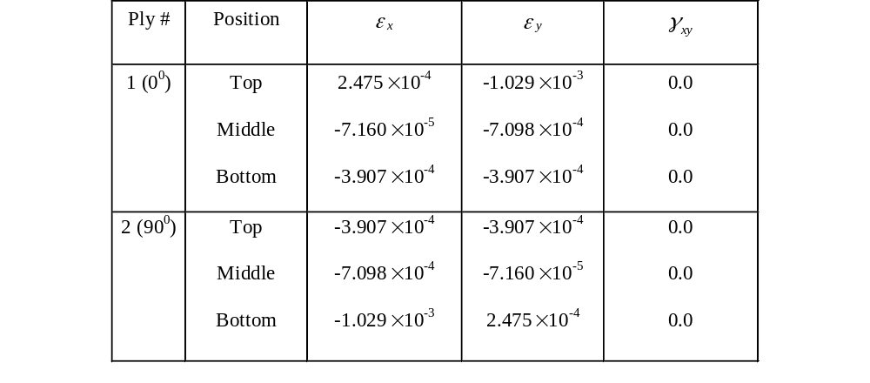
Example 4.5
Global Strains for Example 4.3

Slide 24
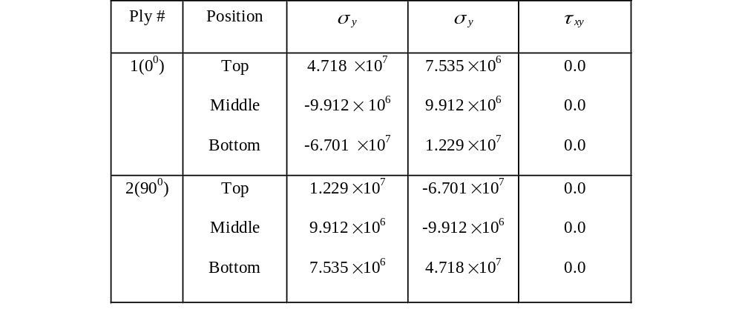
Example 4.5
Global Stresses for Example 4.3

Slide 25
Coefficients of Thermal and Moisture Expansion
To find coefficients of thermal and moisture expansion of laminates
Symmetric laminates [B] = 0
No bending occurs under thermal hygrothermal loads
Assuming ∆T = 1 and ∆C = 0

Slide 26
Coefficients of Thermal and Moisture Expansion
To find coefficients of thermal and moisture expansion of laminates
Symmetric laminates [B] = 0
No bending occurs under thermal hygrothermal loads
Assuming ∆T = 0 and ∆C = 1

Slide 27
Example 4.6

Slide 28
Example 4.6

Slide 29
Example 4.6
∆T = 1°C

Slide 30
Example 4.6

Slide 31
Example 4.6
∆C = 1 kg/kg

Slide 32
Example 4.6

Slide 33
END

