Slide 1

EML 4230 Introduction to Composite Materials
Chapter 5 Design and Analysis of Laminates
Some Examples of Design
Dr. Autar Kaw
Department of Mechanical Engineering
University of South Florida, Tampa, FL 33620
Courtesy of the Textbook
Mechanics of Composite Materials by Kaw

Slide 2
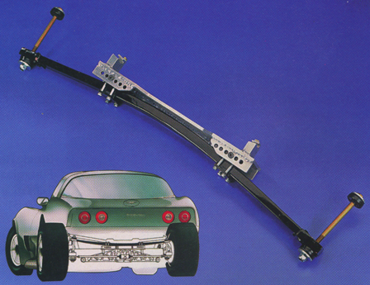
Corvette Leaf Springs

Slide 3

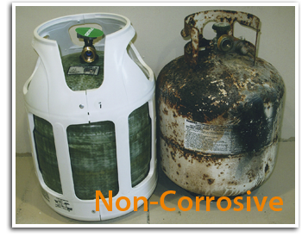
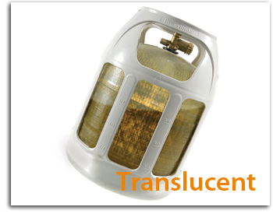
Propane Tanks
Source: Lite Cylinder: http://www.litecylinder.com

Slide 4
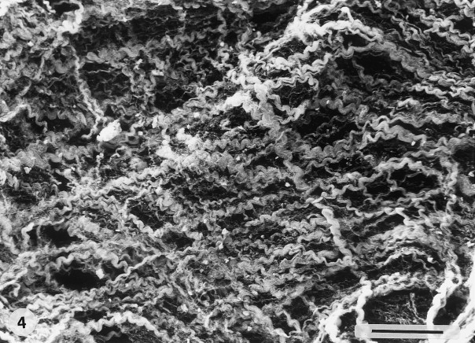
Collagen Fibers in Intestines

Slide 5
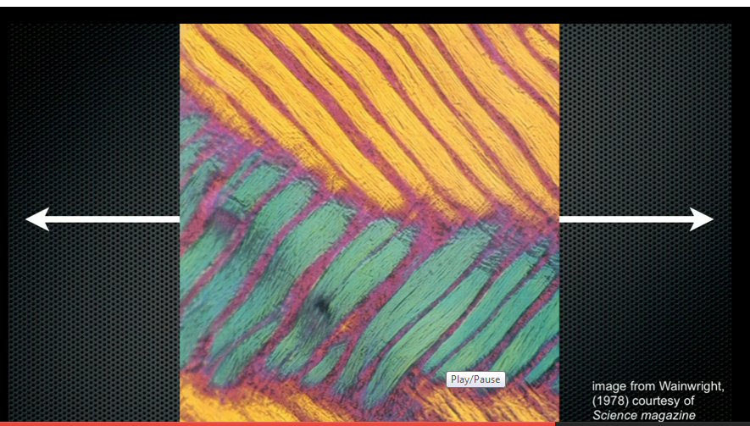
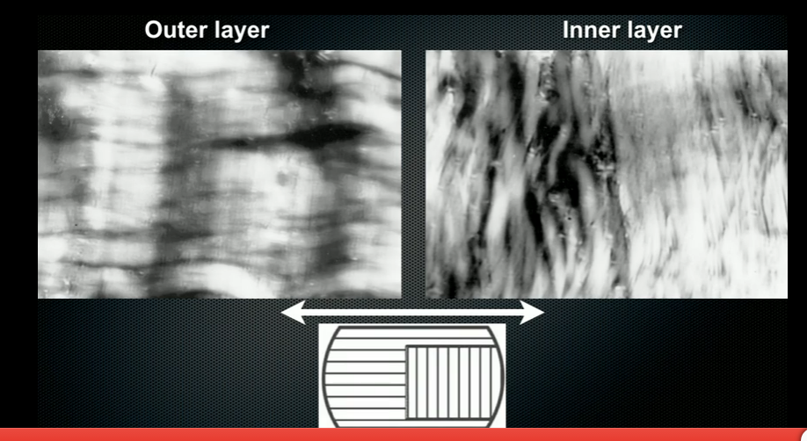
Hydrostatic skeletons

Slide 6
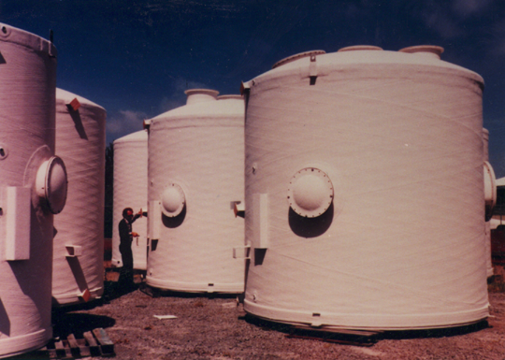
Storage Tanks

Slide 7
END

