Slide 1

EML 4230 Introduction to Composite Materials
Chapter 5 Design and Analysis of a Laminate
Ply by Ply Failure
Dr. Autar Kaw
Department of Mechanical Engineering
University of South Florida, Tampa, FL 33620
Courtesy of the Textbook
Mechanics of Composite Materials by Kaw

Slide 2
Ply by Ply Failure of a Laminate
FIGURE 4.1
Schematic of a lamina
If a ply fails, has the whole laminate failed? Maybe. When the first ply fails, you may get catastrophic failure or you may be able to still apply for more load.

Slide 3
Problem Statement
The only load applied is a tensile normal load in the x-direction, that is, the direction parallel to the fibers in the 0º ply. Find the ply-by-ply failure load for a [0/90/0] Graphite/Epoxy laminate. Assume the thickness of each ply is 5 mm and use properties of unidirectional Graphite/Epoxy lamina from Table 2.1.

Slide 4
Solution
Assume we apply N_{x}=1 N/m
Mid-plane strains (midplane curvature are zero)

Slide 5
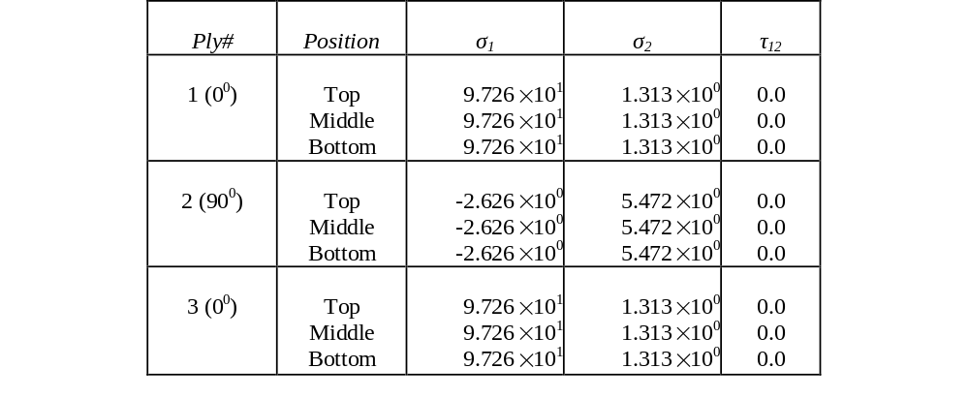
Local Stresses

Slide 6
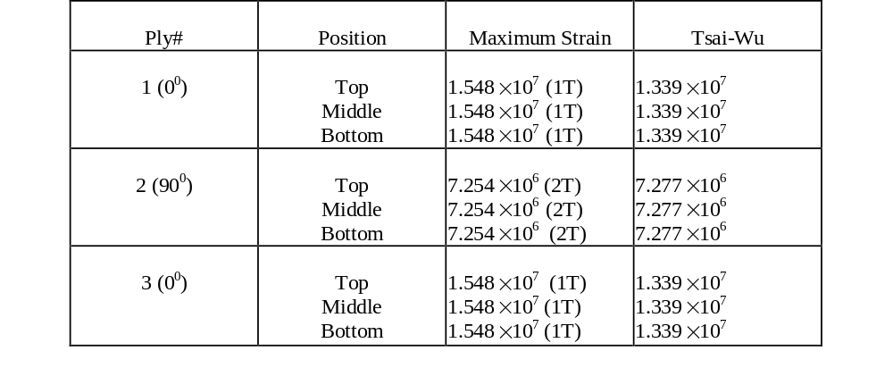
Strength Ratios

Slide 7
What is the N_{x} that can be applied?
N_{x}=(1 N/m)x(7.277x10⁶) =7.277x10⁶ N/m
N_{x}/h = 7.277x10⁶/0.015 = 485.1 MPa
εº_{x} = (5.353x10⁻¹⁰)x(7.277x10⁶) = 0.003895

Slide 8
Will the laminate take more load?

Slide 9
Degrade Ply#2
Q for the undamaged plies
Q for the damaged plies

Slide 10
Solution
Assume we apply N_{x}=1 N/m
Mid-plane strains (midplane curvatures are zero)

Slide 11
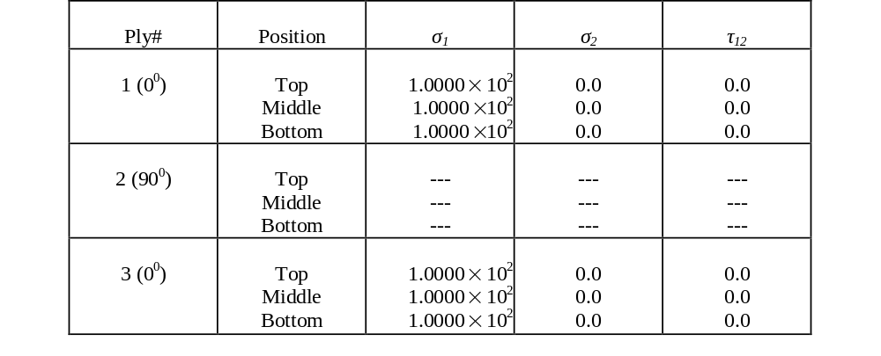
Local Stresses

Slide 12
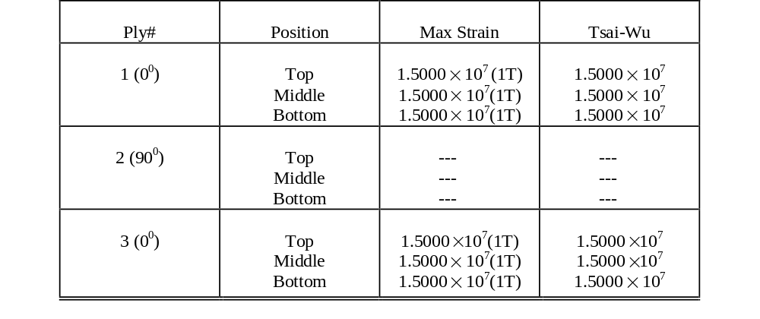
Strength Ratios

Slide 13
What is the N_{x} that can be applied?
N_{x}=(1 N/m)x(1.5x10⁷) =1.5x10⁷ N/m
N_{x}/h = 1.5x10⁷/0.015 = 1000 MPa
εº_{x} = (5.525x10⁻¹⁰)x(1.5x10⁷) =0.008288

Slide 14
Stress-Strain Plot
117 GPa
124 GPa
FIGURE 5.1
Stress-strain curve showing ply-by-ply failure of a laminated composite

Slide 15
END

