Slide 1

EML 4230 Introduction to Composite Materials
Chapter 5 Design and Analysis of a Laminate
The Drive Shaft Problem
Dr. Autar Kaw
Department of Mechanical Engineering
University of South Florida, Tampa, FL 33620
Courtesy of the Textbook
Mechanics of Composite Materials by Kaw

Slide 2
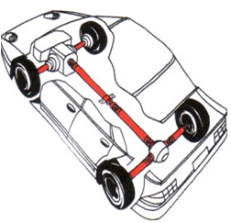
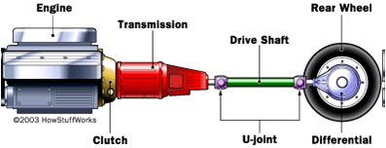
Problem Statement
A drive shaft for a Chevy Pickup truck is made of steel. Check whether replacing it with a drive shaft made of composite materials will save weight?

Slide 3
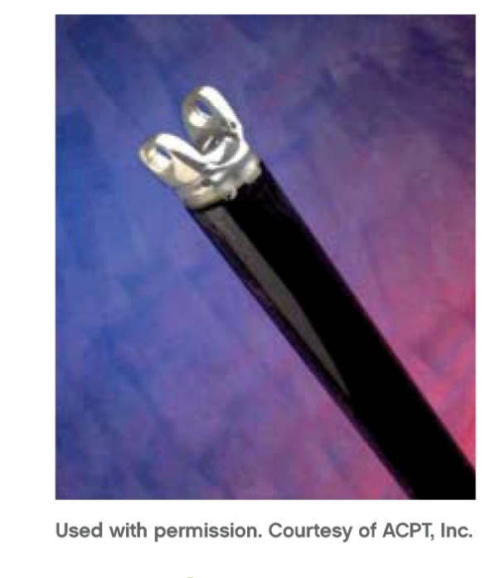
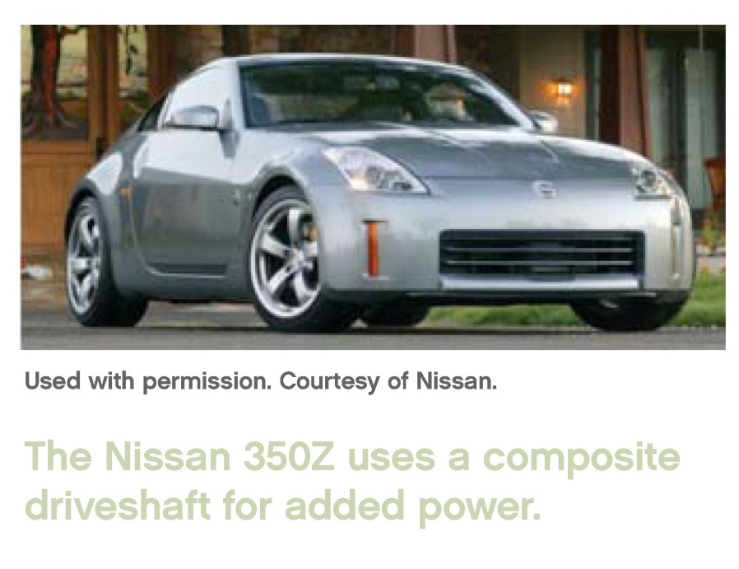
Design of a Composite Drive Shaft

Slide 4
Why composite materials?
Light weight ___ reduces energy consumption; increases amount of power transmitted to the wheels. About 17-22% of engine power is lost to rotating the mass of the drive train.
Fatigue resistant ___ durable life.
Non-corrosive ___ reduced maintenance cost and increased life.
Single piece ___ reduces manufacturing cost.

Slide 5
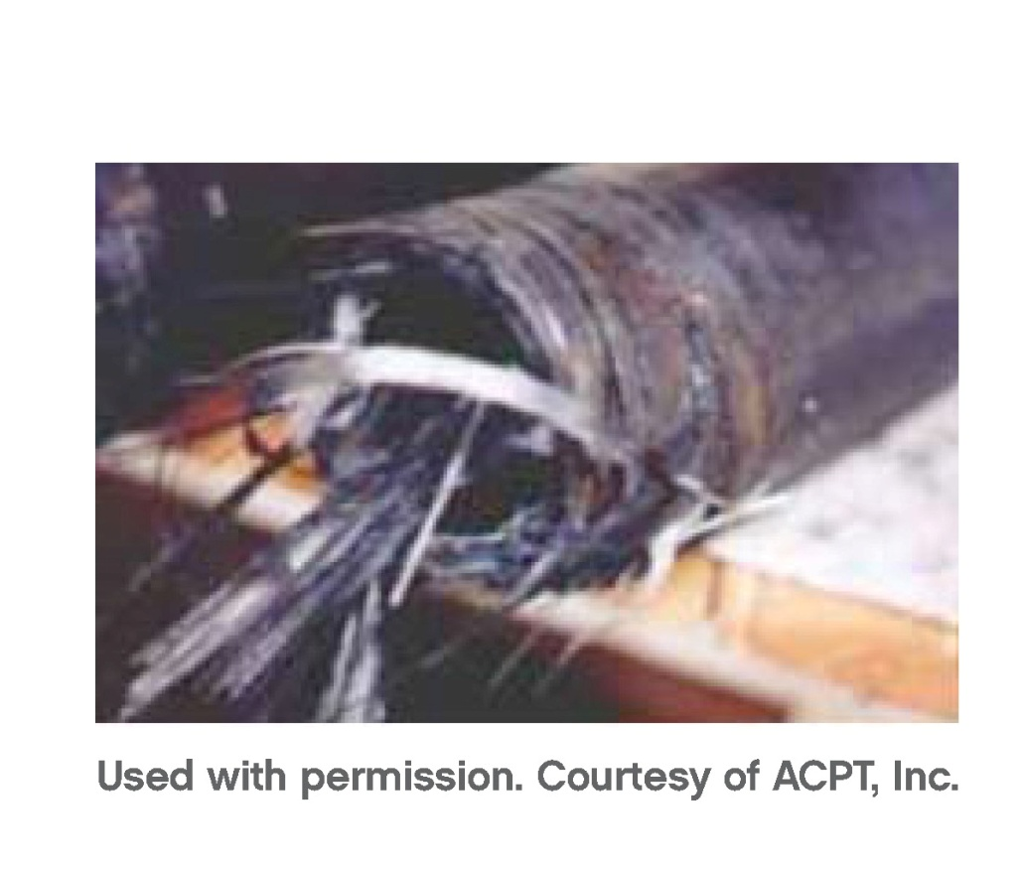
Why composite materials?
Prevent injuries – the composite drive shaft “broom” on failure

Slide 6
Problem Description
Design Constraints
1. Maximum horsepower= 175 HP @4200 rpm
2. Maximum torque = 265 lb-ft @2800 rpm
3. Factor of safety = 3
3. Outside radius = 1.75 in
4. Length = 43.5 in

Slide 7
Torque in Drive Shaft
In first gear
- the speed is 2800 rpm (46.67 rev/s)
- assume ground speed of 23 mph (405 in/sec)
Diameter of tire = 27 in
Revolutions of tire =405/[π(27)] = 4.78 rev/s
Differential ratio = 3.42
Drive shaft speed = 4.78 x 3.42 = 16.35 rev/s
Torque in drive shaft = (265x46.7)/16.35 = 755 lb-ft

Slide 8
Maximum Frequency of Shaft
Maximum Speed = 100 mph (1760 in/sec)
Diameter of tire = 27 in
Revolutions of tire =1760/[π(27)] = 20.74 rev/s
Differential ratio = 3.42
Drive shaft speed = 20.74x3.42 = 71Hz

Slide 9
Design Parameters
Torque Resistance.
  Should carry load without failure
Not rotate close to natural frequency.
  Need high natural frequency otherwise whirling may take place
Buckling Resistance.
  May buckle before failing

Slide 10
Steel Shaft – Torque Resistance
Shear Strength, τ_{max} = 25 Ksi
Torque, T = 755 lb-ft
Factor of Safety, FS = 3
Outer Radius, c = 1.75 in
Polar moment of area, J =
c_{in} = 1.69 in
t = 1.75-1.69 = 0.06 in = 1/16 in

Slide 11
Steel Shaft - Natural Frequency
f_{n} =
Acceleration due to gravity, g= 32.2 ft/s²
Young’s modulus, E = 30 Msi
Weight per unit length, W = 0.19011 lbf/in
Length, L = 43.5 in
Second Moment of Area, I =
f_{n} = 204 Hz
Meets minimum of 71.1Hz

Slide 12
Steel Shaft - Torsional Buckling
T=
Mean radius, r_{m} = 1.6875 in
Thickness, t = 1/16 in
Young’s modulus, E = 30 Msi
Critical Buckling Load, T = 5519 lb-ft
Meets minimum of 755 lb-ft

Slide 13
Designing with a composite

Slide 14
Load calculations for PROMAL
N_{xy} = (Why)
T = 755 lb-ft
r = 1.75 in
N_{xy} = 470.8 lb / in
Neglecting centrifugal force contribution

Slide 15
Composite Shaft-Torque Resistance
Inputs to PROMAL:
Glass/Epoxy from Table 2.1
Lamina Thickness = 0.0049213 in
Stacking Sequence: (45/-45/45/-45/45)_{s}
Load N_{xy} = 470.8 lb / in
Outputs of PROMAL:
Smallest Strength Ratio = 1.52 (not safe)
Thickness of Laminate:
h = 0.0049213*10 = 0.04921 in

Slide 16
Composite Shaft - Natural Frequency
f_{n} =
g = 32.2 ft/s²
E_{x} = 1.814 Msi
I = 0.7942 in⁴
W = 0.03438 lbf/in
L = 43.5 in
Hence
f_{n} = 105.6 Hz (meets minimum 71.1 Hz)

Slide 17
Composite Shaft - Torsional Buckling
T =
r_{m} = 1.75 -0.04921/2= 1.72539 in
t = 0.04921 in
E_{x} = 1.814 Msi
E_{y} = 1.814 Msi
T = 183 lb-ft (does not meet 755 lb-ft torque)

Slide 18
Comparison of Mass

Slide 19
END

