Slide 1

EML 4230 Introduction to Composite Materials
Chapter 5 Design and Analysis of a Laminate
The Drive Shaft Problem
Dr. Autar Kaw
Department of Mechanical Engineering
University of South Florida, Tampa, FL 33620
Courtesy of the Textbook
Mechanics of Composite Materials by Kaw

Slide 2
Sandwich Composites
Figure 5.4 goes here
FIGURE 5.4
Fiberglass facings with a Nomex7 honeycomb core. (Picture Courtesy of M.C. Gill Corporation, http://www.mcgillcorp.com)

Slide 3
Interlaminar Stresses
FIGURE 5.5
Moisture absorption as a function of time and its effect on flexural modulus of a glass/polyester composite rod. (Reprinted from Quinn, J. A., in Design with Advanced Composite Materials, Phillips, L.N., Ed., 1990, Figure 3.10 (p.91) and Figure 3.11 (p.92), Springer-Verlag, Heidelberg.)

Slide 4
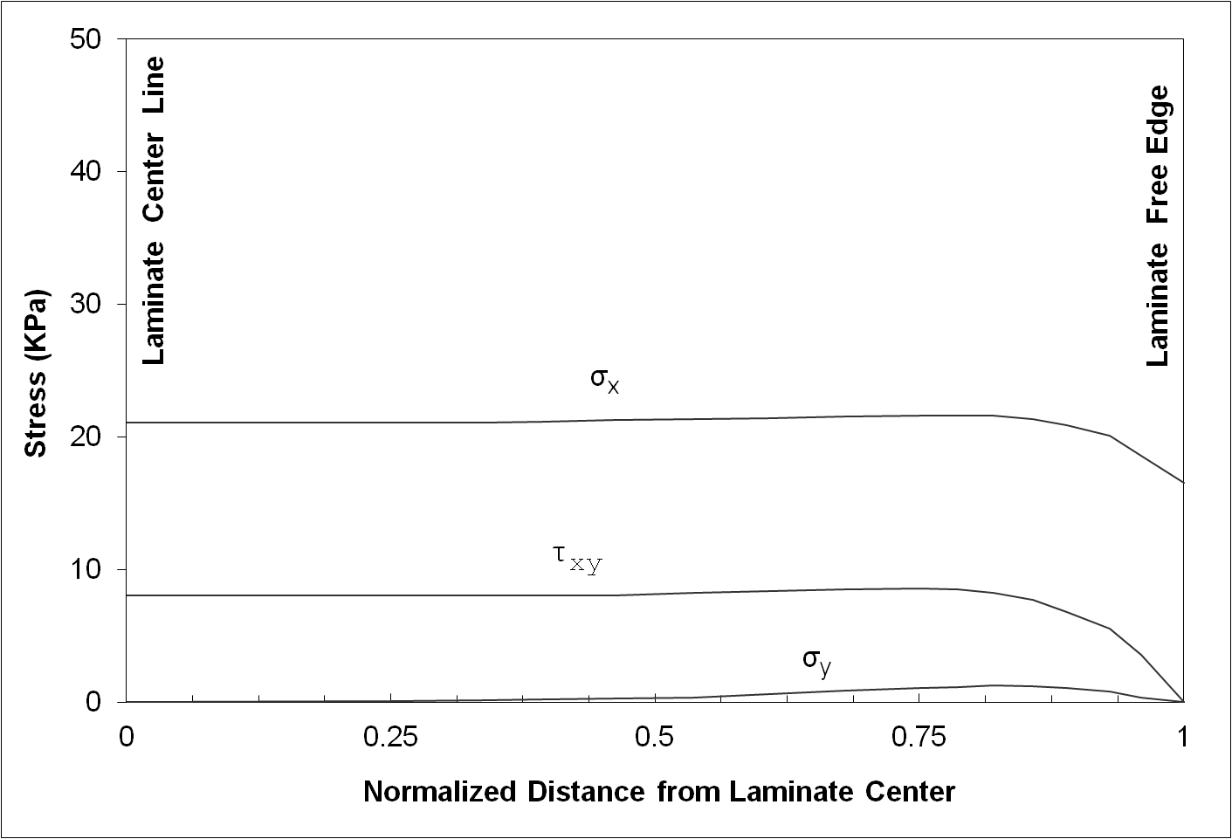
Impact Resistance
FIGURE 5.6
Normal and shear stresses at the interface of bottom surface of top ply in a four-ply laminate. (Reprinted from Pagano, N.J. and Soni, S.R., in Interlaminar Response of Composite Materials, Pagano, N.J., Ed., 1989, p.9, Elsevier Science, New York, with kind permission from authors.)

Slide 5
Fatigue Resistance
FIGURE 5.7
Comparison of residual strength as a function of number of cycles for two laminates. (Reprinted from Pagano, J.J. and Soni, S.R., in Interlaminar Response of Composite Materials, Pagano, N.J., Ed., 1989, p.12, Elsevier Science, New York, with kind permission from authors.

Slide 6
END

