Slide 1
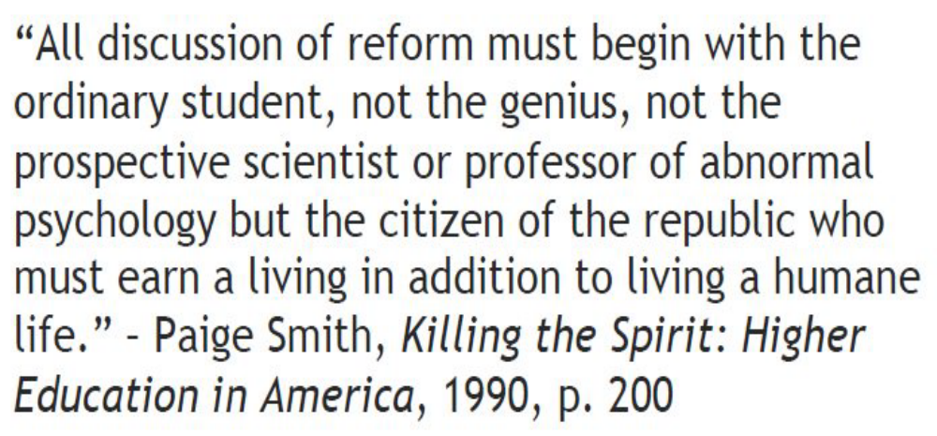
Solution to the paradox of choices: lecturing, flipped, blended…
Autar Kaw
http://AutarKaw.com
University of South Florida
ASEE Mechanics Division Awards Banquet
June 18, 2019

Slide 2
Expected types of course outcomes
Cognitive: “What will students completing this course know?”
Behavioral: “What will students completing this course be able to do?”
Affective: “What will students completing this course care about or think?”
Source: http://tillamookbaycc.edu/wp-content/uploads/2017/03/HowToWriteCourseLearningOutcomesforYourSyllabus.pdf

Slide 3

Active learning
Student performance on examinations and concept inventories under active learning, effect size=0.47
$$Effect Size=\frac{Difference between averages}{Standard Deviation}$$
Small =0.2 | Medium =0.5 | Large =0.8
Source: Active learning increases student performance in science, engineering, and mathematics by Freeman, et. al., 2014

Slide 4
Teaching techniques
Lecturing
Blended
Flipped
Hybrid
Adaptive
Problem based
Case study
…
…

Slide 5
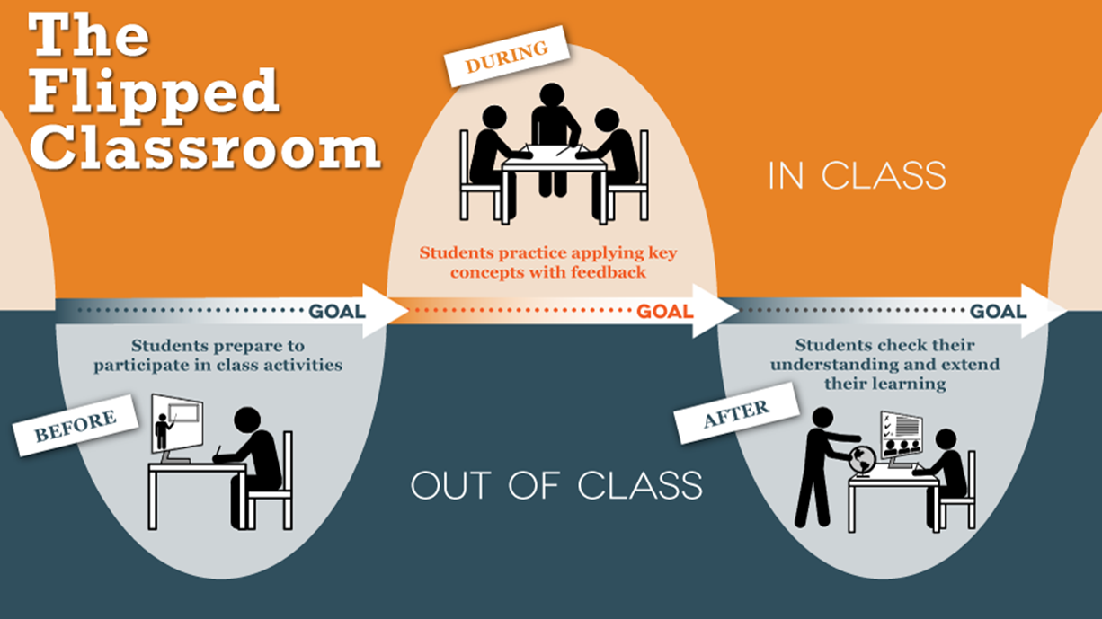
Flipped learning
“The results raise questions about the continued use of traditional lecturing as a control in research studies” Freeman, et. al., 2014

Slide 6

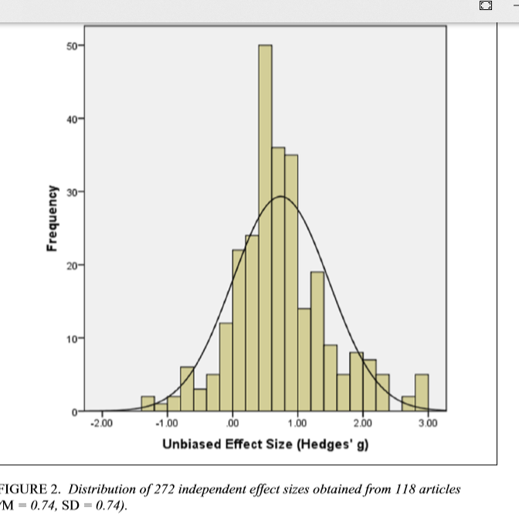
Practice testing
Effect size =0.74

Slide 7
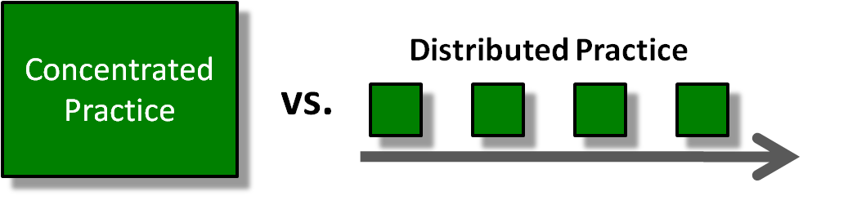
Distributed practice
Effect size=0.46
Source: http://blog.learningelevated.com/archives/62

Slide 8
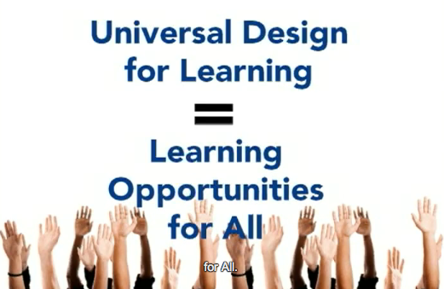
Universal design for learning (UDL)

Slide 9
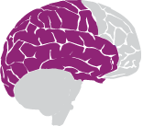
The trinity of UDL
  1. Multiple means of representation
What – Recognition network
Source: National Center on Universal Design for Learning

Slide 10
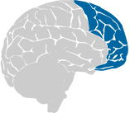
The trinity of UDL
  2. Multiple means of action and expression
How – Strategic Network
Source: National Center on Universal Design for Learning

Slide 11
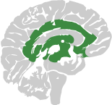
The trinity of UDL
  3. Multiple means of engagement
Why – Affective Network
Source: National Center on Universal Design for Learning

Slide 12
e: kaw@usf.edu w: AutarKaw.com p: 813-974-5626 m: 4202 E Fowler Ave, ENG030, Tampa, FL 33647 t: @numericalguy y: numericalmethodsguy i: numericalguy l: autarkaw f: autarkaw
Solution to the paradox of choices: lecturing, flipped, blended…

