Slide 1
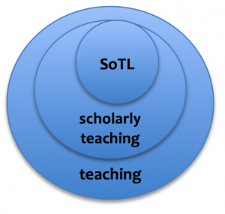

Intro to Education Component of Research Proposals
Autar Kaw, University of South Florida
autarkaw.com
College of Engineering
March 2022

Slide 2
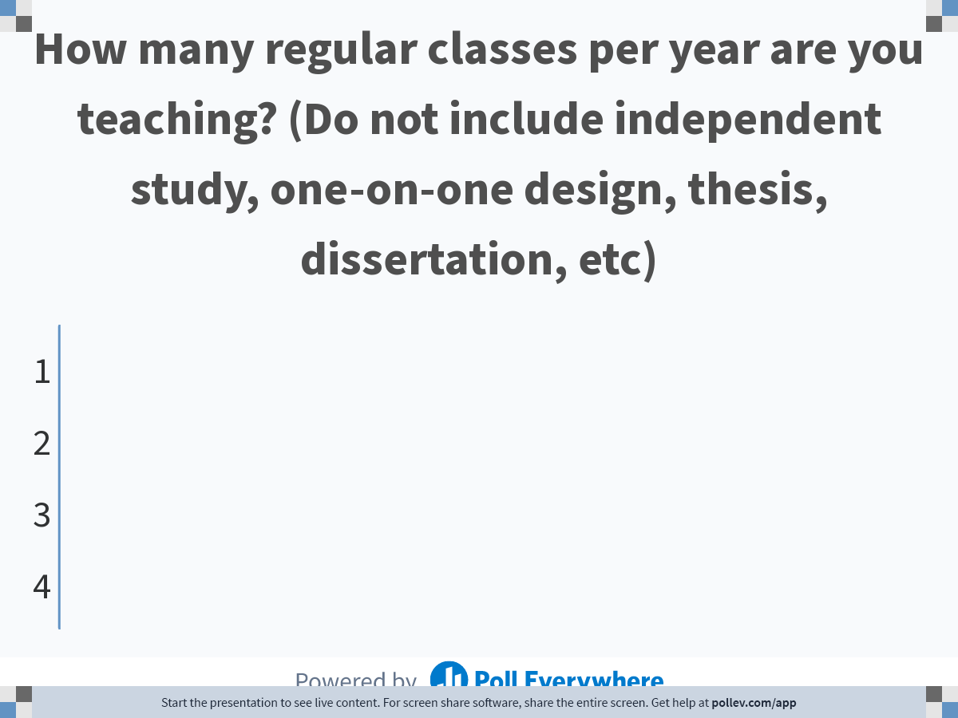
Notes:
Poll Title: Do not modify the notes in this section to avoid tampering with the Poll Everywhere activity.
More info at polleverywhere.com/support
How many regular classes per year are you teaching? (Do not include independent study, one-on-one design, thesis, dissertation, etc)
https://www.polleverywhere.com/multiple_choice_polls/qdDMUdvQudM7fBsrVh1Ew

Slide 3

Notes:
Poll Title: Do not modify the notes in this section to avoid tampering with the Poll Everywhere activity.
More info at polleverywhere.com/support
If offered, would you attend a two-hour long workshop on improving your classroom teaching?
https://www.polleverywhere.com/multiple_choice_polls/EG4mc6uNzwdllkUt0jQ3c

Slide 4

Notes:
Poll Title: Do not modify the notes in this section to avoid tampering with the Poll Everywhere activity.
More info at polleverywhere.com/support
What one teaching advice did you get when you joined as a faculty member who is seeking tenure? Just a short phrase would do.
https://www.polleverywhere.com/discourses/eF1yUkXiSgUs4L1EhhviQ

Slide 5
Teaching, Scholarly Teaching, SoTL
Teaching
Doing what most of us do
Scholarly Teaching
Teaching is informed by research on teaching and learning
SoTL
Creating, sharing and publishing original work

Slide 6
NSF Career Grant Education Activities
Education Activities – The education component of the proposal may be in a broad range of areas and may be directed to any level: K-12 students, undergraduates, graduate students, and/or the general public, but should be related to the proposed research and consistent with the career goals of the PI.

Slide 7
Five steps in a SoTL Study
Identify the research question
Design the study
Collect the data
Analyze the data and draw conclusions
Present and publish the SoTL project
Source: Engaging in the Scholarship of Teaching and Learning by Bishop-Clark & Dietz-Uhler

Slide 8
Step 1
Identify the Research Question

Slide 9
Example of Research Questions
What works - What is the effect of using hands-on exercises in programming class?
What is - How do novice programmers think as they write a computer program?
Visions of possible – Would an active exercise of personal response systems work better than a one-minute paper?
New conceptual framework - How does adaptive learning affect the pre-class learning in a flipped classroom?

Slide 10
Step 2
Design the Study

Slide 11
Designing the Study
State your research question
Methods that you will use
Pilot study or full study
Time frame
Groups you will study
Number of people you will study
Comparison groups
Approaches
Source: Engaging in the Scholarship of Teaching and Learning by Bishop-Clark & Dietz-Uhler

Slide 12
Step 3
Collecting the Data

Slide 13
Collecting the Data
Reliability and validity
Choosing variables
Use own instrument or available one
Source: Engaging in the Scholarship of Teaching and Learning by Bishop-Clark & Dietz-Uhler

Slide 14
Data Collection Plan
Case study
Observation
Interview
Focus groups
Surveys
Quasi-Experimental
Source: Engaging in the Scholarship of Teaching and Learning by Bishop-Clark & Dietz-Uhler

Slide 15
Ethical Considerations
Informed consent
Right to privacy
Risk of harm
Debriefing
Sharing student’s work
Methodology of study
Source: Engaging in the Scholarship of Teaching and Learning by Bishop-Clark & Dietz-Uhler

Slide 16
Step 4
Analyzing The Data

Slide 17
Qualitative Data Analysis
Codify
Rubrics

Slide 18
Rubric
4 - Demonstrates complete understanding of the problem. All requirements of task are included in response.
3 - Demonstrates considerable understanding of the problem. All requirements of task are included.
2 - Demonstrates partial understanding of the problem. Most requirements of task are included.
1 - Demonstrates little understanding of the problem. Many requirements of task are missing. (Is there anything salvageable in the answer)
0 - Left blank or show no demonstration of understanding of the problem – maybe simply repeated the data or copied formulas. Or you show or use formulas that are not even relevant.

Slide 19
Quantitative Data Analysis
Central Tendency: Mean; Median; Mode
Variability: Range; Variance; Standard Deviation
Frequency Distributions: Histograms
Comparisons: Example is t-test to compare two groups
Example of Independent Samples t-test
Comparing the traditional classroom with flipped classroom, we found mean score of final exam to be 50% (SD=8%) for former and mean score of final exam to be 60% (SD=5%) for the latter. This indicated an increase in the final examination score t(78)=-2.81, p=0.007. The Cohen’s effect size is 0.52.

Slide 20
Step 5
Publishing Results

Slide 21
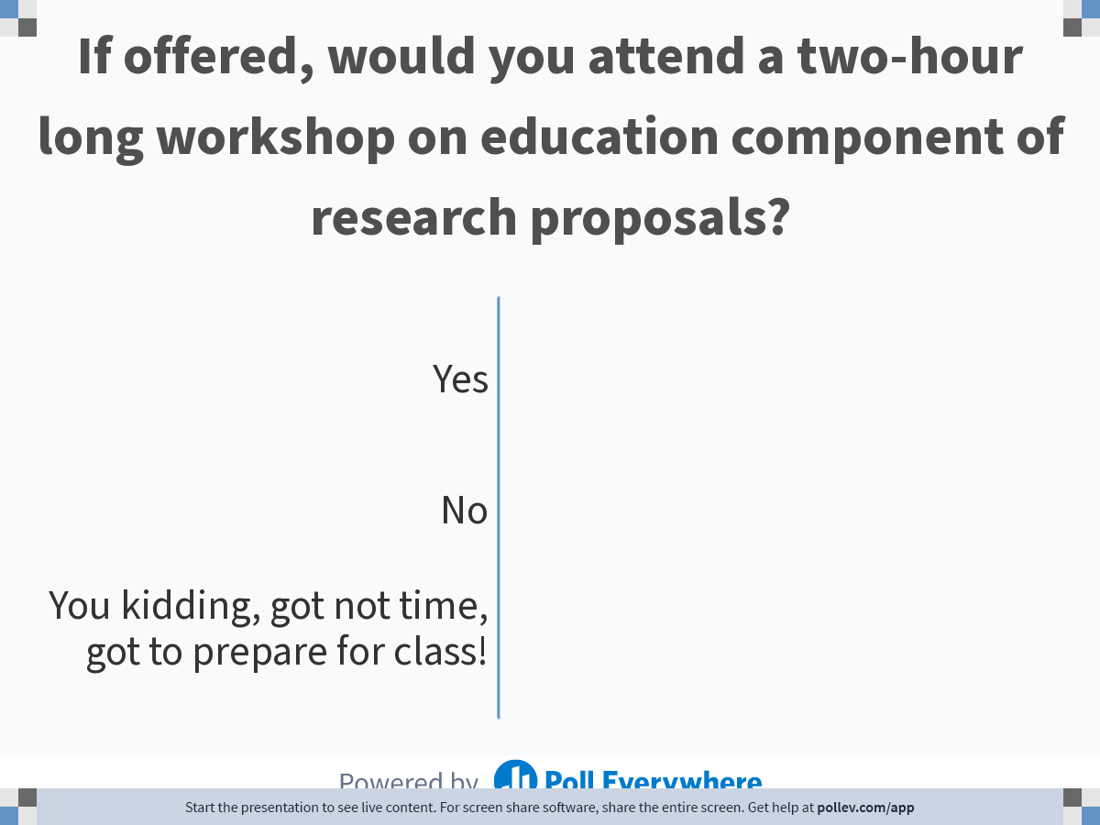
Notes:
Poll Title: Do not modify the notes in this section to avoid tampering with the Poll Everywhere activity.
More info at polleverywhere.com/support
If offered, would you attend a two-hour long workshop on education component of research proposals?
https://www.polleverywhere.com/multiple_choice_polls/32qj7C9pfmkuk9I5ySBKA

Slide 22
Questions
Intro to Education Component
of Research Proposals
Questions: Email me at kaw@usf.edu or let’s chat!

