Slide 1

EML 4230 Introduction to Composite Materials
Chapter 4 Macromechanical Analysis of a Laminate
Laminate Analysis: Example
Dr. Autar Kaw
Department of Mechanical Engineering
University of South Florida, Tampa, FL 33620
Courtesy of the Textbook
Mechanics of Composite Materials by Kaw

Slide 2
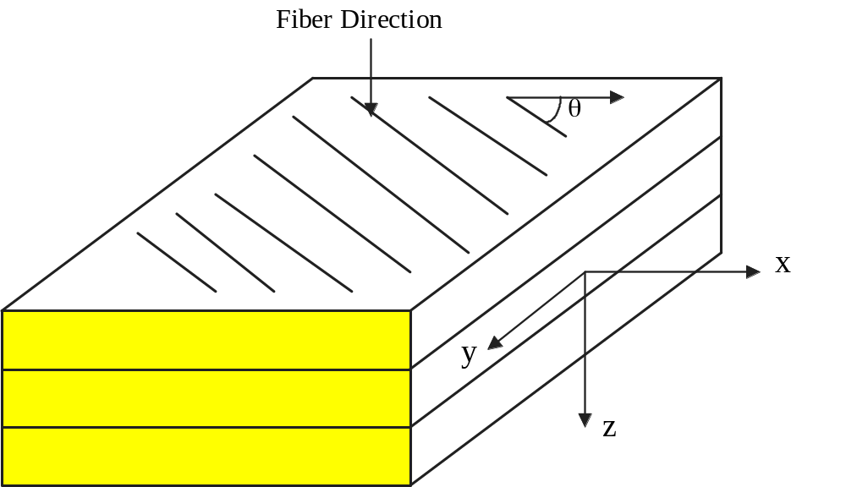
Laminate Stacking Sequence
Schematic of a laminate

Slide 3
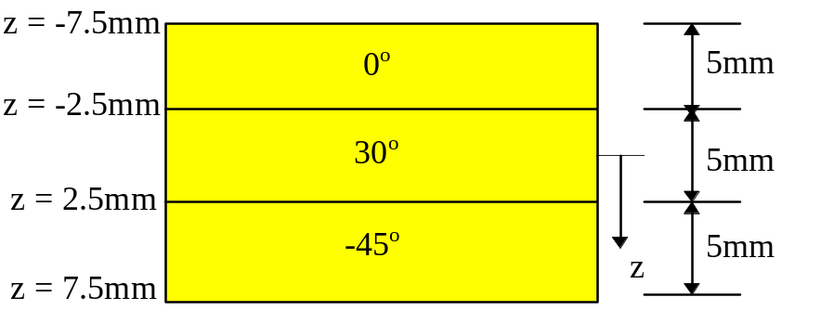
Problem
A [0/30/-45] Graphite/Epoxy laminate is subjected to a load of N_{x} = N_{y} = 1000 N/m. Use the unidirectional properties from Table 2.1 of Graphite/Epoxy. Assume each lamina has a thickness of 5 mm. Find
the three stiffness matrices [A], [B] and [D] for a three ply [0/30/-45] Graphite/Epoxy laminate.
mid-plane strains and curvatures.
global and local stresses on top surface of 30⁰ ply.
percentage of load N_{x} taken by each ply.
Thickness and coordinate locations of the three-ply laminate.

Slide 4
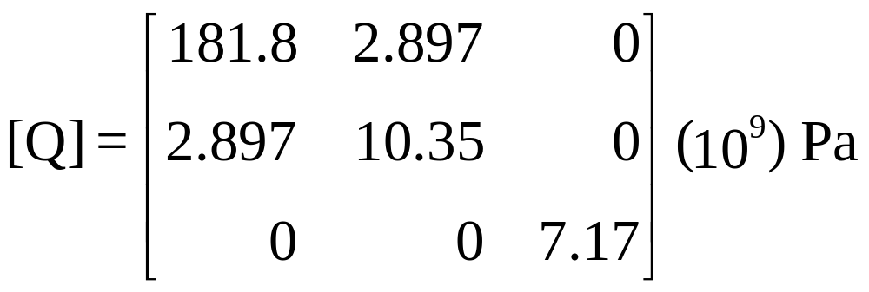
Calculating stiffness matrices
A) The reduced stiffness matrix for the 0$°$ Graphite/Epoxy ply is

Slide 5
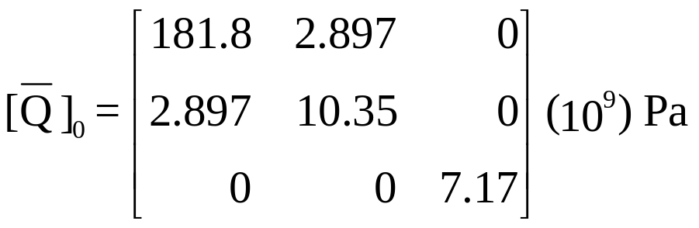
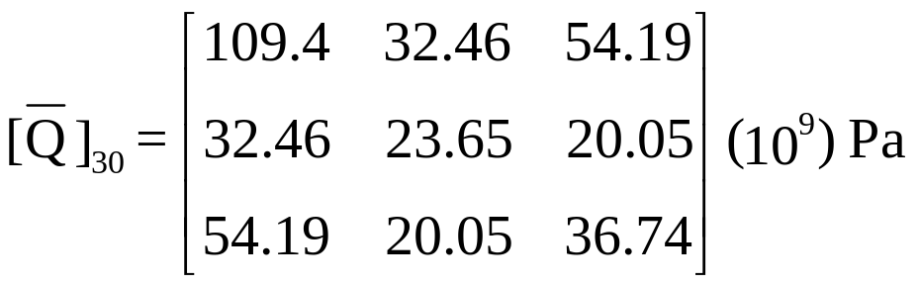
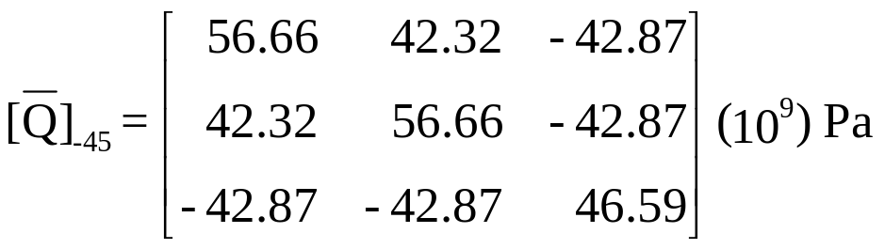
Qbar Matrices for Laminas

Slide 6

Coordinates of top & bottom of plies
The total thickness of the laminate is
h = (0.005)(3) = 0.015 m.
h₀=-0.0075 m
h₁=-0.0025 m
h₂=0.0025 m
h₃=0.0075 m
Thickness and coordinate locations of the three-ply laminate.

Slide 7
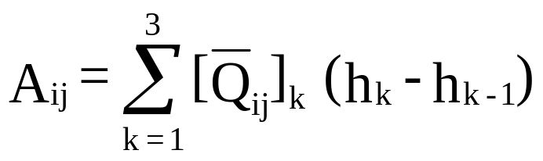
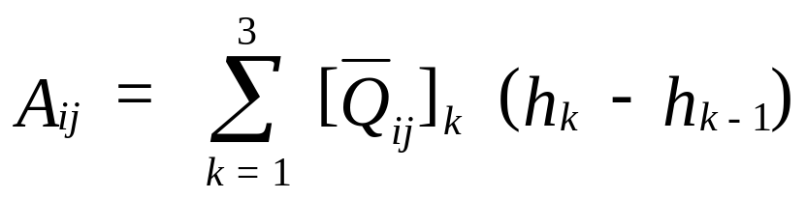
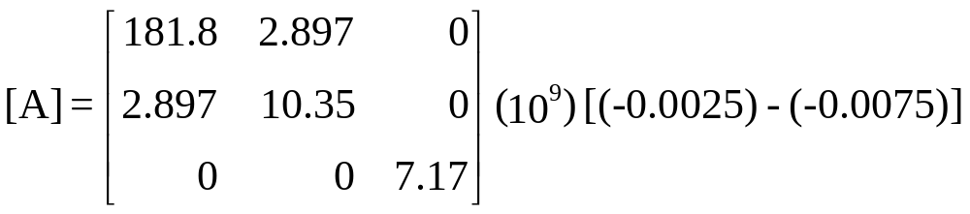
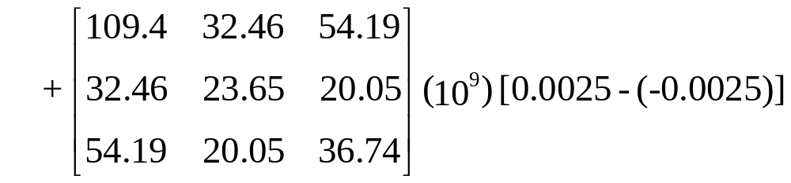
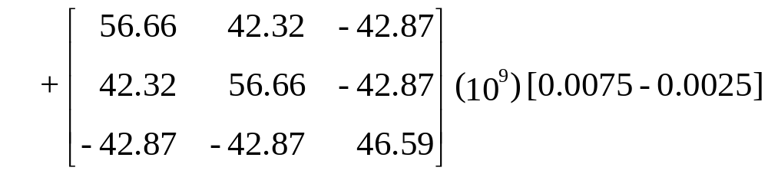
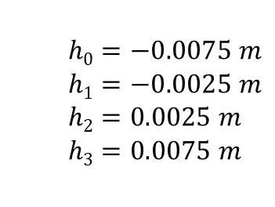
Calculating [A] matrix
$$h0=−0.0075 m$$
$$h1=−0.0025 m$$
$$h2=0.0025 m$$
$$h3=0.0075 m$$

Slide 8
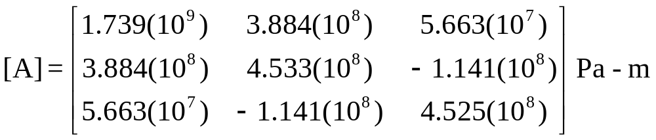
The [A] matrix

Slide 9
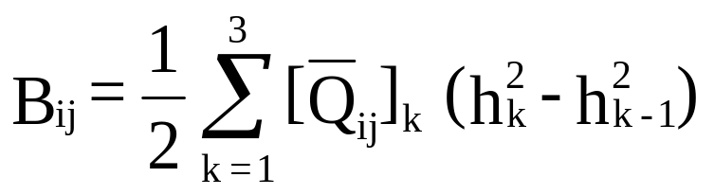
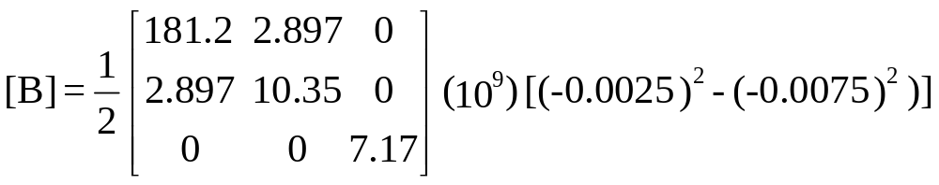
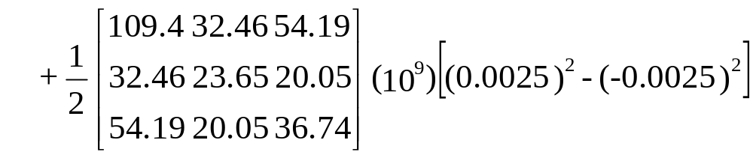
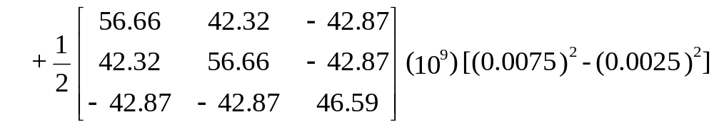
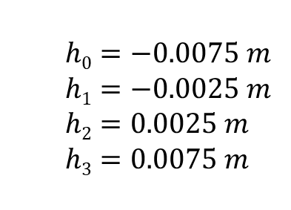
Calculating the [B] Matrix
$$h0=−0.0075 m$$
$$h1=−0.0025 m$$
$$h2=0.0025 m$$
$$h3=0.0075 m$$

Slide 10
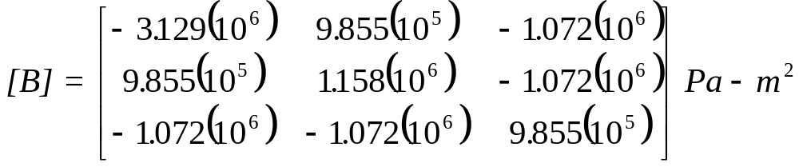
The [B] Matrix

Slide 11
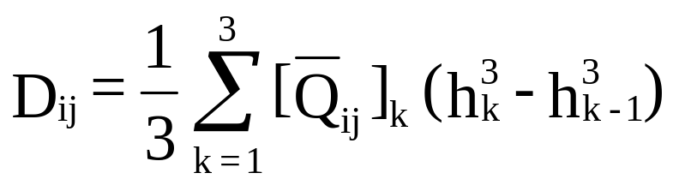
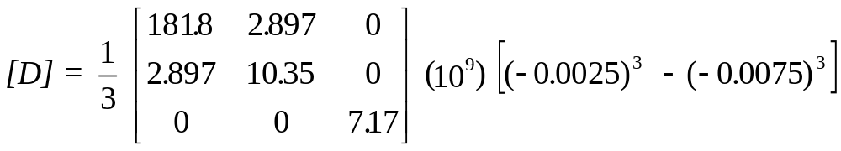
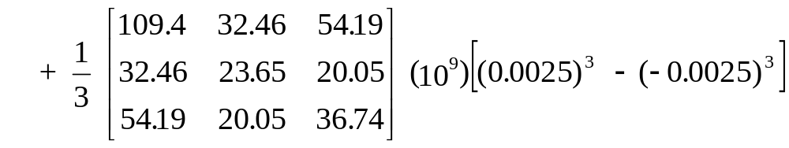
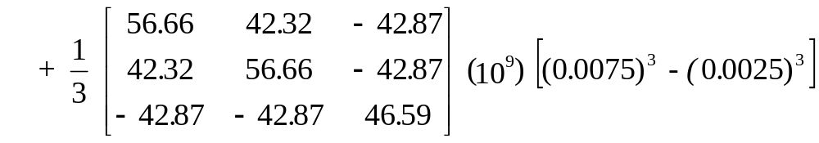
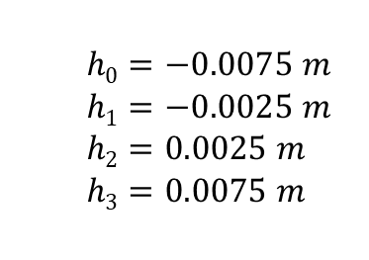
Calculating the [D] matrix
$$h0=−0.0075 m$$
$$h1=−0.0025 m$$
$$h2=0.0025 m$$
$$h3=0.0075 m$$

Slide 12
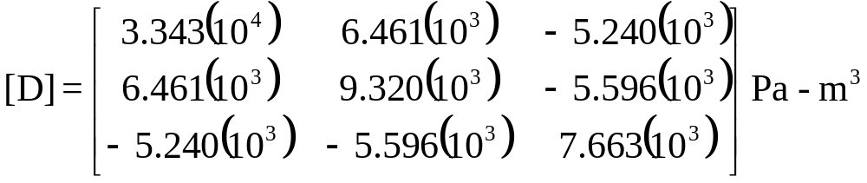
The [D] matrix

Slide 13
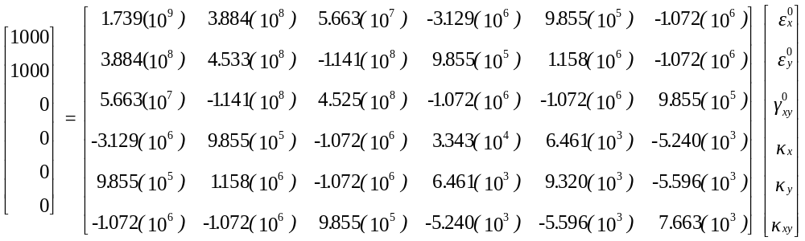
All three stiffness matrices together

Slide 14
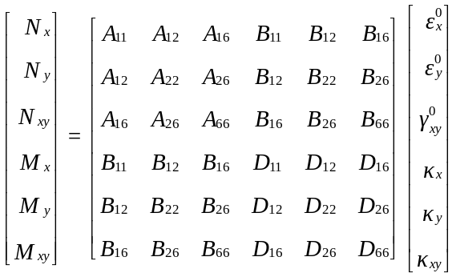

B) Since the applied load is N_{x} = N_{y} = 1000 N/m, the mid-plane strains and curvatures can be found by solving the following set of simultaneous linear equations
Setting up the 6x6 matrix

Slide 15
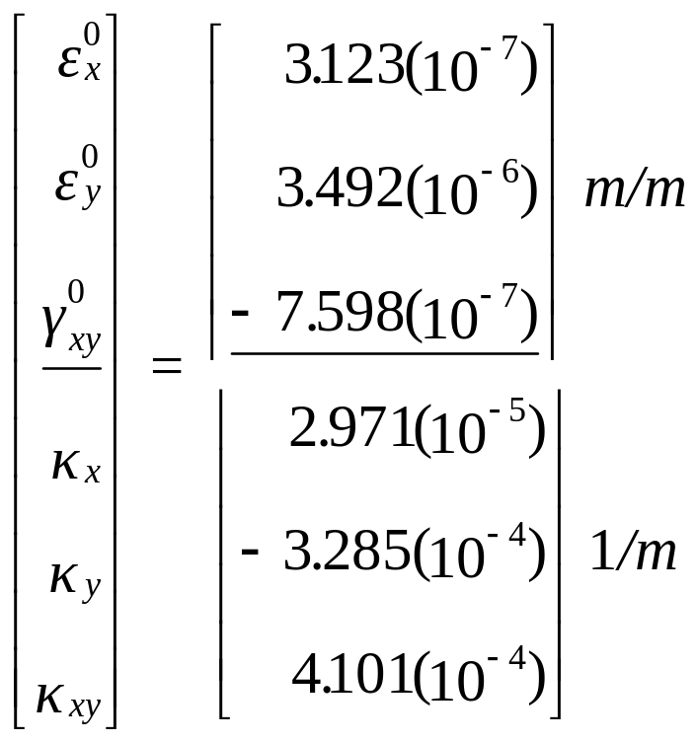
Mid-plane strains and curvatures

Slide 16
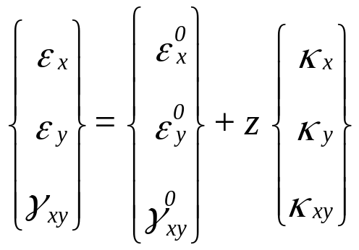
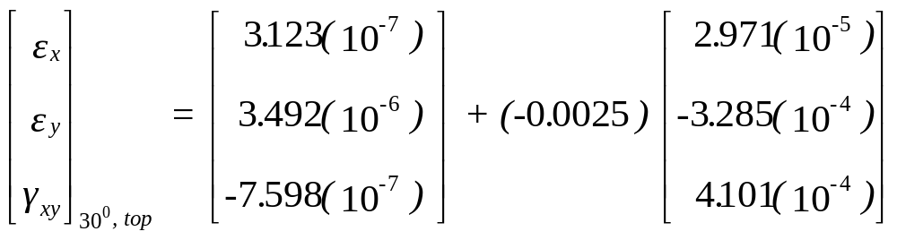
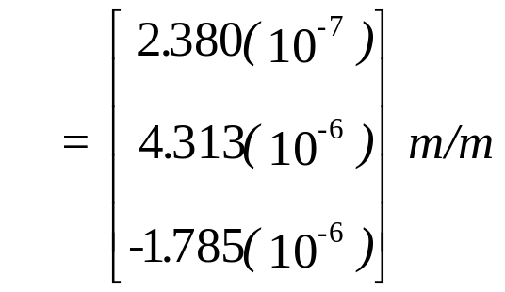
C) The strains and stresses at the top surface of the 30⁰ ply are found as follows. The top surface of the 30⁰ ply is located at z = h₁ = -0.0025 m.
Global strains at top of 30º ply
Thickness and coordinate locations of the three-ply laminate.

Slide 17

Global strains (m/m)
Ply # | Position | ε_{x} | ε_{y}
1 (0⁰) | Top Middle Bottom | 8.944 (10⁻⁸) 1.637 (10⁻⁷) 2.380 (10⁻⁷) | 5.955 (10⁻⁶) 5.134 (10⁻⁶) 4.313 (10⁻⁶) | -3.836 (10⁻⁶) -2.811 (10⁻⁶) -1.785 (10⁻⁶)
2 (30⁰) | Top Middle Bottom | 2.380 (10⁻⁷) 3.123 (10⁻⁷) 3.866 (10⁻⁷) | 4.313 (10⁻⁶) 3.492 (10⁻⁶) 2.670 (10⁻⁶) | -1.785 (10⁻⁶) -7.598 (10⁻⁷) 2.655 (10⁻⁷)
3(-45⁰) | Top Middle Bottom | 3.866 (10⁻⁷) 4.609 (10⁻⁷) 5.352 (10⁻⁷) | 2.670 (10⁻⁶) 1.849 (10⁻⁶) 1.028 (10⁻⁶) | 2.655 (10⁻⁷) 1.291 (10⁻⁶) 2.316 (10⁻⁶)

Slide 18
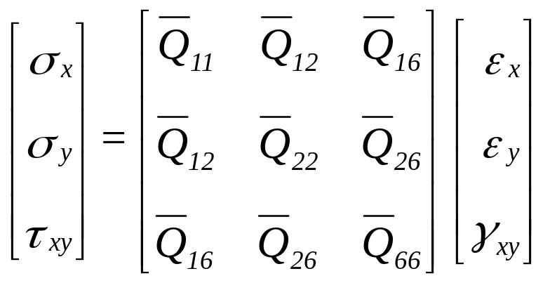
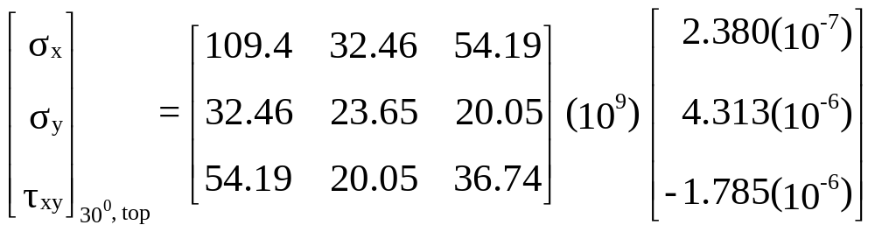
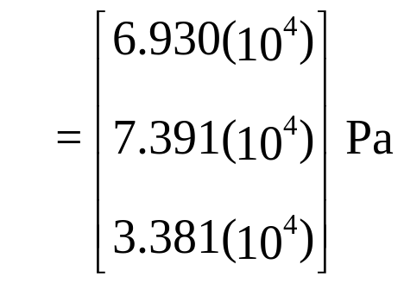
Global stresses in 30º ply at top

Slide 19
Global stresses (Pa)
Ply # | Position | σ_{x} | σ_{y} | τ_{xy}
1 (0⁰) | Top Middle Bottom | 3.351 (10⁴) 4.464 (10⁴) 5.577 (10⁴) | 6.188 (10⁴) 5.359 (10⁴) 4.531 (10⁴) | -2.750 (10⁴) -2.015 (10⁴) -1.280 (10⁴)
2 (30⁰) | Top Middle Bottom | 6.930 (10⁴) 1.063 (10⁵) 1.434 (10⁵) | 7.391 (10⁴) 7.747 (10⁴) 8.102 (10⁴) | 3.381 (10⁴) 5.903 (10⁴) 8.426 (10⁴)
3 (-45⁰) | Top Middle Bottom | 1.235 (10⁵) 4.903 (10⁴) -2.547 (10⁴) | 1.563 (10⁵) 6.894 (10⁴) -1.840 (10⁴) | -1.187 (10⁵) -3.888 (10⁴) 4.091 (10⁴)

Slide 20
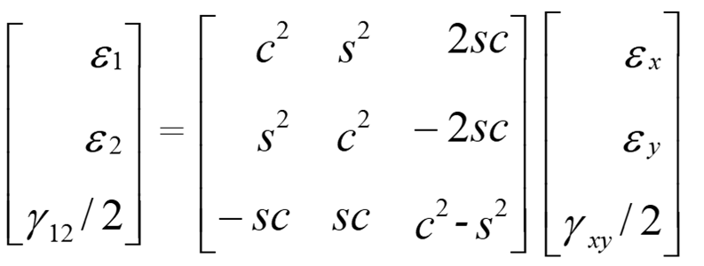
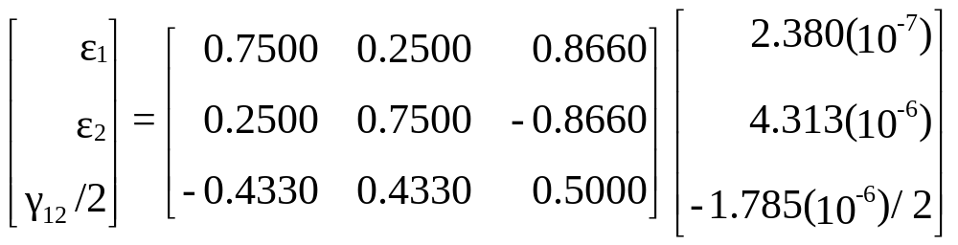
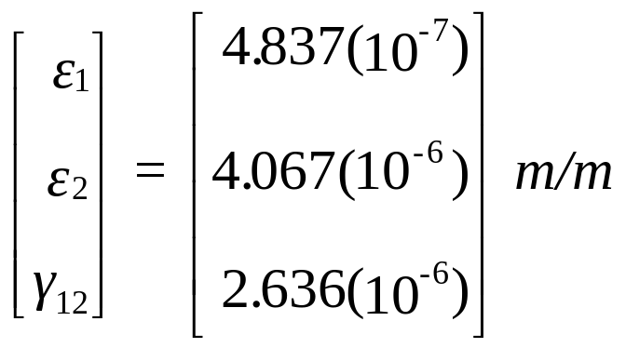
The local strains and local stress as in the 30⁰ ply at the top surface
Local Strains at top of 30º ply

Slide 21
Local strains (m/m)
Ply # | Position | ε₁ | ε₂ | γ₁₂
1 (0⁰) | Top Middle Bottom | 8.944 (10⁻⁸) 1.637 (10⁻⁷) 2.380 (10⁻⁷) | 5.955(10⁻⁶) 5.134(10⁻⁶) 4.313(10⁻⁶) | -3.836(10⁻⁶) -2.811(10⁻⁶) -1.785(10⁻⁶)
2 (30⁰) | Top Middle Bottom | 4.837(10⁻⁷) 7.781(10⁻⁷) 1.073(10⁻⁶) | 4.067(10⁻⁶) 3.026(10⁻⁶) 1.985(10⁻⁶) | 2.636(10⁻⁶) 2.374(10⁻⁶) 2.111(10⁻⁶)
3 (-45⁰) | Top Middle Bottom | 1.396(10⁻⁶) 5.096(10⁻⁷) -3.766(10⁻⁷) | 1.661(10⁻⁶) 1.800(10⁻⁶) 1.940(10⁻⁶) | -2.284(10⁻⁶) -1.388(10⁻⁶) -4.928(10⁻⁷)

Slide 22
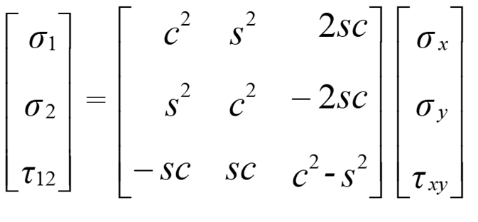
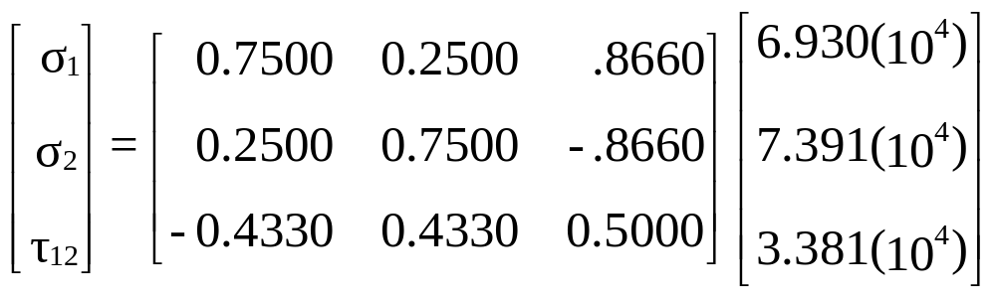
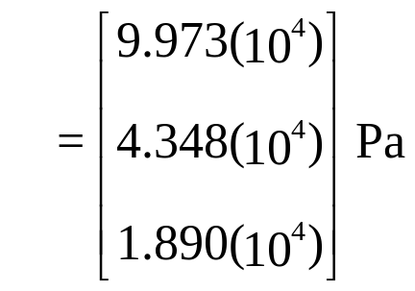
Local stresses in top of 30º ply

Slide 23
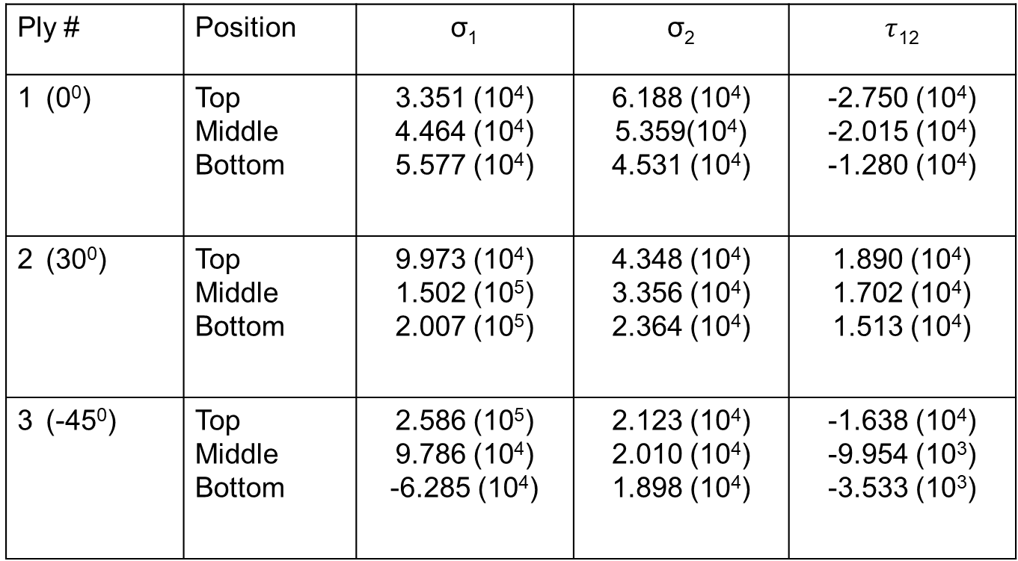
Local stresses (Pa)
Ply # | Position | σ₁ | σ₂ | $τ$₁₂
1 (0⁰) | Top Middle Bottom | 3.351 (10⁴) 4.464 (10⁴) 5.577 (10⁴) | 6.188 (10⁴) 5.359(10⁴) 4.531 (10⁴) | -2.750 (10⁴) -2.015 (10⁴) -1.280 (10⁴)
2 (30⁰) | Top Middle Bottom | 9.973 (10⁴) 1.502 (10⁵) 2.007 (10⁵) | 4.348 (10⁴) 3.356 (10⁴) 2.364 (10⁴) | 1.890 (10⁴) 1.702 (10⁴) 1.513 (10⁴)
3 (-45⁰) | Top Middle Bottom | 2.586 (10⁵) 9.786 (10⁴) -6.285 (10⁴) | 2.123 (10⁴) 2.010 (10⁴) 1.898 (10⁴) | -1.638 (10⁴) -9.954 (10³) -3.533 (10³)

Slide 24
D) Portion of load taken by each ply
Portion of load taken by each ply
Portion of load N_{x} taken by 0⁰ ply = 4.464(10⁴)(5)(10⁻³) = 223.2 N/m
Portion of load N_{x} taken by 30⁰ ply = 1.063(10⁵⁾(5)(10⁻³) = 531.5 N/m
Portion of load N_{x} taken by -45⁰ ply = 4.903(10⁴)(5)(10⁻³) = 245.2 N/m
The sum total of the loads shared by each ply is 1000 N/m, (223.2 + 531.5 + 245.2) which is the applied load in the x-direction, N_{x}.
Thickness and coordinate locations of the three-ply laminate.

Slide 25
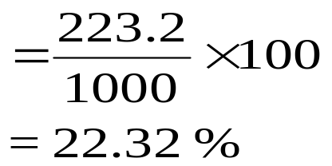
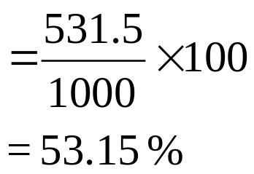
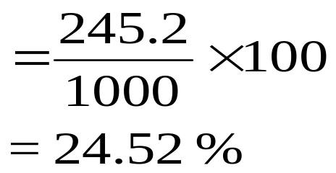
Percentage of load N_{x} taken by 0⁰ ply
Percentage of load N_{x} taken by 30⁰ ply
Percentage of load N_{x} taken by -45⁰ ply

Slide 26
END

