Slide 1

In-class questions Week 2 Session 1 & 2
http://nm.MathForCollege.com
Transforming Numerical Methods Education for STEM Undergraduates

Slide 2
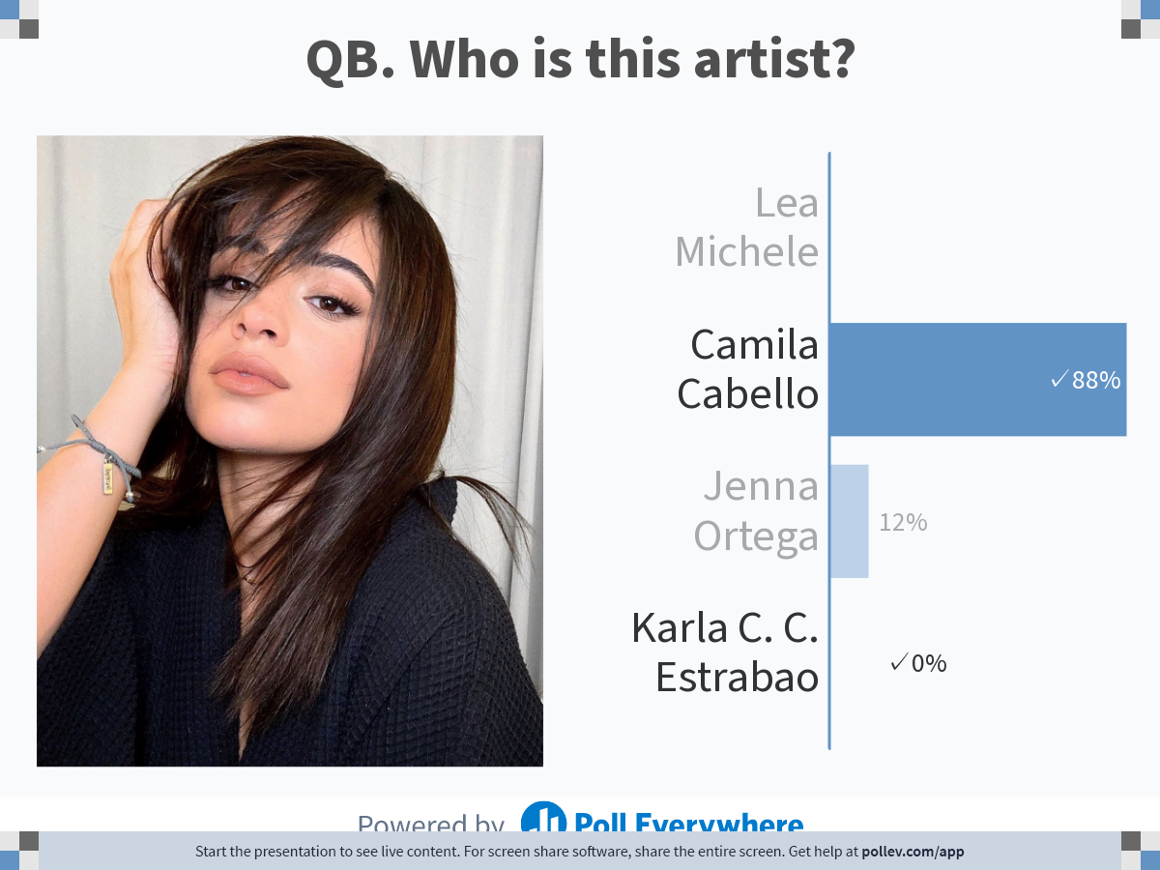
Notes:
Poll Title: Do not modify the notes in this section to avoid tampering with the Poll Everywhere activity.
More info at polleverywhere.com/support
QB. Who is this artist?
https://www.polleverywhere.com/multiple_choice_polls/9AGFOd5pzZyGp826yur8N?state=opened&flow=Default&onscreen=persist

Slide 3
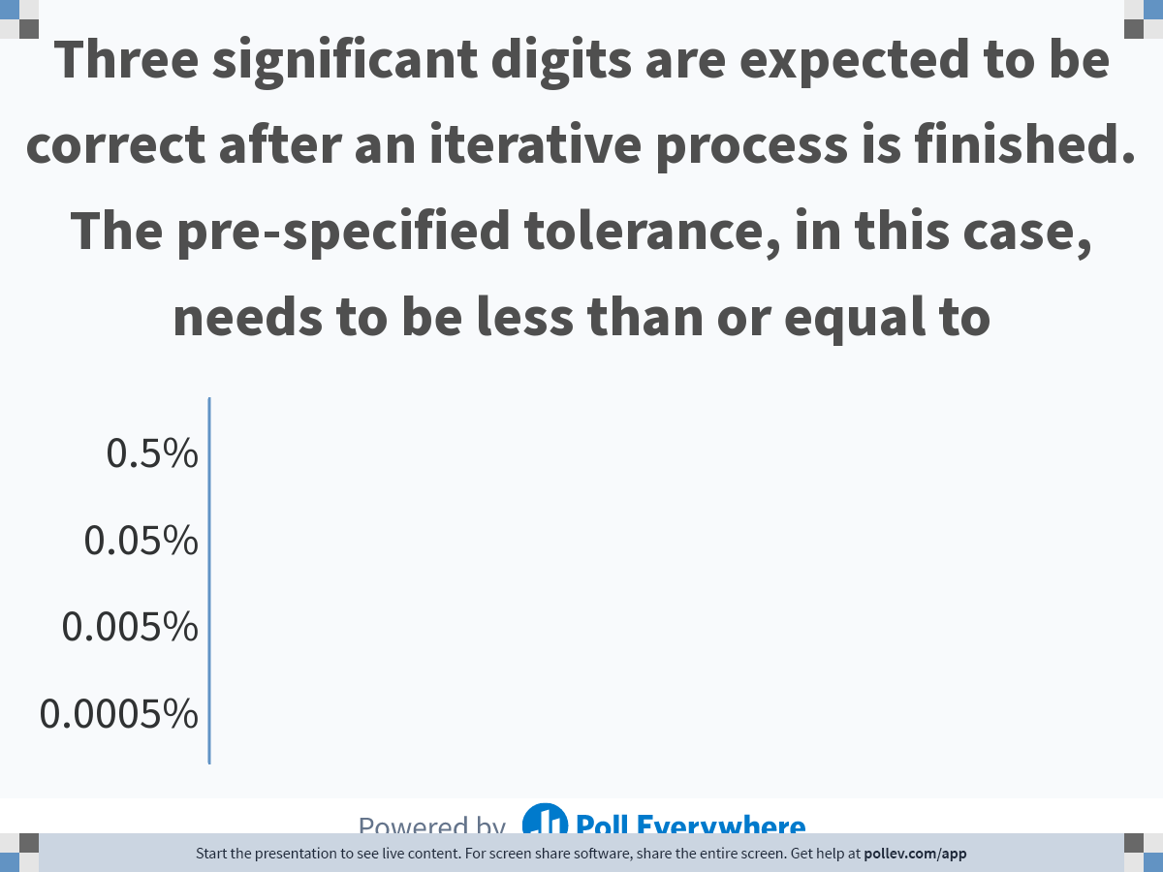
Notes:
Poll Title: Do not modify the notes in this section to avoid tampering with the Poll Everywhere activity.
More info at polleverywhere.com/support
Three significant digits are expected to be correct after an iterative process. The pre-specified tolerance, in this case, needs to be less than or equal to
https://www.polleverywhere.com/multiple_choice_polls/HqCbX84lAUjsmE4OpEcqt

Slide 4
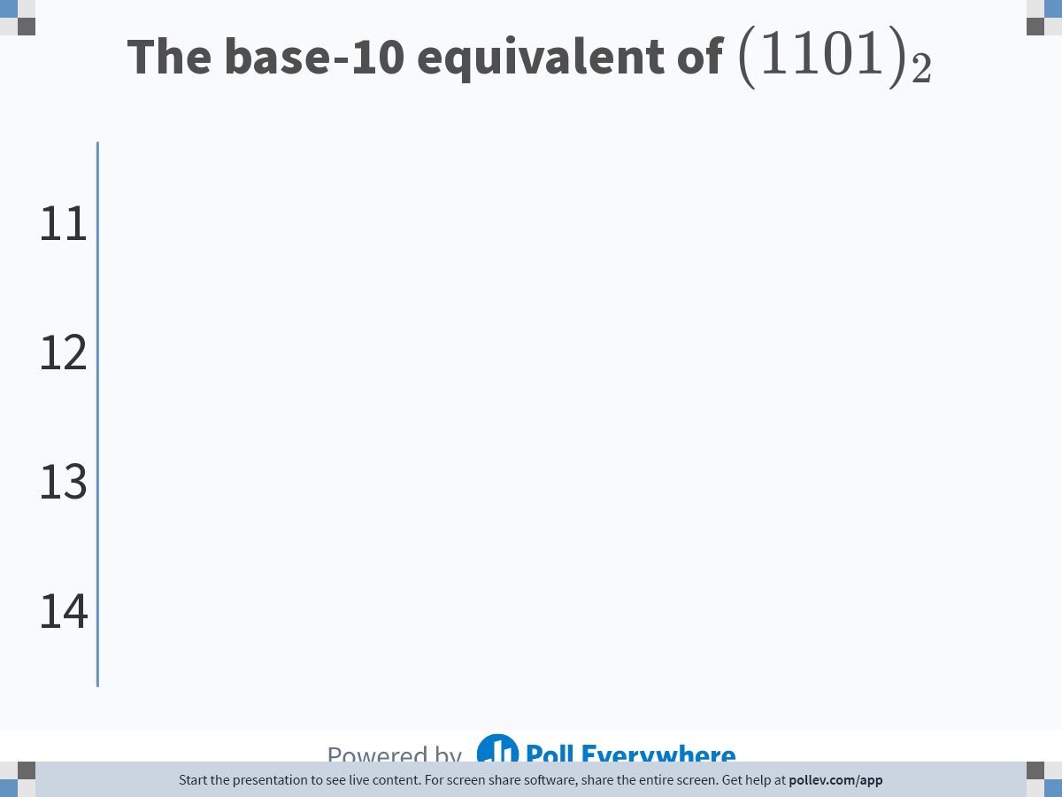
Notes:
Poll Title: Do not modify the notes in this section to avoid tampering with the Poll Everywhere activity.
More info at polleverywhere.com/support
The base-10 equivalent of $$(1101)_2$$
https://www.polleverywhere.com/multiple_choice_polls/8p4tWDaTD5ukZsWvExpdK

Slide 5
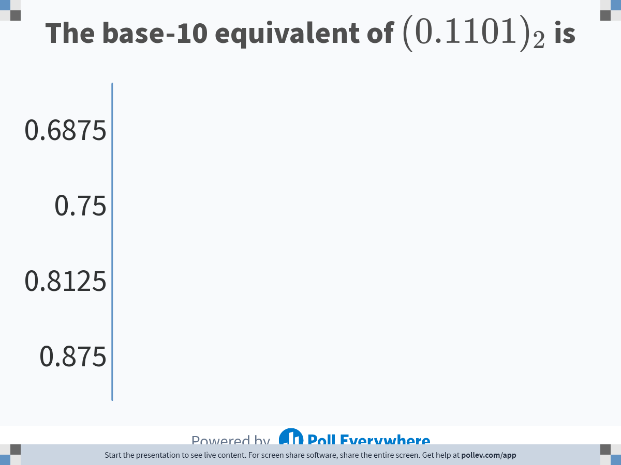
Notes:
Poll Title: Do not modify the notes in this section to avoid tampering with the Poll Everywhere activity.
More info at polleverywhere.com/support
The base-10 equivalent of $$(0.1101)_2$$ is
https://www.polleverywhere.com/multiple_choice_polls/J8Tet3zD1m2nKwXtyPIWk?state=opened&flow=Default&onscreen=persist

Slide 6
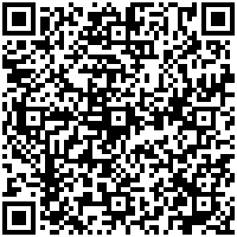
How Many Significant Digits?
https://bit.ly/3R7tn1J

Slide 7
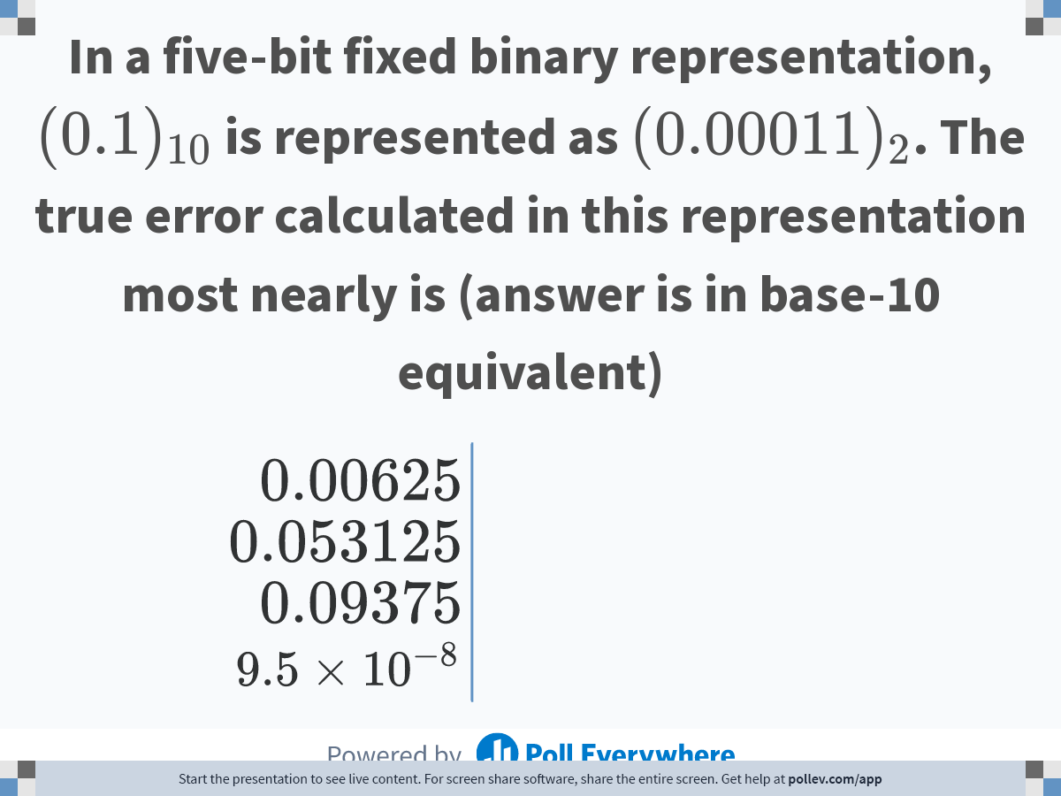
Notes:
Poll Title: Do not modify the notes in this section to avoid tampering with the Poll Everywhere activity.
More info at polleverywhere.com/support
In a five-bit fixed binary representation, $$(0.1)_{10}$$ is represented as $$(0.00011)_2$$. The true error calculated in this representation most nearly is (answer is in base-10 equivalent)
https://www.polleverywhere.com/multiple_choice_polls/dUxgQ2JKPcUN1gYx4iUiw

Slide 8
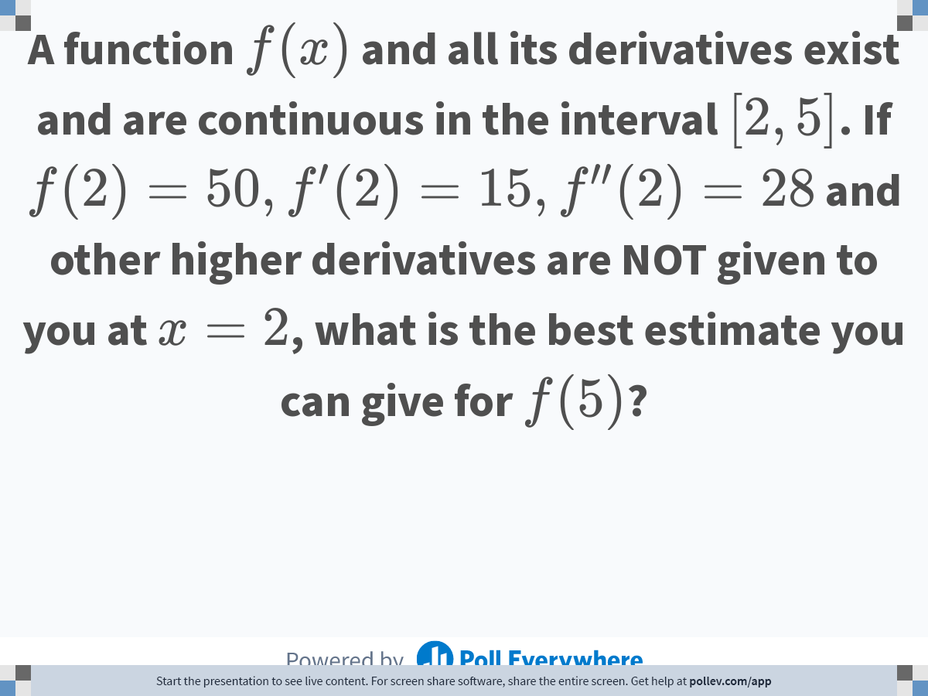
Notes:
Poll Title: Do not modify the notes in this section to avoid tampering with the Poll Everywhere activity.
More info at polleverywhere.com/support
A function $$f(x)$$ and all its derivatives exist and are continuous in the interval $$[2,5]$$. If $$f(2)=50, f'(2)=15, f''(2)=28$$ and other higher derivatives are NOT given to you at $$x=2$$, what is the best estimate you can give for $$f(5)$$?
https://www.polleverywhere.com/free_text_polls/EtoFvbgaRHSDEn4whHYY0

