Slide 1
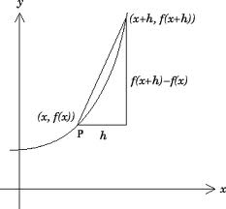
Differentiation
Audience Response Questions

Slide 2
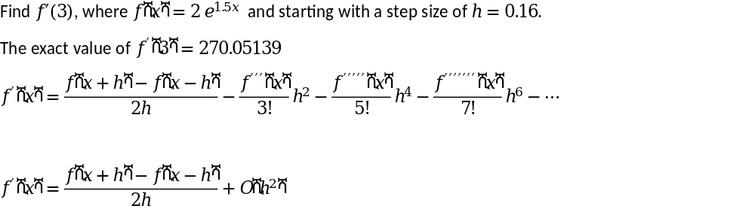
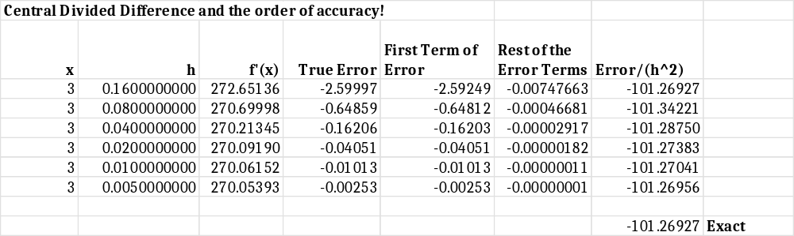

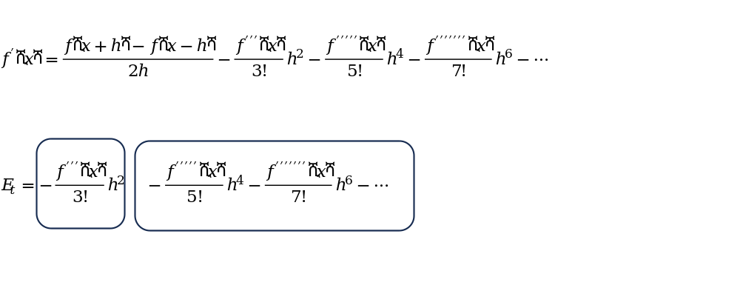

Slide 4

Notes:
Poll Title: Do not modify the notes in this section to avoid tampering with the Poll Everywhere activity.
More info at polleverywhere.com/support
Who is this artist?
https://www.polleverywhere.com/multiple_choice_polls/NpZEWqBeXq5PDSz55ciIH?state=opened&flow=Default&onscreen=persist

Slide 5
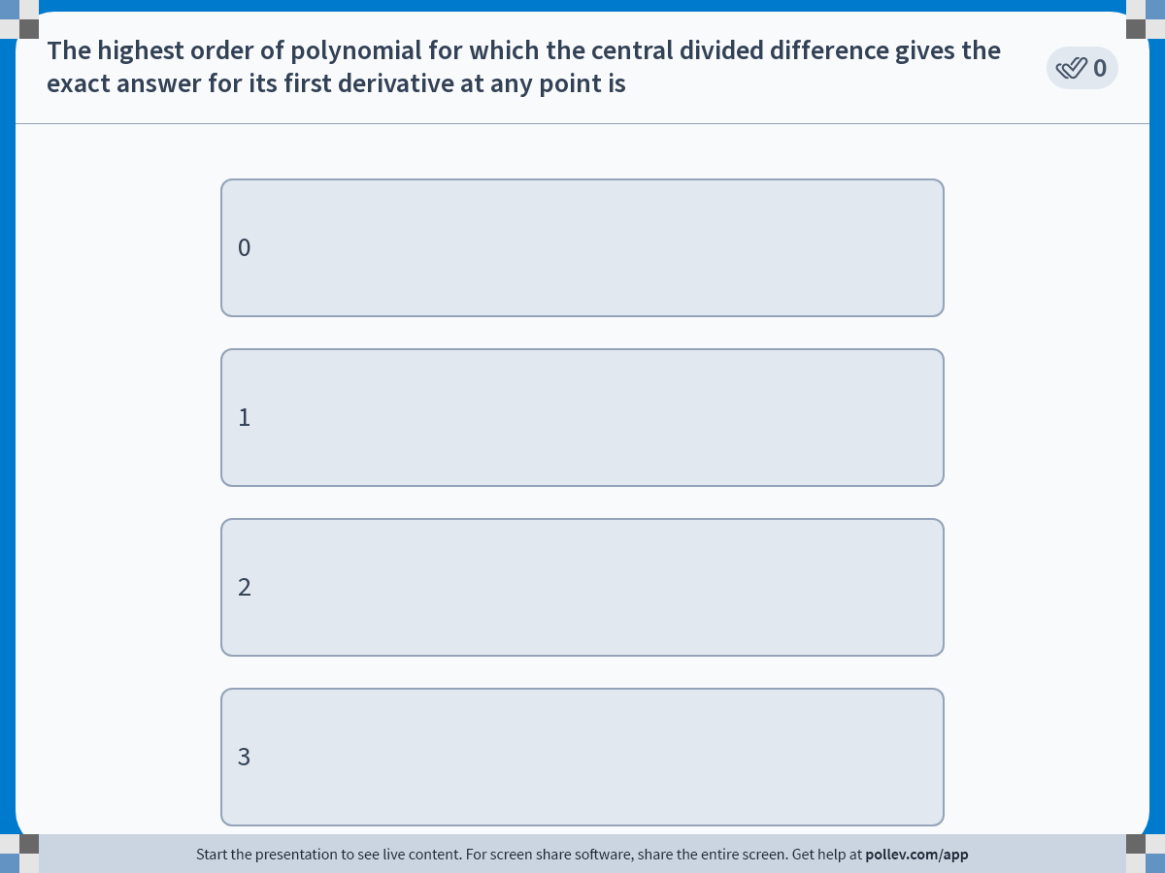
Notes:
Poll Title: Do not modify the notes in this section to avoid tampering with the Poll Everywhere activity.
More info at polleverywhere.com/support
The highest order of polynomial for which the central divided difference gives the exact answer for its first derivative at any point is
https://www.polleverywhere.com/multiple_choice_polls/yq3S7X7nRoMlVYcMQfrBZ?display_state=instructions&activity_state=opened&state=opened&flow=Engagement&onscreen=persist

Slide 6
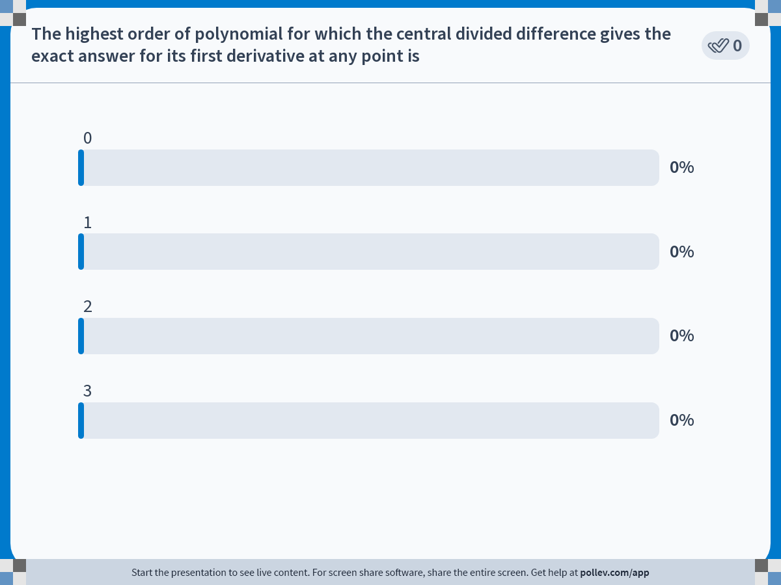
Notes:
Poll Title: Do not modify the notes in this section to avoid tampering with the Poll Everywhere activity.
More info at polleverywhere.com/support
The highest order of polynomial for which the central divided difference gives the exact answer for its first derivative at any point is
https://www.polleverywhere.com/multiple_choice_polls/yq3S7X7nRoMlVYcMQfrBZ?display_state=chart&activity_state=opened&state=opened&flow=Engagement&onscreen=persist

Slide 7
Notes:
Poll Title: Do not modify the notes in this section to avoid tampering with the Poll Everywhere activity.
More info at polleverywhere.com/support
The highest order of polynomial for which the central divided difference gives the exact answer for its first derivative at any point is
https://www.polleverywhere.com/multiple_choice_polls/yq3S7X7nRoMlVYcMQfrBZ?display_state=chart&activity_state=closed&state=closed&flow=Engagement&onscreen=persist

Slide 8
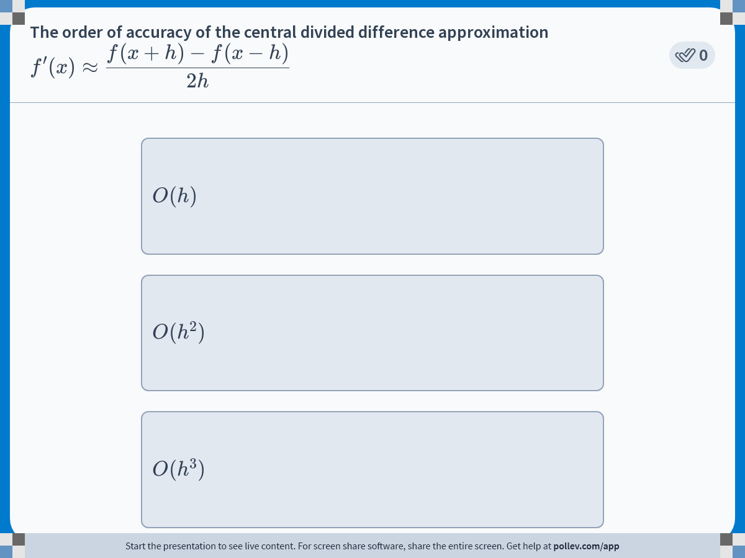
Notes:
Poll Title: Do not modify the notes in this section to avoid tampering with the Poll Everywhere activity.
More info at polleverywhere.com/support
The order of accuracy of the central divided difference approximation $$\\displaystyle f^\\prime(x) \\approx \\frac{f(x+h)-f(x-h)}{2h}$$
https://www.polleverywhere.com/multiple_choice_polls/OP28MTECViW9BpP5bgAdK?display_state=instructions&activity_state=opened&state=opened&flow=Engagement&onscreen=persist

Slide 9
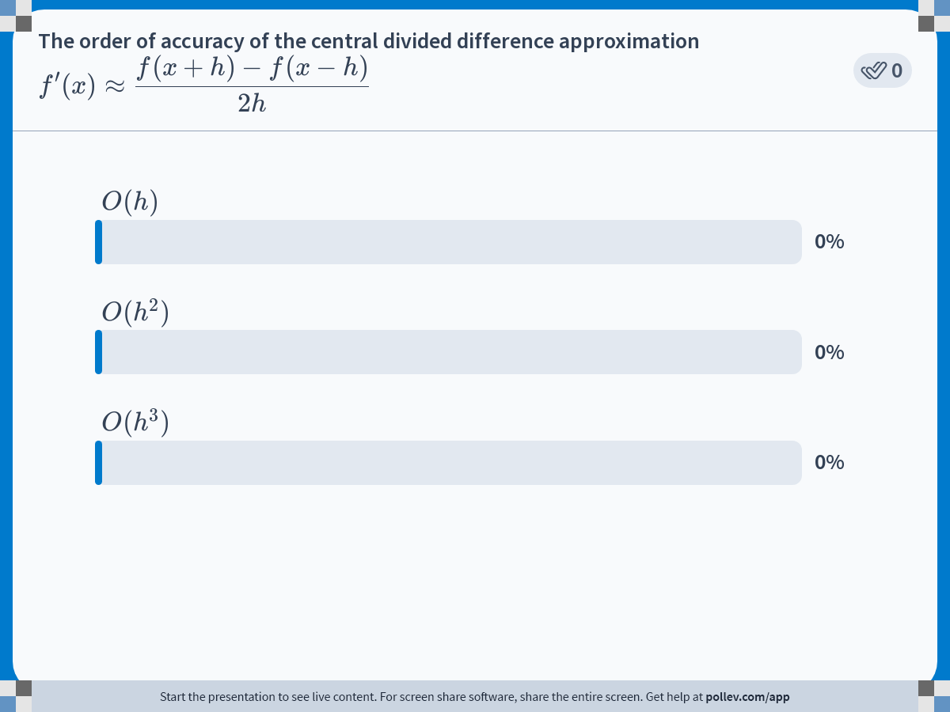
Notes:
Poll Title: Do not modify the notes in this section to avoid tampering with the Poll Everywhere activity.
More info at polleverywhere.com/support
The order of accuracy of the central divided difference approximation $$\\displaystyle f^\\prime(x) \\approx \\frac{f(x+h)-f(x-h)}{2h}$$
https://www.polleverywhere.com/multiple_choice_polls/OP28MTECViW9BpP5bgAdK?display_state=chart&activity_state=opened&state=opened&flow=Engagement&onscreen=persist

Slide 10
Notes:
Poll Title: Do not modify the notes in this section to avoid tampering with the Poll Everywhere activity.
More info at polleverywhere.com/support
The order of accuracy of the central divided difference approximation $$\\displaystyle f^\\prime(x) \\approx \\frac{f(x+h)-f(x-h)}{2h}$$
https://www.polleverywhere.com/multiple_choice_polls/OP28MTECViW9BpP5bgAdK?display_state=chart&activity_state=closed&state=closed&flow=Engagement&onscreen=persist

Slide 11
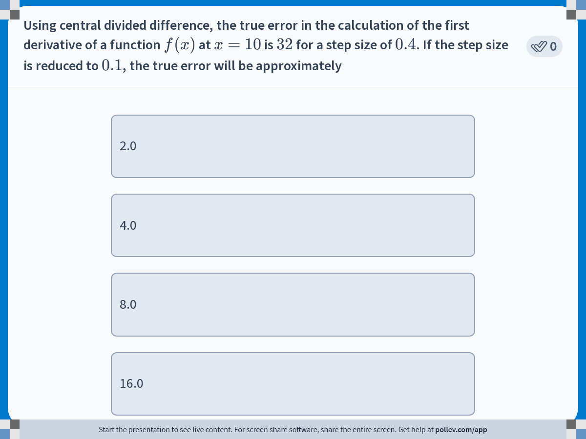
Notes:
Poll Title: Do not modify the notes in this section to avoid tampering with the Poll Everywhere activity.
More info at polleverywhere.com/support
Using central divided difference, the true error in the calculation of a derivative of a function is 32.0 for a step size of 0.4. If the step size is reduced to 0.1, the true error will be approximately
https://www.polleverywhere.com/multiple_choice_polls/fNysA9iUnnyqQUSoiq3E1?display_state=instructions&activity_state=opened&state=opened&flow=Engagement&onscreen=persist

Slide 12
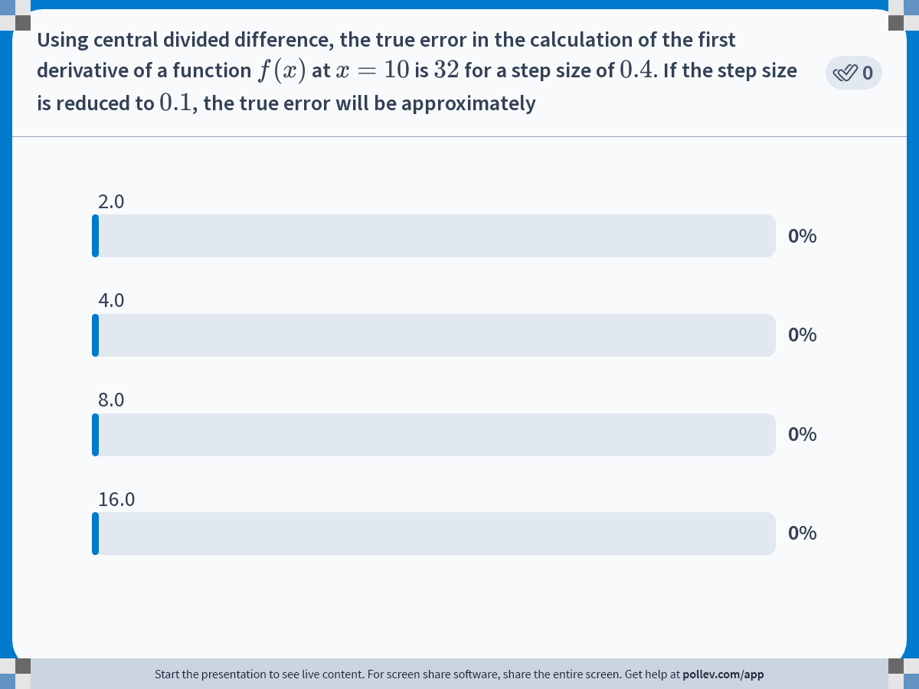
Notes:
Poll Title: Do not modify the notes in this section to avoid tampering with the Poll Everywhere activity.
More info at polleverywhere.com/support
Using central divided difference, the true error in the calculation of a derivative of a function is 32.0 for a step size of 0.4. If the step size is reduced to 0.1, the true error will be approximately
https://www.polleverywhere.com/multiple_choice_polls/fNysA9iUnnyqQUSoiq3E1?display_state=chart&activity_state=opened&state=opened&flow=Engagement&onscreen=persist

Slide 13
Notes:
Poll Title: Do not modify the notes in this section to avoid tampering with the Poll Everywhere activity.
More info at polleverywhere.com/support
Using central divided difference, the true error in the calculation of a derivative of a function is 32.0 for a step size of 0.4. If the step size is reduced to 0.1, the true error will be approximately
https://www.polleverywhere.com/multiple_choice_polls/fNysA9iUnnyqQUSoiq3E1?display_state=chart&activity_state=closed&state=closed&flow=Engagement&onscreen=persist

