Slide 1
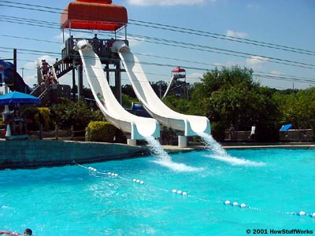
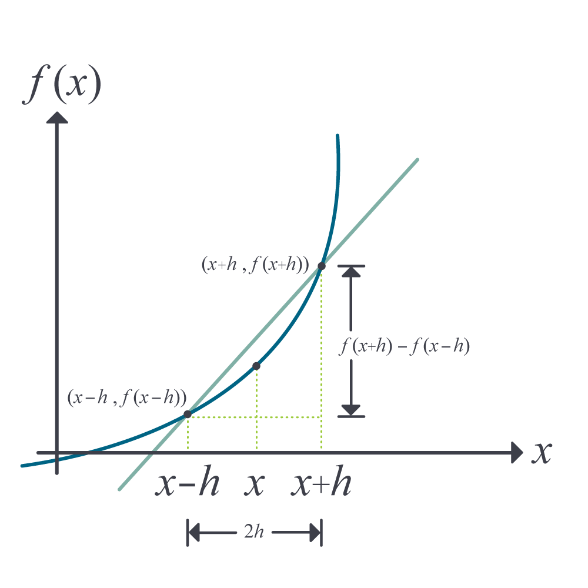
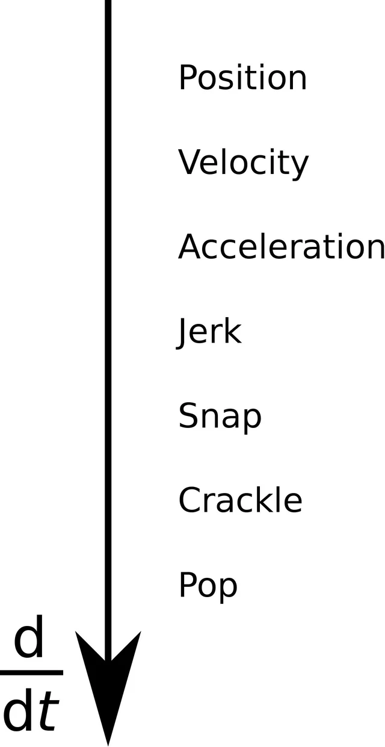
Differentiation
A Slippery Slope - Jerks You Around - Accelerates Your Mind

Slide 2

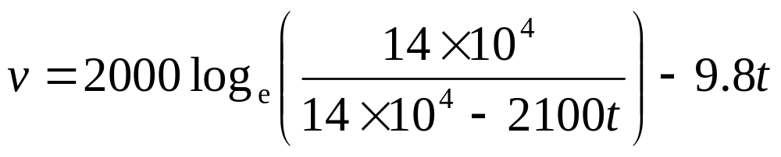
Acceleration of a rocket

Slide 3
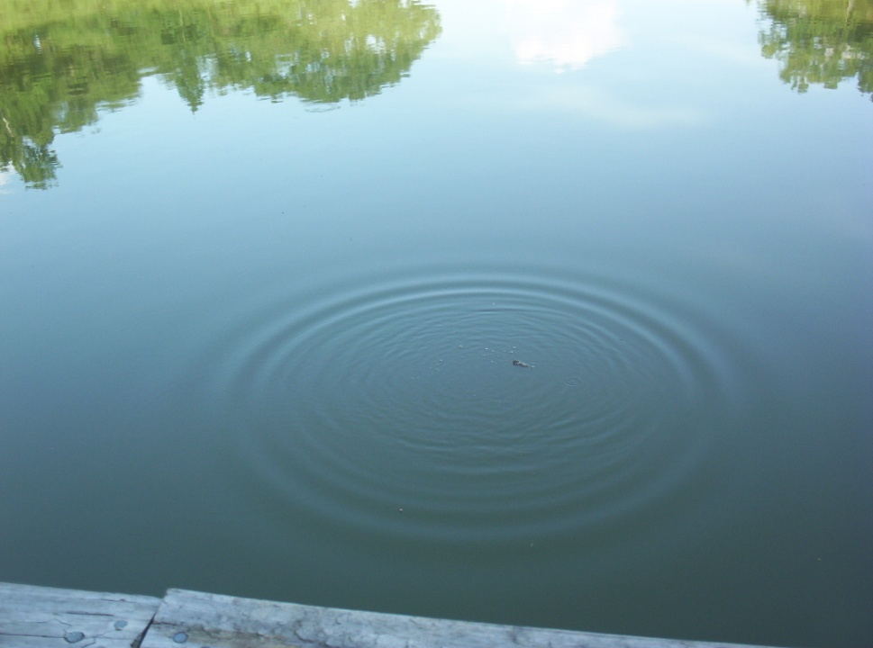
Oil Spill
Time (s ) | 0 | 0.5 | 1.0 | 1.5 | 2.0 | 2.5 | 3.0 | 3.5 | 4.0 | 4.5 | 5.0
Radius(m ) | 0 | 0.236 | 0.667 | 1.225 | 1.886 | 2.635 | 3.464 | 4.365 | 5.333 | 6.364 | 7.454

