Slide 1
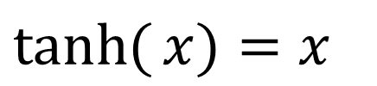
Nonlinear Equations
Your nonlinearity confuses me
$$ax^{5}+bx^{4}+cx^{3}+dx^{2}+ex+f=0$$
$$\tanh{(}x)=x$$

Slide 2
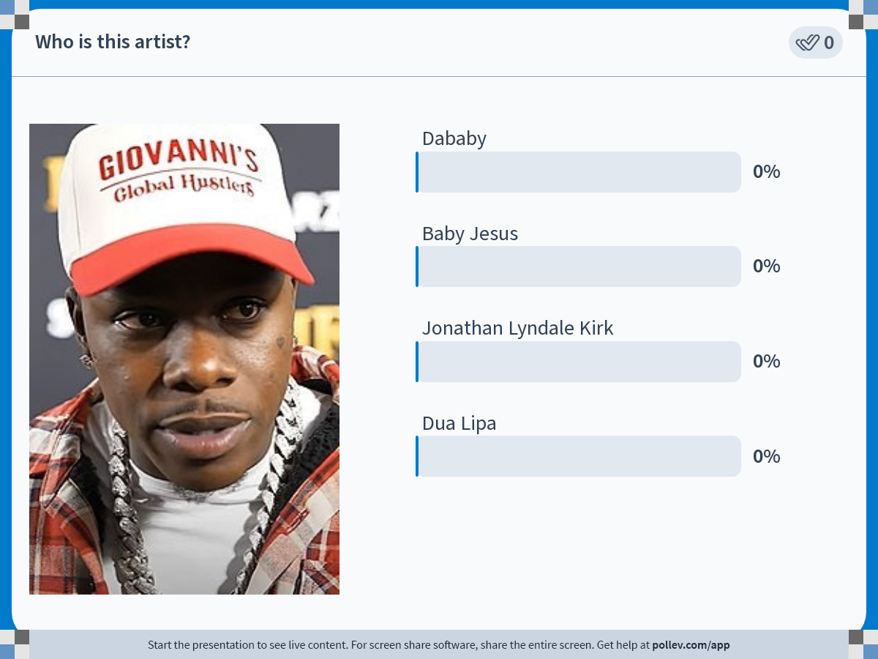
Notes:
Poll Title: Do not modify the notes in this section to avoid tampering with the Poll Everywhere activity.
More info at polleverywhere.com/support
Who is this artist?
https://www.polleverywhere.com/multiple_choice_polls/ExXXhx1qyHk4QpzVIWLfE?state=opened&flow=Default&onscreen=persist

Slide 3
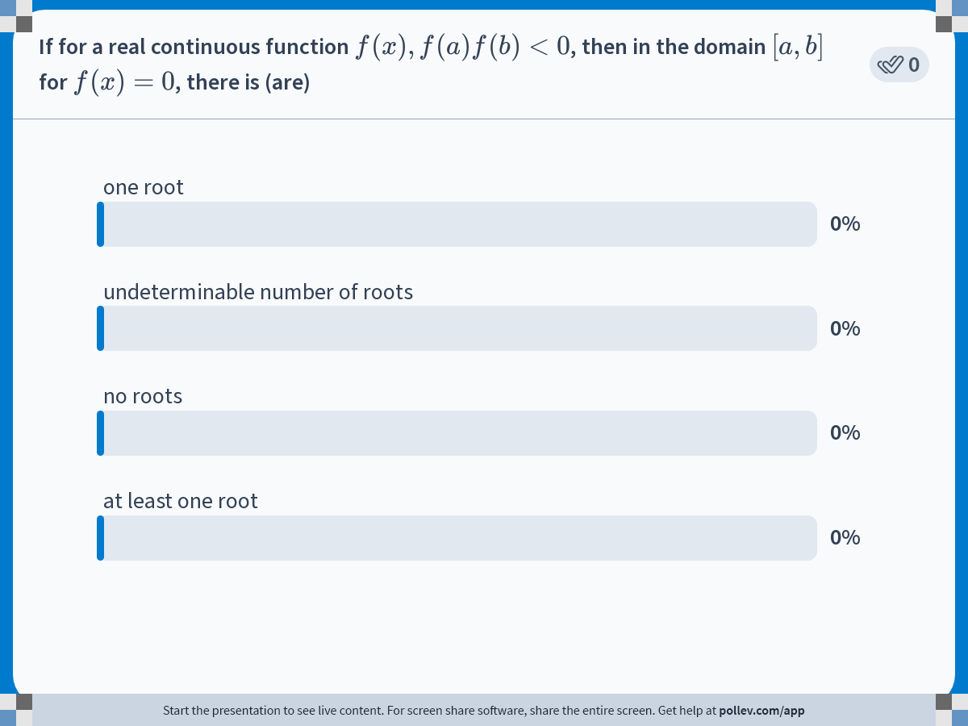
Notes:
Poll Title: Do not modify the notes in this section to avoid tampering with the Poll Everywhere activity.
More info at polleverywhere.com/support
If for a real continuous function $$f(x), f(a)f(b)&lt;0$$, then in the domain $$[a, b]$$ for $$f(x)=0$$, there is (are)
https://www.polleverywhere.com/multiple_choice_polls/bnr6MxGe822lAgxzsfa94

Slide 4
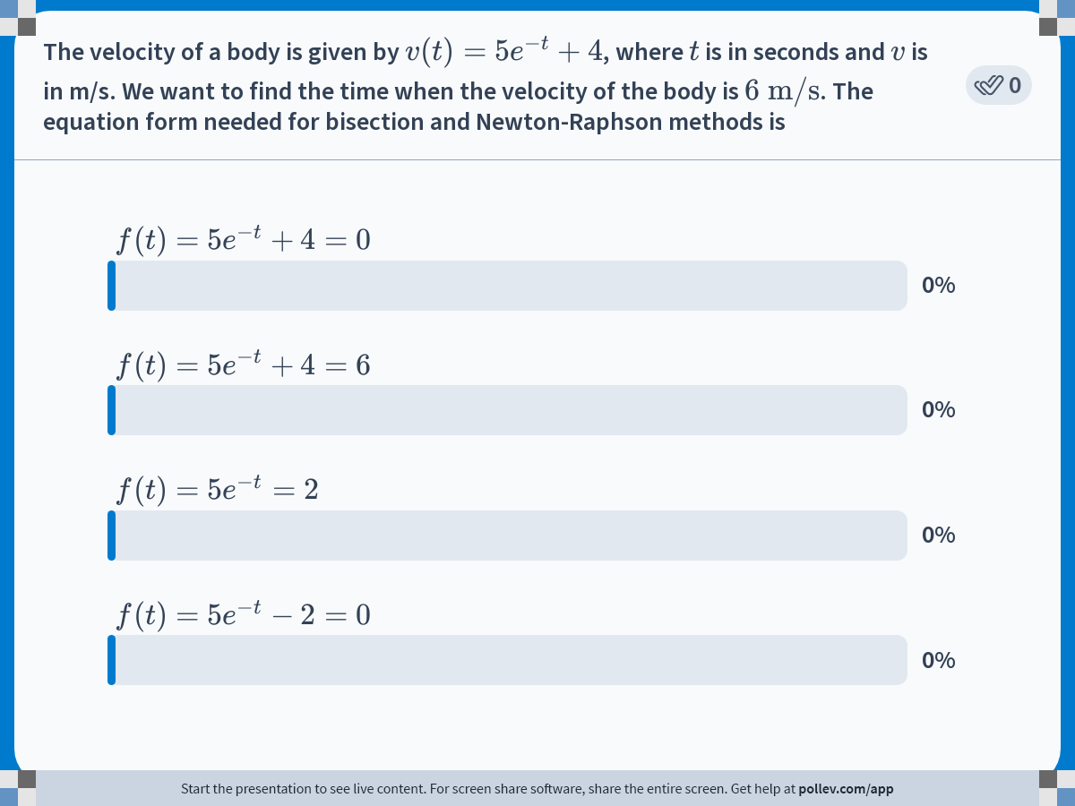
Notes:
Poll Title: Do not modify the notes in this section to avoid tampering with the Poll Everywhere activity.
More info at polleverywhere.com/support
The velocity of a body is given by $$v(t)=5e^{-t}+4$$, where $$t$$ is in seconds and $$v$$ is in m/s. We want to find the time when the velocity of the body is $$6\\ \\text{m/s}$$. The equation form needed for bisection and Newton-Raphson methods is
https://www.polleverywhere.com/multiple_choice_polls/JGAs6pRhiCfsxIGfrMrUd

Slide 5
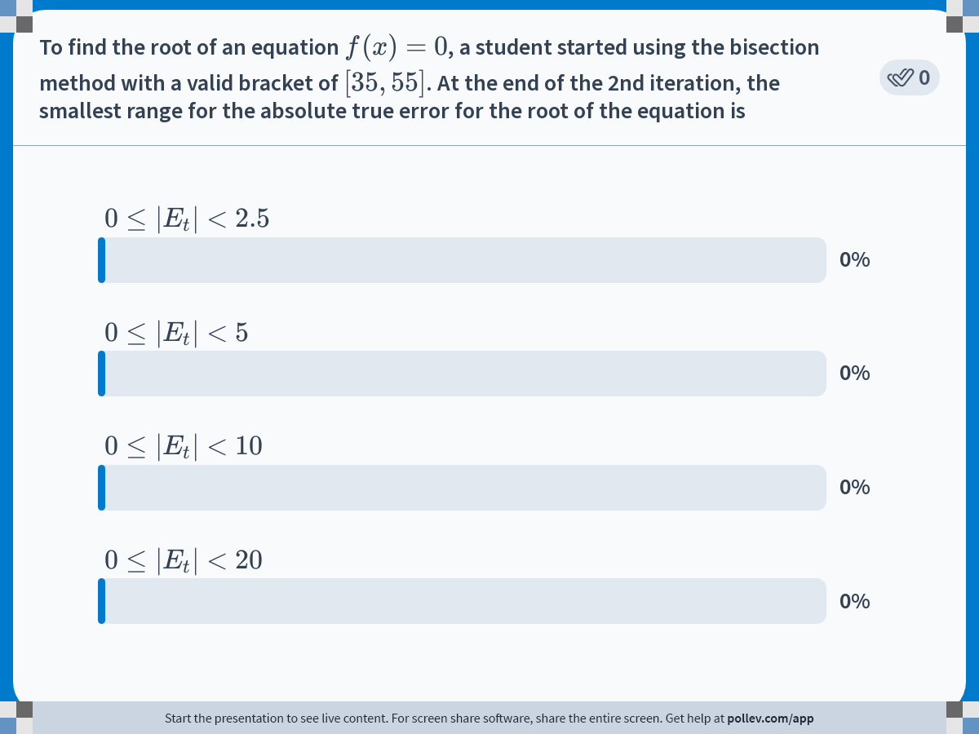
Notes:
Poll Title: Do not modify the notes in this section to avoid tampering with the Poll Everywhere activity.
More info at polleverywhere.com/support
To find the root of an equation $$f(x)=0$$, a student started using the bisection method with a valid bracket of $$[35,55]$$. At the end of the 2nd iteration, the smallest range for the absolute true error for the root of the equation is
https://www.polleverywhere.com/multiple_choice_polls/NLrCVC7x2RGOwTvQ38Fkz

Slide 6
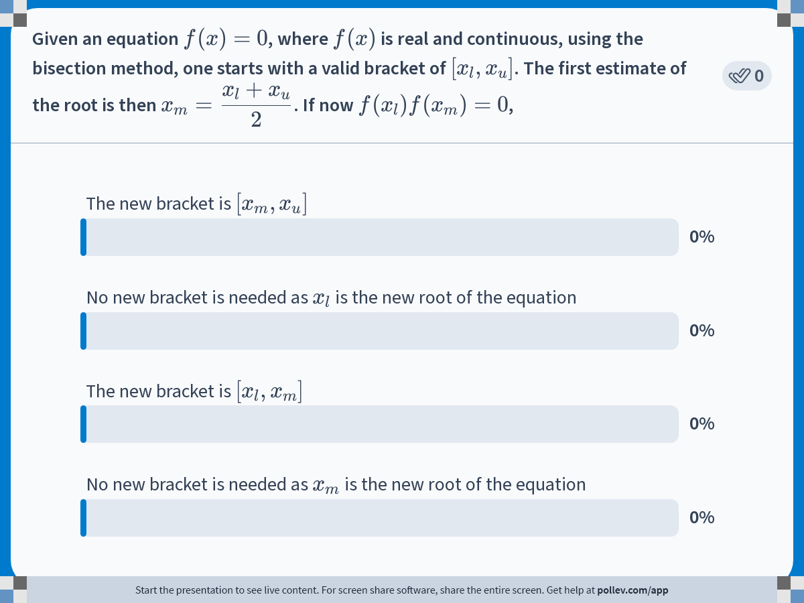
Notes:
Poll Title: Do not modify the notes in this section to avoid tampering with the Poll Everywhere activity.
More info at polleverywhere.com/support
Given an equation $$f(x)=0$$, where $$f(x)$$ is real and continuous, using the bisection method, one starts with a valid bracket of $$[x_l,x_u]$$. The first estimate of the root is then $$\\displaystyle x_m = \\frac{x_l+x_u}{2}$$. If now $$f(x_l)f(x_m)=0$$,
https://www.polleverywhere.com/multiple_choice_polls/30UfTVtywDgPxaU2ZHeW2

Slide 7
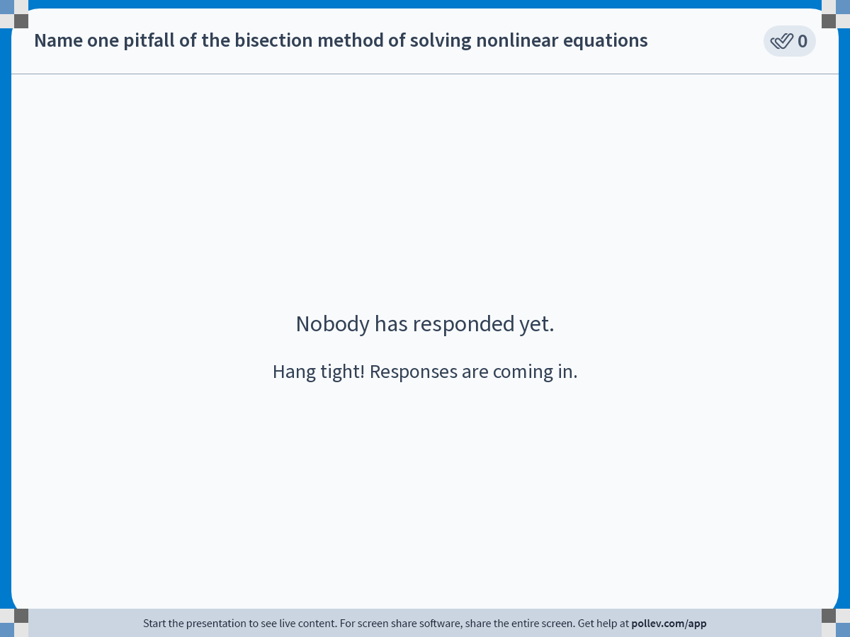
Notes:
Poll Title: Do not modify the notes in this section to avoid tampering with the Poll Everywhere activity.
More info at polleverywhere.com/support
Name one pitfall of the bisection method of solving nonlinear equations
https://www.polleverywhere.com/free_text_polls/bMAg6MkqumkObJz1quMMT

Slide 8
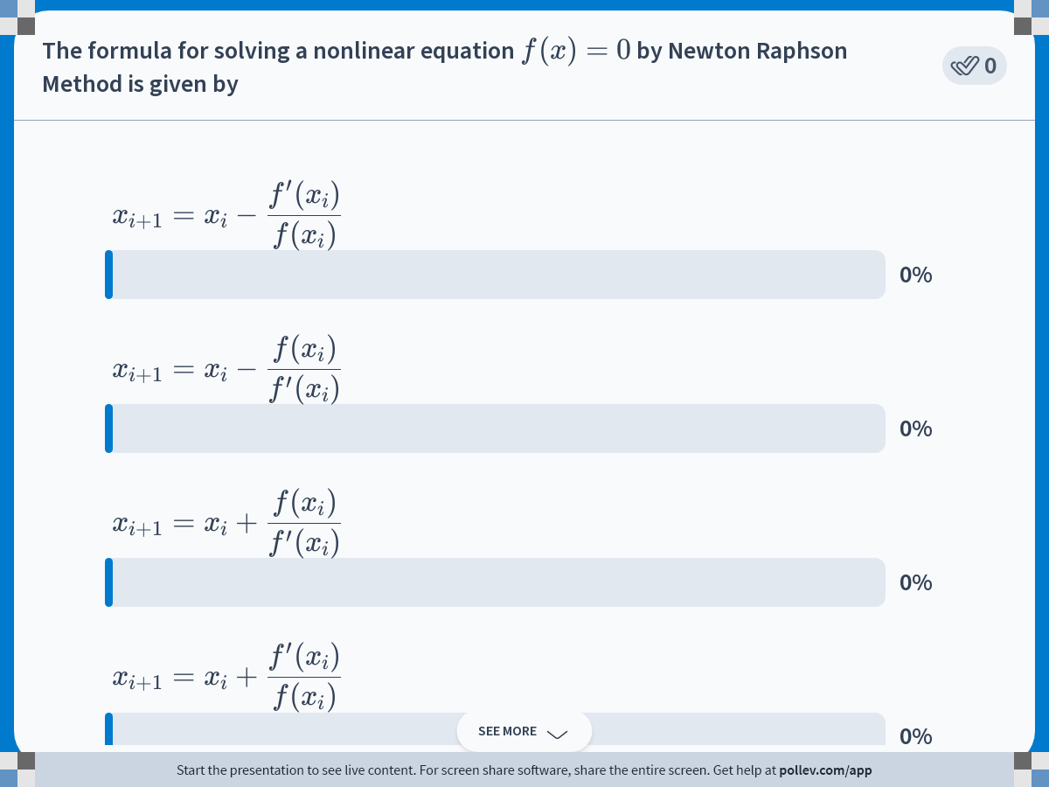
Notes:
Poll Title: Do not modify the notes in this section to avoid tampering with the Poll Everywhere activity.
More info at polleverywhere.com/support
The formula for solving a nonlinear equation $$f(x)=0$$ by Newton Raphson Method is given by
https://www.polleverywhere.com/multiple_choice_polls/iFPnAi6HFyCOci53g9ZSd

Slide 9
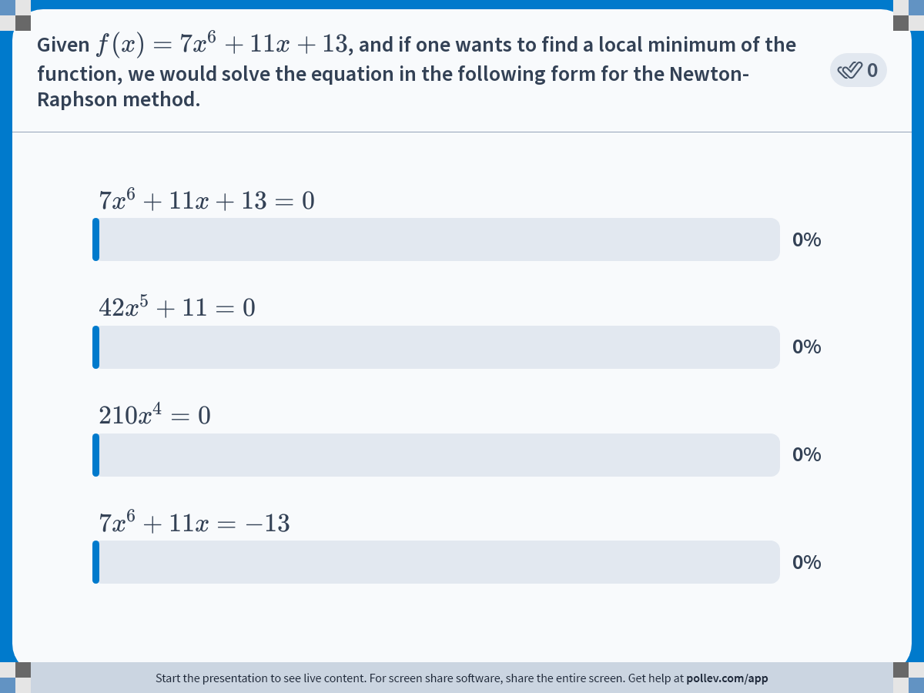
Notes:
Poll Title: Do not modify the notes in this section to avoid tampering with the Poll Everywhere activity.
More info at polleverywhere.com/support
Given $$f(x)=7x^6+11x+13$$, and if one wants to find a local minimum of the function, we would solve the equation in the following form for the Newton-Raphson method.
https://www.polleverywhere.com/multiple_choice_polls/FkiRCI9cmJ51guLZkr25N

Slide 10

Notes:
Poll Title: Do not modify the notes in this section to avoid tampering with the Poll Everywhere activity.
More info at polleverywhere.com/support
Newton Raphson Method
https://www.polleverywhere.com/multiple_choice_polls/SEZ9KvN42LyA4LqQsN1ub

Slide 11
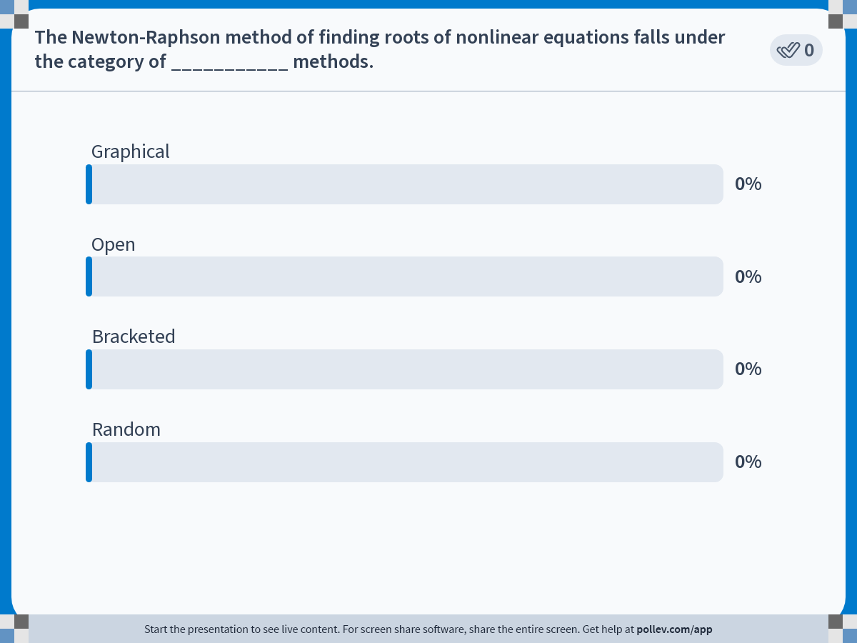
Notes:
Poll Title: Do not modify the notes in this section to avoid tampering with the Poll Everywhere activity.
More info at polleverywhere.com/support
The Newton-Raphson method of finding roots of nonlinear equations falls under the category of ___________ methods.
https://www.polleverywhere.com/multiple_choice_polls/aQ13Yl6lwKKPE8FbtcQNe

Slide 12
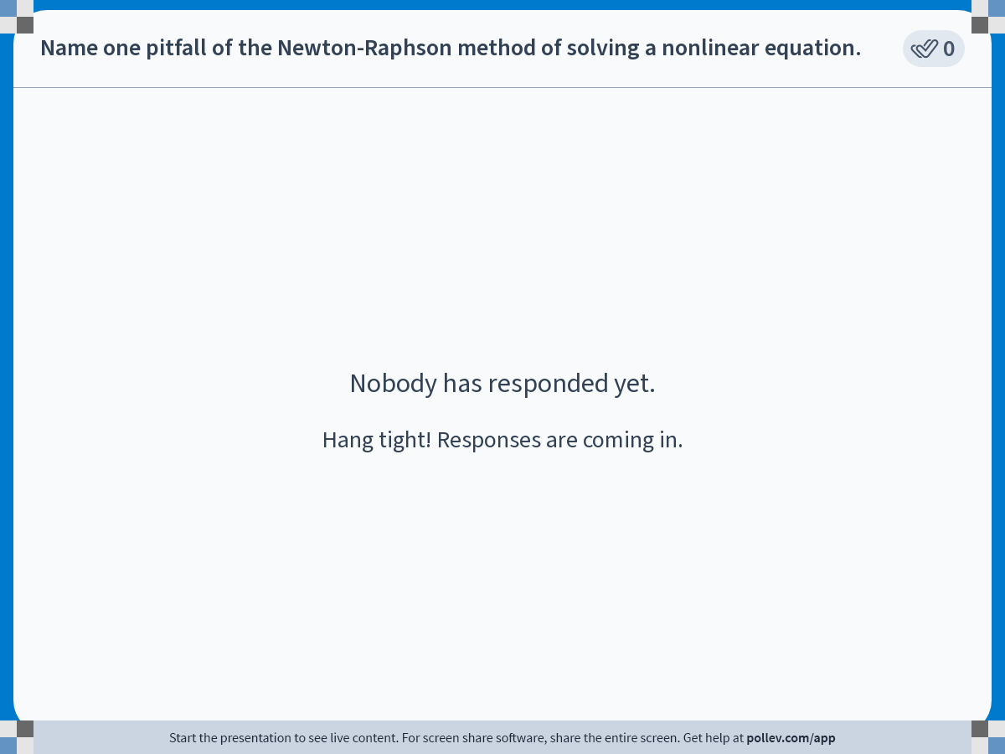
Notes:
Poll Title: Do not modify the notes in this section to avoid tampering with the Poll Everywhere activity.
More info at polleverywhere.com/support
Name one pitfall of the Newton-Raphson method of solving a nonlinear equation.
https://www.polleverywhere.com/free_text_polls/CyM189FCK6MVJX1hFcKvD

