Slide 1
Simultaneous Linear Equations and Matrix Algebra
Major: All Engineering Majors
Author(s): Autar Kaw
http://nm.MathForCollege.com
Transforming Numerical Methods Education for STEM Undergraduates

Slide 2

Notes:
Poll Title: Do not modify the notes in this section to avoid tampering with the Poll Everywhere activity.
More info at polleverywhere.com/support
How do you find what you need to study and do for the course? (CHECK ALL THOSE APPLY)
https://www.polleverywhere.com/multiple_choice_polls/vvuAjVPzORhC4tH0Lf0dF

Slide 3
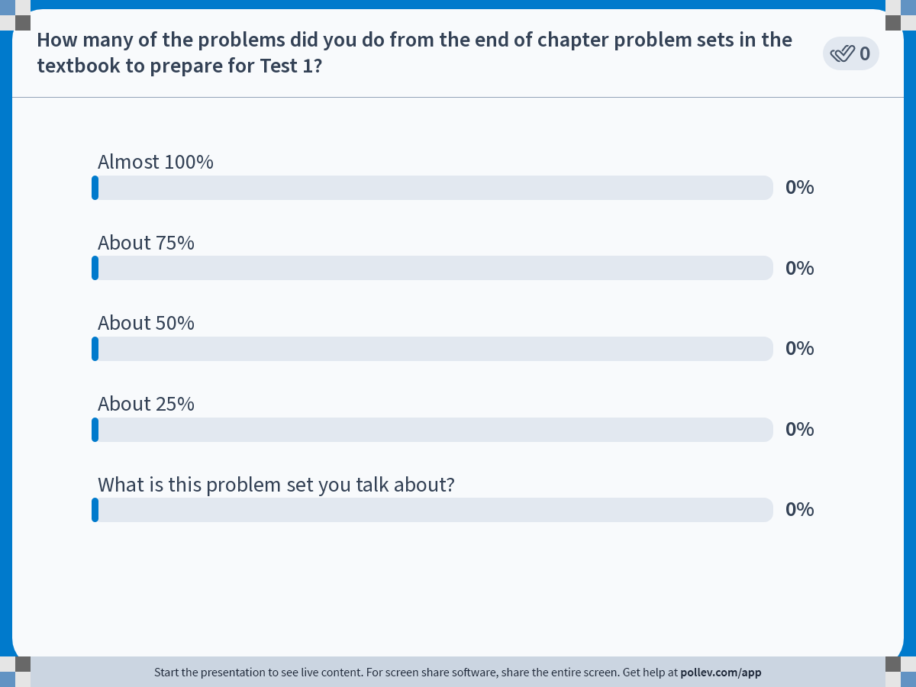
Notes:
Poll Title: Do not modify the notes in this section to avoid tampering with the Poll Everywhere activity.
More info at polleverywhere.com/support
How many of the problems did you do from the end of chapter problem sets in the textbook to prepare for Test 1?
https://www.polleverywhere.com/multiple_choice_polls/3tyMRuRWc7G3cVES4AHUR

Slide 4
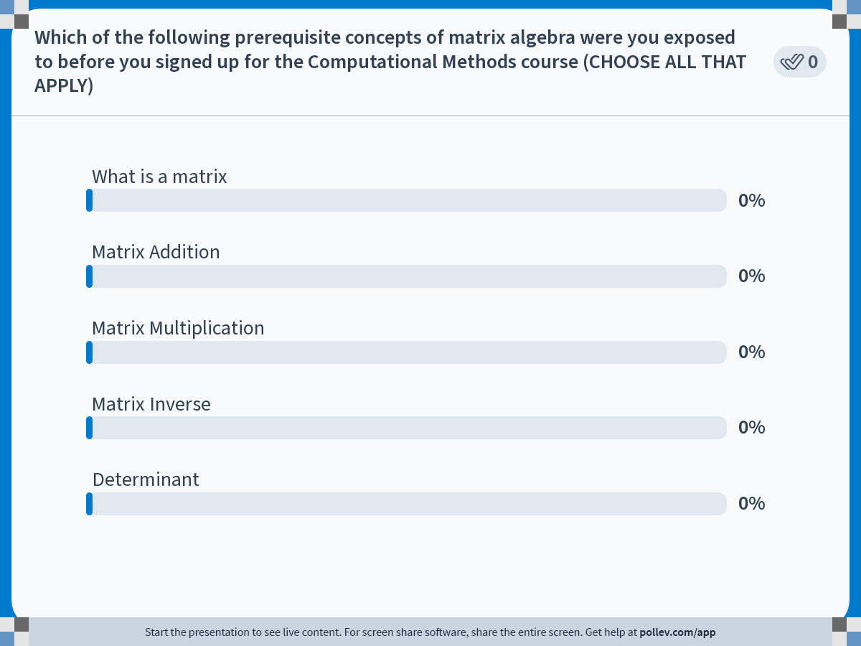
Notes:
Poll Title: Do not modify the notes in this section to avoid tampering with the Poll Everywhere activity.
More info at polleverywhere.com/support
Which of the following prerequisite concepts of matrix algebra were you exposed to before you signed up for the Computational Methods course (CHOOSE ALL THAT APPLY)
https://www.polleverywhere.com/multiple_choice_polls/ZU5rEL8Lg0GCxQ5kNK8tw?state=opened&flow=Default&onscreen=persist

Slide 5
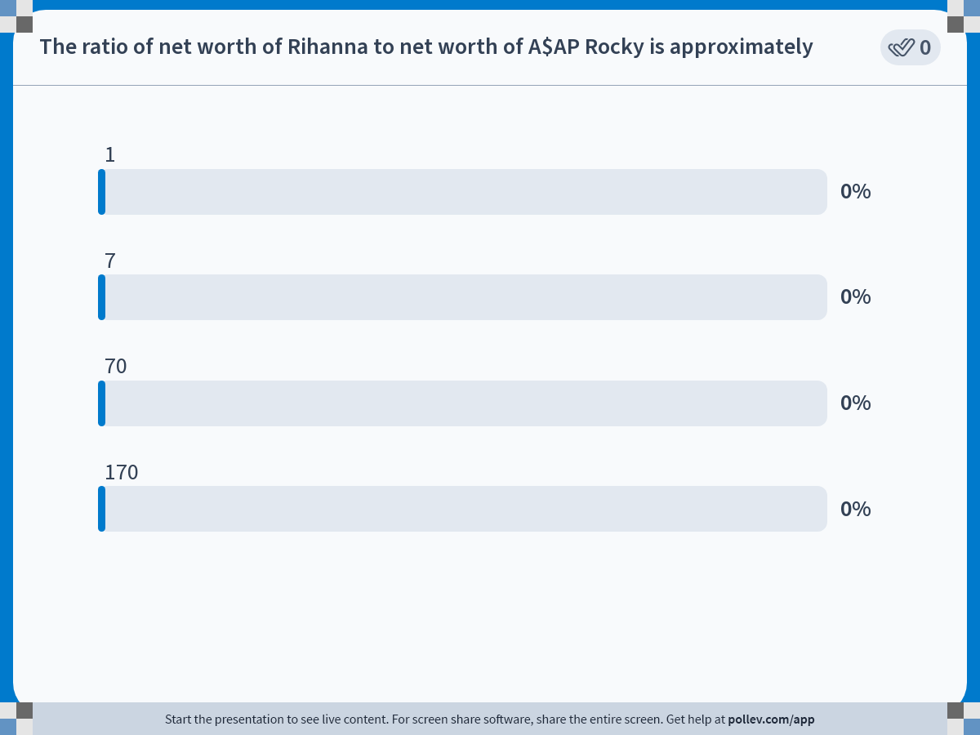
Notes:
Poll Title: Do not modify the notes in this section to avoid tampering with the Poll Everywhere activity.
More info at polleverywhere.com/support
The ratio of net worth of Rihanna to net worth of A$AP Rocky is approximately
https://www.polleverywhere.com/multiple_choice_polls/48Df31DfZuvoq15bzzTF7

Slide 6
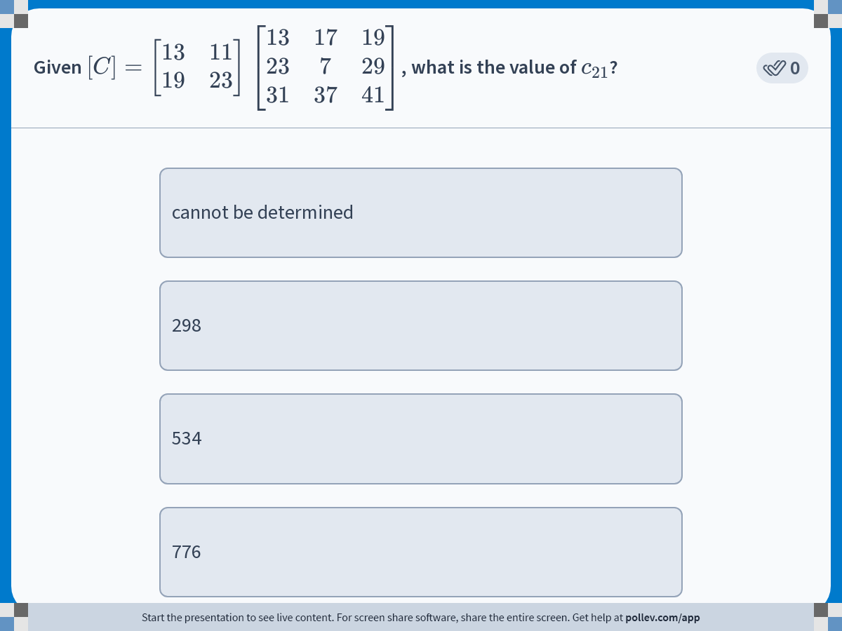
Notes:
Poll Title: Do not modify the notes in this section to avoid tampering with the Poll Everywhere activity.
More info at polleverywhere.com/support
Given $$[C] = \\left[\\begin{matrix}13 & 11 & 17 \\\\ 19 & 23 & 29\\end{matrix}\\right] \\times \\left[\\begin{matrix}13 & 17 & 19 & 29\\\\31 & 37 & 41 & 45\\end{matrix}\\right]$$, what is the value of $$c_{21}$$?
https://www.polleverywhere.com/multiple_choice_polls/wnhQBeBTNe80M3vbLrf04?display_state=instructions&activity_state=opened&state=opened&flow=Engagement&onscreen=persist

Slide 7
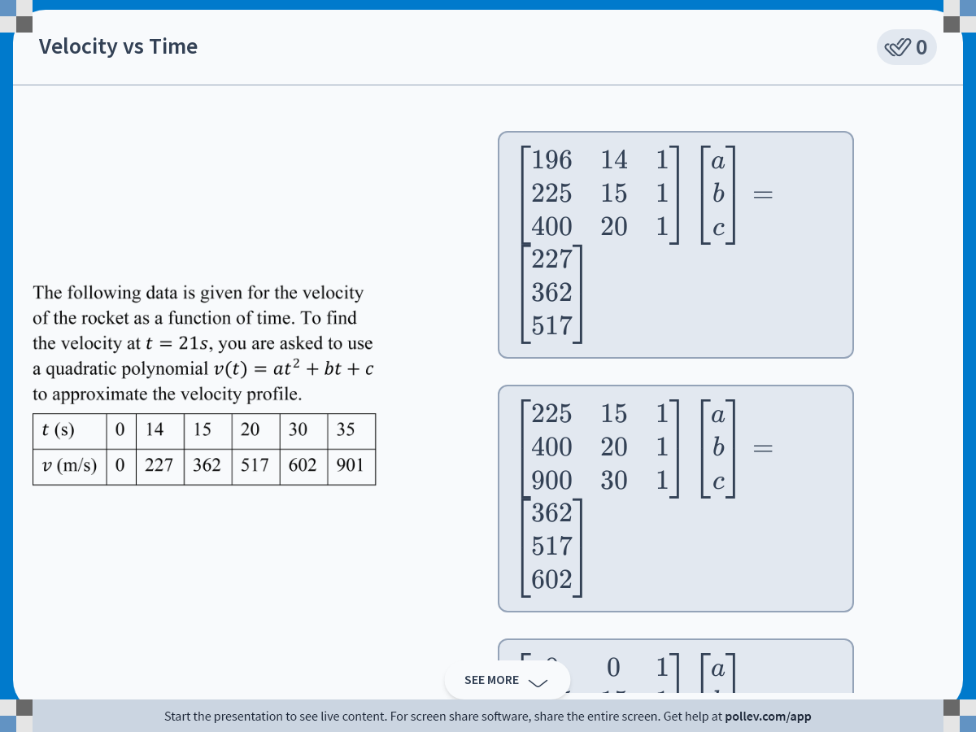
Notes:
Poll Title: Do not modify the notes in this section to avoid tampering with the Poll Everywhere activity.
More info at polleverywhere.com/support
Velocity vs Time
https://www.polleverywhere.com/multiple_choice_polls/mD7Ap5dmAcuJKAiNvwwpo?display_state=instructions&activity_state=opened&state=opened&flow=Engagement&onscreen=persist

Slide 8
Physical Problems

Slide 9
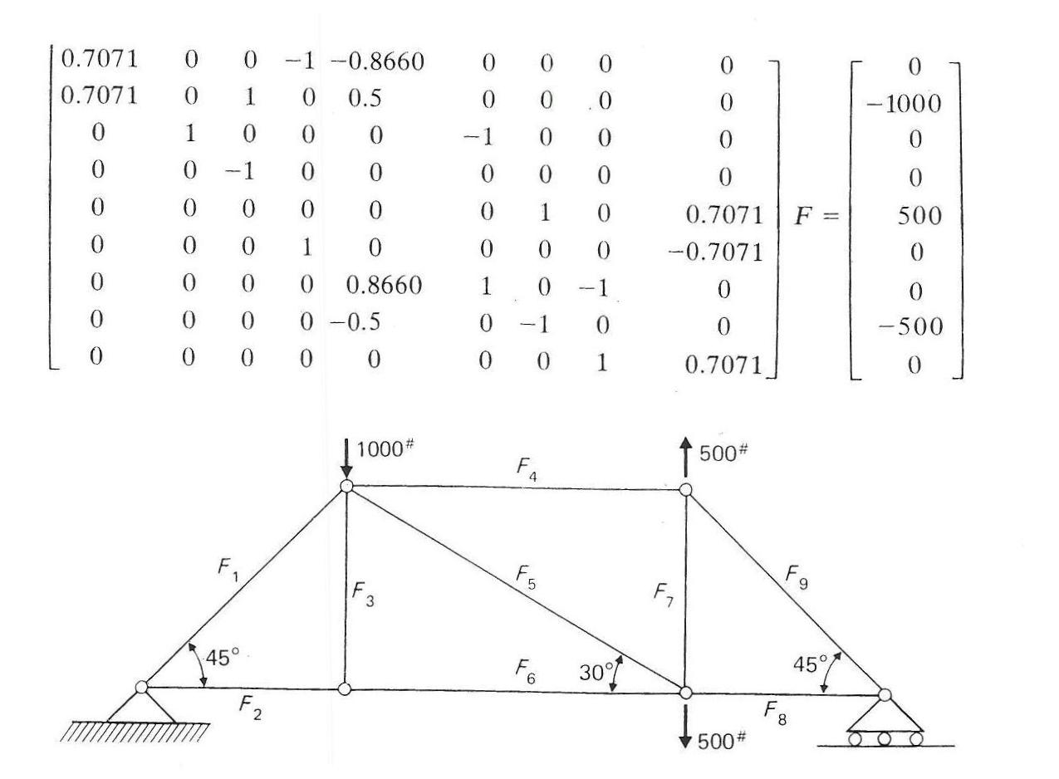
Truss Problem

Slide 10
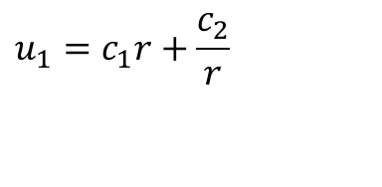
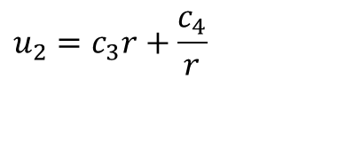
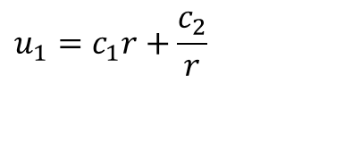
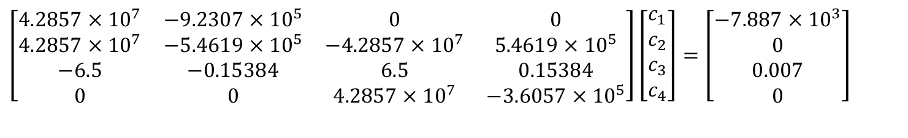
Pressure vessel problem
a
a
c
b
b
$$u_{1}=c_{1}r+\frac{c_{2}}{r}$$
$$u_{1}=c_{1}r+\frac{c_{2}}{r}$$
$$u_{2}=c_{3}r+\frac{c_{4}}{r}$$
$$\left[\begin{matrix}4.2857×10^{7} & −9.2307×10^{5} & 0 & 0 \\ 4.2857×10^{7} & −5.4619×10^{5} & −4.2857×10^{7} & 5.4619×10^{5} \\ −6.5 & −0.15384 & 6.5 & 0.15384 \\ 0 & 0 & 4.2857×10^{7} & −3.6057×10^{5}\end{matrix}\right]\left[\begin{matrix}c_{1} \\ c_{2} \\ c_{3} \\ c_{4}\end{matrix}\right]=\left[\begin{matrix}−7.887×10^{3} \\ 0 \\ 0.007 \\ 0\end{matrix}\right]$$

Slide 11
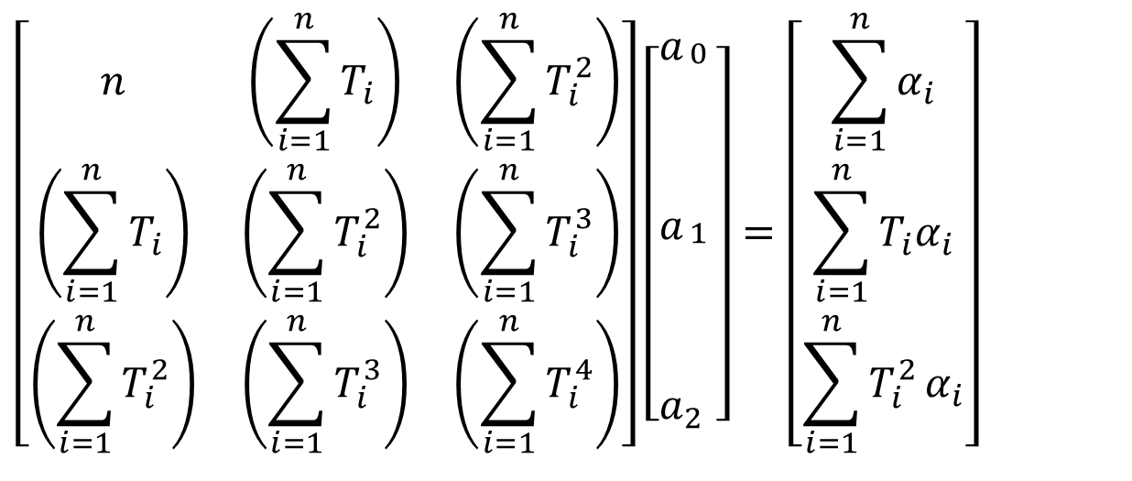
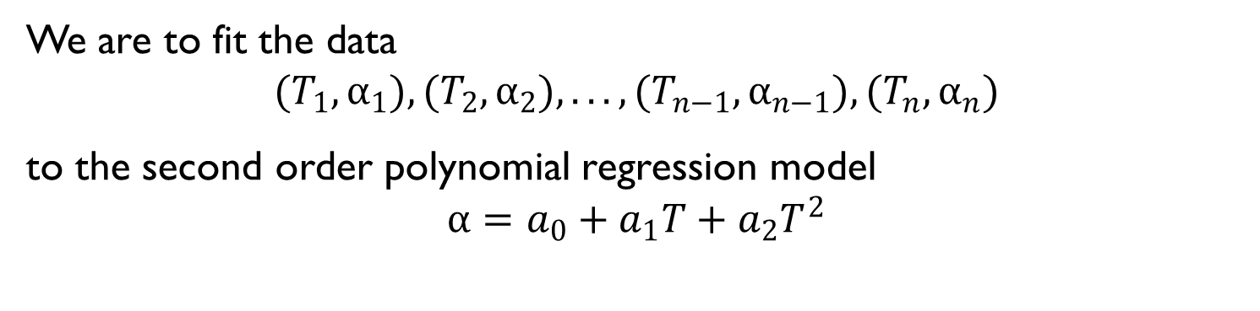
Polynomial Regression
We are to fit the data
$$(T_{1},α_{1}),(T_{2},α_{2}),...,(T_{n−1},α_{n−1}),(T_{n},α_{n})$$
to the second order polynomial regression model
$$α=a_{0}+a_{1}T+a_{2}T^{2}$$
$$\left[\begin{matrix}n & \left(\sum_{i=1}^{n}{T_{i}}\right) & \left(\sum_{i=1}^{n}{T_{i}^{2}}\right) \\ \left(\sum_{i=1}^{n}{T_{i}}\right) & \left(\sum_{i=1}^{n}{T_{i}^{2}}\right) & \left(\sum_{i=1}^{n}{T_{i}^{3}}\right) \\ \left(\sum_{i=1}^{n}{T_{i}^{2}}\right) & \left(\sum_{i=1}^{n}{T_{i}^{3}}\right) & \left(\sum_{i=1}^{n}{T_{i}^{4}}\right)\end{matrix}\right]\left[\begin{aligned}&a_{\begin{aligned}0 \\ \\ \\ \\ \end{aligned}} \\ &a_{\begin{aligned}1 \\ \\ \\ \\ \end{aligned}} \\ &a_{2}\end{aligned}\right]=\left[\begin{matrix}\sum_{i=1}^{n}{α_{i}} \\ \sum_{i=1}^{n}{T_{i}α_{i}} \\ \sum_{i=1}^{n}{T_{i}^{2}}α_{i}\end{matrix}\right]$$

Slide 12
END

Slide 13
Inverse of a matrix

Slide 14
Definition of Inverse
A matrix [B] is inverse of [A] if [B][A]=[I].

Slide 15
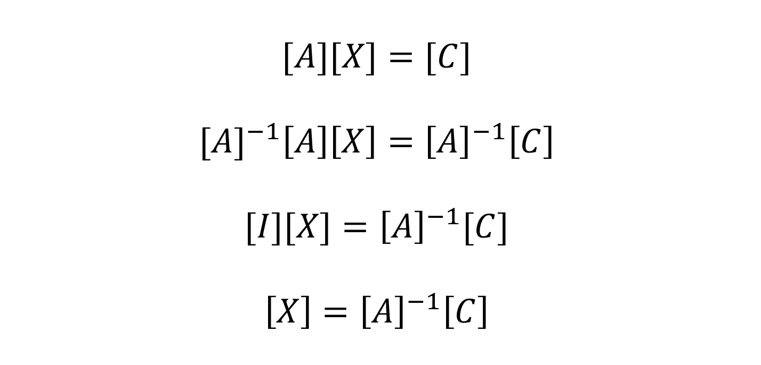
Application of Inverse
$$[A][X]=[C]$$
$${[A]}^{−1}\left[A\right]\left[X\right]={\left[A\right]}^{−1}\left[C\right]$$
$$[I][X]={\left[A\right]}^{−1}[C]$$
$$\left[X\right]={\left[A\right]}^{−1}\left[C\right]$$

Slide 16
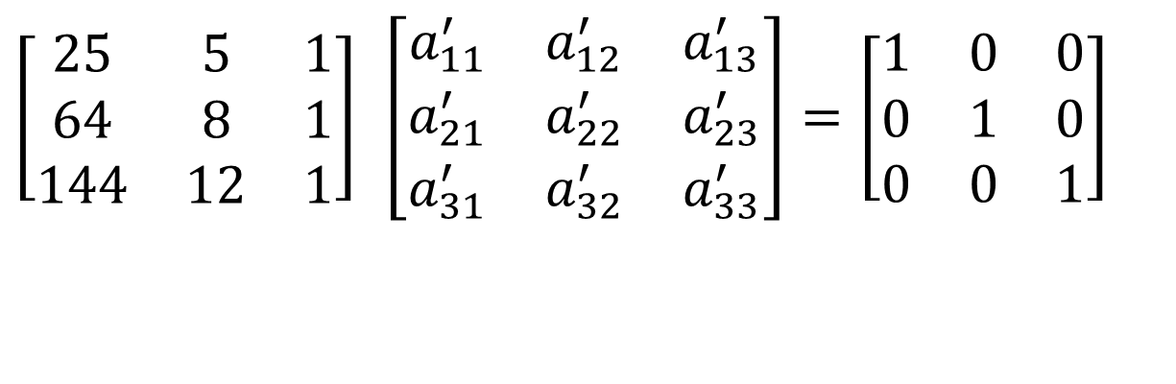
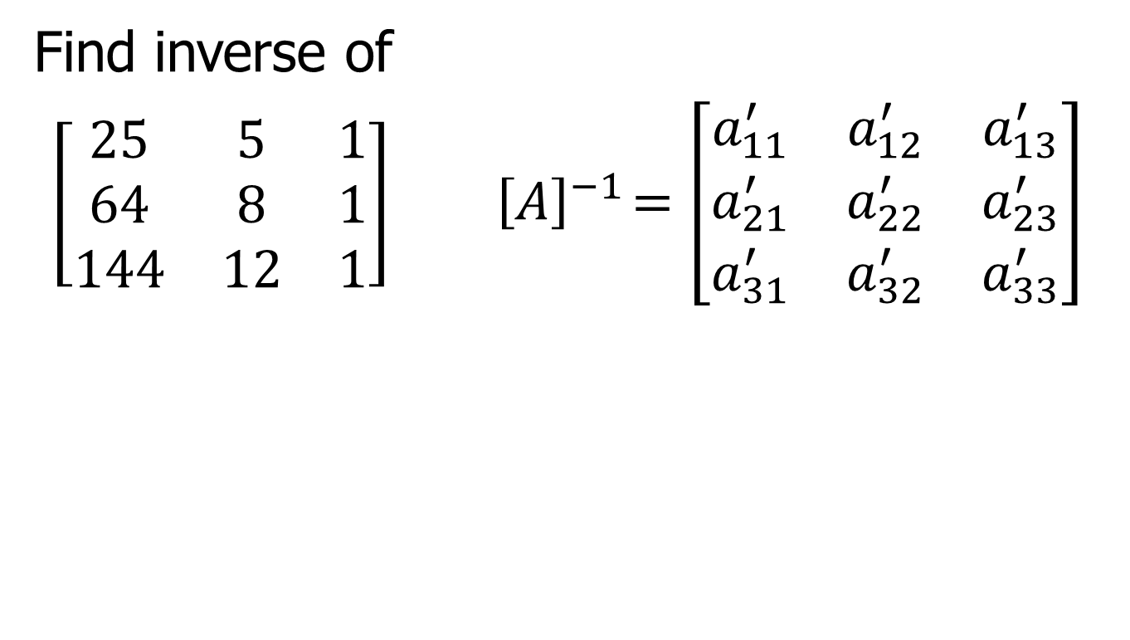
Find Inverse of Matrix
Find inverse of
$\left[\begin{matrix}25 & 5 & 1 \\ 64 & 8 & 1 \\ 144 & 12 & 1\end{matrix}\right]{ \left[A\right]}^{−1}=\left[\begin{matrix}a_{11}^{′} & a_{12}^{′} & a_{13}^{′} \\ a_{21}^{′} & a_{22}^{′} & a_{23}^{′} \\ a_{31}^{′} & a_{32}^{′} & a_{33}^{′}\end{matrix}\right]$
$$\left[\begin{matrix}25 & 5 & 1 \\ 64 & 8 & 1 \\ 144 & 12 & 1\end{matrix}\right] \left[\begin{matrix}a_{11}^{′} & a_{12}^{′} & a_{13}^{′} \\ a_{21}^{′} & a_{22}^{′} & a_{23}^{′} \\ a_{31}^{′} & a_{32}^{′} & a_{33}^{′}\end{matrix}\right]=\left[\begin{matrix}1 & 0 & 0 \\ 0 & 1 & 0 \\ 0 & 0 & 1\end{matrix}\right]$$

Slide 17
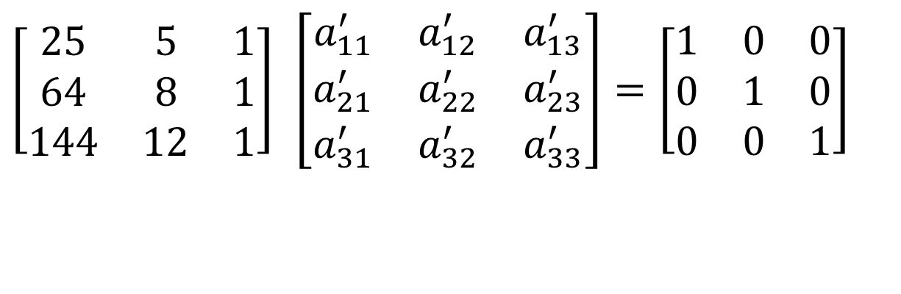
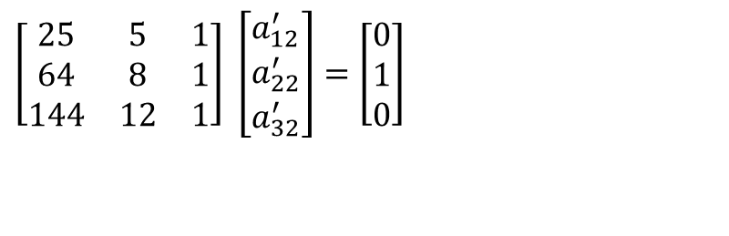
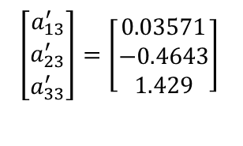
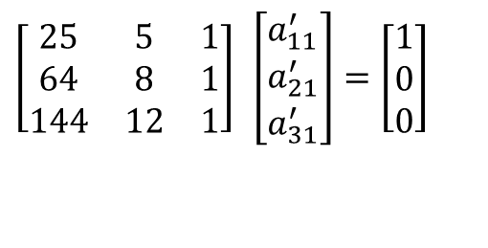
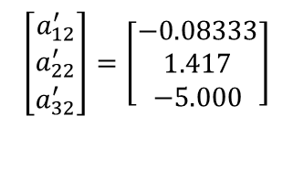
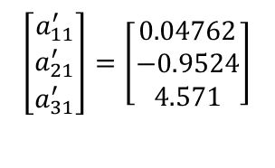
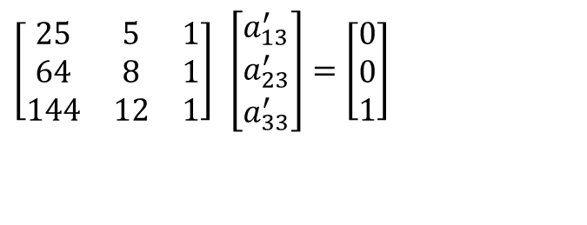
Setting up equations to find inverse
$$\left[\begin{matrix}25 & 5 & 1 \\ 64 & 8 & 1 \\ 144 & 12 & 1\end{matrix}\right] \left[\begin{matrix}a_{11}^{′} & a_{12}^{′} & a_{13}^{′} \\ a_{21}^{′} & a_{22}^{′} & a_{23}^{′} \\ a_{31}^{′} & a_{32}^{′} & a_{33}^{′}\end{matrix}\right]=\left[\begin{matrix}1 & 0 & 0 \\ 0 & 1 & 0 \\ 0 & 0 & 1\end{matrix}\right]$$
$$\left[\begin{matrix}25 & 5 & 1 \\ 64 & 8 & 1 \\ 144 & 12 & 1\end{matrix}\right] \left[\begin{matrix}a_{11}^{′} \\ a_{21}^{′} \\ a_{31}^{′}\end{matrix}\right]=\left[\begin{matrix}1 \\ 0 \\ 0\end{matrix}\right]$$
$$\left[\begin{matrix}a_{11}^{′} \\ a_{21}^{′} \\ a_{31}^{′}\end{matrix}\right]=\left[\begin{matrix}0.04762 \\ −0.9524 \\ 4.571\end{matrix}\right]$$
$$\left[\begin{matrix}25 & 5 & 1 \\ 64 & 8 & 1 \\ 144 & 12 & 1\end{matrix}\right] \left[\begin{matrix}a_{12}^{′} \\ a_{22}^{′} \\ a_{32}^{′}\end{matrix}\right]=\left[\begin{matrix}0 \\ 1 \\ 0\end{matrix}\right]$$
$$\left[\begin{matrix}a_{12}^{′} \\ a_{22}^{′} \\ a_{32}^{′}\end{matrix}\right]=\left[\begin{matrix}−0.08333 \\ 1.417 \\ −5.000\end{matrix}\right]$$
$$\left[\begin{matrix}25 & 5 & 1 \\ 64 & 8 & 1 \\ 144 & 12 & 1\end{matrix}\right] \left[\begin{matrix}a_{13}^{′} \\ a_{23}^{′} \\ a_{33}^{′}\end{matrix}\right]=\left[\begin{matrix}0 \\ 0 \\ 1\end{matrix}\right]$$
$$\left[\begin{matrix}a_{13}^{′} \\ a_{23}^{′} \\ a_{33}^{′}\end{matrix}\right]=\left[\begin{matrix}0.03571 \\ −0.4643 \\ 1.429\end{matrix}\right]$$

Slide 18
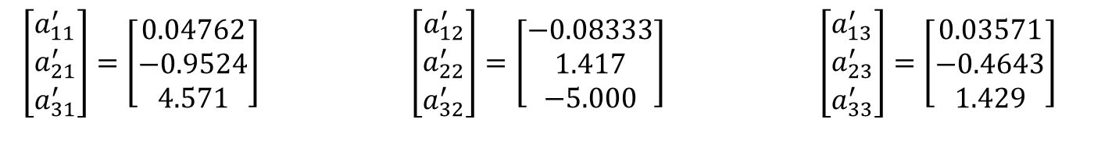
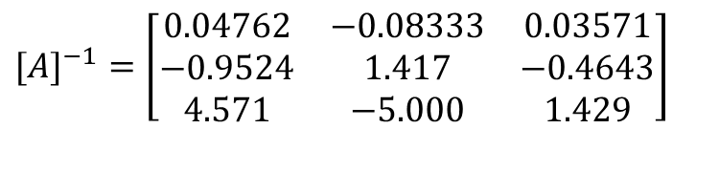
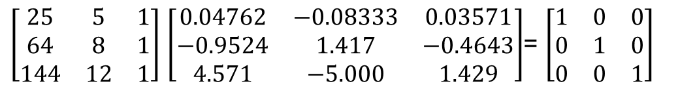

Putting the solutions in matrix
$\left[\begin{matrix}a_{11}^{′} \\ a_{21}^{′} \\ a_{31}^{′}\end{matrix}\right]=\left[\begin{matrix}0.04762 \\ −0.9524 \\ 4.571\end{matrix}\right] \left[\begin{matrix}a_{12}^{′} \\ a_{22}^{′} \\ a_{32}^{′}\end{matrix}\right]=\left[\begin{matrix}−0.08333 \\ 1.417 \\ −5.000\end{matrix}\right]$ $\left[\begin{matrix}a_{13}^{′} \\ a_{23}^{′} \\ a_{33}^{′}\end{matrix}\right]=\left[\begin{matrix}0.03571 \\ −0.4643 \\ 1.429\end{matrix}\right]$
$$[A]^{−1}=\left[\begin{matrix}0.04762 & −0.08333 & 0.03571 \\ −0.9524 & 1.417 & −0.4643 \\ 4.571 & −5.000 & 1.429\end{matrix}\right]$$
$\left[\begin{matrix}25 & 5 & 1 \\ 64 & 8 & 1 \\ 144 & 12 & 1\end{matrix}\right]$ $\left[\begin{matrix}0.04762 & −0.08333 & 0.03571 \\ −0.9524 & 1.417 & −0.4643 \\ 4.571 & −5.000 & 1.429\end{matrix}\right]$= $\left[\begin{matrix}1 & 0 & 0 \\ 0 & 1 & 0 \\ 0 & 0 & 1\end{matrix}\right]$

Slide 19
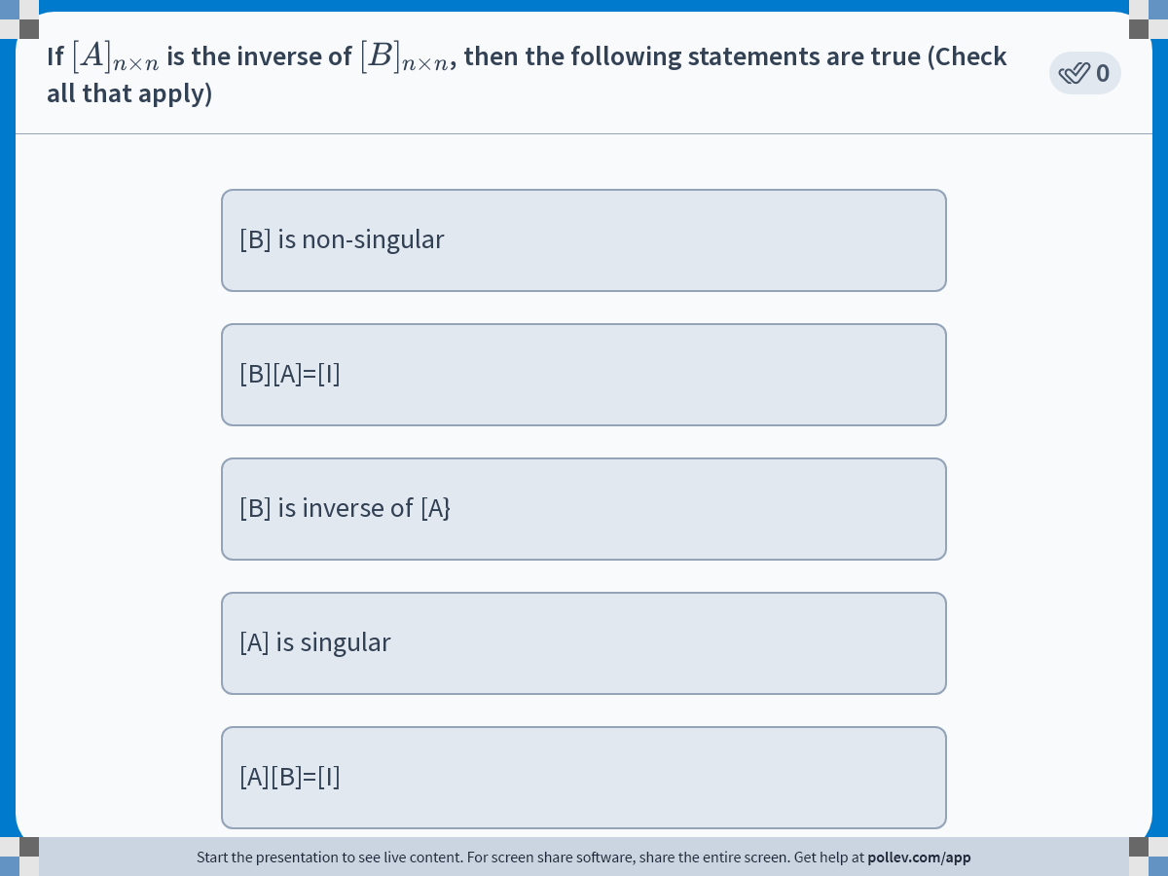
Notes:
Poll Title: Do not modify the notes in this section to avoid tampering with the Poll Everywhere activity.
More info at polleverywhere.com/support
If $$[A]_{n \\times n}$$ is the inverse of $$[B]_{n \\times n}$$, then the following statements are true
https://www.polleverywhere.com/multiple_choice_polls/8RFP8BnffnhviYGYP6AmU?display_state=instructions&activity_state=opened&state=opened&flow=Engagement&onscreen=persist

Slide 20
END

Slide 21
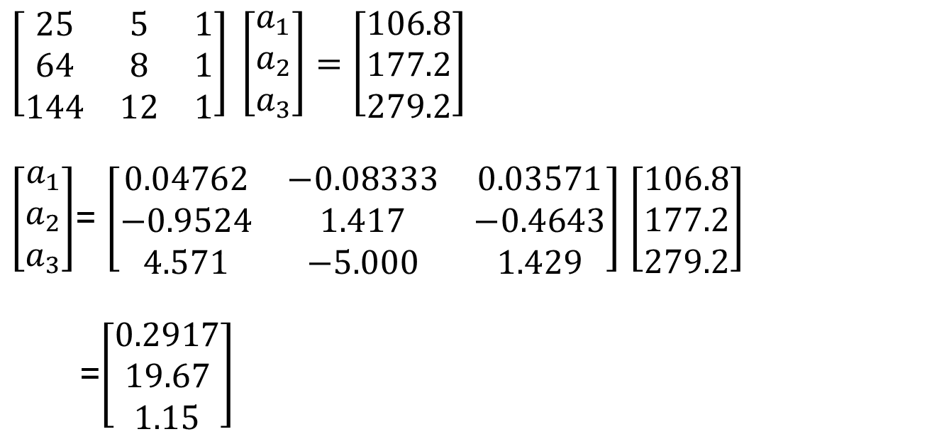
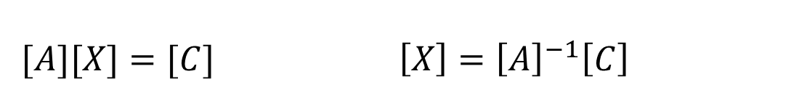
Solve a Set of Equations Using Inverse
$[A][X]=[C]$ $\left[X\right]={\left[A\right]}^{−1}\left[C\right]$
$$\left[\begin{matrix}25 & 5 & 1 \\ 64 & 8 & 1 \\ 144 & 12 & 1\end{matrix}\right] \left[\begin{matrix}a_{1} \\ a_{2} \\ a_{3}\end{matrix}\right]=\left[\begin{matrix}106.8 \\ 177.2 \\ 279.2\end{matrix}\right]$$
$\left[\begin{matrix}a_{1} \\ a_{2} \\ a_{3}\end{matrix}\right]$= $\left[\begin{matrix}0.04762 & −0.08333 & 0.03571 \\ −0.9524 & 1.417 & −0.4643 \\ 4.571 & −5.000 & 1.429\end{matrix}\right]$ $\left[\begin{matrix}106.8 \\ 177.2 \\ 279.2\end{matrix}\right]$
=$\left[\begin{matrix}0.2917 \\ 19.67 \\ 1.15\end{matrix}\right]$

Slide 22
Naive Gauss Elimination Synopsis

Slide 23
Naive Gaussian Elimination
A method to solve simultaneous linear equations of the form [A][X]=[C]
Two parts
1. Forward Elimination
2. Back Substitution

Slide 24
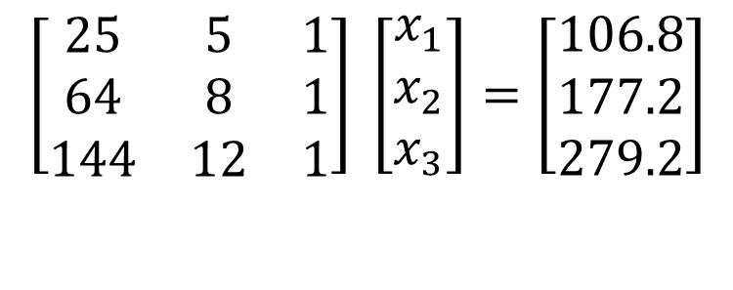
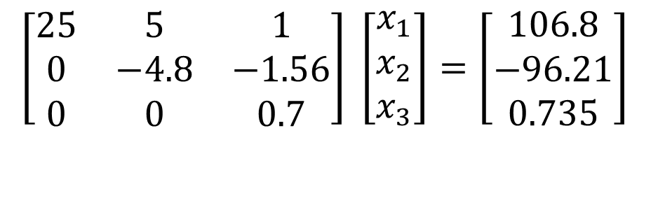
Forward Elimination Part
The goal of forward elimination is to transform the coefficient matrix into an upper triangular matrix
$$\left[\begin{matrix}25 & 5 & 1 \\ 64 & 8 & 1 \\ 144 & 12 & 1\end{matrix}\right] \left[\begin{matrix}x_{1} \\ x_{2} \\ x_{3}\end{matrix}\right]=\left[\begin{matrix}106.8 \\ 177.2 \\ 279.2\end{matrix}\right]$$
$$\left[\begin{matrix}25 & 5 & 1 \\ 0 & −4.8 & −1.56 \\ 0 & 0 & 0.7\end{matrix}\right] \left[\begin{matrix}x_{1} \\ x_{2} \\ x_{3}\end{matrix}\right]=\left[\begin{matrix}106.8 \\ −96.21 \\ 0.735\end{matrix}\right]$$

Slide 25
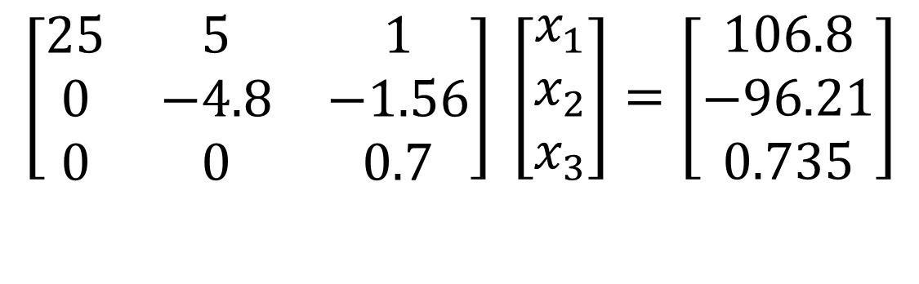
Back Substitution
Solve each equation starting from the last equation
$$\left[\begin{matrix}25 & 5 & 1 \\ 0 & −4.8 & −1.56 \\ 0 & 0 & 0.7\end{matrix}\right] \left[\begin{matrix}x_{1} \\ x_{2} \\ x_{3}\end{matrix}\right]=\left[\begin{matrix}106.8 \\ −96.21 \\ 0.735\end{matrix}\right]$$

Slide 26
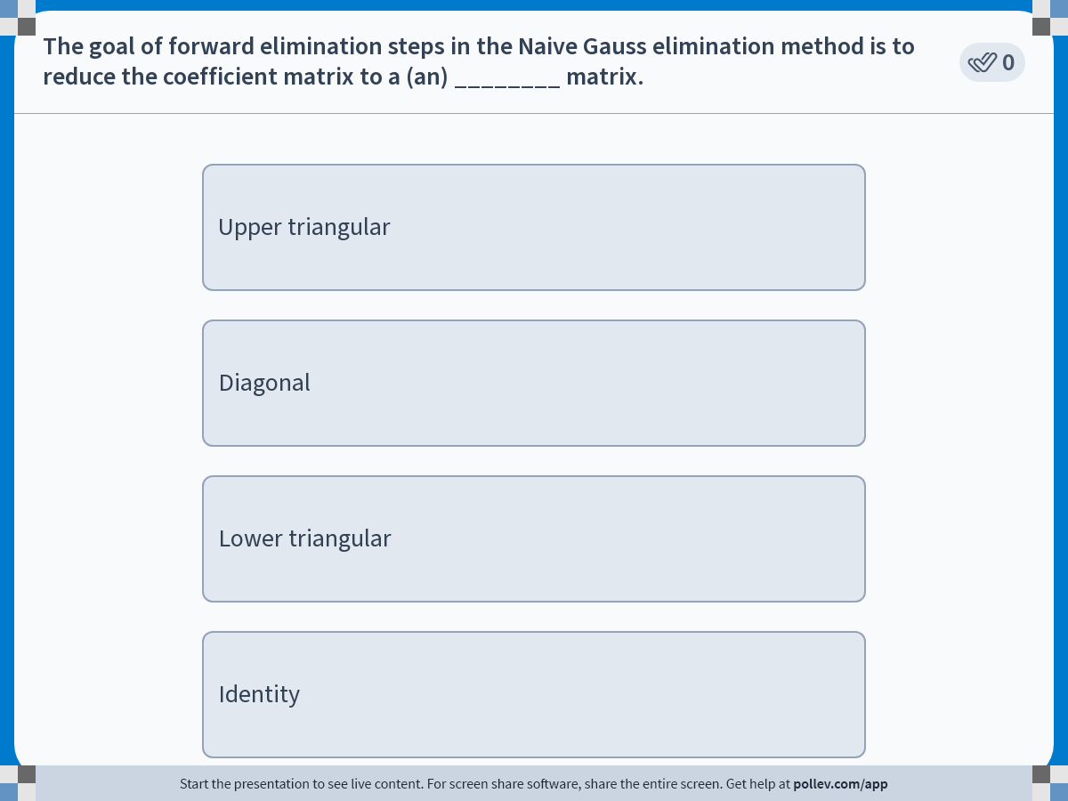
Notes:
Poll Title: Do not modify the notes in this section to avoid tampering with the Poll Everywhere activity.
More info at polleverywhere.com/support
The goal of forward elimination steps in the Naive Gauss elimination method is to reduce the coefficient matrix to a (an) ________ matrix.
https://www.polleverywhere.com/multiple_choice_polls/hRYAJ3zanqGJs2tjKOlD9?display_state=instructions&activity_state=opened&state=opened&flow=Engagement&onscreen=persist

Slide 27
END

Slide 28
Determinant of a Square Matrix Using Naïve Gauss Elimination

Slide 29
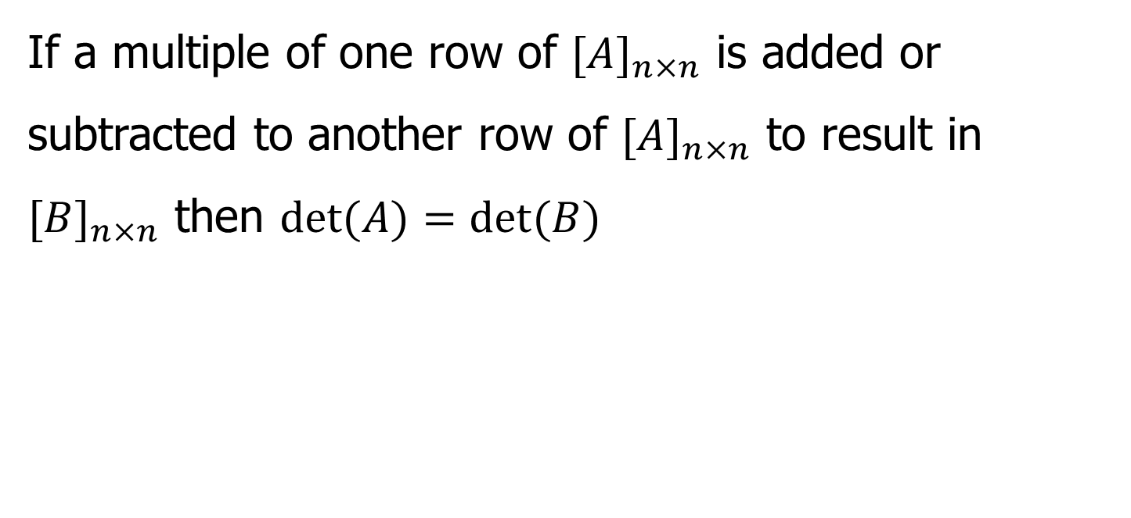
Theorem of Determinants
If a multiple of one row of ${[A]}_{n×n}$ is added or subtracted to another row of ${[A]}_{n×n}$ to result in ${[B]}_{n×n}$ then $det⁡(A)=det⁡(B)$
Notes:
29

Slide 30
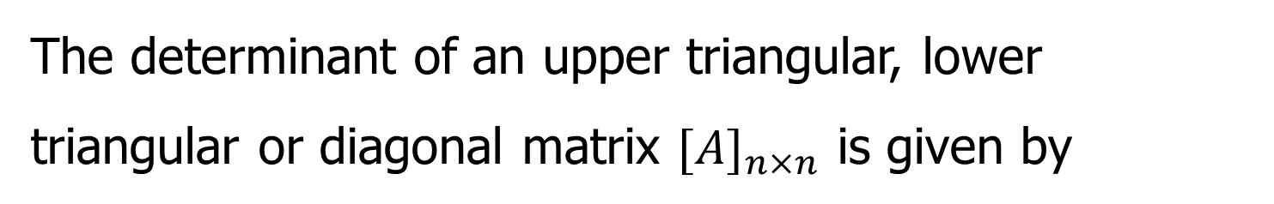
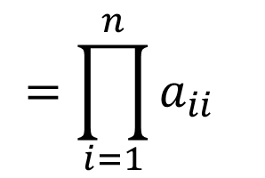
Theorem of Determinants
The determinant of an upper triangular, lower triangular or diagonal matrix ${[A]}_{n×n}$ is given by
$$\text{det}\left(A\right)=a_{11}×a_{22}×...×a_{ii}×...×a_{nn}$$
$$=\prod_{i=1}^{n}{a_{ii}}$$
Notes:
30

Slide 31

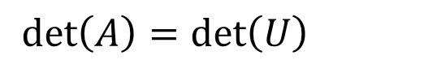
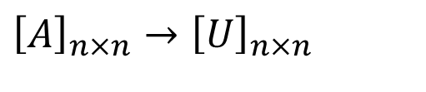
Forward Elimination of a Square Matrix
Use forward elimination part to transform ${[A]}_{n×n}$ to an upper triangular matrix, ${[U]}_{n×n}$ .
$${\left[A\right]}_{n×n}→{\left[U\right]}_{n×n}$$
$$\det\left(A\right)=\det\left(U\right)$$
Notes:
31

Slide 32
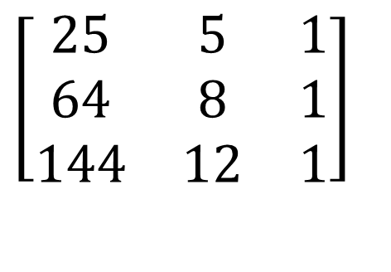
Using Naive Gaussian Elimination method, find the determinant of the following square matrix.
$$\left[\begin{matrix}25 & 5 & 1 \\ 64 & 8 & 1 \\ 144 & 12 & 1\end{matrix}\right]$$
Notes:
32

Slide 33
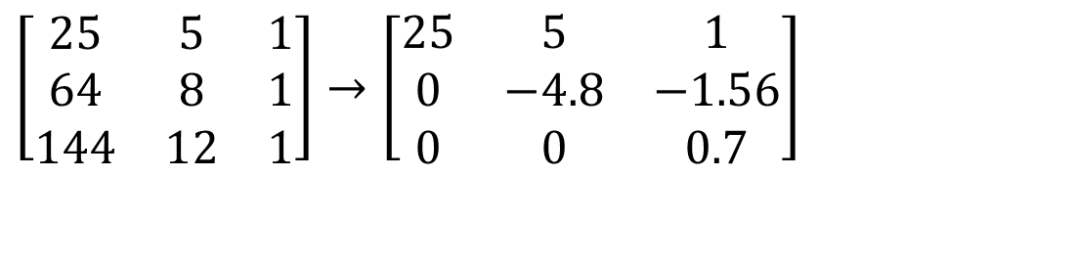
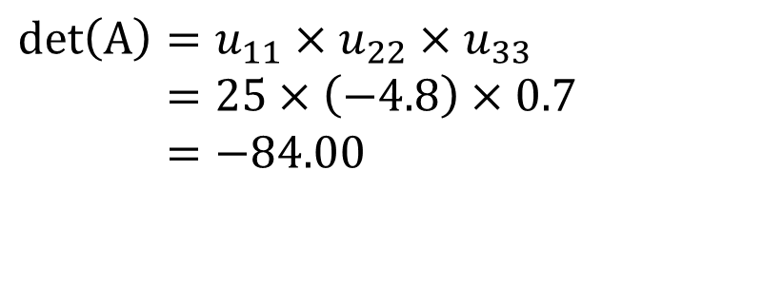
Finding the Determinant
After forward elimination part
$$\left[\begin{matrix}25 & 5 & 1 \\ 64 & 8 & 1 \\ 144 & 12 & 1\end{matrix}\right]→\left[\begin{matrix}25 & 5 & 1 \\ 0 & −4.8 & −1.56 \\ 0 & 0 & 0.7\end{matrix}\right]$$
.
$$\text{det}\left(A\right)=u_{11}×u_{22}×u_{33} \\ =25×\left(−4.8\right)×0.7 \\ =−84.00$$
Notes:
33

Slide 34
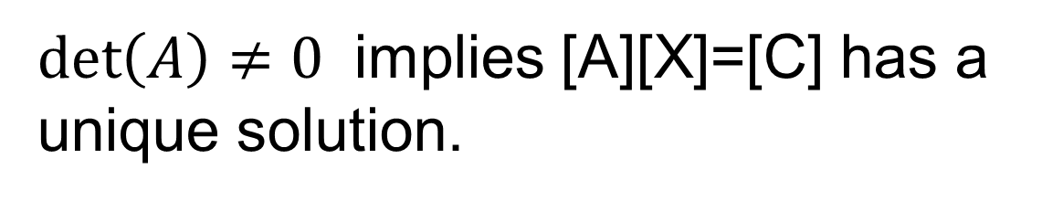
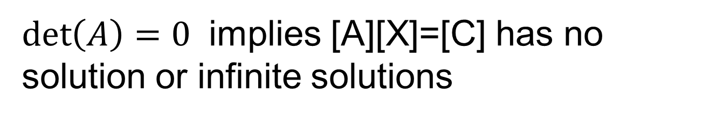
What does det(A)=0 and det(A)≠0 mean for [A][X]=[C]
$\det\left(A\right)=0$ implies [A][X]=[C] has no solution or infinite solutions
$\det\left(A\right)≠0$ implies [A][X]=[C] has a unique solution.

Slide 35
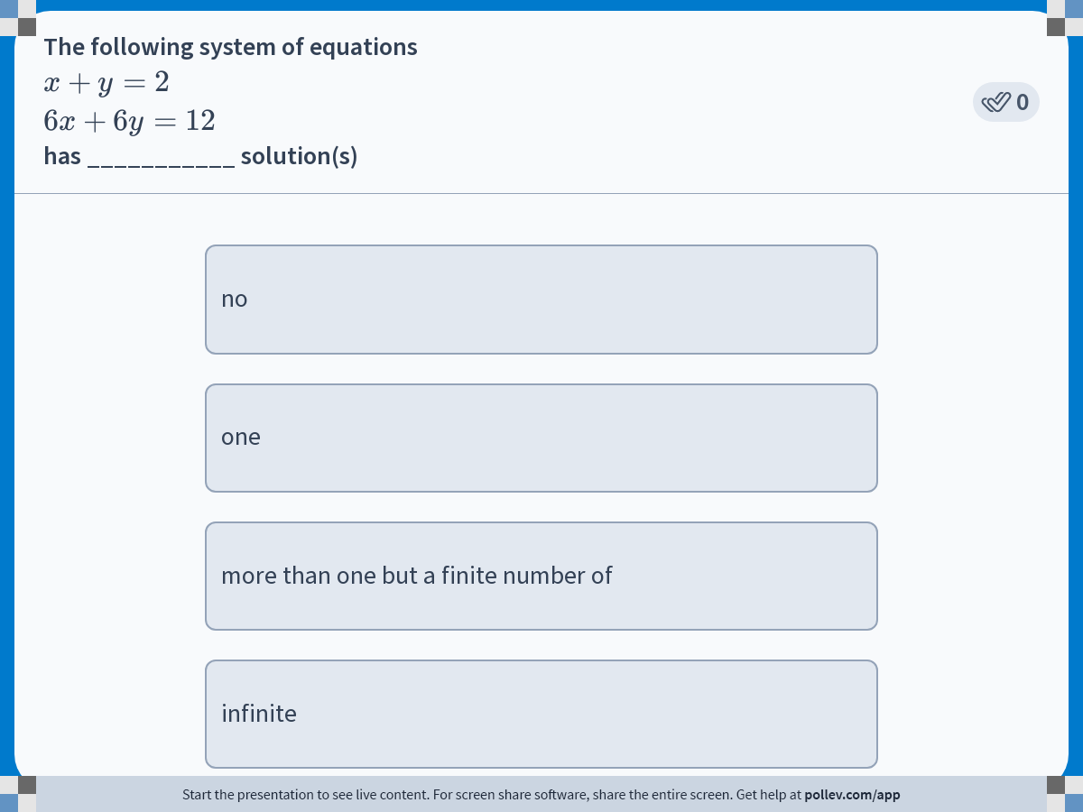
Notes:
Poll Title: Do not modify the notes in this section to avoid tampering with the Poll Everywhere activity.
More info at polleverywhere.com/support
The following system of equations $$x+y=2$$ $$6x+6y=12$$ has ___________ solution(s)
https://www.polleverywhere.com/multiple_choice_polls/wfMi5kdKs7eCjv2R9Vrow?display_state=instructions&activity_state=opened&state=opened&flow=Engagement&onscreen=persist

Slide 36
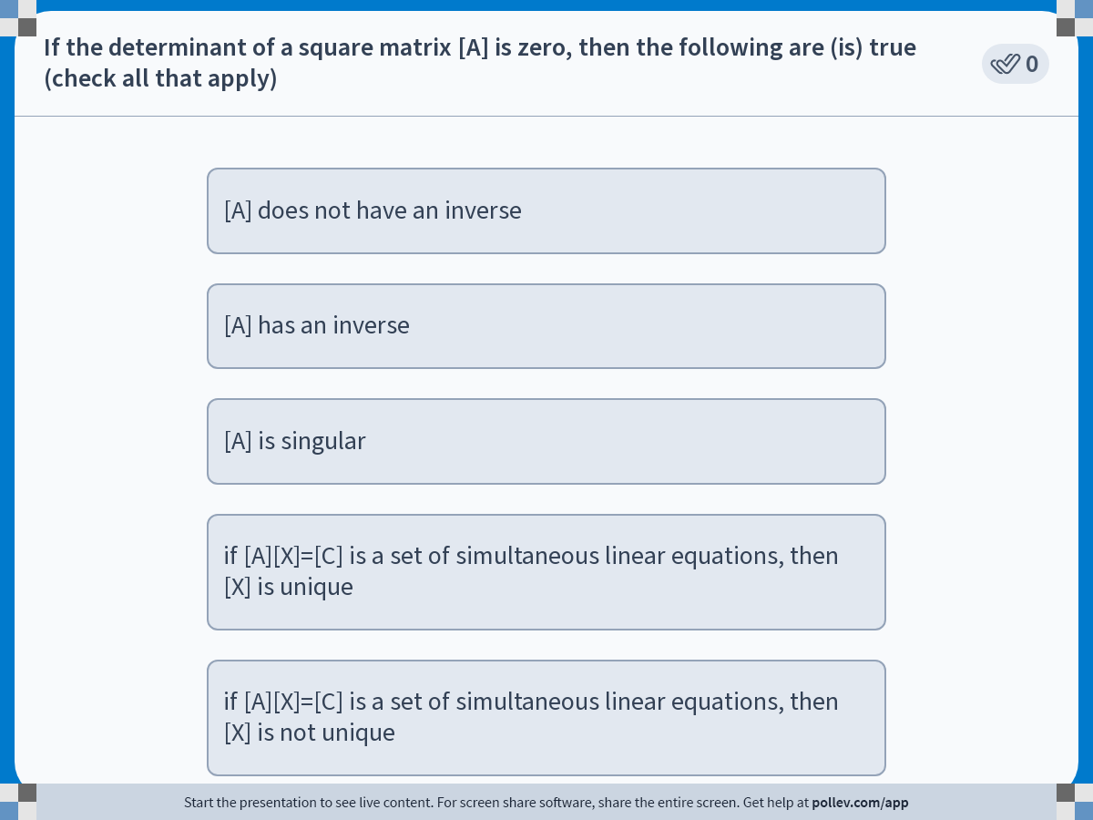
Notes:
Poll Title: Do not modify the notes in this section to avoid tampering with the Poll Everywhere activity.
More info at polleverywhere.com/support
If the determinant of a square matrix [A] is zero, then the following are (is) true
https://www.polleverywhere.com/multiple_choice_polls/RWQ04p4p0WXmfWIHYDscS?display_state=instructions&activity_state=opened&state=opened&flow=Engagement&onscreen=persist

Slide 37


