Slide 1
Gaussian Elimination with Partial Pivoting
http://nm.MathForCollege.com
Transforming Numerical Methods Education for STEM Undergraduates

Slide 2
Regrading and Asking Questions About Test
You can submit your test for re-grading. Submit to me in class, or see me during office hours, or slip under the ENC2215 door the graded test about which questions you want to be re-graded and a statement of why you think they need re-grading. Make this submission within ten business days of the test being returned.
Just want to see how a problem is solved – ask during office hours of any three of us, or make an appointment outside of office hours, etc.

Slide 3

Notes:
Poll Title: Do not modify the notes in this section to avoid tampering with the Poll Everywhere activity.
More info at polleverywhere.com/support
You know Lady Gaga; Who is Shady Gaga
https://www.polleverywhere.com/multiple_choice_polls/AX48BQeL0lsKRxVUJFCoP?state=opened&flow=Default&onscreen=persist

Slide 4

Notes:
Poll Title: Do not modify the notes in this section to avoid tampering with the Poll Everywhere activity.
More info at polleverywhere.com/support
What is your learning style?
https://www.polleverywhere.com/multiple_choice_polls/K2YgqbAs1P8i8BGzdGRN3?state=opened&flow=Default&onscreen=persist

Slide 5
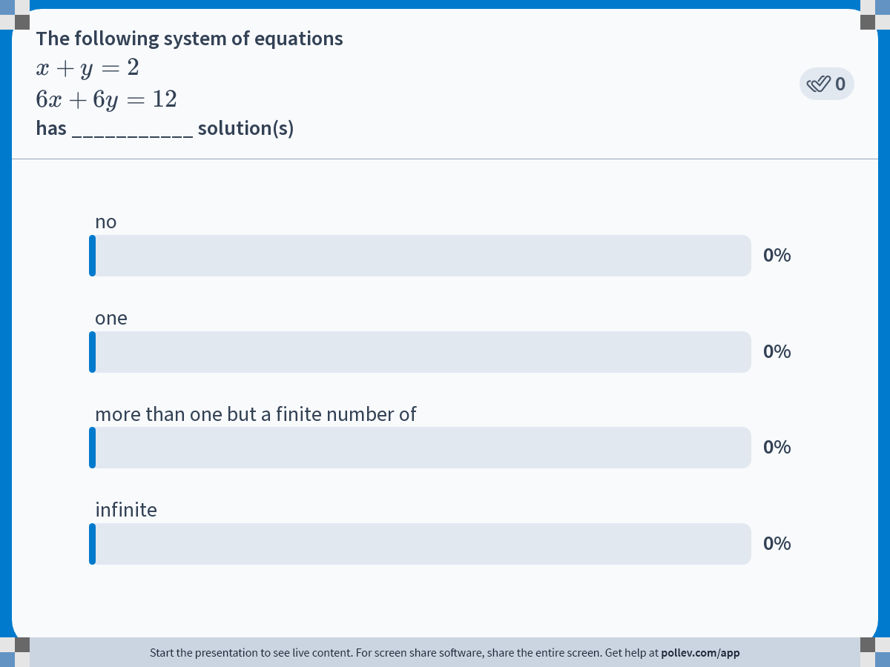
Notes:
Poll Title: Do not modify the notes in this section to avoid tampering with the Poll Everywhere activity.
More info at polleverywhere.com/support
The following system of equations $$x+y=2$$ $$6x+6y=12$$ has ___________ solution(s)
https://www.polleverywhere.com/multiple_choice_polls/wfMi5kdKs7eCjv2R9Vrow?state=opened&flow=Default&onscreen=persist

Slide 6
Naive Gauss Elimination Pitfalls

Slide 7
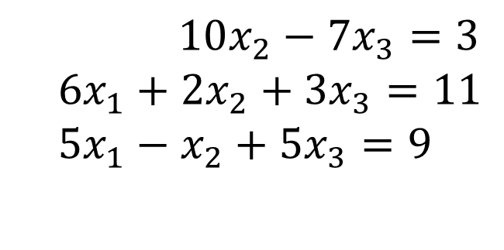
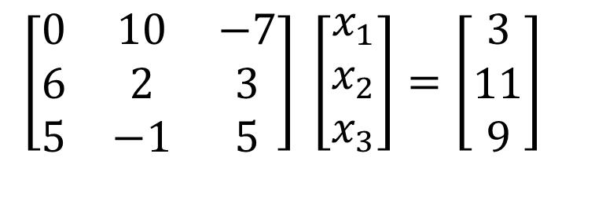
Pitfall#1. Division by zero
$10x_{2}−7x_{3}=3$
$$6x_{1}+2x_{2}+3x_{3}=11 \\ 5x_{1}−x_{2}+5x_{3}=9$$
$$\left[\begin{matrix}0 & 10 & −7 \\ 6 & 2 & 3 \\ 5 & −1 & 5\end{matrix}\right] \left[\begin{matrix}x_{1} \\ x_{2} \\ x_{3}\end{matrix}\right]=\left[\begin{matrix}3 \\ 11 \\ 9\end{matrix}\right]$$

Slide 8
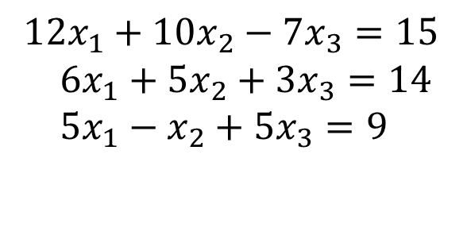
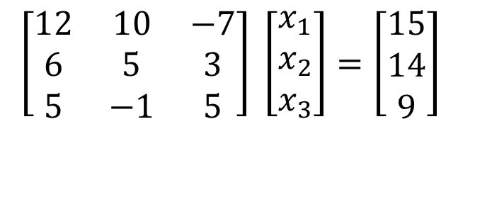
Is division by zero an issue here?
$$12x_{1}+10x_{2}−7x_{3}=15 \\ 6x_{1}+5x_{2}+3x_{3}=14 \\ 5x_{1}−x_{2}+5x_{3}=9$$
$$\left[\begin{matrix}12 & 10 & −7 \\ 6 & 5 & 3 \\ 5 & −1 & 5\end{matrix}\right] \left[\begin{matrix}x_{1} \\ x_{2} \\ x_{3}\end{matrix}\right]=\left[\begin{matrix}15 \\ 14 \\ 9\end{matrix}\right]$$

Slide 9
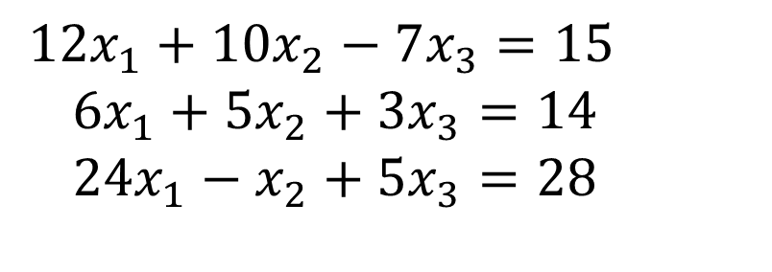
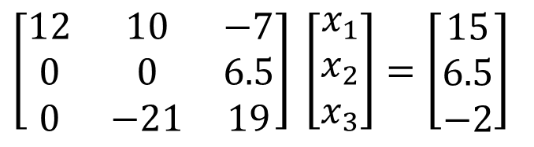
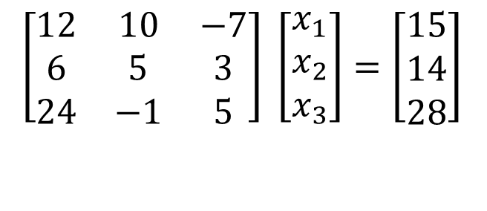
Is division by zero an issue here? YES
$$12x_{1}+10x_{2}−7x_{3}=15 \\ 6x_{1}+5x_{2}+3x_{3}=14 \\ 24x_{1}−x_{2}+5x_{3}=28$$
$$\left[\begin{matrix}12 & 10 & −7 \\ 6 & 5 & 3 \\ 24 & −1 & 5\end{matrix}\right] \left[\begin{matrix}x_{1} \\ x_{2} \\ x_{3}\end{matrix}\right]=\left[\begin{matrix}15 \\ 14 \\ 28\end{matrix}\right]$$
$$\left[\begin{matrix}12 & 10 & −7 \\ 0 & 0 & 6.5 \\ 0 & −21 & 19\end{matrix}\right] \left[\begin{matrix}x_{1} \\ x_{2} \\ x_{3}\end{matrix}\right]=\left[\begin{matrix}15 \\ 6.5 \\ −2\end{matrix}\right]$$
Division by zero is a possibility at any step of forward elimination

Slide 10
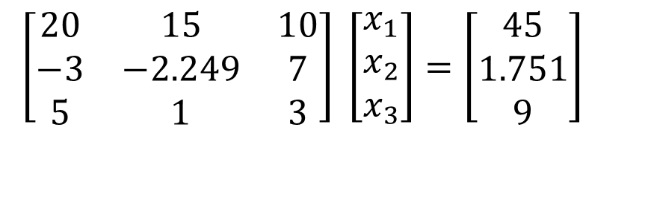
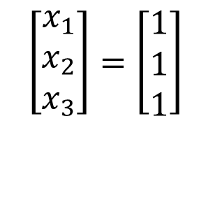
Pitfall#2. Large Round-off Errors
$$\left[\begin{matrix}20 & 15 & 10 \\ −3 & −2.249 & 7 \\ 5 & 1 & 3\end{matrix}\right] \left[\begin{matrix}x_{1} \\ x_{2} \\ x_{3}\end{matrix}\right]=\left[\begin{matrix}45 \\ 1.751 \\ 9\end{matrix}\right]$$
Exact Solution
$$\left[\begin{matrix}x_{1} \\ x_{2} \\ x_{3}\end{matrix}\right]=\left[\begin{matrix}1 \\ 1 \\ 1\end{matrix}\right]$$

Slide 11
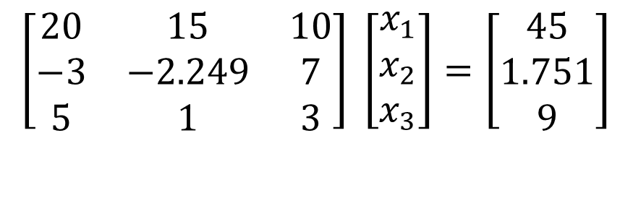
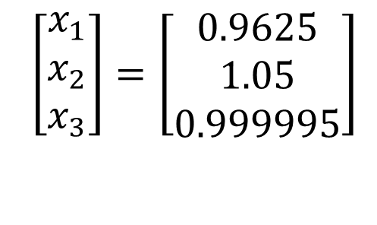
Pitfall#2. Large Round-off Errors
$$\left[\begin{matrix}20 & 15 & 10 \\ −3 & −2.249 & 7 \\ 5 & 1 & 3\end{matrix}\right] \left[\begin{matrix}x_{1} \\ x_{2} \\ x_{3}\end{matrix}\right]=\left[\begin{matrix}45 \\ 1.751 \\ 9\end{matrix}\right]$$
Solve it on a computer using 6 significant digits with chopping
$$\left[\begin{matrix}x_{1} \\ x_{2} \\ x_{3}\end{matrix}\right]=\left[\begin{matrix}0.9625 \\ 1.05 \\ 0.999995\end{matrix}\right]$$

Slide 12
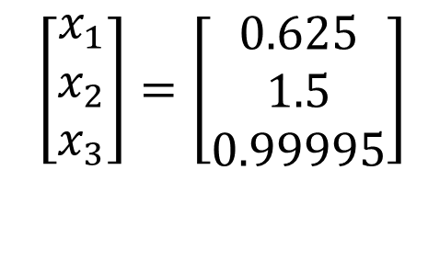
Pitfall#2. Large Round-off Errors
$$\left[\begin{matrix}20 & 15 & 10 \\ −3 & −2.249 & 7 \\ 5 & 1 & 3\end{matrix}\right] \left[\begin{matrix}x_{1} \\ x_{2} \\ x_{3}\end{matrix}\right]=\left[\begin{matrix}45 \\ 1.751 \\ 9\end{matrix}\right]$$
Solve it on a computer using 5 significant digits with chopping
$$\left[\begin{matrix}x_{1} \\ x_{2} \\ x_{3}\end{matrix}\right]=\left[\begin{matrix}0.625 \\ 1.5 \\ 0.99995\end{matrix}\right]$$
Is there a way to reduce the round off error?

Slide 13
Avoiding Pitfalls
Increase the number of significant digits
Decreases round-off error
Does not avoid division by zero

Slide 14
Avoiding Pitfalls
Use Gaussian Elimination with Partial Pivoting
    Avoids division by zero
    Reduces round off error

Slide 15
THE END

Slide 16



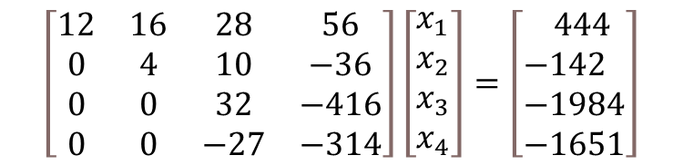
Given a set of equations
1st step of forward elimination
2nd step of forward elimination
3rd step of forward elimination
$$\left[\begin{matrix}12 & 16 & 28 & 56 \\ 0 & 4 & 10 & −36 \\ 0 & 0 & 32 & −416 \\ 0 & 0 & −27 & −314\end{matrix}\right]\left[\begin{aligned}&x_{1} \\ &x_{2} \\ &x_{3} \\ &x_{4}\end{aligned}\right]=\left[\begin{aligned}& 444 \\ &−142 \\ &−1984 \\ &−1651\end{aligned}\right]$$

Slide 17
Gauss Elimination with Partial Pivoting

Slide 18
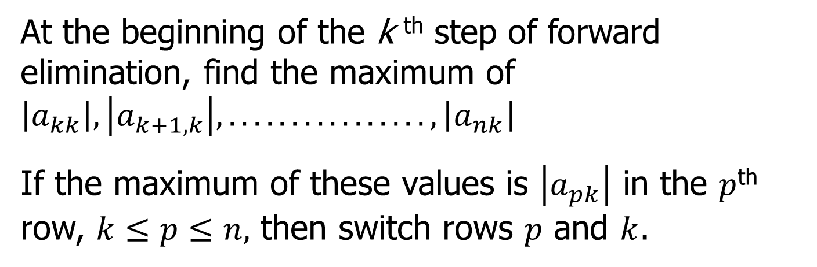
What is Different About Partial Pivoting?
At the beginning of the k ^{th} step of forward elimination, find the maximum of $\left|a_{kk}\right|,\left|a_{k+1,k}\right|,................,\left|a_{nk}\right|$
If the maximum of these values is $\left|a_{pk}\right|$ in the $p$^{th} row, $k≤p≤n,$ then switch rows $p$ and $k$.

Slide 19
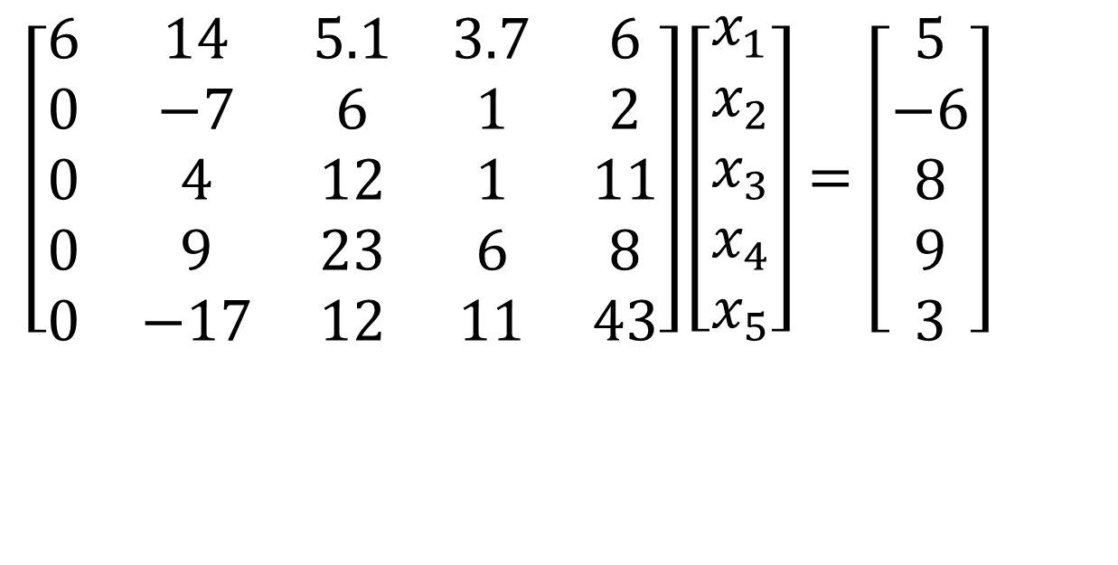
Example (2nd step of FE)
$$\left[\begin{matrix}6 & 14 & 5.1 & 3.7 & 6 \\ 0 & −7 & 6 & 1 & 2 \\ 0 & 4 & 12 & 1 & 11 \\ 0 & 9 & 23 & 6 & 8 \\ 0 & −17 & 12 & 11 & 43\end{matrix}\right]\left[\begin{matrix}x_{1} \\ x_{2} \\ x_{3} \\ x_{4} \\ x_{5}\end{matrix}\right]=\left[\begin{matrix}5 \\ −6 \\ 8 \\ 9 \\ 3\end{matrix}\right]$$
Which two rows would you switch?

Slide 20
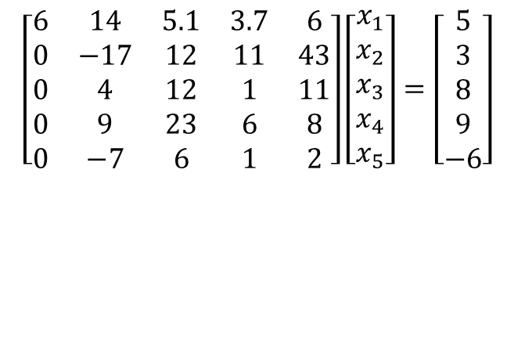
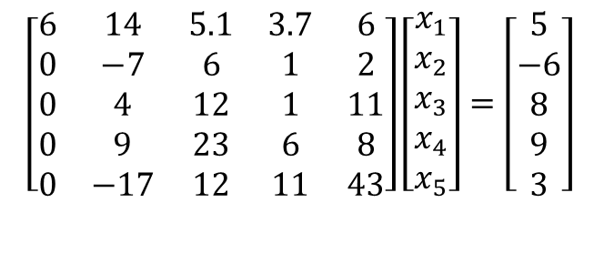
Example (2nd step of FE)
$$\left[\begin{matrix}6 & 14 & 5.1 & 3.7 & 6 \\ 0 & −7 & 6 & 1 & 2 \\ 0 & 4 & 12 & 1 & 11 \\ 0 & 9 & 23 & 6 & 8 \\ 0 & −17 & 12 & 11 & 43\end{matrix}\right]\left[\begin{matrix}x_{1} \\ x_{2} \\ x_{3} \\ x_{4} \\ x_{5}\end{matrix}\right]=\left[\begin{matrix}5 \\ −6 \\ 8 \\ 9 \\ 3\end{matrix}\right]$$
$$\left[\begin{matrix}6 & 14 & 5.1 & 3.7 & 6 \\ 0 & −17 & 12 & 11 & 43 \\ 0 & 4 & 12 & 1 & 11 \\ 0 & 9 & 23 & 6 & 8 \\ 0 & −7 & 6 & 1 & 2\end{matrix}\right]\left[\begin{matrix}x_{1} \\ x_{2} \\ x_{3} \\ x_{4} \\ x_{5}\end{matrix}\right]=\left[\begin{matrix}5 \\ 3 \\ 8 \\ 9 \\ −6\end{matrix}\right]$$

Slide 21
Gaussian Elimination with Partial Pivoting
A method to solve simultaneous linear equations of the form [A][X]=[C]
Two steps
1. Forward Elimination
2. Back Substitution

Slide 22
THE END

Slide 23
Gauss Elimination with Partial Pivoting Example

Slide 24
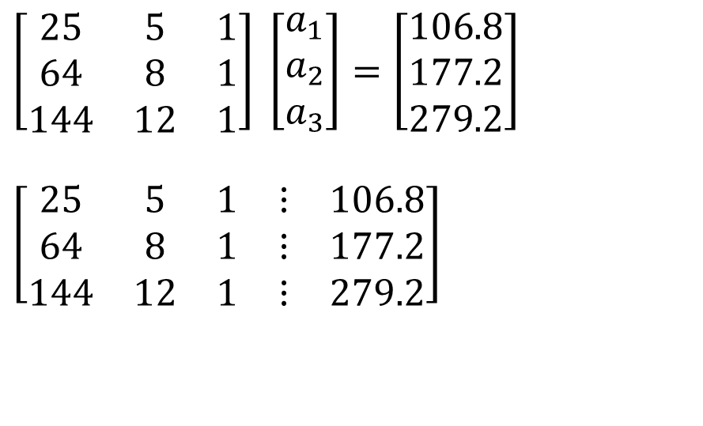
Solve the following set of equations by Gaussian elimination with partial pivoting
$$\left[\begin{matrix}25 & 5 & 1 \\ 64 & 8 & 1 \\ 144 & 12 & 1\end{matrix}\right] \left[\begin{matrix}a_{1} \\ a_{2} \\ a_{3}\end{matrix}\right]=\left[\begin{matrix}106.8 \\ 177.2 \\ 279.2\end{matrix}\right]$$
$$\left[\begin{matrix}25 & 5 & 1 & ⋮ & 106.8 \\ 64 & 8 & 1 & ⋮ & 177.2 \\ 144 & 12 & 1 & ⋮ & 279.2\end{matrix}\right]$$
Notes:
24

Slide 25
Forward Elimination
Notes:
25

Slide 26
Number of Steps of Forward Elimination
Number of steps of forward elimination part is
(n−1)=(3−1)=2

Slide 27
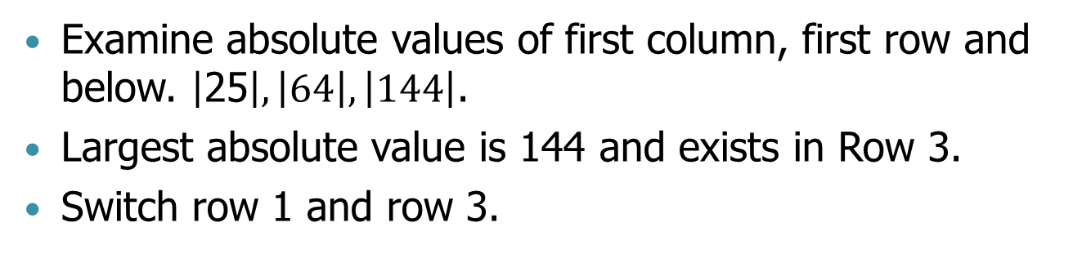
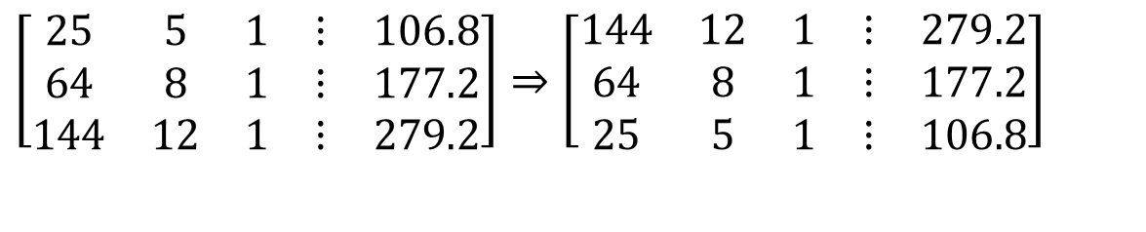
Forward Elimination: Step 1
Examine absolute values of first column, first row and below. $\left|\text{25}\right|,\left|64\right|,\left|144\right|$.
Largest absolute value is 144 and exists in Row 3.
Switch row 1 and row 3.
$$\left[\begin{matrix}25 & 5 & 1 & ⋮ & 106.8 \\ 64 & 8 & 1 & ⋮ & 177.2 \\ 144 & 12 & 1 & ⋮ & 279.2\end{matrix}\right]⇒\left[\begin{matrix}144 & 12 & 1 & ⋮ & 279.2 \\ 64 & 8 & 1 & ⋮ & 177.2 \\ 25 & 5 & 1 & ⋮ & 106.8\end{matrix}\right]$$

Slide 28
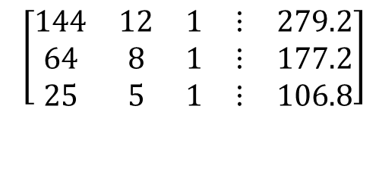

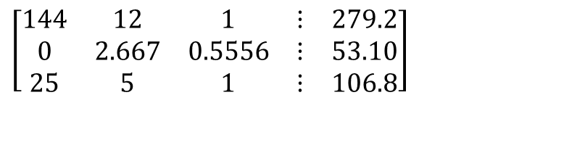
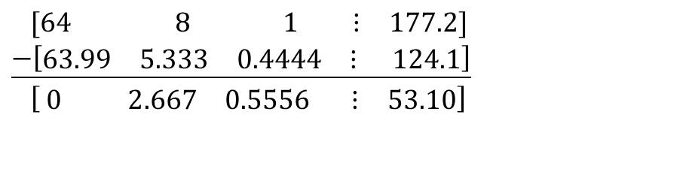
Forward Elimination: Step 1 (cont.)
$$\left[\begin{matrix}144 & 12 & 1 & ⋮ & 279.2 \\ 64 & 8 & 1 & ⋮ & 177.2 \\ 25 & 5 & 1 & ⋮ & 106.8\end{matrix}\right]$$
Divide Row 1 by $144$ and multiply it by $64$, that is the multiplication factor is $64/144=0.4444$
$\left[\begin{matrix}144 & 12 & 1 & ⋮ & 279.2\end{matrix}\right]×0.4444$ $=\left[\begin{matrix}63.99 & 5.333 & 0.4444 & ⋮ & 124.1\end{matrix}\right]$
Subtract the result from Row 2
$$\left[\begin{matrix}\text{64} & \text{ 8} & _{ }\text{ 1} & ⋮ & \text{177.2}\end{matrix}\right] \\ \underline{−\left[\begin{matrix}\text{63.99} & \text{5.333} & \text{0.4444} & ⋮ & \text{ 124.1}\end{matrix}\right]} \\ \left[ \begin{matrix}0 & 2.667 & 0\text{.5556} & ⋮ & 53.10\end{matrix}\right]$$
.
Substitute new row for Row 2
$$\left[\begin{matrix}144 & 12 & 1 & ⋮ & 279.2 \\ 0 & 2.667 & 0.5556 & ⋮ & 53.10 \\ 25 & 5 & 1 & ⋮ & 106.8\end{matrix}\right]$$
Notes:
28

Slide 29
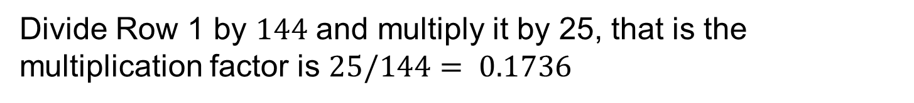
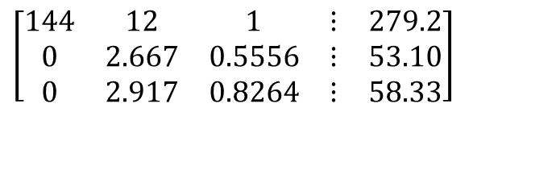
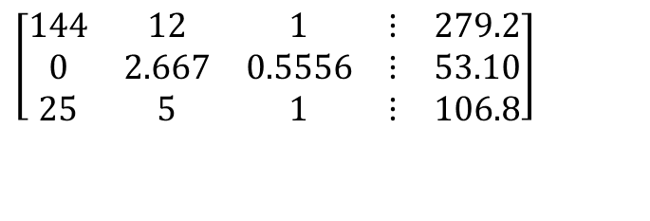
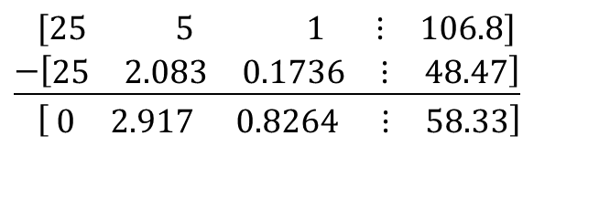
Forward Elimination: Step 1 (cont.)
$$\left[\begin{matrix}144 & 12 & 1 & ⋮ & 279.2 \\ 0 & 2.667 & 0.5556 & ⋮ & 53.10 \\ 25 & 5 & 1 & ⋮ & 106.8\end{matrix}\right]$$
Divide Row 1 by $144$ and multiply it by 25, that is the multiplication factor is $25/144= 0.1736$
$$\left[\begin{matrix}\text{144} & 12 & 1 & ⋮ & \text{279.2}\end{matrix}\right]×0.1736=\left[\begin{matrix}25.00 & 2.083 & 0.1736 & ⋮ & 48.47\end{matrix}\right]$$
Subtract the result from Row 3
$$\left[\begin{matrix}\text{25} & \text{ 5} & _{ }\text{ 1} & ⋮ & \text{106.8}\end{matrix}\right] \\ \underline{−\left[\begin{matrix}\text{25} & \text{2.083} & \text{0.1736} & ⋮ & \text{48.47}\end{matrix}\right]} \\ \left[ \begin{matrix}0 & 2.917 & 0.8264 & ⋮ & 58.33\end{matrix}\right]$$
.
Substitute new equation for Row 3
$$\left[\begin{matrix}144 & 12 & 1 & ⋮ & 279.2 \\ 0 & 2.667 & 0.5556 & ⋮ & 53.10 \\ 0 & 2.917 & 0.8264 & ⋮ & 58.33\end{matrix}\right]$$
Notes:
29

Slide 30
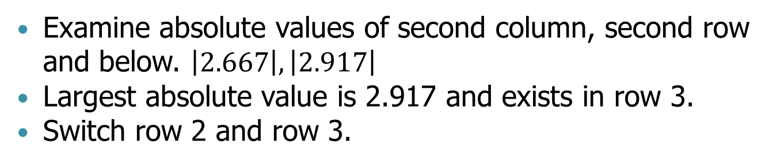
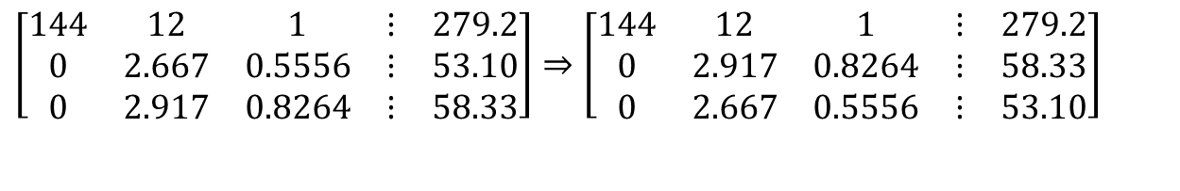
Forward Elimination: Step 2
Examine absolute values of second column, second row and below. $\left|2.667\right|,\left|\text{2.917}\right|$
Largest absolute value is 2.917 and exists in row 3.
Switch row 2 and row 3.
$$\left[\begin{matrix}144 & 12 & 1 & ⋮ & 279.2 \\ 0 & 2.667 & 0.5556 & ⋮ & 53.10 \\ 0 & 2.917 & 0.8264 & ⋮ & 58.33\end{matrix}\right]⇒\left[\begin{matrix}144 & 12 & 1 & ⋮ & 279.2 \\ 0 & 2.917 & 0.8264 & ⋮ & 58.33 \\ 0 & 2.667 & 0.5556 & ⋮ & 53.10\end{matrix}\right]$$

Slide 31
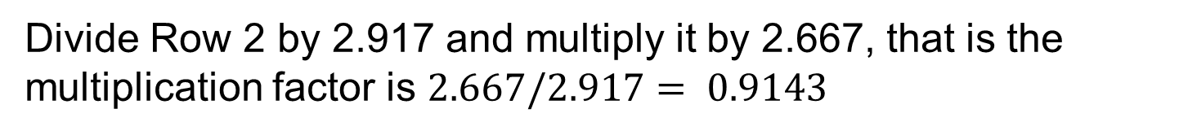
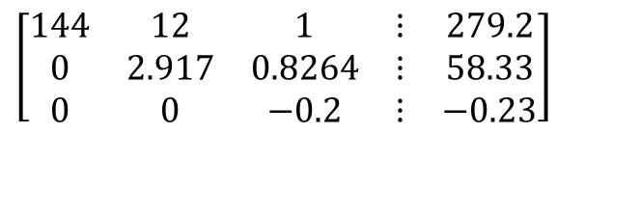
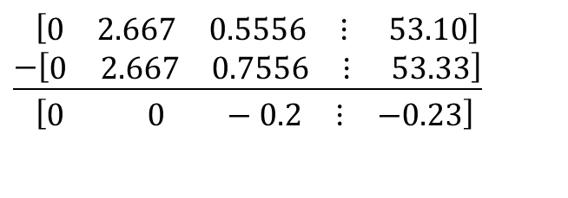
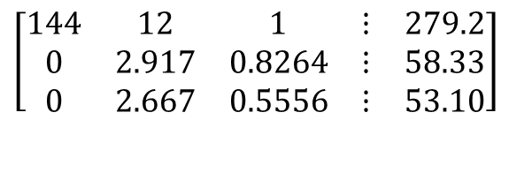
Forward Elimination: Step 2 (cont.)
$$\left[\begin{matrix}144 & 12 & 1 & ⋮ & 279.2 \\ 0 & 2.917 & 0.8264 & ⋮ & 58.33 \\ 0 & 2.667 & 0.5556 & ⋮ & 53.10\end{matrix}\right]$$
Divide Row 2 by 2.917 and multiply it by 2.667, that is the multiplication factor is $2.667/2.917= 0.9143$
$$\left[\begin{matrix}0 & \text{2.917} & \text{0.8264} & ⋮ & \text{58.33}\end{matrix}\right]×0.9143=\left[\begin{matrix}0 & 2.667 & 0.7556 & ⋮ & 53.33\end{matrix}\right]$$
Subtract the result from Equation 3
$$\left[\begin{matrix}0 & \text{2.667} & \text{0.5556} & ⋮ & \text{ 53.10}\end{matrix}\right] \\ \underline{−\left[\begin{matrix}0 & \text{2.667} & \text{0.7556} & ⋮ & \text{ 53.33}\end{matrix}\right]} \\ \left[\begin{matrix}0 & 0 & −0.2 & ⋮ & −0.23\end{matrix}\right]$$
.
$$\left[\begin{matrix}144 & 12 & 1 & ⋮ & 279.2 \\ 0 & 2.917 & 0.8264 & ⋮ & 58.33 \\ 0 & 0 & −0.2 & ⋮ & −0.23\end{matrix}\right]$$
Substitute new equation for Equation 3
Notes:
31

Slide 32
Back Substitution
Notes:
32

Slide 33
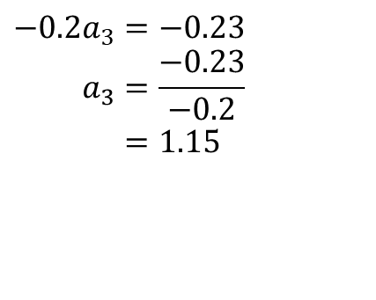
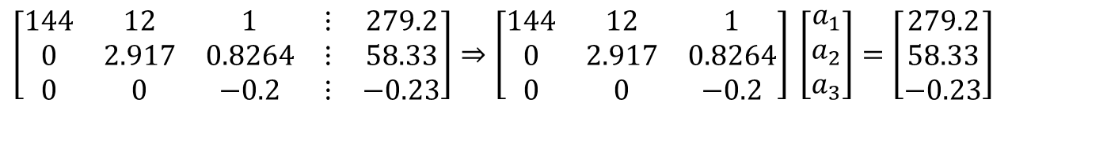
Back Substitution
$$\left[\begin{matrix}144 & 12 & 1 & ⋮ & 279.2 \\ 0 & 2.917 & 0.8264 & ⋮ & 58.33 \\ 0 & 0 & −0.2 & ⋮ & −0.23\end{matrix}\right]⇒\left[\begin{matrix}144 & 12 & 1 \\ 0 & 2.917 & 0.8264 \\ 0 & 0 & −0.2\end{matrix}\right] \left[\begin{matrix}a_{1} \\ a_{2} \\ a_{3}\end{matrix}\right]=\left[\begin{matrix}279.2 \\ 58.33 \\ −0.23\end{matrix}\right]$$
Solving for a₃
$$−0.2a_{3}=−0.23 \\ a_{3}=\frac{−0.23}{−0.2} \\ =\text{1.15}$$
Notes:
33

Slide 34
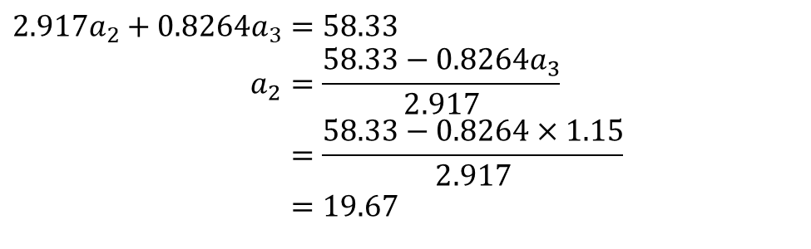
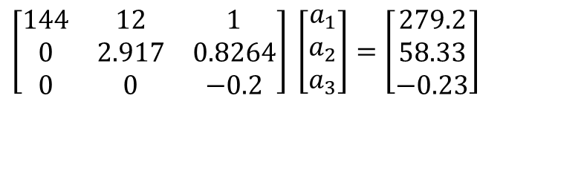
Back Substitution (cont.)
$$\left[\begin{matrix}144 & 12 & 1 \\ 0 & 2.917 & 0.8264 \\ 0 & 0 & −0.2\end{matrix}\right] \left[\begin{matrix}a_{1} \\ a_{2} \\ a_{3}\end{matrix}\right]=\left[\begin{matrix}279.2 \\ 58.33 \\ −0.23\end{matrix}\right]$$
Solving for a₂
$$2.917a_{2}+0.8264a_{3}=58.33 \\ a_{2}=\frac{58.33−0.8264a_{3}}{2.917} \\ =\frac{58.33−0.8264×1.15}{2.917} \\ =\text{19.}67$$
Notes:
34

Slide 35
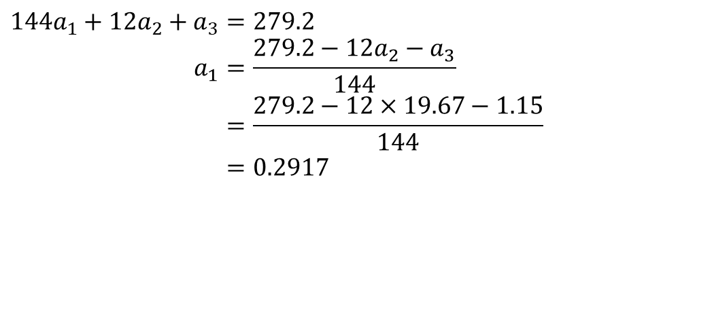
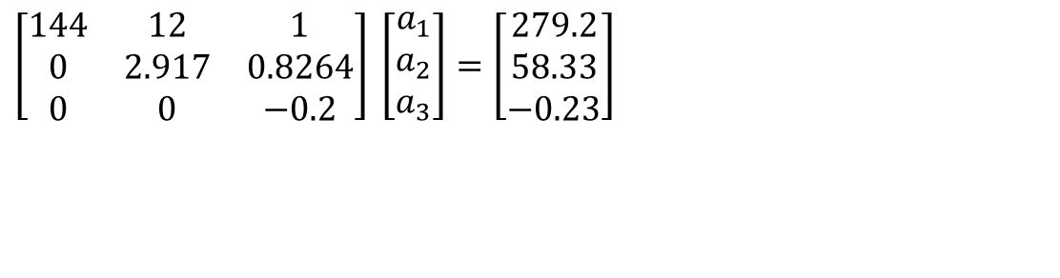
Back Substitution (cont.)
$$\left[\begin{matrix}144 & 12 & 1 \\ 0 & 2.917 & 0.8264 \\ 0 & 0 & −0.2\end{matrix}\right] \left[\begin{matrix}a_{1} \\ a_{2} \\ a_{3}\end{matrix}\right]=\left[\begin{matrix}279.2 \\ 58.33 \\ −0.23\end{matrix}\right]$$
$$144a_{1}+12a_{2}+a_{3}=279.2 \\ a_{1}=\frac{279.2−12a_{2}−a_{3}}{144} \\ =\frac{279.2−12×19.67−1.15}{144} \\ =0.2917$$
Notes:
35

Slide 36
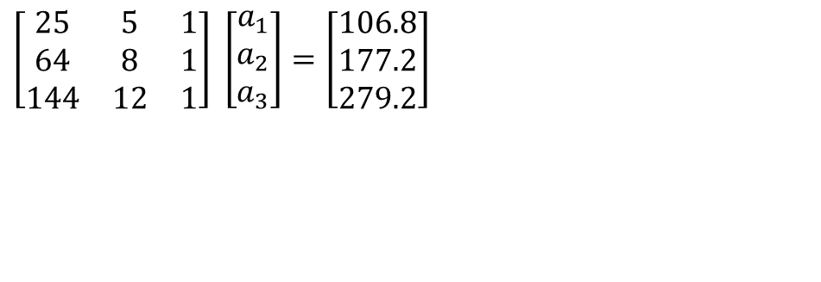
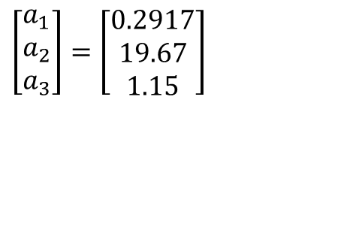
Gaussian Elimination with Partial Pivoting Solution
$$\left[\begin{matrix}25 & 5 & 1 \\ 64 & 8 & 1 \\ 144 & 12 & 1\end{matrix}\right] \left[\begin{matrix}a_{1} \\ a_{2} \\ a_{3}\end{matrix}\right]=\left[\begin{matrix}106.8 \\ 177.2 \\ 279.2\end{matrix}\right]$$
$$\left[\begin{matrix}a_{1} \\ a_{2} \\ a_{3}\end{matrix}\right]=\left[\begin{matrix}0.2917 \\ 19.67 \\ 1.15\end{matrix}\right]$$
Notes:
36

Slide 37


