Slide 1
LU Decomposition Method
Major: All Engineering Majors
Author(s): Autar Kaw
http://nm.MathForCollege.com
Transforming Numerical Methods Education for STEM Undergraduates

Slide 2

Notes:
Poll Title: Do not modify the notes in this section to avoid tampering with the Poll Everywhere activity.
More info at polleverywhere.com/support
Who is this artist?
https://www.polleverywhere.com/multiple_choice_polls/armHsYuftdMGw3TigOLq8?display_state=chart&activity_state=opened&state=opened&flow=Default&onscreen=persist

Slide 3
Questions to have been asked and to ask?
What is LU decomposition method?
How do we decompose a coefficient matrix to LU?
LU decomposition method looks so much like Naïve Gauss elimination, what gives?
How do we use LU decomposition method to find inverse of a matrix?

Slide 4
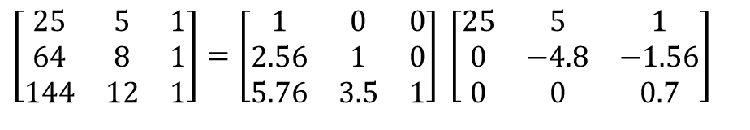
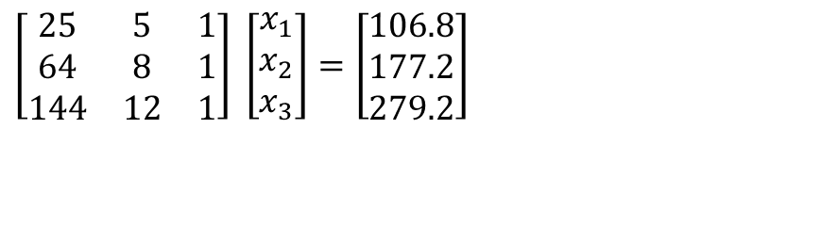
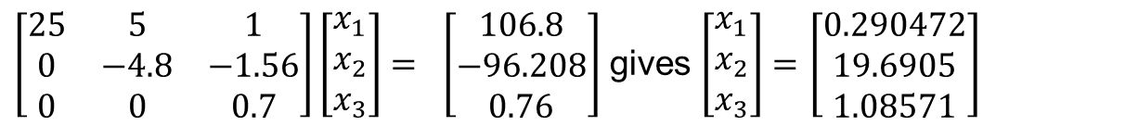
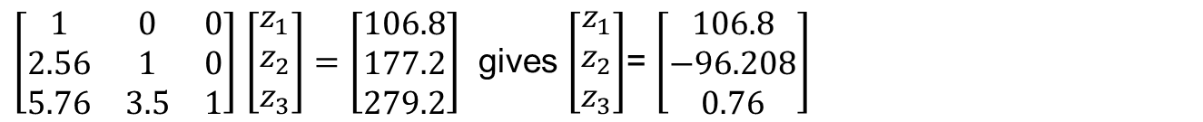
Reviewing the LU Decomposition example
$$\left[\begin{matrix}25 & 5 & 1 \\ 64 & 8 & 1 \\ 144 & 12 & 1\end{matrix}\right] \left[\begin{matrix}x_{1} \\ x_{2} \\ x_{3}\end{matrix}\right]=\left[\begin{matrix}106.8 \\ 177.2 \\ 279.2\end{matrix}\right]$$
$$\left[\begin{matrix}25 & 5 & 1 \\ 64 & 8 & 1 \\ 144 & 12 & 1\end{matrix}\right]=\left[\begin{matrix}1 & 0 & 0 \\ 2.56 & 1 & 0 \\ 5.76 & 3.5 & 1\end{matrix}\right] \left[\begin{matrix}25 & 5 & 1 \\ 0 & −4.8 & −1.56 \\ 0 & 0 & 0.7\end{matrix}\right]$$
$\left[\begin{matrix}1 & 0 & 0 \\ 2.56 & 1 & 0 \\ 5.76 & 3.5 & 1\end{matrix}\right]$ $\left[\begin{matrix}z_{1} \\ z_{2} \\ z_{3}\end{matrix}\right]=$ $\left[\begin{matrix}106.8 \\ 177.2 \\ 279.2\end{matrix}\right]$ gives $\left[\begin{matrix}z_{1} \\ z_{2} \\ z_{3}\end{matrix}\right]$= $\left[\begin{matrix}106.8 \\ −96.208 \\ 0.76\end{matrix}\right]$
$\left[\begin{matrix}25 & 5 & 1 \\ 0 & −4.8 & −1.56 \\ 0 & 0 & 0.7\end{matrix}\right]\left[\begin{matrix}x_{1} \\ x_{2} \\ x_{3}\end{matrix}\right]= \left[\begin{matrix}106.8 \\ −96.208 \\ 0.76\end{matrix}\right]$ gives $\left[\begin{matrix}x_{1} \\ x_{2} \\ x_{3}\end{matrix}\right]=$ $\left[\begin{matrix}0.290472 \\ 19.6905 \\ 1.08571\end{matrix}\right]$

Slide 5
LU Decomposition Method
[A][X] = [C]
Decompose [A] into [L] and [U]
Solve [L][Z] = [C] for [Z] by using forward substitution
Solve [U][X] = [Z] for [X] by using back substitution

Slide 6
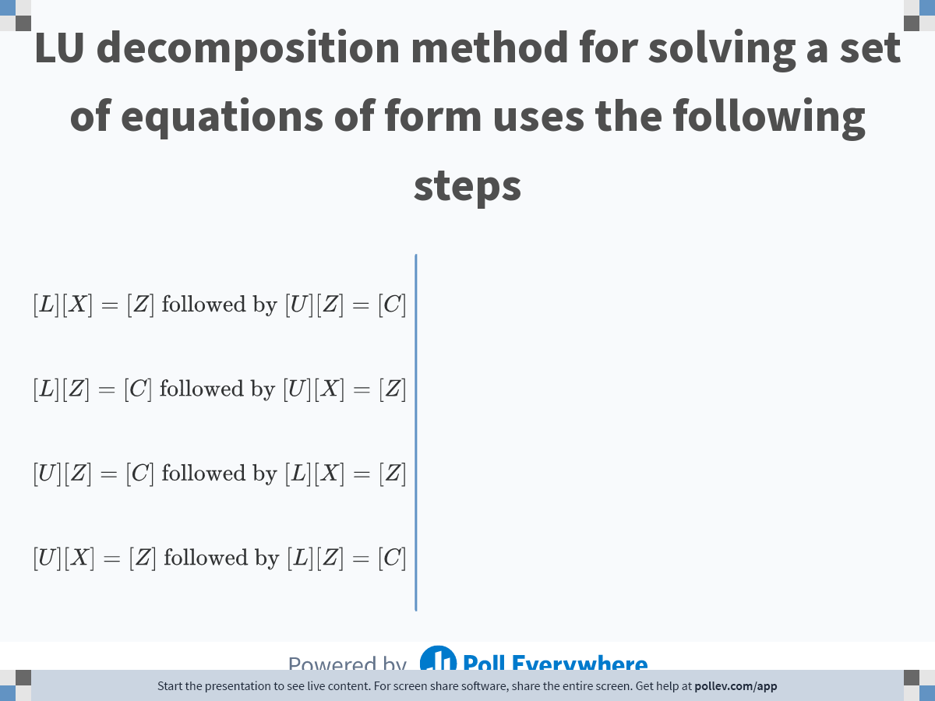
Notes:
Poll Title: Do not modify the notes in this section to avoid tampering with the Poll Everywhere activity.
More info at polleverywhere.com/support
LU decomposition method for solving a set of equations of form uses the following steps
https://www.polleverywhere.com/multiple_choice_polls/8Z56PI8udv3AtbsY7cdIF

Slide 7
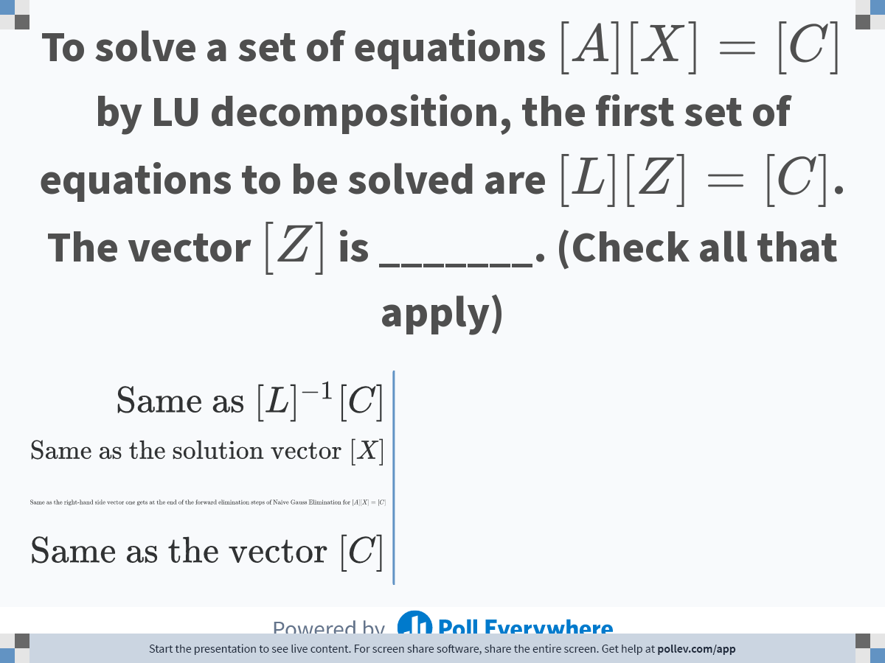
Notes:
Poll Title: Do not modify the notes in this section to avoid tampering with the Poll Everywhere activity.
More info at polleverywhere.com/support
To solve a set of equations $$[A][X]=[C]$$ by LU decomposition, the first set of equations to be solved are $$[L][Z]=[C]$$. The vector $$[Z]$$ is _______. (Check all that apply)
https://www.polleverywhere.com/multiple_choice_polls/BWclx8LhHGTai5o7D3Nmk

Slide 8

Notes:
Poll Title: Do not modify the notes in this section to avoid tampering with the Poll Everywhere activity.
More info at polleverywhere.com/support
Given the decomposition of a square matrix $$[A]=[L][U]$$, where $$[L] $$ has ones in the diagonal, the determinant of $$[A]$$ is
https://www.polleverywhere.com/multiple_choice_polls/eVvYJRmIJTdIm12MQwZQM

Slide 9
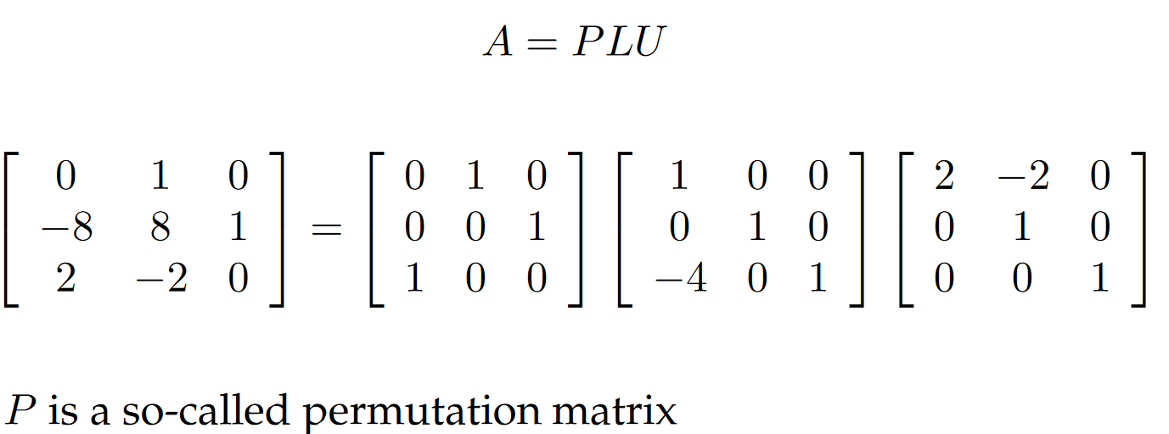
Every A matrix that has inverse can be decomposed to LU or PLU

Slide 10
THE END

Slide 11
Is LU Decomposition better than Gaussian Elimination?

Slide 12
Naïve Gaussian Elimination
[A][X] = [C]
Conduct forward elimination to get [U][X] = [Z]
Conduct back substitution to solve [U][X] = [Z] for [X]

Slide 13
LU Decomposition Method
[A][X] = [C]
Decompose [A] into [L] and [U]
Solve [L][Z] = [C] for [Z] by using forward substitution
Solve [U][X] = [Z] for [X] by using back substitution

Slide 14

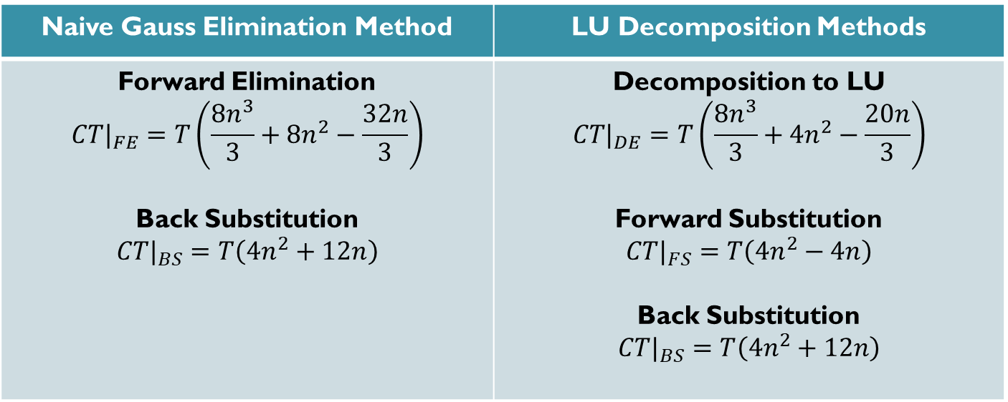

Is LU Decomposition Method better than Gaussian Elimination Method?
Solve $[A][X]=[B]$
$T$ = clock cycle time
$n×n$ = size of the matrix
$CT$= computational time
Naive Gauss Elimination Method | LU Decomposition Methods
Forward Elimination $$CT|_{FE}=T\left(\frac{8n^{3}}{3}+8n^{2}−\frac{32n}{3}\right)$$ Back Substitution $$CT|_{BS}=T\left(4n^{2}+12n\right)$$ | Decomposition to LU $$CT|_{DE}=T\left(\frac{8n^{3}}{3}+4n^{2}−\frac{20n}{3}\right)$$ Forward Substitution $$CT|_{FS}=T\left(4n^{2}−4n\right)$$ Back Substitution $$CT|_{BS}=T\left(4n^{2}+12n\right)$$

Slide 15
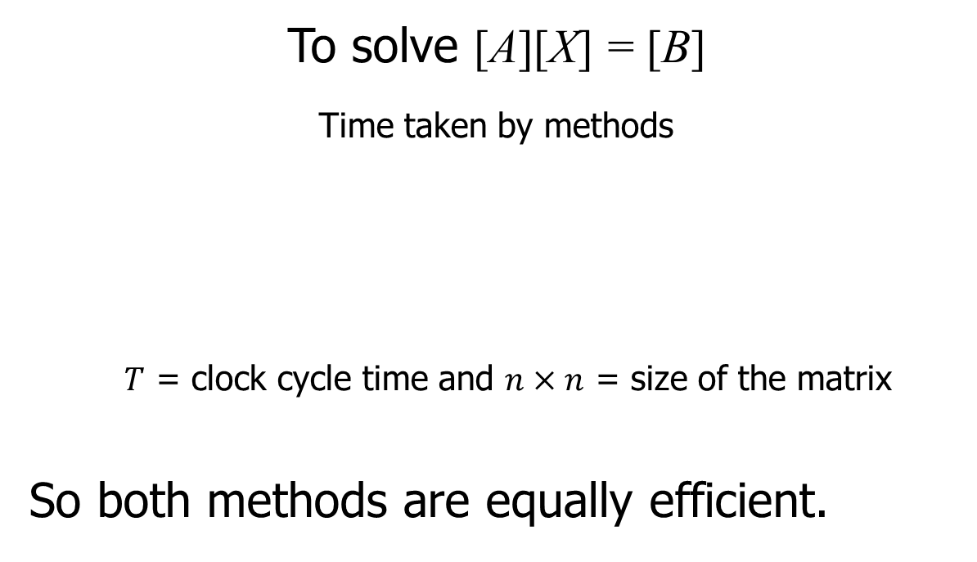
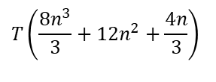
Is LU Decomposition better than Gaussian Elimination?
To solve [A][X] = [B]
Time taken by methods
$T$ = clock cycle time and $n×n$ = size of the matrix
So both methods are equally efficient.
Gaussian Elimination | LU Decomposition
$$T\left(\frac{8n^{3}}{3}+12n^{2}+\frac{4n}{3}\right)$$
$$T\left(\frac{8n^{3}}{3}+12n^{2}+\frac{4n}{3}\right)$$

Slide 16
THE END

Slide 17
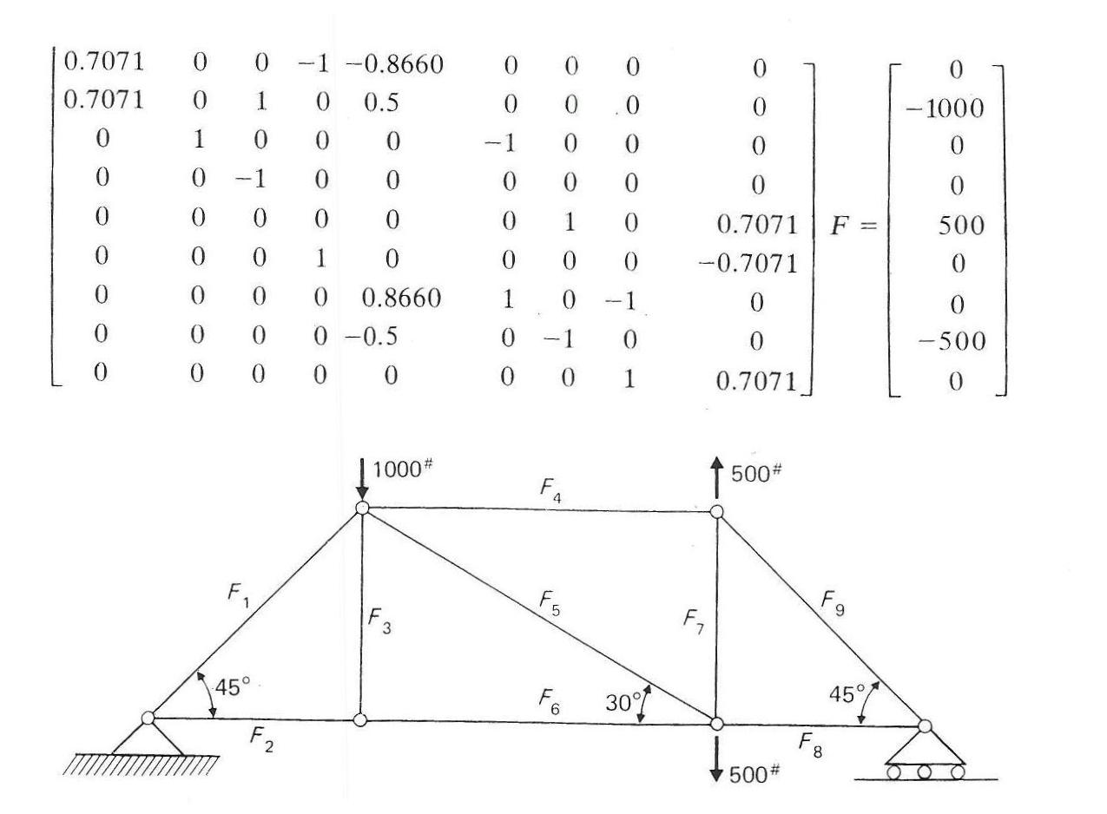
Truss Problem

Slide 18
Finding the inverse of a square matrix
[B] is inverse of a square matrix [A] if
[A][B] = [I] OR [B][A] = [I]

Slide 19
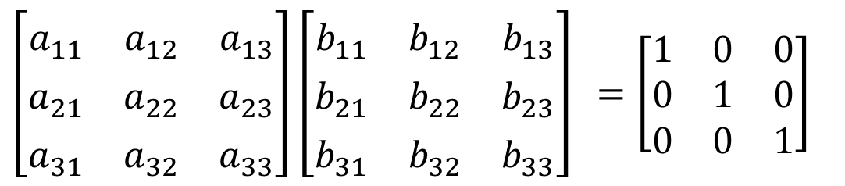
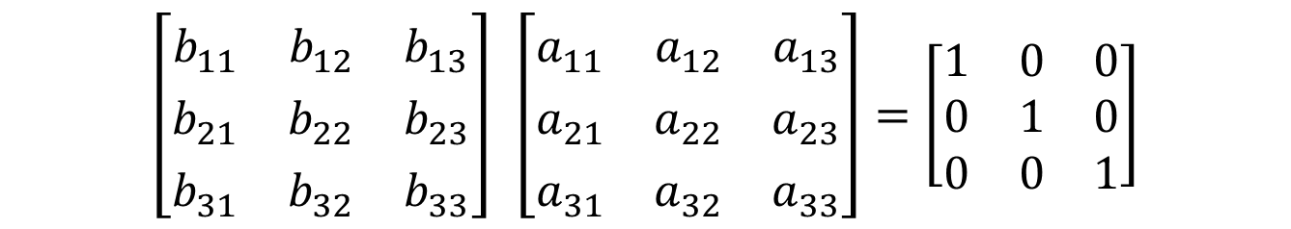
Two ways to show what inverse means?
$$\left[\begin{matrix}b_{11}^{} & b_{12}^{} & b_{13}^{} \\ b_{21}^{} & b_{22}^{} & b_{23}^{} \\ b_{31}^{} & b_{32}^{} & b_{33}^{}\end{matrix}\right] \left[\begin{matrix}a_{11}^{} & a_{12}^{} & a_{13}^{} \\ a_{21}^{} & a_{22}^{} & a_{23}^{} \\ a_{31}^{} & a_{32}^{} & a_{33}^{}\end{matrix}\right]=\left[\begin{matrix}1 & 0 & 0 \\ 0 & 1 & 0 \\ 0 & 0 & 1\end{matrix}\right]$$
$\left[\begin{matrix}a_{11}^{} & a_{12}^{} & a_{13}^{} \\ a_{21}^{} & a_{22}^{} & a_{23}^{} \\ a_{31}^{} & a_{32}^{} & a_{33}^{}\end{matrix}\right]\left[\begin{matrix}b_{11}^{} & b_{12}^{} & b_{13}^{} \\ b_{21}^{} & b_{22}^{} & b_{23}^{} \\ b_{31}^{} & b_{32}^{} & b_{33}^{}\end{matrix}\right]$ $=\left[\begin{matrix}1 & 0 & 0 \\ 0 & 1 & 0 \\ 0 & 0 & 1\end{matrix}\right]$

Slide 20
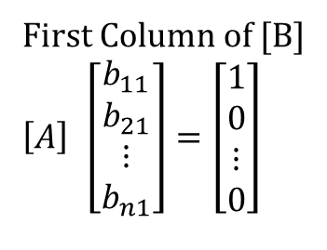
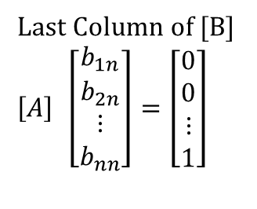
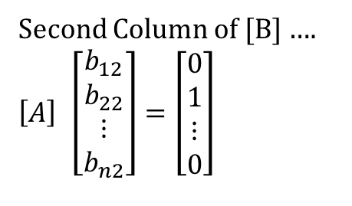
Finding the inverse of a square matrix
How can LU Decomposition be used to find the inverse?
[A][B] = [I]
First Column of [B]
$$\left[A\right] \left[\begin{matrix}b_{11} \\ b_{21} \\ ⋮ \\ b_{n1}\end{matrix}\right]=\left[\begin{matrix}1 \\ 0 \\ ⋮ \\ 0\end{matrix}\right]$$
Second Column of [B] ….
$$\left[A\right] \left[\begin{matrix}b_{12} \\ b_{22} \\ ⋮ \\ b_{n2}\end{matrix}\right]=\left[\begin{matrix}0 \\ 1 \\ ⋮ \\ 0\end{matrix}\right]$$
Last Column of [B]
$$\left[A\right] \left[\begin{matrix}b_{1n} \\ b_{2n} \\ ⋮ \\ b_{nn}\end{matrix}\right]=\left[\begin{matrix}0 \\ 0 \\ ⋮ \\ 1\end{matrix}\right]$$

Slide 21
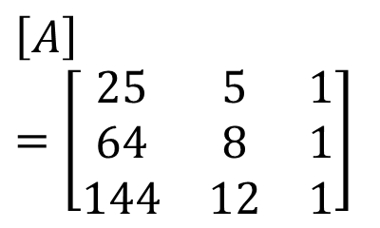
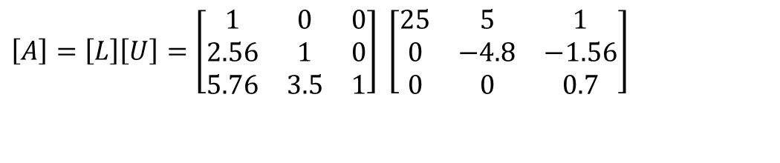
Example: Inverse of a Matrix
Find the inverse of a square matrix [A]
$$\left[A\right]=\left[\begin{matrix}25 & 5 & 1 \\ 64 & 8 & 1 \\ 144 & 12 & 1\end{matrix}\right]$$
Using the decomposition procedure, the [L] and [U] matrices are found to be
$$\left[A\right]=\left[L\right]\left[U\right]=\left[\begin{matrix}1 & 0 & 0 \\ 2.56 & 1 & 0 \\ 5.76 & 3.5 & 1\end{matrix}\right] \left[\begin{matrix}25 & 5 & 1 \\ 0 & −4.8 & −1.56 \\ 0 & 0 & 0.7\end{matrix}\right]$$
Solving for each column of [B] requires two steps
Solve [L] [Z] = [C] for [Z]
Solve [U] [X] = [Z] for [X]

Slide 22
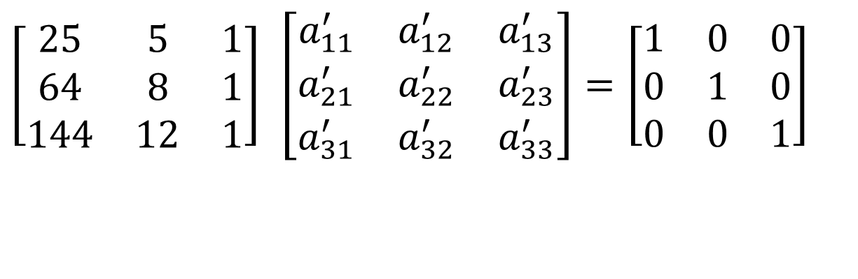
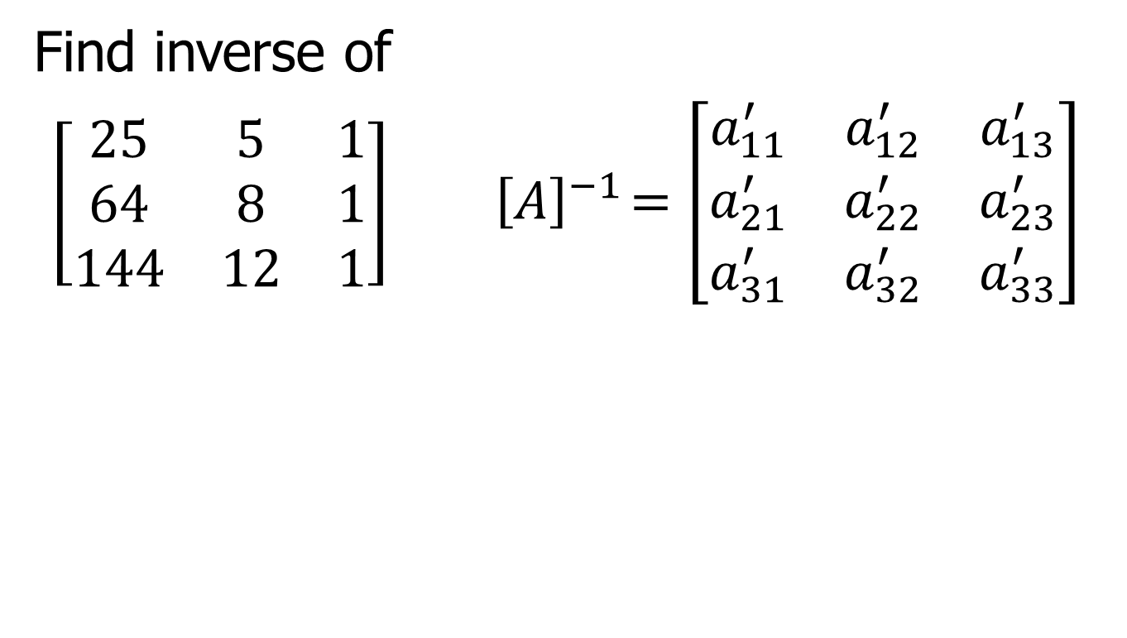
Find Inverse of Matrix
Find inverse of
$\left[\begin{matrix}25 & 5 & 1 \\ 64 & 8 & 1 \\ 144 & 12 & 1\end{matrix}\right]{ \left[A\right]}^{−1}=\left[\begin{matrix}a_{11}^{′} & a_{12}^{′} & a_{13}^{′} \\ a_{21}^{′} & a_{22}^{′} & a_{23}^{′} \\ a_{31}^{′} & a_{32}^{′} & a_{33}^{′}\end{matrix}\right]$
$$\left[\begin{matrix}25 & 5 & 1 \\ 64 & 8 & 1 \\ 144 & 12 & 1\end{matrix}\right] \left[\begin{matrix}a_{11}^{′} & a_{12}^{′} & a_{13}^{′} \\ a_{21}^{′} & a_{22}^{′} & a_{23}^{′} \\ a_{31}^{′} & a_{32}^{′} & a_{33}^{′}\end{matrix}\right]=\left[\begin{matrix}1 & 0 & 0 \\ 0 & 1 & 0 \\ 0 & 0 & 1\end{matrix}\right]$$

Slide 23
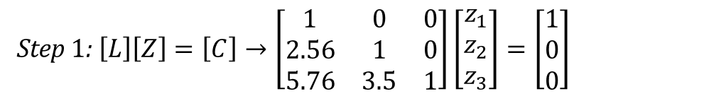
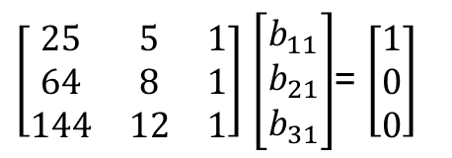
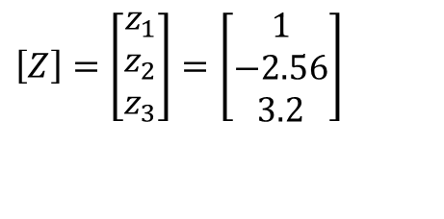
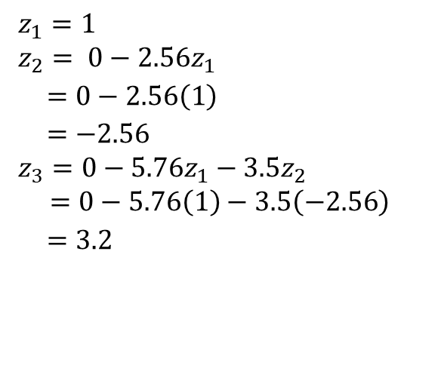
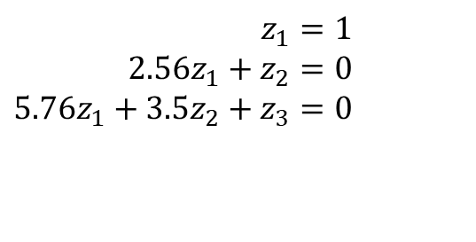
Finding 1st column of inverse: LZ=C
$\left[\begin{matrix}25 & 5 & 1 \\ 64 & 8 & 1 \\ 144 & 12 & 1\end{matrix}\right]$ $\left[\begin{matrix}b_{11} \\ b_{21} \\ b_{31}\end{matrix}\right]$= $\left[\begin{matrix}1 \\ 0 \\ 0\end{matrix}\right]$
Step 1: $\left[L\right]\left[Z\right]=\left[C\right]→\left[\begin{matrix}1 & 0 & 0 \\ 2.56 & 1 & 0 \\ 5.76 & 3.5 & 1\end{matrix}\right]\left[\begin{matrix}z_{1} \\ z_{2} \\ z_{3}\end{matrix}\right]=\left[\begin{matrix}1 \\ 0 \\ 0\end{matrix}\right]$
$$z_{1}=1 \\ z_{2}= 0−2.56z_{1} \\ =0−2.56\left(1\right) \\ =−2.56 \\ z_{3}=0−5.76z_{1}−3.5z_{2} \\ =0−5.76\left(1\right)−3.5\left(−2.56\right) \\ =3.2$$
$$z_{1}=1 \\ 2.56z_{1}+z_{2}=0 \\ 5.76z_{1}+3.5z_{2}+z_{3}=0$$
$$\left[Z\right]=\left[\begin{matrix}z_{1} \\ z_{2} \\ z_{3}\end{matrix}\right]=\left[\begin{matrix}1 \\ −2.56 \\ 3.2\end{matrix}\right]$$

Slide 24
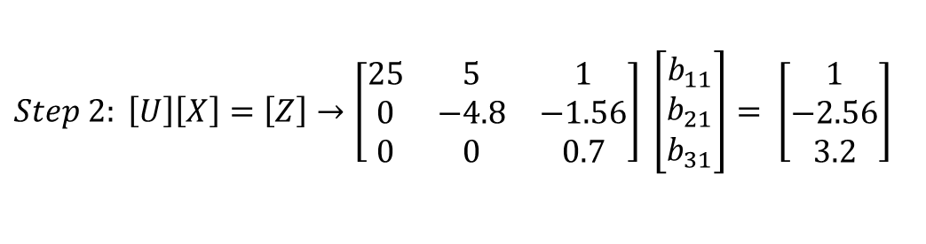
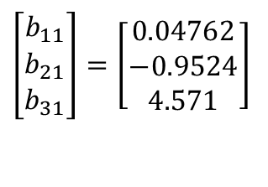
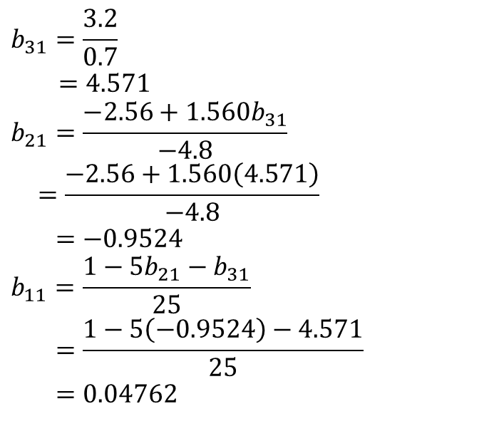
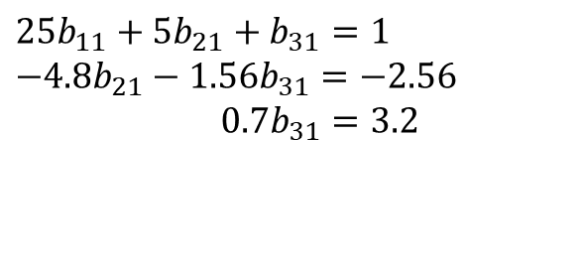
Finding 1st column of inverse: UX=Z
$$Step 2: \left[U\right]\left[X\right]=\left[Z\right]→\left[\begin{matrix}25 & 5 & 1 \\ 0 & −4.8 & −1.56 \\ 0 & 0 & 0.7\end{matrix}\right] \left[\begin{matrix}b_{11} \\ b_{21} \\ b_{31}\end{matrix}\right]= \left[\begin{matrix}1 \\ −\text{2.56} \\ \text{3.2}\end{matrix}\right]$$
$$b_{31}=\frac{3.2}{0.7}$$
$$=4.571 \\ b_{21}=\frac{−2.56+1.560b_{31}}{−4.8} \\ =\frac{−2.56+1.560\left(4.571\right)}{−4.8}$$
$=−0.9524$
$$b_{11}=\frac{1−5b_{21}−b_{31}}{25} \\ =\frac{1−5\left(−0.9524\right)−4.571}{25}$$
$=0.04762$
$$25b_{11}+5b_{21}+b_{31}=1 \\ −4.8b_{21}−1.56b_{31}=−2.56 \\ 0.7b_{31}=3.2$$
$$\left[\begin{matrix}b_{11} \\ b_{21} \\ b_{31}\end{matrix}\right]=\left[\begin{matrix}0.04762 \\ −0.9524 \\ 4.571\end{matrix}\right]$$

Slide 25
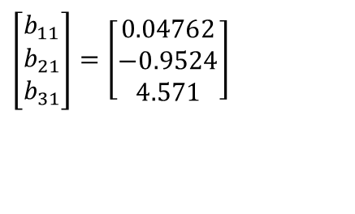
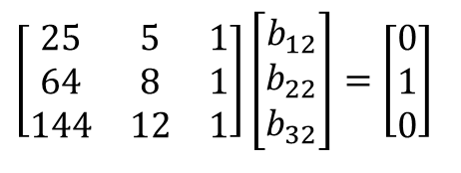
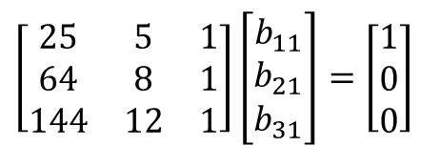
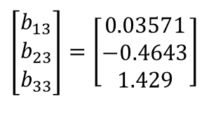
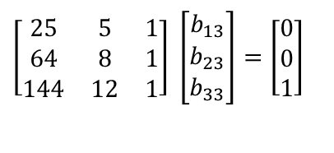
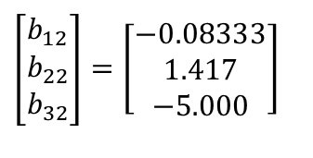
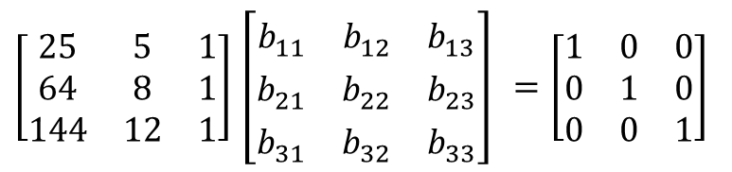
Inverse of a Matrix
$\left[\begin{matrix}25 & 5 & 1 \\ 64 & 8 & 1 \\ 144 & 12 & 1\end{matrix}\right]$ $\left[\begin{matrix}b_{11}^{} & b_{12}^{} & b_{13}^{} \\ b_{21}^{} & b_{22}^{} & b_{23}^{} \\ b_{31}^{} & b_{32}^{} & b_{33}^{}\end{matrix}\right]$ $=\left[\begin{matrix}1 & 0 & 0 \\ 0 & 1 & 0 \\ 0 & 0 & 1\end{matrix}\right]$
First Column Second Column Third Column
$$\left[\begin{matrix}25 & 5 & 1 \\ 64 & 8 & 1 \\ 144 & 12 & 1\end{matrix}\right]\left[\begin{matrix}b_{11} \\ b_{21} \\ b_{31}\end{matrix}\right]=\left[\begin{matrix}1 \\ 0 \\ 0\end{matrix}\right]$$
$$\left[\begin{matrix}25 & 5 & 1 \\ 64 & 8 & 1 \\ 144 & 12 & 1\end{matrix}\right]\left[\begin{matrix}b_{12} \\ b_{22} \\ b_{32}\end{matrix}\right]=\left[\begin{matrix}0 \\ 1 \\ 0\end{matrix}\right]$$
$$\left[\begin{matrix}25 & 5 & 1 \\ 64 & 8 & 1 \\ 144 & 12 & 1\end{matrix}\right] \left[\begin{matrix}b_{13} \\ b_{23} \\ b_{33}\end{matrix}\right]=\left[\begin{matrix}0 \\ 0 \\ 1\end{matrix}\right]$$
$$\left[\begin{matrix}b_{11} \\ b_{21} \\ b_{31}\end{matrix}\right]=\left[\begin{matrix}0.04762 \\ −0.9524 \\ 4.571\end{matrix}\right]$$
$$\left[\begin{matrix}b_{12} \\ b_{22} \\ b_{32}\end{matrix}\right]=\left[\begin{matrix}−0.08333 \\ 1.417 \\ −5.000\end{matrix}\right]$$
$$\left[\begin{matrix}b_{13} \\ b_{23} \\ b_{33}\end{matrix}\right]=\left[\begin{matrix}0.03571 \\ −0.4643 \\ 1.429\end{matrix}\right]$$

Slide 26
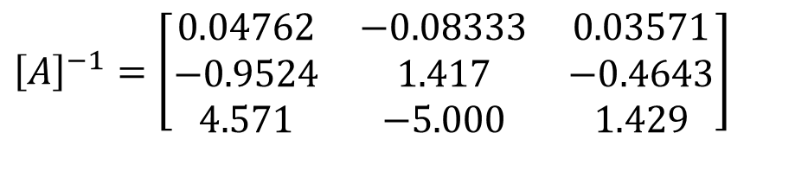
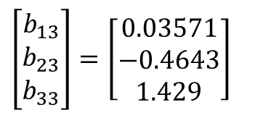
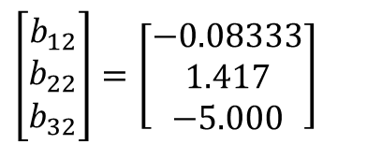
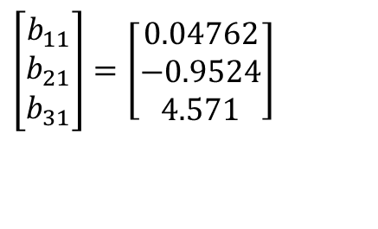
Example: Inverse of a Matrix
$$\left[\begin{matrix}b_{11} \\ b_{21} \\ b_{31}\end{matrix}\right]=\left[\begin{matrix}0.04762 \\ −0.9524 \\ 4.571\end{matrix}\right]$$
$$\left[\begin{matrix}b_{12} \\ b_{22} \\ b_{32}\end{matrix}\right]=\left[\begin{matrix}−0.08333 \\ 1.417 \\ −5.000\end{matrix}\right]$$
$$\left[\begin{matrix}b_{13} \\ b_{23} \\ b_{33}\end{matrix}\right]=\left[\begin{matrix}0.03571 \\ −0.4643 \\ 1.429\end{matrix}\right]$$
$${\left[A\right]}^{−1}=\left[\begin{matrix}0.04762 & −0.08333 & 0.03571 \\ −0.9524 & 1.417 & −0.4643 \\ 4.571 & −5.000 & 1.429\end{matrix}\right]$$
To check your work, check the following
[A][A]⁻¹ = [I] = [A]⁻¹[A]

Slide 27
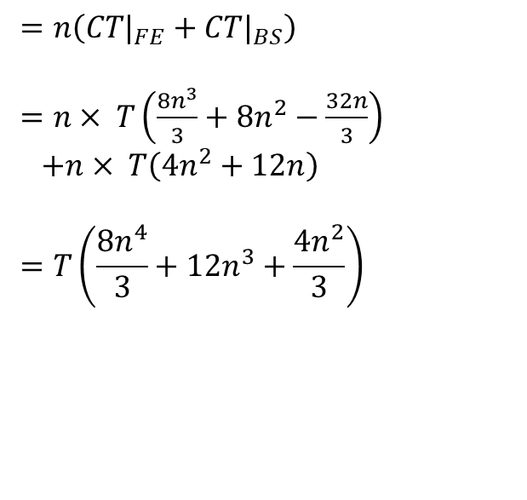
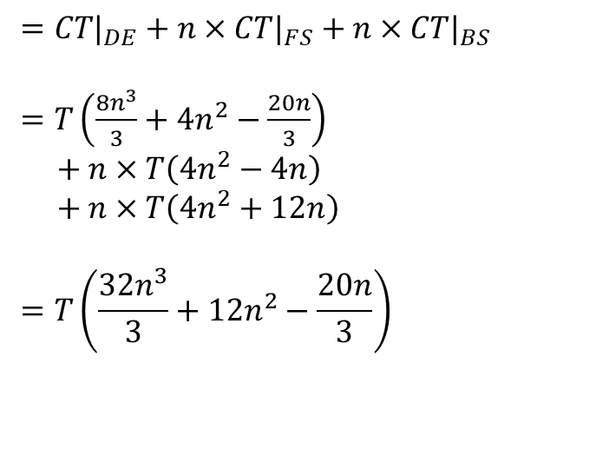
To find inverse of [A]
Time taken by Gaussian Elimination Time taken by LU Decomposition
$$=n\left(CT|_{FE}+CT|_{BS}\right)$$
= $n× T\left(\frac{8n^{3}}{3}+8n^{2}−\frac{32n}{3}\right)$
+$n× T\left(4n^{2}+12n\right)$
$$=T\left(\frac{8n^{4}}{3}+12n^{3}+\frac{4n^{2}}{3}\right)$$
$$=CT|_{DE}+n×CT|_{FS}+n×CT|_{BS}$$
= $T\left(\frac{8n^{3}}{3}+4n^{2}−\frac{20n}{3}\right)$
$$+ n×T\left(4n^{2}−4n\right)$$
+$n×T\left(4n^{2}+12n\right)$
$$=T\left(\frac{32n^{3}}{3}+12n^{2}−\frac{20n}{3}\right)$$

Slide 28
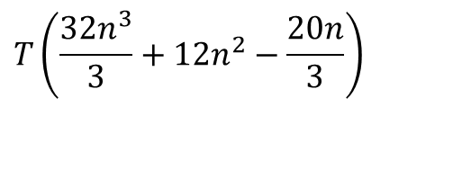
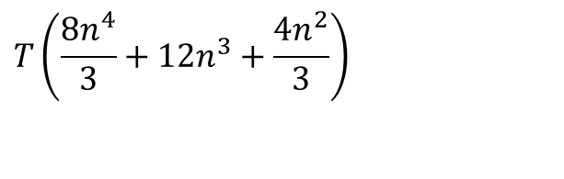
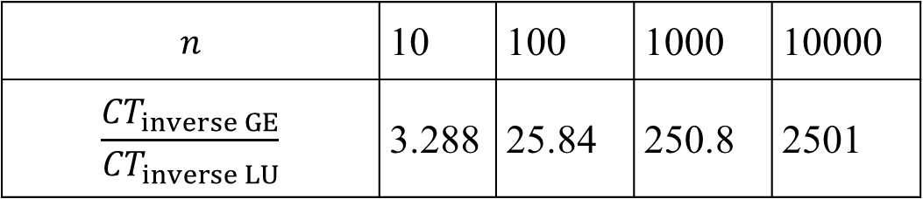
To find inverse of [A]
Time taken by Gaussian Elimination Time taken by LU Decomposition
$$T\left(\frac{8n^{4}}{3}+12n^{3}+\frac{4n^{2}}{3}\right)$$
$$T\left(\frac{32n^{3}}{3}+12n^{2}−\frac{20n}{3}\right)$$
Table 1 Comparing computational times of finding inverse of a matrix using LU decomposition and Naive Gauss elimination.
$$n$$ | 10 | 100 | 1000 | 10000
$$\frac{{CT}_{inverse GE}}{{CT}_{inverse LU}}$$ | 3.288 | 25.84 | 250.8 | 2501
For large n, $\frac{{CT}_{inverse GE}}{{CT}_{inverse LU}}≈\frac{n}{4}$

Slide 29


Slide 30


Slide 31


Slide 32


Slide 33


Slide 34
Time taken by back substitution

Slide 35

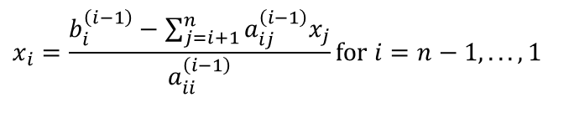
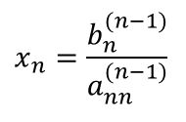
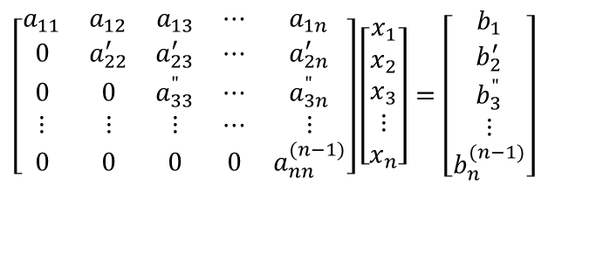
Time Taken by Back Substitution
n = length(B);
X(n)=B(n)/A(n,n)
for i=n-1:-1:1
X(i) = B(i);
for j=(i+1):1:n
X(i) = X(i) - A(i, j)*X(j);
end
X(i) = X(i)/A(i, i);
end
$$\left[\begin{matrix}a_{11} & a_{12} & a_{13} & ⋯ & a_{1n} \\ 0 & a_{22}^{′} & a_{23}^{′} & ⋯ & a_{2n}^{′} \\ 0 & 0 & a_{33}^{"} & ⋯ & a_{3n}^{"} \\ ⋮ & ⋮ & ⋮ & ⋯ & ⋮ \\ 0 & 0 & 0 & 0 & a_{nn}^{(n−1)}\end{matrix}\right]\left[\begin{matrix}x_{1} \\ x_{2} \\ x_{3} \\ ⋮ \\ x_{n}\end{matrix}\right]=\left[\begin{matrix}b_{1} \\ b_{2}^{′} \\ b_{3}^{"} \\ ⋮ \\ b_{n}^{(n−1)}\end{matrix}\right]$$
$$x_{n}=\frac{b_{n}^{(n−1)}}{a_{nn}^{(n−1)}}$$
$$x_{i}=\frac{b_{i}^{\left(i−1\right)}−\sum_{j=i+1}^{n}{a_{ij}^{\left(i−1\right)}x_{j}}}{a_{ii}^{\left(i−1\right)}}\text{for} i=n−1,...,1$$
Back Substitution CT
$$CT|_{BS}=T\left(4n^{2}+12n\right)$$

Slide 36
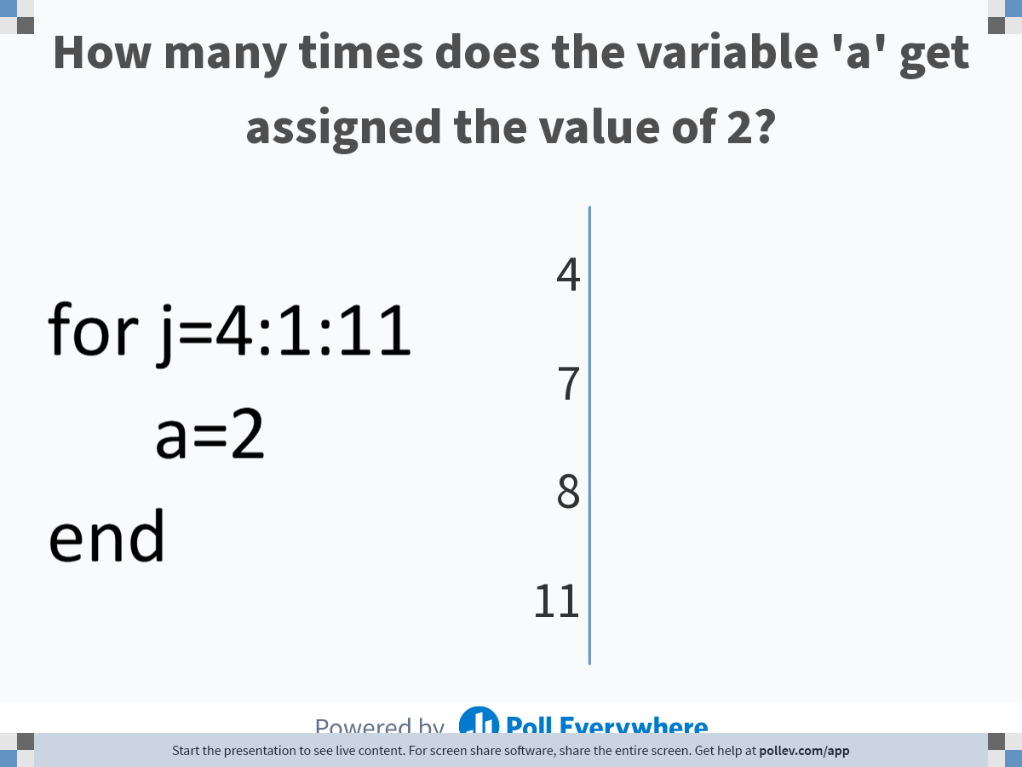
Notes:
Poll Title: Do not modify the notes in this section to avoid tampering with the Poll Everywhere activity.
More info at polleverywhere.com/support
How many times does the variable 'a' get assigned the value of 2?
https://www.polleverywhere.com/multiple_choice_polls/Xz7Xf9vuqkTGmaGfwUpnF

Slide 37
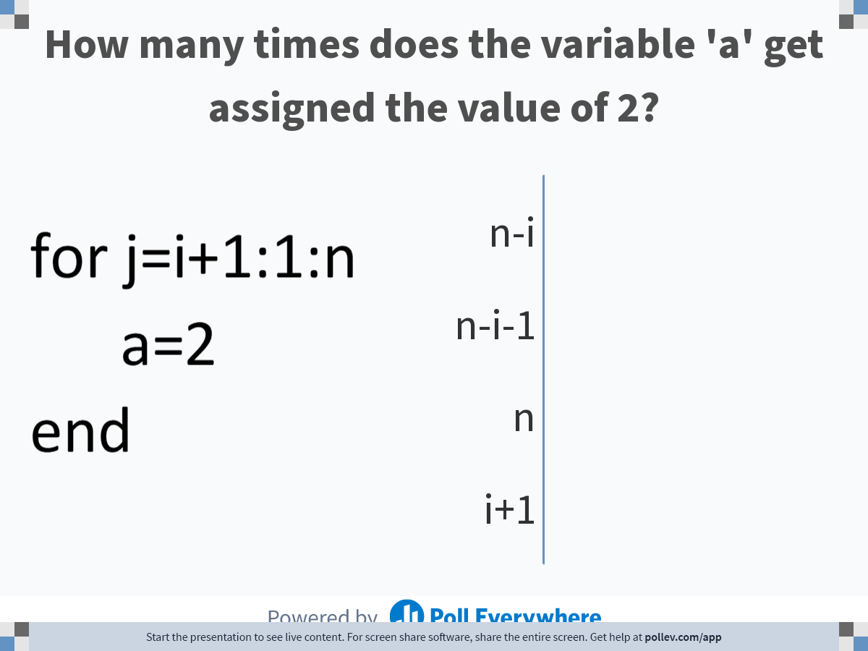
Notes:
Poll Title: Do not modify the notes in this section to avoid tampering with the Poll Everywhere activity.
More info at polleverywhere.com/support
How many times does the variable 'a' get assigned the value of 2?
https://www.polleverywhere.com/multiple_choice_polls/2S9eoggdmAodoocfDaL9W

Slide 38

Notes:
Poll Title: Do not modify the notes in this section to avoid tampering with the Poll Everywhere activity.
More info at polleverywhere.com/support
How many times does the variable 'a' get assigned the value of 2?
https://www.polleverywhere.com/multiple_choice_polls/jXdhrtLu0pUL0yiOYRHoC

Slide 39
Notes:
Poll Title: Do not modify the notes in this section to avoid tampering with the Poll Everywhere activity.
More info at polleverywhere.com/support
You are conducting back substitution part in naive Gauss elimination method to solve [U][X]=[C] for a set of 5 equations. To calculate $$x_3$$, you need to have already calculated the values of
https://www.polleverywhere.com/multiple_choice_polls/vjSAwS6dyrPcTbXJD05au

Slide 40

Notes:
Poll Title: Do not modify the notes in this section to avoid tampering with the Poll Everywhere activity.
More info at polleverywhere.com/support
What is the sum of 5+6+7+...+122?
https://www.polleverywhere.com/free_text_polls/PlXzT1GiGrvOv46Jpz16k

Slide 41


Time Taken by Back Substitution
n = length(B);
X(n)=B(n)/A(n,n)
for i=n-1:-1:1
X(i) = B(i);
for j=(i+1):1:n
X(i) = X(i) - A(i, j)*X(j);
end
X(i) = X(i)/A(i, i);
end
$$\left[\begin{matrix}a_{11} & a_{12} & a_{13} & ⋯ & a_{1n} \\ 0 & a_{22}^{′} & a_{23}^{′} & ⋯ & a_{2n}^{′} \\ 0 & 0 & a_{33}^{"} & ⋯ & a_{3n}^{"} \\ ⋮ & ⋮ & ⋮ & ⋯ & ⋮ \\ 0 & 0 & 0 & 0 & a_{nn}^{(n−1)}\end{matrix}\right]\left[\begin{matrix}x_{1} \\ x_{2} \\ x_{3} \\ ⋮ \\ x_{n}\end{matrix}\right]=\left[\begin{matrix}b_{1} \\ b_{2}^{′} \\ b_{3}^{"} \\ ⋮ \\ b_{n}^{(n−1)}\end{matrix}\right]$$
$$x_{n}=\frac{b_{n}^{(n−1)}}{a_{nn}^{(n−1)}}$$
$$x_{i}=\frac{b_{i}^{\left(i−1\right)}−\sum_{j=i+1}^{n}{a_{ij}^{\left(i−1\right)}x_{j}}}{a_{ii}^{\left(i−1\right)}}\text{for} i=n−1,...,1$$
Back Substitution CT
$$CT|_{BS}=T\left(4n^{2}+12n\right)$$

Slide 42

Time Taken by Back Substitution

Slide 43
THE END

Slide 44

Notes:
Poll Title: Do not modify the notes in this section to avoid tampering with the Poll Everywhere activity.
More info at polleverywhere.com/support
Two ice cubes are floating in the water in a glass. After the ice melts, will the water level be:
https://www.polleverywhere.com/multiple_choice_polls/x3l8gOdybmxofyWPHDCMz?state=opened&flow=Default&onscreen=persist

Slide 45

Notes:
Poll Title: Do not modify the notes in this section to avoid tampering with the Poll Everywhere activity.
More info at polleverywhere.com/support
Increasing the precision of numbers from single to double in the Naïve Gaussian elimination method (check all that apply).
https://www.polleverywhere.com/multiple_choice_polls/LoPNE2ZDfBcguD4O7THWv

Slide 46

Notes:
Poll Title: Do not modify the notes in this section to avoid tampering with the Poll Everywhere activity.
More info at polleverywhere.com/support
Someone is asking you to use LU decomposition method to solve $$m$$ sets of ($$n$$ equations, $$n$$ unknowns) of the form [A][X]=[C]. If the coefficient matrix [A] stays the same in all sets, how many times does one need to decompose the matrix [A]?
https://www.polleverywhere.com/multiple_choice_polls/evWFJTvpCxbwGhGzhnFl8?state=opened&flow=Default&onscreen=persist

Slide 47

Notes:
Poll Title: Do not modify the notes in this section to avoid tampering with the Poll Everywhere activity.
More info at polleverywhere.com/support
There are two steps in Naive Gaussian Elimination - forward elimination and back substitution. If we are solving n equations for n unknowns, how many steps are in the forward elimination part.
https://www.polleverywhere.com/multiple_choice_polls/yK11NupI5TLwo8POpNCZ3

Slide 48

Notes:
Poll Title: Do not modify the notes in this section to avoid tampering with the Poll Everywhere activity.
More info at polleverywhere.com/support
Naive Gaussian elimination has these inherent numerical methods errors (Check all that apply)
https://www.polleverywhere.com/multiple_choice_polls/5DeQp9Nghv6QGmFutEJgh

Slide 49

Notes:
Poll Title: Do not modify the notes in this section to avoid tampering with the Poll Everywhere activity.
More info at polleverywhere.com/support
LU decomposition method is computationally more efficient than Naïve Gauss elimination for solving
https://www.polleverywhere.com/multiple_choice_polls/fwb3mbnfT4qwuSYwgdQxL

Slide 50

Notes:
Poll Title: Do not modify the notes in this section to avoid tampering with the Poll Everywhere activity.
More info at polleverywhere.com/support
Using 3 significant digits with chopping at all stages, the result for the following calculation is $$x_1 = \\displaystyle \\frac{6.095-3.456 \\times 1.99}{8}$$
https://www.polleverywhere.com/multiple_choice_polls/yRqNbh096TpJTFcp1mM9s

Slide 51

Notes:
Poll Title: Do not modify the notes in this section to avoid tampering with the Poll Everywhere activity.
More info at polleverywhere.com/support
Division by zero during forward elimination steps in Naïve Gaussian elimination for [A][X]=[C] implies the coefficient matrix [A].
https://www.polleverywhere.com/multiple_choice_polls/YemBA8Gf5W2l3UVCQSqc2

Slide 52
THE END

Slide 53


Slide 54


