Slide 1
Regression
Reading While Skimming the Lines

Slide 2
6.04
Nonlinear Regression

Slide 3
Nonlinear Regression Without Transformation of Data (Untransformed Data)
3

Slide 4
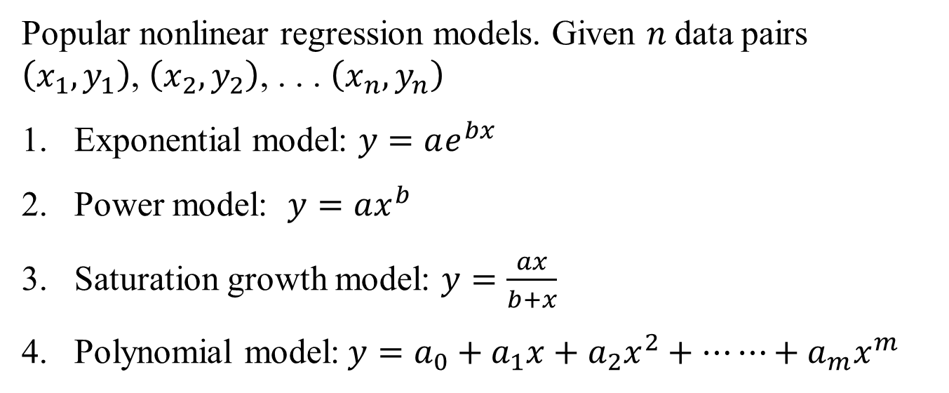
Nonlinear Regression
Popular nonlinear regression models. Given $n$data pairs $\left(x_{1},y_{1}\right)$, $\left(x_{2},y_{2}\right)$, . . . $\left(x_{n},y_{n}\right)$
Exponential model: $y=ae^{bx}$
Power model: $y=ax^{b}$
Saturation growth model: $y=\frac{ax}{b+x}$
Polynomial model:$y=a_{0}+a_{1}x+a_{2}x^{2}+⋯⋯+a_{m}x^{m}$

Slide 5




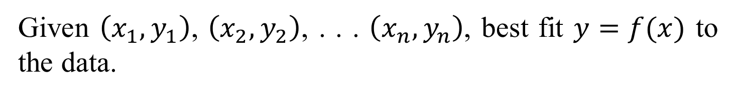


Nonlinear Regression
Given $\left(x_{1},y_{1}\right)$, $\left(x_{2},y_{2}\right)$, . . . $\left(x_{n},y_{n}\right)$, best fit $y=f(x)$ to the data.
$$(x_{n},y_{n})$$
$$(x_{2},y_{2})$$
$$y=f(x)$$
$$(x_{i},y_{i})$$
$$y_{i}−f(x_{i})$$
$$(x_{1},y_{1})$$
Figure. Nonlinear regression model for discrete y vs. x data

Slide 6




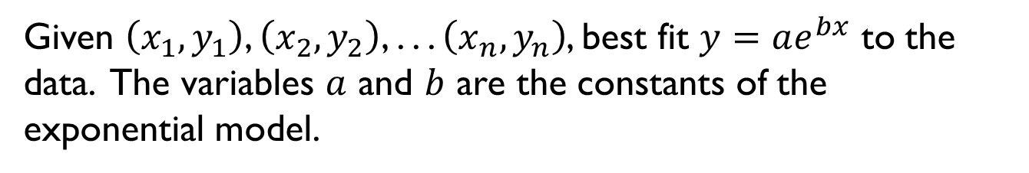

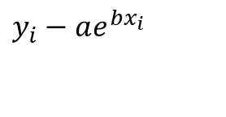
Exponential Model
Given $\left(x_{1},y_{1}\right)$, $\left(x_{2},y_{2}\right)$, . . . $\left(x_{n},y_{n}\right)$, best fit $y=ae^{bx}$ to the data. The variables $a$ and $b$ are the constants of the exponential model.
$$(x_{1},y_{1})$$
$$y=ae^{bx}$$
$$y_{i}−ae^{bx_{i}}$$
$$(x_{i},y_{i})$$
$$(x_{2},y_{2})$$
$$(x_{n},y_{n})$$
Figure. Exponential model of nonlinear regression for y vs. x data

Slide 7
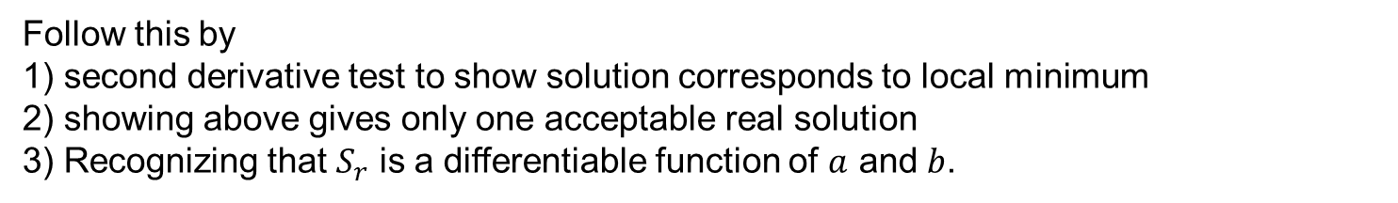
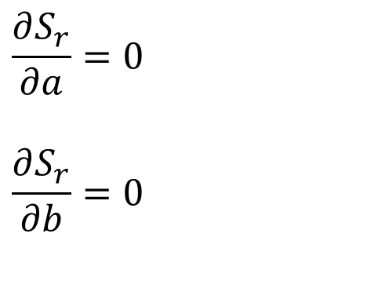
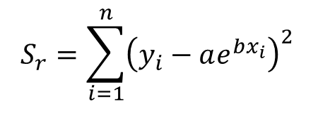
Finding Constants of Exponential Model
$$S_{r}=\sum_{i=1}^{n}{{\left(y_{i}−ae^{bx_{i}}\right)}^{2}}$$
$$\frac{∂S_{r}}{∂a}=0$$
$$\frac{∂S_{r}}{∂b}=0$$
Follow this by
1) second derivative test to show solution corresponds to local minimum
2) showing above gives only one acceptable real solution
3) Recognizing that $S_{r}$ is a differentiable function of $a$ and $b$.

Slide 8
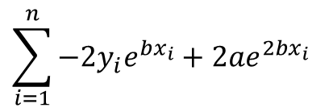
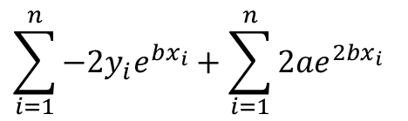
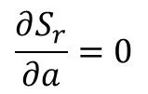
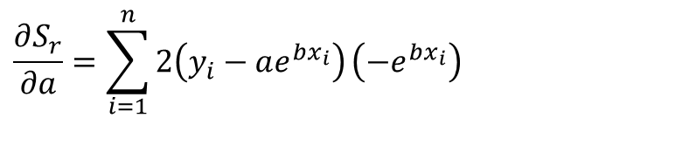
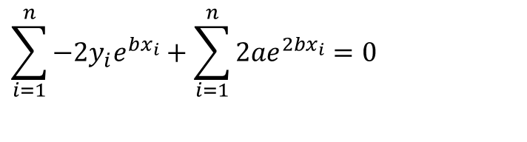

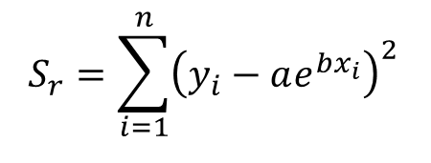

Finding Constants of Exponential Model
$$S_{r}=\sum_{i=1}^{n}{{\left(y_{i}−ae^{bx_{i}}\right)}^{2}}$$
Differentiate with respect to $a$
$$\frac{∂S_{r}}{∂a}=\sum_{i=1}^{n}{2\left(y_{i}−ae^{bx_{i}}\right)}\left(−e^{bx_{i}}\right)$$
$$\sum_{i=1}^{n}{−{2y}_{i}e^{bx_{i}}}+{2ae}^{2bx_{i}}$$
$$=$$
$$\sum_{i=1}^{n}{−{2y}_{i}e^{bx_{i}}}+\sum_{i=1}^{n}{{2ae}^{2bx_{i}}}$$
$$=$$
$$\frac{∂S_{r}}{∂a}=0$$
$$\sum_{i=1}^{n}{−{2y}_{i}e^{bx_{i}}}+\sum_{i=1}^{n}{{2ae}^{2bx_{i}}}=0$$
Equation 1

Slide 9

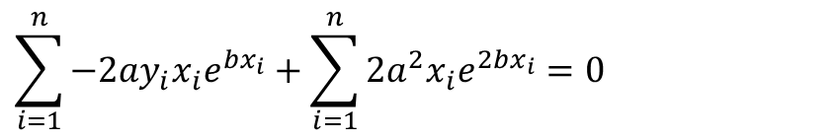
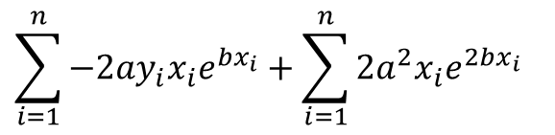
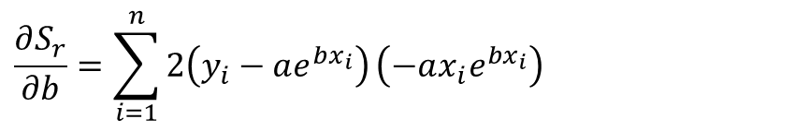
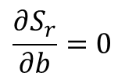

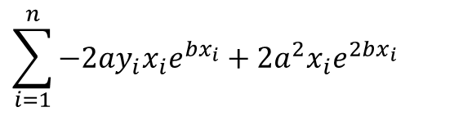
Finding Constants of Exponential Model
$$S_{r}=\sum_{i=1}^{n}{{\left(y_{i}−ae^{bx_{i}}\right)}^{2}}$$
Differentiate with respect to $b$
$$\frac{∂S_{r}}{∂b}=\sum_{i=1}^{n}{2\left(y_{i}−ae^{bx_{i}}\right)}\left(−ax_{i}e^{bx_{i}}\right)$$
$$\sum_{i=1}^{n}{{−2ay}_{i}x_{i}e^{bx_{i}}}+{2a^{2}x}_{i}e^{2bx_{i}}$$
$$=$$
$$\sum_{i=1}^{n}{{−2ay}_{i}x_{i}e^{bx_{i}}}+\sum_{i=1}^{n}{{2a^{2}x}_{i}e^{2bx_{i}}}$$
$$=$$
$$\frac{∂S_{r}}{∂b}=0$$
$$\sum_{i=1}^{n}{{−2ay}_{i}x_{i}e^{bx_{i}}}+\sum_{i=1}^{n}{{2a^{2}x}_{i}e^{2bx_{i}}}=0$$
Equation 2

Slide 10
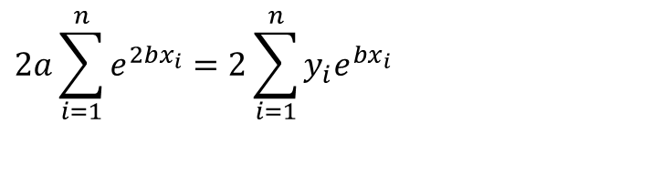
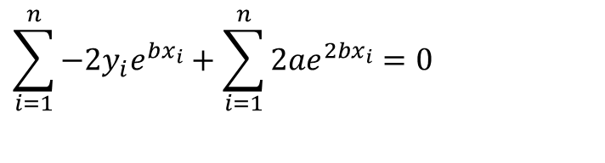
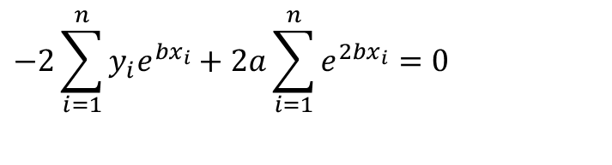
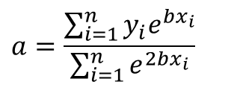
Finding Constants of Exponential Model
$$\sum_{i=1}^{n}{−{2y}_{i}e^{bx_{i}}}+\sum_{i=1}^{n}{{2ae}^{2bx_{i}}}=0$$
Equation 1
$$−2\sum_{i=1}^{n}{y_{i}e^{bx_{i}}}+2a\sum_{i=1}^{n}{e^{2bx_{i}}}=0$$
$$2a\sum_{i=1}^{n}{e^{2bx_{i}}}=2\sum_{i=1}^{n}{y_{i}e^{bx_{i}}}$$
$$a=\frac{\sum_{i=1}^{n}{y_{i}e^{bx_{i}}}}{\sum_{i=1}^{n}{e^{2bx_{i}}}}$$

Slide 11
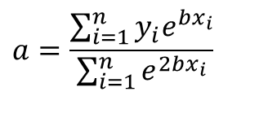
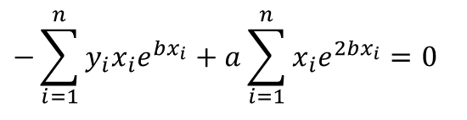
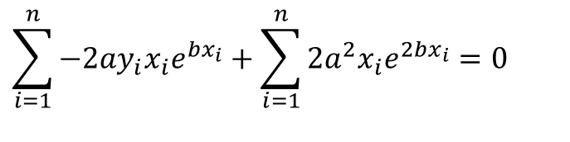
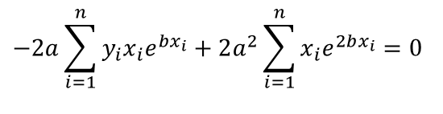
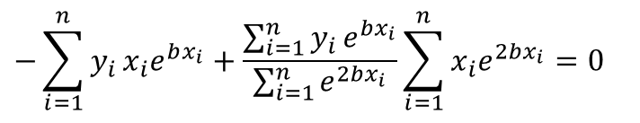
Finding Constants of Exponential Model
$$a=\frac{\sum_{i=1}^{n}{y_{i}e^{bx_{i}}}}{\sum_{i=1}^{n}{e^{2bx_{i}}}}$$
$$\sum_{i=1}^{n}{{−2ay}_{i}x_{i}e^{bx_{i}}}+\sum_{i=1}^{n}{{2a^{2}x}_{i}e^{2bx_{i}}}=0$$
Equation 2
$$−2a\sum_{i=1}^{n}{y_{i}x_{i}e^{bx_{i}}}+2a^{2}\sum_{i=1}^{n}{x_{i}e^{2bx_{i}}}=0$$
$$−\sum_{i=1}^{n}{y_{i}x_{i}e^{bx_{i}}}+a\sum_{i=1}^{n}{x_{i}e^{2bx_{i}}}=0$$
$$−\sum_{i=1}^{n}{y_{i}}x_{i}e^{bx_{i}}+\frac{\sum_{i=1}^{n}{y_{i}}e^{bx_{i}}}{\sum_{i=1}^{n}{e^{2bx_{i}}}}\sum_{i=1}^{n}{x_{i}e^{2bx_{i}}}=0$$

Slide 12
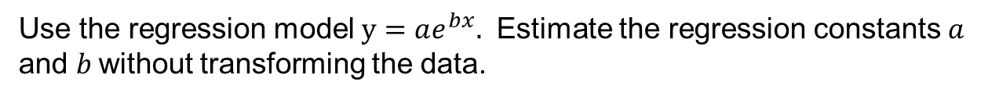
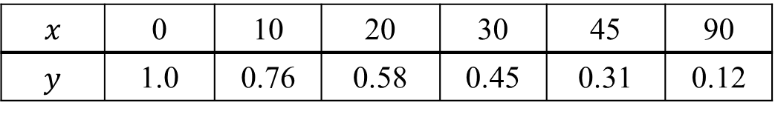
Example - Exponential Model
$$x$$ | 0 | 10 | 20 | 30 | 45 | 90
$$y$$ | 1.0 | 0.76 | 0.58 | 0.45 | 0.31 | 0.12
Use the regression model $y=ae^{bx}.$ Estimate the regression constants $a$ and $b$without transforming the data.

Slide 13
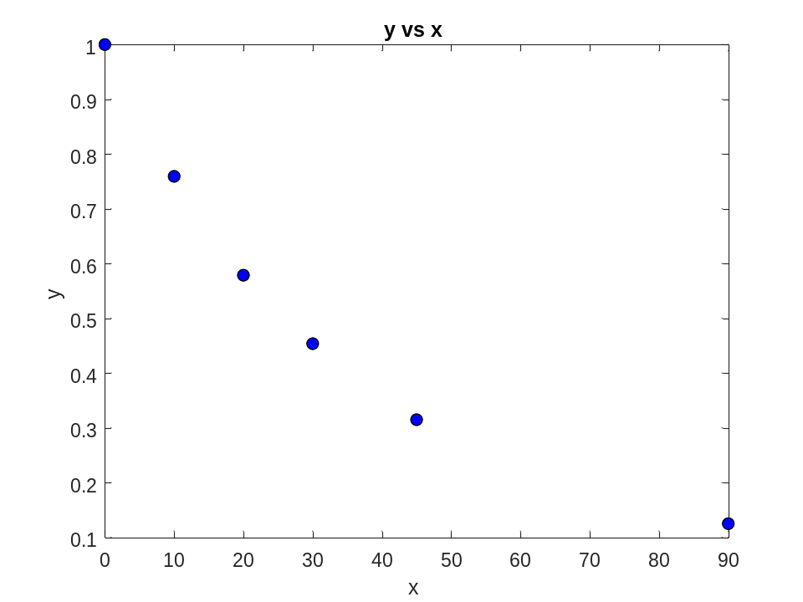
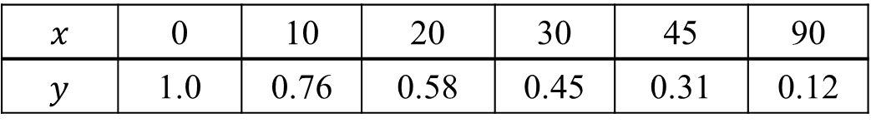
Plot of data
$$x$$ | 0 | 10 | 20 | 30 | 45 | 90
$$y$$ | 1.0 | 0.76 | 0.58 | 0.45 | 0.31 | 0.12

Slide 14

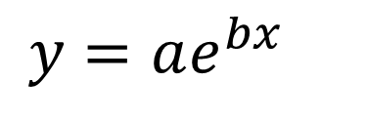
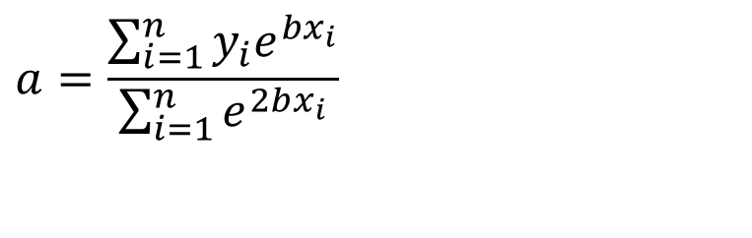
Constants of the Model
$$y=ae^{bx}$$
The value of $b$ is found by solving the nonlinear equation
$$f(b)=$$
$$a=\frac{\sum_{i=1}^{n}{y_{i}e^{bx_{i}}}}{\sum_{i=1}^{n}{e^{2bx_{i}}}}$$

Slide 15
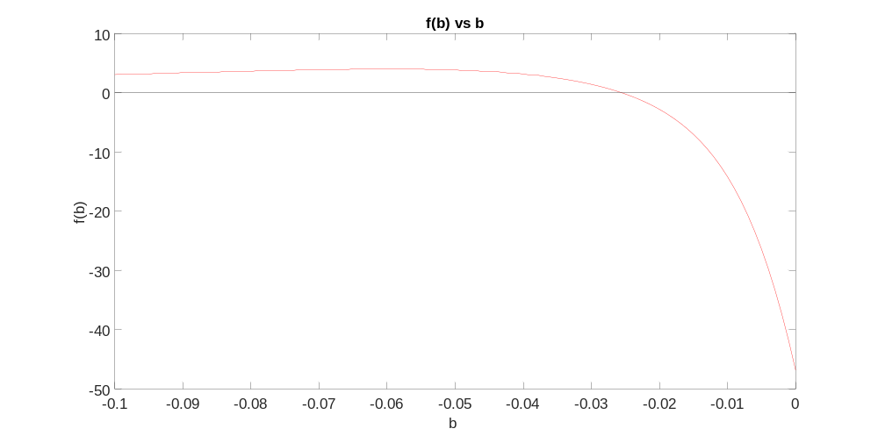
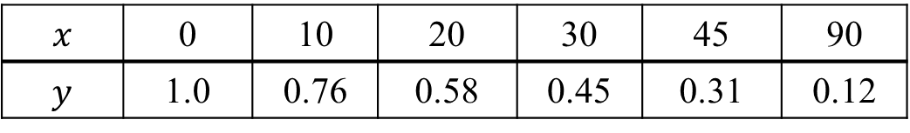

Setting up the Equation in MATLAB
$$f(b)=$$
$$x$$ | 0 | 10 | 20 | 30 | 45 | 90
$$y$$ | 1.0 | 0.76 | 0.58 | 0.45 | 0.31 | 0.12

Slide 16

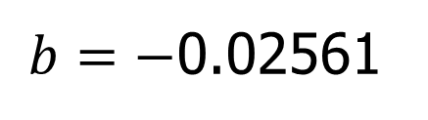
Setting up the Equation in MATLAB
$$f(b)=$$
x=[0 10 20 30 45 90]
y=[1.0 0.76 0.58 0.45 0.31 0.12]
syms b real
sum1=sum(y.*x.*exp(b*x));
sum2=sum(y.*exp(b*x));
sum3=sum(exp(2*b*x));
sum4=sum(x.*exp(2*b*x));
f=-sum1+sum2/sum3*sum4;
b_soln=vpasolve(f,b);
$b=−$0.02561

Slide 17
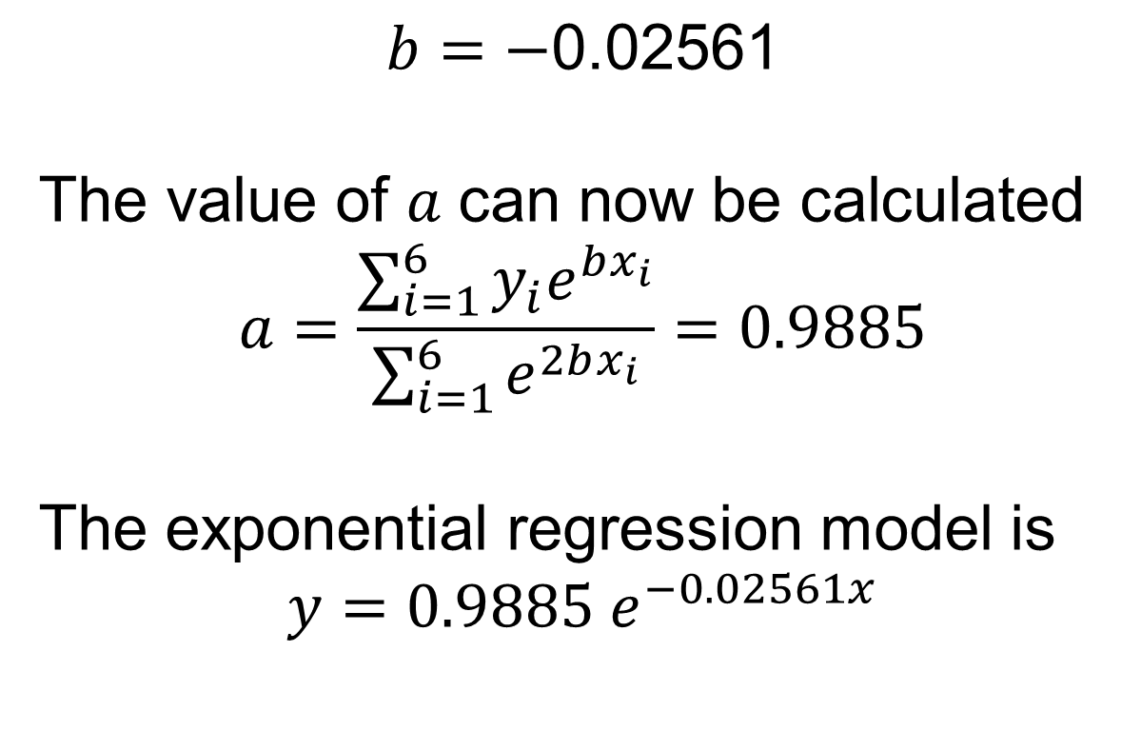
Calculating the Other Constant
$$b=−\text{0.02561}$$
$$\text{The} \text{value} \text{of} a \text{can} \text{now} \text{be} \text{calculated}$$
$$a=\frac{\sum_{i=1}^{6}{y_{i}e^{bx_{i}}}}{\sum_{i=1}^{6}{e^{2bx_{i}}}}=0.9885$$
The exponential regression model is
$$y=0.9885 e^{−0.02561x}$$

Slide 18
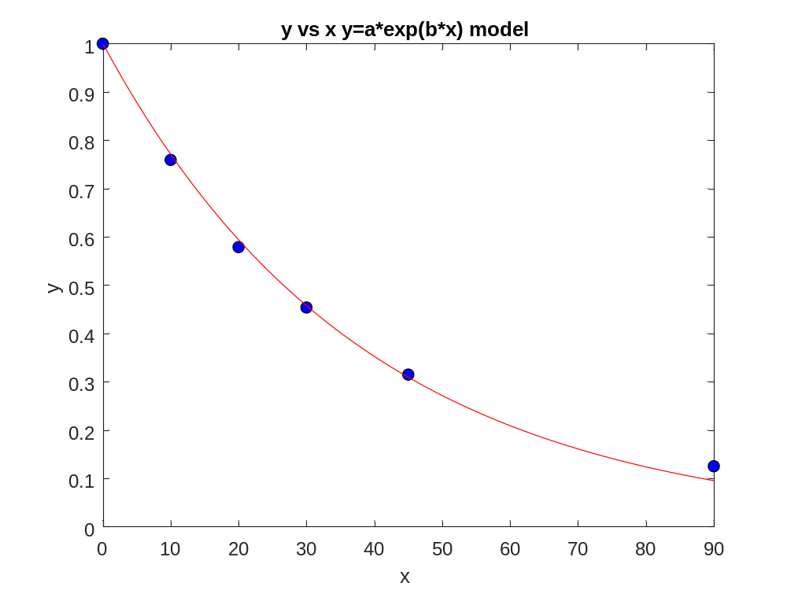
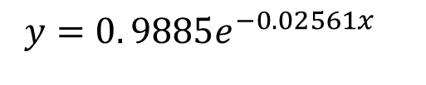
Plot of data and regression curve
$$y=0. 9885e^{−0.02561x}$$

Slide 19
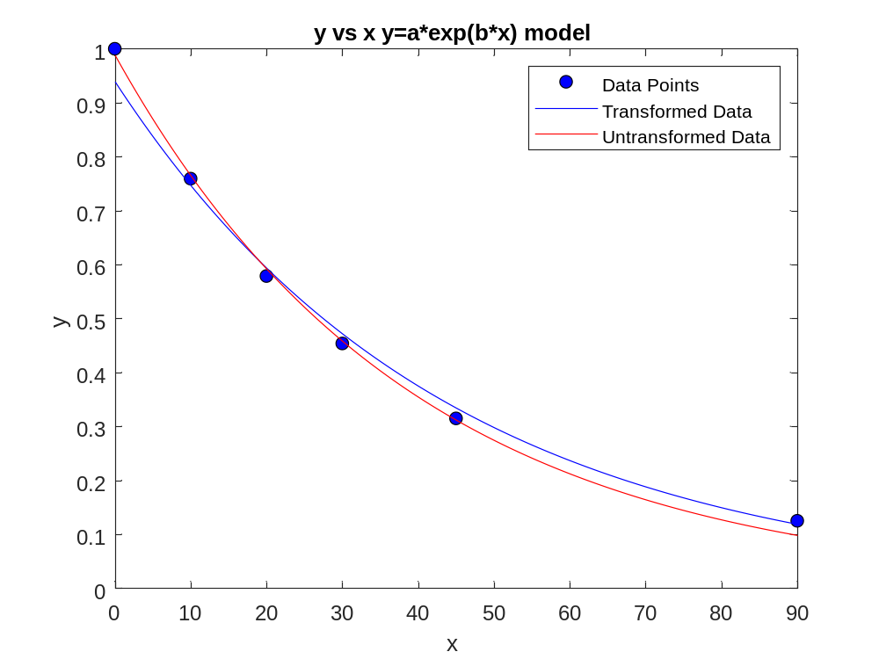
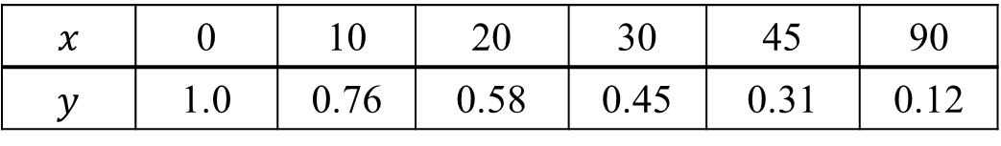
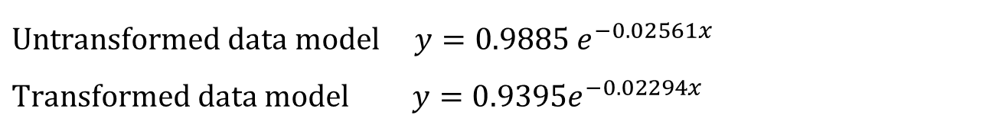
Transformed vs Untransformed Data
$$x$$ | 0 | 10 | 20 | 30 | 45 | 90
$$y$$ | 1.0 | 0.76 | 0.58 | 0.45 | 0.31 | 0.12
$$\text{Unt}\text{ransform}\text{ed} data model y=0.9885 e^{−0.02561x}$$
$$\text{Transform}\text{ed} data model y=0.9395e^{−0.02294x}$$

Slide 20
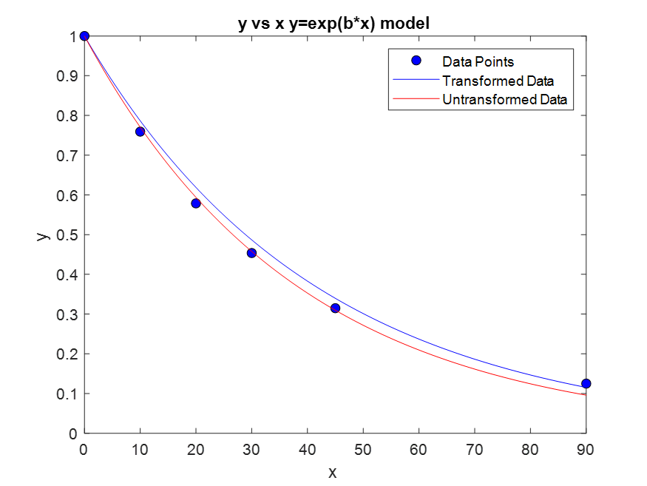
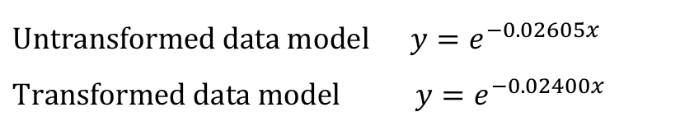
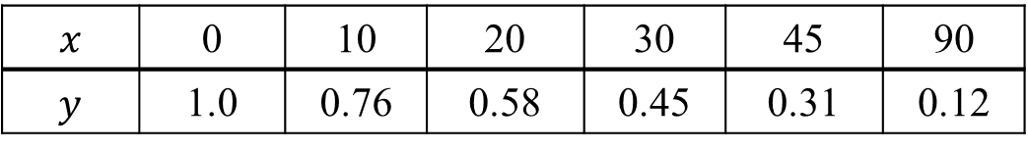

Classwork/Homework: Transformed vs Untransformed Data
$$x$$ | 0 | 10 | 20 | 30 | 45 | 90
$$y$$ | 1.0 | 0.76 | 0.58 | 0.45 | 0.31 | 0.12
What if the model was $y=e^{bx}$? What is the solution with and without transformation?
$$\text{Unt}\text{ransform}\text{ed} data model y=e^{−0.02605x}$$
$$\text{T}\text{ransform}\text{ed} \text{data} \text{model} y=e^{−0.02400x}$$

Slide 21
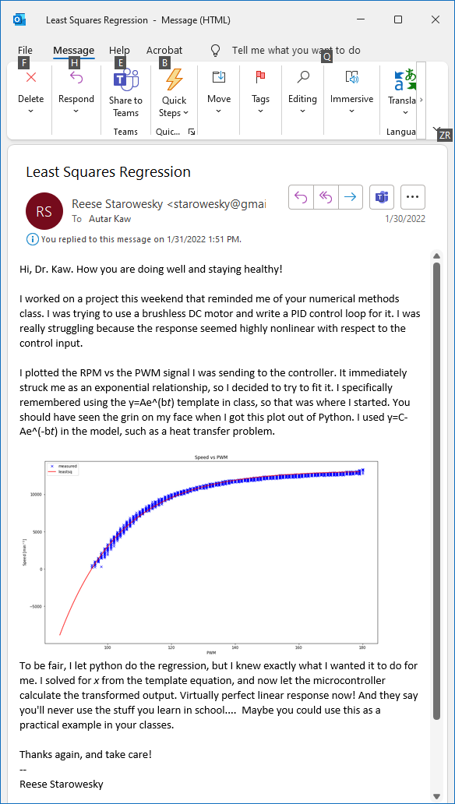
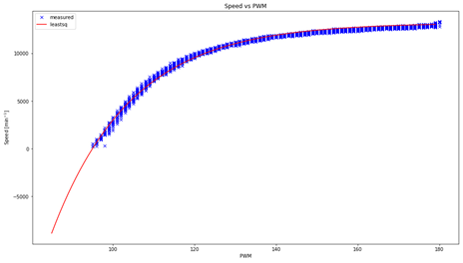

Slide 22
What polynomial model to choose if one needs to be chosen?

Slide 23
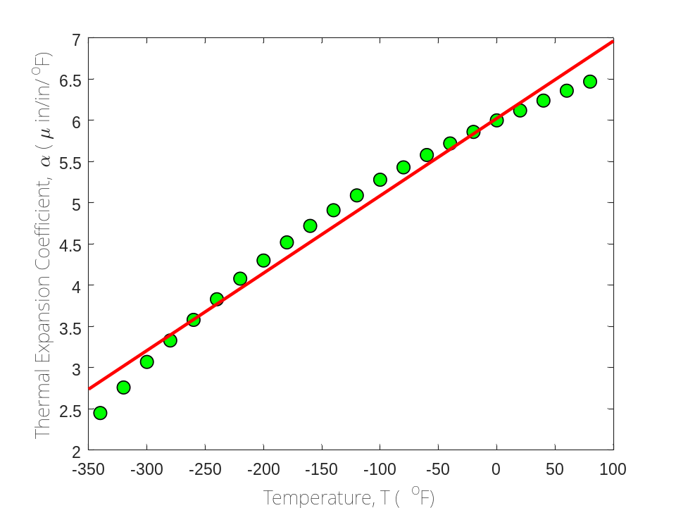
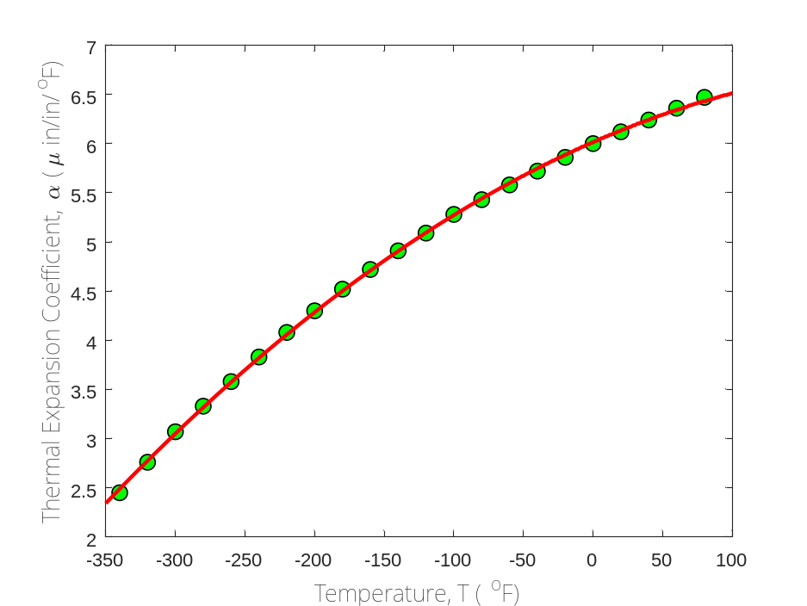

Which model to choose?
$$α=0.009387T+6.025$$
$$α=−0.000012{28T}^{2}+0.006196T+6.015$$

Slide 24
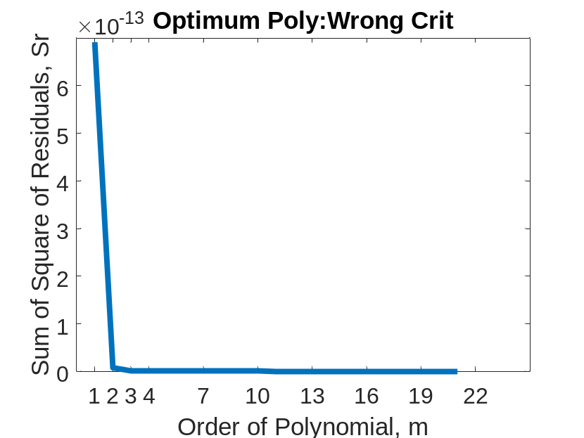

Optimum Polynomial: Wrong Criterion
Both graphs are same
Left one starts at m=1
Right one starts at m=2

Slide 25


Optimum Polynomial: Correct Criterion
Both graphs are same
Left one starts at m=1
Right one starts at m=2

Slide 26

Notes:
Poll Title: Do not modify the notes in this section to avoid tampering with the Poll Everywhere activity.
More info at polleverywhere.com/support
Who is this artist?
https://www.polleverywhere.com/multiple_choice_polls/cHcAgyXAhIaoYa09bH6Ky?state=opened&flow=Default&onscreen=persist

Slide 27

Notes:
Do not modify the notes in this section to avoid tampering with the Poll Everywhere activity.
More info at polleverywhere.com/support
LiveSlide
https://nm.mathforcollege.com/nmsims/06REG/06REG_transformed_untransformed_regression/regression_en.html

Slide 28

Notes:
Poll Title: Do not modify the notes in this section to avoid tampering with the Poll Everywhere activity.
More info at polleverywhere.com/support
Without transforming the data to find the constants of the regression model $$y=ae^{bx}$$ to best fit $$(x_1,y_1),(x_2,y_2),................(x_n,y_n)$$, the sum of the square of the residuals that is minimized is
https://www.polleverywhere.com/multiple_choice_polls/ONkZoStGFTq97As5QDjF5

Slide 29

Notes:
Poll Title: Do not modify the notes in this section to avoid tampering with the Poll Everywhere activity.
More info at polleverywhere.com/support
When transforming the data to find the constants of the regression model $$y=ae^{bx}$$ to best fit $$(x_1,y_1),(x_2,y_2),................(x_n,y_n)$$, the sum of the square of the residuals that is minimized is
https://www.polleverywhere.com/multiple_choice_polls/WyT4ltd6kg29KTrQtJjC4

Slide 30

Notes:
Poll Title: Do not modify the notes in this section to avoid tampering with the Poll Everywhere activity.
More info at polleverywhere.com/support
When transforming the data for stress-strain curve $$\\sigma = k_1 \\varepsilon e^{-k_2 \\varepsilon}$$ for concrete in compression, where $$\\sigma$$ is the stress and $$\\varepsilon$$ is the strain, the model is rewritten as
https://www.polleverywhere.com/multiple_choice_polls/5fePUyebYZGd9JEqw7acP

Slide 32
6.05
Adequacy of Linear Regression Models

Slide 33

Data

Slide 34

Therm exp coeff vs temperature
T | α
80 | 6.47
60 | 6.36
40 | 6.24
20 | 6.12
0 | 6.00
-20 | 5.86
-40 | 5.2
-60 | 5.58
-80 | 5.43
-100 | 5.28
-120 | 5.09
T | α
-140 | 4.91
-160 | 4.72
-180 | 4.52
-200 | 4.30
-220 | 4.08
-240 | 3.83
-260 | 3.58
-280 | 3.33
-300 | 3.07
-320 | 2.76
-340 | 2.45
$T$ is in $oF$
$α$ is in $μin/in/ oF$

Slide 35
Is this adequate?
Straight Line Model

Slide 36
Quality of Fitted Data
Does the model describe the data adequately?
How well does the model predict the response variable predictably?

Slide 37
Linear Regression Models
Limit our discussion to adequacy of straight-line regression models

Slide 38
Four checks
Does the model look like it explains the data?
Do 95%of the residuals fall with ±2 standard error of estimate?
Is the coefficient of determination acceptable?
Does the model meet the assumption of random errors?

Slide 39


Check 1:Plot Model and Data
T | α
80 | 6.47
60 | 6.36
40 | 6.24
20 | 6.12
0 | 6.00
-20 | 5.86
-40 | 5.2
-60 | 5.58
-80 | 5.43
-100 | 5.28
-120 | 5.09
T | α
-140 | 4.91
-160 | 4.72
-180 | 4.52
-200 | 4.30
-220 | 4.08
-240 | 3.83
-260 | 3.58
-280 | 3.33
-300 | 3.07
-320 | 2.76
-340 | 2.45
$$α=6.0248+0.0093868T$$

Slide 41




Check 2: Using Standard Error of Estimate
$$α=(6.0248+2∗0.1700)+0.0093868T$$
$$α=6.0248+0.0093868T$$
$$α=(6.0248−2∗0.1700)+0.0093868T$$
$$s_{α/T}=\sqrt{\frac{S_{r}}{n−2}}$$
$s_{α/T}=$0.1700

Slide 42

Problem Assigned
Given (2,4), (2,5), (3,5) and (3,6) as data points
1) Regress to a general straight line,
$y=a_{0}+$ $a_{1}x$. (Answer: y=1x+2.5)
2) Find the standard error of estimate (Ans: 0.7071).
3) Find the scaled residuals (Answer: -0.7071 0.7071 -0.7071 0.7071).

Slide 43



Check 3: Using Coefficient of Determination

Slide 44
Notes:
Do not modify the notes in this section to avoid tampering with the Poll Everywhere activity.
More info at polleverywhere.com/support
LiveSlide
https://nm.mathforcollege.com/nmsims/06REG/06REG_adequacy_of_linear_regression/adequacy_en.html

Slide 45
Final Exam Grade

Slide 46

Final Exam Grade vs Pre-Req GPA

Slide 47
Problem Assigned
Given (2,4), (2,5), (3,5) and (3,6) as data points (extension of previous problem)
1) Find the sum of the square of the differences with the mean (Ans: 2).
2) Find the sum of the square of the residuals. (Ans: 1)
3) Find the coefficient of determination (Ans: 0.5).
4) Find the correlation coefficient (Ans: 0.7071).

Slide 48
Check 4. Does the model meet assumption of random errors?

Slide 49
Model meets assumption of random errors
Residuals are negative as well as positive
Variation of residuals as a function of the independent variable is random
Residuals follow a normal distribution
There is no autocorrelation between the data points.

Slide 50

Are residuals negative and positive?

Slide 51
Is variation of residuals as a function of independent variable random?

Slide 52

Do the residuals follow normal distribution?

Slide 53
06.XX
Parting Thoughts

Slide 54

Same but different
The following are same for both lines.
Mean of x
Sample variance of x
Mean of y
Sample variance of y
Correlation between x and y
Linear regression line
Coefficient of determination of the linear regression
Source: Cliff Pickover: https://twitter.com/pickover/status/1576630790309707776/photo/1

Slide 55

Pizza price vs Pizza Diameter
Sources: https://www.npr.org/sections/money/2014/02/26/282132576/74-476-reasons-you-should-always-get-the-bigger-pizza
https://www.themarysue.com/mpr-pizza-graph/

Slide 56
END

