Slide 1
Higher Order and Coupled Ordinary Differential Equations

Slide 2
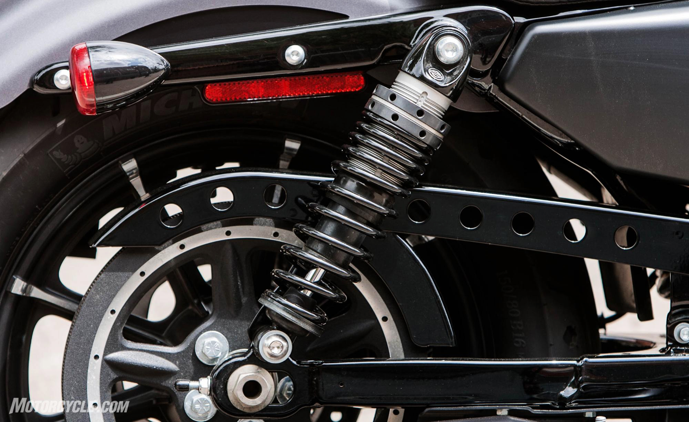
Motorcycle suspension system

Slide 3
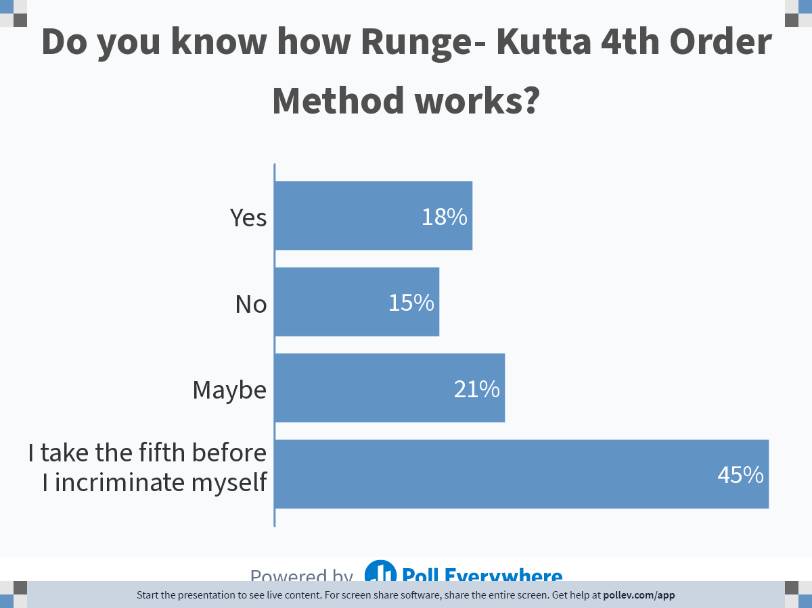
Notes:
Poll Title: Do not modify the notes in this section to avoid tampering with the Poll Everywhere activity.
More info at polleverywhere.com/support
Do you know how Runge- Kutta 4th Order Method works?
https://www.polleverywhere.com/multiple_choice_polls/kxPO38j6CKoCXcjC4fL2z?state=opened&flow=Default&onscreen=persist

Slide 4
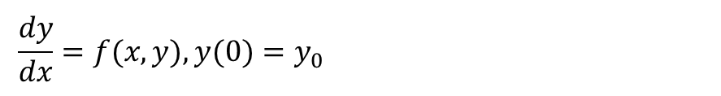
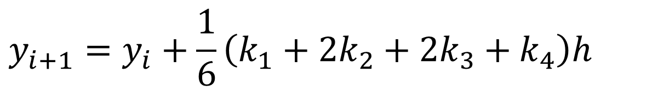

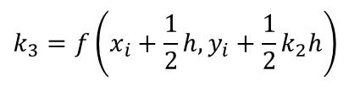
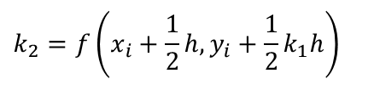

Runge-Kutta 4th Order Method
$$\frac{dy}{dx}=f(x,y),y(0)=y_{0}$$
$$y_{i+1}=y_{i}+\frac{1}{6}\left(k_{1}+2k_{2}+2k_{3}+k_{4}\right)h$$
$$k_{1}=f\left(x_{i},y_{i}\right)$$
$$k_{2}=f\left(x_{i}+\frac{1}{2}h,y_{i}+\frac{1}{2}k_{1}h\right)$$
$$k_{3}=f\left(x_{i}+\frac{1}{2}h,y_{i}+\frac{1}{2}k_{2}h\right)$$
$$k_{4}=f\left(x_{i}+h,y_{i}+k_{3}h\right)$$

Slide 5
Bus Suspension System
http://nm.MathForCollege.com

Slide 6
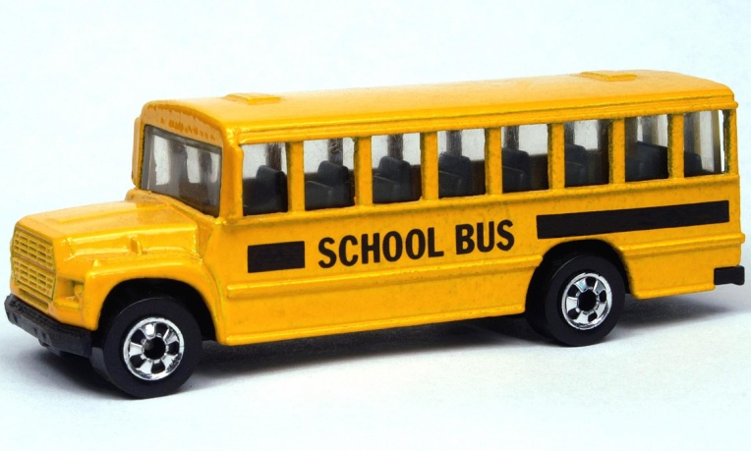
Bus Suspension System
An Example to Show How to Reduce Coupled Differential Equations to a Set of First Order Differential Equations
3
Figure 1: A school bus.

Slide 7
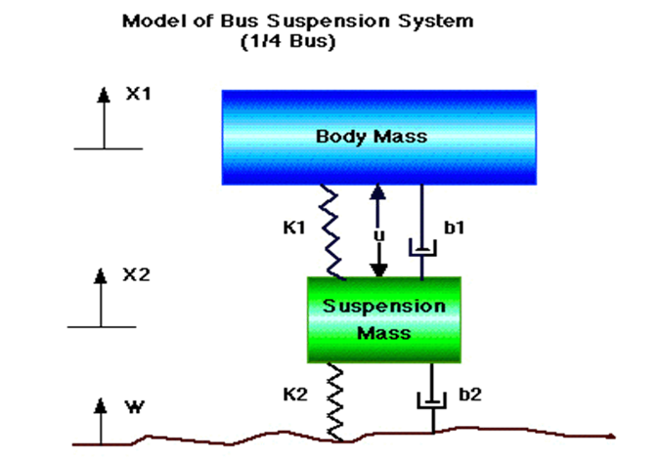
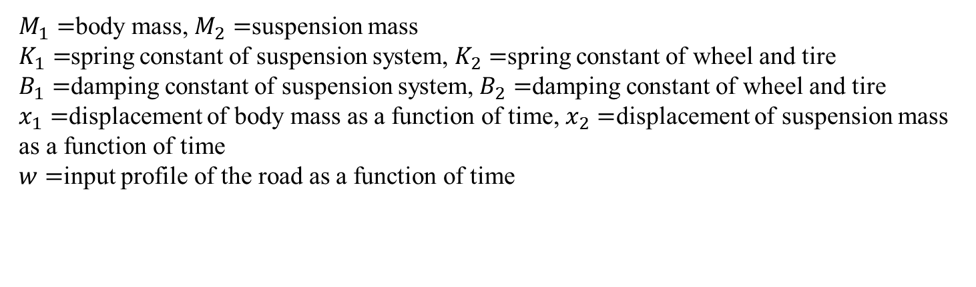
Bus Suspension System (cont.)
$M_{1}=$body mass, $M_{2}=$suspension mass
$K_{1}=$spring constant of suspension system, $K_{2}=$spring constant of wheel and tire
$B_{1}=$damping constant of suspension system, $B_{2}=$damping constant of wheel and tire
$x_{1}=$displacement of body mass as a function of time, $x_{2}=$displacement of suspension mass as a function of time
$w=$input profile of the road as a function of time

Slide 8
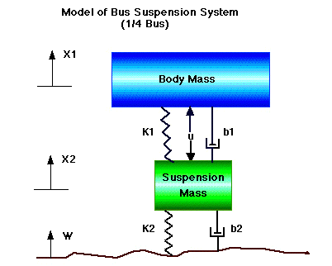
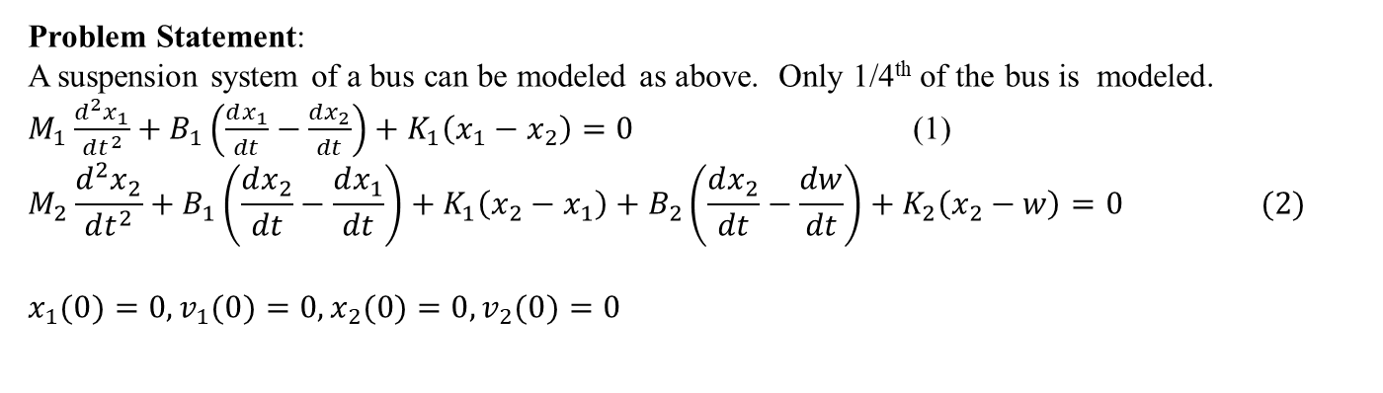
Bus Suspension System (cont.)
Problem Statement:
A suspension system of a bus can be modeled as above. Only 1/4th of the bus is modeled.
$M_{1}\frac{d^{2}x_{1}}{dt^{2}}+B_{1}\left(\frac{dx_{1}}{dt}−\frac{dx_{2}}{dt}\right)+K_{1}\left(x_{1}−x_{2}\right)=0$ (1)
$$M_{2}\frac{d^{2}x_{2}}{dt^{2}}+B_{1}\left(\frac{dx_{2}}{dt}−\frac{dx_{1}}{dt}\right)+K_{1}\left(x_{2}−x_{1}\right)+B_{2}\left(\frac{dx_{2}}{dt}−\frac{dw}{dt}\right)+K_{2}\left(x_{2}−w\right)=0 (2)$$
$$x_{1}(0)=0,v_{1}(0)=0,x_{2}(0)=0,v_{2}(0)=0$$

Slide 9






Bus Suspension System (cont.)
The constants are given as
Reduce the simultaneous differential equations (1) and (2) to simultaneous first order differential equations and put them in the state variable form complete with corresponding initial conditions.
$$m_{1}=2500\text{kg}$$
$$m_{2}=320\text{kg}$$
$$K_{1}=80,000 \text{N}\text{/}\text{m}$$
$$K_{2}=500,000 \text{N}\text{/}\text{m}$$
$$B_{1}=350 \text{N}\text{−}\text{s}\text{/}\text{m}$$
$$B_{2}=15,020 \text{N}\text{−}\text{s}\text{/}\text{m}$$

Slide 10
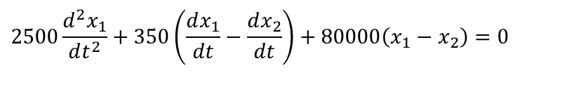
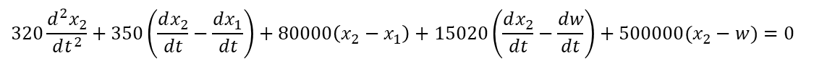
Bus Suspension System (cont.)
Solution
Substituting the values of the constants in the two differential equations (1) and (2) gives the differential equations (3) and (4), respectively.
(3)
(4)
$$2500\frac{d^{2}x_{1}}{dt^{2}}+350\left(\frac{dx_{1}}{dt}−\frac{dx_{2}}{dt}\right)+80000\left(x_{1}−x_{2}\right)=0$$
$$320\frac{d^{2}x_{2}}{dt^{2}}+350\left(\frac{dx_{2}}{dt}−\frac{dx_{1}}{dt}\right)+80000\left(x_{2}−x_{1}\right)+15020\left(\frac{dx_{2}}{dt}−\frac{dw}{dt}\right)+500000(x_{2}−w)=0$$

Slide 11
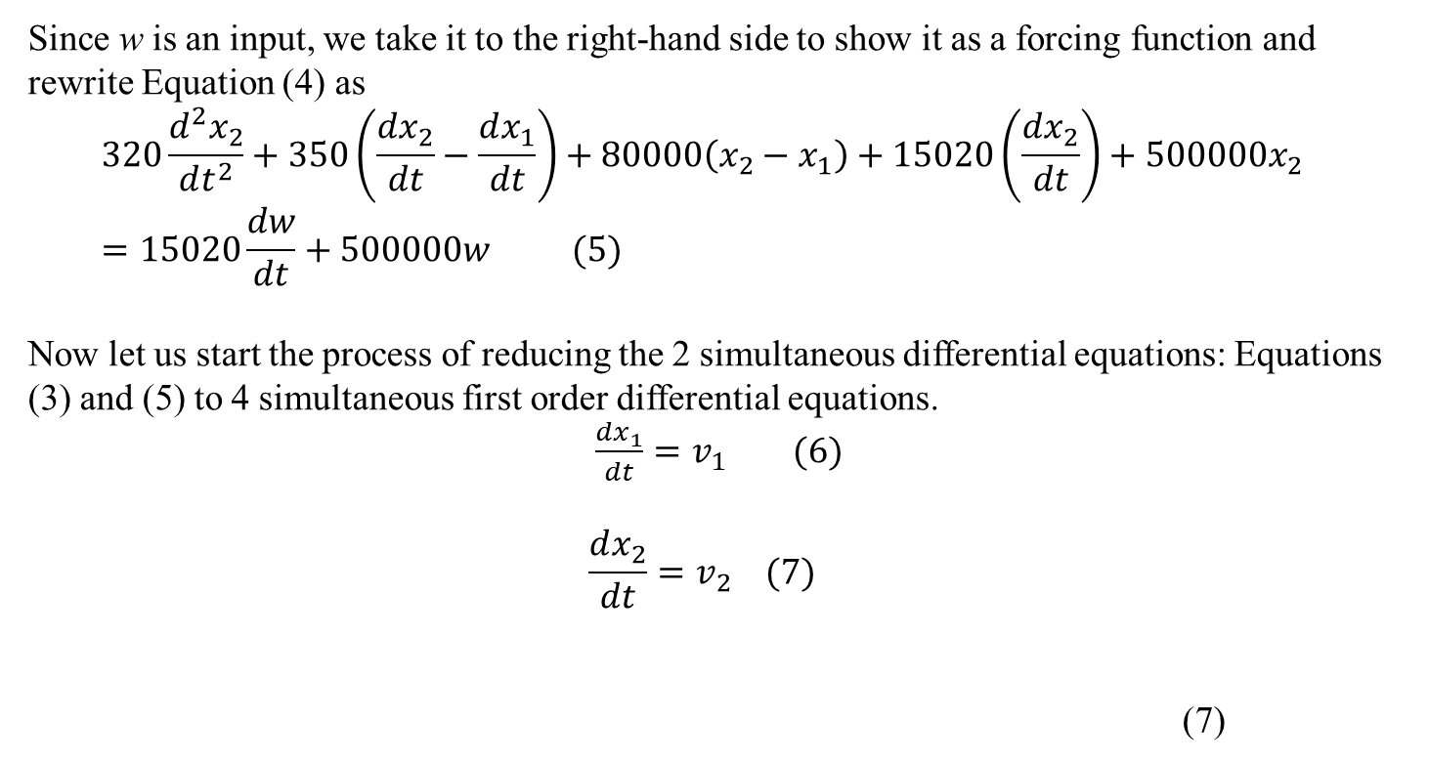
Bus Suspension System (cont.)
,
,
Since w is an input, we take it to the right-hand side to show it as a forcing function and rewrite Equation (4) as
$$320\frac{d^{2}x_{2}}{dt^{2}}+350\left(\frac{dx_{2}}{dt}−\frac{dx_{1}}{dt}\right)+80000\left(x_{2}−x_{1}\right)+15020\left(\frac{dx_{2}}{dt}\right)+500000x_{2}=15020\frac{dw}{dt}+500000w (5)$$
Now let us start the process of reducing the 2 simultaneous differential equations: Equations (3) and (5) to 4 simultaneous first order differential equations.
$\frac{dx_{1}}{dt}=v_{1} (6)$
$$\frac{dx_{2}}{dt}=v_{2} (7)$$
(7)

Slide 12
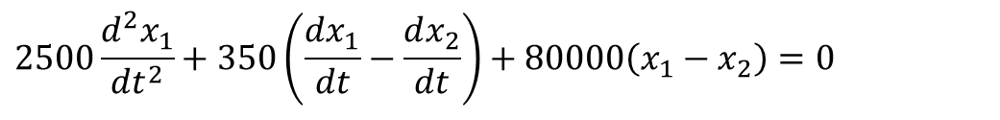
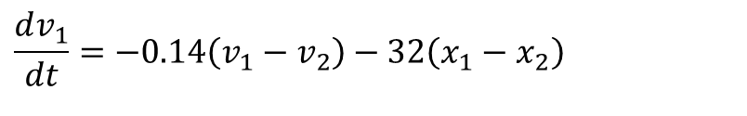
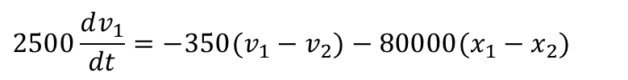
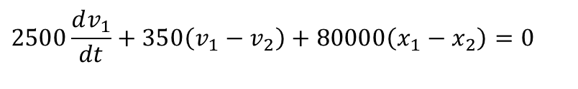
Bus Suspension System (cont.)
then Equation (3)
can be written as
(8)
$$2500\frac{d^{2}x_{1}}{dt^{2}}+350\left(\frac{dx_{1}}{dt}−\frac{dx_{2}}{dt}\right)+80000\left(x_{1}−x_{2}\right)=0$$
$$2500\frac{dv_{1}}{dt}+350\left(v_{1}−v_{2}\right)+80000\left(x_{1}−x_{2}\right)=0$$
$$2500\frac{dv_{1}}{dt}=−350(v_{1}−v_{2})−80000(x_{1}−x_{2})$$
$$\frac{dv_{1}}{dt}=−0.14\left(v_{1}−v_{2}\right)−32\left(x_{1}−x_{2}\right)$$

Slide 13
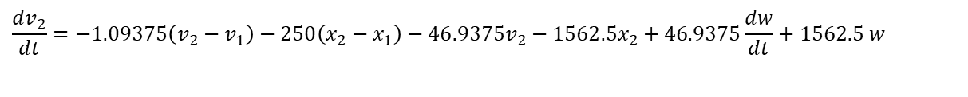
Bus Suspension System (cont.)
and Equation (5)
can be written as
(9)
$$320\frac{d^{2}x_{2}}{dt^{2}}+350\left(\frac{dx_{2}}{dt}−\frac{dx_{1}}{dt}\right)+80000\left(x_{2}−x_{1}\right)+15020\left(\frac{dx_{2}}{dt}\right)+500000x_{2}=15020\frac{dw}{dt}+500000w$$
$$320\frac{dv_{2}}{dt}+350\left(v_{2}−v_{1}\right)+80000\left(x_{2}−x_{1}\right)+15020v_{2}+500000x_{2}=15020\frac{dw}{dt}+500000w$$
$$320\frac{dv_{2}}{dt}=−350(v_{2}−v_{1})−80000(x_{2}−x_{1})−15020v_{2}−500000x_{2}+15020\frac{dw}{dt}+500000w$$
$$\frac{dv_{2}}{dt}=−1.09375\left(v_{2}−v_{1}\right)−250\left(x_{2}−x_{1}\right)−46.9375v_{2}−1562.5x_{2}+46.9375\frac{dw}{dt}+1562.5 w$$

Slide 14
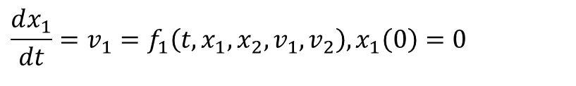
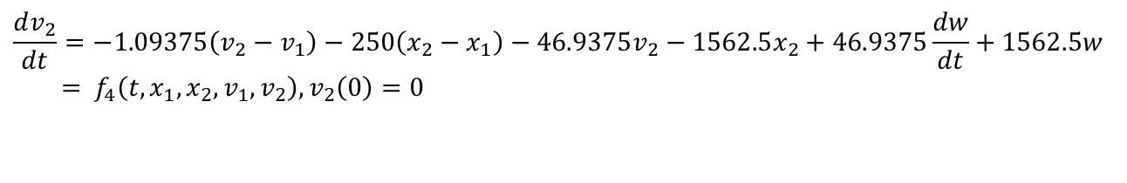

Bus Suspension System (cont.)
The 4 simultaneous first order differential equations given by Equations 6 thru 9 complete with the corresponding initial condition then are
(10)
(11)
(12)
(13)
$$\frac{dx_{1}}{dt}=v_{1}=f_{1}\left(t,x_{1},x_{2},v_{1},v_{2}\right),x_{1}\left(0\right)=0$$
$$\frac{dx_{2}}{dt}=v_{2}=f_{2}\left(t,x_{1},x_{2},v_{1},v_{2}\right),x_{2}\left(0\right)=0$$
$$\frac{dv_{1}}{dt}=−0.14\left(v_{1}−v_{2}\right)−32\left(x_{1}−x_{2}\right)=f_{3}\left(t,x_{1},x_{2},v_{1},v_{2}\right),v_{1}\left(0\right)=0$$
$$\frac{dv_{2}}{dt}=−1.09375\left(v_{2}−v_{1}\right)−250\left(x_{2}−x_{1}\right)−46.9375v_{2}−1562.5x_{2}+46.9375\frac{dw}{dt}+1562.5w \\ = f_{4}\left(t,x_{1},x_{2},v_{1},v_{2}\right),v_{2}\left(0\right)=0$$

Slide 15
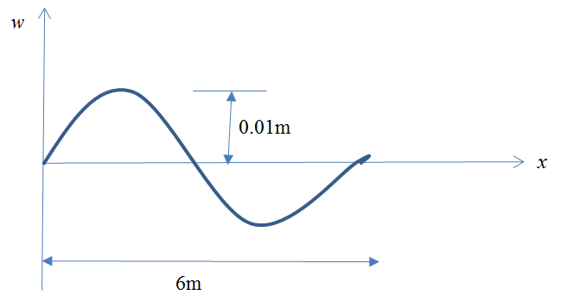

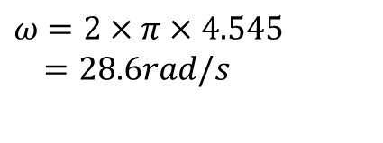
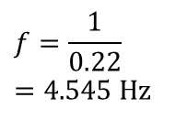
Bus Suspension System (cont.)
Assuming that the bus is going at 60 mph, that is, approximately 27 m/s, it takes
to go through one period. So, the frequency
The angular frequency then is
$$\frac{6m}{27m/s}=0.22s$$
$$f=\frac{1}{0.22} \\ =\text{4.545 }\text{Hz}$$
$$ω=2×π×4.545 \\ =28.6rad/s$$

Slide 16
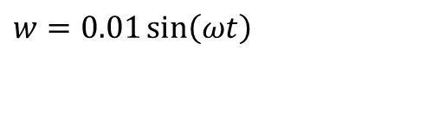
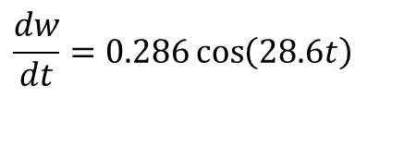
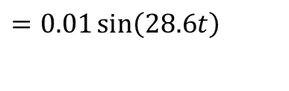
Bus Suspension System (cont.)
Giving
and
$$w=0.01\sin\left(ωt\right)$$
$$=0.01\sin\left(28.6t\right)$$
$$\frac{dw}{dt}=0.286\cos\left(28.6t\right)$$

Slide 17
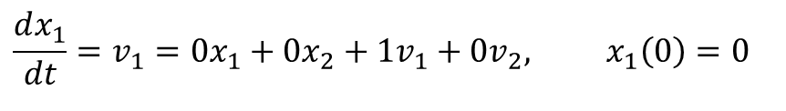
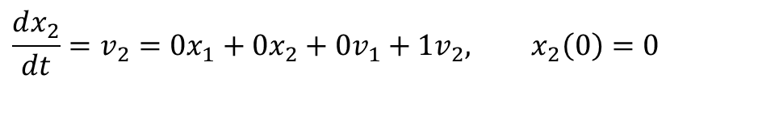
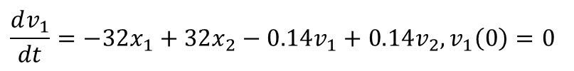
Bus Suspension System (cont.)
To put the differential equations given by Equations in matrix form, we rewrite them as
$$\frac{dx_{1}}{dt}=v_{1}=0x_{1}+0x_{2}+1v_{1}+0v_{2}, x_{1}\left(0\right)=0$$
$$\frac{dx_{2}}{dt}=v_{2}=0x_{1}+0x_{2}+0v_{1}+1v_{2}, x_{2}\left(0\right)=0$$
$$\frac{dv_{1}}{dt}=−32x_{1}+32x_{2}−0.14v_{1}+0.14v_{2},v_{1}\left(0\right)=0$$
$$\frac{dv_{2}}{dt}=250x_{1}−1812.5x_{2}+1.09375v_{1}−48.03125v_{2}+1562.5w+46.9375\frac{dw}{dt},v_{2}\left(0\right)=0$$

Slide 18

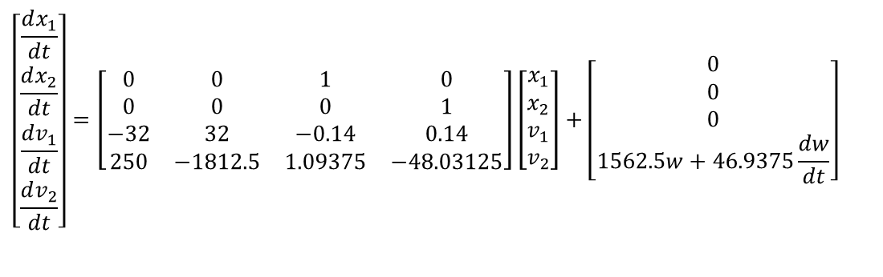
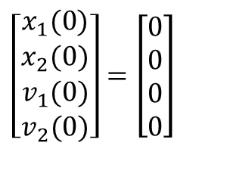
Bus Suspension System (cont.)
In state variable matrix form, the differential equations are given by
where
and the corresponding initial conditions are
$$\left[\begin{matrix}\frac{dx_{1}}{dt} \\ \frac{dx_{2}}{dt} \\ \frac{dv_{1}}{dt} \\ \frac{dv_{2}}{dt}\end{matrix}\right]=\left[\begin{matrix}0 & 0 & 1 & 0 \\ 0 & 0 & 0 & 1 \\ −32 & 32 & −0.14 & 0.14 \\ 250 & −1812.5 & 1.09375 & −48.03125\end{matrix}\right]\left[\begin{matrix}x_{1} \\ x_{2} \\ v_{1} \\ v_{2}\end{matrix}\right]+\left[\begin{matrix}0 \\ 0 \\ 0 \\ 1562.5w+46.9375\frac{dw}{dt}\end{matrix}\right]$$
$$w=0.01\sin{(}28.6t)$$
$$\left[\begin{matrix}x_{1}(0) \\ x_{2}(0) \\ v_{1}(0) \\ v_{2}(0)\end{matrix}\right]=\left[\begin{matrix}0 \\ 0 \\ 0 \\ 0\end{matrix}\right]$$

Slide 19
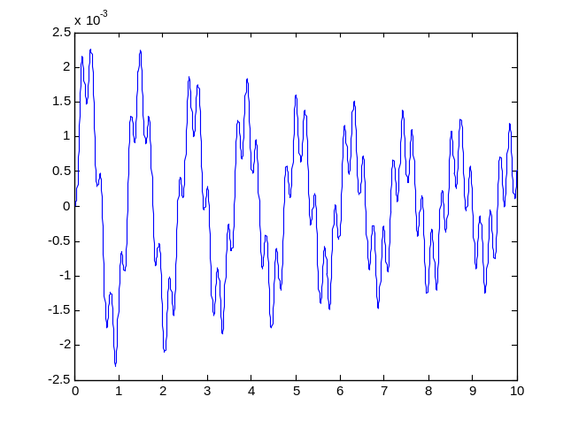
Using MATLAB to Solve
function diffx=sysofeqn(t,x)
A=[0 0 1 0; ...
0 0 0 1; ...
-32 32 -0.14 0.14; ...
250 -1812.5 1.09375 -48.03125];
w=0.01*sin(28.6*t);
dw=0.286*cos(28.6*t);
B=[0; 0; 0; 1652.5*w+46.9375*dw];
diffx=A*x+B;
end
tspan=[0 10];
initial_cond=[0;0;0;0];
[t,x]=ode45('sysofeqn',tspan,initial_cond);
figure (1)
plot(t,x(:,1))

Slide 20
How the output data looks like
t =
0
0.000003742346606
0.000007484693212
0.000011227039818
0.000014969386423
0.000033681119453
0.000052392852482
x =
0 0 0 0
0.000000000000000 0.000000000094002 0.000000000013164 0.000050236522812
0.000000000000000 0.000000000376002 0.000000000052670 0.000100470633045
0.000000000000000 0.000000000845991 0.000000000118540 0.000150702329280
0.000000000000001 0.000000001503960 0.000000000210794 0.000200931610101
0.000000000000012 0.000000007613185 0.000000001068580 0.000452041733437
0.000000000000045 0.000000018420550 0.000000002589166 0.000703091259071

Slide 21
MATLAB routine
See how MATLAB ode45 is used to solve such problems
http://www.math.purdue.edu/academic/files/courses/past//2004fall/MA266/ode45.pdf

Slide 22
END

Slide 23


