Slide 1

Bring Computational Methods Course Together
http://nm.MathForCollege.com
Transforming Numerical Methods Education for STEM Undergraduates
1

Slide 2

Notes:
Poll Title: Do not modify the notes in this section to avoid tampering with the Poll Everywhere activity.
More info at polleverywhere.com/support
This artist was awarded citizenship by the President of Albania.
https://www.polleverywhere.com/multiple_choice_polls/zolctoTkEqPv8pmJCJfaA?state=opened&flow=Default&onscreen=persist

Slide 3
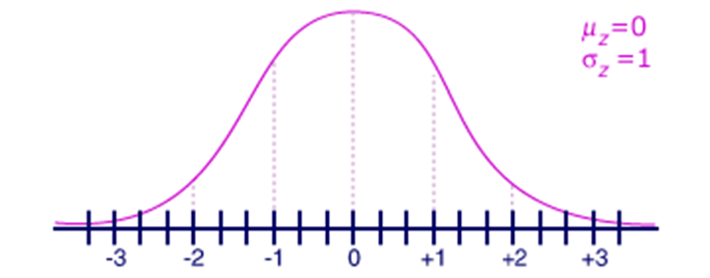
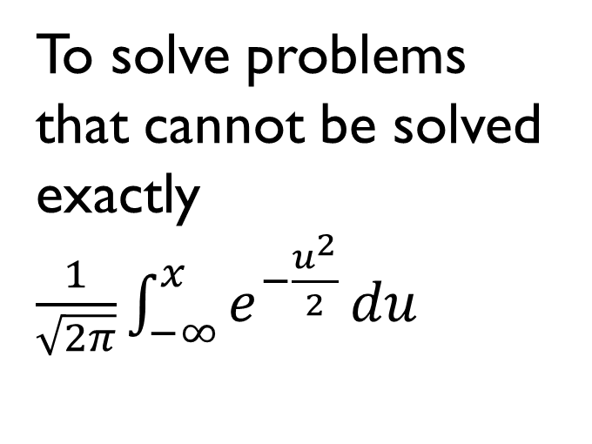
Why Use Numerical Methods?
To solve problems that cannot be solved exactly$\frac{1}{\sqrt{2π}}\int_{−∞}^{x}{e^{−\frac{u^{2}}{2}}}du$

Slide 4
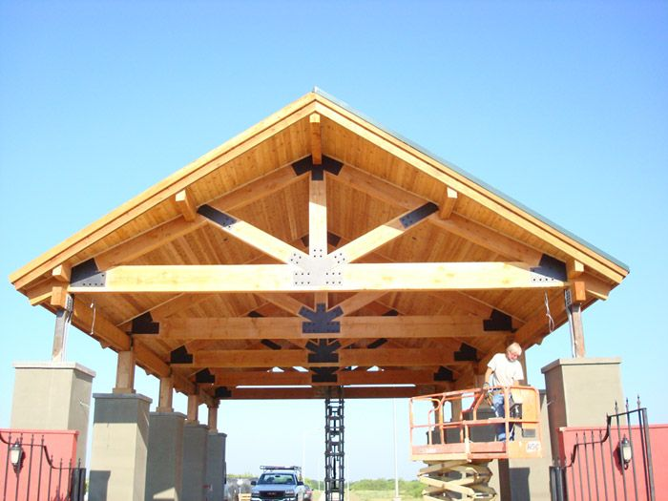
Why Use Numerical Methods?
To solve problems that are intractable to solve exactly!

Slide 5
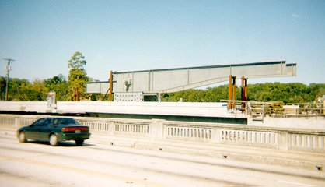
Bascule Bridge THG

Slide 6

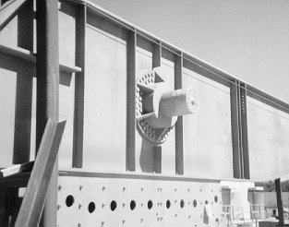
Bascule Bridge THG
Hub
Trunnion
Girder
Notes:
THG picture

Slide 7



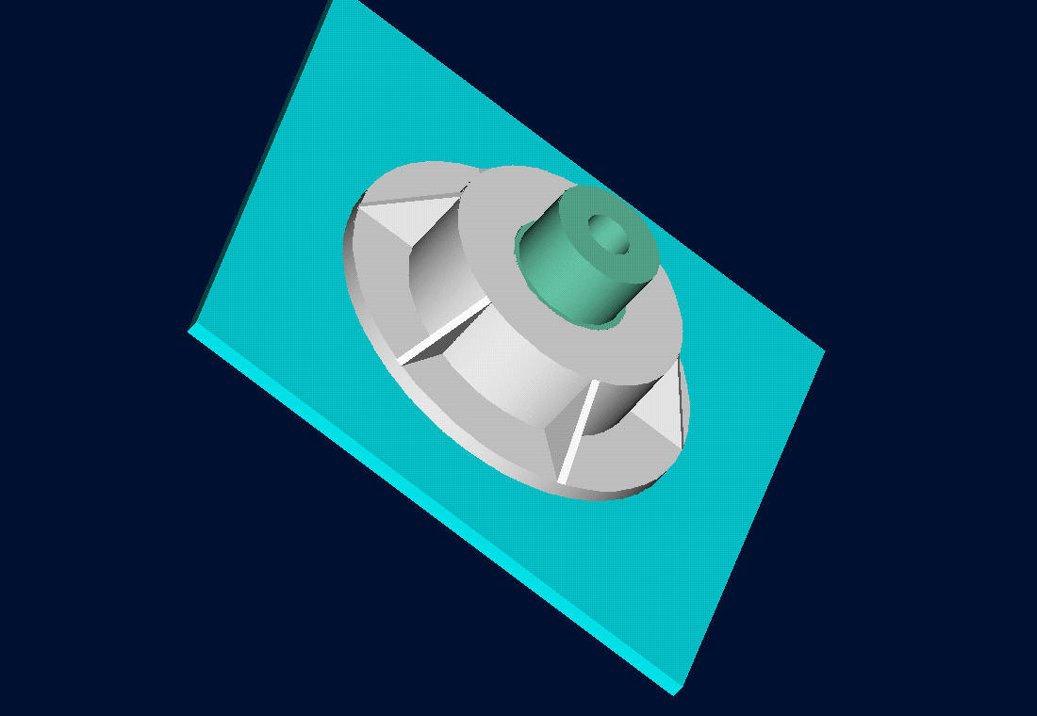
Trunnion-Hub-Girder Assembly Procedure
  Step1. Trunnion immersed in dry-ice/alcohol
  Step2. Trunnion warm-up in hub
  Step3. Trunnion-Hub immersed in dry-ice/alcohol
  Step4. Trunnion-Hub warm-up into girder

Slide 8
Problem
After Cooling, the Trunnion Got Stuck in Hub

Slide 9

Why did it get stuck?
Magnitude of contraction needed in the trunnion was $0.015′′$ or more. Did it contract enough?

Slide 10
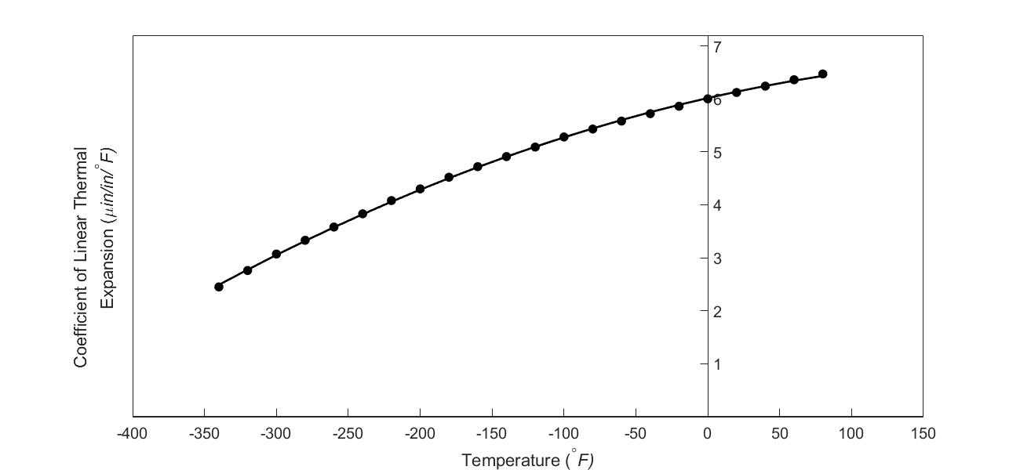

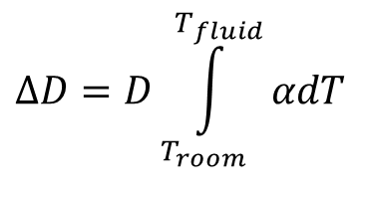
What model should I use to calculate contraction of trunnion?
$$ΔD=D\int_{T_{room}}^{T_{fluid}}{αdT}$$
$$ΔD=DαΔT$$

Slide 11
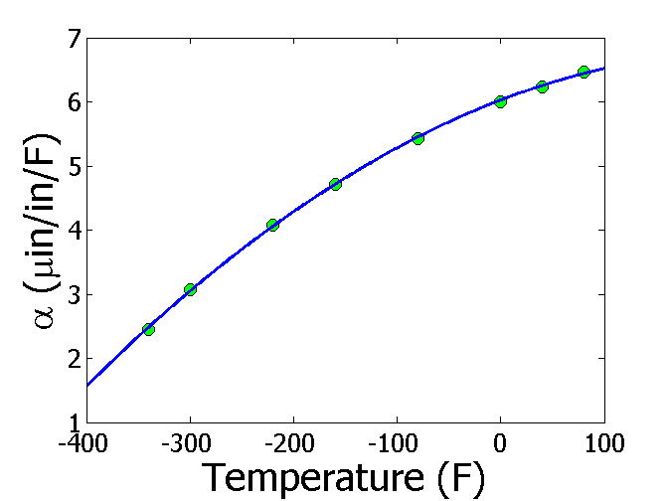
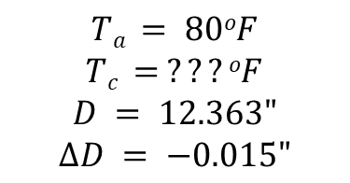
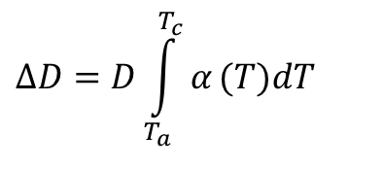
Finding the fluid temperature to get enough contraction
$$ΔD=D\int_{T_{a}}^{T_{c}}{α}(T)dT$$
$$Ta = 80oF$$
$$Tc = ???oF$$
$$D = 12.363"$$
$$∆D = −0.015"$$
$$α=−1.228×10^{−5}T^{2}+6.195×10^{−3}T+6.015$$
$$−0.015=12.363\int_{80}^{T_{c}}{(−1.228×10^{−5}T^{2}+6.195×10^{−3}T+6.015)}dT$$
$$−0.015=−5.059×10^{−9}{T_{c}}^{3}+3.829×10^{−6}{T_{c}}^{2}+7.435×10^{−5}T_{c}−6.166×10^{−3}$$
$$f(T_{c})=−5.059×10^{−9}{T_{c}}^{3}+3.829×10^{−6}{T_{c}}^{2}+7.435×10^{−5}T_{c}+8.834×10^{−3}=0$$

Slide 12
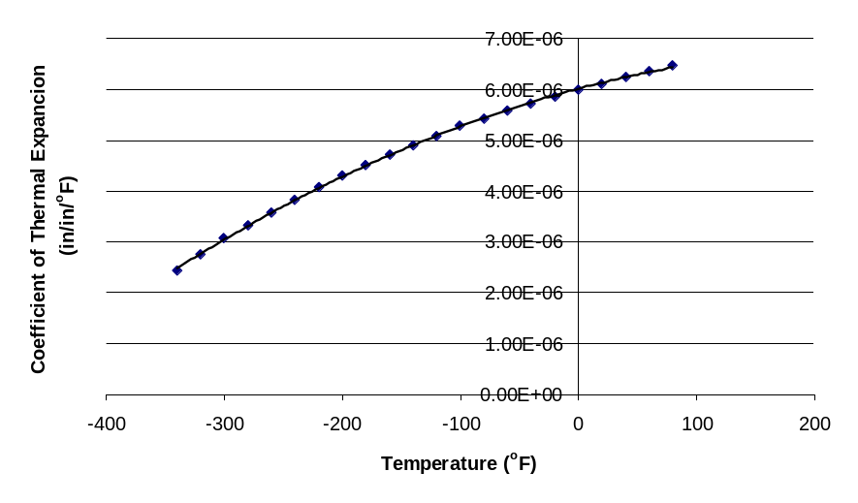
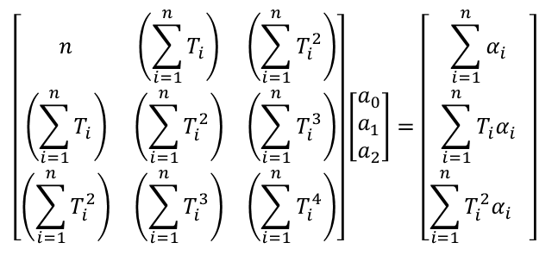

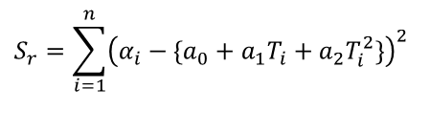
Finding the expression for thermal expansion coefficient
$$α=a_{0}+a_{1}T+a_{2}T^{2}$$
$$S_{r}=\sum_{i=1}^{n}{{\left(α_{i}−\{a_{0}+a_{1}T_{i}+a_{2}T_{i}^{2}\}\right)}^{2}}$$
$$\left[\begin{matrix}n & \left(\sum_{i=1}^{n}{T_{i}}\right) & \left(\sum_{i=1}^{n}{T_{i}^{2}}\right) \\ \left(\sum_{i=1}^{n}{T_{i}}\right) & \left(\sum_{i=1}^{n}{T_{i}^{2}}\right) & \left(\sum_{i=1}^{n}{T_{i}^{3}}\right) \\ \left(\sum_{i=1}^{n}{T_{i}^{2}}\right) & \left(\sum_{i=1}^{n}{T_{i}^{3}}\right) & \left(\sum_{i=1}^{n}{T_{i}^{4}}\right)\end{matrix}\right]\left[\begin{aligned}&a_{0} \\ &a_{1} \\ &a_{2}\end{aligned}\right]=\left[\begin{matrix}\sum_{i=1}^{n}{α_{i}} \\ \sum_{i=1}^{n}{T_{i}α_{i}} \\ \sum_{i=1}^{n}{T_{i}^{2}{α_{i}}^{}}\end{matrix}\right]$$
$$α=−1.2278×10^{−11}T^{2}+6.1946×10^{−9}T+6.0150×10^{−6}$$

Slide 13
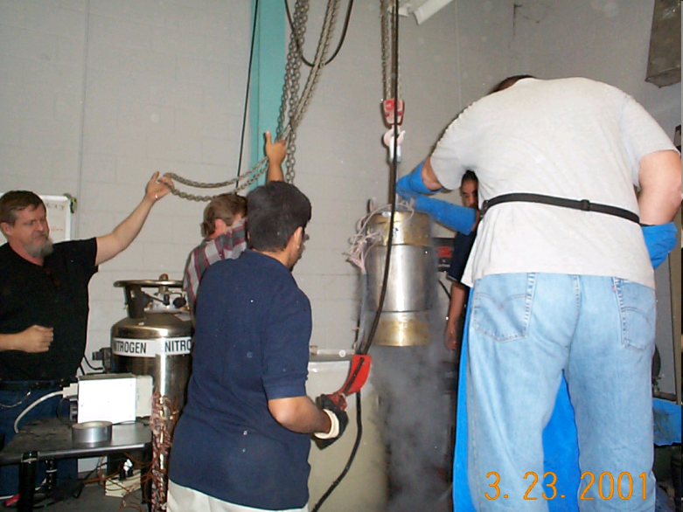


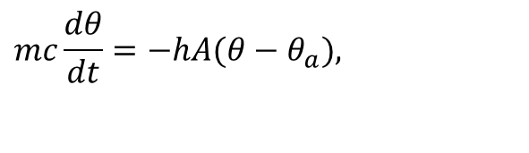
What is the temperature of the trunnion after half an hour?
$$mc\frac{dθ}{dt}=−hA(θ−θ_{a}),$$
$$θ(0)=θ_{room}$$

Slide 14

How long does it take a trunnion to cool down?
$$mc\frac{dθ}{dt}=−hA(θ−θ_{a}),$$
$$θ(0)=θ_{room}$$

Slide 15

What is the rate of change of heat stored in the cylinder?
$$mc\frac{dθ}{dt}=−hA(θ−θ_{a}),$$
$$θ(0)=θ_{room}$$

Slide 16
Can you identify?
We talked about 7 mathematical procedures in this course. Write them down.
Now connect the problem just discussed to these 7 mathematical procedures on each of the previous slides.
Write down the names of the various numerical methods under the 7 mathematical procedures

Slide 17
Chapter by Chapter Review by the Fire Hose

Slide 18
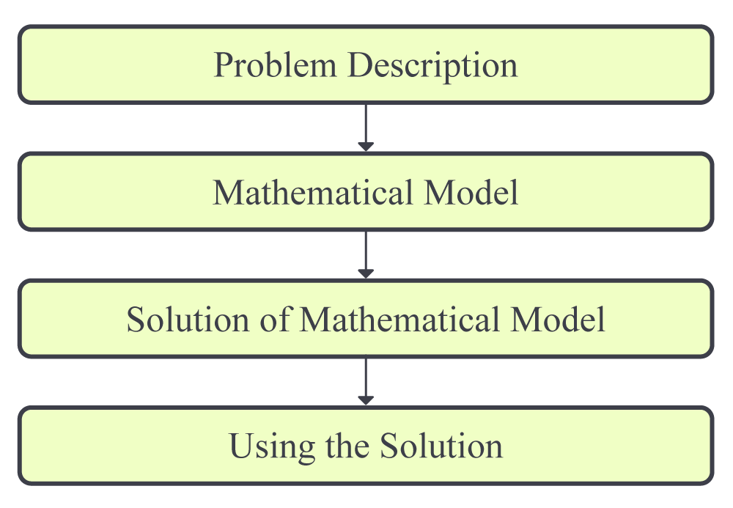
01.01 Introduction to Numerical Methods

Slide 19
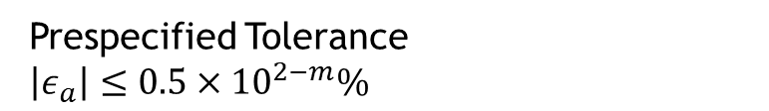
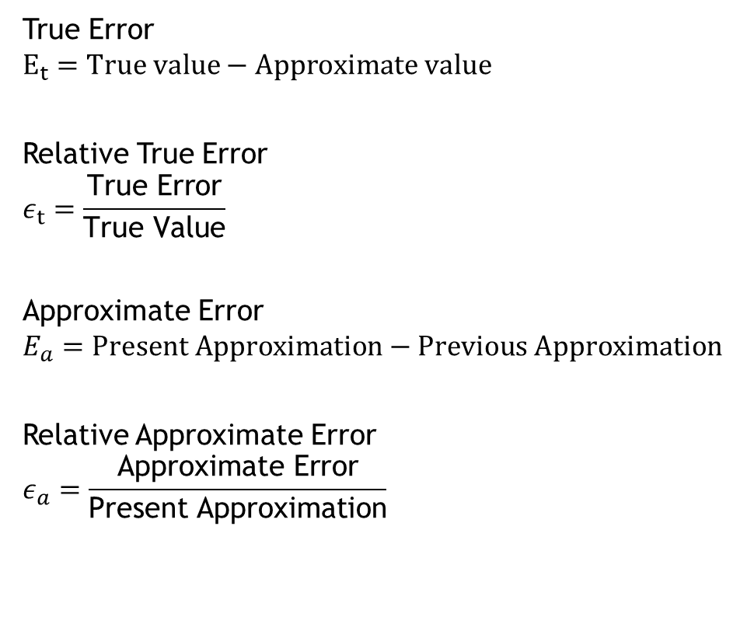
01.02 Measuring Errors
True Error
$$E_{t}=True value−Approximate value$$
Relative True Error
$$ε_{t}=\frac{\text{True} \text{Error}}{\text{True} \text{Value}}$$
Approximate Error
$$E_{a}=Present Approximation−Previous Approximation$$
Relative Approximate Error
$$ε_{a}=\frac{\text{Approximate} \text{Error}}{\text{Present} \text{Approximation}}$$
Prespecified Tolerance
$\left|ε_{a}\right|≤0.5×{10}^{2−m}\%$

Slide 20
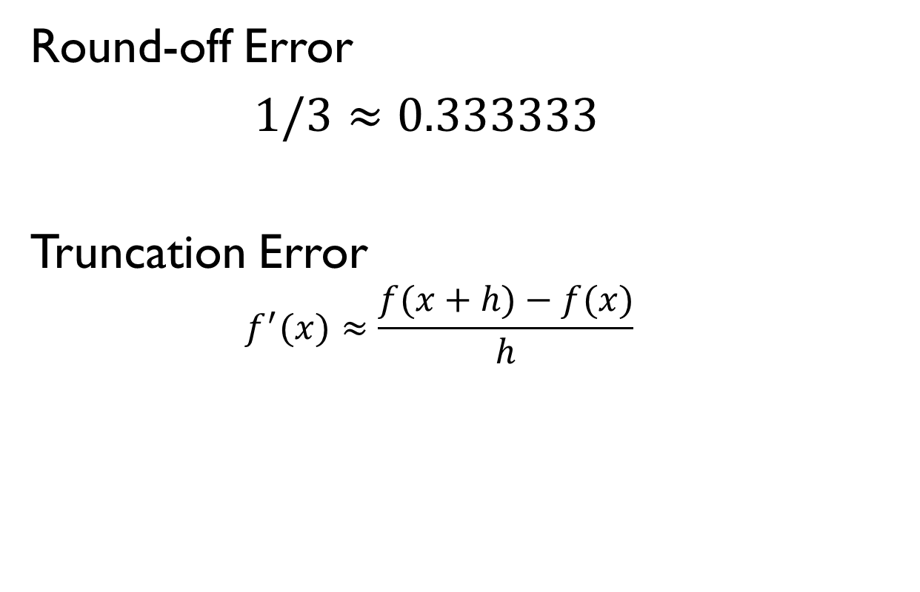
01.03 Sources of Error
Round-off Error
$1/3≈0.333333$
Truncation Error
  $$f^{′}(x)≈\frac{f(x+h)−f(x)}{h}$$

Slide 21
01.04 Fixed Binary Representation
$$(11.1875)_{10}=(1011.0011)_{2}$$
0 | 1 | 0 | 1 | 1
0 | 0 | 1 | 1 | 0 | 0

Slide 22
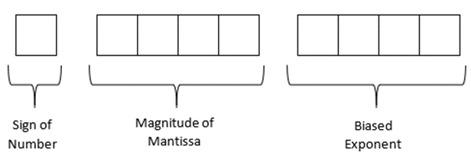
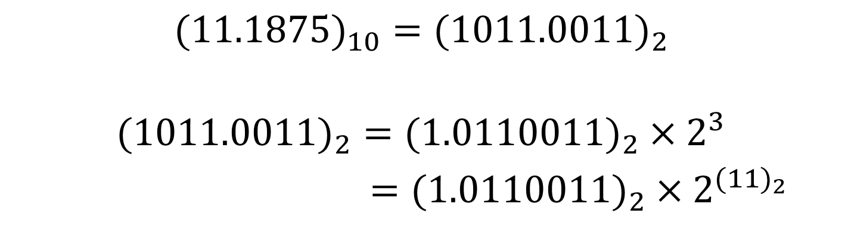
01.05 Floating Point Representation
$$(11.1875)_{10}=(1011.0011)_{2}$$
$$(1011.0011)_{2}=(1.0110011)_{2}×2^{3}$$
$=(1.0110011)_{2}×2^{{(11)}_{2}}$

Slide 23
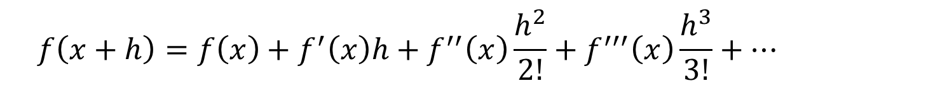
01.07 Taylor Series
$$f\left(x+h\right)=f\left(x\right)+f^{′}\left(x\right)h+f^{′′}\left(x\right)\frac{h^{2}}{2!}+f^{′′′}\left(x\right)\frac{h^{3}}{3!}+…$$

Slide 24
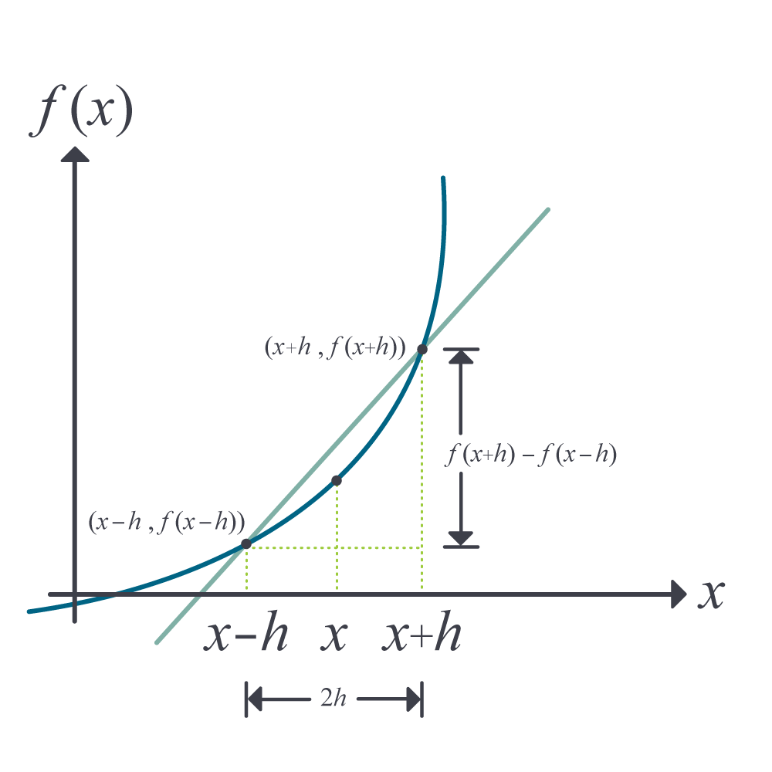
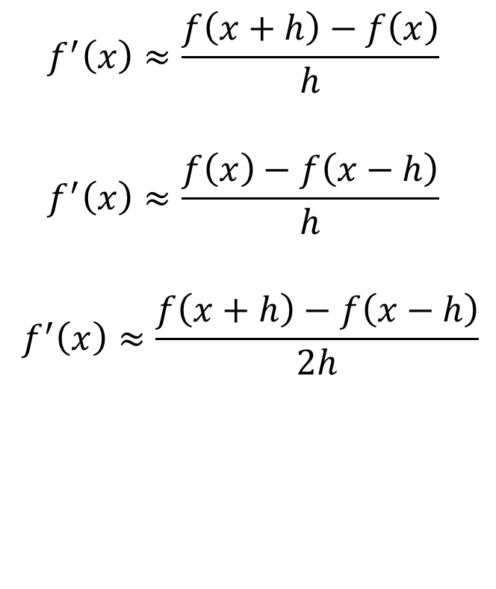
02.02 Differentiation of Continuous Functions
$$f^{′}\left(x\right)≈\frac{f\left(x+h\right)−f\left(x\right)}{h}$$
$$f^{′}\left(x\right)≈\frac{f\left(x\right)−f\left(x−h\right)}{h}$$
$$f^{′}\left(x\right)≈\frac{f\left(x+h\right)−f\left(x−h\right)}{2h}$$

Slide 25
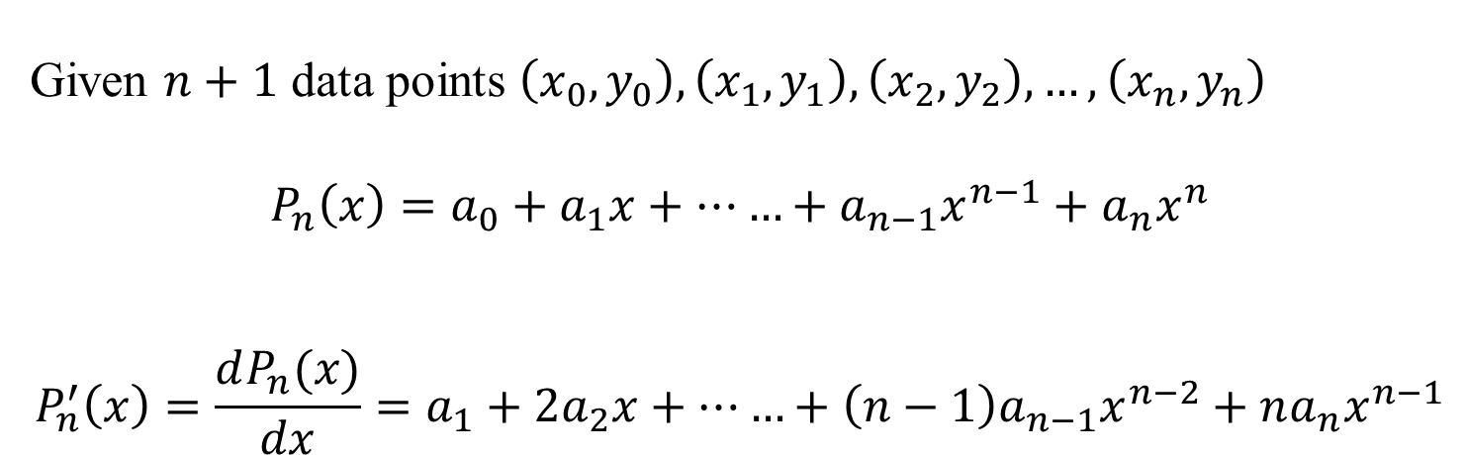
02.03 Differentiation of Function Given at Discrete Points
Given $n+1$ data points $\left(x_{0},y_{0}\right),\left(x_{1},y_{1}\right),\left(x_{2},y_{2}\right),…,\left(x_{n},y_{n}\right)$
$$P_{n}\left(x\right)=a_{0}+a_{1}x+……+a_{n−1}x^{n−1}+a_{n}x^{n}$$
$$P_{n}^{′}\left(x\right)=\frac{dP_{n}(x)}{dx}=a_{1}+2a_{2}x+……+\left(n−1\right)a_{n−1}x^{n−2}+na_{n}x^{n−1}$$

Slide 26
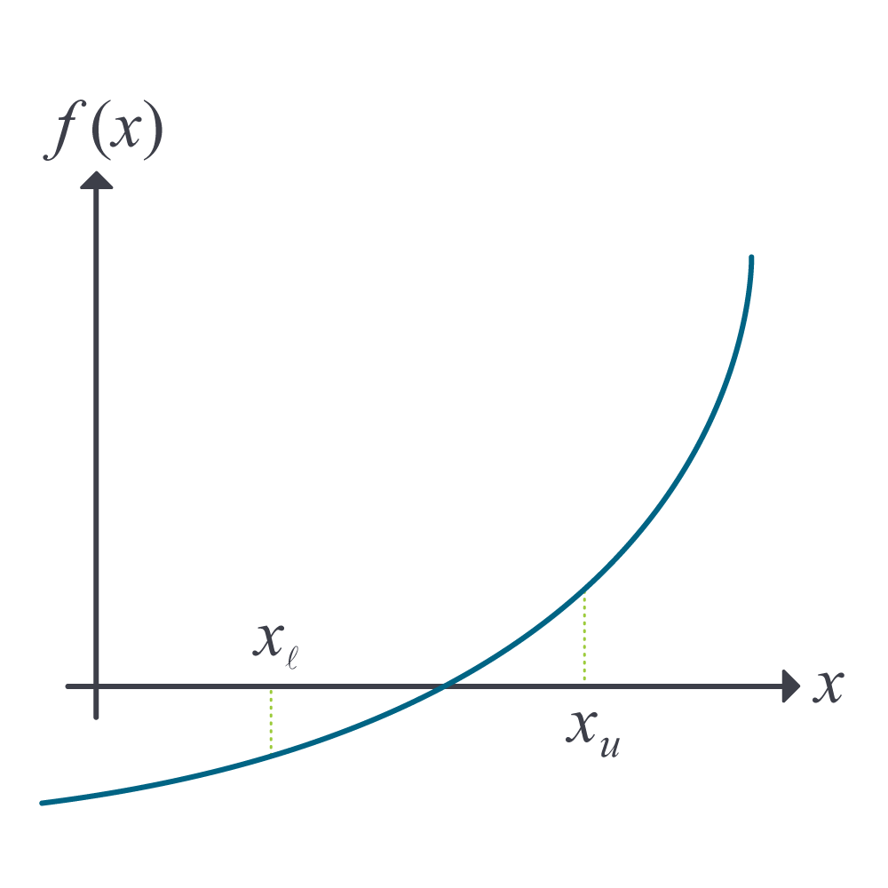

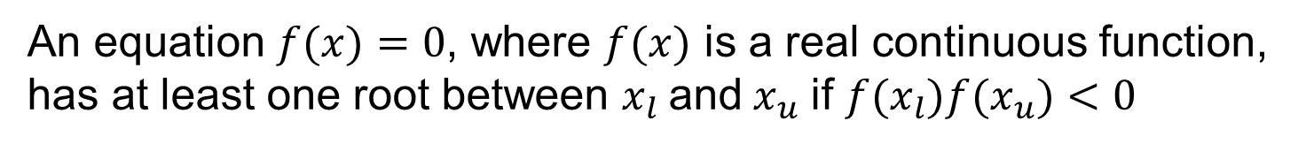
03.02 Bisection Method
An equation $f(x)=0$, where $f(x)$ is a real continuous function,
has at least one root between $x_{l}$and${ x}_{u}$ if $f(x_{l})f(x_{u})<0$
$$x_{m}=\frac{x_{l}+ x_{u}}{2}$$

Slide 27
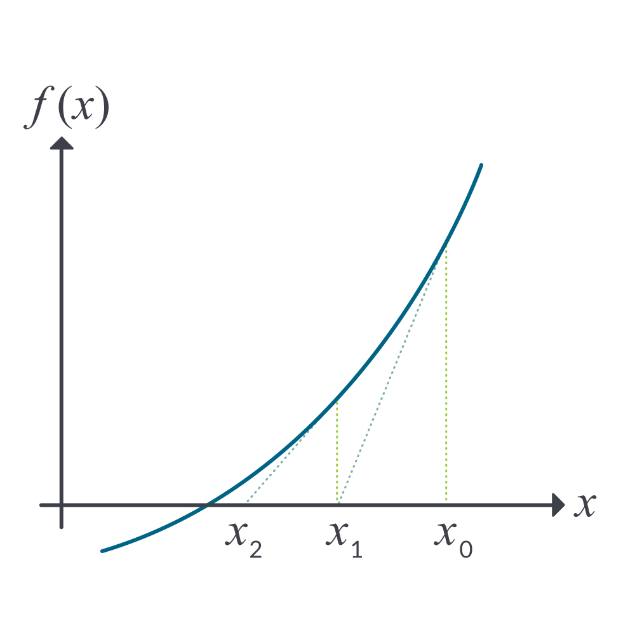

03.03 Newton Raphson Method
$$x_{i+1} = x_{i}−\frac{f\left(x_{i}\right)}{f^{′}\left(x_{i}\right)}$$

Slide 28
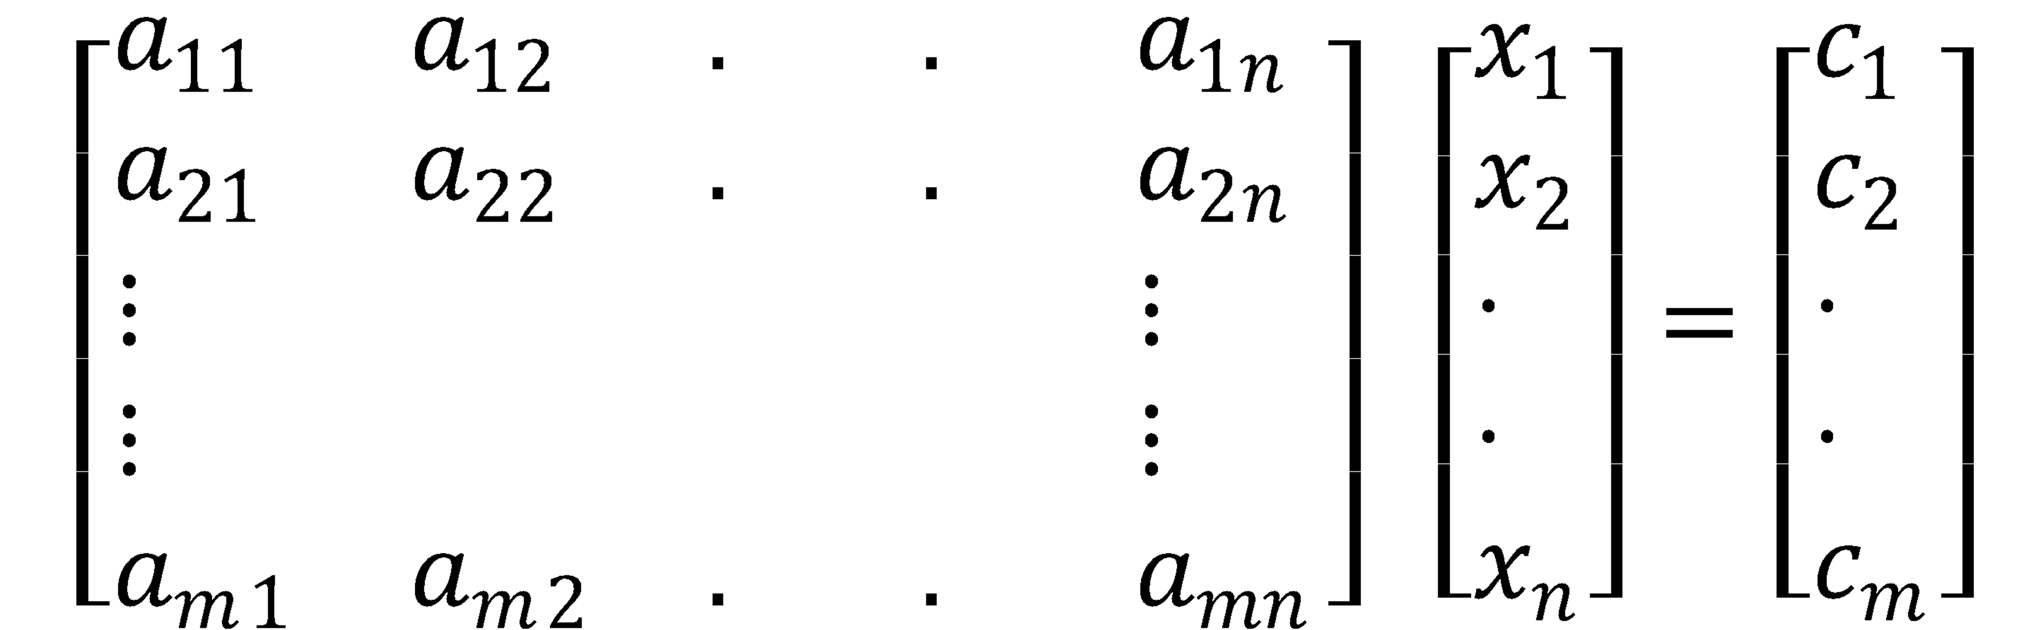
04.01 Prerequisites to Simultaneous Linear Equations
Binary matrix operations
Inverse of a matrix
Determinant of a matrix

Slide 29
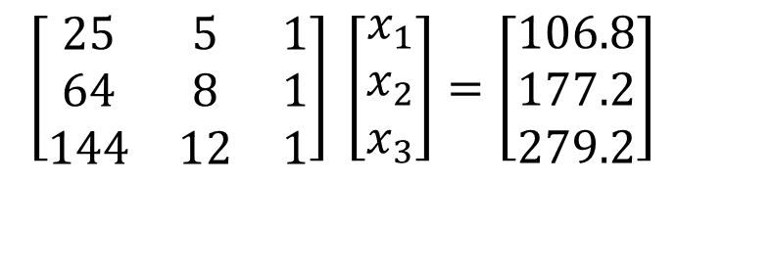
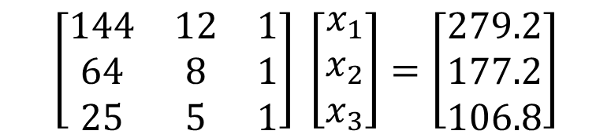
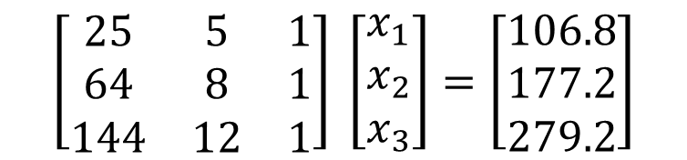
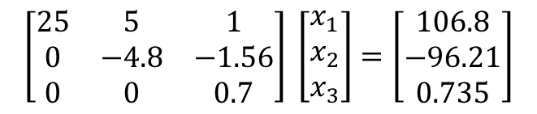
04.06 Gaussian Elimination
$$\left[\begin{matrix}25 & 5 & 1 \\ 64 & 8 & 1 \\ 144 & 12 & 1\end{matrix}\right] \left[\begin{matrix}x_{1} \\ x_{2} \\ x_{3}\end{matrix}\right]=\left[\begin{matrix}106.8 \\ 177.2 \\ 279.2\end{matrix}\right]$$
$$\left[\begin{matrix}25 & 5 & 1 \\ 0 & −4.8 & −1.56 \\ 0 & 0 & 0.7\end{matrix}\right] \left[\begin{matrix}x_{1} \\ x_{2} \\ x_{3}\end{matrix}\right]=\left[\begin{matrix}106.8 \\ −96.21 \\ 0.735\end{matrix}\right]$$
$$\left[\begin{matrix}25 & 5 & 1 \\ 64 & 8 & 1 \\ 144 & 12 & 1\end{matrix}\right] \left[\begin{matrix}x_{1} \\ x_{2} \\ x_{3}\end{matrix}\right]=\left[\begin{matrix}106.8 \\ 177.2 \\ 279.2\end{matrix}\right]$$
$$\left[\begin{matrix}144 & 12 & 1 \\ 64 & 8 & 1 \\ 25 & 5 & 1\end{matrix}\right] \left[\begin{matrix}x_{1} \\ x_{2} \\ x_{3}\end{matrix}\right]=\left[\begin{matrix}279.2 \\ 177.2 \\ 106.8\end{matrix}\right]$$

Slide 30
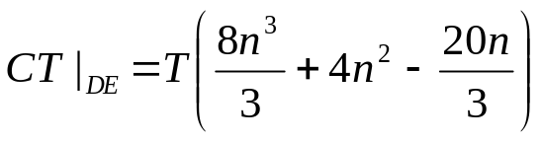


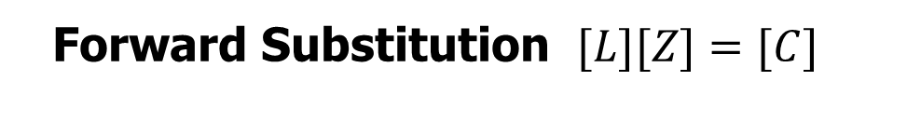


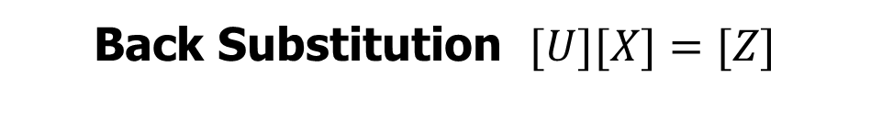
04.07 LU Decomposition
$$[A][X]=[C]$$
Decomposition of [A] to LU$[A]=[L][U]$
Forward Substitution $[L][Z]=[C]$
Back Substitution $[U][X]=[Z]$

Slide 31
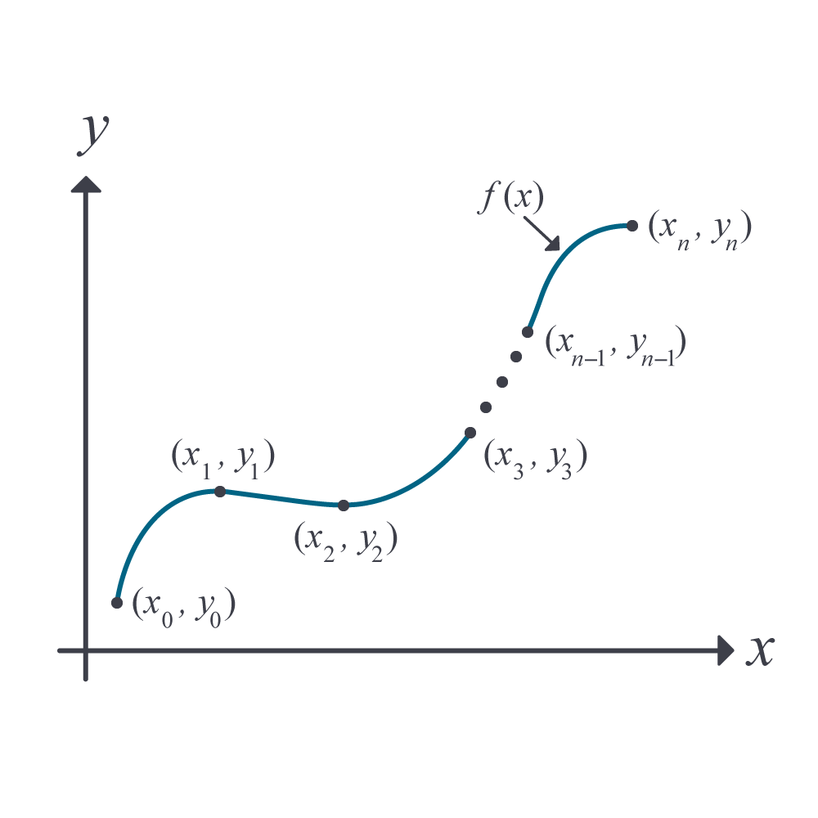
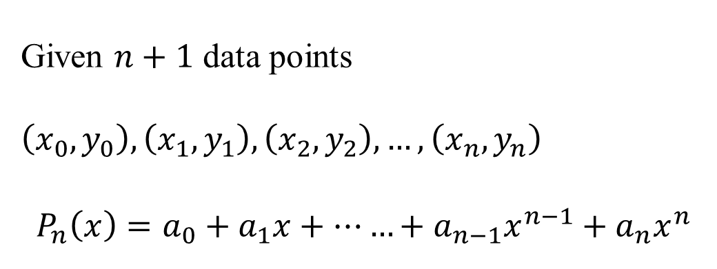
05.02 Direct Method of Interpolation
Given $n+1$ data points $\left(x_{0},y_{0}\right),\left(x_{1},y_{1}\right),\left(x_{2},y_{2}\right),…,\left(x_{n},y_{n}\right)$
$$P_{n}\left(x\right)=a_{0}+a_{1}x+……+a_{n−1}x^{n−1}+a_{n}x^{n}$$

Slide 32
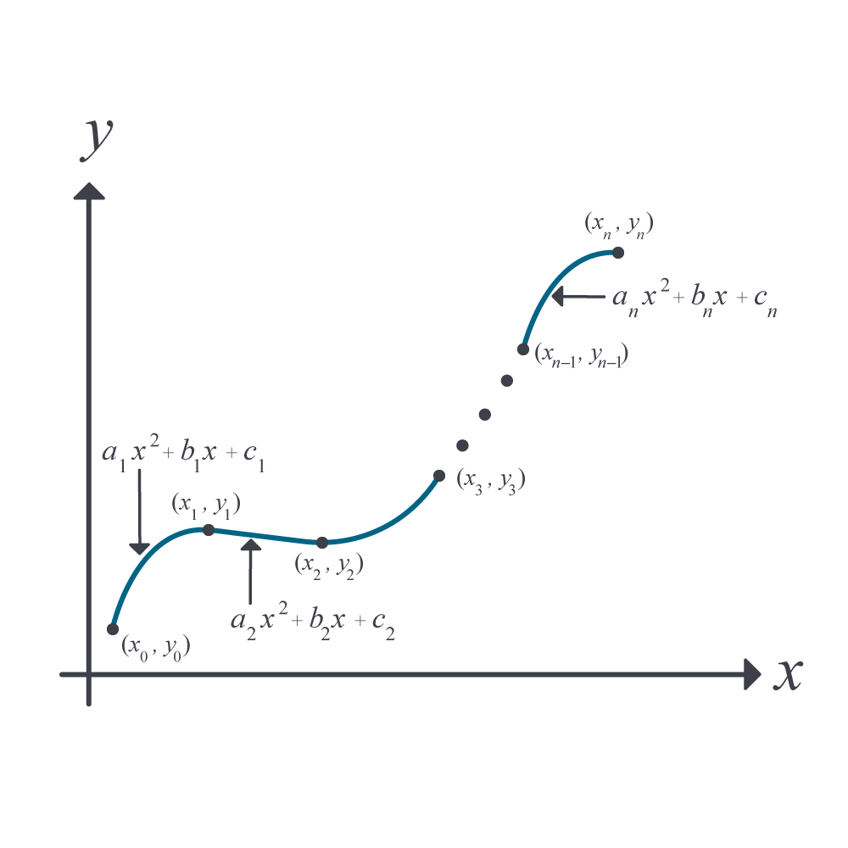
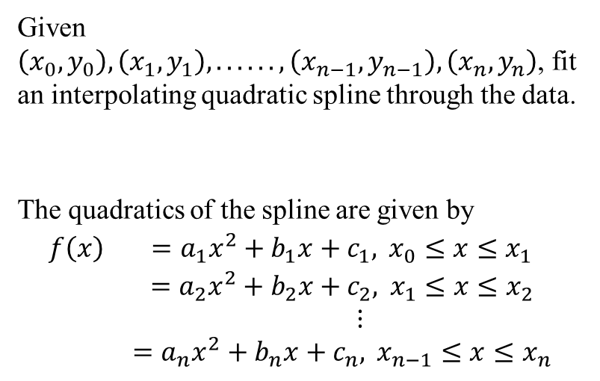
05.05 Spline Interpolation
Given $\left(x_{0},y_{0}\right),\left(x_{1},y_{1}\right),......,\left(x_{n−1},y_{n−1}\right),\left(x_{n},y_{n}\right)$, fit an interpolating quadratic spline through the data.
The quadratics of the spline are given by
$$\begin{matrix}f\left(x\right) & =a_{1}x^{2}+b_{1}x+c_{1}, x_{0}≤x≤x_{1} \\ & =a_{2}x^{2}+b_{2}x+c_{2}, x_{1}≤x≤x_{2} \\ & ⋮ \\ & =a_{n}x^{2}+b_{n}x+c_{n}, x_{n−1}≤x≤x_{n}\end{matrix}$$

Slide 33
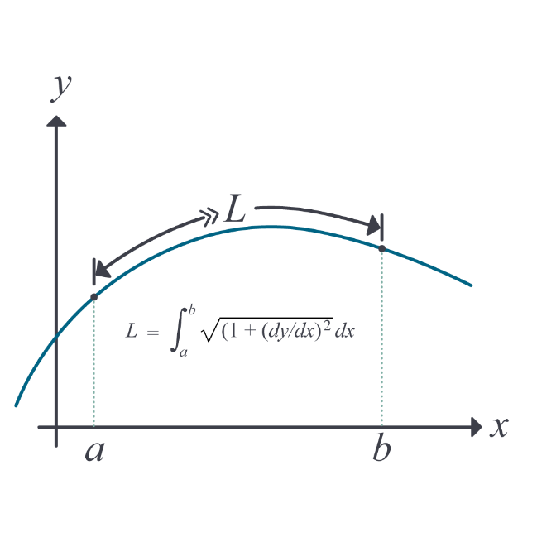
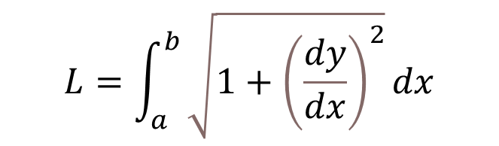
05.10 Length of a Curve
$$L=\int_{a}^{b}{\sqrt{1+{\left(\frac{dy}{dx}\right)}^{2}}dx}$$

Slide 34
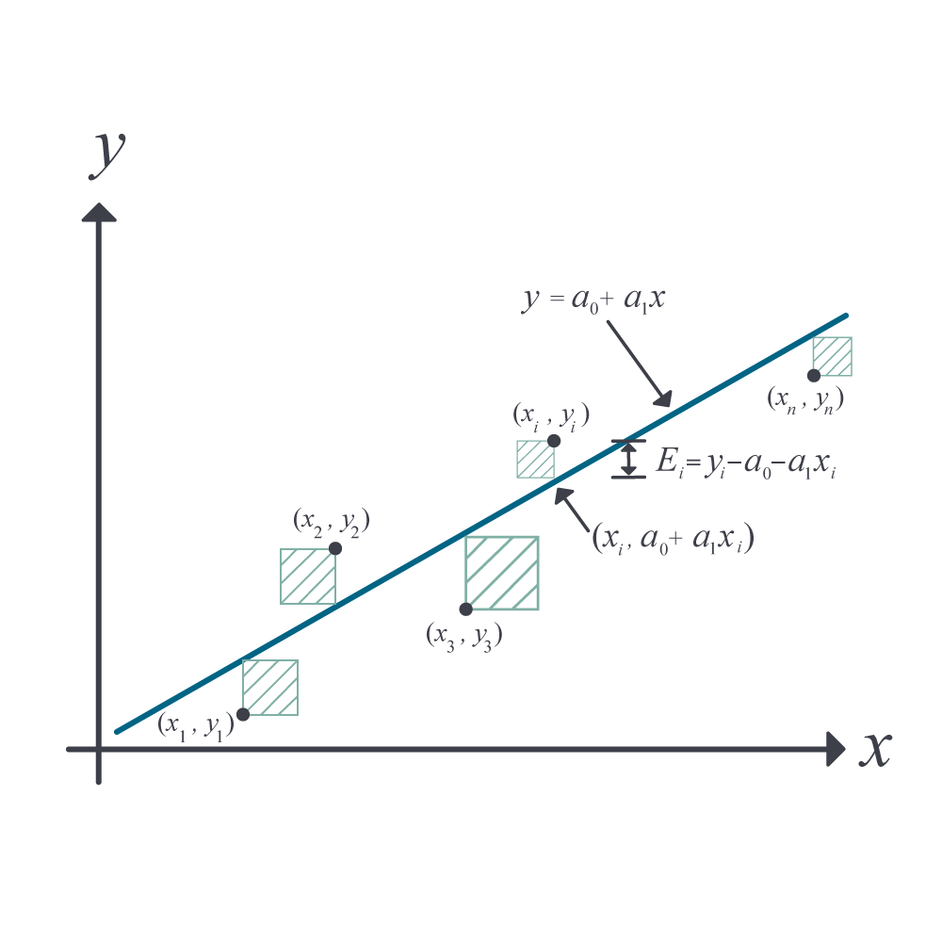
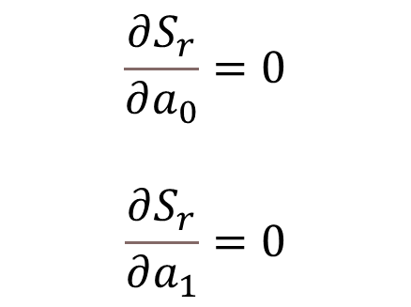
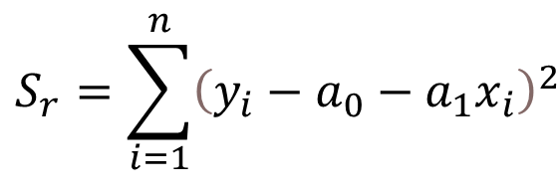
06.03 Linear Regression
$$\begin{matrix}S_{r}=\sum_{i=1}^{n}{{\left(y_{i}−a_{0}−a_{1}x_{i}\right)}^{2}} & \\ & \end{matrix}$$
$$\frac{∂S_{r}}{∂a_{0}}=0$$
$$\frac{∂S_{r}}{∂a_{1}}=0$$
Second derivative test

Slide 35
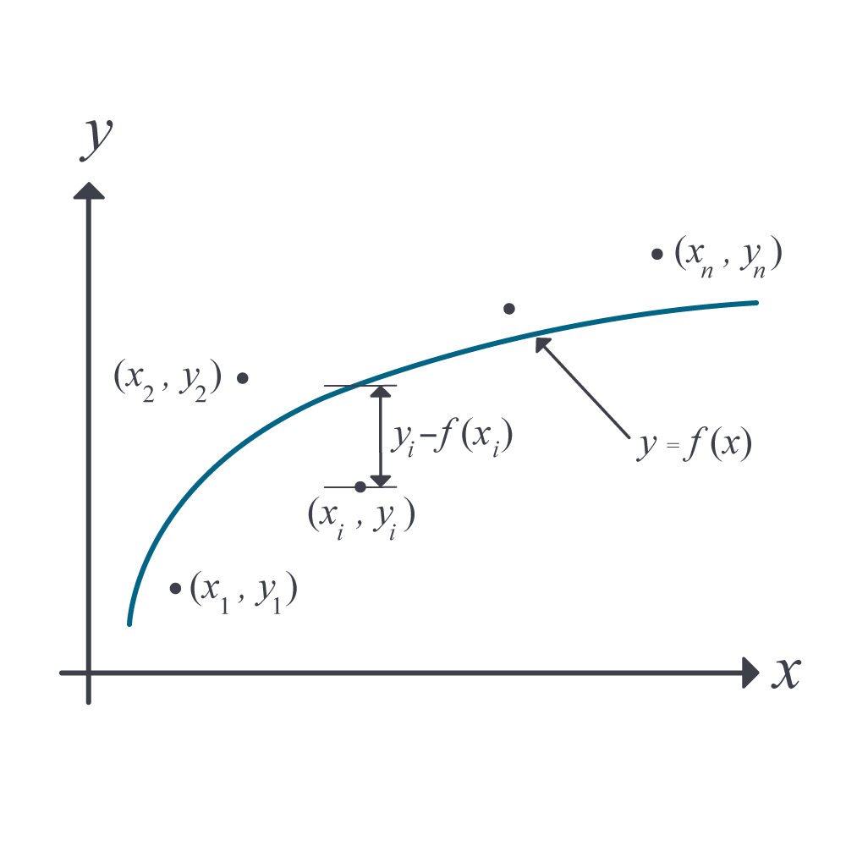
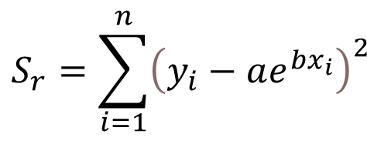
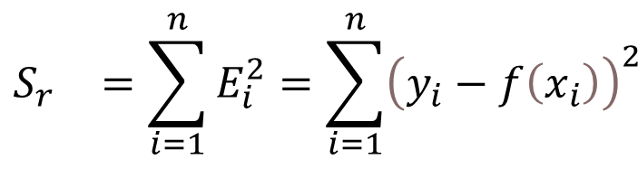
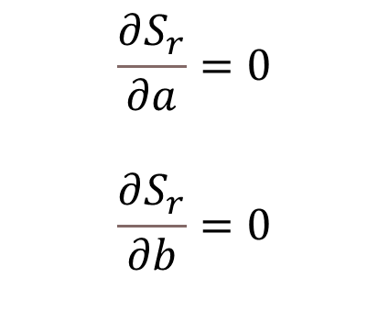
06.04 Nonlinear Regression
$$\begin{matrix}S_{r}=\sum_{i=1}^{n}{{\left(y_{i}−ae^{bx_{i}}\right)}^{2}} & \\ & \end{matrix}$$
$$\frac{∂S_{r}}{∂a}=0$$
$$\frac{∂S_{r}}{∂b}=0$$
$$\begin{matrix}S_{r} & =\sum_{i=1}^{n}{E_{i}^{2}=\sum_{i=1}^{n}{{\left(y_{i}−f\left(x_{i}\right)\right)}^{2}}} \\ & \end{matrix}$$

Slide 36

06.05 Adequacy of Regression Model
Checks
1) Plotting the data and the linear regression model.
2) Calculate a standard estimate of the error. Calculate scaled residuals. Calculate how many scaled residuals are in the [-2,2] bracket.
3) Calculate the coefficient of determination. Calculate how close the coefficient of determination is to 1.
4) Calculate if it meets the assumptions of random errors.

Slide 37



07.02 Trapezoidal Rule of Integration
$$\int_{a}^{b}{f\left(x\right)dx=}$$
$$=\frac{b−a}{2n}\left[f\left(a\right)+2\left\{\sum_{i=1}^{n−1}{f\left(a+ih\right)}\right\}+f\left(b\right)\right]$$
$$h=\frac{b−a}{n}$$
$$E_{t}≈−\frac{{\left(b−a\right)}^{3}}{12n^{2}}\overline{f^{′′}}$$

Slide 38


07.06 Integrating Functions Given at Discrete Points
$\int_{x_{1}}^{x_{n}}{f\left(x\right)}dx≈\sum_{i=1}^{n−1}{\left(x_{i+1}−x_{i}\right)\frac{f\left(x_{i}\right)+f\left(x_{i+1}\right)}{2}}$

Slide 39


07.05 Gauss Quadrature Rule of Integration
$$\begin{matrix}\int_{a}^{b}{f\left(x\right)dx}≈\frac{b−a}{2}f\left(\frac{b−a}{2}\left(−\frac{1}{\sqrt{3}}\right)+\frac{b+a}{2}\right)+\frac{b−a}{2}f\left(\frac{b−a}{2}\left(\frac{1}{\sqrt{3}}\right)+\frac{b+a}{2}\right) & \\ & \\ & \end{matrix}$$

Slide 40



08.02 Euler’s Method
$$\frac{dy}{dx}=f(x,y),y\left(a\right)=y_{a}$$
$$y_{i+1}=y_{i}+f\left(x_{i},y_{i}\right)h$$

Slide 41



08.03 Runge Kutta 2nd Order Method
$$\frac{dy}{dx}=f(x,y),y\left(a\right)=y_{a}$$
$$y_{i+1}=y_{i}+\left(\frac{1}{2}k_{1}+\frac{1}{2}k_{2}\right)h$$
$$k_{1}=f\left(x_{i},y_{i}\right)$$
$$k_{2}=f\left(x_{i}+h,y_{i}+k_{1}h\right)$$

Slide 42


08.05 Solving Higher-Order/Coupled Ordinary Differential Equations
$$10\frac{d^{2}x_{1}}{dt^{2}}−15\left(−2x_{1}+x_{2}\right)=\sin{t}$$
$$20\frac{d^{2}x_{2}}{dt^{2}}−15\left(x_{1}−2x_{2}\right)=0$$
$$\frac{dx_{1}}{dt}\left(0\right)=4, \frac{dx_{2}}{dt}\left(0\right)=5,$$
$$x_{1}\left(0\right)=2, x_{2}\left(0\right)=3$$
$\left[\begin{matrix}{\dot{x}}_{1} \\ {\dot{x}}_{2} \\ {\dot{x}}_{3} \\ {\dot{x}}_{4}\end{matrix}\right]=\left[\begin{matrix}0 & 0 & 1 & 0 \\ 0 & 0 & 0 & 1 \\ −3 & 1.5 & 0 & 0 \\ 0.75 & −1.5 & 0 & 0\end{matrix}\right]\left[\begin{matrix}x_{1} \\ x_{2} \\ x_{3} \\ x_{4}\end{matrix}\right]$+ $\left[\begin{matrix}0 \\ 0 \\ 0.1\sin{t} \\ 0\end{matrix}\right]$
$$\left[\begin{matrix}x_{1}\left(0\right) \\ x_{2}\left(0\right) \\ x_{3}\left(0\right) \\ x_{4}\left(0\right)\end{matrix}\right]=\left[\begin{matrix}2 \\ 3 \\ 4 \\ 5\end{matrix}\right]$$

Slide 43


