Slide 1
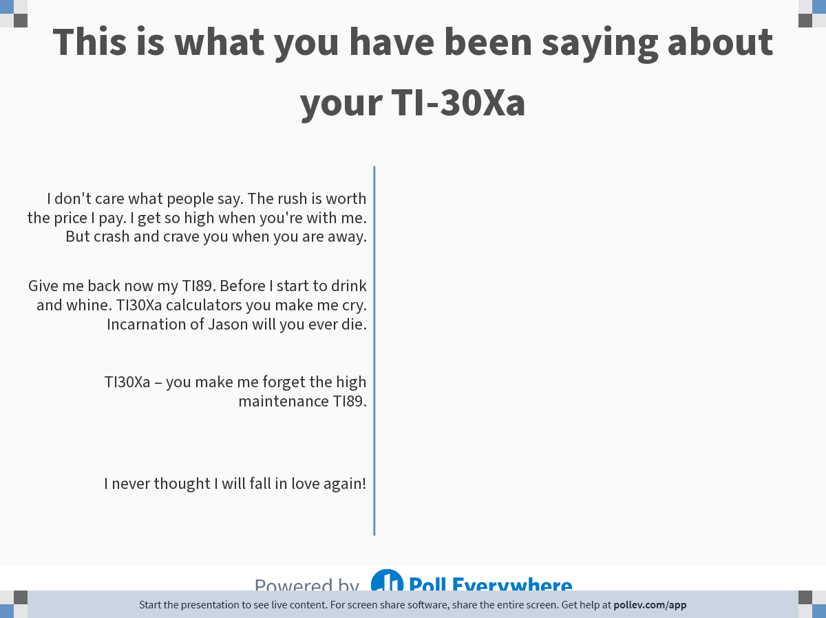
Notes:
Poll Title: Do not modify the notes in this section to avoid tampering with the Poll Everywhere activity.
More info at polleverywhere.com/support
This is what you have been saying about your TI-30Xa
https://www.polleverywhere.com/multiple_choice_polls/nWTerqLAB3hLDoW8JGidi?display_state=chart&activity_state=opened&state=opened&flow=Default&onscreen=persist

