Slide 1
Computational Methods
http://nm.MathForCollege.com
Transforming Numerical Methods Education for STEM Undergraduates

Slide 2
Welcome to EML3041: Computational Methods.
My name is Dr. Kaw.
Introduce yourself to the person on your left and right. Say one thing (nothing personal) about yourself to them.
All is well that ends well; well-begun is half-done.
Cell phones, laptops or other distractions are discouraged other than for allowed use. Tablet when laid flat and writing with a pen is OK.
Daydreamers and sleepers will not be disturbed.

Slide 3

Why use Numerical Methods?

Slide 4
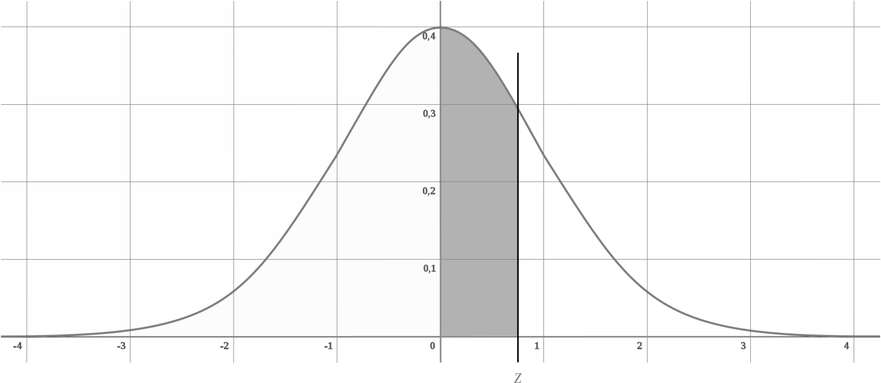
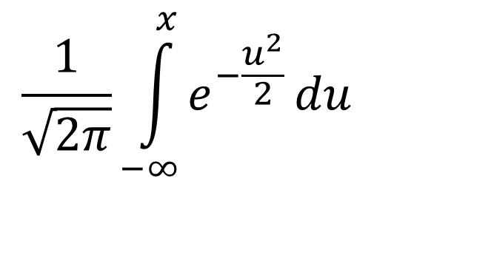
Why use Numerical Methods?
To solve problems that cannot be solved exactly
$$\frac{1}{\sqrt{2π}}\int_{−∞}^{x}{e^{−\frac{u^{2}}{2}}}du$$

Slide 5
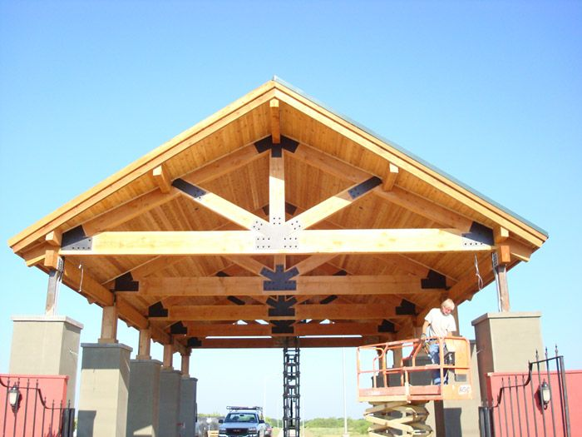
Why use Numerical Methods?
To solve problems that are intractable to solve exactly!

Slide 6
Steps in Solving an
Engineering Problem

Slide 7
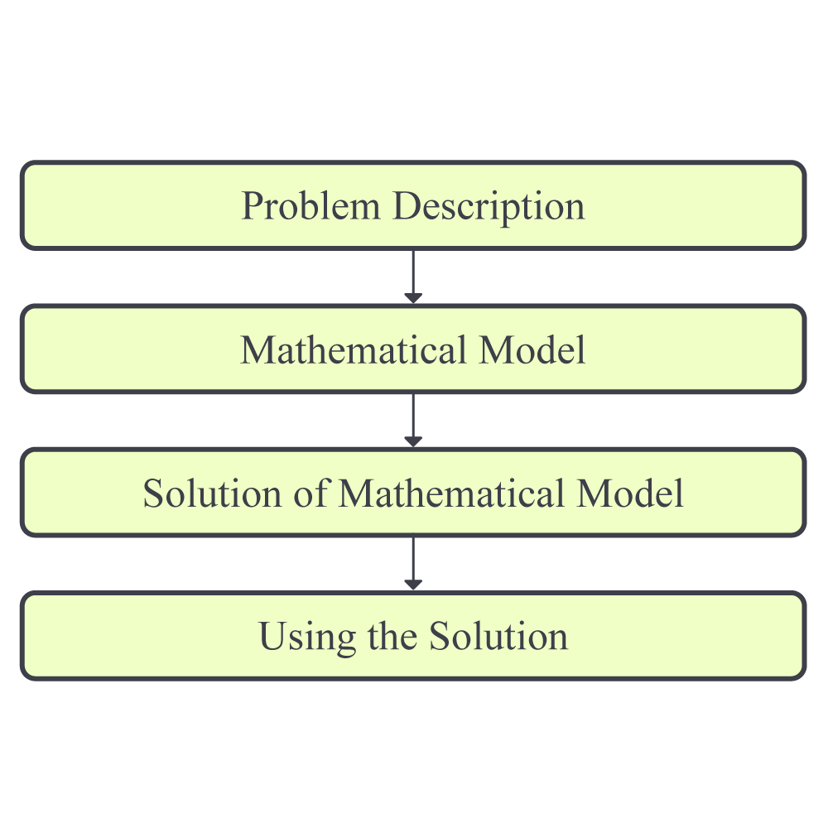
How do we solve an engineering problem?

Slide 8
PROBLEM DESCRIPTION

Slide 9
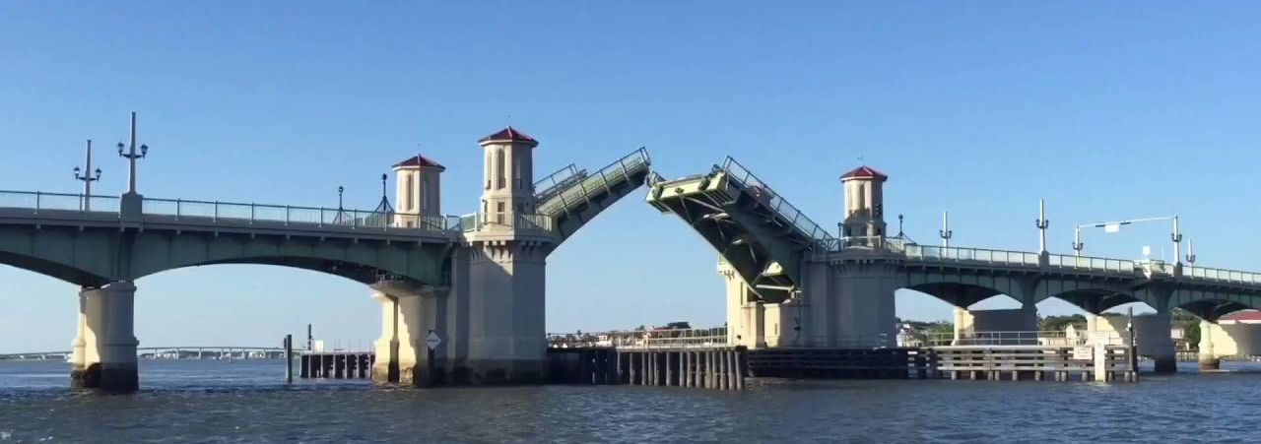
Example of Solving an Engineering Problem
Notes:
Oldest city’s oldest bascule bridge – the Bridge of Lions in St. Augustine, Florida

Slide 10
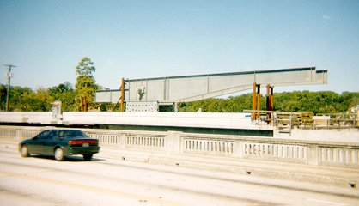
Bascule Bridge THG

Slide 11

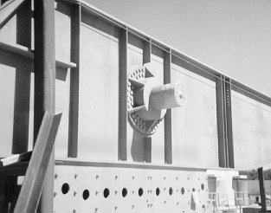
Bascule Bridge THG
Hub
Trunnion
Girder
Notes:
THG picture

Slide 12



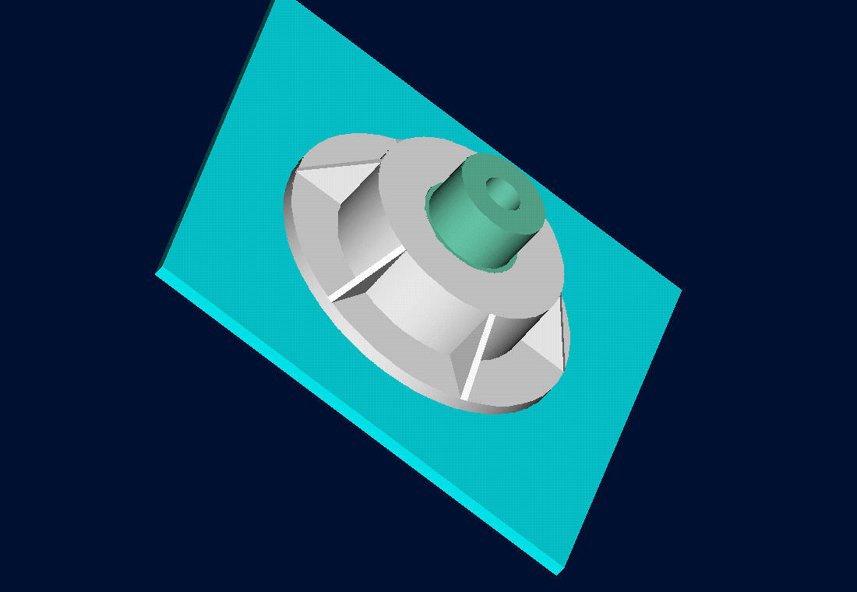
Trunnion-Hub-Girder Assembly Procedure
  Step1. Trunnion immersed in dry-ice/alcohol
  Step2. Trunnion shrink fit and warm up
  Step3. Trunnion-hub immersed in dry-ice/alcohol
  Step4. Trunnion-hub shrink fit and warm-up

Slide 13
Problem
After cooling the trunnion, the trunnion got stuck in hub

Slide 14
Why did it get stuck?
Magnitude of contraction needed in the trunnion was 0.015" or more. Did it contract enough?

Slide 15
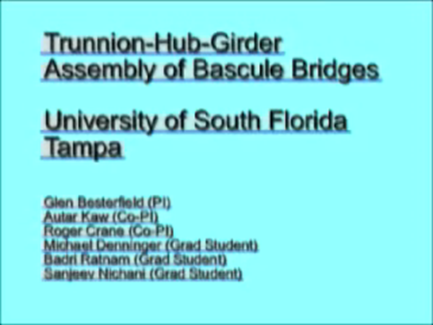
Video of Assembly Process
http://www.eng.usf.edu/~kaw/download/today/Assembly_procedure2_256.wmv

Slide 16
MATHEMATICAL MODELING

Slide 17
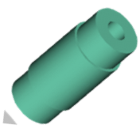
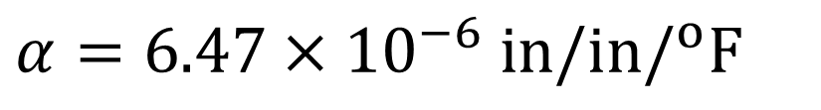
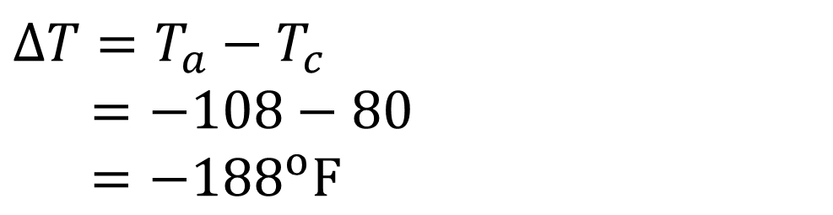
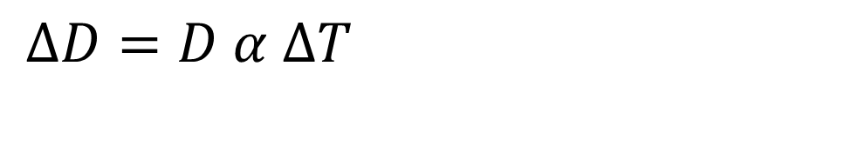

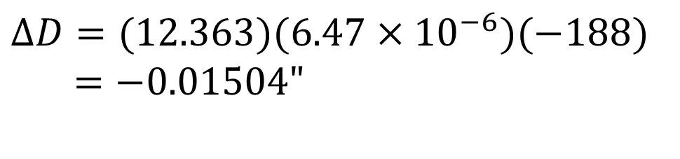
Consultant Calculations
$$ΔD=D α ΔT$$
$$D=12.363"$$
$$α=6.47×10^{−6} in/in/^{o}F$$
$$ΔT=T_{a}−T_{c}$$
$=−108−80$
$=−188^{o}F$
$$ΔD=(12.363)(6.47×10^{−6})(−188) \\ =−\text{0.01504"}$$

Slide 18
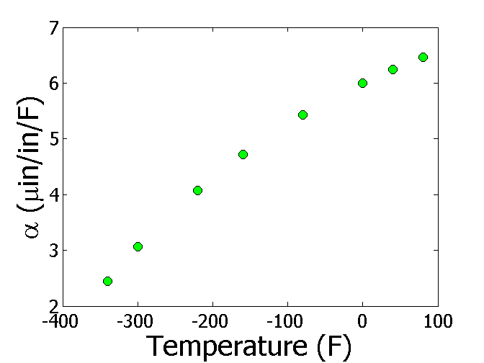
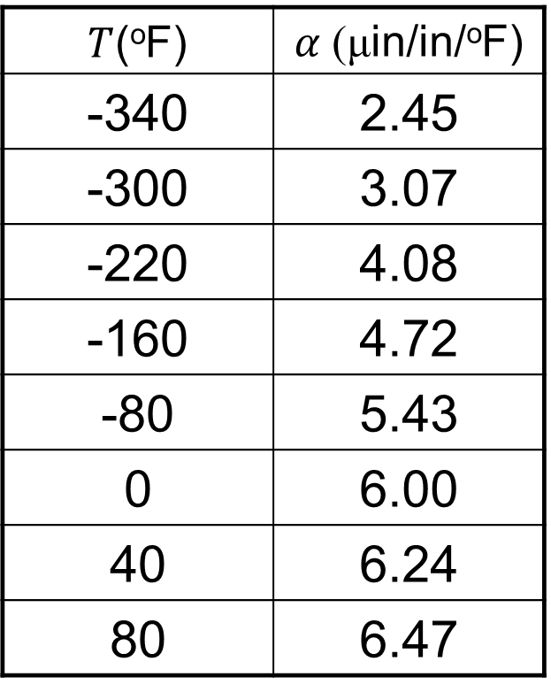
Is the Δ𝐷=𝐷𝛼Δ𝑇 formula, correct?
$T$(ºF) | $α$ (μin/in/ºF)
-340 | 2.45
-300 | 3.07
-220 | 4.08
-160 | 4.72
-80 | 5.43
0 | 6.00
40 | 6.24
80 | 6.47

Slide 19
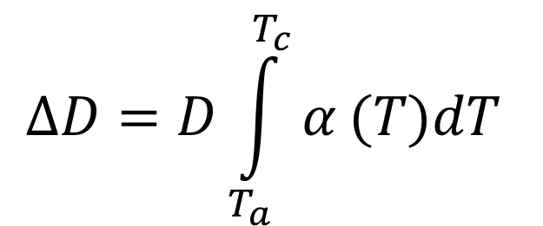
The correct model would account for varying linear coefficient of thermal expansion
$$ΔD=D\int_{T_{a}}^{T_{c}}{α}(T)dT$$

Slide 20
SOLUTION OF MATHEMATICAL MODEL

Slide 21
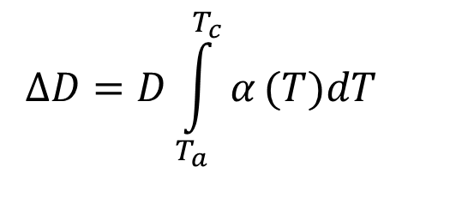
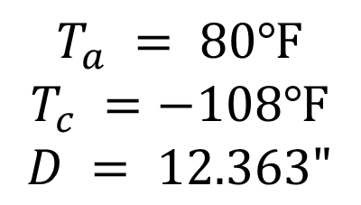
Can you roughly estimate the contraction?
$$ΔD=D\int_{T_{a}}^{T_{c}}{α}(T)dT$$
$$T_{a} = 80℉$$
$$T_{c} =−108℉$$
$$D = 12.363"$$

Slide 22
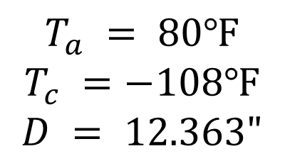
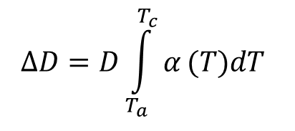
Can you find a better estimate for the contraction?
$$ΔD=D\int_{T_{a}}^{T_{c}}{α}(T)dT$$
$$T_{a} = 80℉$$
$$T_{c} =−108℉$$
$$D = 12.363"$$

Slide 23
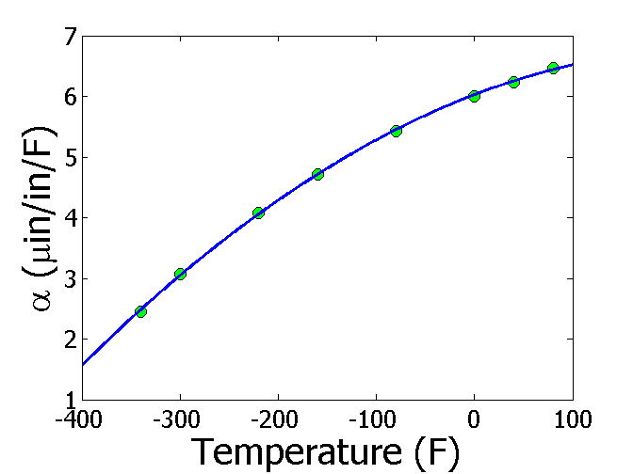
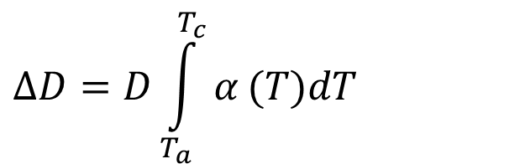

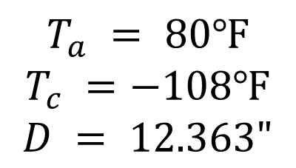
Can you estimate the contraction more accurately?
$$α=−1.2278×10^{−5}T^{2}+6.1946×10^{−3}T+6.0150$$
$$ΔD=D\int_{T_{a}}^{T_{c}}{α}(T)dT$$
$$T_{a} = 80℉$$
$$T_{c} =−108℉$$
$$D = 12.363"$$
$$ΔD=−0.0137"$$

Slide 24
USING THE SOLUTION

Slide 25
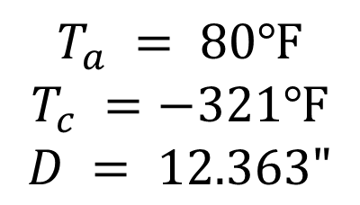

So, what is the solution to the problem?
$$α=−1.2278×10^{−5}T^{2}+6.1946×10^{−3}T+6.0150$$
$$ΔD=D\int_{T_{a}}^{T_{c}}{α}(T)dT$$
$$T_{a} = 80℉$$
$$T_{c} =−321℉$$
$$D = 12.363"$$
$$ΔD=−0.0244"$$

Slide 26
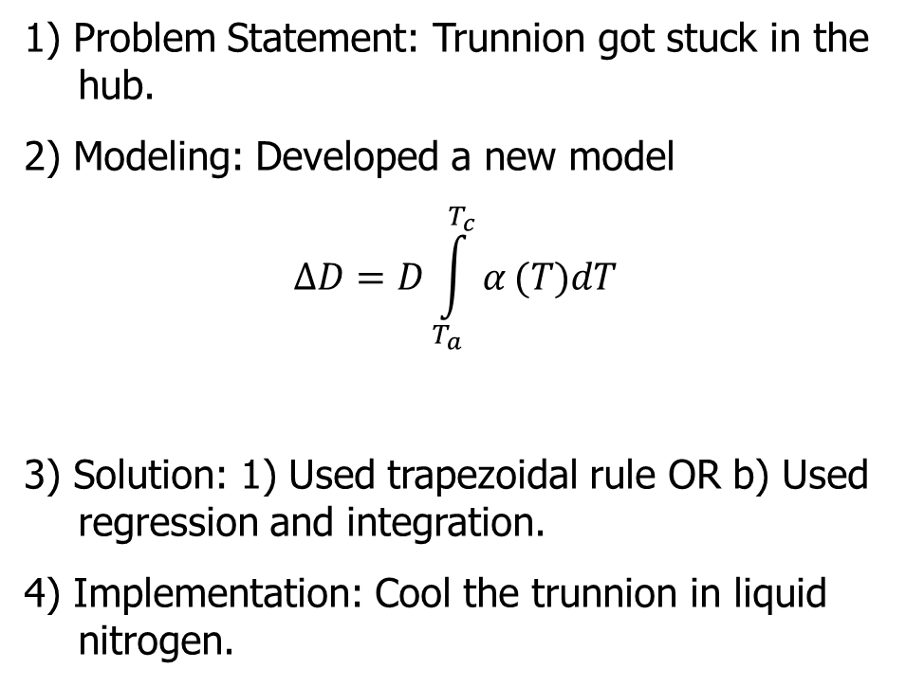
Revisiting steps to solve a problem
1) Problem Statement: Trunnion got stuck in the hub.
2) Modeling: Developed a new model
$$ΔD=D\int_{T_{a}}^{T_{c}}{α}(T)dT$$
3) Solution: 1) Used trapezoidal rule OR b) Used regression and integration.
4) Implementation: Cool the trunnion in liquid nitrogen.

Slide 27
How the course works
Before Tuesday class
1) Do adaptive lessons assigned due before Tuesday class
2) See solution of MC questions for extra help with adaptive lessons
During class
1) Minilectures
2) Respond to concept questions via phone
3) Solve and submit free-response questions on paper
4) Pick your graded papers
After class
1) Read assigned textbook pages as given in CANVAS modules
2) See solution of assigned MC questions if you haven’t already
3) Do assigned problem set questions from textbook by Saturday

Slide 28
To Do List
Go through the Module 00.XX and syllabus.
Take attendance quiz on CANVAS before Thursday 2pm and start on it today as it will take you sometime to do it.
Finish adaptive lessons of Module 01.01-01.03 before coming to class.
Have you gotten your TI30Xa calculator?
Download MATLAB and Adobe Acrobat DC today for free.
Bring charged laptop with MATLAB on Friday.
Turn on your notifications in CANVAS.

Slide 29
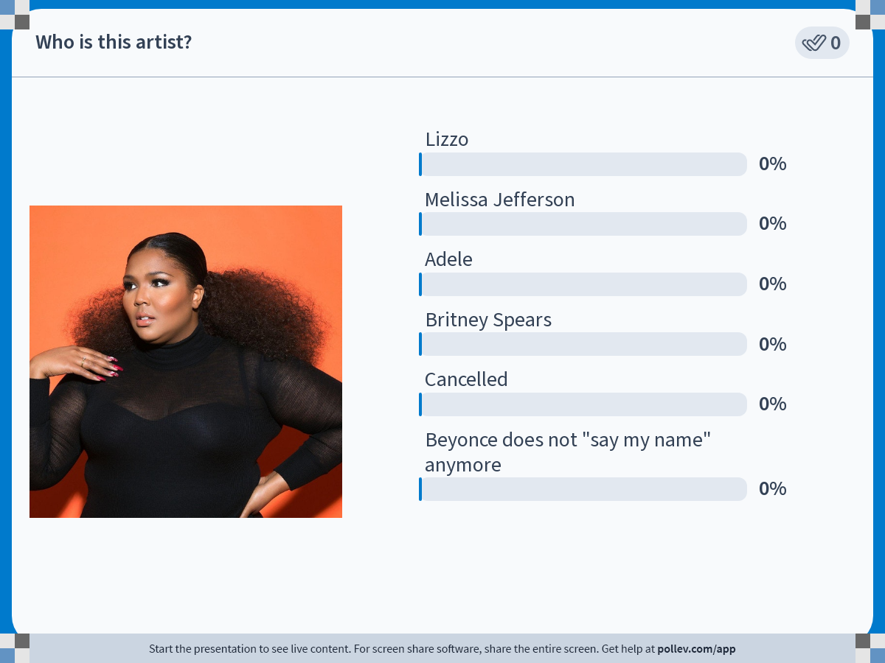
Notes:
Poll Title: Do not modify the notes in this section to avoid tampering with the Poll Everywhere activity.
More info at polleverywhere.com/support
Who is this artist?
https://www.polleverywhere.com/multiple_choice_polls/1L3EKVqzE1ibEMP0XxQTS?state=opened&flow=Default&onscreen=persist

Slide 30
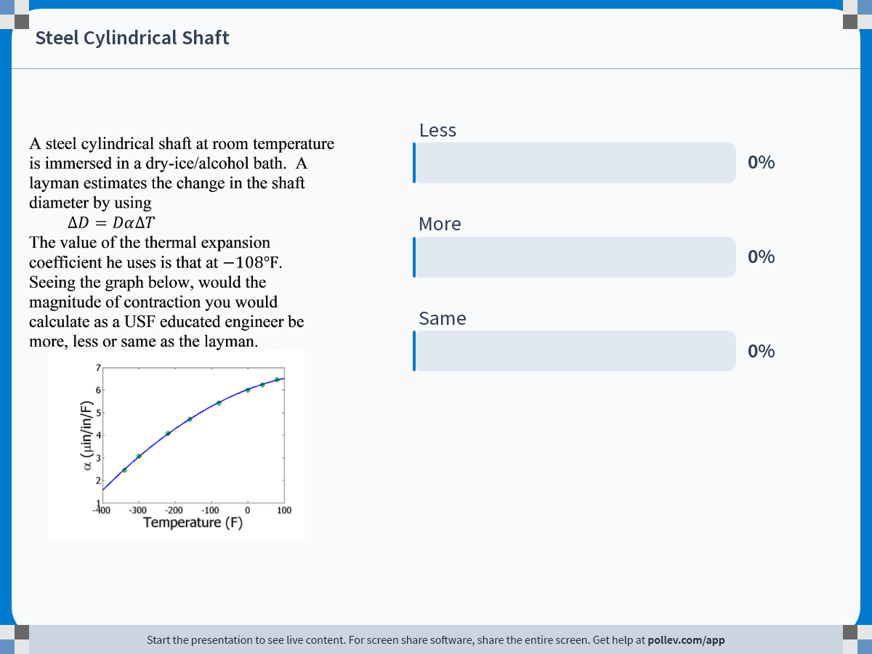
Notes:
Poll Title: Do not modify the notes in this section to avoid tampering with the Poll Everywhere activity.
More info at polleverywhere.com/support
Steel Cylindrical Shaft
https://www.polleverywhere.com/multiple_choice_polls/b6Gn2SwTyqzuI33lIp08l

Slide 31
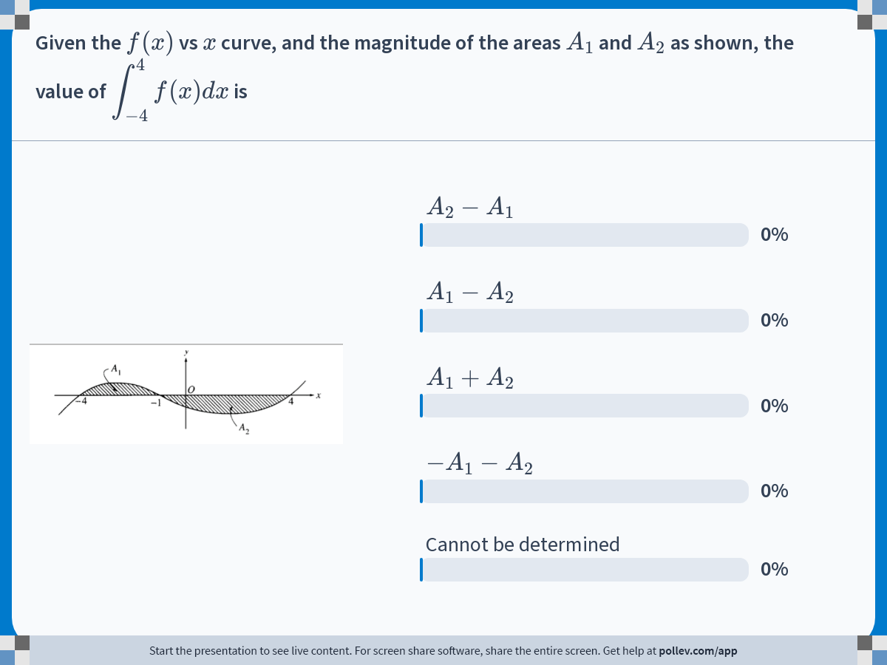
Notes:
Poll Title: Do not modify the notes in this section to avoid tampering with the Poll Everywhere activity.
More info at polleverywhere.com/support
Given the $$f(x)$$ vs $$x$$ curve, and the magnitude of the areas $$A_1$$ and $$A_2$$ as shown, the value of $$\\displaystyle \\int_{-4}^{4}{f(x)dx}$$ is
https://www.polleverywhere.com/multiple_choice_polls/7Cdqwhcu6DNwSGPSCAjgu?state=opened&flow=Default&onscreen=persist

Slide 32
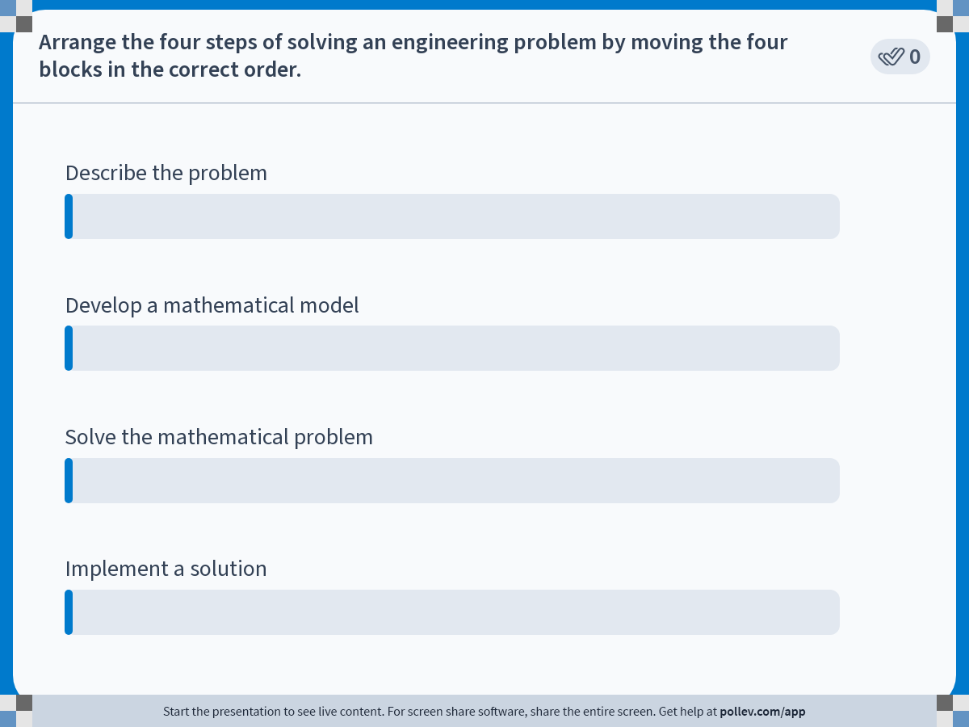
Notes:
Poll Title: Do not modify the notes in this section to avoid tampering with the Poll Everywhere activity.
More info at polleverywhere.com/support
Arrange the four steps of solving an engineering problem by moving the four blocks in the correct order.
https://www.polleverywhere.com/ranking_polls/FPP0eX74YqSzNwLnEEq22

Slide 33
THE END

Slide 34
Introduction to Numerical Methods
Mathematical Procedures

Slide 35
Mathematical Procedures
Nonlinear Equations
Differentiation
Simultaneous Linear Equations
Curve Fitting
  Interpolation
  Regression
Integration
Ordinary Differential Equations
Other Advanced Mathematical Procedures:
  Partial Differential Equations
  Optimization
  Fast Fourier Transforms

Slide 36

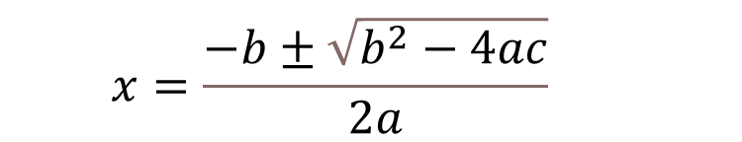
Nonlinear Equations
$$ax^{2}+bx+c=0$$
$$x=\frac{−b±\sqrt{b^{2}−4ac}}{2a}$$

Slide 37
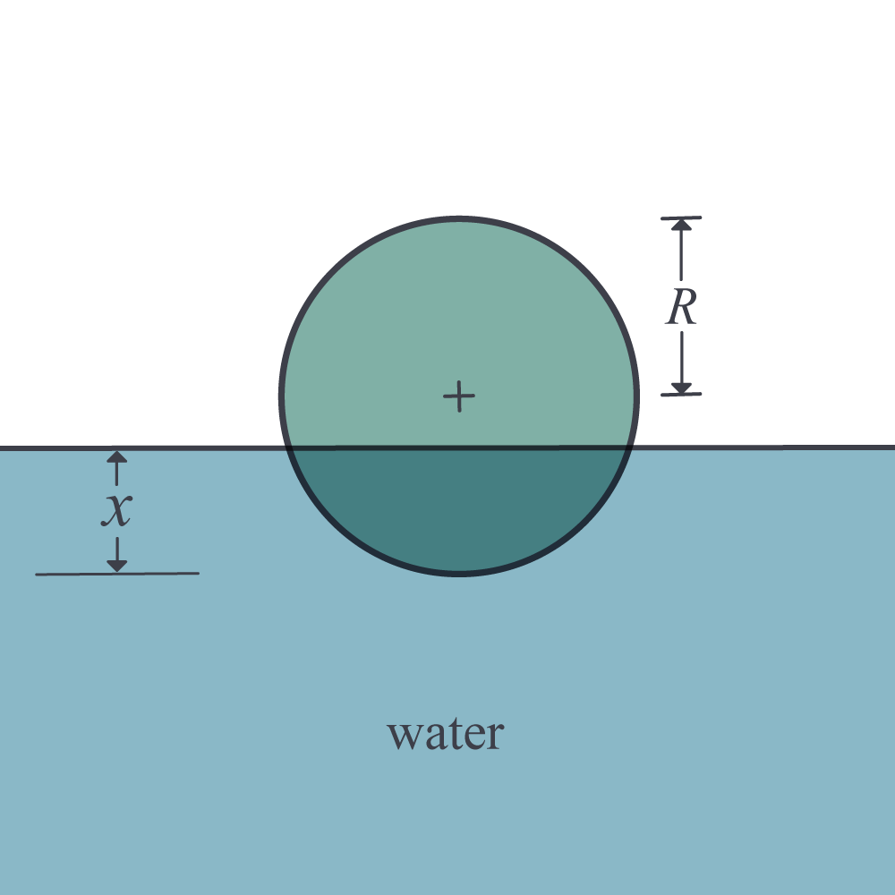
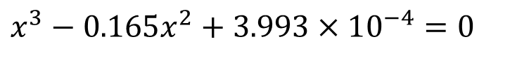
Nonlinear Equations
How much of the floating ball is under water?
Radius=0.055 m
Specific Gravity=0.6
$$x^{3}−0.165x^{2}+3.993×10^{−4}=0$$

Slide 38

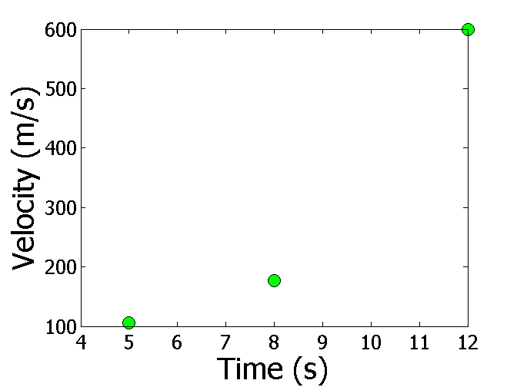
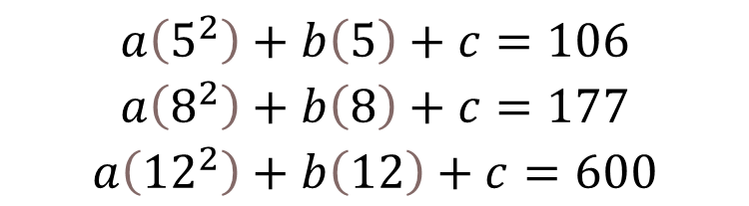
Simultaneous Linear Equations
Find the velocity profile, given
Time (s) | 5 | 8 | 12
Vel (m/s) | 106 | 177 | 600
$v(t)=at^{2}+bt+c,$ $5≤t≤12$
Three simultaneous linear equations
$$\begin{matrix}a\left(5^{2}\right)+b\left(5\right)+c=106 \\ a\left(8^{2}\right)+b\left(8\right)+c=177 \\ a\left({12}^{2}\right)+b\left(12\right)+c=600\end{matrix}$$
Source: Photo by NASA

Slide 39
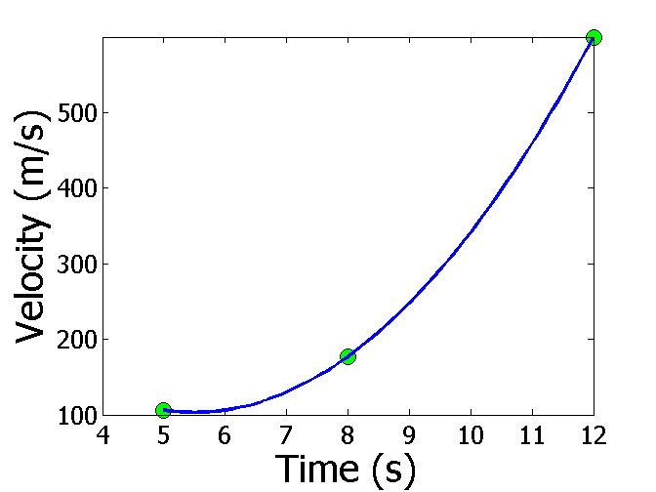
Interpolation
What is the velocity of the rocket at t=7 seconds?
Time (s) | 5 | 8 | 12
Vel (m/s) | 106 | 177 | 600
Source: Photo by NASA

Slide 40
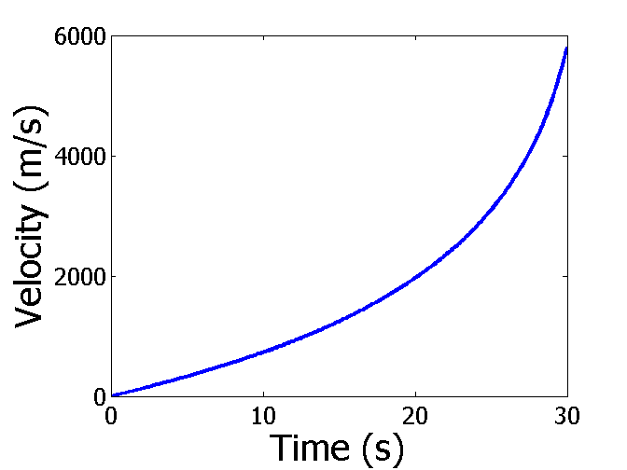
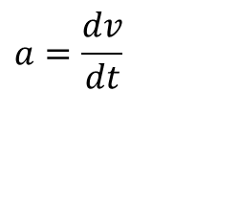
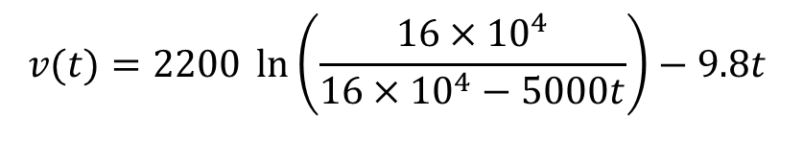
Differentiation
What is the acceleration at t=7 seconds?
$$v(t)=2200 \ln\left(\frac{16×10^{4}}{16×10^{4}−5000t}\right)−9.8t$$
$$a=\frac{dv}{dt}$$
Source: Photo by NASA

Slide 41
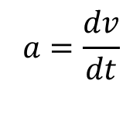
Differentiation
What is the acceleration at t=7 seconds?
Time (s) | 5 | 8 | 12
Vel (m/s) | 106 | 177 | 600
$$a=\frac{dv}{dt}$$

Slide 42
Regression
Thermal expansion coefficient data for cast steel

Slide 43
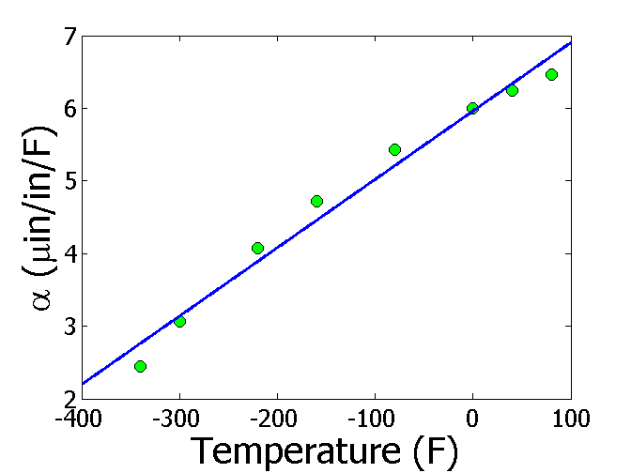
Regression – Linear

Slide 44
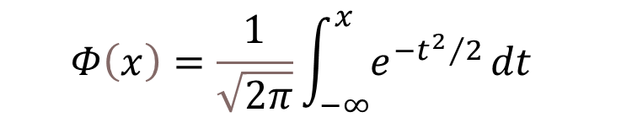
Integration
$$Φ\left(x\right)=\frac{1}{\sqrt{2π}}\int_{−∞}^{x}{e^{−{t^{2}}/2}}dt$$
Source: Wikipedia.org https://upload.wikimedia.org/wikipedia/commons/thumb/f/f9/Z_cumulative_from_mean.svg/1704px-Z_cumulative_from_mean.svg.png

Slide 45
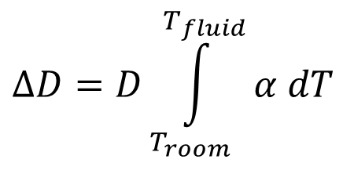
Integration
Finding the diametric contraction in a steel shaft when dipped in liquid nitrogen.
$$ΔD=D\int_{T_{room}}^{T_{fluid}}{α dT}$$

Slide 46
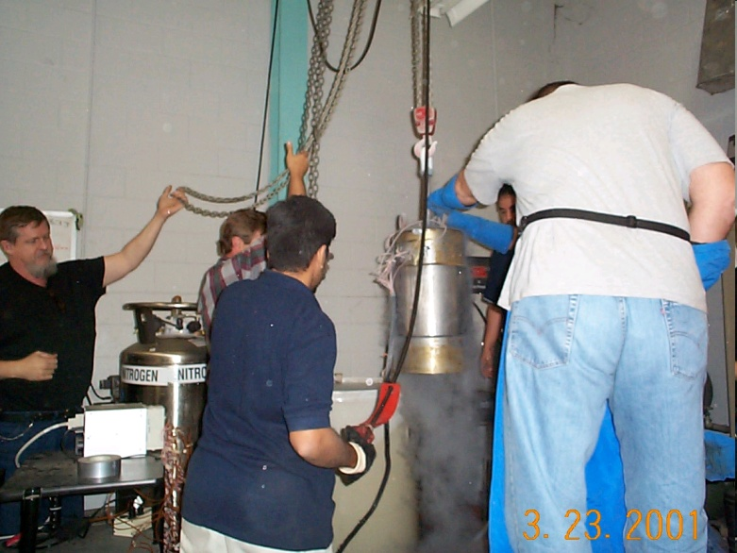
Ordinary Differential Equations
How long does it take a trunnion to cool down?
$$mc\frac{dθ}{dt}=−hA\left(θ−θ_{a}\right),θ(0)=θ_{room}$$

Slide 47
THE END
http://nm.MathForCollege.com

Slide 48
How the course works
Before Tuesday class
Have all the assigned modules including post-class quizzes and problem sets. done. Check syllabus link in CANVAS
During class
Attend lectures, answer concept questions via PollEverywhere, free-response questions.
After every class
Finish assigned modules including textbook pages, post-class quizzes, multiple-choice quiz solutions, and problem sets as per CANVAS announcement of the week.

Slide 49
How Standard Based Grading Works?
Unit Test
Take unit test on assigned chapters
Retake Unit Test
Take retake of unit test on any chapter(s). You can earn PARTIAL credit if you do better (max of 90%)
Final Exam
Final exam is mandatory for all students but the questions on it will count as a retake also. You can earn PARTIAL credit if you do better (max of 90%)

Slide 50
Some examples of standards-based grading
Example 1: You take Unit Test 1 and you will get a score for Chapter1, Chapter 2 and Chapter 3. You score a 25/40 in Chapter 1 questions. In the retake, you make 20/40 in Chapter 1 questions, and in the final exam, you make 15/40 in Chapter 1 questions. Your score for Chapter 1 Unit Test will stay at 25 out of 40.

Slide 51
Some examples of standards-based grading
Example 2: You take Unit Test 1 and you will get a score for Chapter1, Chapter 2 and Chapter 3. You score a 25/40 in Chapter 1 questions. In the retake, you make 32/40 in Chapter 1 questions, and in the final exam, you make 15/40 in Chapter 1 questions. Your score for Chapter 1 will be 25+(32-25)/2=28.5 out of 40. Since the final exam score is lower than 28.5, your Chapter 1 Unit Test will stay at 28.5 out of 40 score.

Slide 52
Some examples of standards-based grading
Example 3: You take Unit Test 1 and you will get a score for Chapter1, Chapter 2 and Chapter 3. You score a 25/40 in Chapter 1 questions. In the retake, you make 32/40 in Chapter 1 questions, and in the final exam, you make 38/40 in Chapter 1 questions. Your score for Chapter 1 after the retake will be 25+(32-25)/2=28.5 out of 40 as shown in Example 2. After the final exam, Chapter 1 Unit Test score will be 28.5+(38-28.5)/2=33.25 out of 40.

