Slide 1
Programming Review
EML3041: Computational Methods
More than just teach you how to program, programming courses teach you how to think more methodically and how to solve problems more effectively. As such, its lessons are applicable well beyond the boundaries of computer science itself. With this skill comes the ability to solve real-world problems in ways and at speeds beyond the abilities of most humans - David Malan.
1

Slide 2
What do you believe corelates most with becoming a good programmer
Language skills
Reasoning skills
Mathematics skills
17%
44%
2%

Slide 3
Working memory
abk mzr bdw xtn
fbi cia fox cnn

Slide 4
Main concepts
Sequential programming
Conditions (if-end; if-else-end)
Loops (for-end; while-end)
Functions

Slide 5
Some common MATLAB functions
Find cos of 60 degrees
Val=cos(60*pi/180), Val=cosd(60)
Find ln(5)
Val=log(5)
Find e^{1.3}
Val=exp(1.3)
Go ahead and try sin(90º), sin⁻¹(0.5)
Answer: 1, 0.5236

Slide 6
Caution
The MATLAB snippets given here may need editing for strings to run in MATLAB.
For example, the single quotes have to be replaced with a straighter single quote ' , otherwise, you will get an error. Error: Invalid text character. Check for unsupported symbol, invisible character, or pasting of non-ASCII characters.

Slide 7
Some important MATLAB statements
disp disp('My name is Slim Shady') fprintf a=12.4; b=12 fprintf('\n Value of a=%g and b=%g',a,b) % Search help for %g, %e, %f, %s two lines statement syms x func=x^2-3*x+ ... 4 | comment % Project One – EML3041 sections %% Problem One help % do this in command window help syms

Slide 8
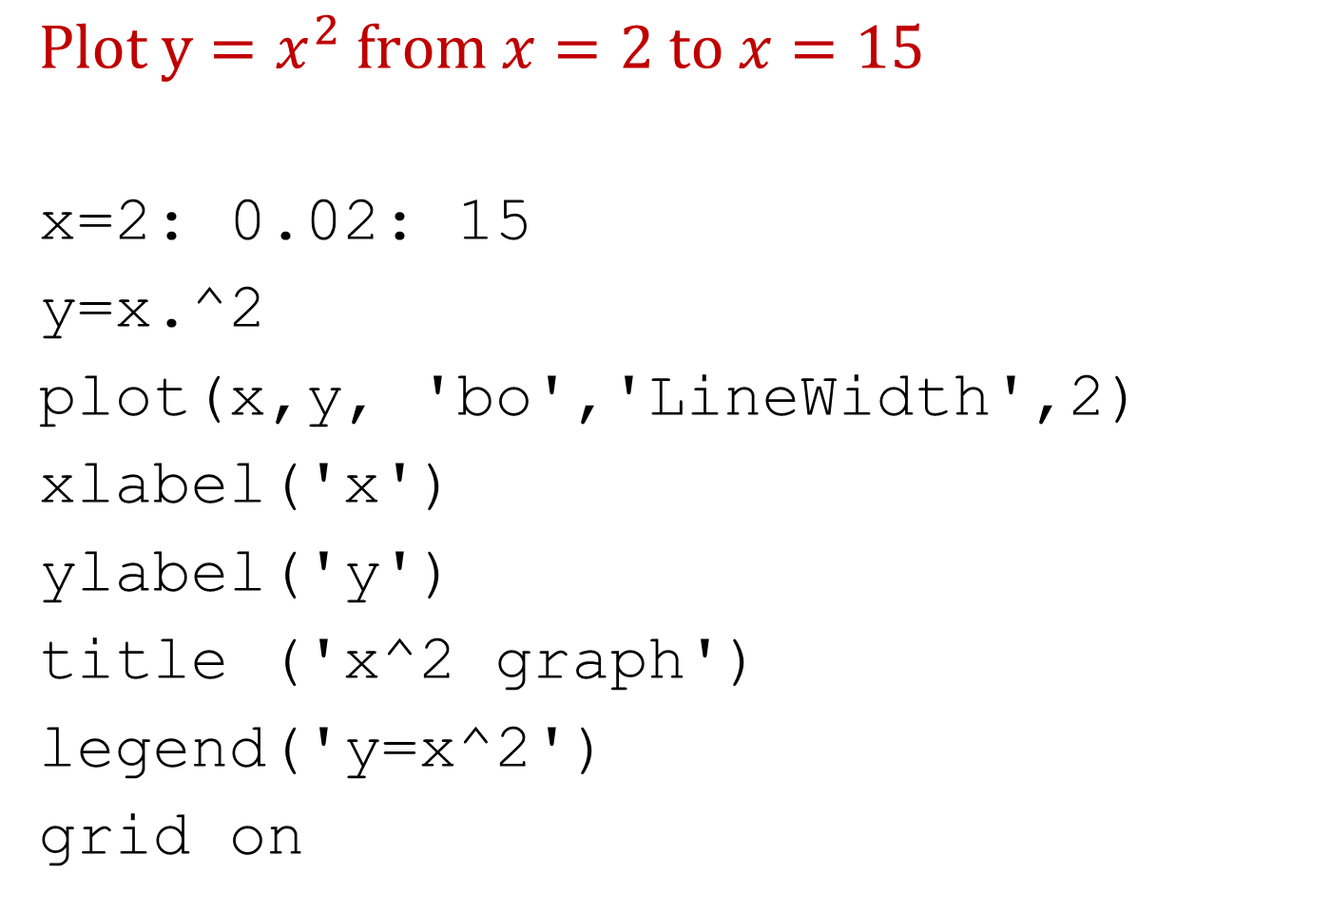
Plotting
$$Plot y=x^{2} from x=2 to x=15$$
x=2: 0.02: 15
y=x.^2
plot(x,y, 'bo','LineWidth',2)
xlabel('x')
ylabel('y')
title ('x^2 graph')
legend('y=x^2')
grid on

Slide 9
Some common mistakes
Using single letter names for variables
Filenames such as program 2.m or just 2.m or cos.m
Using “ ; ” while first writing the program
Using reserved words, e.g. “length” for a variable
Not commenting the program
Not breaking a problem into smaller parts
Not following the format of given sample project
Not writing separate programs to learn single tasks

Slide 10
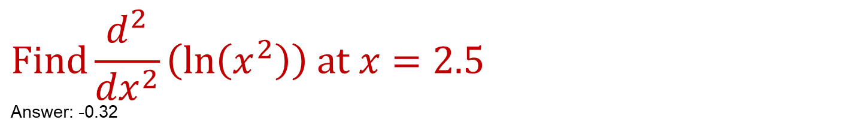
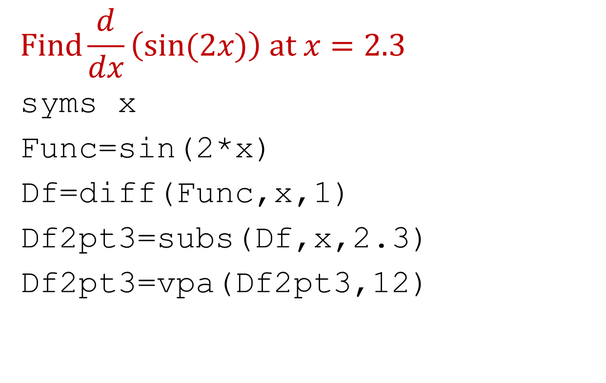
Differentiate a function
$$Find\frac{d}{dx}\left(sin⁡(2x)\right) at x=2.3$$
syms x
Func=sin(2*x)
Df=diff(Func,x,1)
Df2pt3=subs(Df,x,2.3)
Df2pt3=vpa(Df2pt3,12)
$$Find\frac{d^{2}}{{dx}^{2}}\left(\ln\left(x^{2}\right)\right) at x=2.5$$
Answer: -0.32

Slide 11
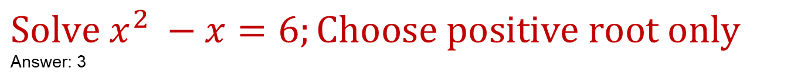
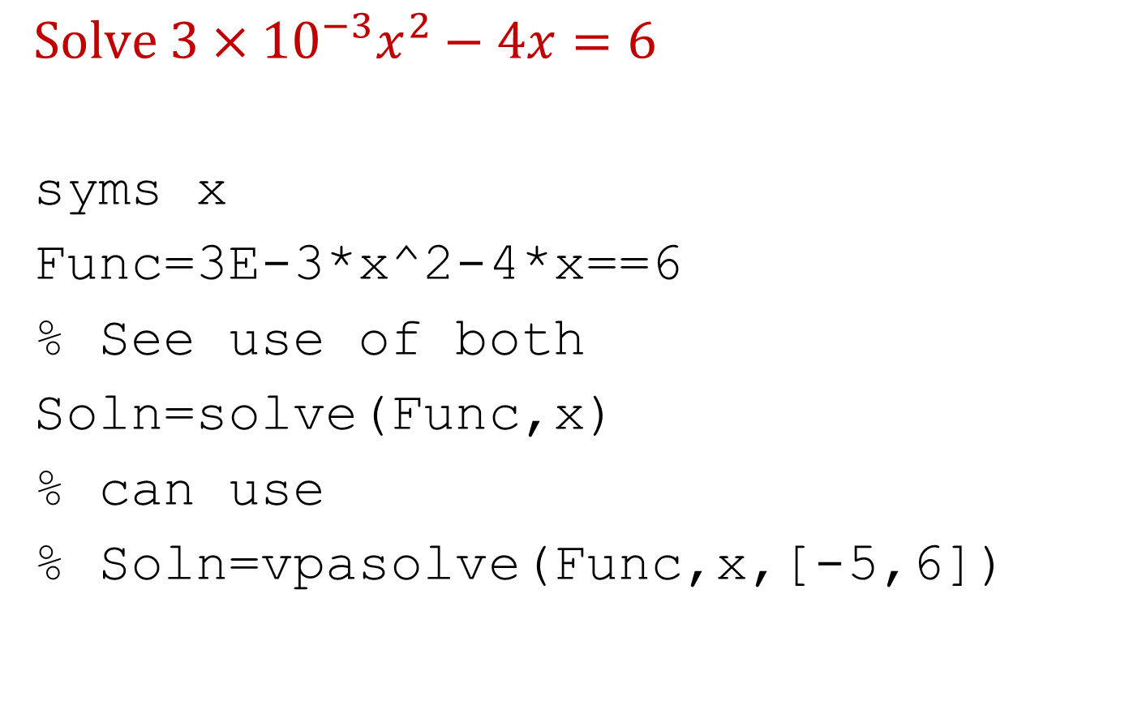
Solve a nonlinear equation
$$Solve 3×{10}^{−3}x^{2}−4x=6$$
syms x
Func=3E-3*x^2-4*x==6
% See use of both
Soln=solve(Func,x)
% can use
% Soln=vpasolve(Func,x,[-5,6])
$$Solve x^{2} −x=6;Choose positive root only$$
Answer: 3

Slide 12
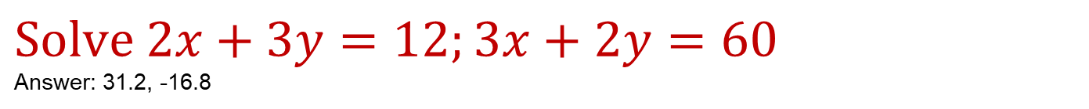
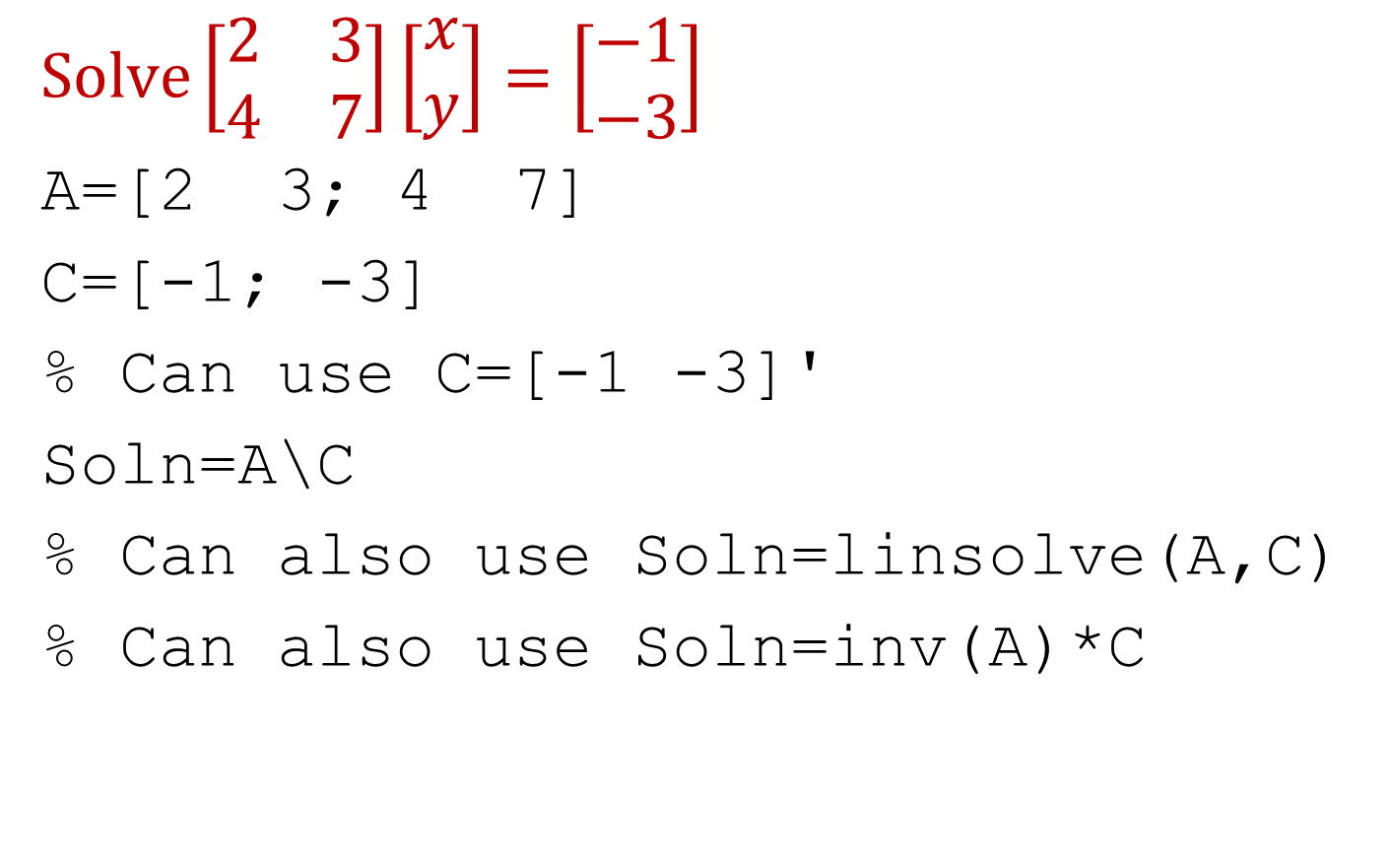
Simultaneous linear equations
$$Solve\left[\begin{matrix}2 & 3 \\ 4 & 7\end{matrix}\right]\left[\begin{matrix}x \\ y\end{matrix}\right]=\left[\begin{matrix}−1 \\ −3\end{matrix}\right]$$
A=[2 3; 4 7]
C=[-1; -3]
% Can use C=[-1 -3]'
Soln=A\C
% Can also use Soln=linsolve(A,C)
% Can also use Soln=inv(A)*C
$$Solve 2x+3y=12;3x+2y=60$$
Answer: 31.2, -16.8

Slide 13
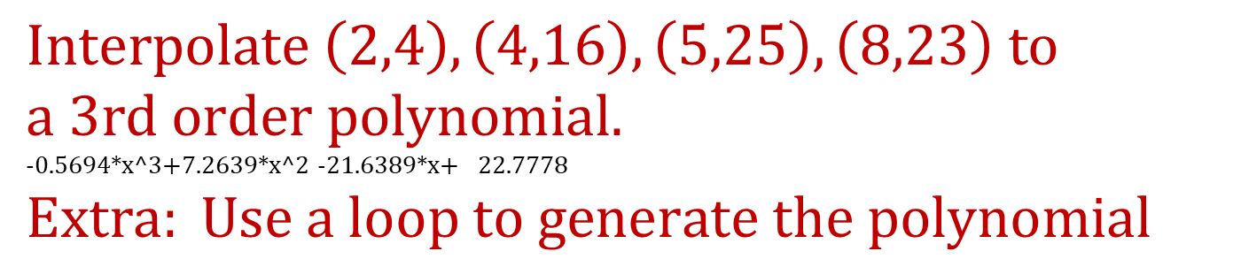
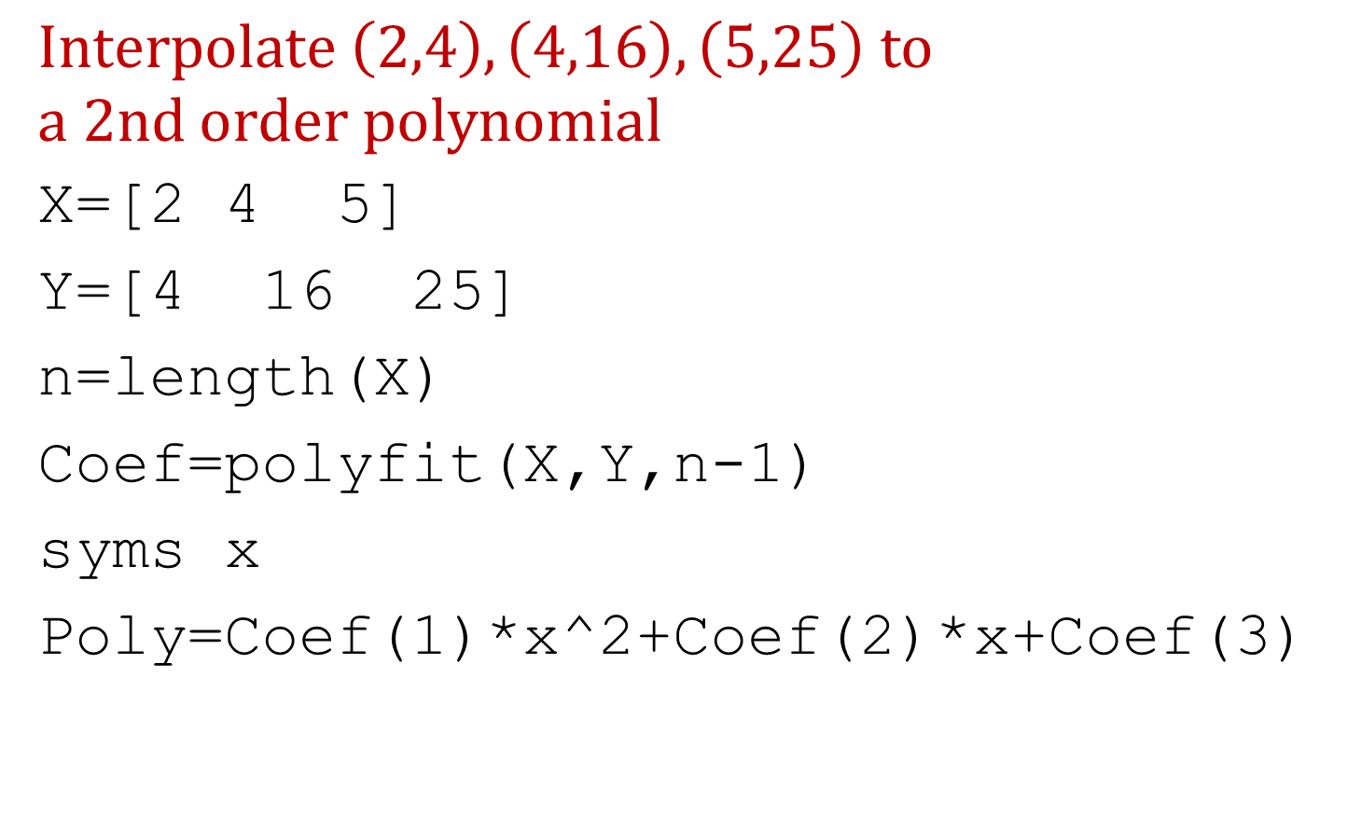
Interpolation
$$Interpolate \left(2,4\right),\left(4,16\right),\left(5,25\right) to$$
$$a 2nd order polynomial$$
X=[2 4 5]
Y=[4 16 25]
n=length(X)
Coef=polyfit(X,Y,n-1)
syms x
Poly=Coef(1)*x^2+Coef(2)*x+Coef(3)
$$Interpolate \left(2,4\right),\left(4,16\right),\left(5,25\right), \left(8,23\right) to$$
$$a 3rd order polynomial.$$
-0.5694*x^3+7.2639*x^2 -21.6389*x+ 22.7778
$$Extra: Use a loop to generate the polynomial$$

Slide 14
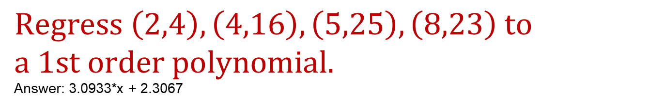
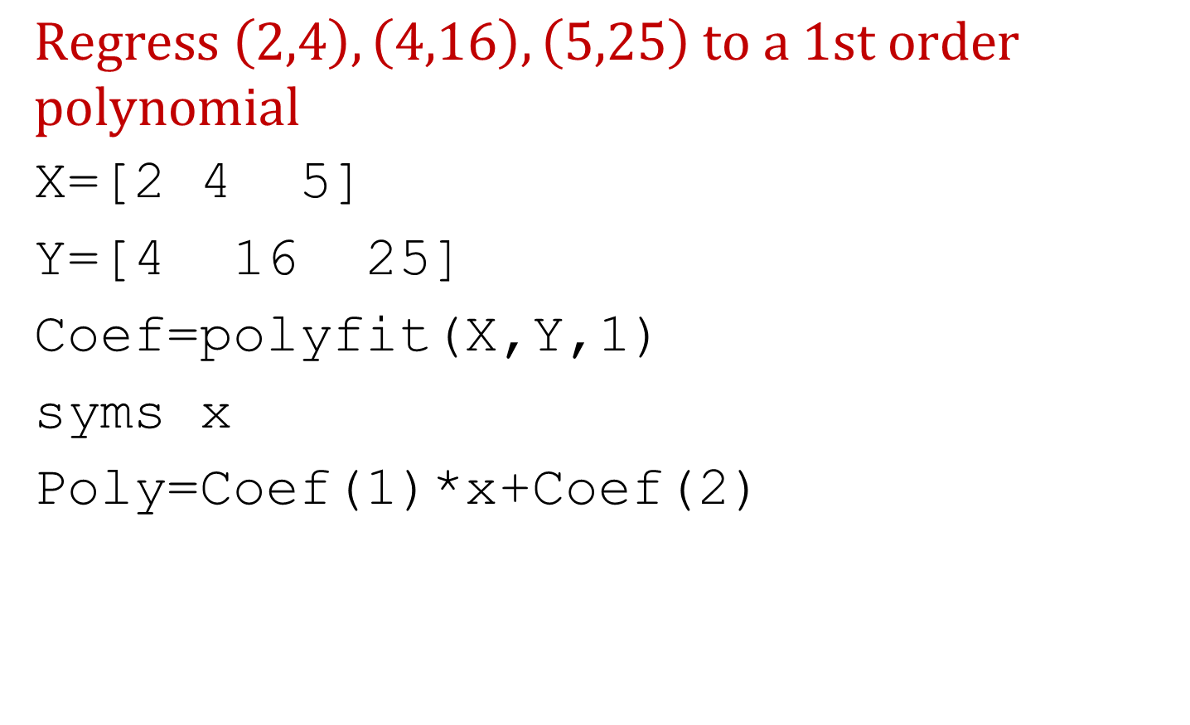
Regression
$$Regress \left(2,4\right),\left(4,16\right),\left(5,25\right) to a 1st order$$
$$polynomial$$
X=[2 4 5]
Y=[4 16 25]
Coef=polyfit(X,Y,1)
syms x
Poly=Coef(1)*x+Coef(2)
$$Regress \left(2,4\right),\left(4,16\right),\left(5,25\right), \left(8,23\right) to$$
$$a 1st order polynomial.$$
Answer: 3.0933*x + 2.3067

Slide 15
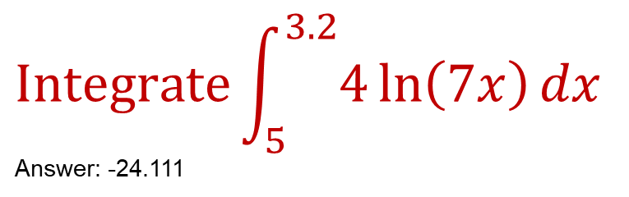
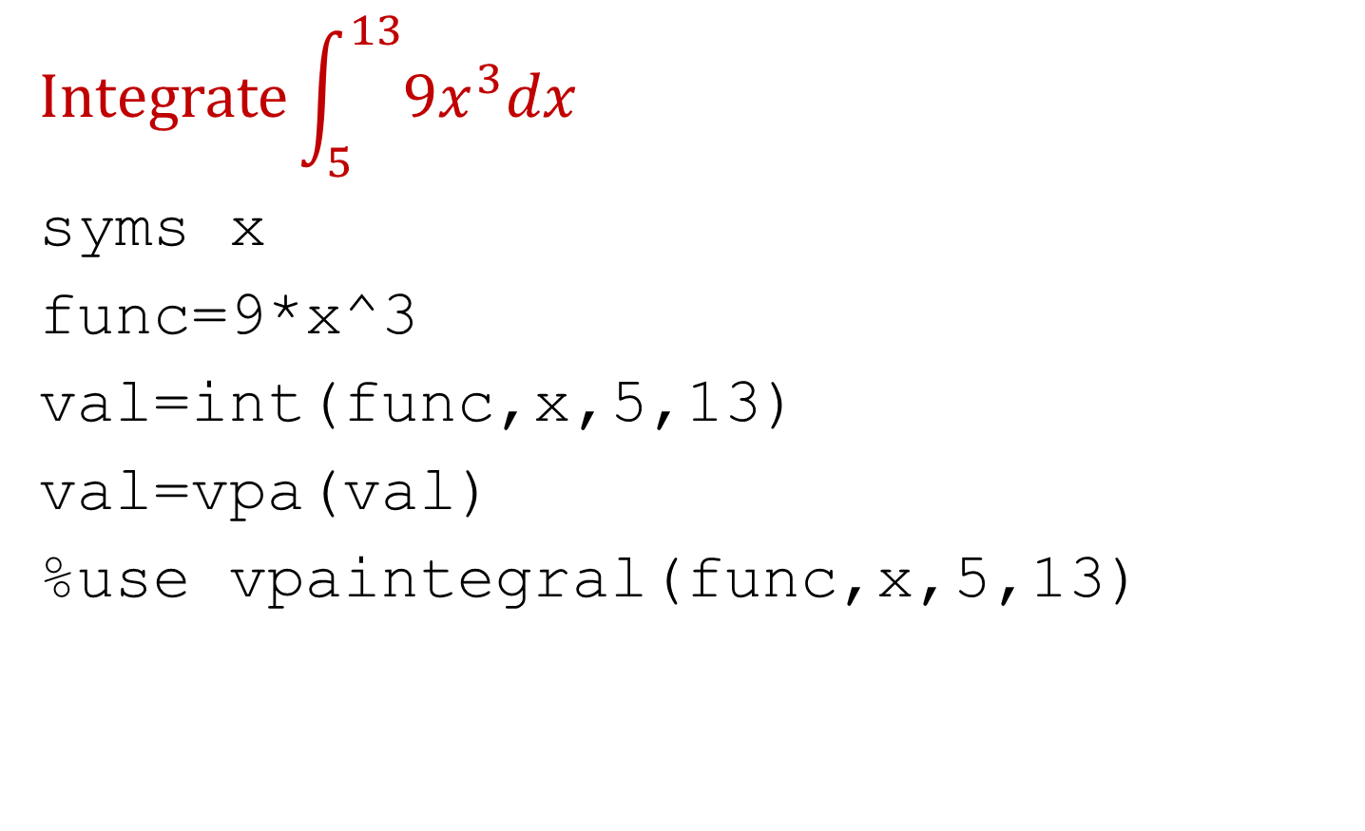
Solve an integral
$$Integrate\int_{5}^{13}{{9x}^{3}dx}$$
syms x
func=9*x^3
val=int(func,x,5,13)
val=vpa(val)
%use vpaintegral(func,x,5,13)
$$Integrate\int_{5}^{3.2}{4\ln\left(7x\right)dx}$$
Answer: -24.111

Slide 16
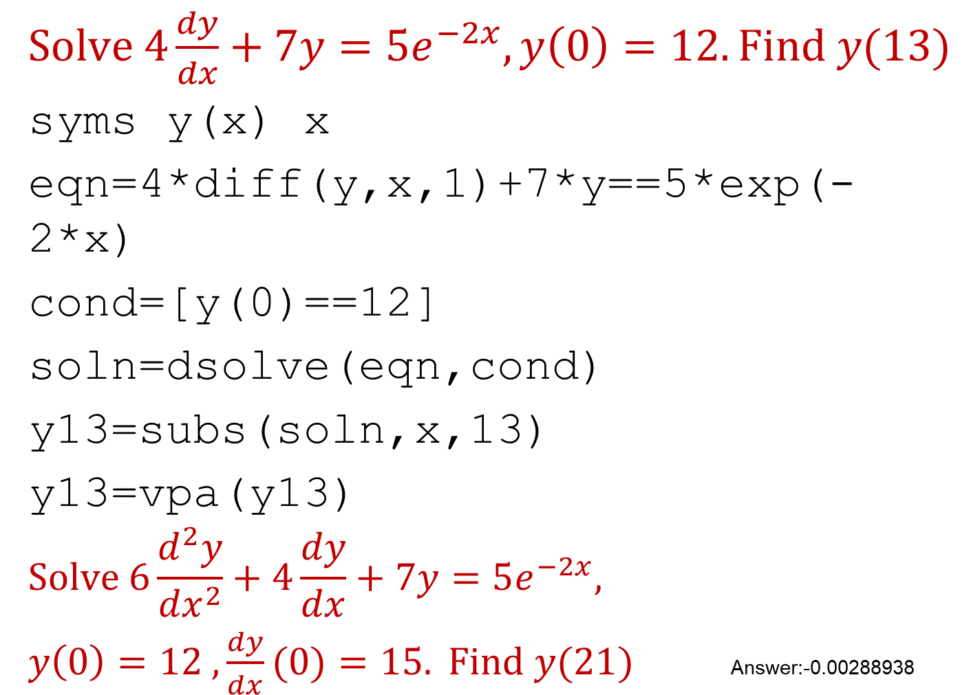
Solve ordinary differential equations
$Solve 4\frac{dy}{dx}+7y=5e^{−2x}, y\left(0\right)=12. Find y(13)$
syms y(x) x
eqn=4*diff(y,x,1)+7*y==5*exp(-2*x)
cond=[y(0)==12]
soln=dsolve(eqn,cond)
y13=subs(soln,x,13)
y13=vpa(y13)
$$Solve 6\frac{d^{2}y}{{dx}^{2}}+4\frac{dy}{dx}+7y=5e^{−2x},$$
$y\left(0\right)=12 ,\frac{dy}{dx}(0)=15. Find y(21)$ Answer:-0.00288938

Slide 17
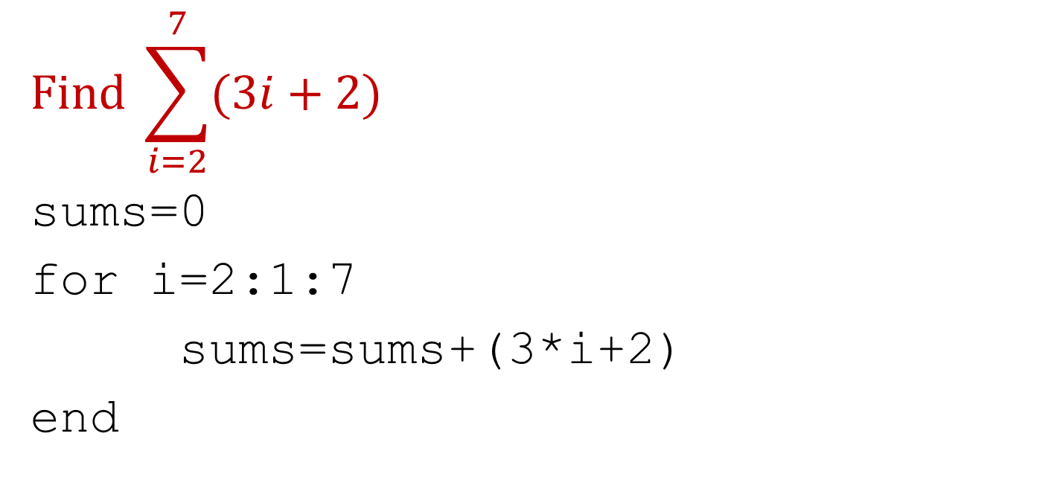
Find the sum of a series (example of loop)
$$Find \sum_{i=2}^{7}{(3i+2)}$$
sums=0
for i=2:1:7
sums=sums+(3*i+2)
end

Slide 18
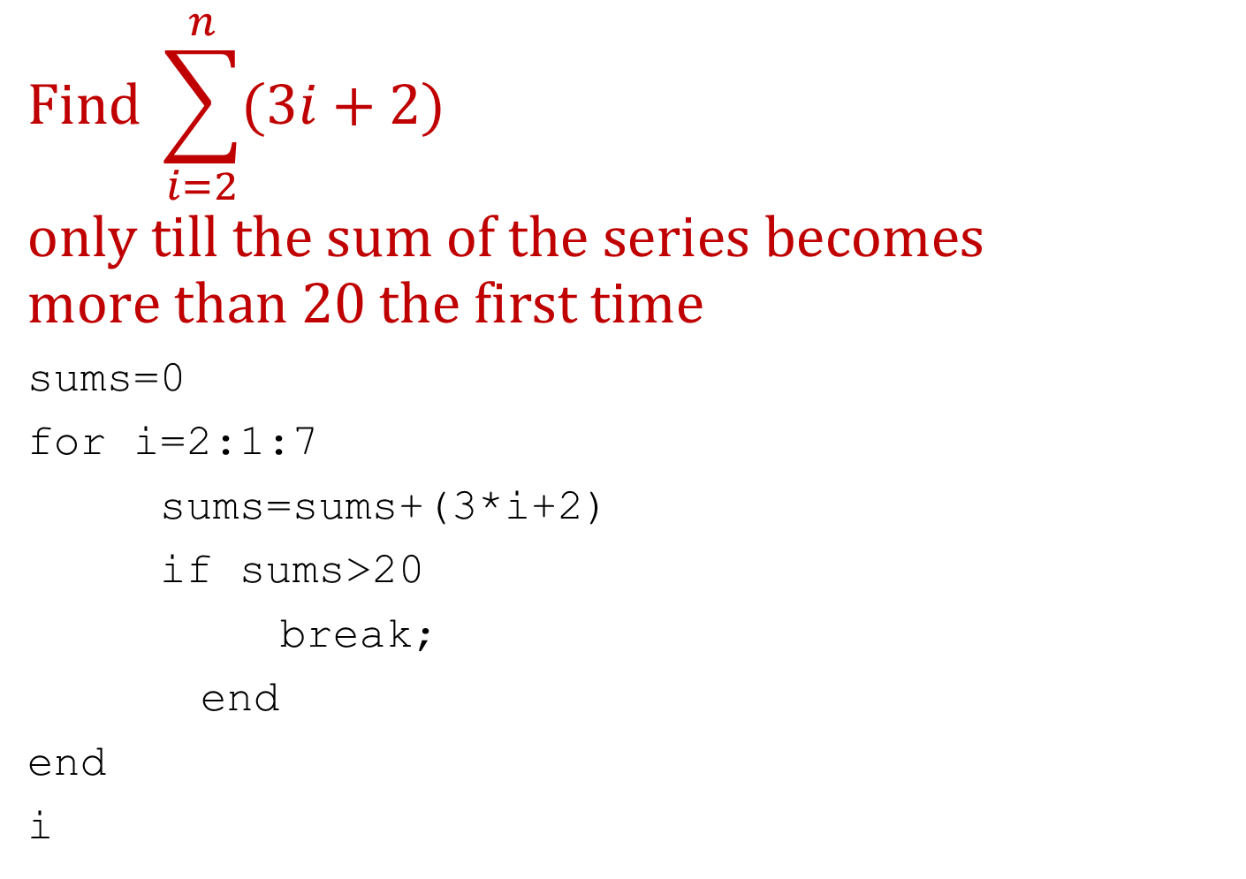
Find the sum of a series (example of break)
$$Find \sum_{i=2}^{n}{(3i+2)}$$
$$only till the sum of the series becomes$$
$$more than 20 the first time$$
sums=0
for i=2:1:7
sums=sums+(3*i+2)
if sums>20
break;
end
end
i

Slide 19
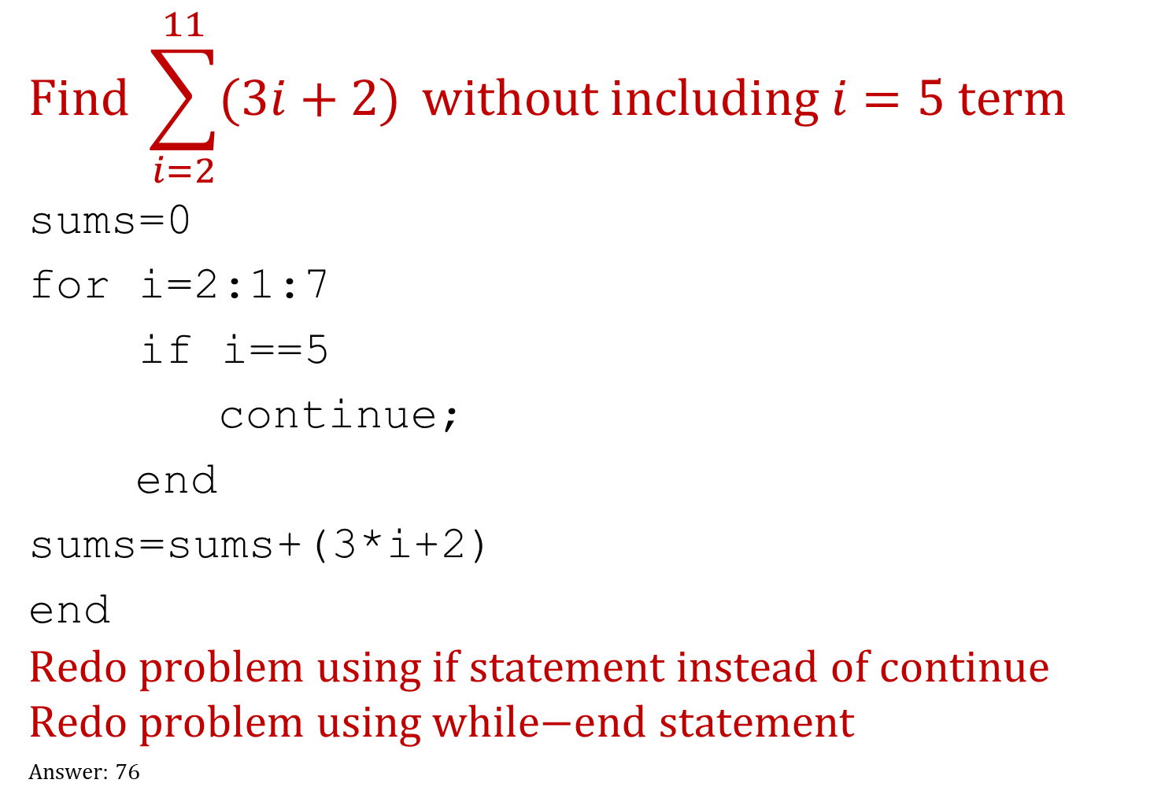
Find the sum of a series (example of continue)
$$Find \sum_{i=2}^{11}{(3i+2)} without including i=5 term$$
sums=0
for i=2:1:7
if i==5
continue;
end
sums=sums+(3*i+2)
end
$$\text{Redo} \text{problem} \text{using} \text{if} \text{statement} \text{instead} \text{of} \text{continue}$$
$$\text{Redo} \text{problem} \text{using} \text{while}\text{−}\text{end} \text{statement}$$
Answer: 76

Slide 20
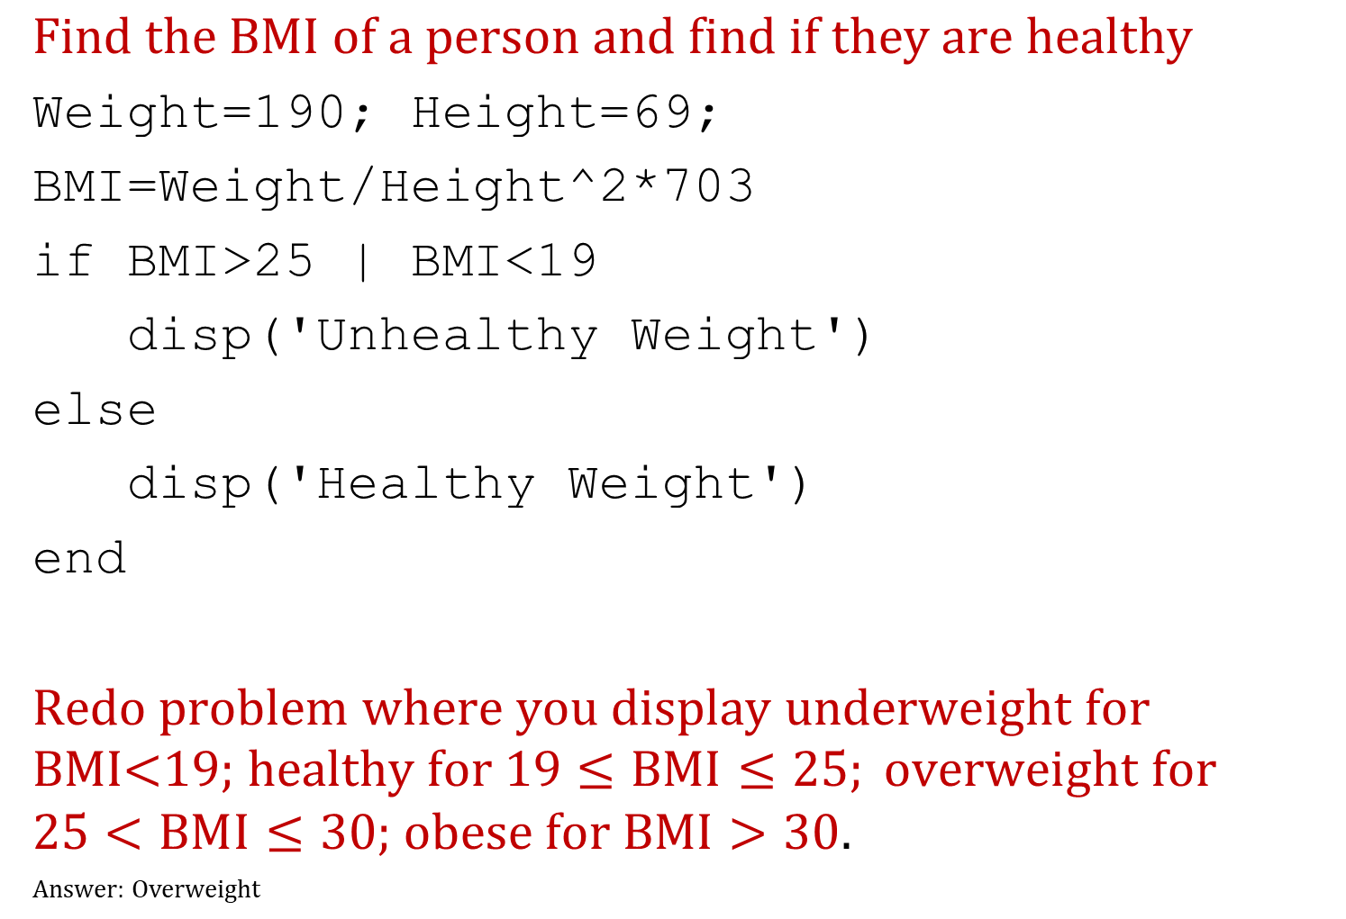
BMI problem (example of if-end)
$$Find the BMI of a person and find if they are healthy$$
Weight=190; Height=69;
BMI=Weight/Height^2*703
if BMI>25 | BMI<19
disp('Unhealthy Weight')
else
disp('Healthy Weight')
end
$\text{Redo} \text{problem} \text{where} \text{you} \text{display} \text{underweight} \text{for} \text{BMI}\text{<19; }\text{healthy} \text{for}\text{ 19}≤BMI≤25; \text{overweight} \text{for}\text{ 25}<BMI≤30;$ $\text{obese} \text{for} BMI>30$.
Answer: Overweight

Slide 21
Functions
% How to use the function
bas=8;
ht=15;
[AreaRAT,PerimRAT] = RAT(bas,ht)
function [area,perimeter]=RAT(base, height)
hypotenuse=sqrt(base^2+height^2);
perimeter=base + height + hypotenuse;
area=0.5*base*height;
end

Slide 22
Resources
Take the practice test on CANVAS?
How do I do that in the MATLAB series? This series is highly helpful when you are doing the projects for the course: https://blog.autarkaw.com/2020/12/22/how-do-i-do-that-in-matlab-for-usf-students/
MathWorks Onramp course: https://www.mathworks.com/learn/tutorials/matlab-onramp.html
Still needing help, take the free Coursera course https://www.coursera.org/learn/matlab
Still needing help, here are some lecture videos freely available from Vanderbilt University: https://blog.autarkaw.com/2020/05/08/need-help-with-programming-in-matlab/
For help on commands, either enter help in command window or go to https://www.mathworks.com/help/matlab/index.html

