Slide 1
Students Choosing Grade Weights
^{Autar Kaw}
^{kaw@usf.edu}
^{http://AutarKaw.com}
^{University of South Florida}
ATLE First Fridays
April 5, 2019

Slide 2
What is variable grading?
Let students pick the weights of the grading categories within reason.
Category Weightage
Tests#1, 2, 3 12 to 14% each
Computer Projects 8% to 10%
CANVAS Quizzes 5% to 9%
CANVAS Online Adaptive Lessons 6% to 10%
Special Assignments 6% to 8%
Concept Test 4% to 6%
Final Exam 25% to 25%
Source: https://www.chronicle.com/article/How-Much-Do-You-Want-Your/242802?cid=rclink

Slide 3
Why practice variable grading?
Let students take ownership of their education
Meets the 2nd Universal Design for Learning (UDL) Principle of “Ways of Expression”
Source: https://udlcenter.org

Slide 4
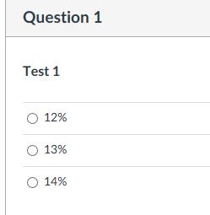
How do students choose variable grades?

Slide 5
When do students choose the weights
By end of the 7th week, they make a choice via a Canvas Quiz.

Slide 6
What did they choose for weights?
96% of the students made a choice
4% of the students chose the default weights

Slide 7
QUESTIONS?
Students Choosing Grade Weights
Autar Kaw
kaw@usf.edu
University of South Florida

